Slide 1










WELCOME TO OUR CLASS!
Presented by: ………………

Slide 2


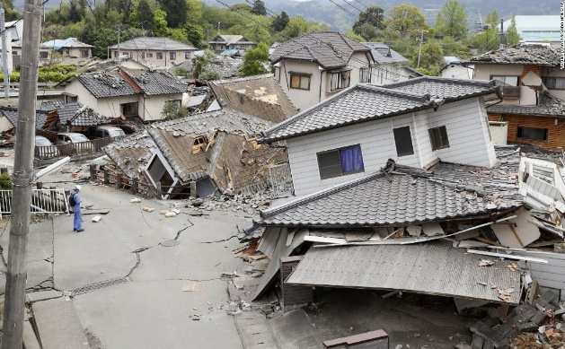
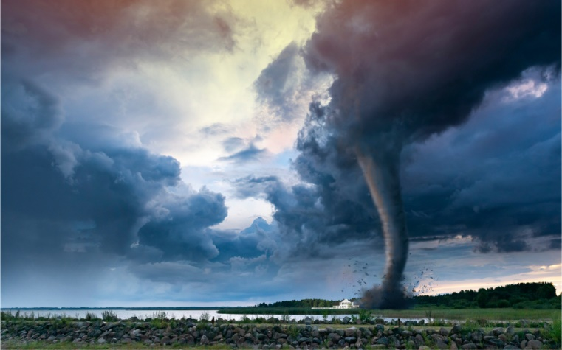
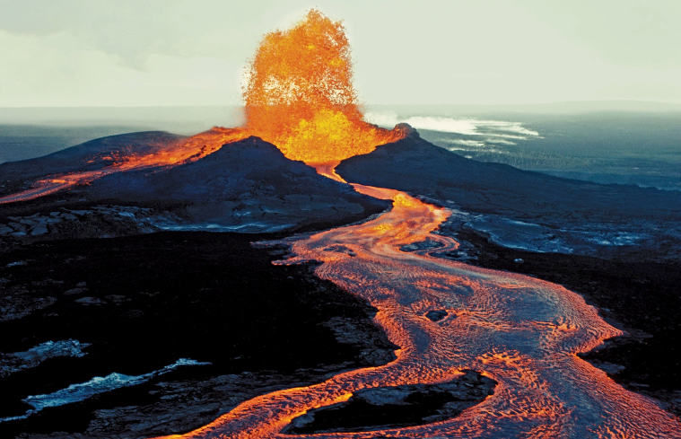
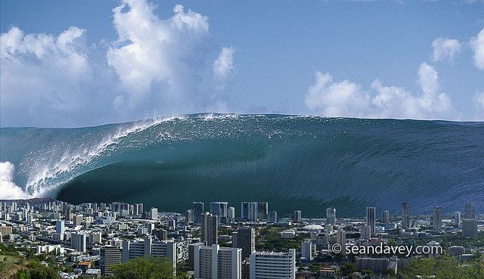
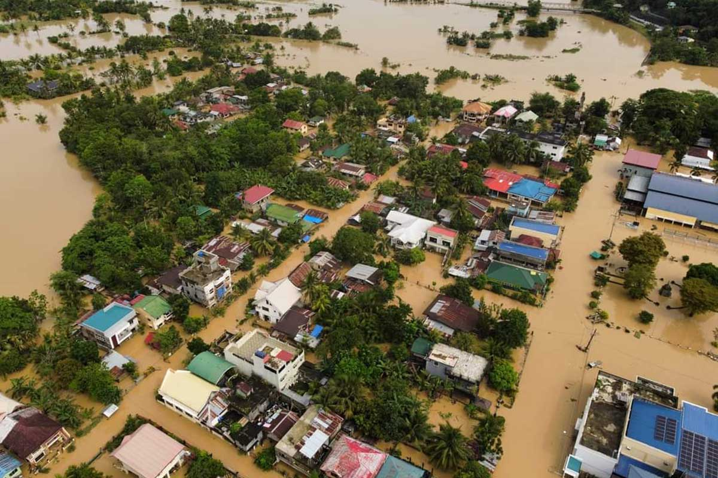
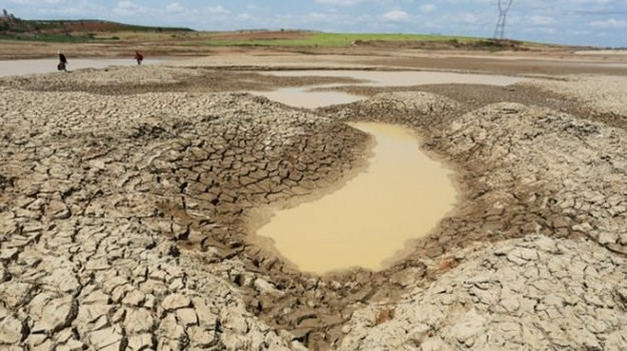
Match the natural disasters with the correct pictures
drought
volcano
tornado
tidal wave/ tsunami
flood
earthquake

Slide 3







REVIEW 3
SKILLS

Slide 4
READING

Slide 5



1. Read the passage and tick T (True) or F (False) for each sentence
 | T | F
1. Landslides hardly ever occur in mountainous areas.
2. You should follow the instructions about landslide emergencies.
3. Avoid going to public shelters as they are unsafe.
4. Landslides may occur one after another.
5. You should stay cautious until the storm is over.

Slide 6
SPEAKING

Slide 7




2. Work in pairs. Take turns to ask your classmate the following question.
Do you face any of the following disasters where you live?
– volcanic eruptions
– earthquakes
– droughts
– floods
– storms
– landslides
Then talk about the damage that the disaster(s) may cause.

Slide 8
LISTENING

Slide 9



3. Listen to the passage and fill in each blank with no more than TWO words.
1. The exhaust fumes from vehicles are the main cause of ______________________ in our cities.
2. Bad gases can be very _________________ for children.
3. Transport is not the only reason why we have _______________________.
4. Less pollution today comes from ____________________ than in the past.
5. Bad gases are being released into the air from _____________________.
pollution
dangerous
air pollution
coal
other sources

Slide 10
WRITING

Slide 11





4. Write a paragraph (80-100 words) about where your family shops and give reasons for your choice.
My family usually shops ___________________________________________________________________________________________________________________________________________________________________________________________________________________________________________________________________________

Slide 12
4. Write a paragraph (80-100 words) about where your family shops and give reasons for your choice.
My family usually shops at the supermarket. The supermarket provides a wide range of goods which are displayed under one roof. This helps save a lot of time. If you go to a local market, you have to go to a lot of stores and stalls to buy stuff which is really time-consuming and tiring. Another advantage of shopping in a supermarket is that you can have more options for the same product for you to choose. For example, there are often one or two fixed brands of soap to choose from a store, but you can see about 10 – 15 brands of soap if you go to the supermarket. Another thing we like about shopping in the supermarket is that you can enjoy your shopping experience without worrying about the weather. A lot of people come to the supermarket to avoid the heating or rain from outside. To summarize, we like to shop in the supermarket because there are a lot of kinds of goods, each good has many options to choose and we can enjoy shopping without worrying about the weather.

Slide 13

Wrap - up
What have we learnt in this lesson?
The skills students have practiced in Units 7 8 9.

Slide 14

HOMEWORK
Prepare for the mid-term second test

Slide 15


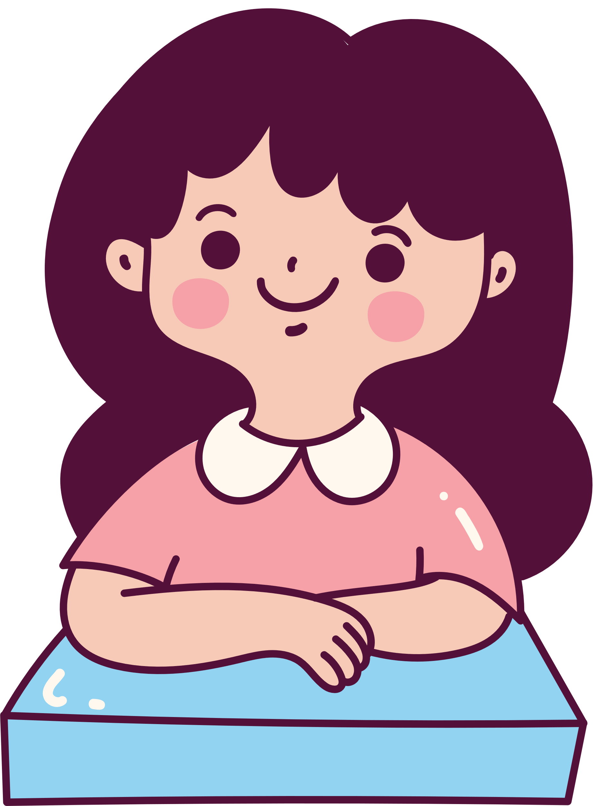

THANK YOU!

