Slide 1
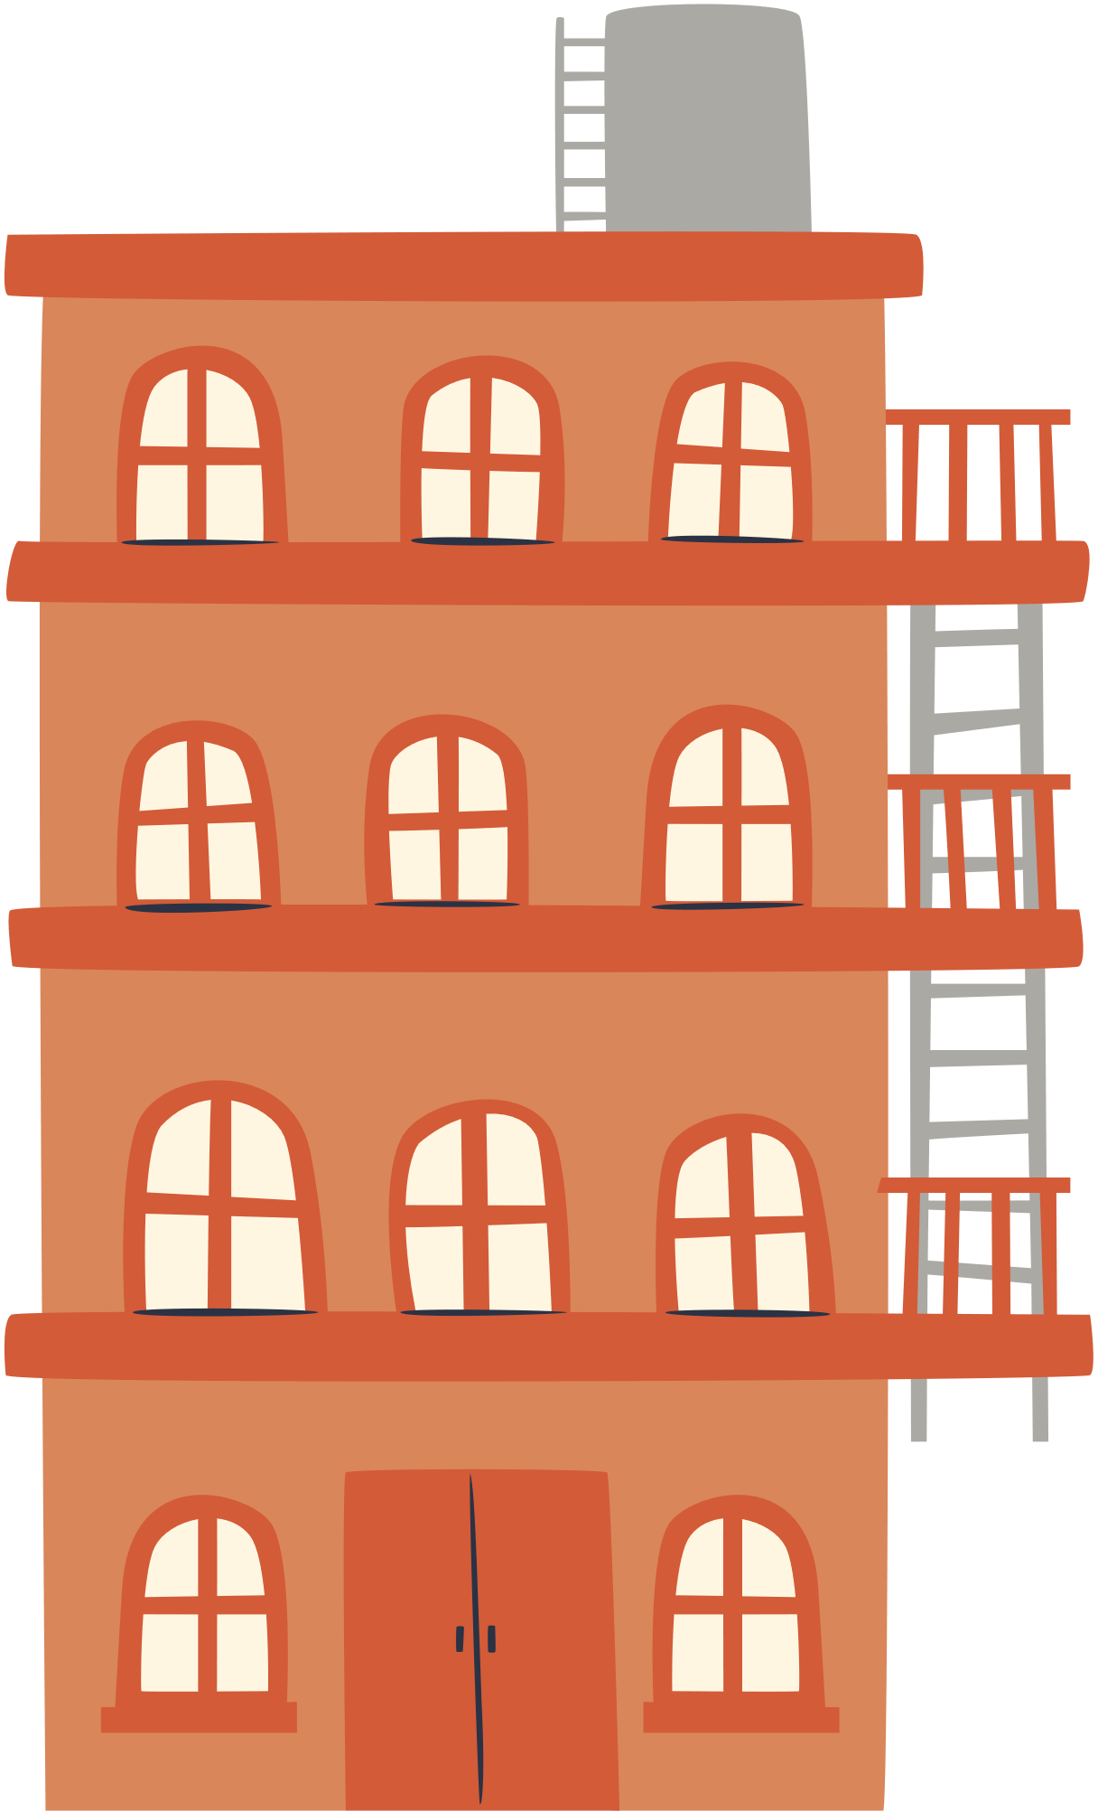

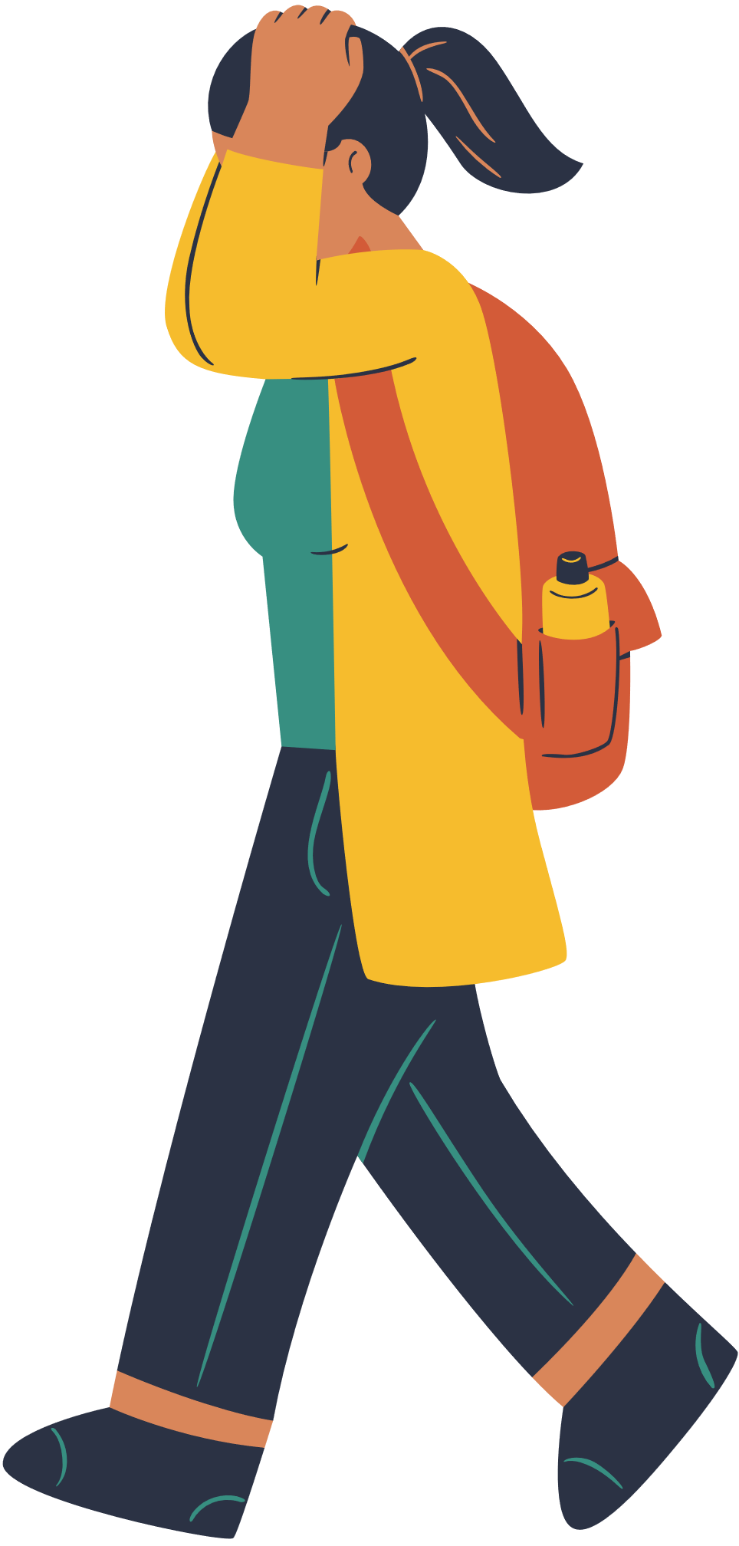
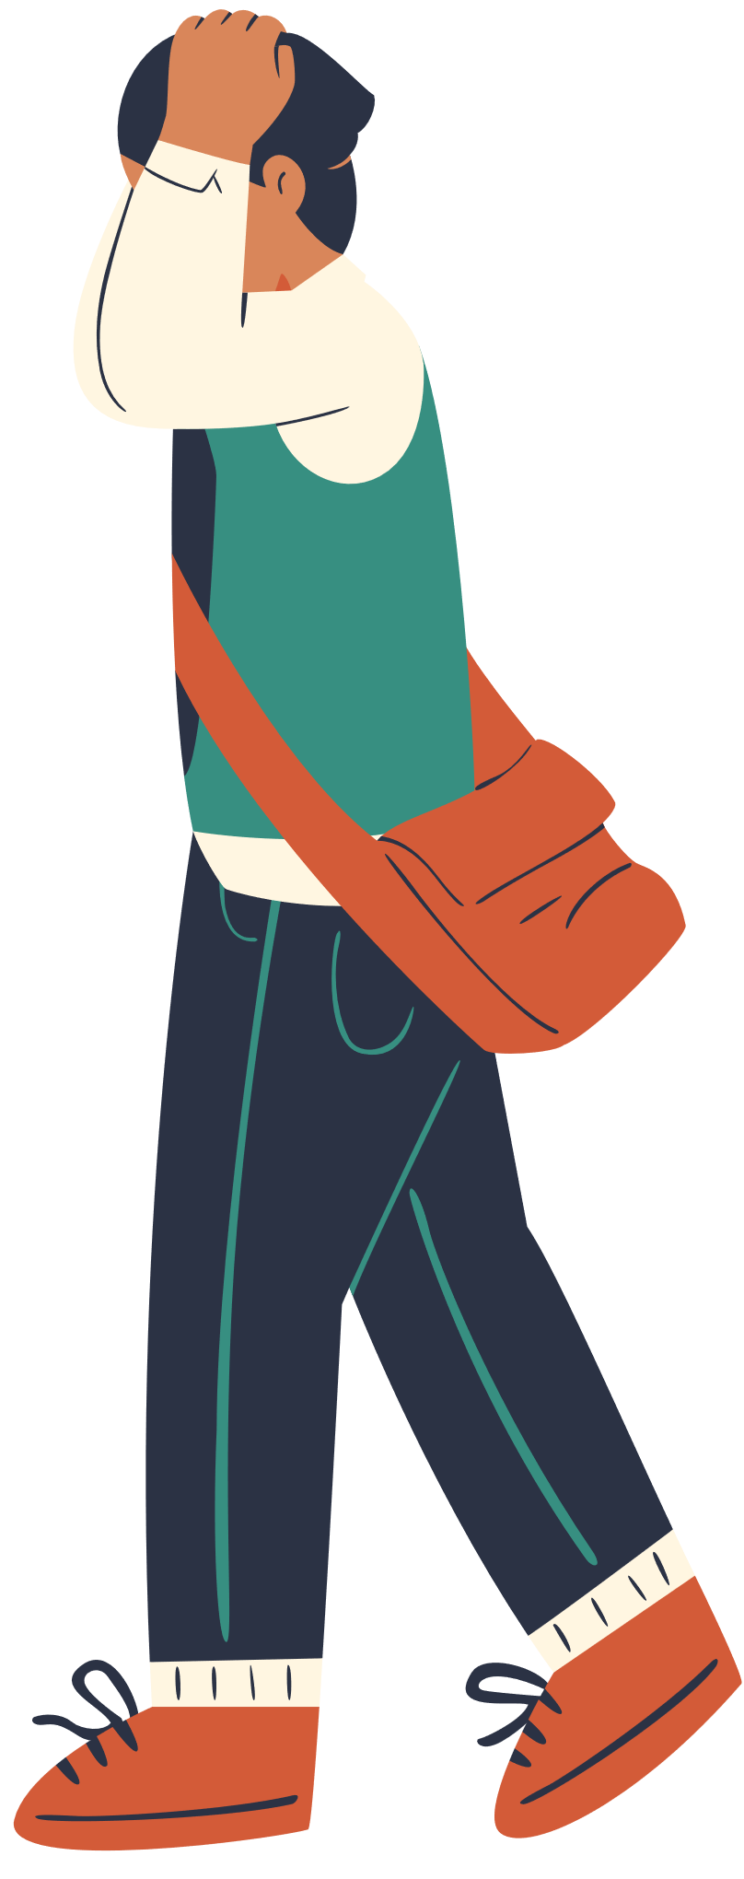
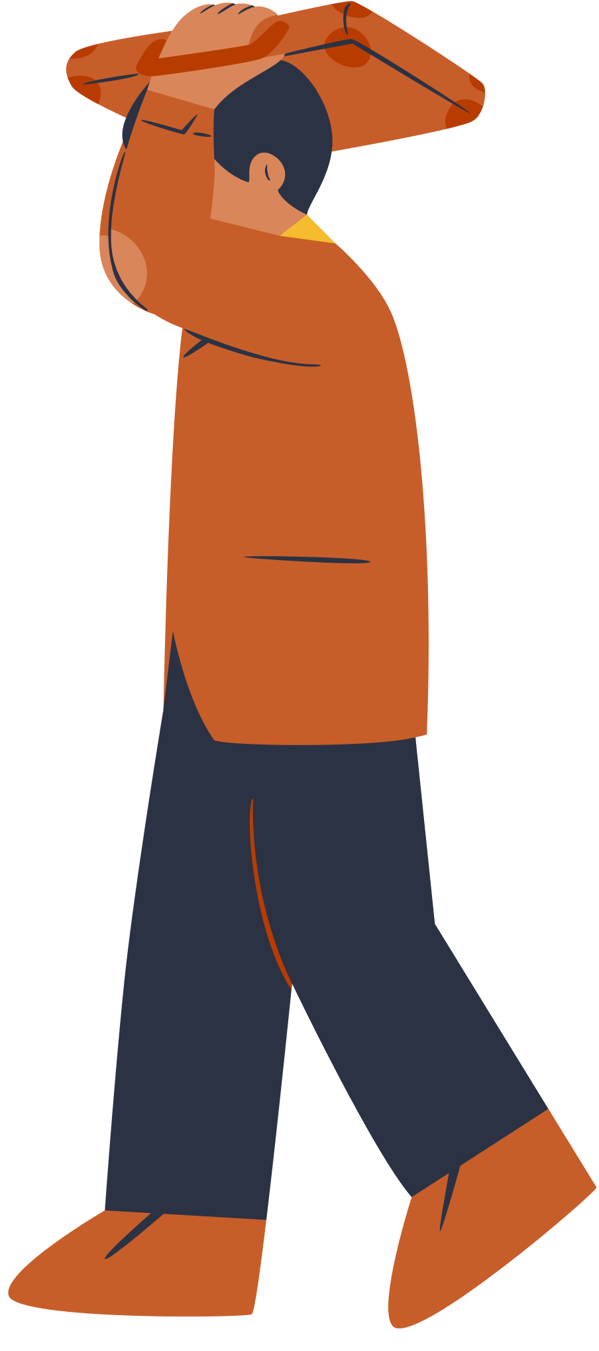
WELCOME TO OUR CLASS!

Slide 2
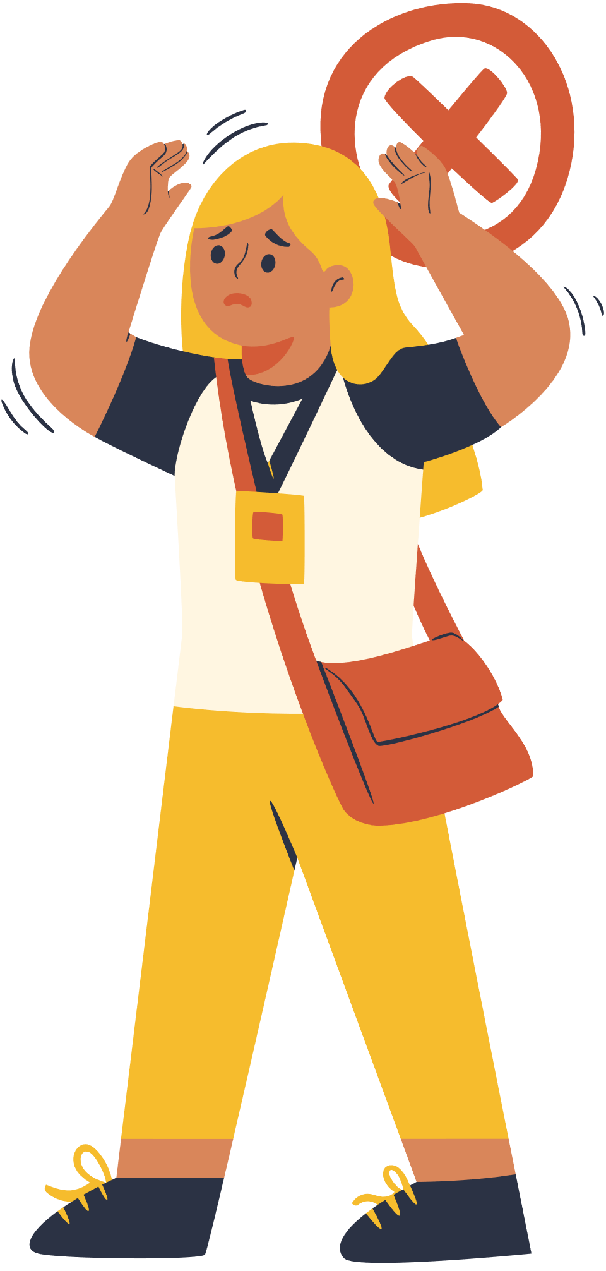
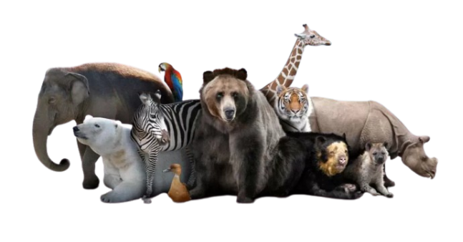

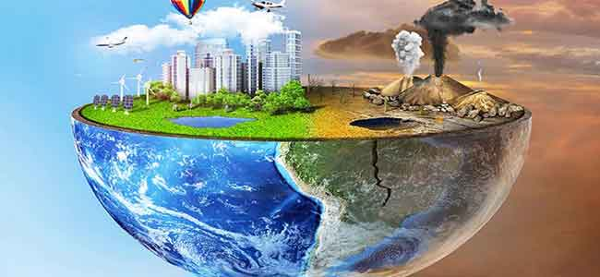
UNIT 7: ENVIRONMENTAL PROTECTION
SET 1

Slide 3
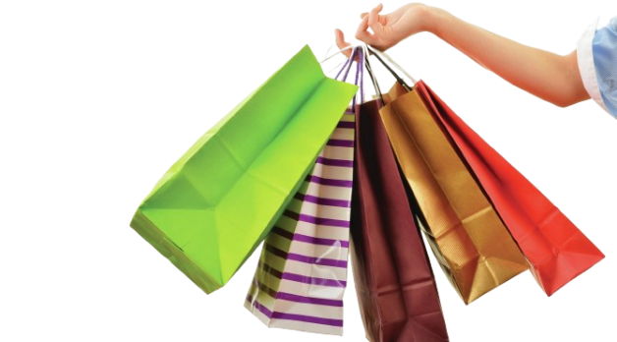
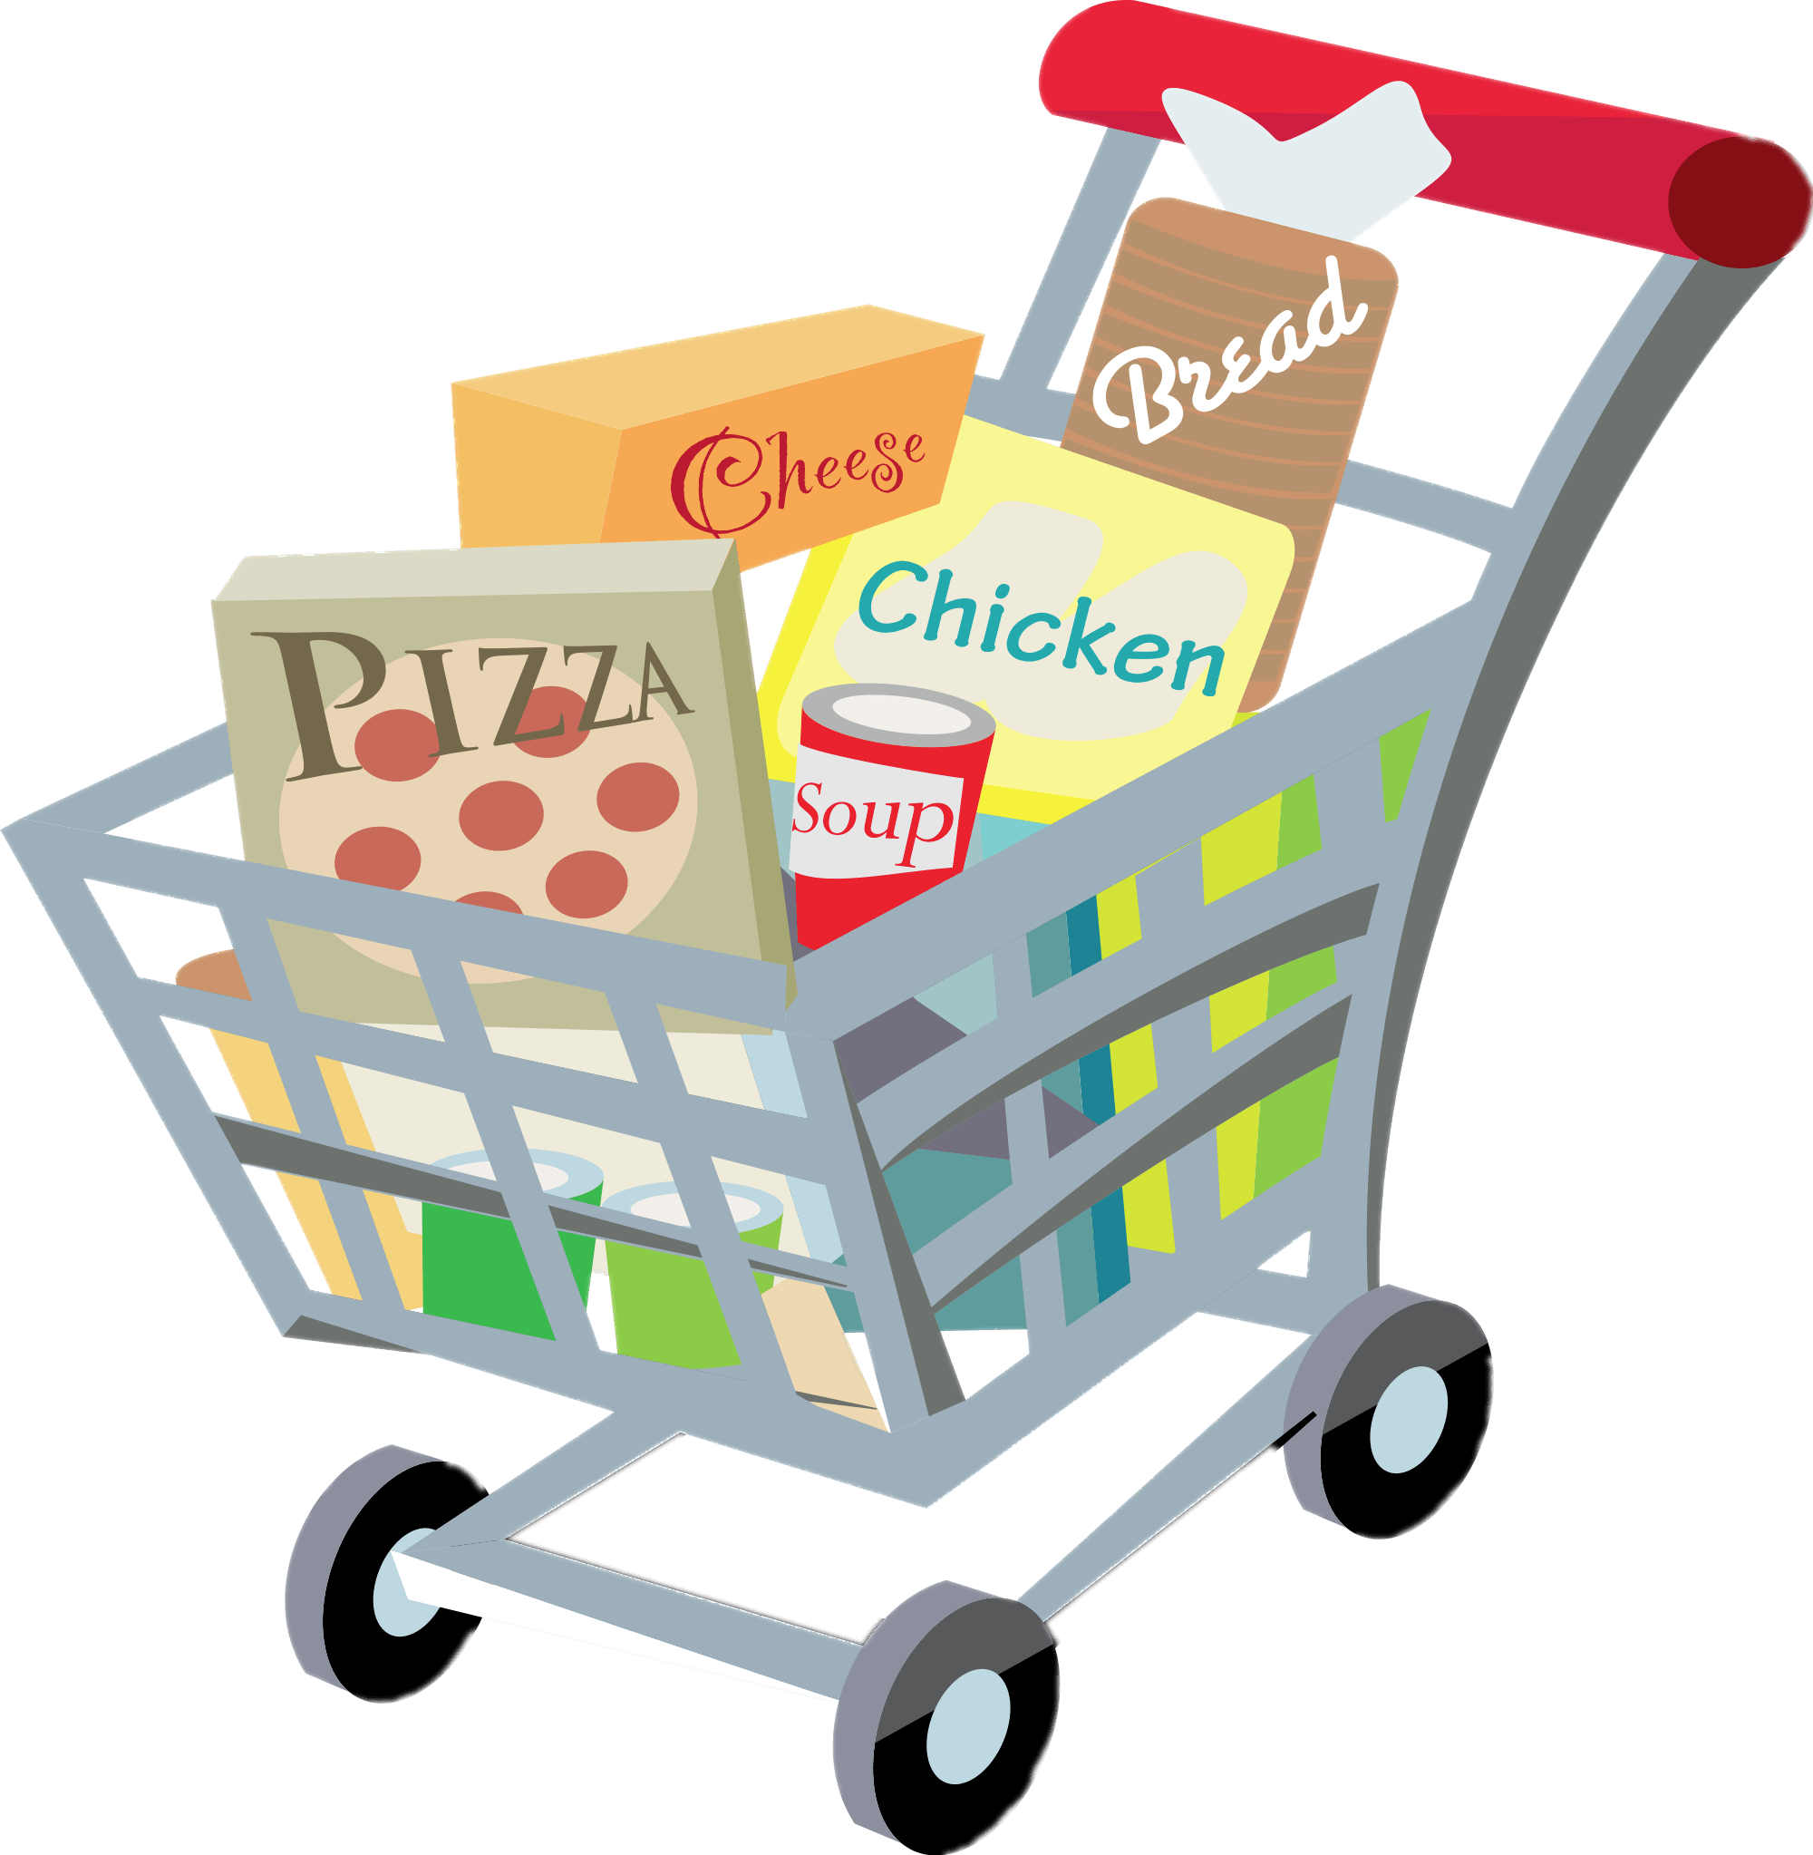

SET 2
UNIT 8: SHOPPING

Slide 4
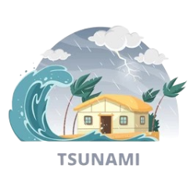
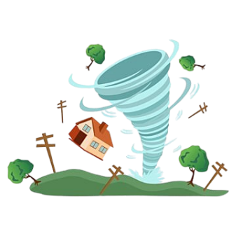


SET 3
UNIT 9: NATURAL DISASTERS

Slide 5
REVIEW 3
LANGUAGE

Slide 6

1a. Listen and repeat, paying attention to the underlined words
1. The sky today is clear and blue.
2. The speaker talked a lot about honesty.
3. The store on that corner sells local specialities.
1b. Choose A, B, C, or D to show the word in each group with a different stress pattern.
1. A. humorous B. tremendous C. numerous D. generous
2. A. national B. animal C. arrival D. typical
3. A. festival B. cultural C. poisonous D. ambitious

Slide 7
2. Complete each of the sentences with a word or phrase from the box.
customers bargain single-use habitats natural disasters
single-use
1. We should recycle various __________ products instead of throwing them away.
2. Shopping centres attract a lot of ____________ during the sales season.
3. Population growth is causing destruction of wildlife ________ throughout the world.
4. Luckily, my hometown rarely suffers from _____________, such as floods or storms.
5. Generally you can’t _____________ over prices of goods in supermarkets.
customers
habitats
natural disasters
bargain

Slide 8
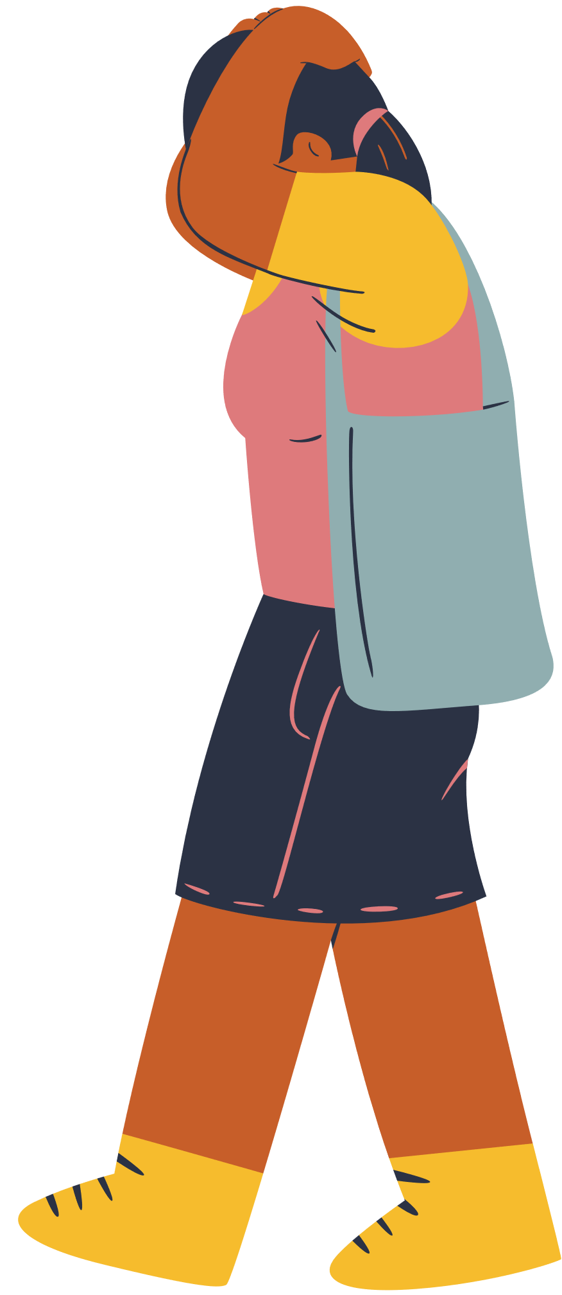
3. Use the=correct forms of the words in brackets to complete the sentences.
destructive
1. The tsunami in Tonga was very (destroy) ___________; hundreds of houses were swept away.
2. One (advantage) __________of shopping online is that you do not know exactly what you will get.
3. Endangered species are animals in the wild that face a high risk of (extinct) _________.
4. (Addict) ________shopping is a form of behaviour that makes shoppers buy many items they don’t need.
5. When a natural disaster happens, we must listen to (instruct) ___________ from local authorities.
disadvantage
extinction
addictive
instructions

Slide 9
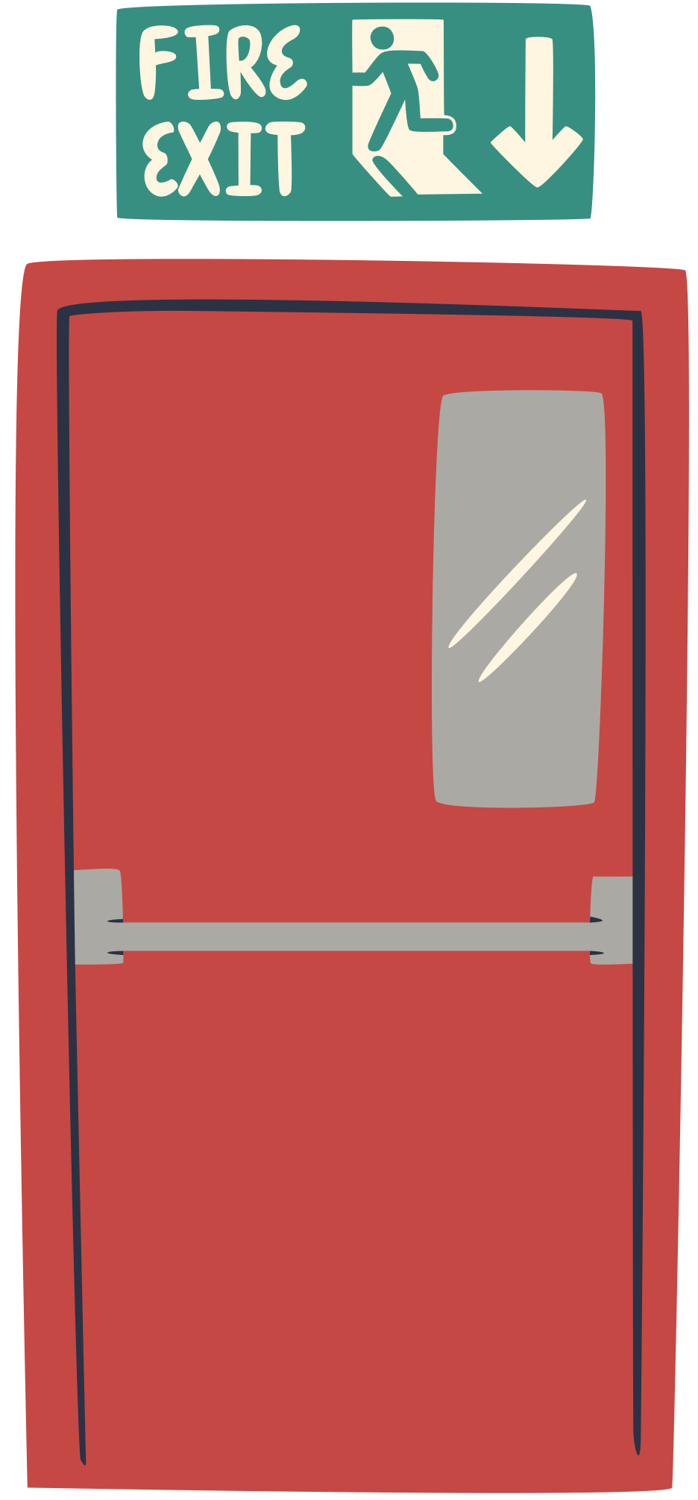
4. Use the correct forms of the words in brackets to complete the sentences
was cleaning
1. While I (clean) ______________ out my cupboards, I found these photos.
2. Sam is studying hard. He (have) ______ his exam this Friday.
3. This brochure says that the big sale (start) _____ next Friday.
4. ________ the flood victims still (wait) _________ when the rescuers came?
5. I (fall) ______________ asleep last night when I (hear) ______________ a knock at the door
has
starts
Were waiting
was just falling heard

Slide 10


5. Complete the sentences, so that they are true for you.
my friends were waiting for me
1. When I finished my lessons yesterday, ________________________.
2. Before I go to bed at night, _______________________________.
3. I will wait until the teacher _______________________________.
4. As soon as we have our summer holiday, _______________________.
5. I usually listen to music while ______________________________.
my mother read a story for me
finds out my exam paper
we will go to our uncle’s farm
I am doing my housework

Slide 11

WRAP UP
What have we learnt in this lesson?
review the vocabulary and grammar of Unit 7, 8, 9

Slide 12
HOMEWORK
Do exercises in the workbook
Prepare for the next lesson

Slide 13
THANK YOU!

