Slide 1
Guessing game
01
Look at the pictures.
02
Guess the health problems.
03
Write them down.

Slide 2
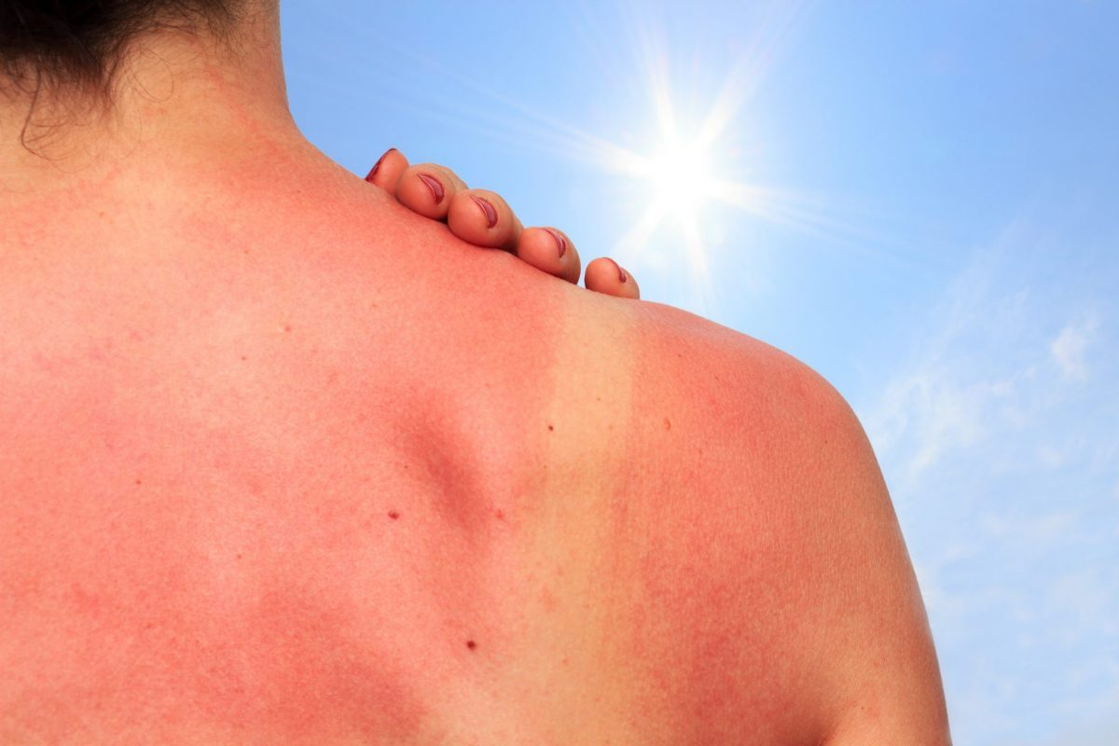
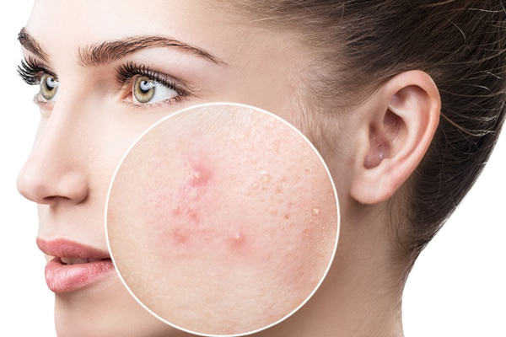
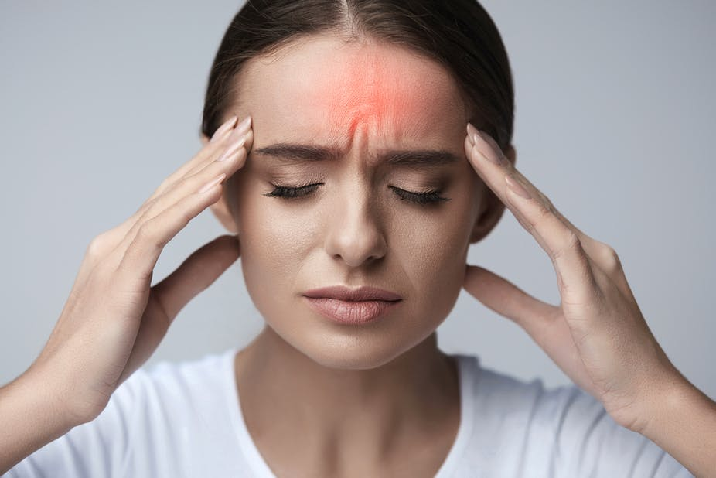
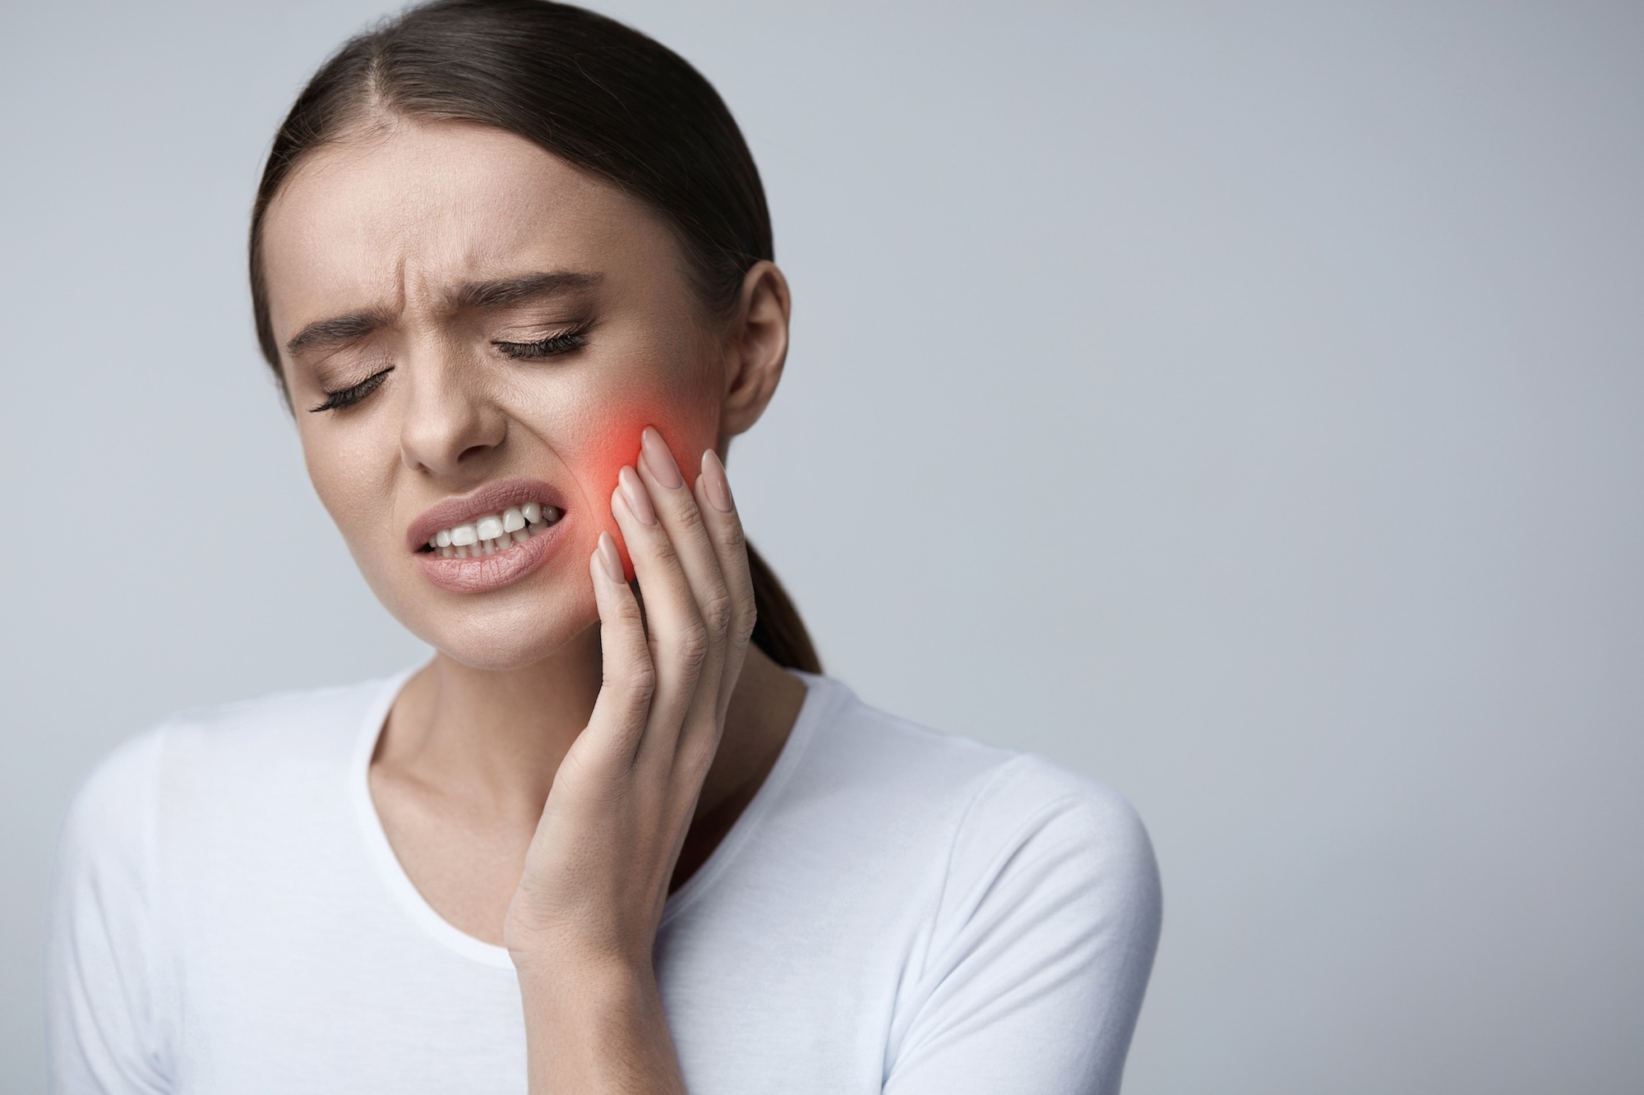
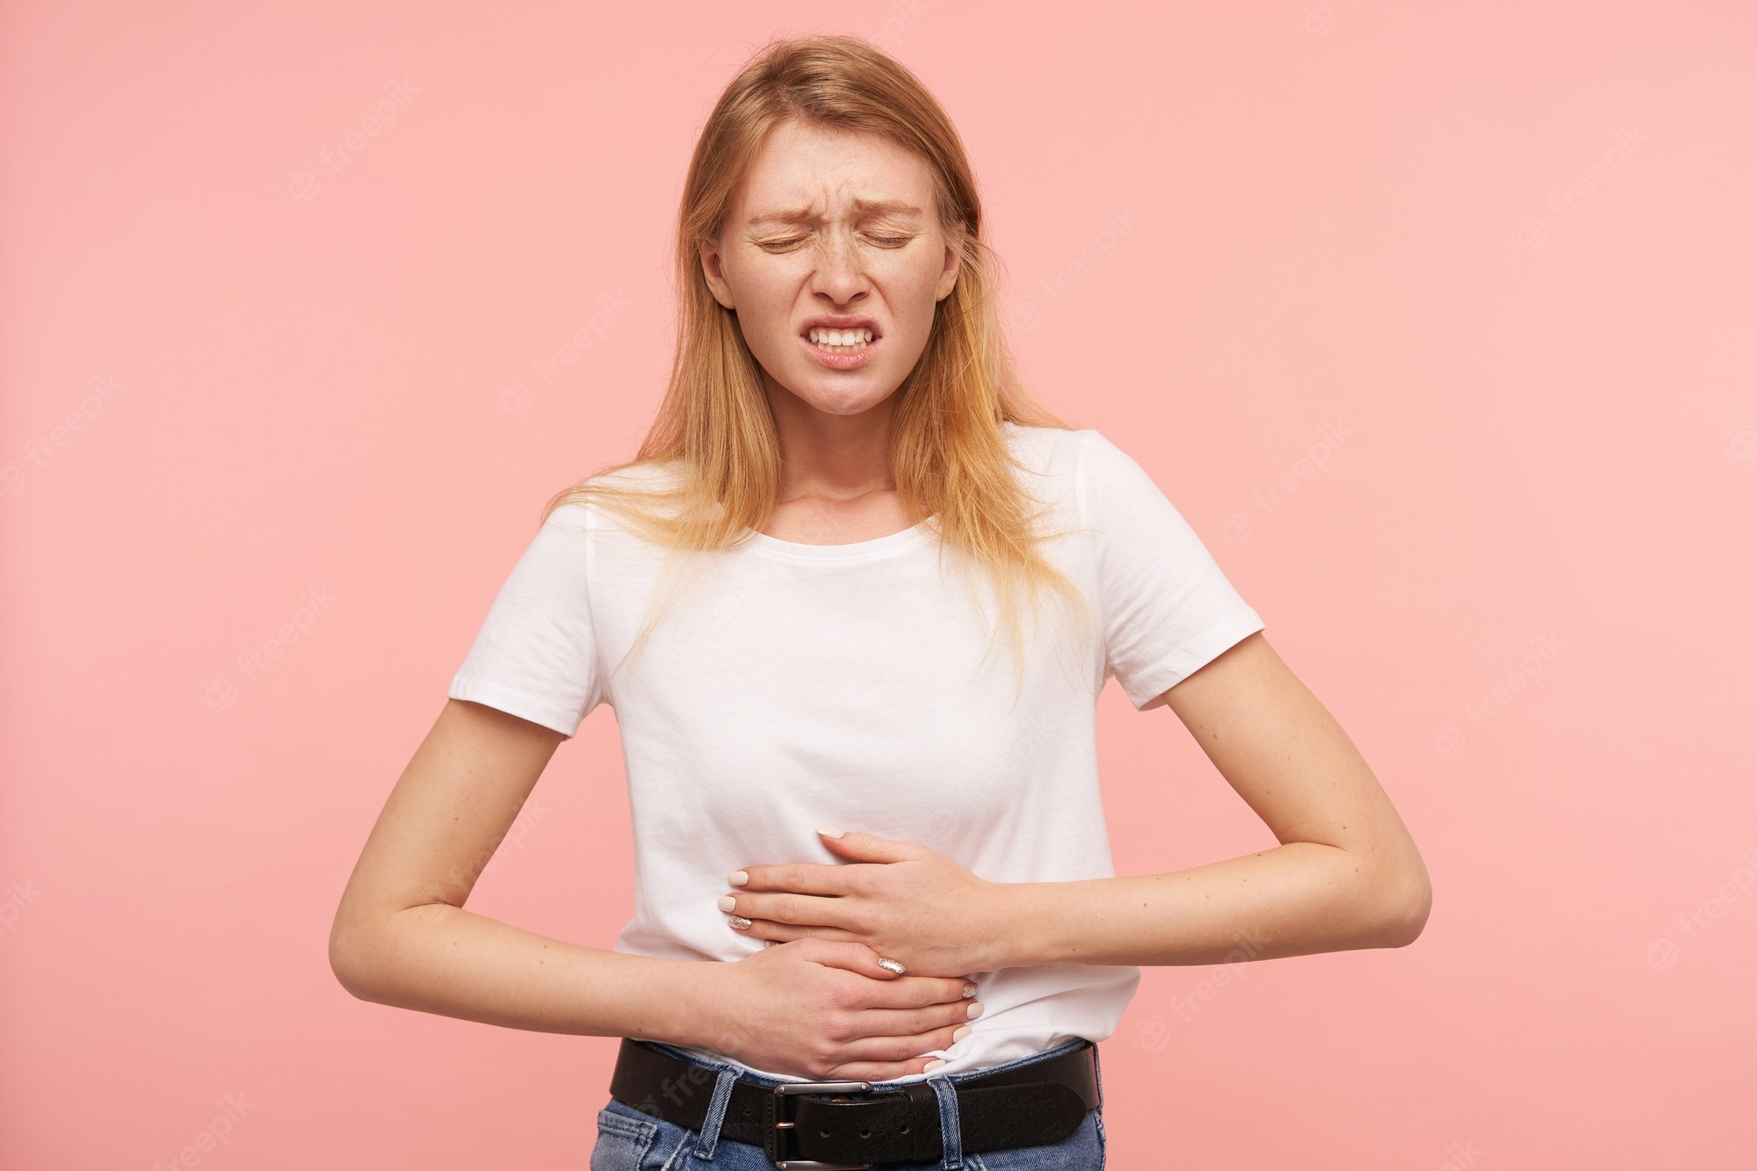
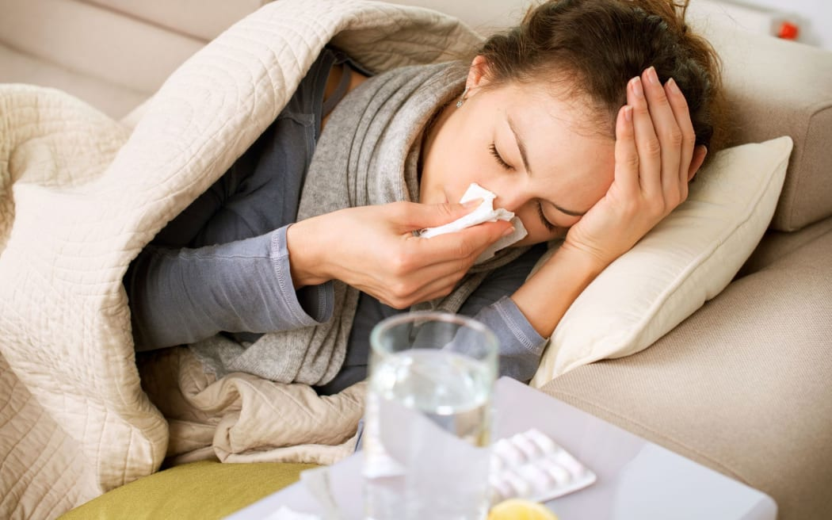
What health problem is it?
sunburn
spots
headache
toothache
stomachache
flu

Slide 3
Can you add more?

Slide 4
Unit 2: Healthy living
Lesson 2: A closer look 1

Slide 5
OBJECTIVES
By the end of the lesson, students will be able to:
1
use the lexical items related to the topic Healthy living
2
use the words about healthy activities and health problems.
3
pronounce and recognize the sounds /f/ and /v/

Slide 6
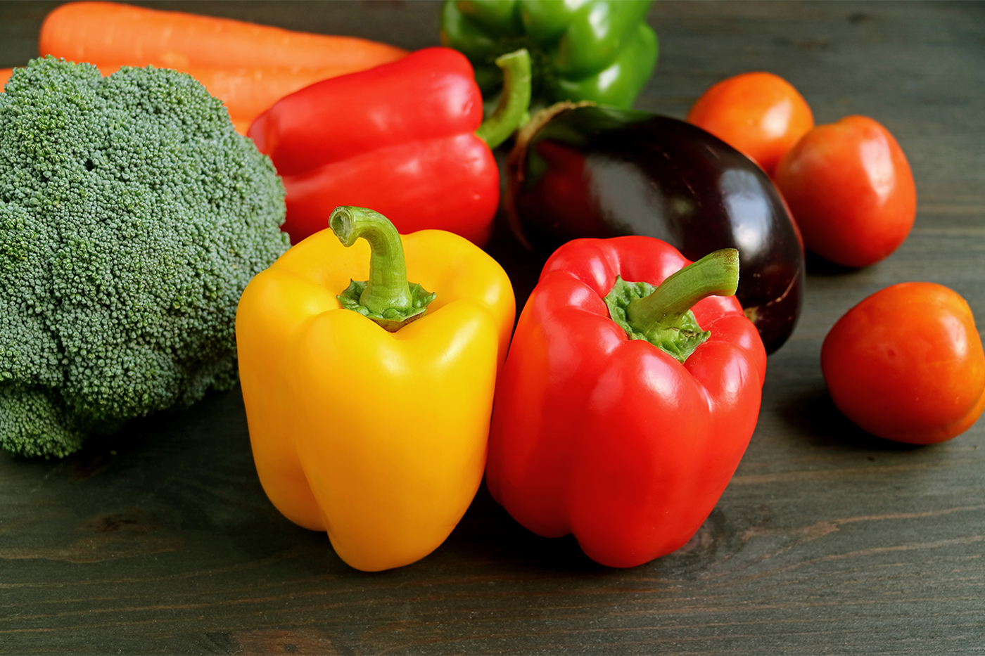
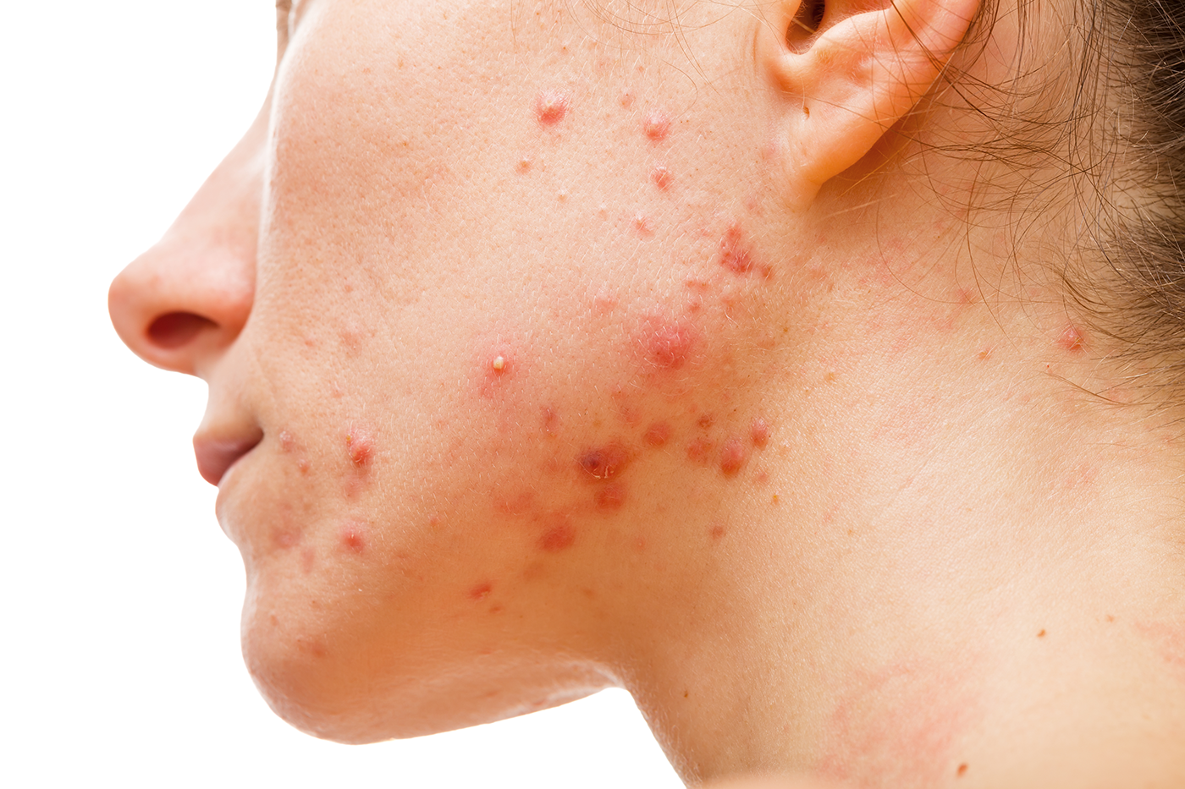
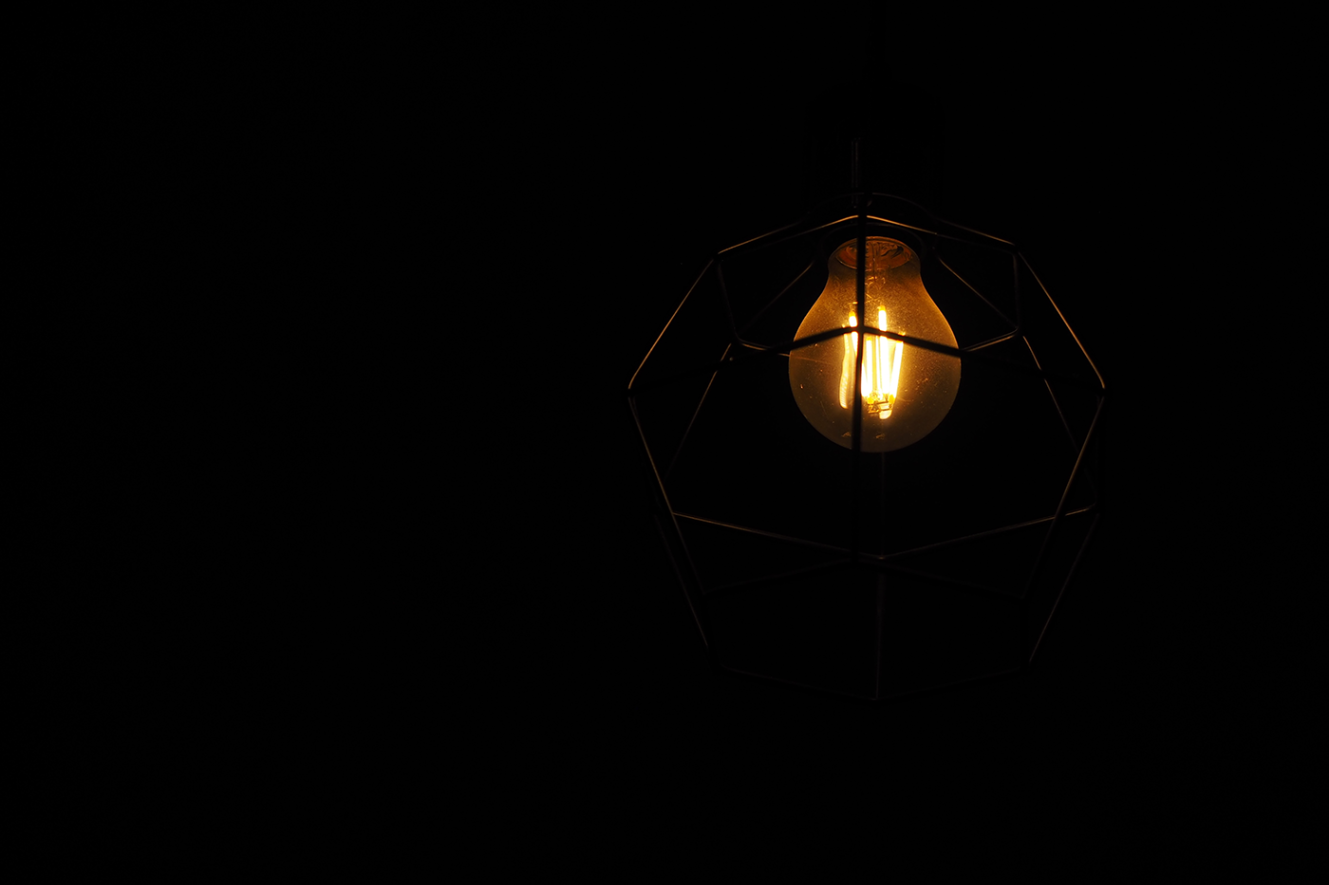
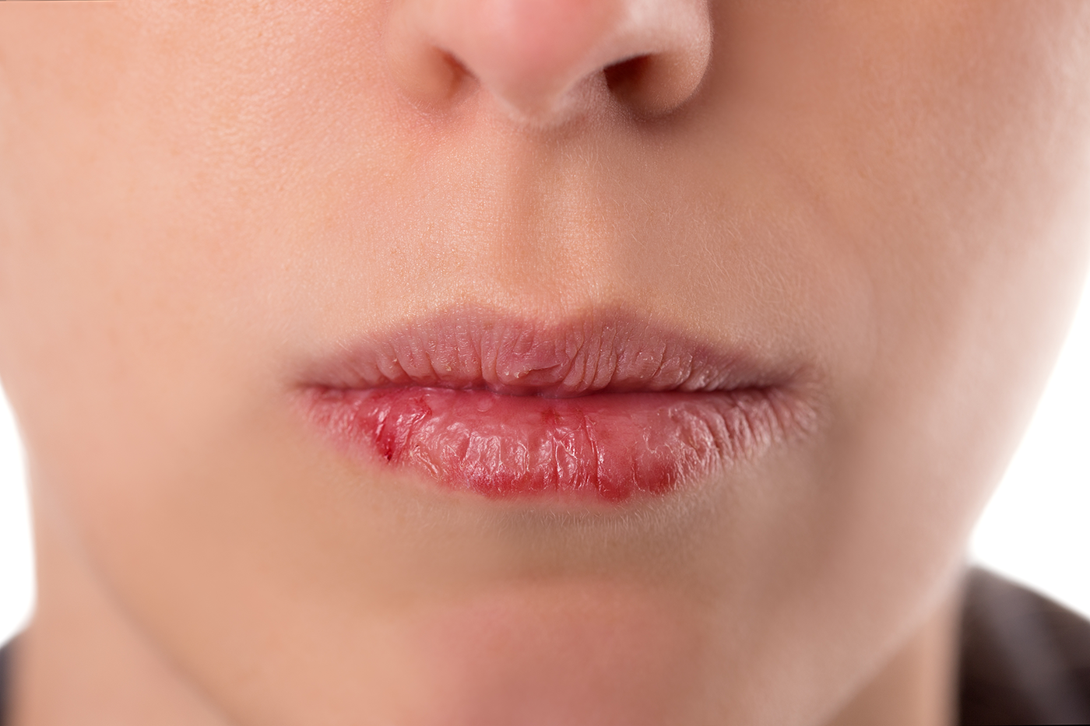
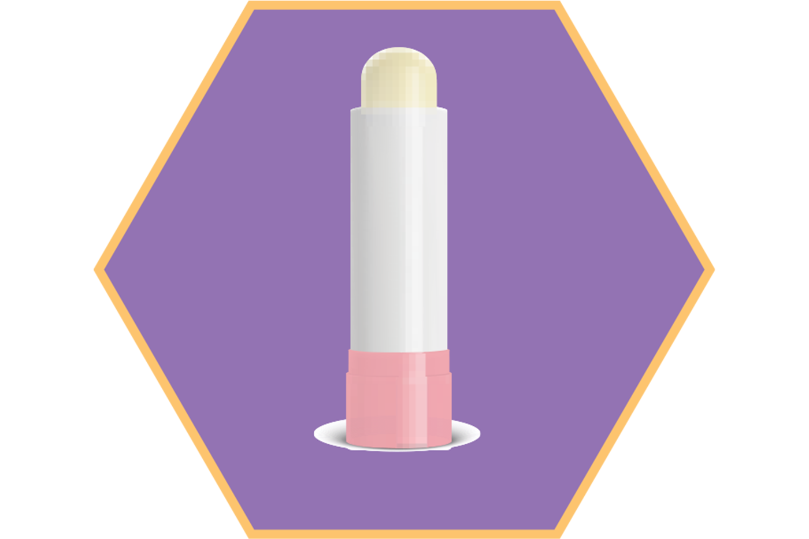
1. Match the phrases on the left with the correct pictures on the right. (P.20)
1. dim light
2. lip balm
a
b
3. chapped lips
4. coloured vegetables
c
5. red spots
d
e

Slide 7

Let’s check!
1. dim light (n)
/dɪm lait/
ánh sáng lờ mờ
c

Slide 8
Let’s check!
2. lip balm (n)
/ˈlɪp ˌbɑːm/
son dưỡng môi
e

Slide 9
Let’s check!
3. chapped lips (n)
/tʃæpt lɪps/
môi nứt nẻ
d

Slide 10
Let’s check!
4. coloured vegetables (n)
/ˈkʌləd ˈvedʒtəbəl/
rau có màu sắc
a

Slide 11
Let’s check!
5. red spots (n)
/red spɒt/
mụn đỏ
b

Slide 12
VOCABULARY
New words | Pronunciation | Meaning
1. dim light (n) | /dɪm lait/ | ánh sáng lờ mờ
2. lip balm (n) | /ˈlɪp ˌbɑːm/ | son dưỡng môi
3. chapped lips (n) | /tʃæpt lɪps / | môi nứt nẻ
4. coloured vegetables (n) | / ˈkʌləd ˈvedʒtəbəl/ | rau có màu sắc
5. red spots (n) | /red spɒt/ | mụn đỏ

Slide 13
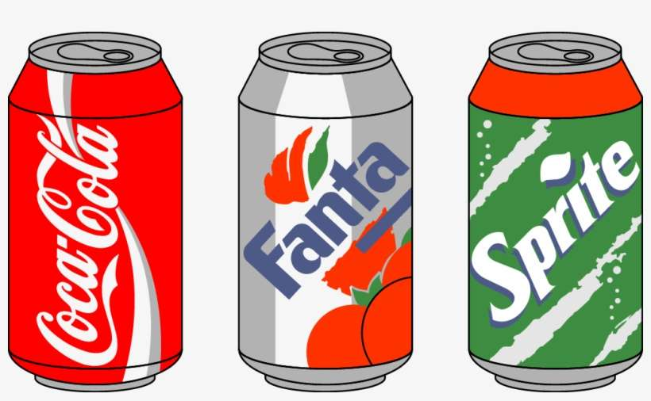
2. Complete the sentences with the correct words and phrases below. (P.20)
skin condition
soft drinks
coloured vegetables
sunburn
fit
coloured vegetables
1. - Please name some ___________________.
- Carrots and tomatoes.
2. ___________________ are not good for your health. 3. My parents go cycling every Sunday. It keeps them ___________________. 4. The weather may affect our ___________________. 5. - How do we get ___________________?
- When we spend a long time in the sun without a hat or suncream.
soft drinks (n):
Nước ngọt có ga
Soft drinks
fit
skin condition
sunburn

Slide 14


3. Discuss and tick each activity in the table as H (Healthy) or U (Unhealthy). (P.20)
Activities | H | U
1. washing your hands often
2. reading in dim light
3. eating tofu and coloured vegetables
4. brushing your teeth twice a day
5. touching your face with dirty hands
Work in pairs.
Discuss and tick
Give reason why.

Slide 15
3. Discuss and tick each activity in the table as H (Healthy) or U (Unhealthy). (P.20)
Activities | H | U
1. washing your hands often
2. reading in dim light
3. eating tofu and coloured vegetables
4. brushing your teeth twice a day
5. touching your face with dirty hands






Slide 16
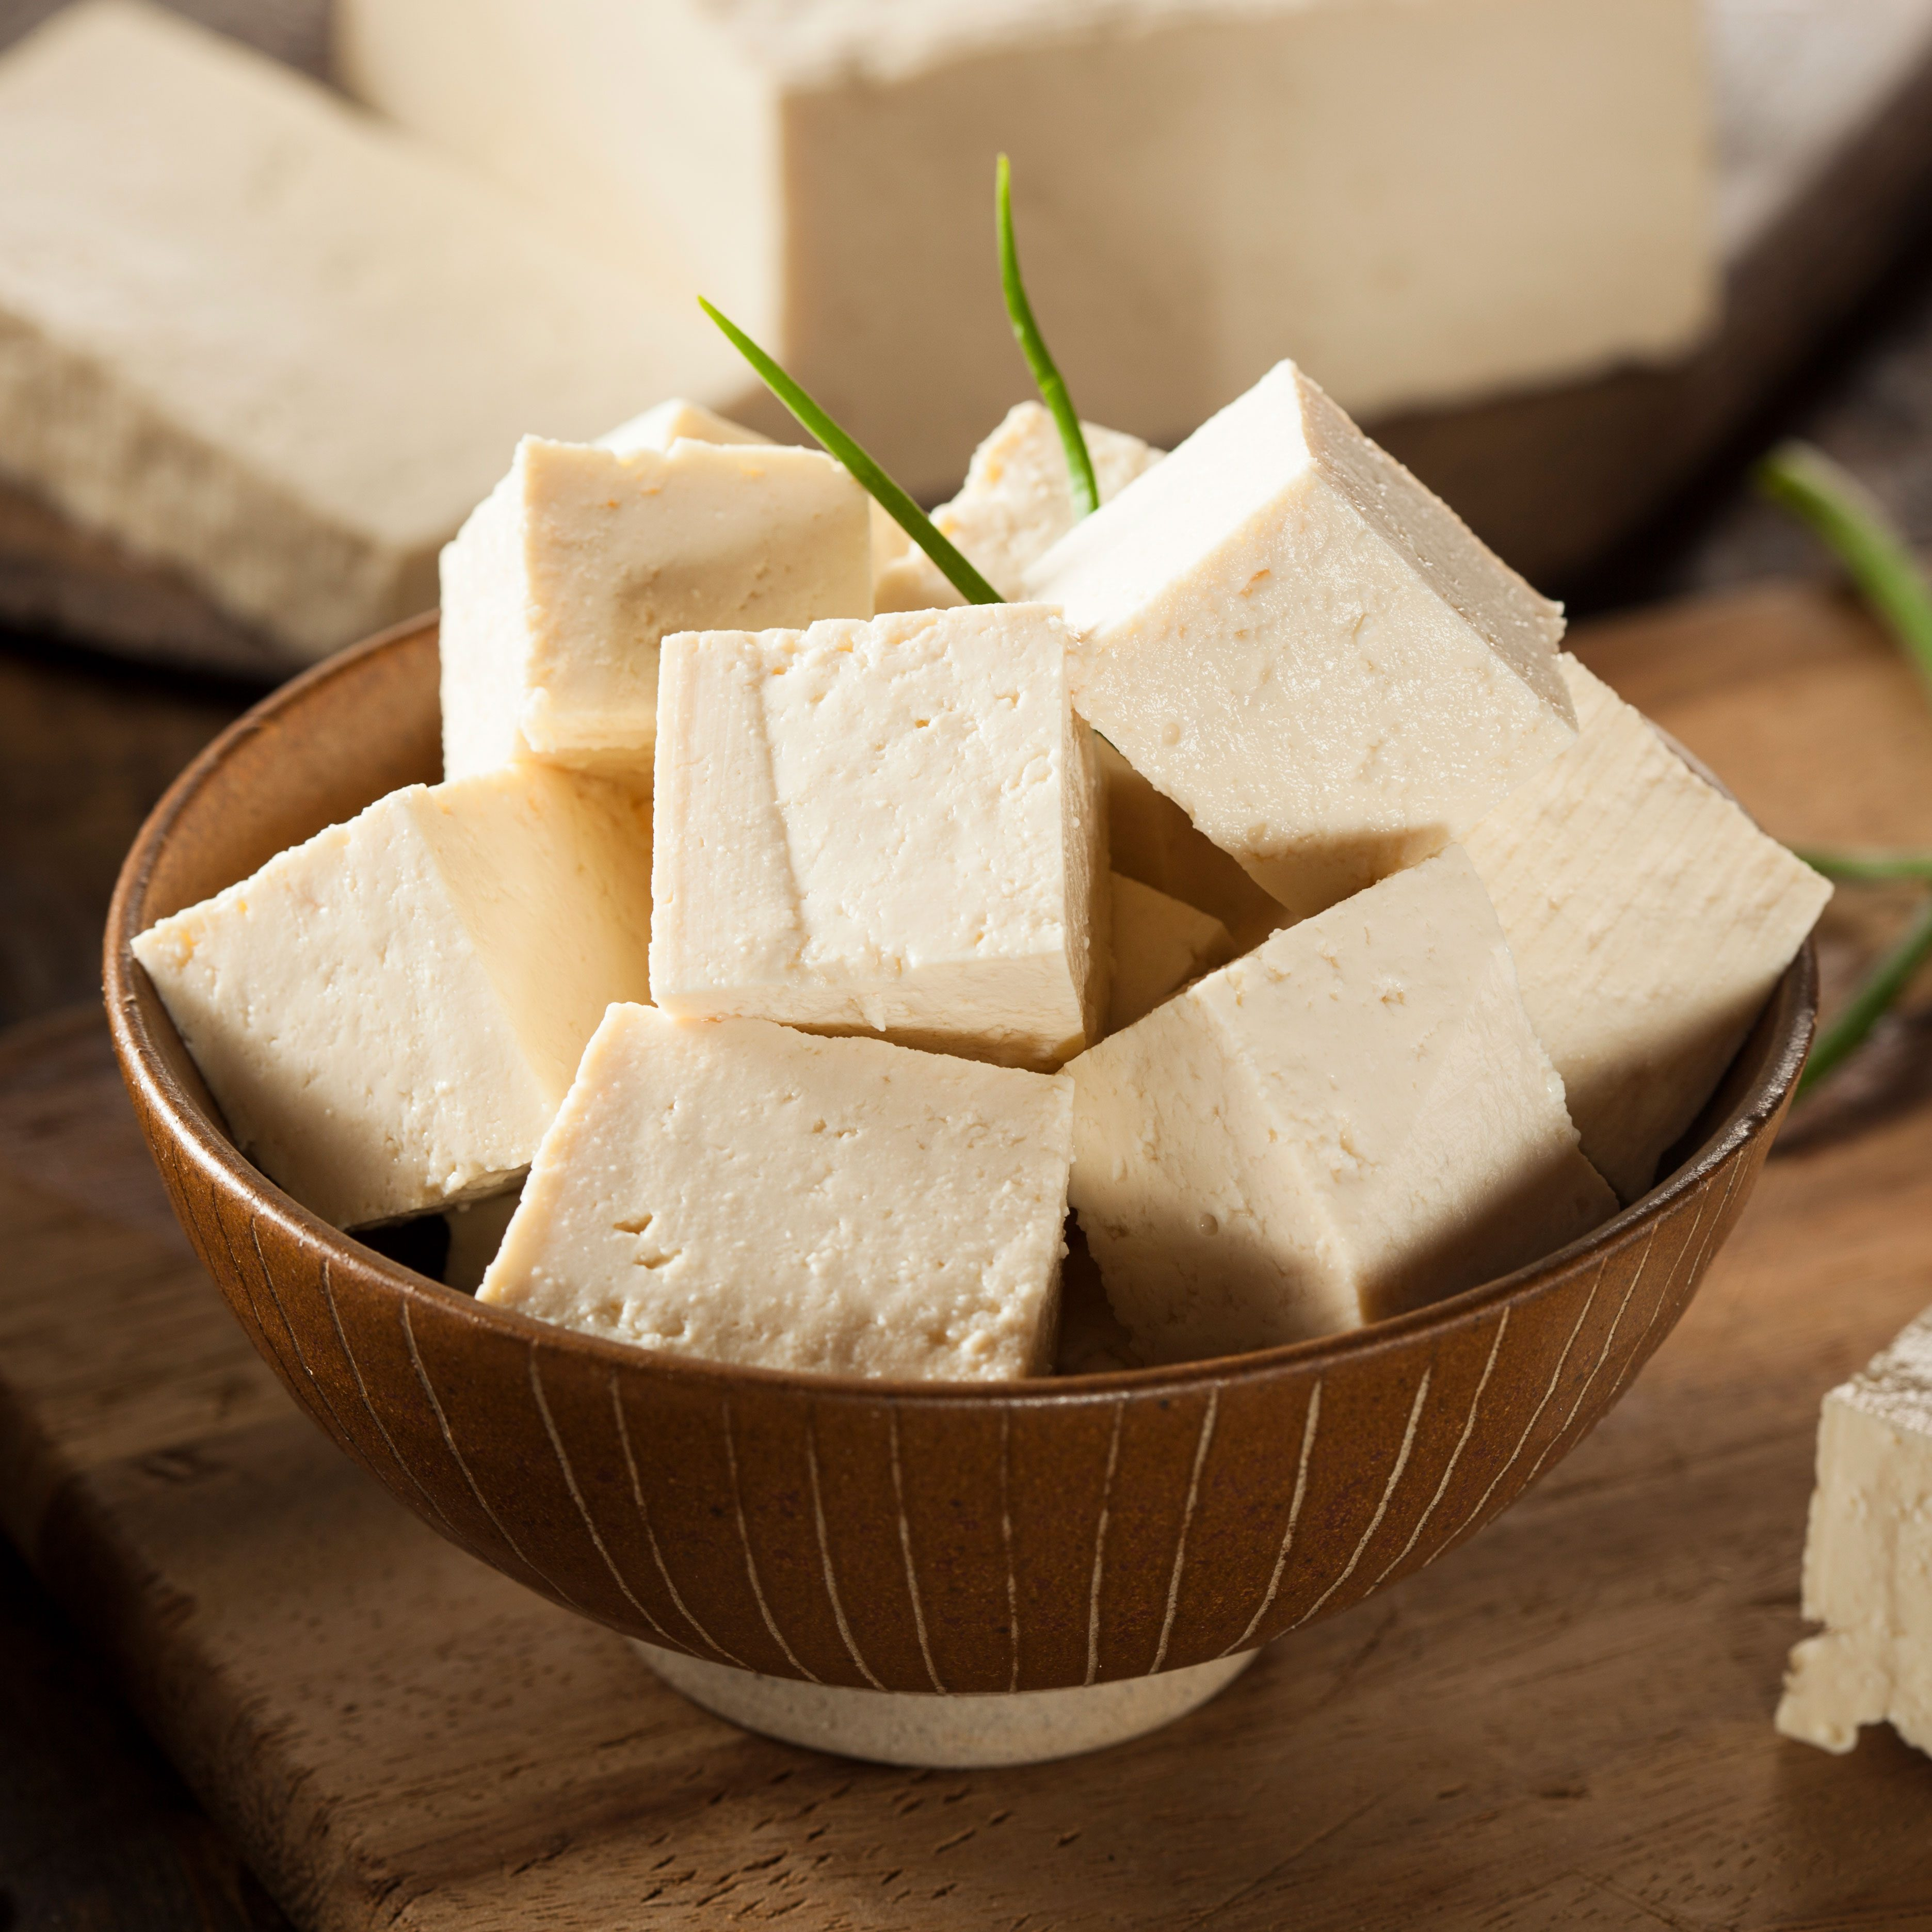
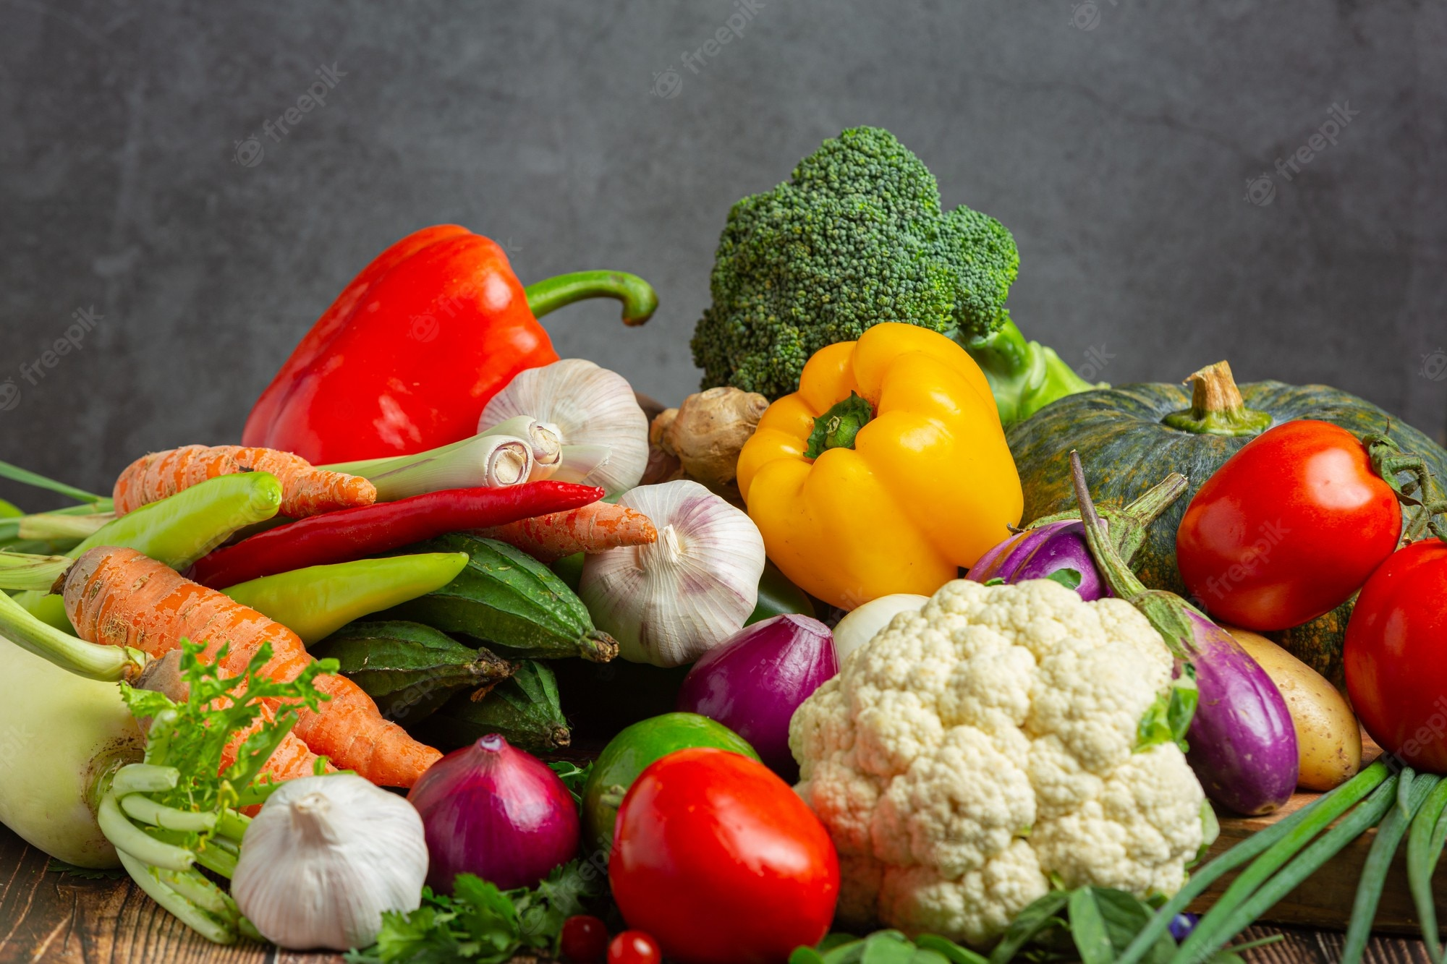
What’s that?
tofu
vegetables
tofu
vegetables
/f/
/v/

Slide 17
PRONUNCIATION
/f/ and /v/

Slide 18

Watch a video. Pay attention to the sounds /f/ and /v/

Slide 19
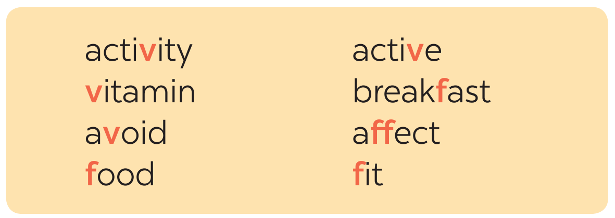
4. Listen and repeat. (P.20)

Slide 20
5. Listen and repeat, pay attention to the underlined words. (P.20)
1. Coloured vegetables are good food. 2. My favorite outdoor activity is cycling. 3. We need vitamin A for our eyes. 4. Being active helps keep you fit. 5. Jack never eats fish.
/v/
/f/
/f/
/v/
/v/
/f/
/v/
/f/
/v/
/f/

Slide 21
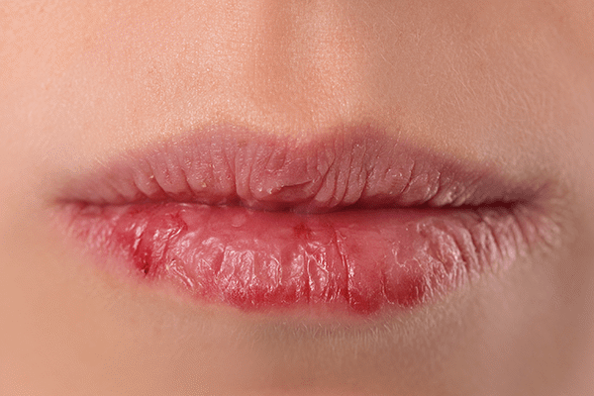
RECAP
01
What health problem is it?
chapped lips
red spots
sunburn
02
Reading in dim light is ______.
A. healthy B. unhealthy
03
Find the different sound.
A. of B. foot C. fit
/v/
/f/
/f/

