Slide 1

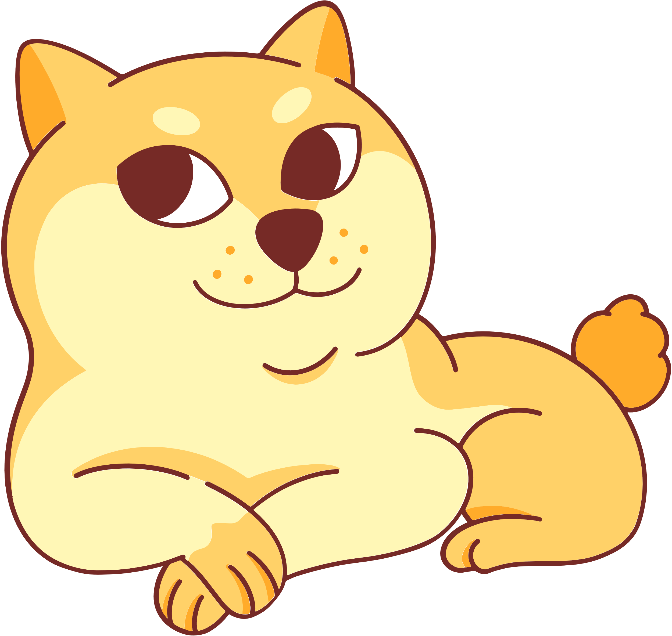
Welcome to our class!

Slide 2



CHAIN GAME
Example: I’m interested in doing DIY.
I’m crazy about ______. I’m keen on ______. I’m fond of ______.
I’m not interested in ______.
I’m not into ______.

Slide 3


Unit 1:
Leisure Time
Lesson 3: A Closer Look 2

Slide 4


Verbs of liking
love
prefer
like
enjoy
fancy
Verbs of liking are used to express positive attitudes towards people or things.

Slide 5


Verbs of disliking
detest
hate
dislike
Verbs of disliking are used to express negative attitudes towards people or things.

Slide 6

REMEMBER!
Some verbs of liking and disliking can be followed by gerunds only.
Example: They dislike surfing the net.
Some are followed by both gerunds and
to-infinitives.
Example: I love going / to go to the cinema.

Slide 7
1. Work in pairs. Put the verbs in the appropriate column.
love like detest fancy
dislike enjoy hate prefer
Verbs followed by gerunds only | Verbs followed by both gerunds and to-infinitives
love
detest
fancy
like
dislike
hate
enjoy
prefer

Slide 8
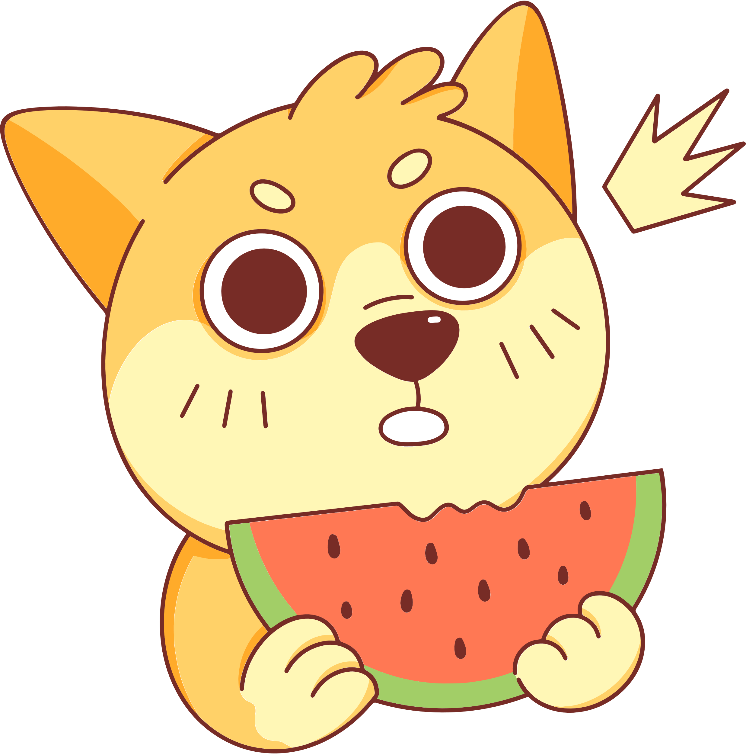
2. Choose the correct answer A, B, or C
1. I love ______, so in my leisure time, I go to some villages near Ha Noi to relax and enjoy the outdoors.
A. travelling B. travelled C. to travel
2. Tom enjoys ______ puzzles, especially Sudoku. A. doing B. do C. to do
3. When do you like ______ TV? A. watched B. watch C. to watch
4. Do you fancy ______ to the cinema this weekend?
A. go B. going C. to go
5. I detest ______. I think it’s cruel to harm animals. A. hunting B. to hunt C. hunt

Slide 9








MARIO’S ADVENTURE

Slide 10
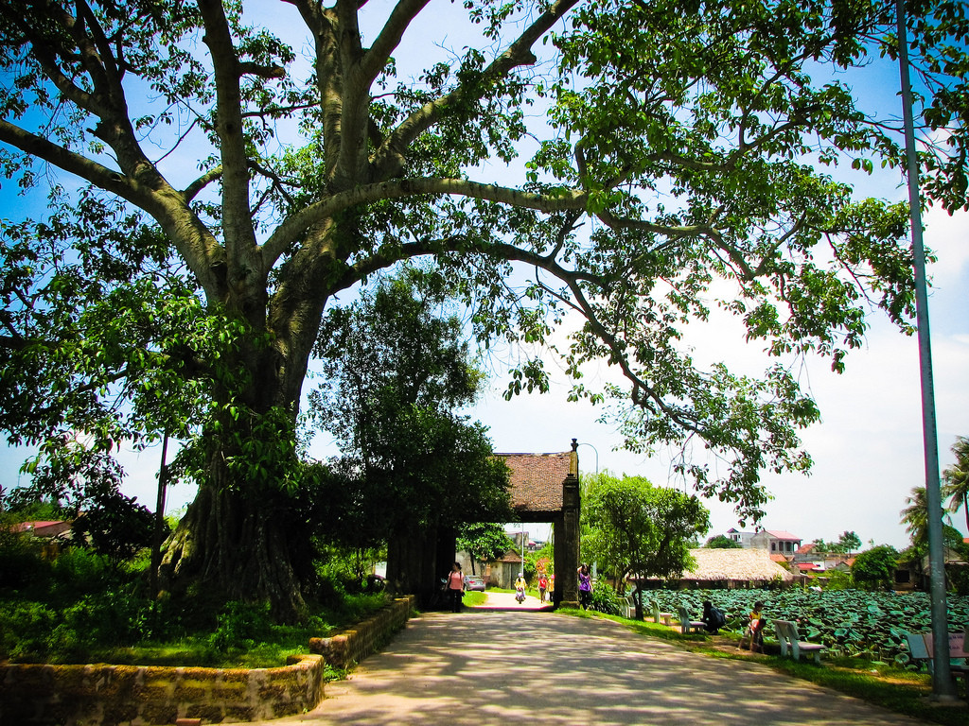

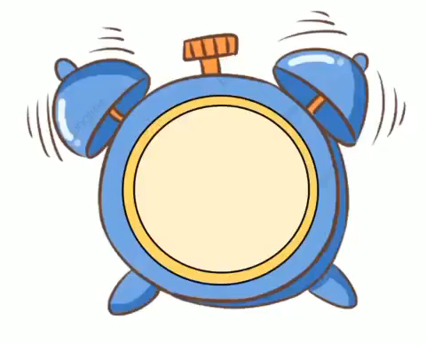
1. I love ______, so in my leisure time, I go to some villages near Ha Noi to relax and enjoy the outdoors.
A. travelling
B. travelled
C. to travel

Slide 11
2. Tom enjoys ______ puzzles, especially Sudoku.
A. doing
B. do
C. to do

Slide 12
3. When do you like ______ TV?
A. watched
B. watch
C. to watch

Slide 13
4. Do you fancy ______ to the cinema this weekend?
A. go
B. going
C. to go

Slide 14
5. I detest ______. I think it’s cruel to harm animals.
A. hunting
B. to hunt
C. hunt

Slide 15

Look at the answer again.
1. I love ______, so in my leisure time, I go to some villages near Ha Noi to relax and enjoy the outdoors.
A. travelling B. travelled C. to travel
2. Tom enjoys ______ puzzles, especially Sudoku. A. doing B. do C. to do
3. When do you like ______ TV? A. watched B. watch C. to watch
4. Do you fancy ______ to the cinema this weekend?
A. go B. going C. to go
5. I detest ______. I think it’s cruel to harm animals. A. hunting B. to hunt C. hunt

Slide 16


3. Look at the pictures and complete the sentences, using the verbs in brackets in their suitable form.
1. Mark ___________________________. (like)
2. The girls ____________. (enjoy)
3. My cousin ______________. (dislike)
4. My father________________________. (hate)
5. Tom and his sister ______________________. (prefer)

Slide 17

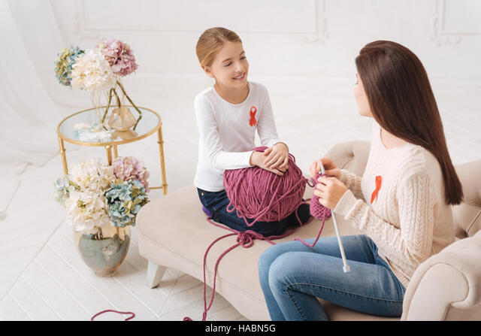
3. Look at the pictures and complete the sentences, using the verbs in brackets in their suitable form.
1. Mark ___________________________. (like)
likes surfing / to surf the Internet
enjoy knitting
2. The girls ____________. (enjoy)

Slide 18
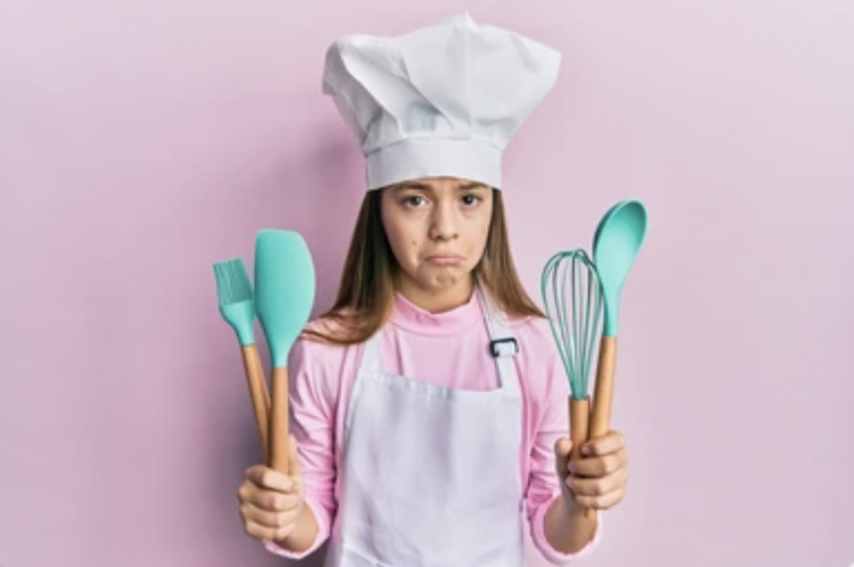
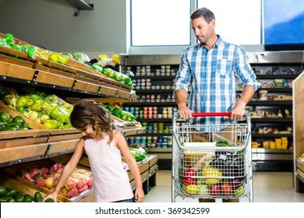
3. Look at the pictures and complete the sentences, using the verbs in brackets in their suitable form.
dislikes cooking
3. My cousin ______________. (dislike)
hates going / to go shopping
4. My father_________________________. (hate)

Slide 19
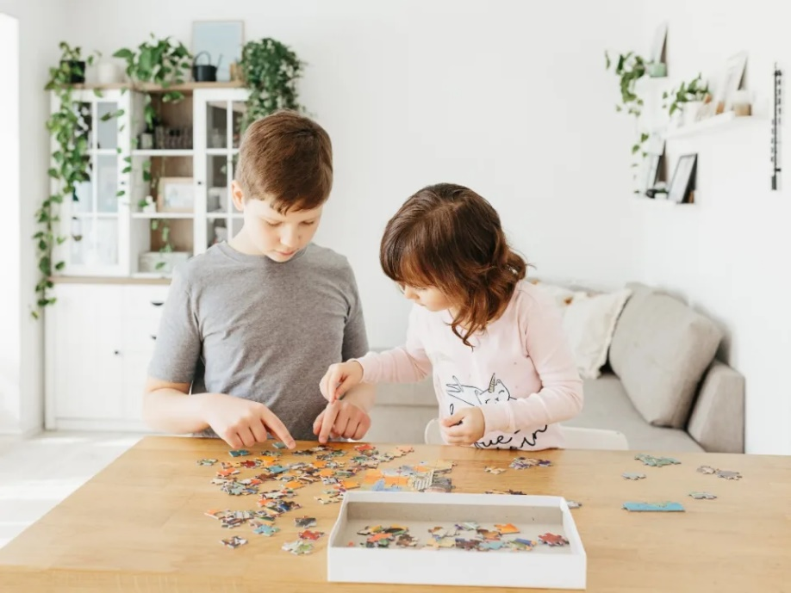
3. Look at the pictures and complete the sentences, using the verbs in brackets in their suitable form.
5. Tom and his sister __________________________. (prefer)
prefer doing / to do puzzles

Slide 20
About you

Slide 21





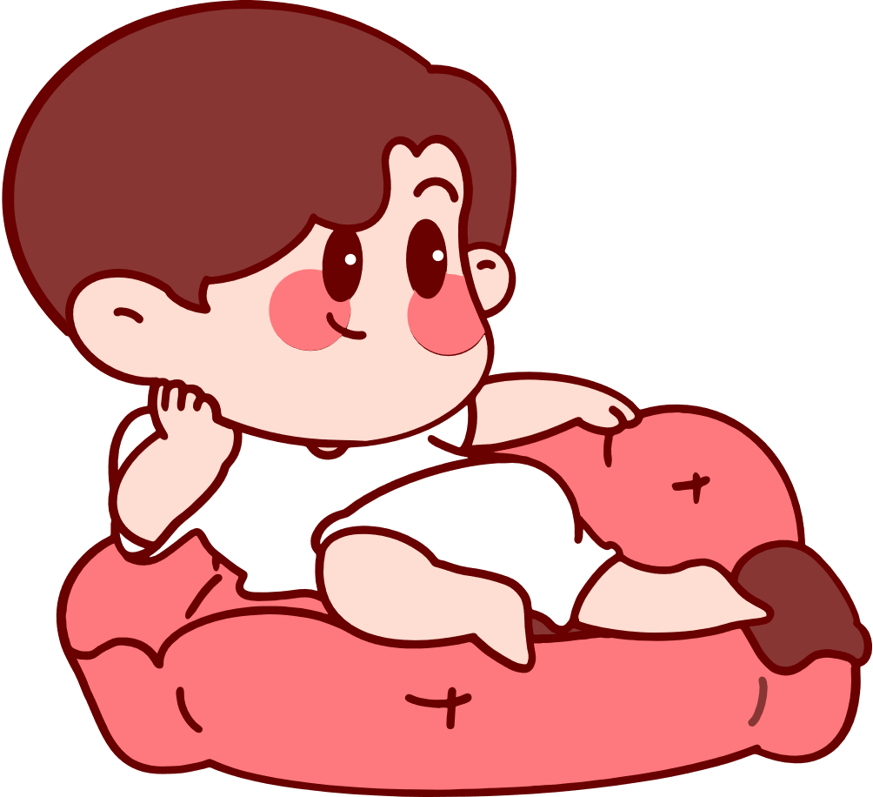
4. Complete the sentences about yourself.
All about me
I like ______. I prefer ______. I love ______. | I dislike ______. I hate ______. I detest ______.

Slide 22

Thank you!
Homework
Review the grammar point
Make 5 sentences with verbs of liking/ disliking
Prepare: Lesson: Communication

Slide 23


See you next time!

Slide 24

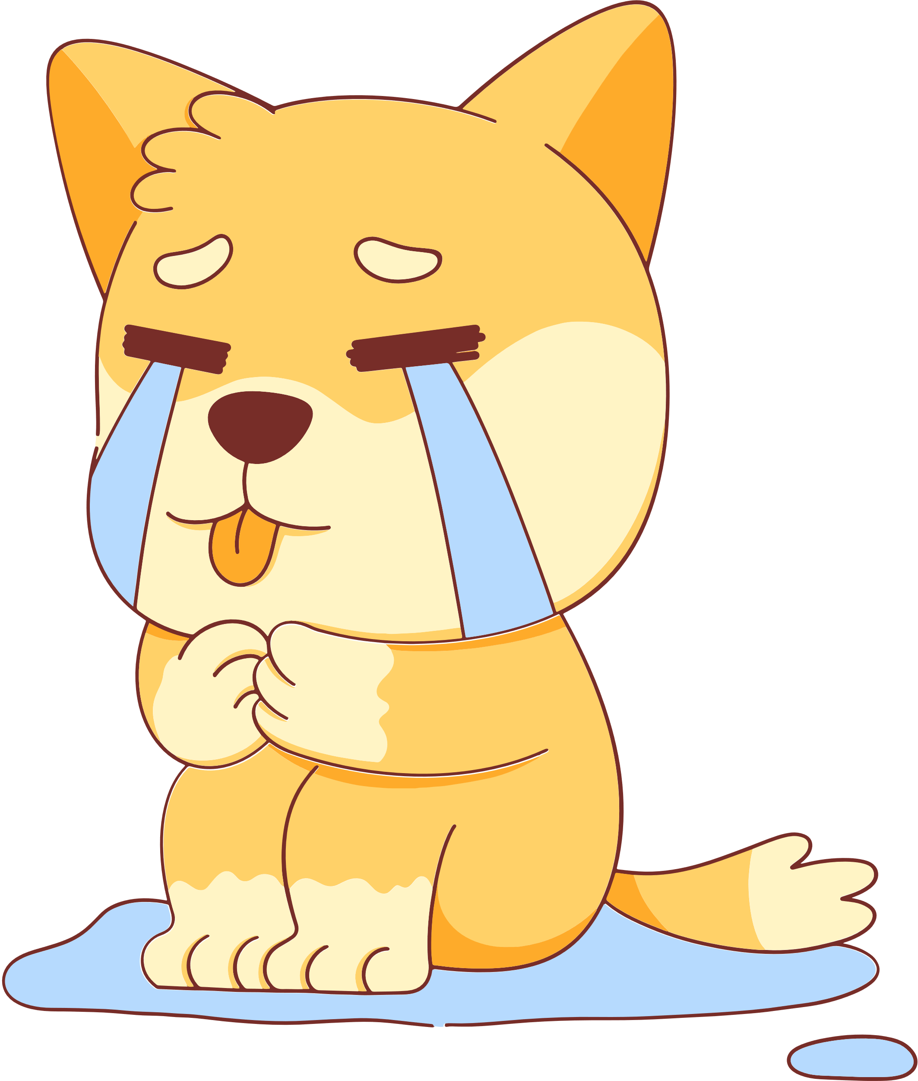






Game Resource Page

