Slide 1





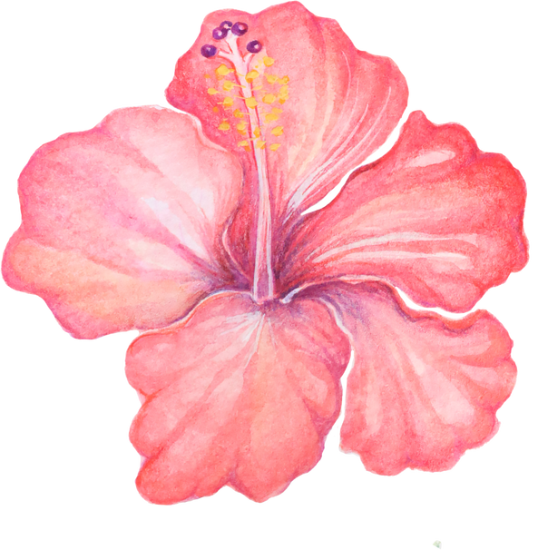
WELCOME TO OUR CLASS

Slide 2


Look at the pictures and guess the topic.

Slide 3




What is the topic?
Teenagers

Slide 4
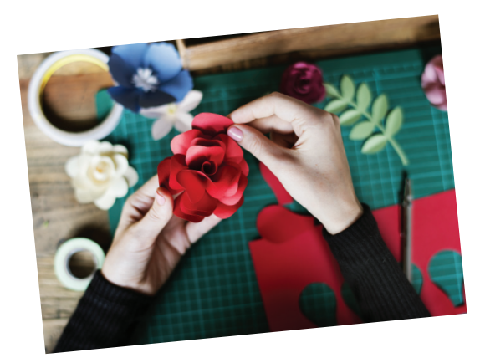
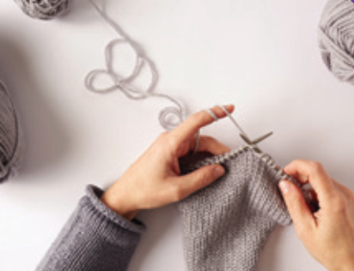
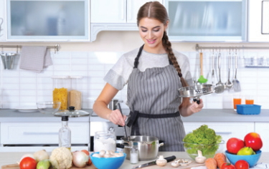
What is the topic?
Leisure time

Slide 5
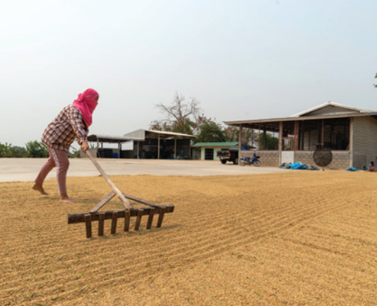
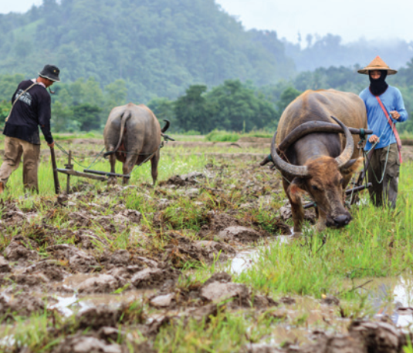
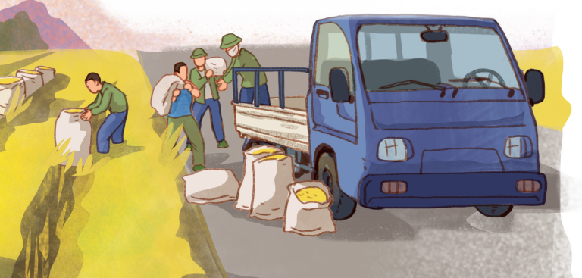
What is the topic?
Life in the countryside

Slide 6

REVIEW 1
Lesson 1: Language

Slide 7

PRONUNCIATION

Slide 8

1. Circle the word whose underlined part pronounced differently from the others.
1. A. good B. cool C. foot D. cook
2. A. June B. rude C. truth D. put
3. A. village B. buffalo C. cottage D. shortage
4. A. ensure B. insure C. picture D. surely
5. A. avoid B. doing C. choice D. join
/ gʊd /
/kuːl/
/fʊt/
/kʊk/
/dʒuːn/
/ruːd/
/ truːθ/
/pʊt/
/ˈvɪlɪdʒ/
/ˈbʌfələʊ/
/ˈkɒtɪdʒ/
/ˈʃɔːtɪdʒ/
/ɪnˈʃʊə(r)/
/ɪnˈʃʊə(r)/
/ˈpɪktʃə(r)/
/ˈʃʊəli/
/ˈduːɪŋ/
/tʃɔɪs/
/əˈvɔɪd/
/dʒɔɪn/

Slide 9

VOCABULARY

Slide 10

2. Choose the correct answer A, B or C.
1. Mi is ______ gardening in her free time.
A. in B. into C. to
2. Mai is interested ______ building websites for her friends.
A. of B. with C. in
be into: thích
be interested in: thú vị với
3. Minh is not fond of ______ puzzles because he thinks it takes a lot of time.
A. making B. doing C. building
4. I’m not keen on ______ our class photos to the forum.
A. uploading B. surfing C. messaging
5. While I was ______ some websites, I saw an advertisement about a resort.
A. creating B. browsing C. uploading
do puzzles
upload photos
browse websites

Slide 11


3. Complete the sentences with the words from the box.
bully trained hospitable pressure focus
hospitable
1. People in my village are very ________________ to all visitors.
2. Parents in our village don’t put much ___________ on their children to do well at school.
3. In my school, we can __________ on study and play, and do not have to worry about bullies.
4. The best __________ player in our chess club will not be able to join the competition.
5. If a boy uses his strength to frighten weaker peers, he is a _________.
pressure
focus
trained
bully

Slide 12

GRAMMAR

Slide 13


4. Choose the correct answers A, B or C
1. Mai dislikes ______ her pictures to Facebook. She prefers not to show them to others.
A. to upload B. uploading C. upload
2. We enjoy ______ photos of different types of scenery, so we took a camera with us.
A. taking B. to take C. take
3. She did the puzzles ______ than I did, so I won the competition.
A. slowly B. slower C. more slowly
4. Tom worked ______ than Mi; therefore, he got better results in the exams.
A. hardly B. harder C. more hard
5. Now they all chat with each other ______ than before because they have smartphones.
A. more frequently B. frequent C. frequently

Slide 14


5. Underline the correct bold word in each sentence.
1. Minh is interested in painting, so / but yesterday he decided to join the arts and crafts club.
2. Life in the city seems to be more comfortable, otherwise / but I prefer life in the countryside.
3. She tries to focus more on her studies; therefore / otherwise, she won’t pass her exams.
4. During harvest time, farmers have to get up earlier, and / so they have to work harder.
5. Parents now have higher expectations of their children; therefore / so, children are under more pressure than before.

Slide 15


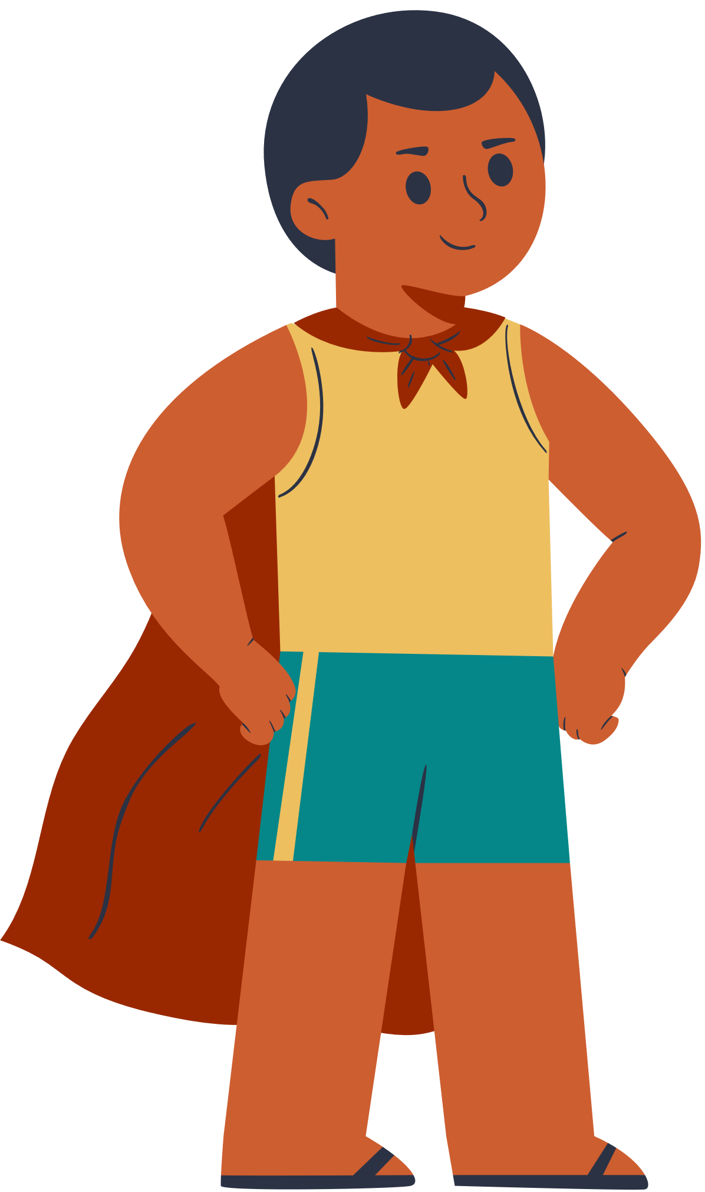
Wrap - up
What have we learnt in this lesson?
Pronunciation in Units 1-2-3
Vocabulary of Units 1-2-3
Grammar of Units 1-2-3

Slide 16

Thank you!

