Slide 2


Unit
5
OUR EXPERIENCES
LESSON 2: A CLOSER LOOK 1
1

Slide 3
LESSON 2: A CLOSER LOOK 1
LESSON 1: GETTING STARTED
WARM-UP
Asking questions
Vocabulary
Task 1: Write an activity next to each picture.
Task 2: Complete each sentence with an adjective in the box.
Task 3: Choose the correct answer A, B, C or D.
VOCABULARY
Pronunciation
Task 4: Listen and repeat the words. Pay attention to the sounds /j/ and /w/.
Task 5: Listen to the sentences. Underline the words with /j/ and circle the words with /w/. Practise the sentences.
PRONUNCIATION
CONSOLIDATION
Wrap-up
Homework

Slide 4
HOT SEAT!!
WARM-UP
1. Work in 4 teams.
2. Act out some learnt vocabulary given by the teacher one by one and let their team members guess the word.
3. The team with the most correct answers in the fastest time is the winner.
EXPERIENCES

Slide 5
WARM-UP
VOCABULARY LIST
1. experience
2. eco-tour
3. memorable
4. thrilling
5. brilliant
6. tribal dance
EXPERIENCES

Slide 6


VOCABULARY
learn by rote
/ˈlɜːn baɪ rəʊt/
học vẹt

Slide 7


VOCABULARY
campus (n)
/ˈkæmpəs/
khuôn viên
(của một trường học)

Slide 8
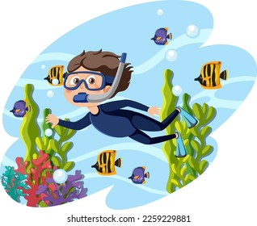
VOCABULARY
snorkelling (n)
/ˈsnɔːkəlɪŋ/
môn thể thao bơi lặn
dưới nước có bộ lặn
và ống thở

Slide 9

VOCABULARY
performance (n)
/pəˈfɔːməns/
buổi biểu diễn

Slide 10

VOCABULARY
exhilarating (adj)
/ɪɡˈzɪləreɪtɪŋ/
đầy phấn khích

Slide 11
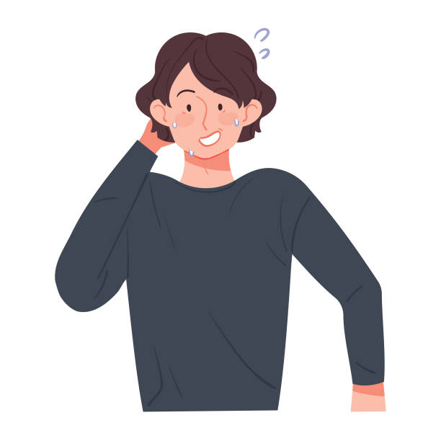
VOCABULARY
embarrassing
(adj)
/ɪmˈbærəsɪŋ/
làm ai bối rối, ngượng ngùng.

Slide 12
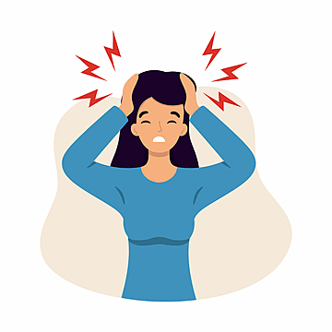
VOCABULARY
unpleasant (adj)
/ ʌnˈpleznt /
không thoải mái, không vui vẻ

Slide 13
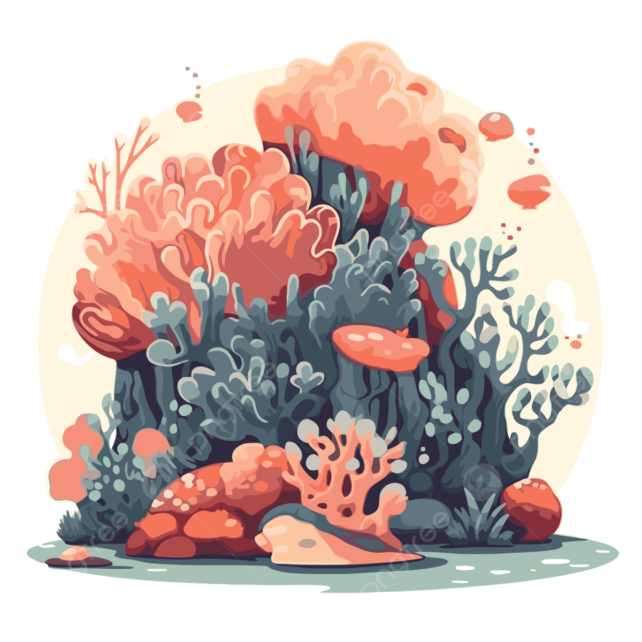
VOCABULARY
coral reef (n)
/ ˈkɒrəl riːf /
rặng san hô

Slide 14
VOCABULARY
New words | Pronunciation | Meaning
1. learn by rote | /ˈlɜːn baɪ rəʊt/ | học vẹt
2. campus (n) | /ˈkæmpəs/ | khuôn viên (của một trường học)
3. snorkelling (n) | /ˈsnɔːkəlɪŋ/ | môn thể thao bơi lặn dưới nước có bộ lặn và ống thở
4. performance (n) | /pəˈfɔːməns/ | buổi biểu diễn

Slide 15
VOCABULARY
New words | Pronunciation | Meaning
5. exhilarating (adj) | /ɪɡˈzɪləreɪtɪŋ/ | đầy phấn khích
6. embarrassing (adj) | /ɪmˈbærəsɪŋ/ | làm ai bối rối, ngượng ngùng
7. unpleasant (adj) | /ʌnˈpleznt/ | không thoải mái, không vui vẻ
8. coral reef (n phr) | /ˈkɒrəl riːf/ | rặng san hô

Slide 16
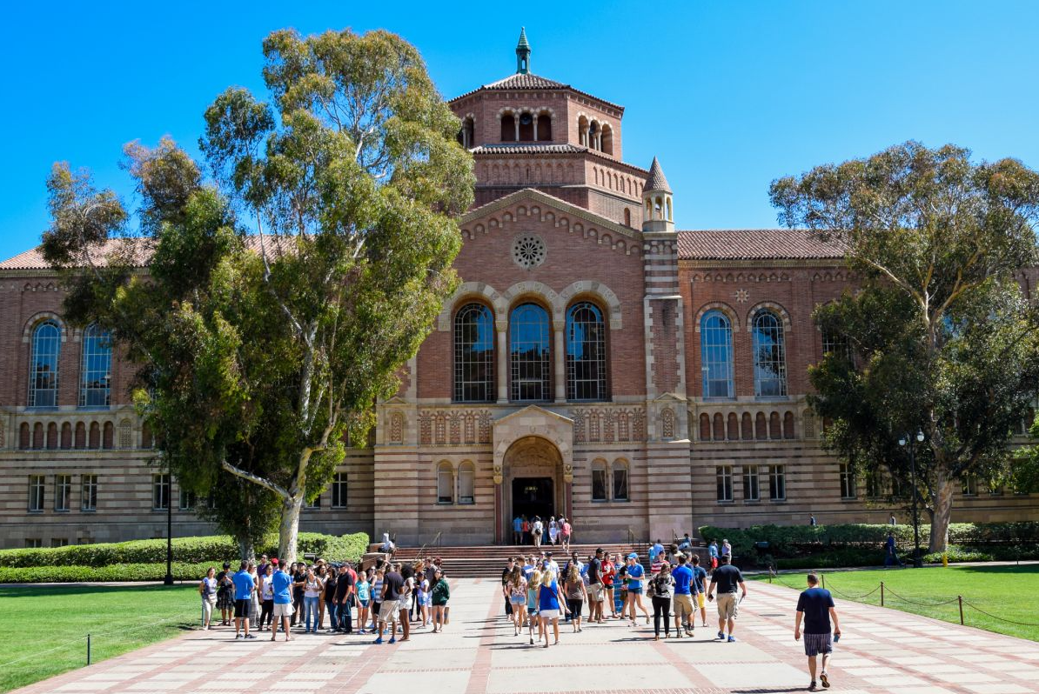
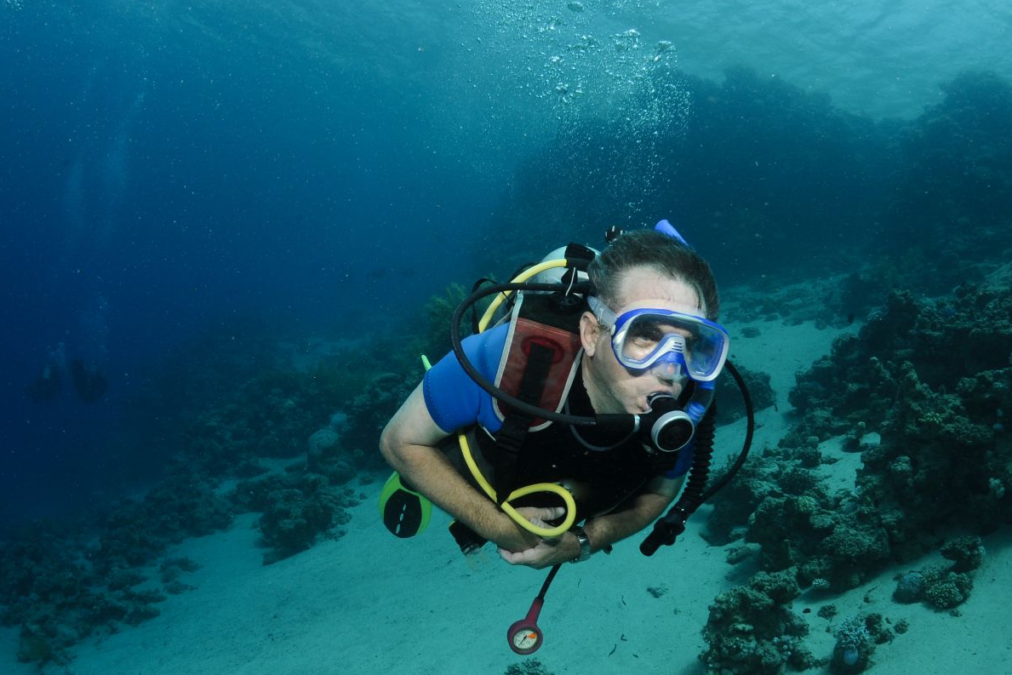
VOCABULARY
1
Write an activity next to each picture
learning by rote putting up tents touring a campus going snorkelling giving a performance
1. ______________
going snorkelling
touring a campus
2. ______________

Slide 17
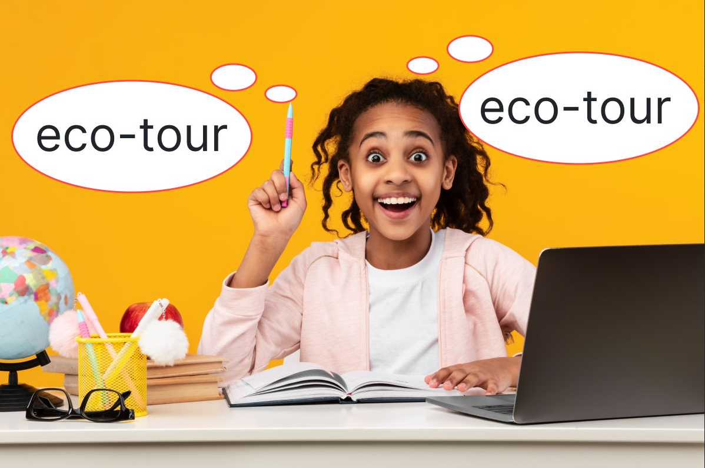
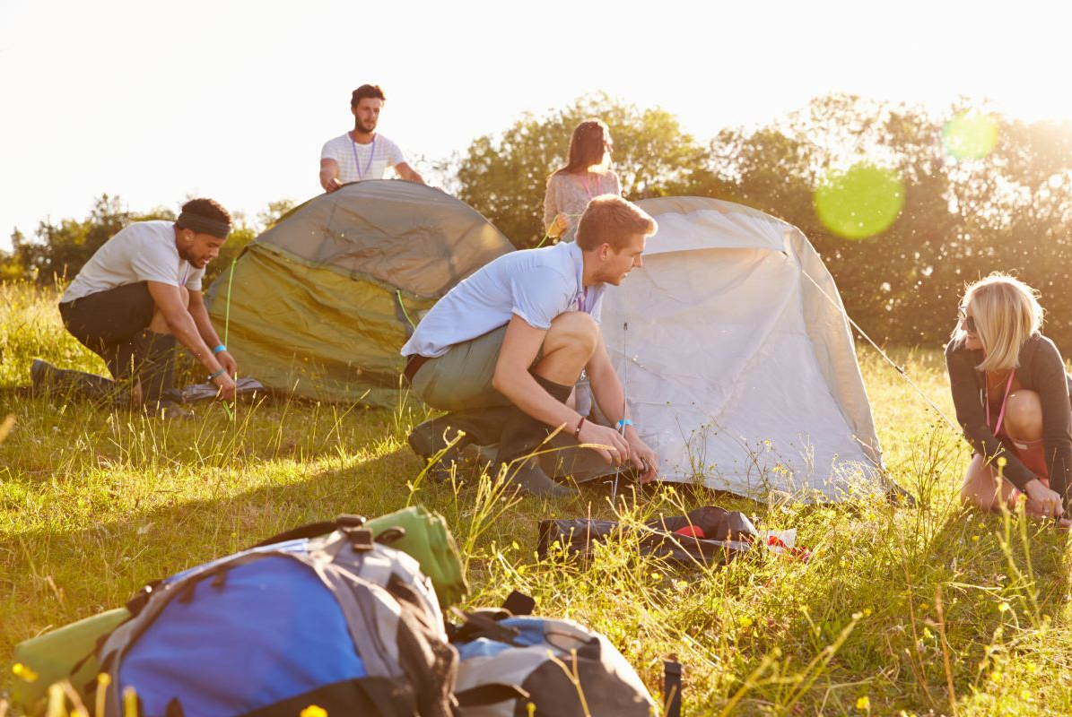
VOCABULARY
1
Write an activity next to each picture
learning by rote putting up tents touring a campus going snorkelling giving a performance
3. ______________
putting up tents
learning by rote
4. ______________

Slide 18
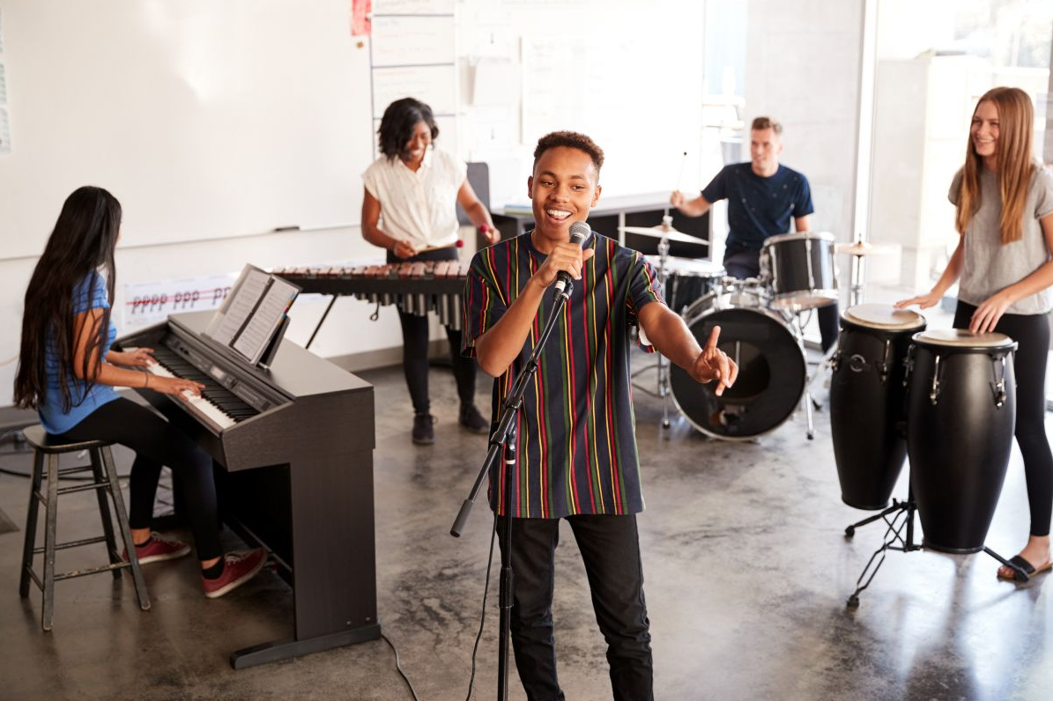
VOCABULARY
1
Write an activity next to each picture
learning by rote putting up tents touring a campus going snorkelling giving a performance
5. __________________
giving a performance

Slide 19
VOCABULARY
2
Complete each sentence with an adjective in the box.
amazing exhilarating unpleasant helpless embarrassing
1. He felt _______ when he couldn’t protect himself from bullying.
2. The parachute jump was a(n) ___________ experience for the boy. He was so excited.
3. It was so ________ to view the mountain range from the distance.
helpless
exhilarating
amazing

Slide 20
VOCABULARY
2
Complete each sentence with an adjective in the box.
amazing exhilarating unpleasant helpless embarrassing
4. I had a(n) ____________ experience when I took her bag by mistake.
5. The Tom had a(n) ___________ experience putting up a tent in the rain.
embarrassing
unpleasant

Slide 21
VOCABULARY
3
Choose the correct answer A, B, C, or D.
1. His mind ______ when I asked him how to do the homework.
A. went blank B. went empty C. became exhausted D. put up
2. Students could see the university’s facilities when they ______.
A. took an excursion B. toured the campus
C. gave a performance D. took an eco-tour

Slide 22
VOCABULARY
3
Choose the correct answer A, B, C, or D.
3. Snorkelling in the coral reef is a(n) ______.
A. touching moment B. happy time C. exciting experience D. embarrassing moment
4. Nam and his friends felt ______ when they couldn’t put up a tent by themselves.
A. pleasant B. embarrassing C. embarrassed D. pleased

Slide 23
VOCABULARY
3
Choose the correct answer A, B, C, or D.
5. I didn’t understand the lesson. I learnt it ______.
A. on purpose B. by chance
C. with memory D. by rote

Slide 24
PRONUNCIATION
4
Listen and repeat the words. Pay attention to the sounds /j/ and /w/.
/j/ | /w/
yellow yesterday yahoo yogurt yield | watching sandwich highway crossword forward

Slide 25
PRONUNCIATION
5
Listen to the sentences. Underline the words with /j/ and circle the words with /w/. Practise the sentences.
1. He tried sailing a yacht, and he did it well.
2. We’ve made a class yearbook. It looks wonderful.
3. They awarded him a gold medal yesterday.
4. Youngsters should be aware of their responsibilities.
5. They haven’t yet learnt about the role of wildlife.

Slide 26

CONSOLIDATION
1
Wrap-up
What have we learnt in this lesson?
Vocabulary: The lexical items related to experiences;
Pronunciation: How to correctly pronounce words that contain the sounds: /j/ and /w/.

Slide 27

CONSOLIDATION
2
Homework
Do exercises in the workbook;
Find 10 more words describing experiences that have the sound /j/ or /w/.

Slide 28
Website: hoclieu.vn
Fanpage: facebook.com/tienganhglobalsuccess.vn/

