Slide 2



4
Unit
REMEMBERING
THE PAST
LESSON 6: SKILLS 2

Slide 3

OBJECTIVES
By the end of the lesson, students will be able to:
Listen for general and specific information about old school days;
Write about old school days.

Slide 4
LESSON 6: SKILLS 2
LESSON 1: GETTING STARTED
WARM-UP
Option 1: Chatting
Option 2: Compare and Contrast
Task 1: Match each phrase with the right picture.
Task 2: Listen to the talk between Thanh and his grandma and tick (√) the things you hear.
Task 3: Listen again and choose the correct answers.
LISTENING
Task 4: Work in pairs. Ask and answer about school days in the past.
Task 5: Write a paragraph (100 - 120 words) about school days in the past.
WRITING
CONSOLIDATION
Wrap-up
Homework

Slide 5
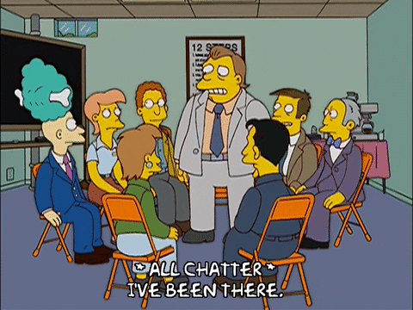
WARM-UP
OPTION 1
CHATTING

Slide 6
WARM-UP
OPTION 1
What do you know about schools and school days in the past?
CHATTING

Slide 7
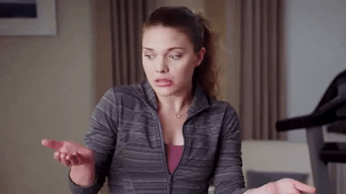
WARM-UP
OPTION 2
COMPARE AND CONTRAST

Slide 8
2. talking face to face
WARM-UP
OPTION 2
- Create a Venn diagram to compare and contrast school days in the past and school days today with information.
IN THE PAST
TODAY
1. walking barefoot
Information Venn diagram:
- What students wore to school?
- What subjects students studied?
- How students got to school?
…
3. traditional game

Slide 9

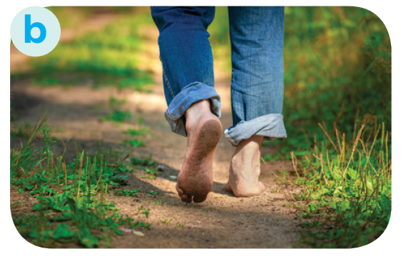
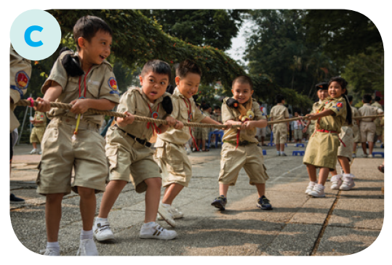
LISTENING
1
Match each phrase with the right picture.
1. walking barefoot
2. talking face to face
3. playing a traditional game

Slide 10

LISTENING
2
Listen to the talk between Thanh and his grandma and tick (√) the things you hear.
1. Three-month summer holiday
2. Lessons in the morning only
3. A lot of extra lessons
4. Walking barefoot
5. Chatting on mobile phones
√
√
√

Slide 11
LISTENING
3
Listen again and choose the correct answer.
1. The conversation is generally about Thanh’s ______. | 2. Thanh’s grandma didn’t have a lot of ______.
A. school days B. grandma’s school days C. grandma’s life in the past | A. homework B. lessons C. subjects

Slide 12
LISTENING
3
Listen again and choose the correct answer.
3. Thanh’s grandma ______ went to school on foot. | 4. Students in the past played ______during break time.
A. always B. sometimes C. never | A. computer games B. games on mobile phones C. traditional games

Slide 13
LESSON 6: SKILLS 2
LESSON 1: GETTING STARTED
WARM-UP
Option 1: Chatting
Option 2: Compare and Contrast
Task 1: Match each phrase with the right picture.
Task 2: Listen to the talk between Thanh and his grandma and tick (√) the things you hear.
Task 3: Listen again and choose the correct answers.
LISTENING
Task 4: Work in pairs. Ask and answer about school days in the past.
Task 5: Write a paragraph (100 - 120 words) about school days in the past.
WRITING

Slide 14
WRITING
4
Work in pairs. Ask and answer about school days in the past.
- Work in pairs. You can use the cues given to ask and answer about school days in the past.
Your talk may include the following:
– school time (When …)
– school subjects (What …)
– leisure time activities (What …)
– summer holiday (How long …)
– means of transport to school (How …)
in the morning only
maths, language, history, physics, etc.
traditional games
three months
walk
- You can refer to the listening text for your answers.

Slide 15
WRITING
5
Write a paragraph (100 - 120 words) about school days in the past.
- Use the ideas in Activity 4 for your writing.
In the past, students had lessons in the morning only. ___________________________________________
___________________________________________
___________________________________________
___________________________________________
___________________________________________.
In the past, students had lessons in the morning only. In the afternoon, they stayed home and did other things to help their parents. At school, they learned subjects such as maths, language, history, physics, etc. but they did not have music and arts, or sciences. They did not have extra lessons. In their free time they played traditional games such as hide-and-seek, tug of war, skipping, and so on. Every day they went to school on foot. My grandmother told me that they walked barefoot all the time, as they did not have shoes or sandals. They were lucky in that they had a long summer holiday – about three months!
(111 words)

Slide 16
In the past, students had lessons in the morning only. ___________________________________________
___________________________________________
___________________________________________
___________________________________________
___________________________________________.
WRITING
Sample paragraph:
5
In the past, students had lessons in the morning only. In the afternoon, they stayed home and did other things to help their parents. At school, they learned subjects such as maths, language, history, physics, etc. but they did not have music and arts or computer sciences. They did not have extra lessons. In their free time they played traditional games such as hide-and-seek, tug of war, skipping, and so on. Every day they went to school on foot. My grandmother told me that they walked barefoot all the time, as they did not have shoes or sandals. They were lucky in that they had a long summer holiday – about three months!
(111 words)

Slide 17
LESSON 6: SKILLS 2
LESSON 1: GETTING STARTED
WARM-UP
Option 1: Chatting
Option 2: Compare and Contrast
Task 1: Match each phrase with the right picture.
Task 2: Listen to the talk between Thanh and his grandma and tick (√) the things you hear.
Task 3: Listen again and choose the correct answers.
LISTENING
Task 4: Work in pairs. Ask and answer about school days in the past.
Task 5: Write a paragraph (100 - 120 words) about school days in the past.
WRITING
CONSOLIDATION
Wrap-up
Homework

Slide 18

CONSOLIDATION
1
Wrap-up
What have we learnt in this lesson?
Listen for general and specific information about old school days;
Write about old school days.

Slide 19

CONSOLIDATION
2
Homework
- Rewrite the paragraph in the notebooks;
- Do exercises in the workbook.

Slide 20
Website: hoclieu.vn
Fanpage: facebook.com/www.tienganhglobalsuccess.vn/

