Slide 2
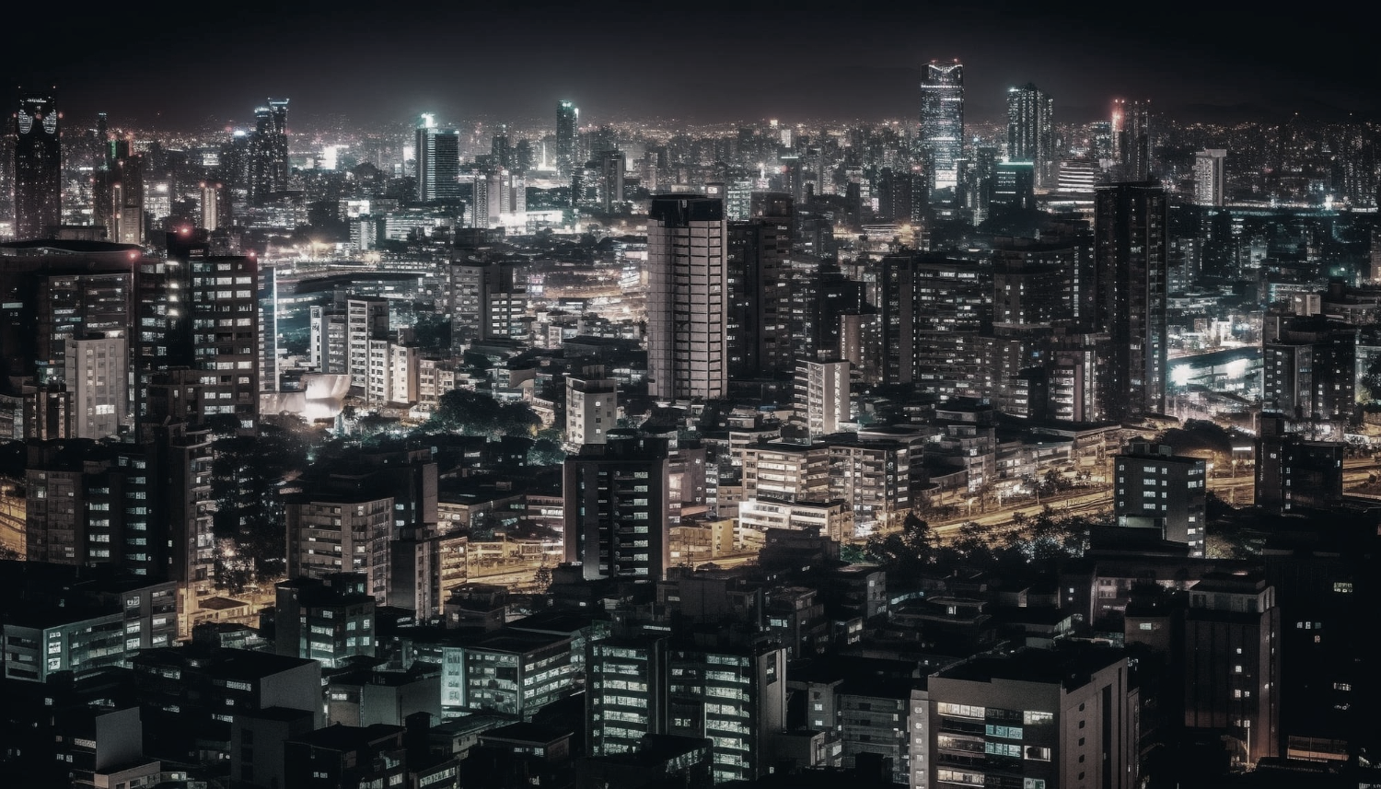

Slide 3
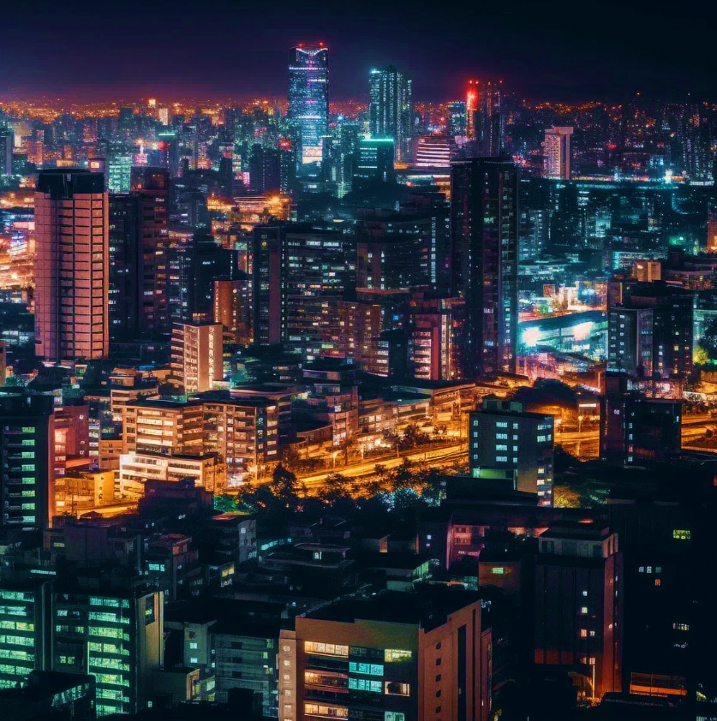


Unit
2
CITY LIFE
LESSON 5: SKILLS 1

Slide 4
LESSON 5: SKILLS 1
LESSON 1: GETTING STARTED
WARM-UP
Option 1: Mind map
Option 2: Survey
Vocabulary
Task 1: Work in pairs. Match the words / phrases with their pictures.
Task 2: Read part of an announcement about the Teenovator competition. Match the topics in the competition with their winners. There is one extra topic.
Task 3: Read the announcement again. Choose the correct answer.
READING
Task 4: Make a list of city problems and some solutions to them.
Task 5: Work in pairs. Talk to your friends about the city problems and suggest solutions to them. You can use the ideas in 4.
SPEAKING
CONSOLIDATION
Wrap-up
Homework

Slide 5
WARM-UP
OPTION 1
- List some problems of living in the city.
traffic jam
CITY PROBLEMS
pollution
congested road

Slide 6

WARM-UP
OPTION 2
Survey

Slide 7
WARM-UP
OPTION 2
- Conduct a survey among your classmates about city problems.
Questions:
“What is the biggest problem in your city?”
“How does it affect you or your family?”
“What do you think is the best solution to it?”

Slide 8
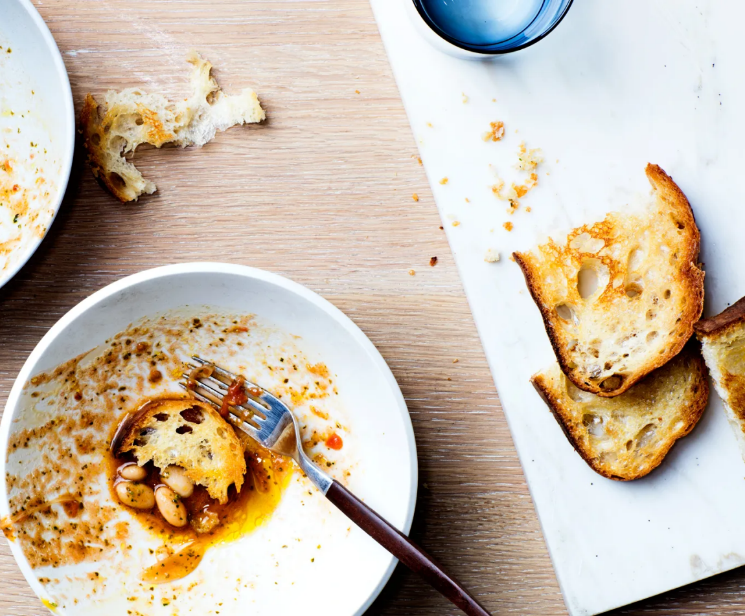

READING
leftover (n)
/ˈleftəʊvə/
thức ăn thừa

Slide 9
READING
biogas (n)
a gas containing methane (CH₄) that can be burned as a fuel, produced by dead plants and animals as they decay.
/ˈbaɪəʊˌɡæs/
khí sinh học

Slide 10
4. cafeteria
1. food waste
READING
New words | Pronunciation | Meaning
1. leftover (n) | /ˈleftəʊvə/ | thức ăn thừa
2. biogas (n) | /ˈbaɪ.əʊˌɡæs/ | khí sinh học
2. learning space
3. leftovers

Slide 11
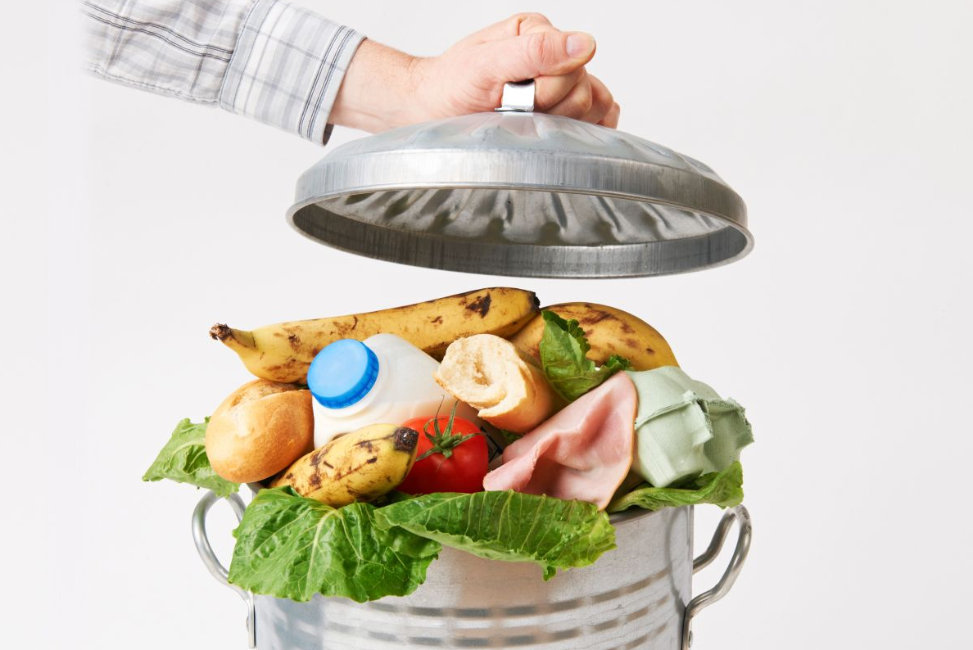
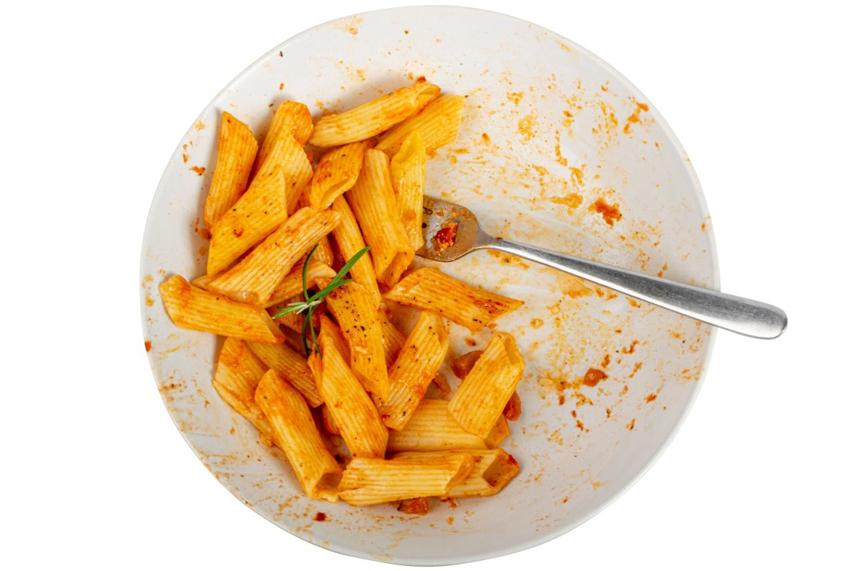
READING
1
Work in pairs. Match the words / phrases with their pictures.
1. food waste
2. learning space
3. leftovers
4. cafeteria
a
b

Slide 12

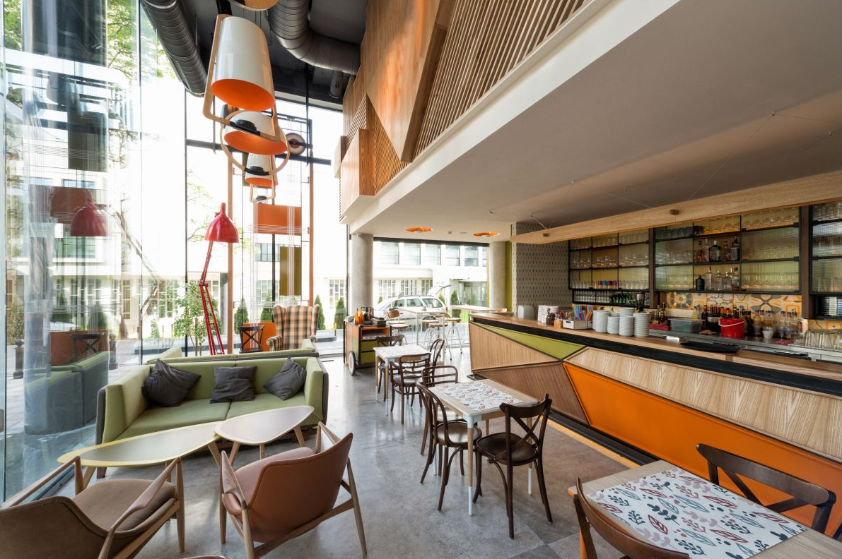
READING
1
Work in pairs. Match the words / phrases with their pictures.
1. food waste
2. learning space
3. leftovers
4. cafeteria
c
d

Slide 13
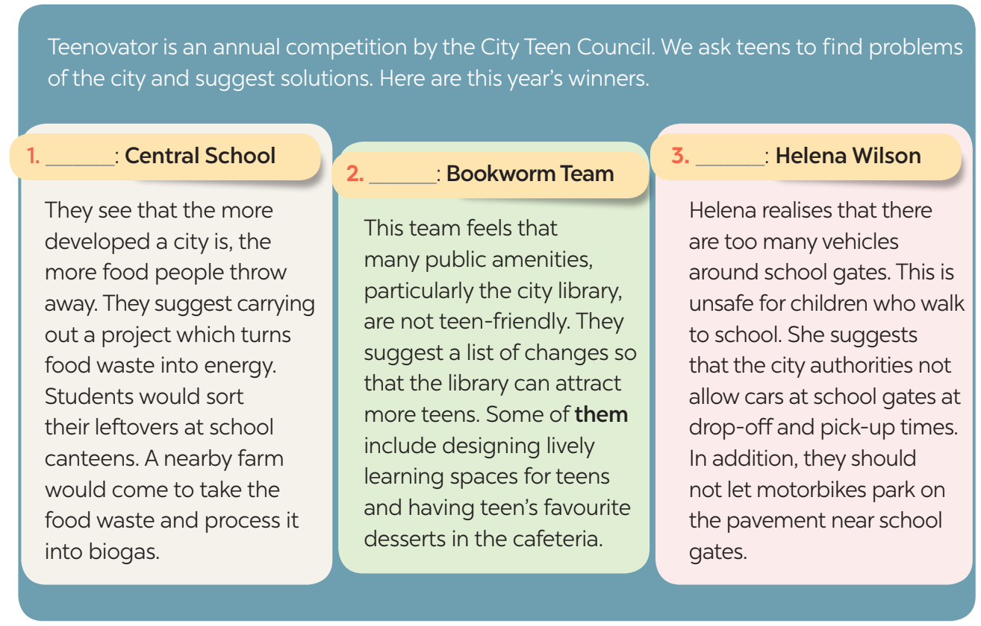
READING
2
Read the passages again and complete the sentences.
A. The street-safe city
C
A
B. The teen-friendly city
B
3 steps.
C. The food-smart city
D. The waste-free city

Slide 14
READING
3
Read the announcement again. Choose the correct answer.
read the questions
3 steps.
underline the key words in each question
locate the keywords in the text and find the information to answer the question

Slide 15
READING
3
Read the announcement again. Choose the correct answer.
1. How often does the City Teen Council organise the Teenovator competition?
A. Once a year. B. Twice a year.
C. Every two years. D. Every three years.
2. Who would partner with Central School in Topic 1?
A. The city council. B. The university’s canteen.
C. A biogas factory. D. A nearby farm.
3. What does the word “them” in Topic 2 refer to?
A. Teen users. B. Changes.
C. Learning spaces. D. Libraries.

Slide 16
READING
3
Read the announcement again. Choose the correct answer.
4. Which topic has an individual winner?
A. Topic 1. B. Topic 2.
C. Topic 3. D. All topics.
5. Which of the following is INCORRECT about Helena Wilson?
A. She suggests banning bikes at school gates.
B. She wants the city authorities to take action.
C. She thinks cars moving near school gates can cause accidents to children.
D. Her concern is road safety around school for children.

Slide 17
SPEAKING
4
Make a list of city problems and some solutions to them.
- Work in pairs and add as many details of problems of city life and solutions.
Example:
Problems | Solutions
– Dirty streets | – Tell people to throw rubbish away properly
– Lack of green spaces | – Plant more trees

Slide 18
SPEAKING
5
Work in pairs. Talk to your friends about the city problems and suggest solutions to them. You can use the ideas in 4.
Structures:
- I think/ In my opinion/I would say that...
- First, Second, Third.....
- Then, After that,......
- On one hand, On the other hand.....

Slide 19
SPEAKING
Suggested answer:
We think that there are several problems in our city. First, some streets are dirty. Many people put rubbish on the pavements or near the walls. Second, the city looks like a concrete jungle. It lacks green space and the air is not fresh. To solve these problems, the city authority should instruct people to throw rubbish properly. Another solution is to plant more trees even on the roof of high buildings. By doing so, the city can be a more liveable place.

Slide 20
EXTRA ACTIVITY
- Work in five groups and teacher assigns one of the following roles for each group: the local authority, the school board, the local television channel, the local newspaper, and the student association.
- There are two city problems. Example: food waste and crowded traffic in front of school gates.
- Think of solutions to these problems.
- Call a meeting of the group representatives after a certain time. Present your answers to the class as a group, and develop a plan of action to solve the problems.

Slide 21

CONSOLIDATION
1
Wrap-up
What have we learnt in this lesson?
Read for main idea and specific information in an announcement about a competition to find solutions to city problems.
Talk about city problems and their solutions.

Slide 22

CONSOLIDATION
2
Homework
- Do exercises in the workbook.

Slide 23
Website: hoclieu.vn
Fanpage: facebook.com/www.tienganhglobalsuccess.vn/

