Slide 1
7th grade
Unit 4: Music and Arts
Lesson 6: Skills 2

Slide 2

Objectives
By the end of this lesson, students will be able to:
listen for specific information about street painting
write an informal letter of invitation

Slide 3

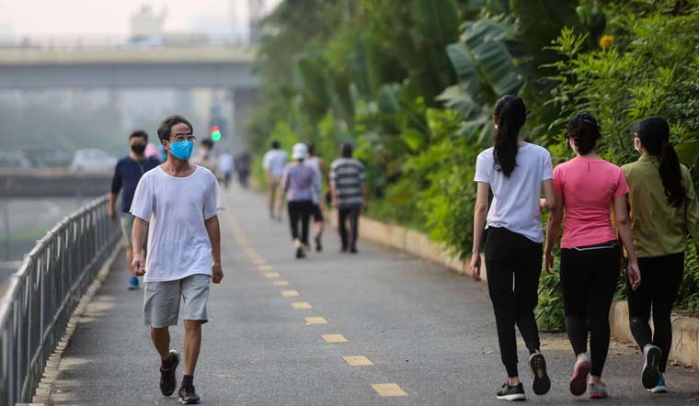
Pre-listening
01
pavement (n)
/ˈpeɪvmənt/
vỉa hè

Slide 4

Pre-listening
02
occur (v)
/əˈkɜːr/
xuất hiện

Slide 5

Pre-listening
03
support (v,n)
/səˈpɔːt/
sự ủng hộ/ ủng hộ

Slide 6

Pre-listening
04
huge (adj)
/hjuːdʒ/
to lớn

Slide 7
Pre-listening - Vocabulary
01
pavement (n)
02
occur (v)
support (n, v)
03
huge (adj)
04
/ˈpeɪvmənt/
vỉa hè
xuất hiện
/əˈkɜːr/
ủng hộ
/səˈpɔːt/
/hjuːdʒ/
to lớn

Slide 8
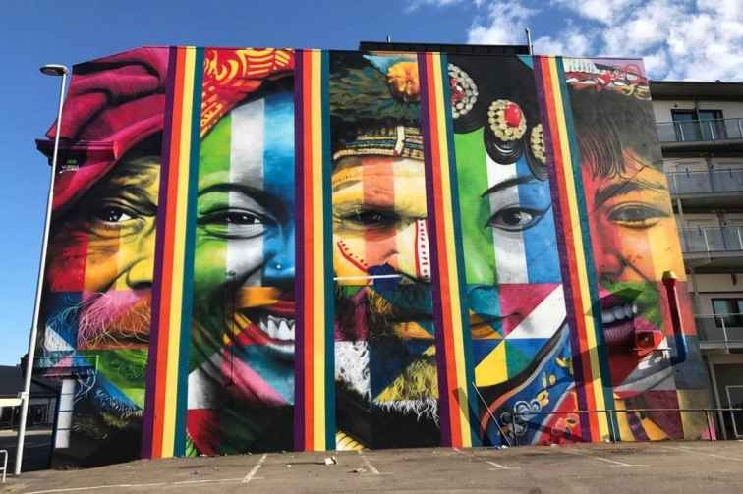
What is the type of art?
Street painting

Slide 9
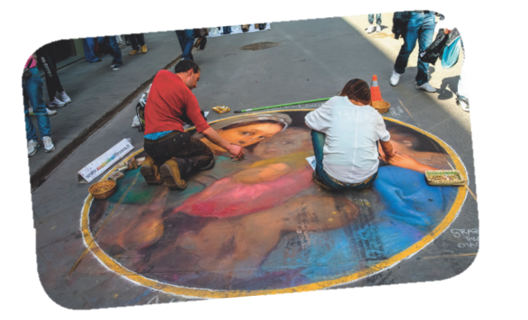
Discuss the questions below with your partners (page 47).
01
1. Do you know about street painting?
2. Where do artists paint their pictures?
3. Do they have to pay to paint there?

Slide 10
Listen tick the words you hear (page 47).
02
✓
1. artists
✓
4. enjoy
2. music
5. museum
✓
3. painting
Notes:
Answer key: 1 3 4

Slide 11
Underline the keywords.
03
1. Street painting began ______________.
A. in the 16th century B. in the 6th century C. in 1994
2. At a street painting event, you can ______________.
A. buy a painting B. talk to artists C. become an artist
3. The Lake Worth Street Painting Festival happens ______________.
A. only sometimes B. every month C. every year
4. About ______________ artists take part in the Lake Worth Street Painting Festival.
A. 100,000 B. 600 C. 60
Notes:
Answer key: 1 3 4

Slide 12
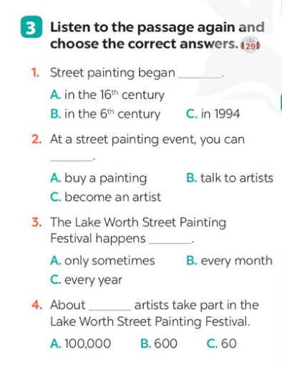
Listen again and choose correct answer.
03
1. Street painting began ______________.
A. in the 16th century B. in the 6th century C. in 1994
2. At a street painting event, you can ______________.
A. buy a painting B. talk to artists C. become an artist
3. The Lake Worth Street Painting Festival happens ______________.
A. only sometimes B. every month C. every year
4. About ______________ artists take part in the Lake Worth Street Painting Festival.
A. 100,000 B. 600 C. 60
Notes:
Answer key: 1 3 4

Slide 13
Check your answer
03
1. Street painting began ______________.
A. in the 16th century B. in the 6th century C. in 1994
In the 16th century artists began to draw on the pavement using chalk. Today, you can see street painting events everywhere.
Notes:
Answer key: 1 3 4

Slide 14
Check your answer
03
2. At a street painting event, you can ______________.
A. buy a painting B. talk to artists C. become an artist
They attract many people who come to enjoy and take part in them. Many of them are free too. So join in and become an artist yourself!
Notes:
Answer key: 1A 2C 3C 4B

Slide 15
Check your answer
03
3. The Lake Worth Street Painting Festival happens ______________.
A. only sometimes B. every month C. every year
One of the largest events in the United States is the Lake Worth Street Painting Festival. It began in 1994 and now occurs every February with the support of artists and volunteers.
Notes:
Answer key: 1A 2C 3C 4B

Slide 16
Check your answer
03
4. About ______________ artists take part in the Lake Worth Street Painting Festival.
A. 100,000 B. 600 C. 60
It is free for everyone. About 100,000 visitors come to enjoy it. About 600 artists work on the pavement to make the street a huge art gallery!
Notes:
Answer key: 1A 2C 3C 4B

Slide 17
Re-tell
04
Street painting - or street art - is an old type of art. In the 16th century artists began to draw on the pavement using chalk. Today, you can see street painting events everywhere. They attract many people who come to enjoy and take part in them. Many of them are free too. So join in and become an artist yourself!
One of the largest events in the United States is the Lake Worth Street Painting Festival. It began in 1994 and now occurs every February with the support of artists and volunteers. It is free for everyone. About 100,000 visitors come to enjoy it. About 600 artists work on the pavement to make the street a huge art gallery!
Notes:
Answer key: 1A 2C 3C 4B

Slide 18
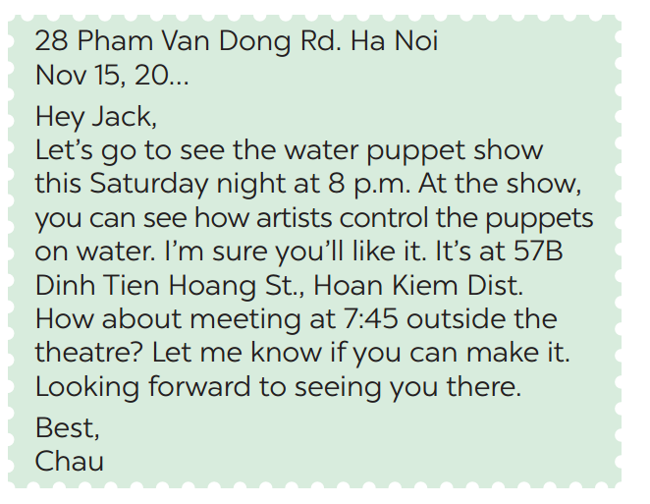
Read the letter and choose the correct answers.
05
1. This letter is from Chau to
A. a friend
B. a teacher
C. an old man
2. Chau writes this letter to
A. order Jack to perform a show B. invite Jack to see a show
C. make a complaint

Slide 19
Read the letter again and discuss with your friends.
05
+ Is it an invitation letter?
+ Is it formal or informal?
+ What is the event?
+ What time does the show begin?
+ Where does it take place?
+ What time do Chau want to meet Jack for the show?

Slide 20
Read the letter again and discuss with your friends
05
+ Is it an invitation letter?
→ Yes, it is. Because it invites Jack to see the water puppet show
+ Is it formal or informal?
→ It is informal because Jack is Chau’s friend.
+ What is the event?
→ The water puppet show.

Slide 21
Read the letter again and discuss with your friends
05
+ What time does the show begin?
→ At 8p.m.
+ Where does it take place?
→ At 57 B Dinh Tien Hoang St, Hoan Kiem Dist.
+ What time do Chau want to meet Jack for the show?
→ At 7: 45.

Slide 22
Format of informal letter of invitation
* Event: _____
* Start time: _____
* Place: _____
* Activities: _____
* Time to meet: _____
Writing tips:
In an informal letter of invitation, you can use:
- Let's ...
- How about + V-ing?

Slide 23

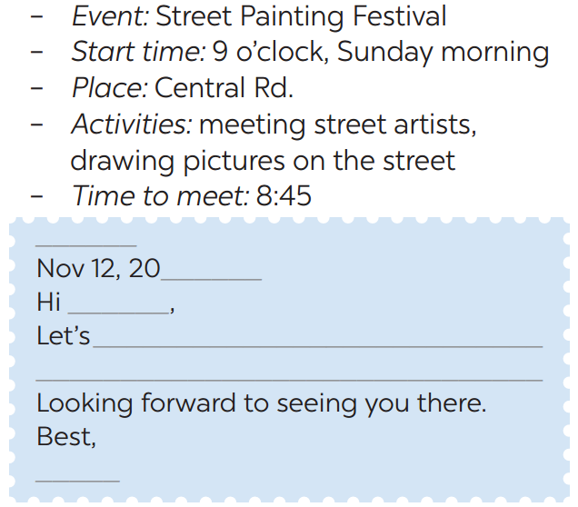

Using this following cue to write invite someone to a street painting festival.
06

Slide 24

Class gallery
Students give feedback to each other
1. Does your friend’s letter include?
* Event: _____
* Start time: _____
* Place: _____
* Activities: _____
* Time to meet: _____
2. Does he/she have spelling mistakes?

Slide 25
Re-cap
01
What skills do we learn today?
A. Listening and Reading
B. Listening and Writing
C. Reading and Writing

Slide 26
Re-cap
02
True or False? We have learnt to write a formal letter to invite friend.
A. True
B. False
An informal letter to invite friend.

Slide 27
Homework
Prepare for the next lesson.
Do homework Part E – Exercise 1,2,3 - WB (page 34).

Slide 28
Thank you

