Slide 1
GUESS
THE WORDS

Slide 2
RULES
Listen carefully
Write the words in your notebook.

Slide 3

1
2
3
4
5
6

Slide 4
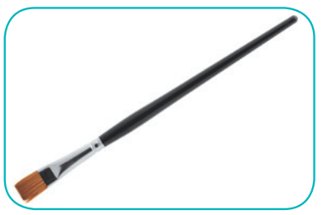

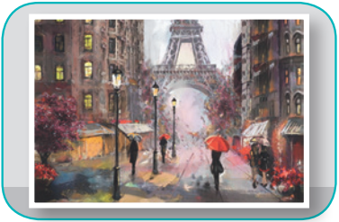
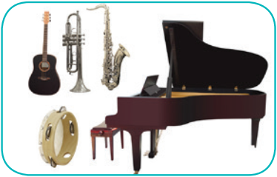
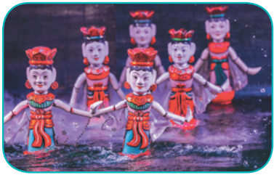
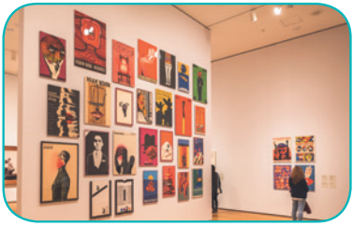
Check your answers.
1. paintbrush
2. camera
3. painting
4. musical instruments
5. water puppet show
6. art gallery

Slide 5
Unit 4
Music and Arts
Grade 7
Lesson 1: Getting Started

Slide 6

OBJECTIVES
By the end of the lesson, students will be able to:
get an overview about the topic Music and arts.
use the vocabulary to talk about Music and arts.

Slide 7
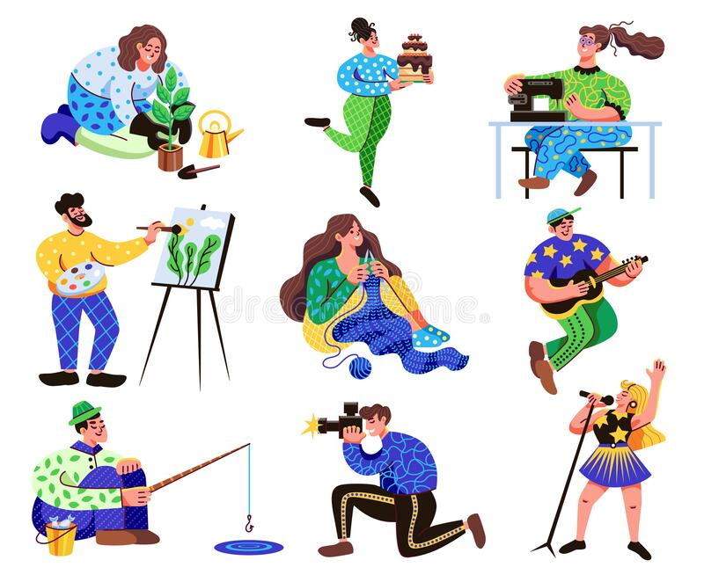
NEW WORDS
spare time (n)
/speər taɪm/
thời gian rảnh rỗi

Slide 8
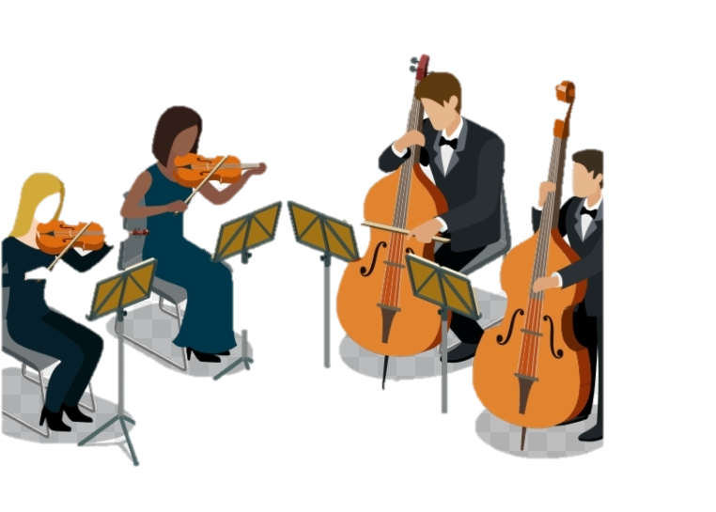
NEW WORDS
classical (adj)
/ˈklæsɪkəl/
cổ điển

Slide 9
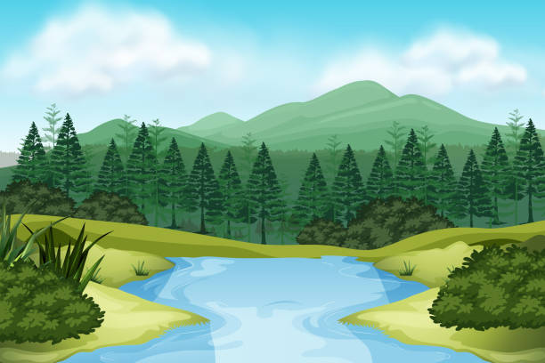
NEW WORDS
landscape (n)
/ˈlændskeɪp/
phong cảnh

Slide 10
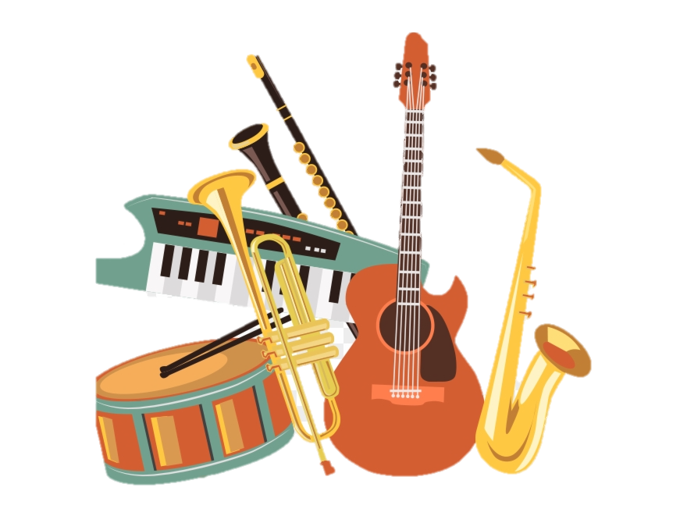
NEW WORDS
musical instruments (n)
/ˈmjuːzɪkəl ˈɪnstrəmənts/
nhạc cụ

Slide 11
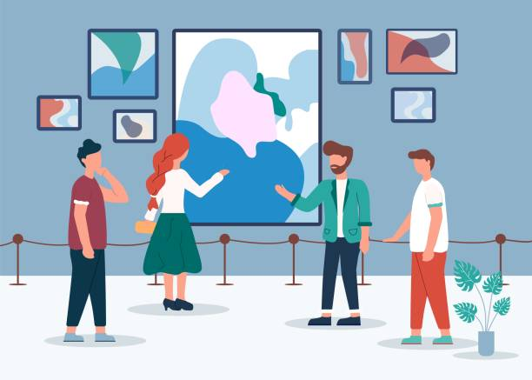
NEW WORDS
art gallery (n)
/ˈɑːt ˌɡæləri/
phòng tranh

Slide 12
NEW WORDS
/speər taɪm/
thời gian rảnh rỗi
/ˈklæsɪkəl/
cổ điển
phòng tranh
/ˈɑːt ˌɡæləri/
phong cảnh
/ˈlændskeɪp/
/ˈmjuːzɪkəl ˈɪnstrəmənts/
nhạc cụ

Slide 13
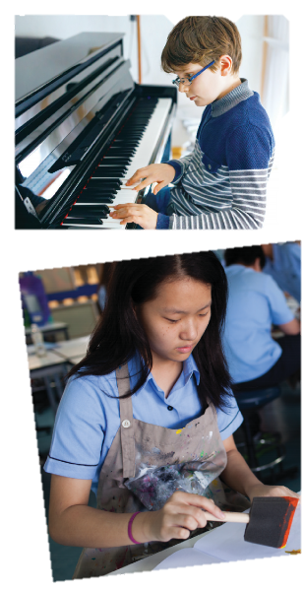

Who are they?
Nick
What are they doing?
What are they talking about?
Trang

Slide 14
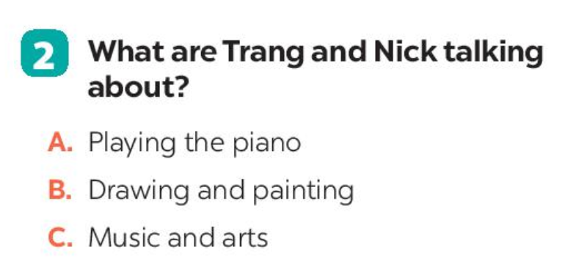
Ex 2. What are Trang and Nick talking about? (p. 41)
Trang: Hi, Nick. What are you listening to?
Nick: I'm listening to music. I like classical music, and I often play the piano in my spare time.
Trang: Wow. I can't play any instruments.
Nick: And what about you? What's your hobby?
Trang: I like painting and taking photos.
Nick: Taking photos? I've never tried it. Is it fun?
Trang: Yeah, it is, but not as fun as painting.
Nick: Right. They seem quite different from each other. What do you normally paint?
Trang: Landscapes and animals, just for pleasure, you know. I sometimes share them with my friends.
Nick: Really? Um, maybe we should go to an art gallery next weekend?
Trang: Sounds good, but I'd prefer to go to the music festival at my school.
Nick: Well ... OK. That's fine.
A. Playing the piano
B. Drawing and painting
C. Music and arts
Notes:
Click to the sound to open audio

Slide 15
Ex 2. What are Trang and Nick talking about? (p. 41)
Trang: Hi, Nick. What are you listening to?
Nick: I'm listening to music. I like classical music, and I often play the piano in my spare time.
Trang: Wow. I can't play any instruments.
Nick: And what about you? What's your hobby?
Trang: I like painting and taking photos.
Nick: Taking photos? I've never tried it. Is it fun?
Trang: Yeah, it is, but not as fun as painting.
Nick: Right. They seem quite different from each other. What do you normally paint?
Trang: Landscapes and animals, just for pleasure, you know. I sometimes share them with my friends.
Nick: Really? Um, maybe we should go to an art gallery next weekend?
Trang: Sounds good, but I'd prefer to go to the music festival at my school.
Nick: Well ... OK. That's fine.
Trang: Hi, Nick. What are you listening to?
Nick: I'm listening to music. I like classical music, and I often play the piano in my spare time.
Trang: Wow. I can't play any instruments.
Nick: And what about you? What's your hobby?
Trang: I like painting and taking photos.
Nick: Taking photos? I've never tried it. Is it fun?
Trang: Yeah, it is, but not as fun as painting.
Nick: Right. They seem quite different from each other. What do you normally paint?
Trang: Landscapes and animals, just for pleasure, you know. I sometimes share them with my friends.
Nick: Really? Um, maybe we should go to an art gallery next weekend?
Trang: Sounds good, but I'd prefer to go to the music festival at my school.
Nick: Well ... OK. That's fine.
A. Playing the piano
B. Drawing and painting
C. Music and arts
Notes:
Click to the sound to open audio

Slide 16
Ex 3. Complete each of the sentences with a suitable word or phrase from the box. (p.41)
photos like different from
art gallery musical instruments
1. Nick wants to go to a(n) ____________next weekend.
2. You can use your smartphone to take __________.
3. This photo is very bright. It is _______________ that dark one.
4. Nick and Trang agree that taking photos is not _____ painting.
5. My friend David is very talented. He plays three ____________________.
art gallery
photos
different from
like
musical instruments
Notes:
Click to the sound to open audio

Slide 17
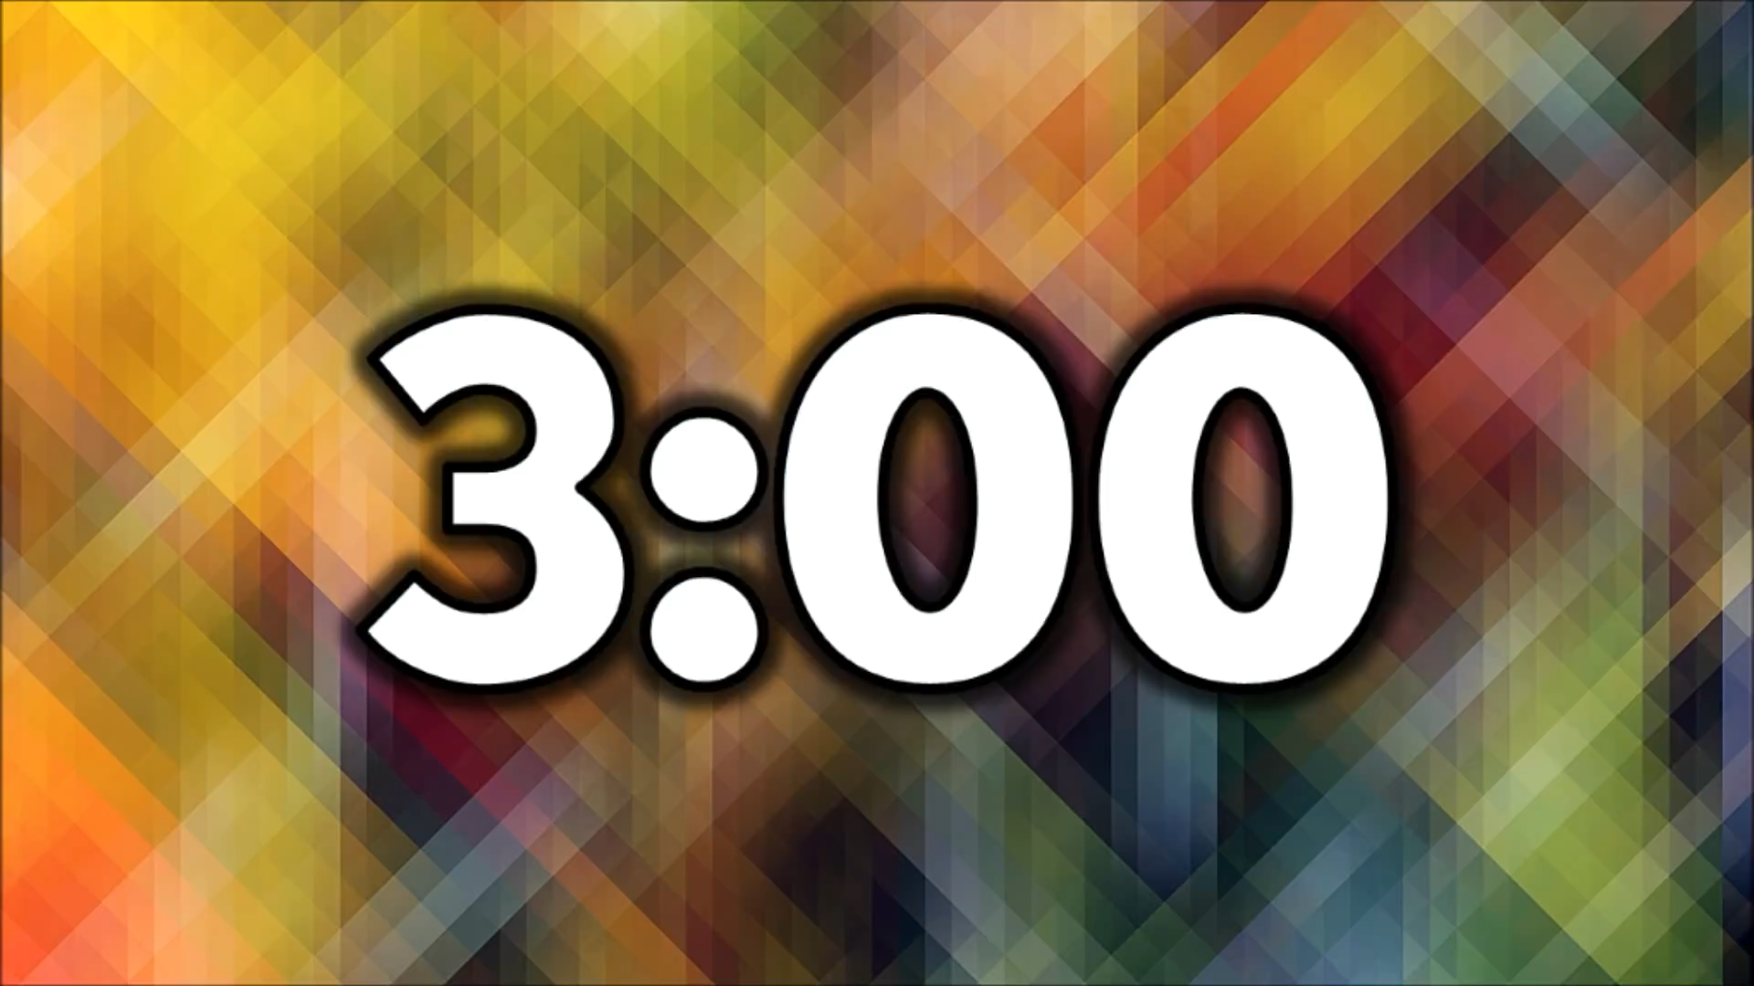


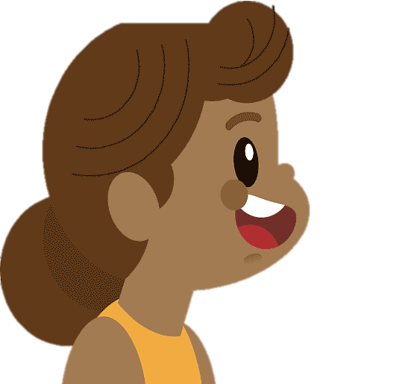



QUIZTIME
How artistic are you?
1. Your hobby is _____
      A. playing an instrument
      B. playing computer games
  2. Do you like listening to music or playing sports?
  A. Listening to music. B. Playing sports.
3. Which of these do you prefer doing?
A. Going to an art gallery. B. Going to a book fair.
4. You describe yourself as
A. creative B. hard-working
5. What do you want to be when you grow up?
A. A musician. B. An engineer.
Scoring:
From 1-4: Not very
From 5-7: Somewhat
From 8-10: Verry

Slide 18
RECAP
Complete the vocabulary
1
pa_nt_n_
painting
2
_rt g_ll_r_y
art gallery
3
m_s_ca_ in_t_men_s
musical
instruments

Slide 19
RECAP
Which is not belong to topic “Music and Arts?”
photos
classical music
camera
water puppet
pork
pork
paintbrush

Slide 20
Homework
1
Prepare for the next lesson.
2
Do homework Part A
Exercise 1,2 – page 28, 29

Slide 21
Thank you!

