Slide 1
UNIT 2: HEALTHY LIVING
7TH GRADE
Lesson 4: Communication

Slide 2
OBJECTIVES
By the end of the lesson, students can be able to:
ask for and give tips for health problems.
practise using some grammar points and vocabulary related to the topic.

Slide 3

MINI GAME: PASS THE BALL
Pass the ball one by one.
Say a health problem when getting the ball.
The student cannot say after 5 seconds will lose.

Slide 4
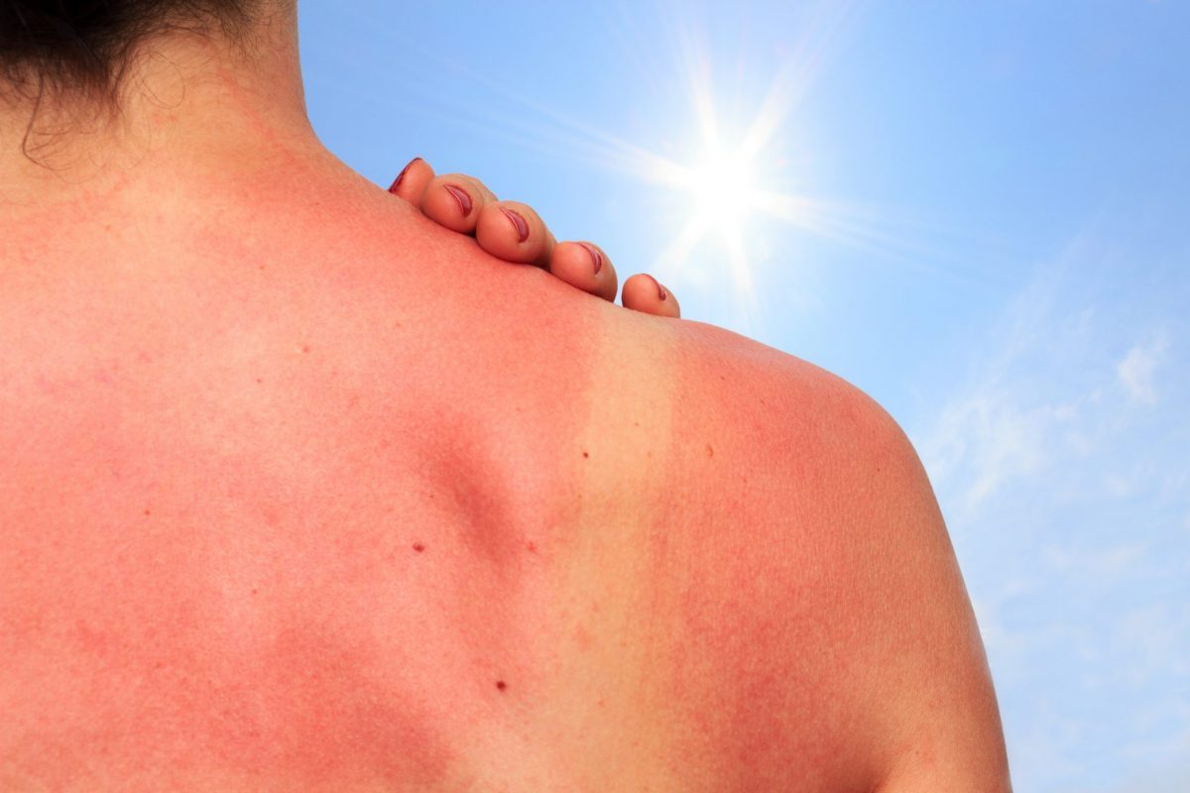
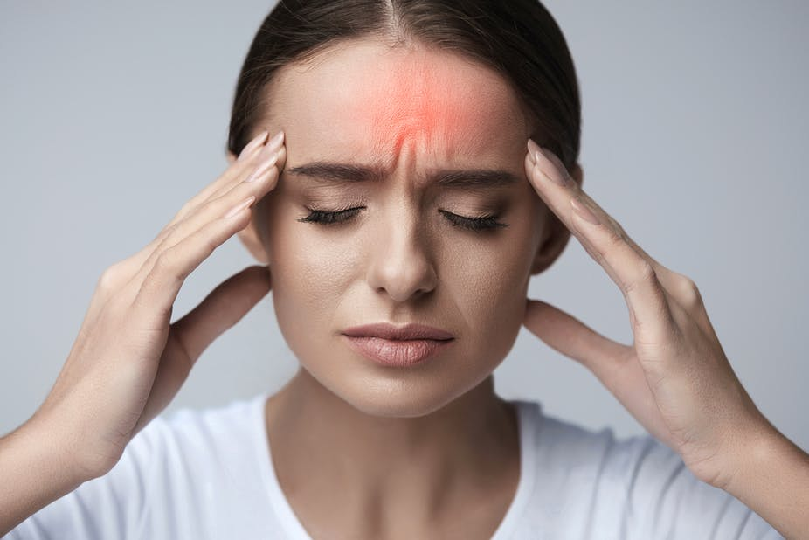
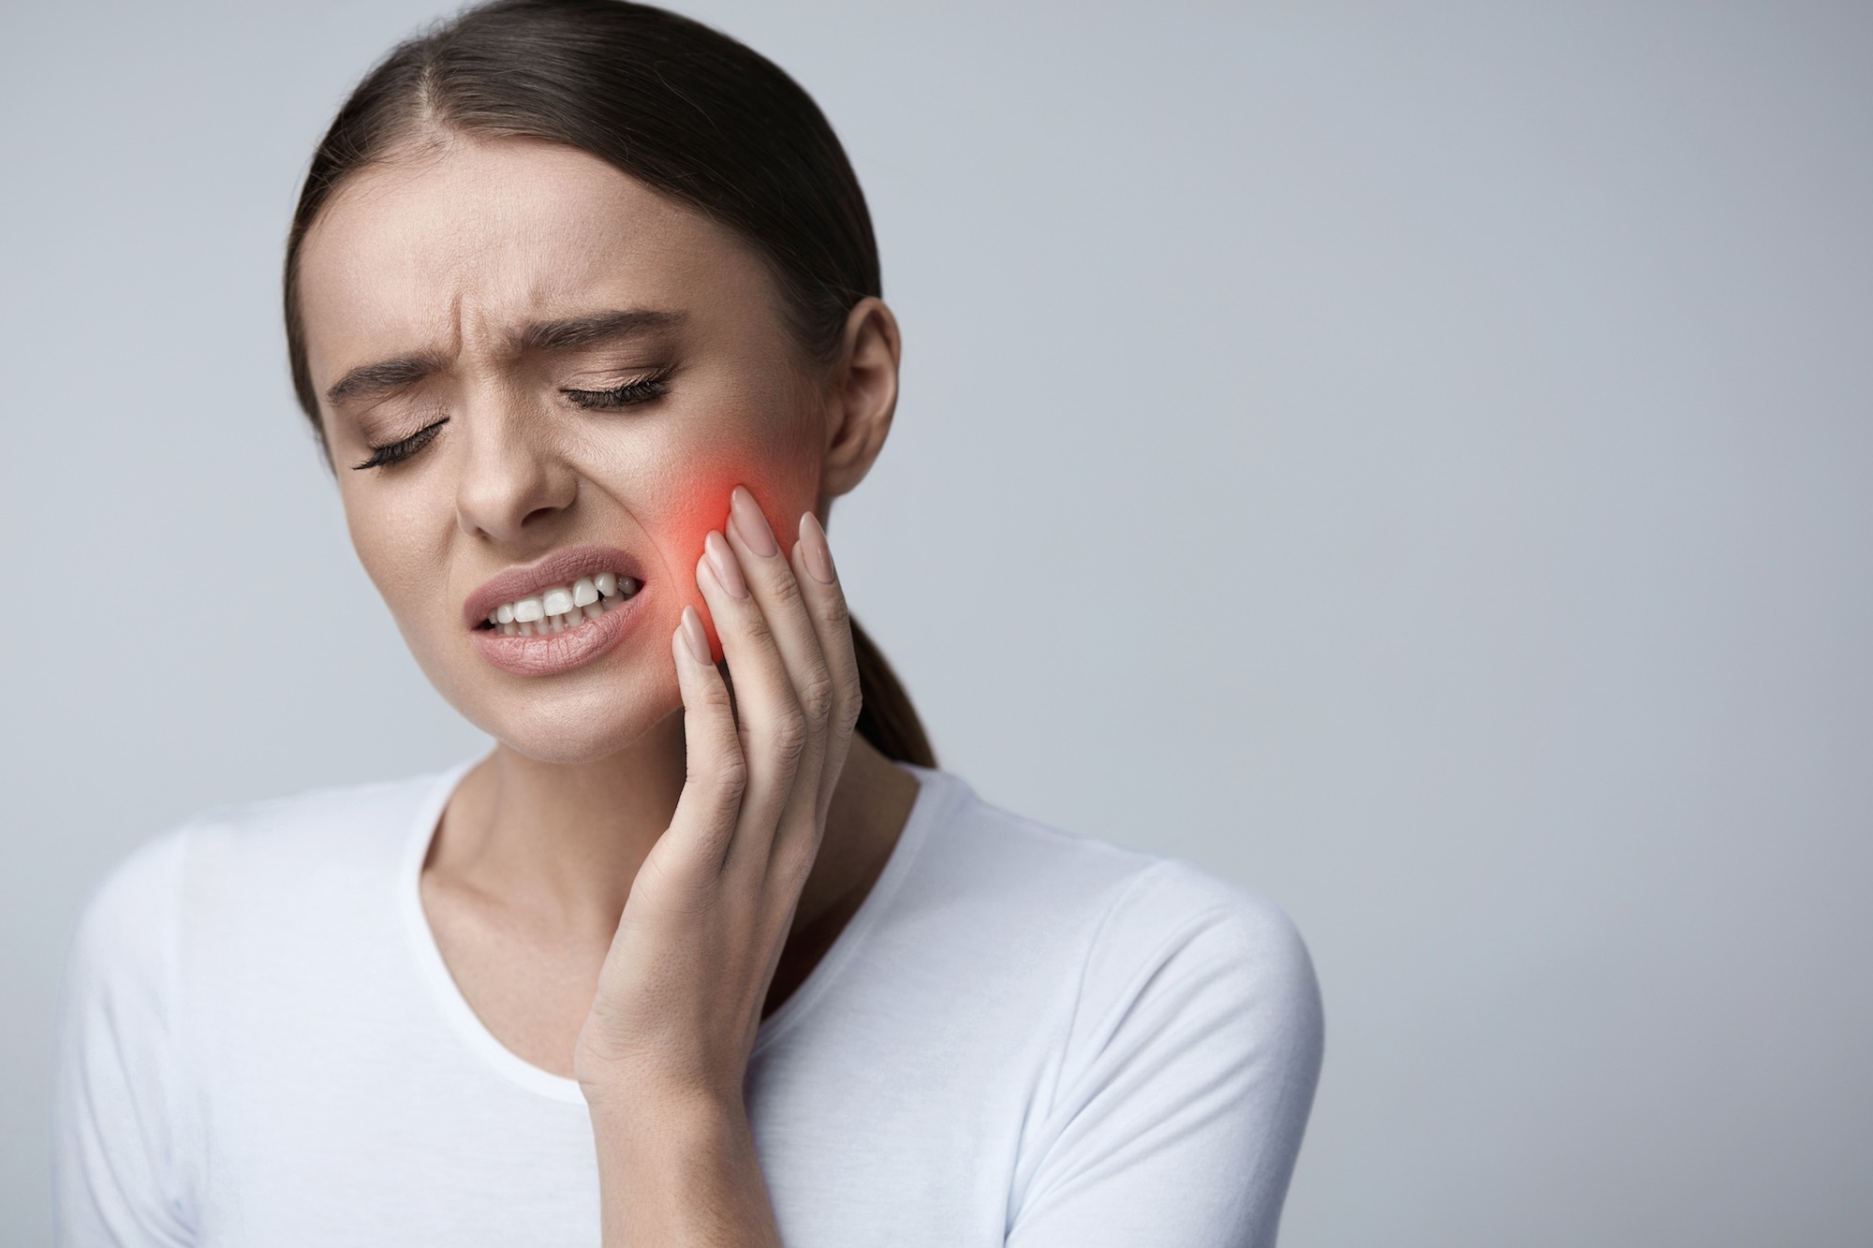
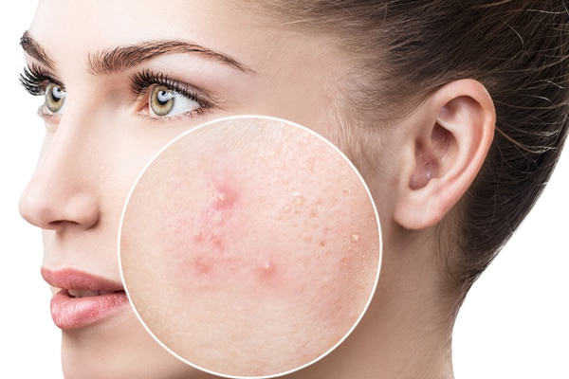
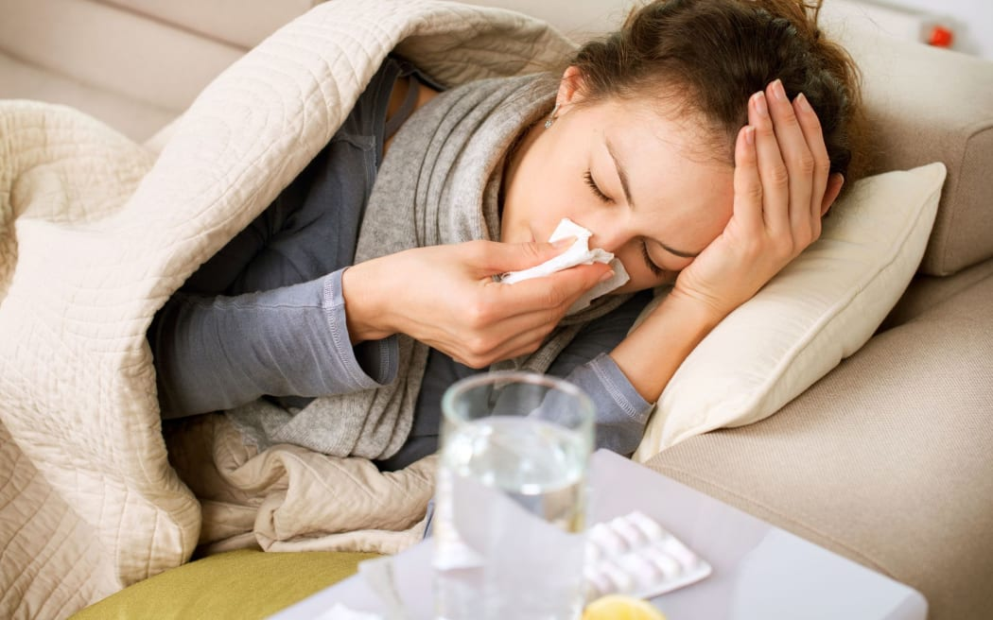
SUGGESTED ANSWERS
Can you give some tips for these health problems?
Health problems
sunburn
headache
toothache
spots
flu

Slide 5
01
EVERYDAY ENGLISH
Giving tips for healthy problems

Slide 6
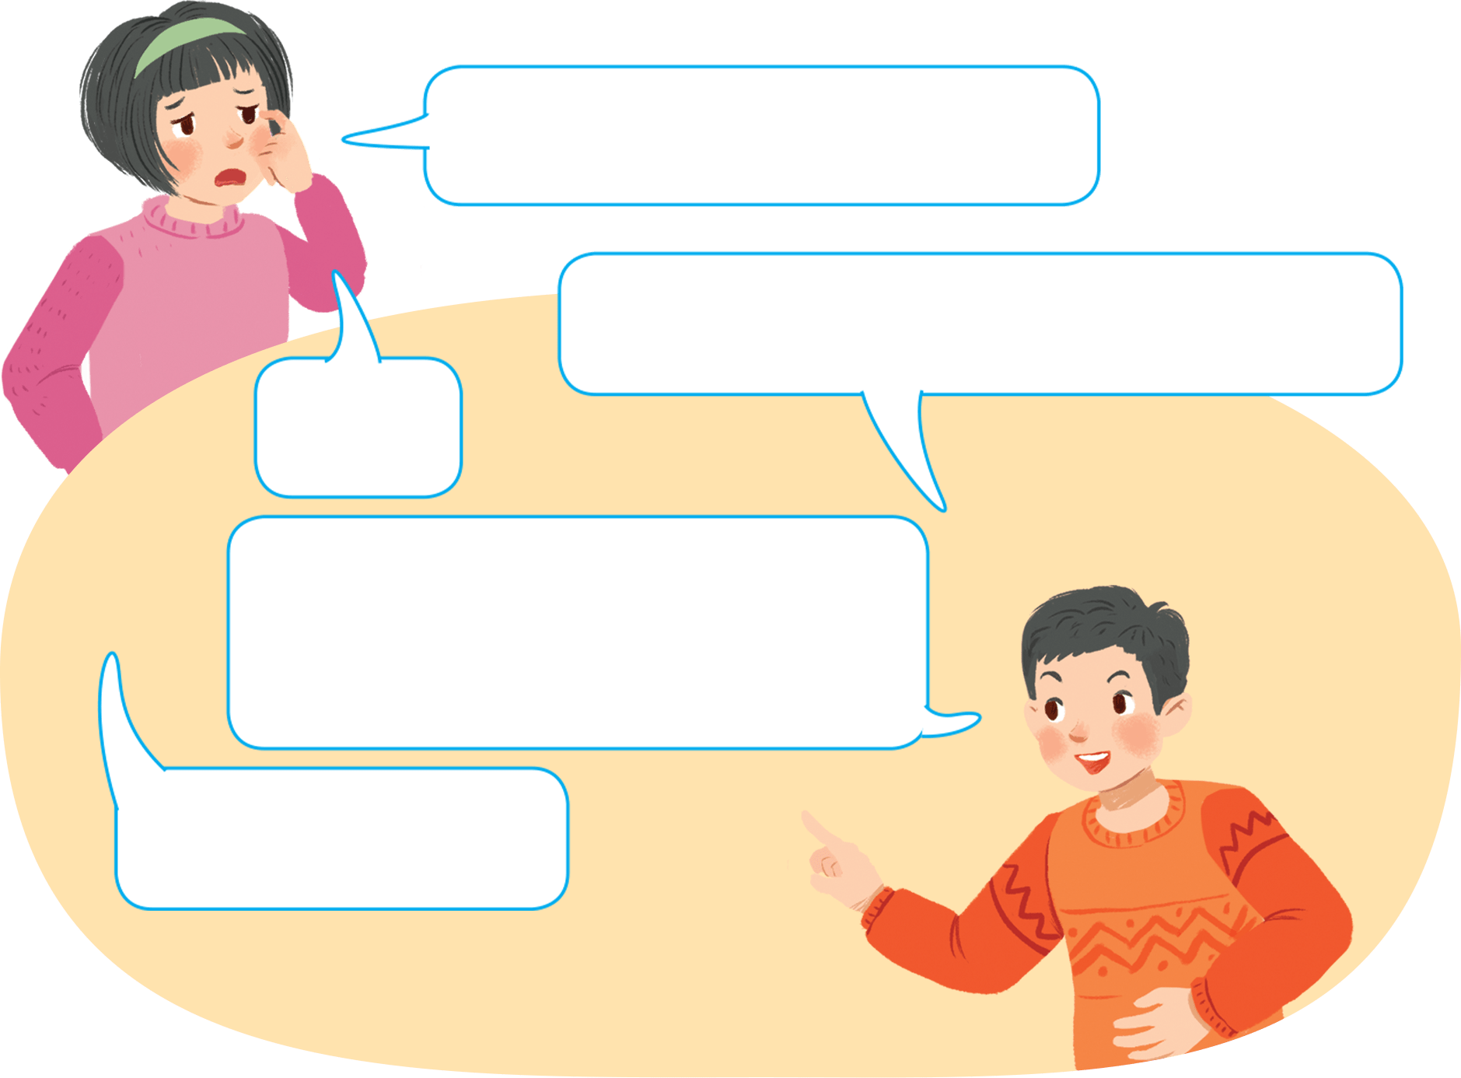

Ex 1: Listen and read the conversations. Pay attention to the highlighted sentences.
My eyes are tired.
How does the boy give tips?
You can use eyedrops.
Yes.
S + can + V
And you shouldn’t read in dim light.
S + should/shouldn’t + V
Thank you.

Slide 7
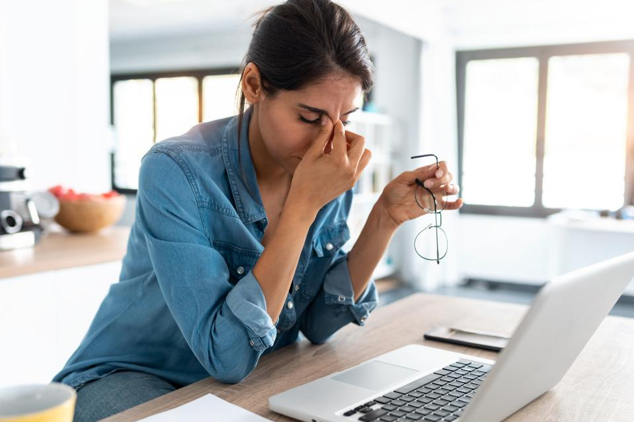
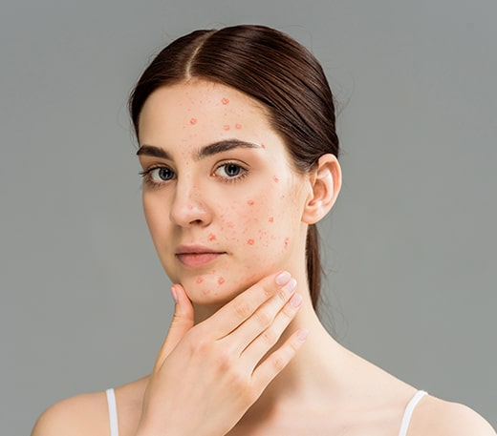
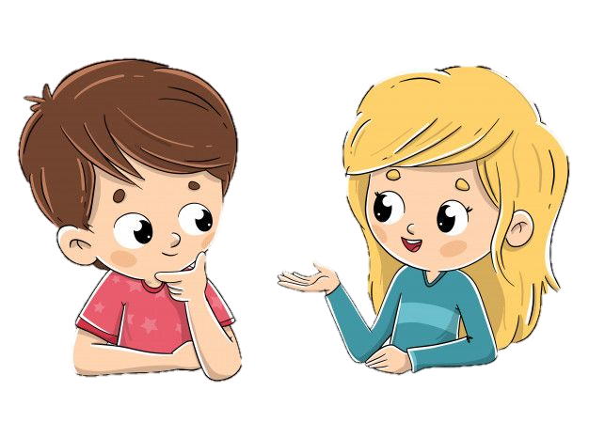
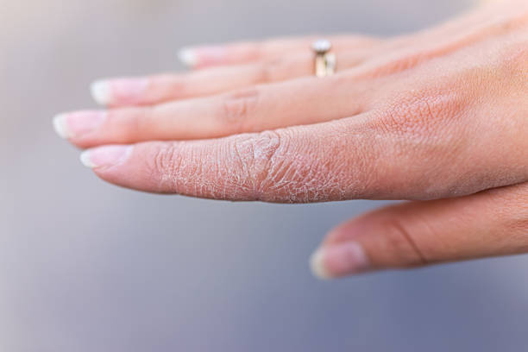
Ex 2: Work in pairs. Make similar conversations for the health problems below.
I’m tired.
I have acne.
My hands are chapped.

Slide 8
02
Tips for healthy life

Slide 9
Ex 3. Read the passage and choose the correct title for it.
The Japanese live long lives. The main reason is their diet. They eat a lot of fish and vegetables. They cook fish with little cooking oil. They also eat a lot of tofu, a product from soybeans. Tofu has vegetable protein and vitamin B. It doesn’t have any fat. The Japanese work hard and do a lot of outdoor activities too. This helps them keep fit.
A. How to live long
B. What food to eat
live long lives
main
reason
their diet

Slide 10

Ex 4. Work in pairs. Discuss and make a list for the tips which help the Japanese live long lives.
eat a lot of fish and vegetables
cook fish with little cooking oil
eat a lot of tofu, a product from soybeans
work hard and do a lot of outdoor activities

Slide 11
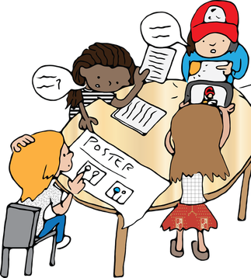

Ex 5. Work in groups. Discuss and make a list for the tips that the Vietnamese can do to live longer.
Work in groups of 6.
Make a list of tips that Vietnamese can do to live longer.
5 minutes
Present it to the class.

Slide 12
Present time

Slide 13

Present time
There are some tips that Vietnamese can do to live longer.
First, we should …

Slide 14
RECAP
Tick (✓) how you can give health tips.

S + can + V

S + should / shouldn’t + V
Let’s + V

Slide 15
THANKS!!
Do you have any questions?

Slide 16
ICON PACK: HUMAN RELATIONS AND EMOTIONS

