Slide 1
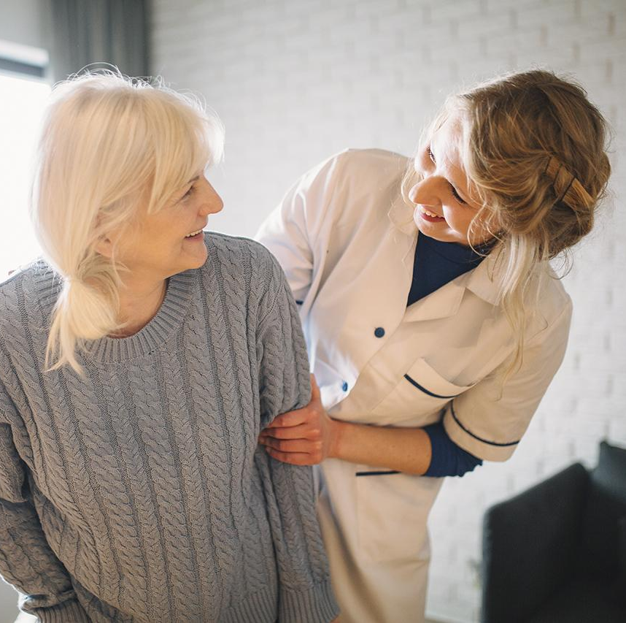
Unit 3
Community service
Lesson 1: A closer look 1

Slide 2
Objectives
Vocabulary
Pronunciation
After this lesson, students will be able to:
- use the words related to community activities;
- pronounce the sounds /t/, /d/, /id/ correctly;

Slide 3
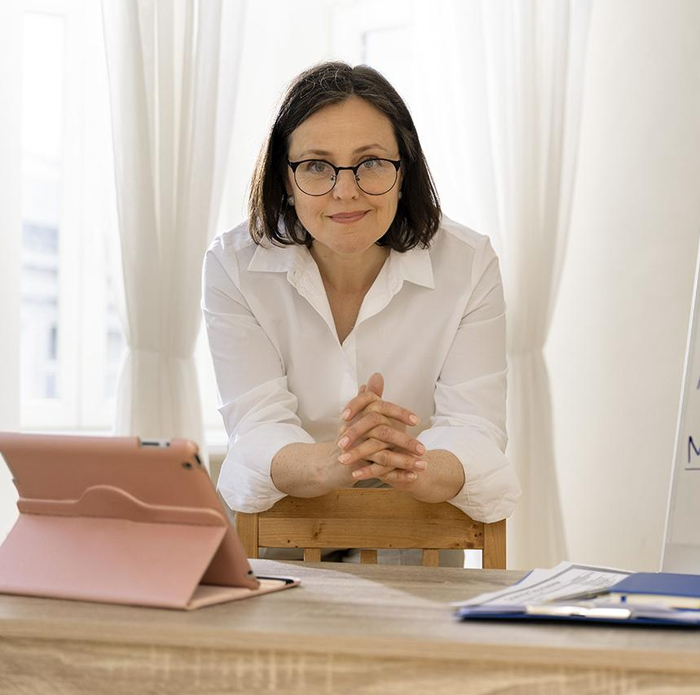
01
Vocabulary

Slide 4


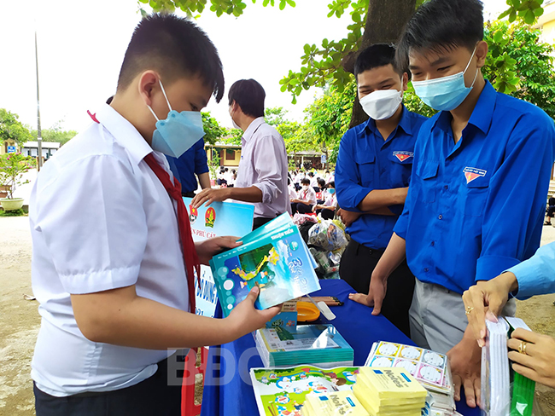
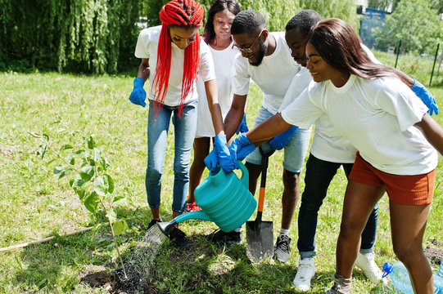
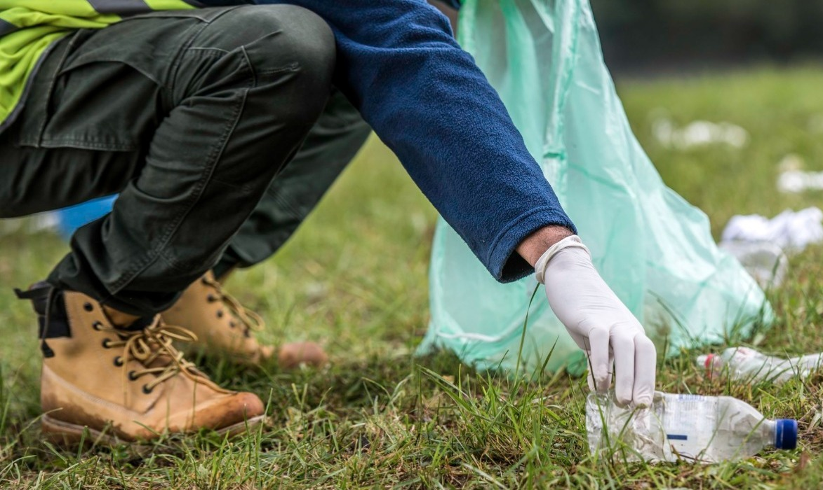
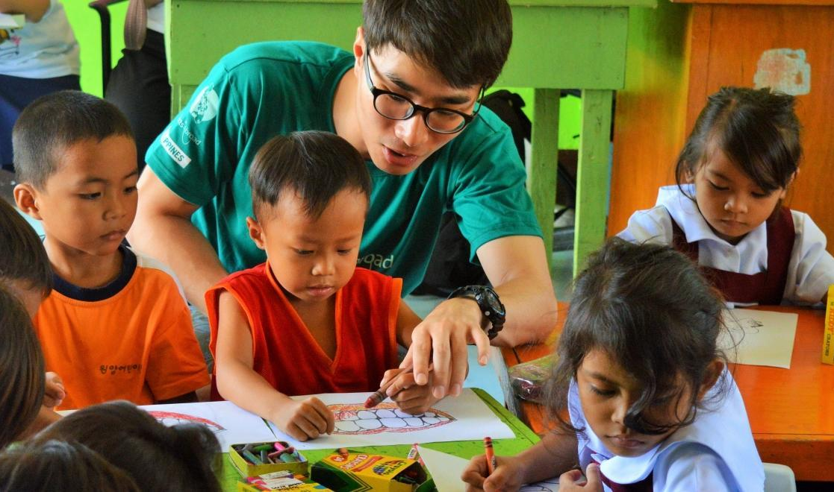
Look. Guess the verbs and theirs meaning.
1. d_ _ _ _ _
o n a t e
2. e_ _ _ _ _ _ _
x c h a n g e
/dəʊˈneɪt/
/ɪksˈtʃeɪndʒ/
ủng hộ
đổi
3. w_ _ _ _
a t e r
4. p_ _ _ u _
/ˈwɔːtə/
i c k p
/pɪk ʌp/
u t o r
5. t_ _ _ _
/ˈtjuːtə/
tưới
nhặt
dạy kèm

Slide 5
1. Match a verb in A with a word or phrase in B.
A
B
1. donate
a. used paper for notebook
2. exchange
b. primary students
3. water
c. litter
4. pick up
d. plants
5. tutor
e. books

Slide 6
2. Complete each of the sentences with a suitable word or phrase from the box.
tutor litter water donate used paper for notebooks
1. We pick up ____________ at the local park every Sunday.
2. Children in our village exchange _____________________ every school year.
3. Tom and his friends ____________ the plants in their neighbourhood every weekend.
4. We ____________ old textbooks to children in rural areas.
5. Minh and his friends often ____________ small children in their village.

Slide 7
2. Complete each of the sentences with a suitable word or phrase from the box.
tutor litter water donate used paper for notebooks
1. We pick up ____________ at the local park every Sunday.
2. Children in our village exchange _____________________ every school year.
3. Tom and his friends ____________ the plants in their neighbourhood every weekend.
4. We ____________ old textbooks to children in rural areas.
5. Minh and his friends often ____________ small children in their village.
pick up
litter
exchange
used paper for notebooks
water
the plants
donate
old textbooks
tutor
small children

Slide 8
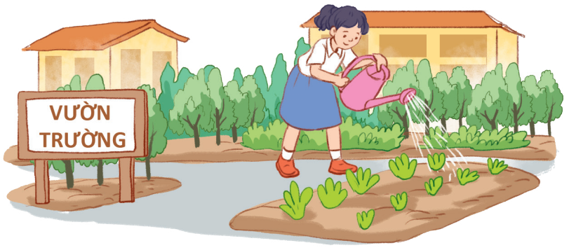
3. Use the phrases from the box to write full sentences under the correct pictures.
watering vegetables in the school garden
giving gifts to old people
exchanging used paper for notebooks
planting trees in the park
reading books to the elderly
donating clothes to poor children
watering vegetables in the school garden
Example:
0. Lan is watering vegetables in the school garden.

Slide 9
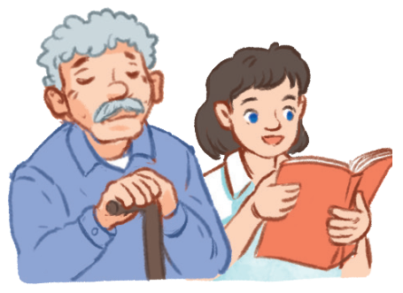
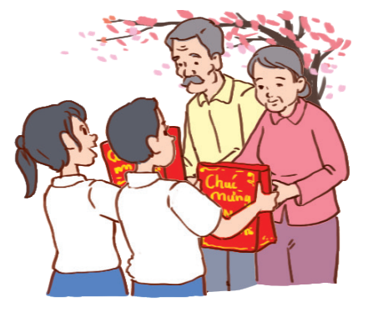
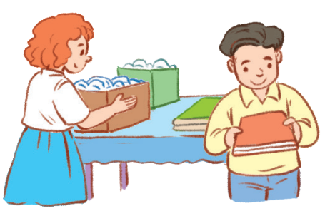
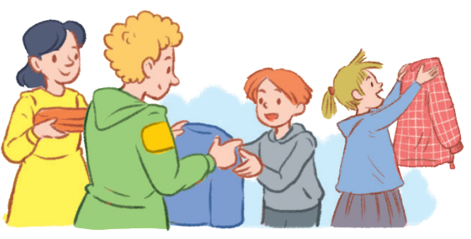
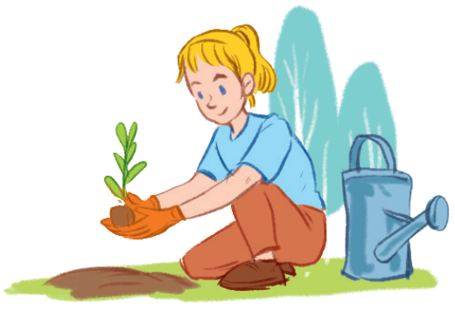
3. Use the phrases from the box to write full sentences under the correct pictures.
giving gifts to old people
exchanging used paper for notebooks
planting trees in the park
reading books to the elderly
donating clothes to poor children
1. _________
2. _________
3. _________
4. _________
5. _________

Slide 10
3. Use the phrases from the box to write full sentences under the correct pictures.
giving gifts to old people
exchanging used paper for notebooks
planting trees in the park
reading books to the elderly
donating clothes to poor children
reading books to the elderly
She is reading books to the elderly
1. _________

Slide 11
3. Use the phrases from the box to write full sentences under the correct pictures.
giving gifts to old people
exchanging used paper for notebooks
planting trees in the park
donating clothes to poor children
giving gifts to old people
She is giving gifts to old people
2. _________

Slide 12
3. Use the phrases from the box to write full sentences under the correct pictures.
exchanging used paper for notebooks
exchanging used paper for notebooks
planting trees in the park
donating clothes to poor children
They are exchanging used paper for notebooks
3. _________

Slide 13
3. Use the phrases from the box to write full sentences under the correct pictures.
planting trees in the park
donating clothes to poor children
donating clothes to poor children
They are donating clothes to poor children.
4. _________

Slide 14
3. Use the phrases from the box to write full sentences under the correct pictures.
planting trees in the park
planting trees in the park
She is planting trees in the park
5. _________

Slide 15
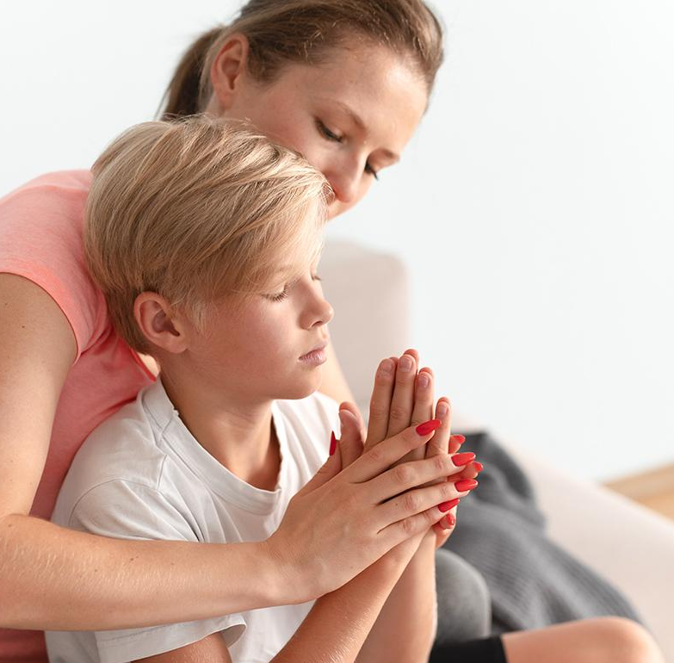
Pronunciation
02

Slide 16
How can you pronounce these words?
wanted
danced
saved
/wɒntid/
/dɑːnst/
/seɪvd/
How to pronounce-ed ending

Slide 17

Watch and note down the rules.

Slide 18
-ed ending
/t/
/d/
/id/
danced
/dɑːnst/
kicked
/kɪkt/
loved
/lʌvd/
wanted
/wɒntid/
claped
/klæpt/
washed
/wɒʃt/
amazed
/əˈmeɪzt/
needed
/niːdid/
/t/ after unvoiced consonants /p/, /k/, /f/, /s/, /ʃ/,/tʃ/
/d/ after voiced consonants, vowels /m/,/n/,/i/, /e/…
/id/ after sounds /d/ or /t/

Slide 19
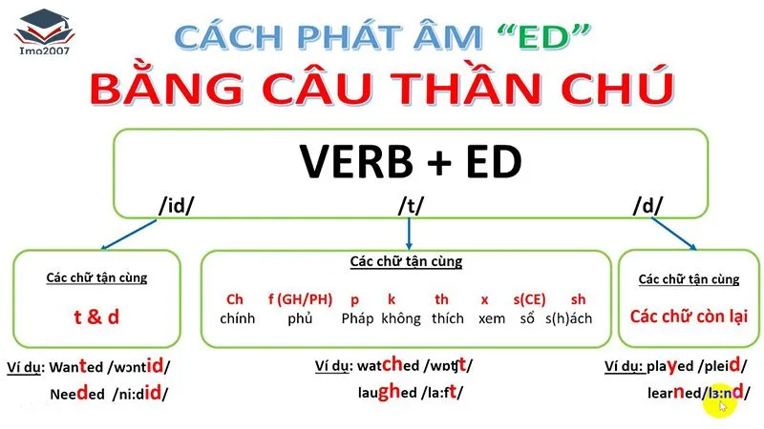

Slide 20
4. Listen and repeat. Pay attention to the sounds /t/, /d/, and /ɪd/.
/t/ | /d/ | /id/
cooked | watered | collected
passed | cleaned | donated
helped | volunteered | provided

Slide 21
5. Listen to the sentences and pay attention to the underlined parts. Tick (✓) the appropriate sounds. Practise.
 | /t/ | /d/ | /id/
1. Our club cooked soup for old patients.
2. Students watered the trees in the school.
3. We provided food for homeless children last Tet holiday.
4. Our school donated clothes to poor people.
5. Teenagers volunteered to clean streets.
✓
✓
✓
✓
✓

Slide 22
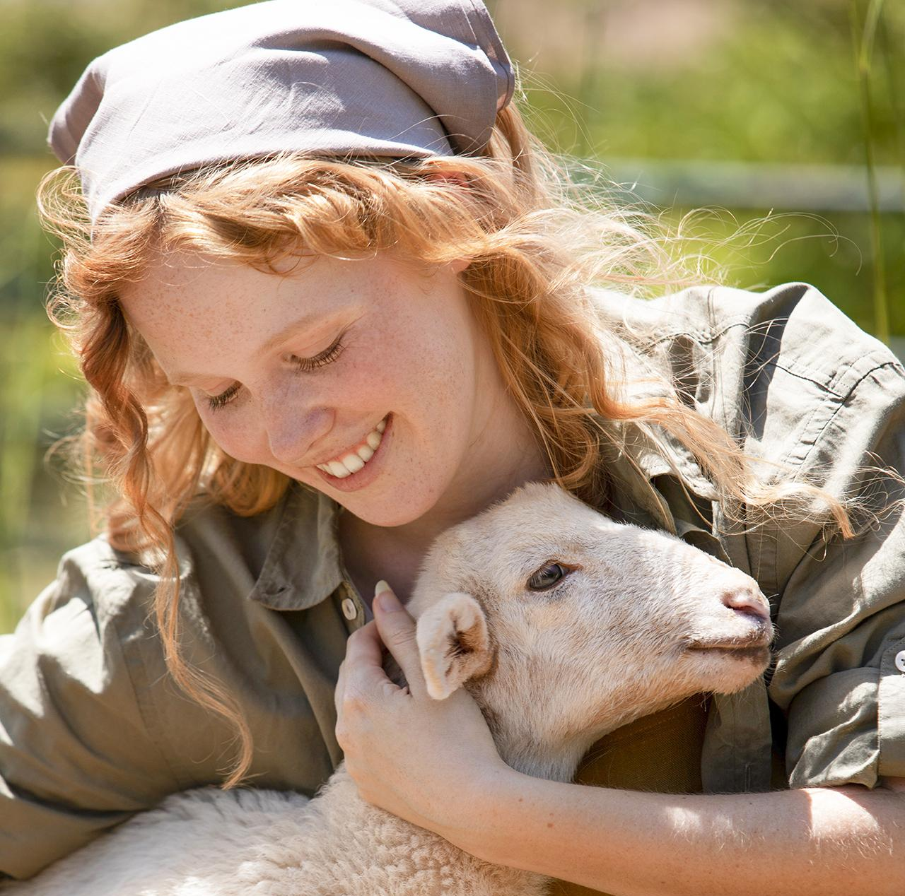
Wrap- up

Slide 23
Choose the best answer.
1. He is _____ primary students in the SOS village.
A. planting B. exchanging C. tutoring
2. Yesterday, we pick up _____ around our area and recycle them.
A. litter B. used paper C. books
Mark the letter A, B, C or D to indicate the word whose underlined part is pronounced differently from that of the rest in each of the following questions.
3. A. tried B. obeyed C. cleaned D. asked
4. A. walked B. ended C. started D. wanted
/traɪd/ /əʊˈbeɪd/ /kliːnd/ /ɑːskt/
/wɔːkt/ /endɪd/ /stɑːtid/ /wɒntid/

Slide 24
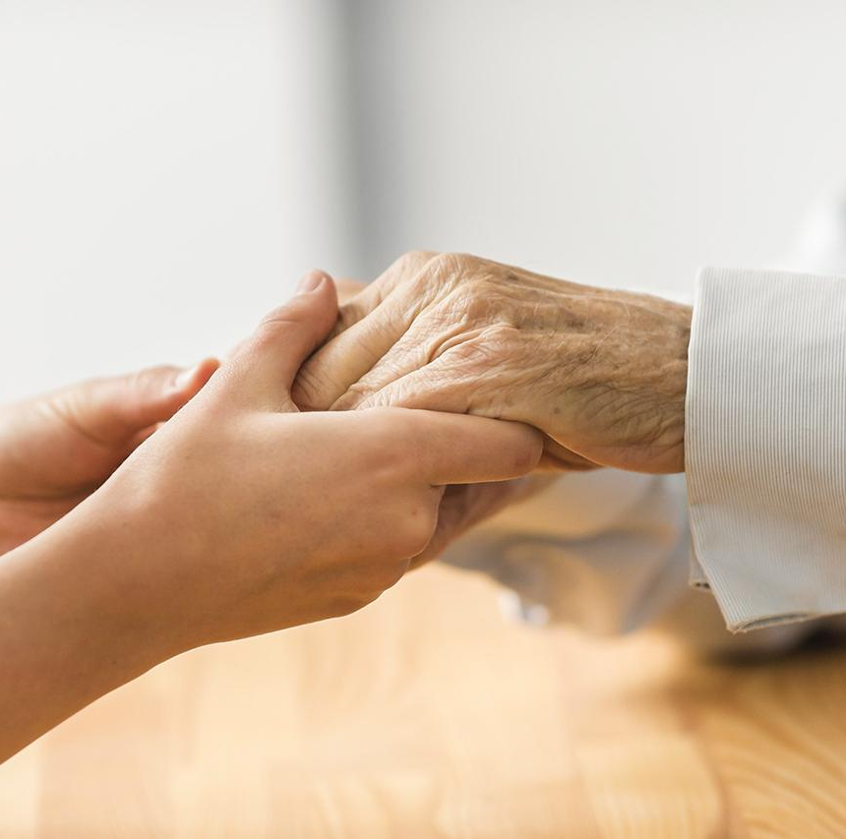
Thanks for your attention!

