Slide 1


GUESS THE WORD
A group of people living in the same area, town, etc.
C
O
M
M
U
N
I
T
Y
____
____
____
____
____
____
____
____
____
Work for free to help your community
COMMUNITY SERVICE
Notes:
Do you ever think of helping the community? Should we try to do good things for people around us? Let’s find more in our lesson today.

Slide 2
Unit 3
Community service
Lesson 1 Getting started

Slide 3
OBJECTIVES
After this lesson, students will be able to:
01
identify the topic of the unit
02
use lexical items related to community activities

Slide 4


Vocabulary
community activity
/kəˈmjuːnɪti ækˈtɪvɪti/
Hoạt động cộng đồng

Slide 5

Vocabulary
donate
/dəʊˈneɪt/
Quyên góp, ủng hộ

Slide 6
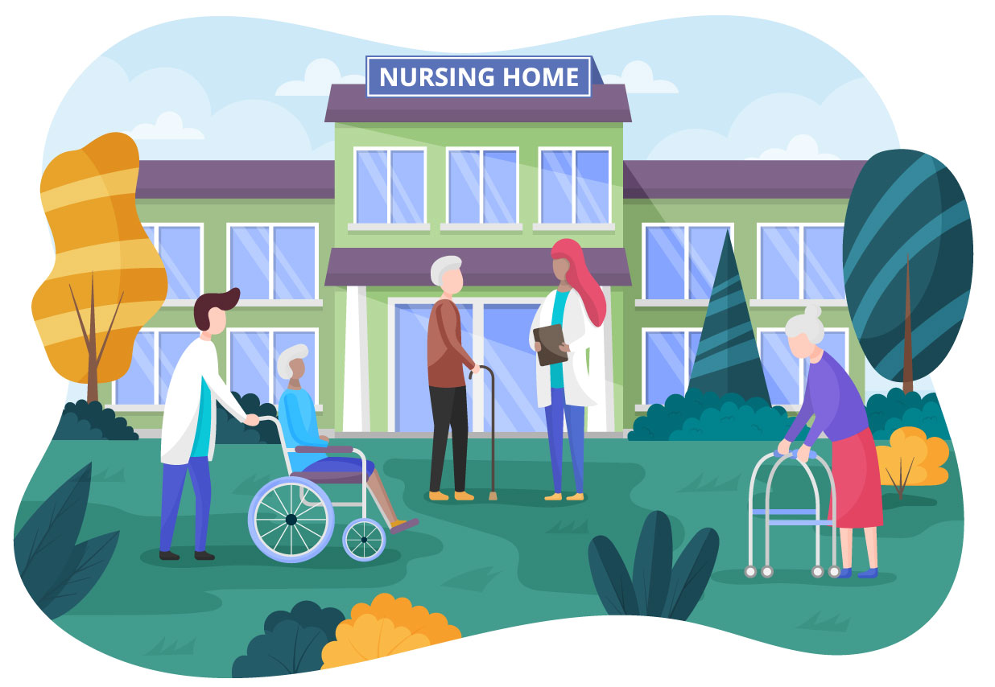
Vocabulary
nursing home
/ˈnɜːsɪŋ həʊm/
Viện dưỡng lão

Slide 7
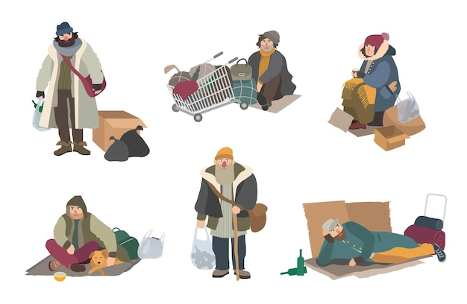
Vocabulary
homeless
/ˈhəʊmləs/
Người vô gia cư

Slide 8
Vocabulary
community activity
/kəˈmjuːnɪti ækˈtɪvɪti/
donate
/dəʊˈneɪt/
Quyên góp, ủng hộ
Hoạt động cộng đồng
nursing home
/ˈnɜːsɪŋ həʊm/
homeless
/ˈhəʊmləs/
Viện dưỡng lão
Người vô gia cư

Slide 9
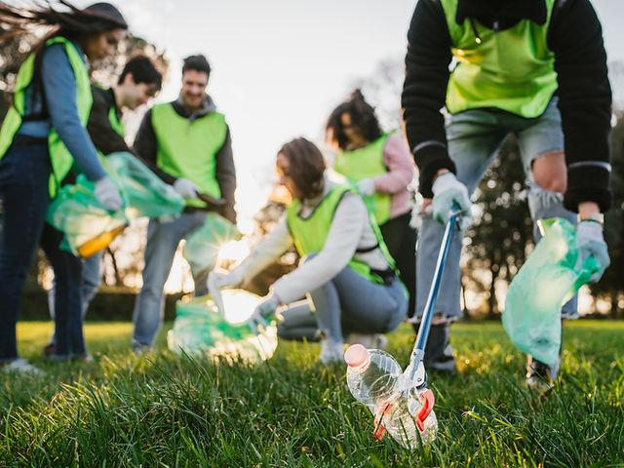
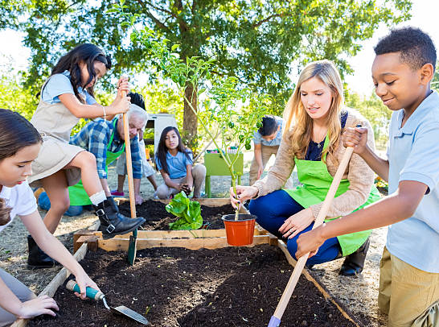
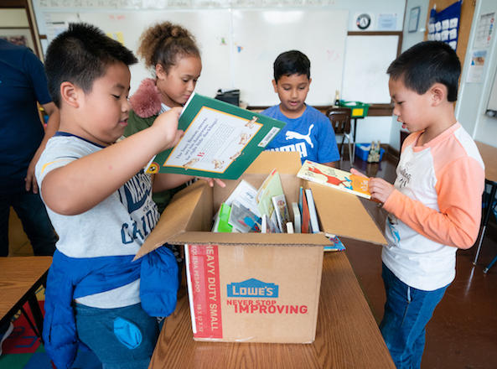
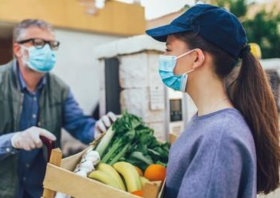
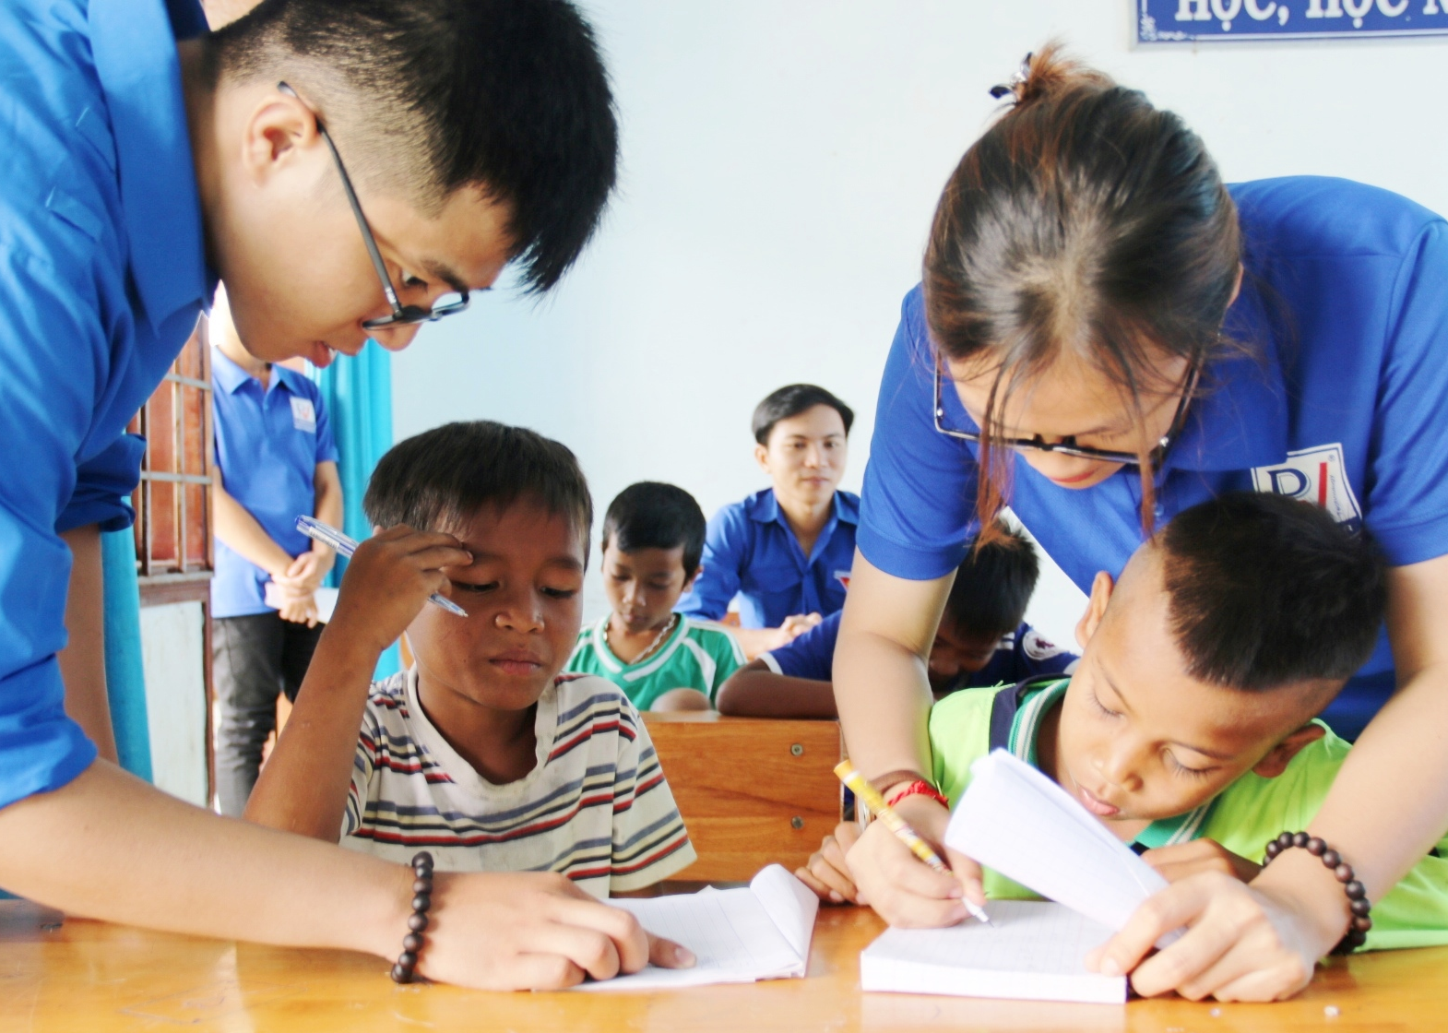
Look and answer.
What can you see in the picture?
pick up litter
planting vegetables
What do you think the boys and the girls are doing?
donating books
Listen and check.
donating vegetables
teaching English

Slide 10
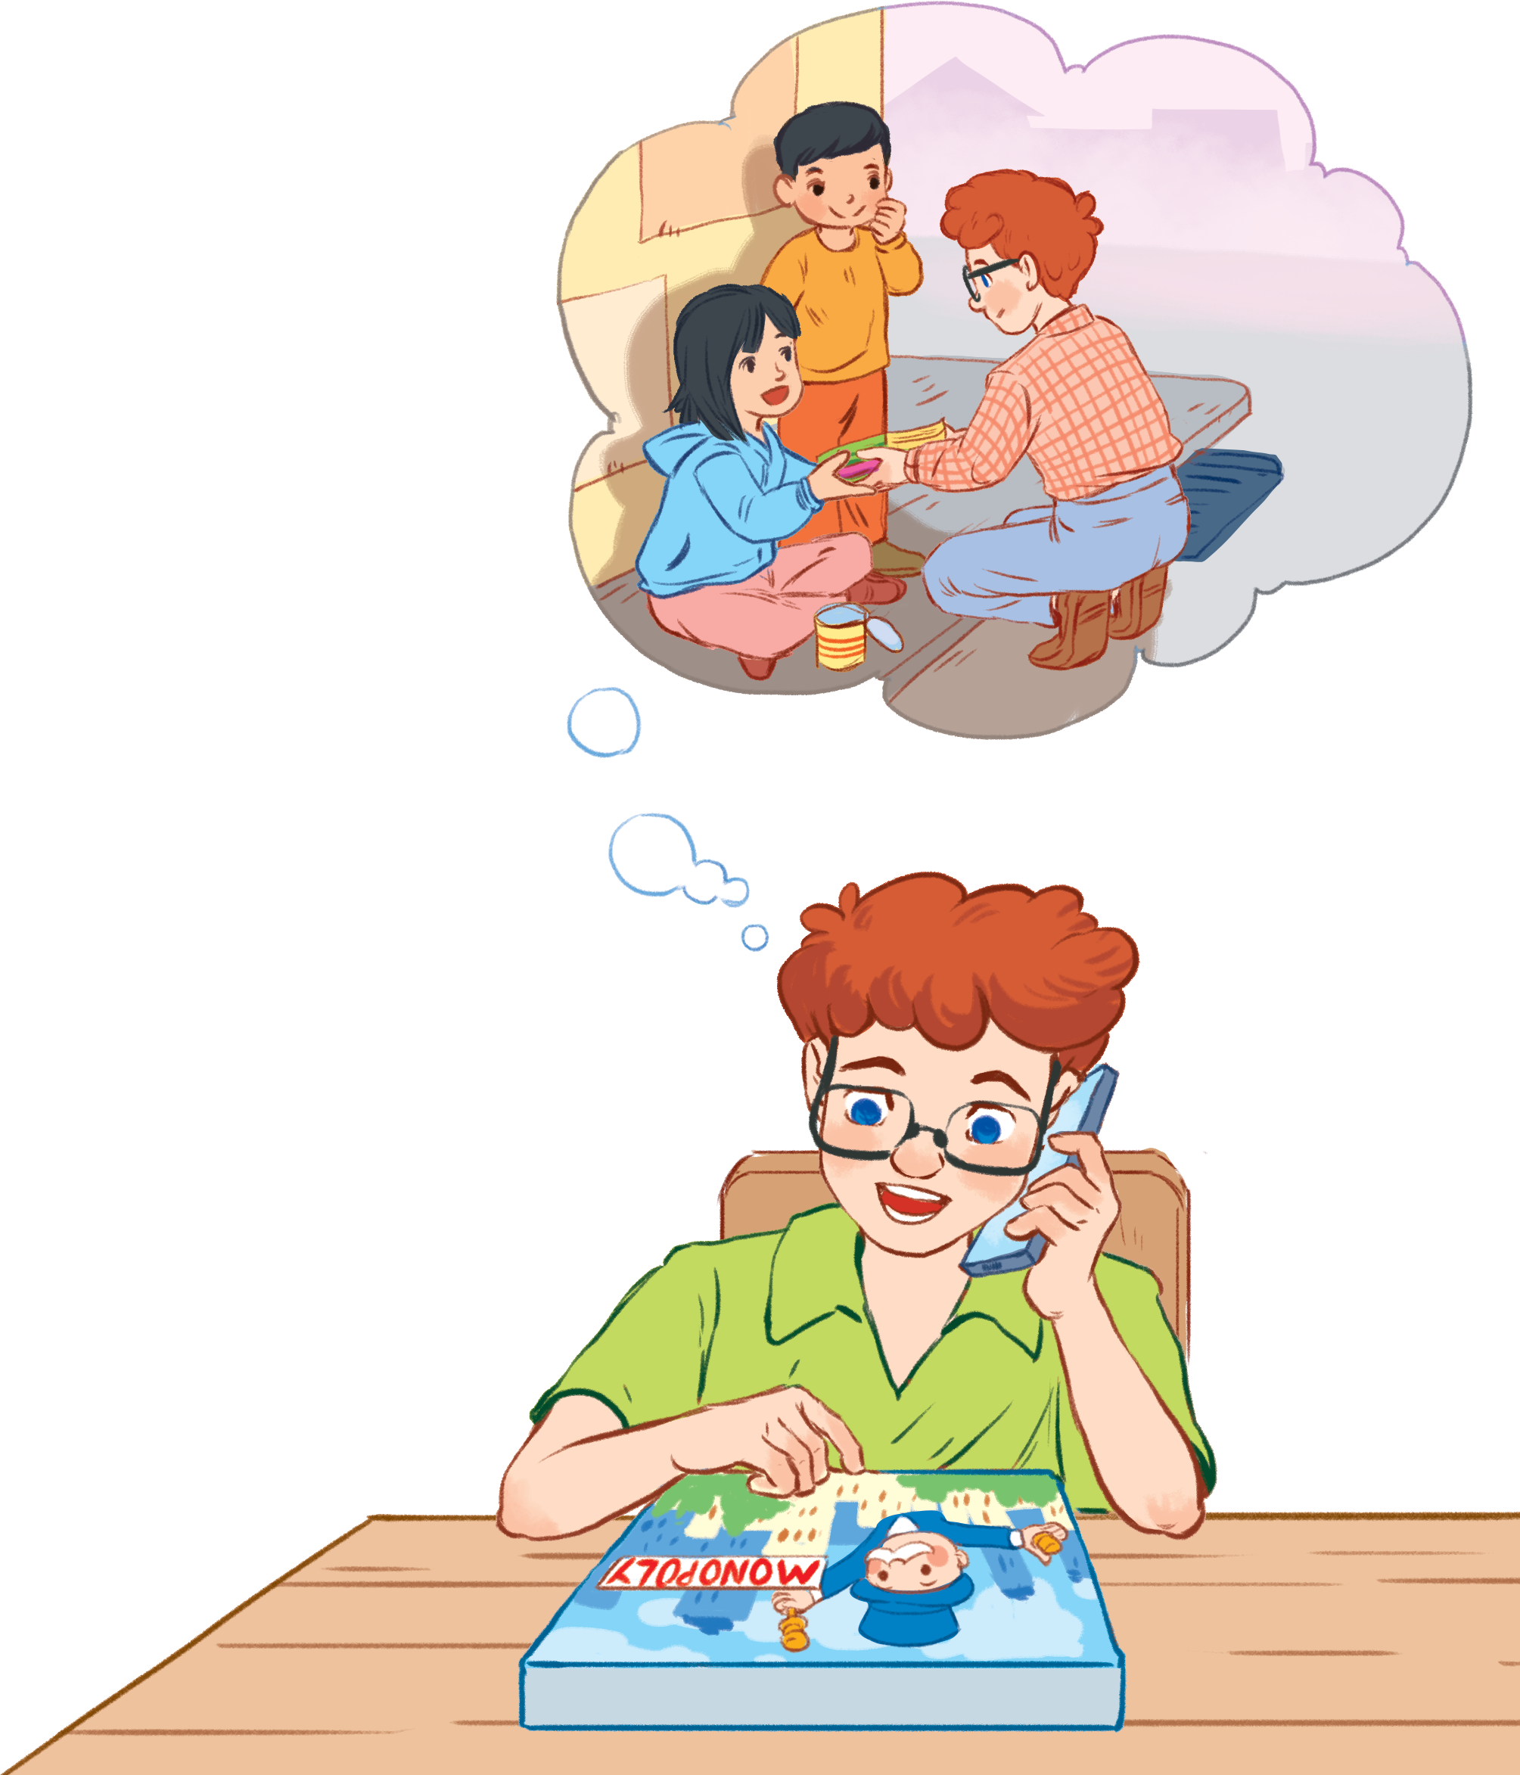
2. Read the conversation again and tick (✔) the appropriate box.
Community activity | Minh’s club | Tom’s Club
1. picking up litter
2. planting vegetables
3. donating books
4. donating vegetables
5. teaching English
Minh

Slide 11
2. Read the conversation again and tick (✔) the appropriate box.
Minh: Well, we pick up litter around our school and plant vegetables in our school garden.
Tom: School gardening? That’s fantastic!
Minh: Yes. We donate the vegetables to a nursing home.
Community activity | Minh’s club | Tom’s Club
1. picking up litter
2. planting vegetables
3. donating books
4. donating vegetables
5. teaching English
✔
✔
✔

Slide 12
2. Read the conversation again and tick (✔) the appropriate box.
Minh: Does your school have any activities like these?
Tom: Yes. We donate books to homeless children. We also have English classes. Last summer, we taught English to 30 kids in the area.
Community activity | Minh’s club | Tom’s Club
1. picking up litter
2. planting vegetables
3. donating books
4. donating vegetables
5. teaching English
✔
✔
✔
✔
✔

Slide 13
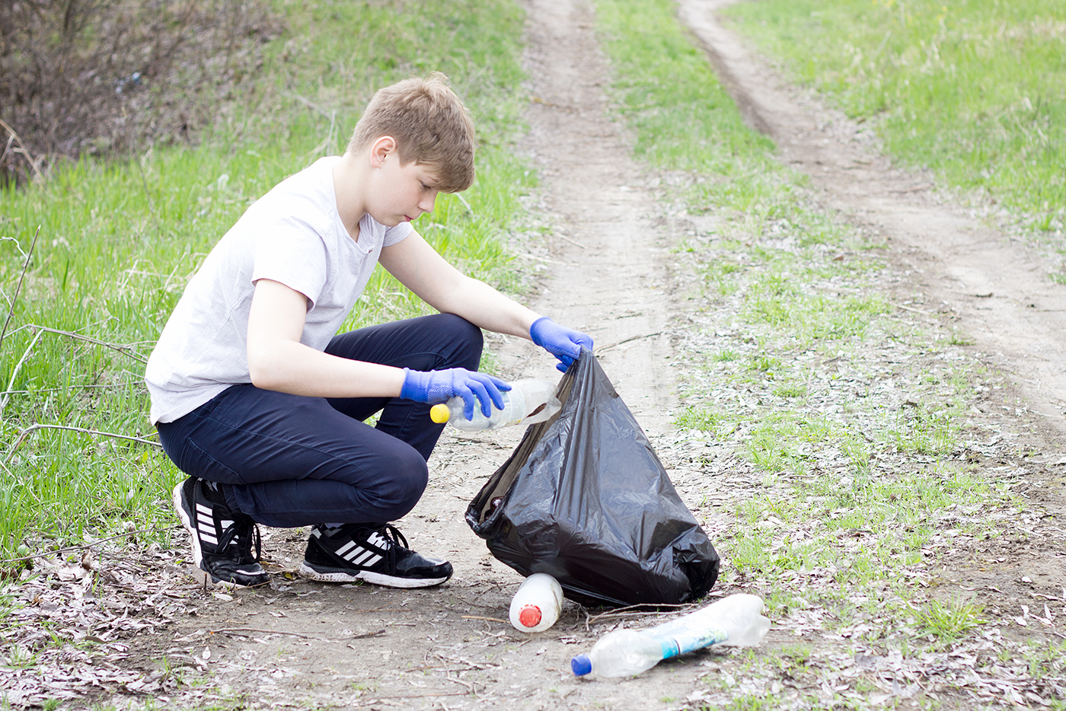
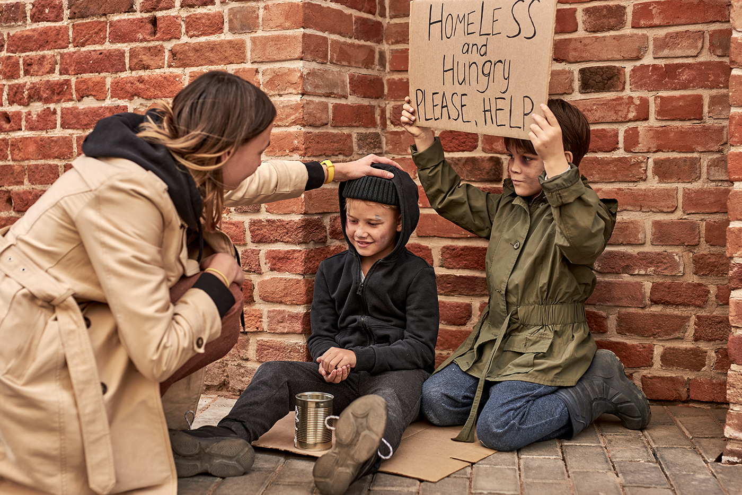
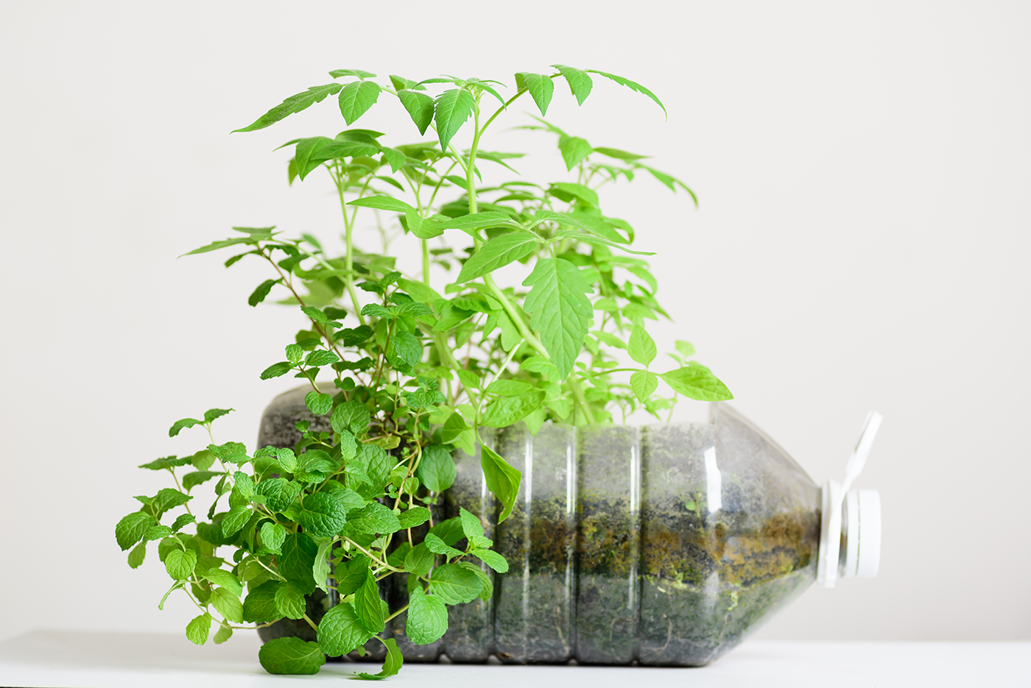
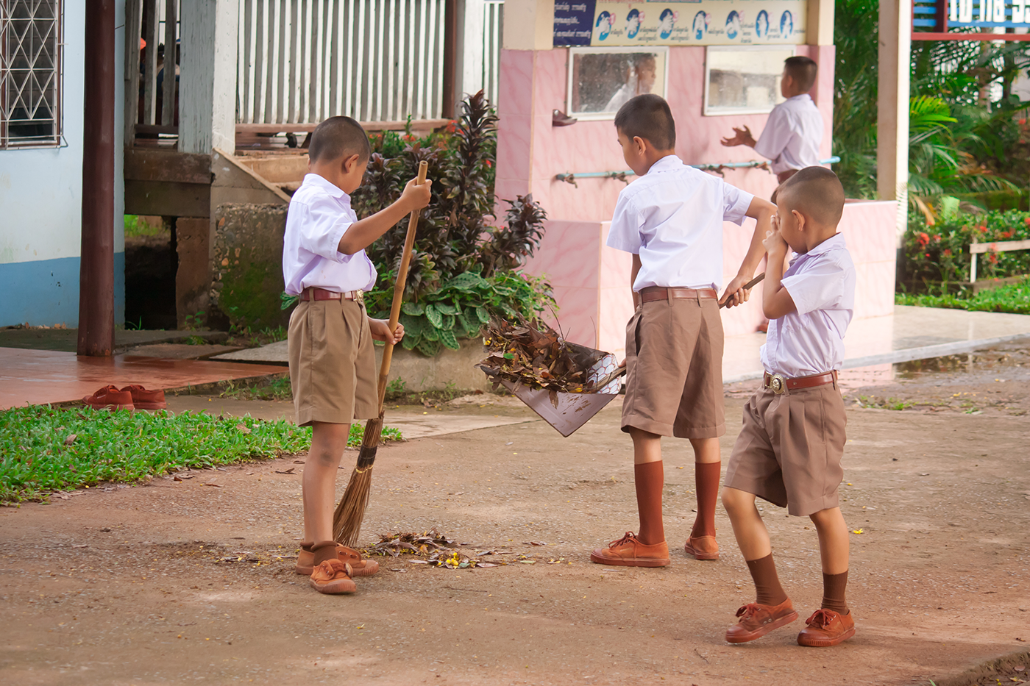

3. Complete the phrases under the pictures with the verbs below.
pick up clean donate recycle help
pick up
help
recycle
1. ________ litter
2. ________ homeless children
3. ________ plastic bottles
clean
donate
4. ________ the playground
5. ________ clothes

Slide 14
4. Complete the sentences with the correct words or phrases below.
old people homeless children planted litter taught
1. We collected clothes and gave them to ________.
2. Those students picked up all the ________ on the street.
3. We helped ___________ in the nursing home last Sunday.
4. The club members ________ maths to primary students during school holidays.
5. We ________a lot of trees in the park last summer.
homeless children
litter
old people
taught
planted

Slide 15

5. Game: Vocabulary Ping-pong
Two teams, A and B.
Team A provides a cue word.
Team B makes up a sentence with it.
Then switch roles.
Example:
A: Litter
B: We often pick up litter in the park. Trees
A: We plant trees in our school every year. Book
…

Slide 16
Recap
1. What does “community service” mean?
A. Các hoạt động từ thiện
B. Các hoạt động phục vụ cộng đồng
C. Các hoạt động bảo vệ môi trường
2. What are some community activities you have learnt?
A. donating books
B. help homeless children
C. teaching English
D. pick up litter
E. Cook food for sick children
Notes:
1. picking up litter
2. planting vegetables
3. donating books
4. donating vegetables
5. teaching English

Slide 17
Thank you for your attention!

Slide 18
Giáo án điện tử Global Success mới nhất, cập nhật phương pháp giáo dục hiện đại, nội dung chi tiết bám sát sách giáo khoa.
Tài liệu phù hợp để:
- Làm bài giảng điện tử, thao giảng,
- Phiếu bài tập củng cố kiến thức
- Practice Test dạy bổ trợ, buổi 2
PHƯƠNG ANH TRẦN – Zalo 0326962323

