Slide 1
Unit 2:
HEALTHY LIVING
Lesson 7: Looking back

Slide 2
Objectives
“Review the vocabulary and grammar of Unit 2.”

Slide 3
Vocabulary
washing your hands often, eating tofu and coloured vegetables, brushing your teeth twice a day, taking enough water, do exercise, etc.
Healthy active:
stress, tired, bored, shortness of breath, etc.
Health problems:

Slide 4
Pronunciation
/f/ | /v/
Five, fat, far, photo, office, find, family, feeling, life, phone, tough, laugh.
Travel, violin, have, leave, seven, of, village, voice, event, advice.

Slide 5
Grammar:
SIMPLE SENTENCES
Subject + Verb
Ex: It is raining.
S V
Subject + Verb + Object
Ex: I like cats.
S V O
Subject + Verb + Adverb
Ex: I live in the city.
S V adverb
Subject + Verb + Adjective
Ex: She is tall.
S V Adj

Slide 6
01
Vocabulary review

Slide 7
EX1: Complete the sentences with the verbs below.
are
avoid
affects
keep
exercise
1. Healthy food and exercise help people ______________ fit.
2. Weather that is too cold or too hot ___________ your skin condition.
3. Children should ____________ fast food and soft drinks.
4. Bad habits like eating too much sweetened food and going to bed late ____________ harmful to our health.
5. We can _____________ indoors and outdoors.
keep fit: giữ dáng
keep
affects
affect your skin: ảnh hưởng tới da
avoid sth: tránh thứ gì đó
avoid
tobe harmful to: có hại tới
are
exercise (v): vận động
exercise

Slide 8
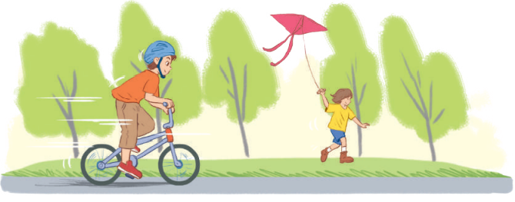
Ex2: Write the words below next to their definitions
fit
dirty
tidy
healthy
active
1. always busy doing things,
especially physical activities
2. good for your health
3. everything in order
4. in good shape
5. not clean
active
healthy
tidy
fit
dirty

Slide 9
02
Grammar review

Slide 10
Ex3: Tick the simple sentences.
1. Asians eat a lot of rice, but Europeans don’t.
2. Most children love fast food and soft drinks.
3. There is a lot of fresh air in the countryside.
4. Eat less sweetened food, and you won't put on weight.
5. Hard-working people often stay fit.
S₁ V₁ S₂ V₂
✓
S V
✓
S V
S₁ V₁ S₂ V₂
✓
S V

Slide 11
Ex4: Change the following sentences into simple ones.
1. You are active, and your brother is active too.
→ Both you and ______________________________.
2. Your room looks dark, and it looks untidy too.
→ Your room _________________________________.
3. The Japanese work hard, and they exercise regularly.
→ The Japanese _______________________________.
4. My mother eats a lot of fruit, and she eats a lot of vegetables too.
→ My mother eats _____________________________.
your brother are active
looks dark and untidy
work hard and exercise regularly
a lot of fruit and vegetable

Slide 12
Thank you
See you next time
Enter

