Slide 1
UNIT 2:
MY HOUSE
LESSON 3: A CLOSER LOOK 2

Slide 2
Circle the correct words or phrases.
1 My friend's / friends' name is Mike.
2 This is the cat's / cats bowl.
3 Our children's / childrens' Art teacher is Ms Black.
4 Look at Philip's and Lucy's / Philip and Lucy new cameras!
5 My cousin's / cousins car is blue.

Slide 3
Choose the word or phrase that best completes each sentence blow.
Trên
1. Ms. Jenny is _______ work now.
on B. next to C. at D. in
2. Is Mark _______ bed with his headache?
at B. in C. on D. under
3. He hangs his raincoat _______ the door.
in B. between C. at D. behind
4. The kitten is hiding _______ the bed.
A. under B. in front of C. between D. at
trên
bên cạnh
tại, ở
trong
tại, ở
trong
trên
phía dưới
trong
ở giữa
tại, ở
đằng sau
phía dưới
ở đằng trước
ở giữa
tại, ở

Slide 4
Choose the word or phrase that best completes each sentence blow.
5. You can find the old book _______ that bookshelf.
at B. on C. in D. under
6. Anna wears braces _______ her teeth.
in front of B. in C. next to D. on
7. I can’t see the board because of Nick sitting_______ me.
behind B. in front of C. at D. in
tại, ở
trên
trong
phía dưới
ở đằng trước
trong
bên cạnh
trên
đằng sau
ở đằng trước
tại, ở
trong

Slide 5
Choose the word or phrase that best completes each sentence blow.
8. Tom is standing _______ the window over there.
between B. in C. at D. on
9. Our family had a picnic _______ the river.
on B. in C. under D. next to
10. There is a mirror _______ a chest of drawers and a wardrobe.
A. between B. under C. at D. in
ở giữa
trong
tại, ở
trên
trên
trong
dưới
bên cạnh
ở giữa
dưới
tại, ở
trong

Slide 6
Find out the mistake in the four underlined parts of each sentence.
1. The student favourite subject is science.
A. The B. student C. is D. science
2. Samuel and Anna’s flower garden are really big.
A. Samuel B. Anna’s C. are D. big
3. Lucas’s and Amanda’s new apartment is really modern.
A. Lucas’s B. Amanda’s C. is D. modern
4. Mais’ mother is my teacher of English.
A. Mais’ B. is C. my D. of
5. The color this picture is so beautiful.
A. The color B. picture C. is D. beautiful
Student’s favourite
Samuel’s
Lucas
Mai’s
The color of this picture

Slide 7
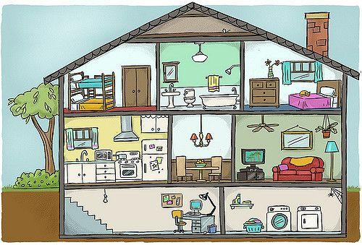
Look at the picture. Complete the sentences with the correct prepositions from the box
near above under in (3) on (3)
next to (2) between behind
1. The trees are ____________ the house.
2. The dining room is ____________ the living room and the kitchen.
3. The kitchen sink is ____________ the window.
4. The bath is ____________ the bathroom.
5. The flower vase is ________ the chest of drawers.
behind
between
under
in
on

Slide 8
Look at the picture. Complete the sentences with the correct prepositions from the box
near above under in (3) on (3)
next to (2) between behind
6. The fridge is ____________ the cooker.
7. The mirror is ____________ the bathroom sink.
8. The television is ____________ the cupboard ____________ the sofa.
9. The microwave is ____________ the counter ____________ the kitchen.
10. The washing machine is ____________ the dryer ____________ the basement.
.
next to
above
on
near
on
in
next to
in

Slide 9
THANK
YOU

