Slide 1
Unit 1:
My new school
Lesson 1 : Getting started

Slide 2
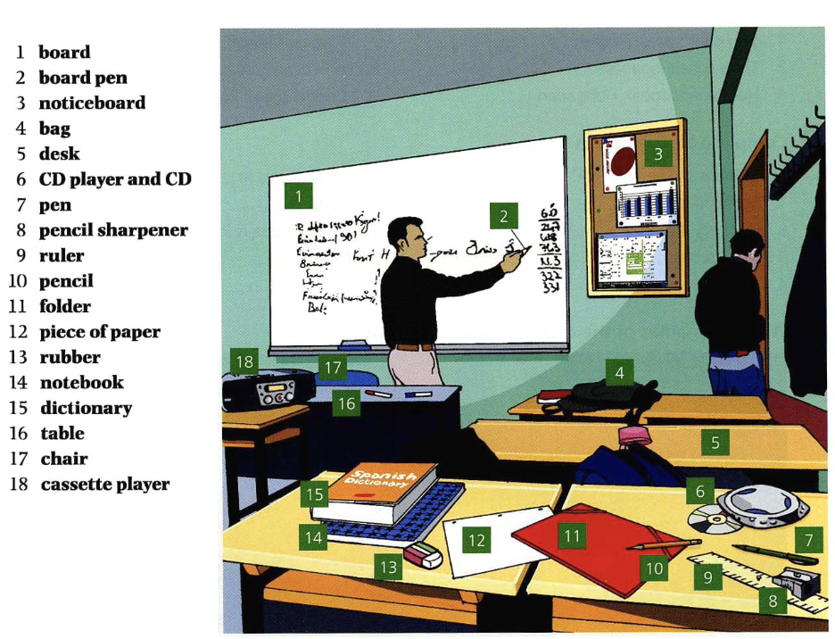

Slide 3
Tick (✔) the things you can put in a bag. Put a cross (🗶) by the things you can’t.
1. desk | 2. piece of paper | 3. chair
4. rubber | 5. board pen | 6. CD
7. dictionary | 8. ruler | 9. notice board
10. pencil | 11. table | 12. pencil sharpener
🗶
✔
🗶
bàn
giấy
ghế
✔
✔
✔
tẩy
bút viết bảng
đĩa CD
✔
✔
🗶
từ điển
thước kẻ
bảng ghi chú
✔
🗶
✔
bút chì
bàn
gọt bút chì

Slide 4
Add another word to make a longer word or phrase.
Ex: notebook | 1. board _________ | 2. cassette ________
4. pencil _________ | 5. piece of _________ | 6. CD _________
pen
player
sharpener
paper
player

Slide 5
Write your answers.
Example: You put your things in this. A bag
A board
1. The teacher writes on this in the classroom __________________
2. You use this if you make a mistake. __________________
3. You put notices on this. __________________
4. You find the meaning of words in this. __________________
5. You sharpen pencils with this. __________________
6. You write new vocabulary in this. __________________
7. You listen to CDs on this. __________________
8. You sit on this. __________________
9. You sit at one of these. __________________
10. You can put pieces of paper in this. __________________
11. You go here when you want to find a book to read __________________
12. You may need to wear this when you go to school __________________
An eraser
A notice board
A dictionary
A pencil sharpener
A notebook
A CD player
A chair
A table or A desk
A bag/ A folder
A library
A uniform

Slide 6
ABOUT YOU Write four things you’ve got at home, and four things you haven’t got.
Example: I’ve got a dictionary. I haven’t got a cassette player.
_____________________________ _________________________________
_____________________________ _________________________________
_____________________________ _________________________________
______________________________ __________________________________

Slide 7
Put the words in order to make a sentence.
1. secondary/ first/ your/ at/ school/ is/ how/ week?
→ How is your first week at your secondary school?
2. many/ we/ subjects/ school/ study / to / have/ so / at/./
→ We have so many subjects to study at school.
3. smart/ look/ we/ always/ uniforms/ our / in /./
→ We look smart in our uniforms.
4. school/ at/ English/ we/ have/ classes/ don’t/ today /./
→ We don’t have English classes at school today.
5. on / let/ put/ my / uniform/ me /./
→ Let me put on my uniform.

Slide 8
THANK YOU!

