Slide 1

HELLO EVERYBODY

Slide 2

UNIT 4: LIFE IN THE PAST.
PROJECT

Slide 3


PROBLEM:
PRESERVING THE PAST
life has changed a lot over the past
50 Years, and there are many good
pastimes and traditions which seem to be
dying out. Work in group and
Search for a past tradition or pastime which you highly appreciate.
Give reasons why you like it.
Work out a plan to help preserve it.
Then make a poster presenting your ideas and share it with your class

Slide 4

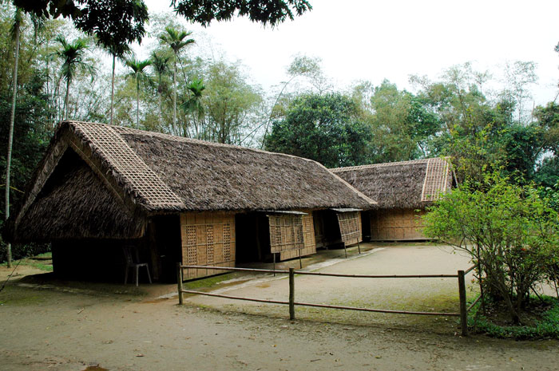
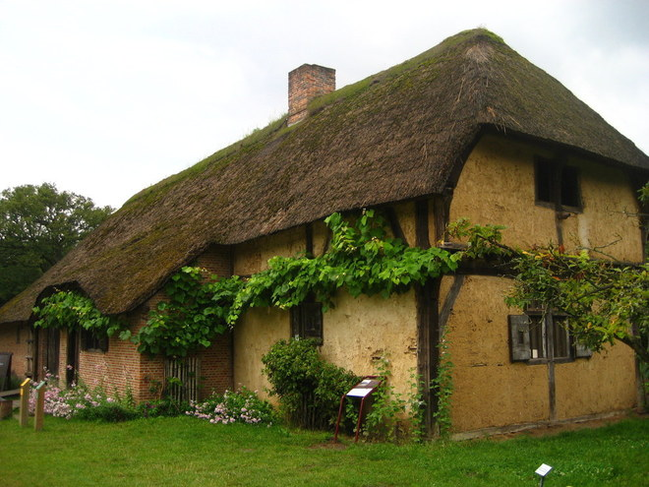
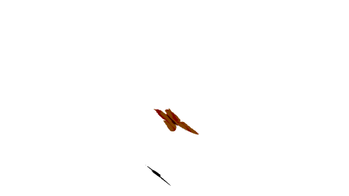
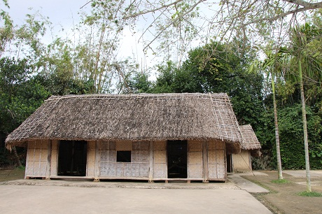
THATCHED HOUSE

Slide 5

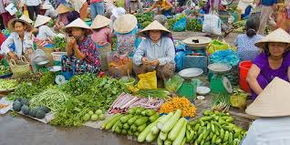
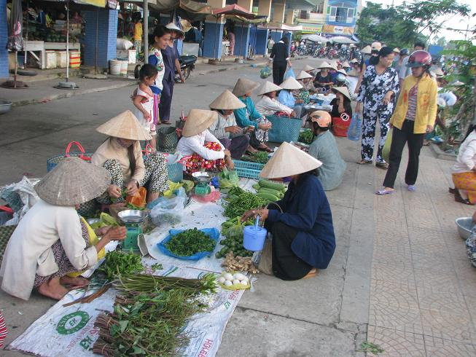
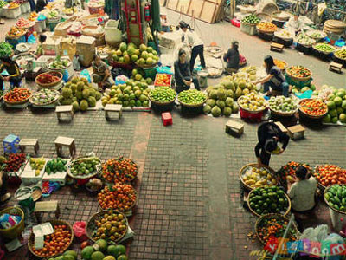
OPEN MARKET

Slide 6

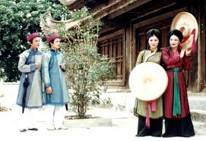
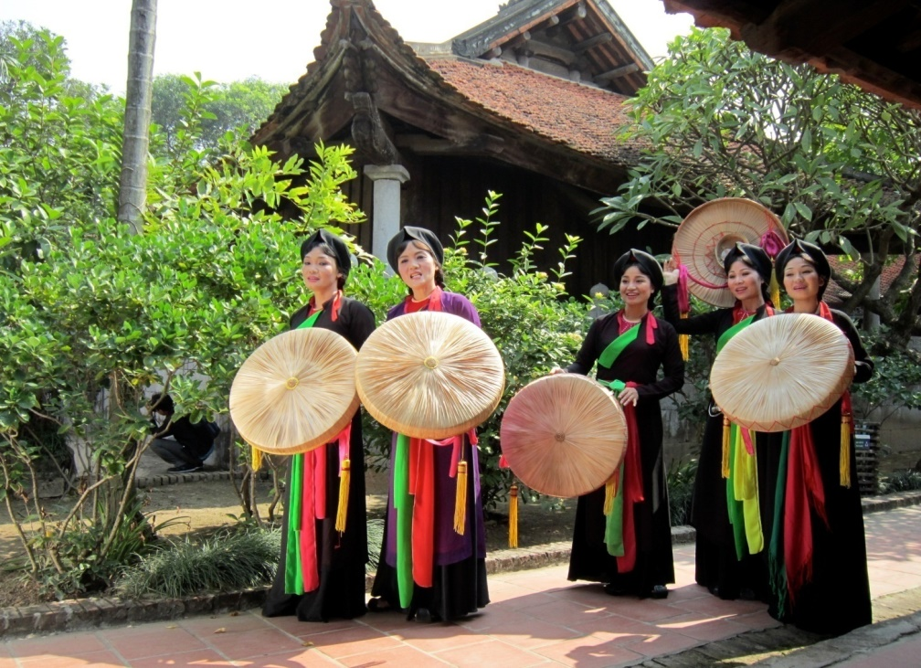
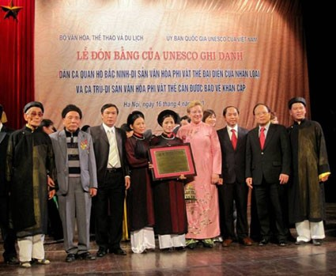

Quan ho folk songs

Slide 7
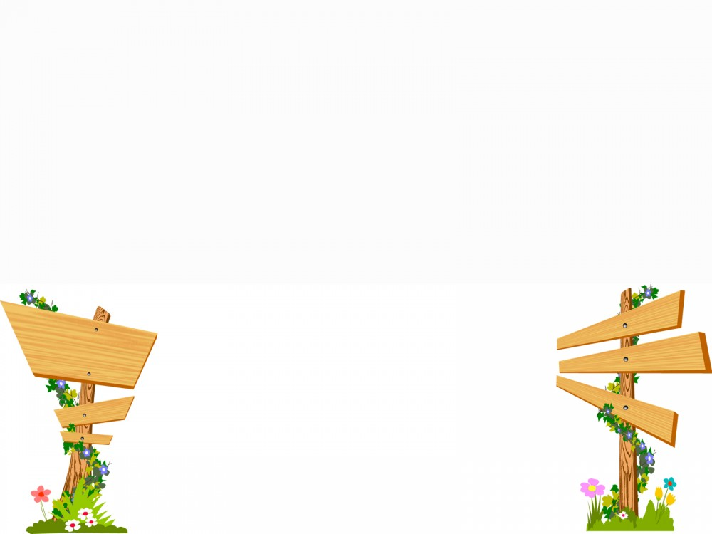

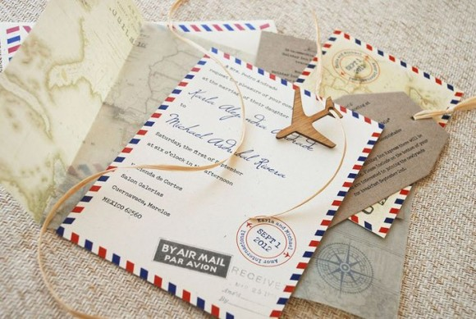

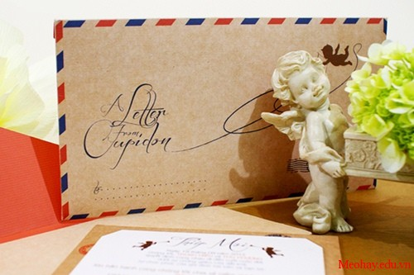
HAND LETTER

Slide 8

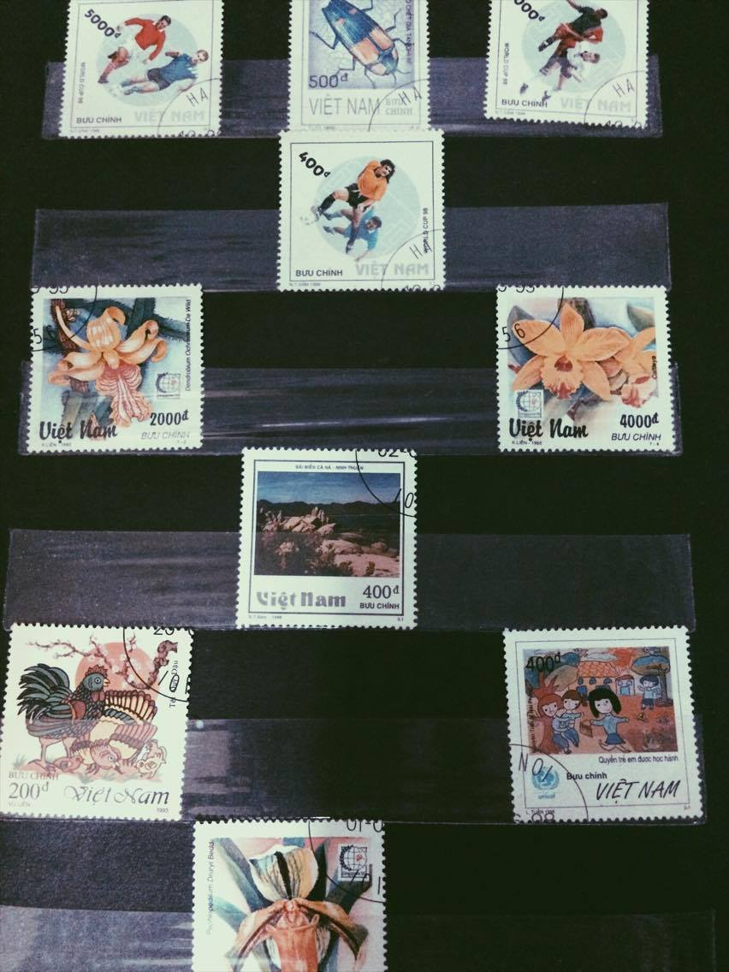
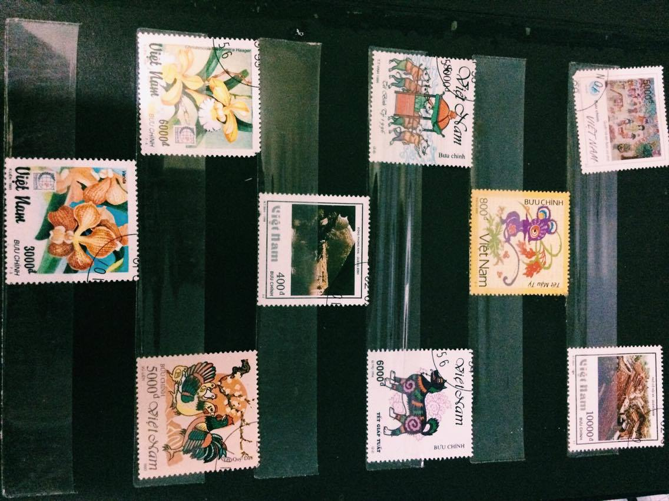
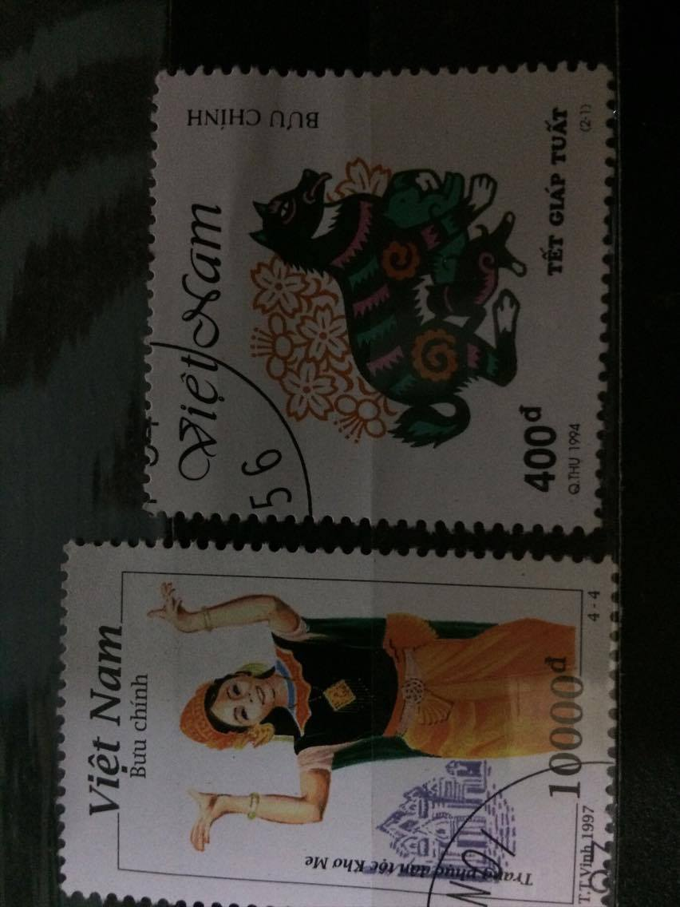
TOAN’s stamps collecting

Slide 9

GOODBYE!

