Slide 1
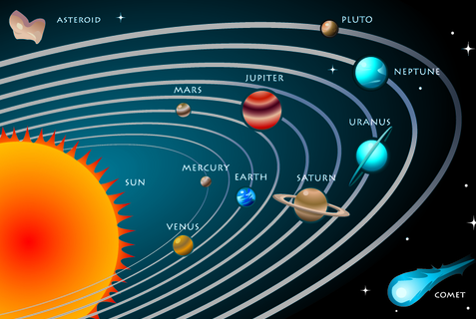

Slide 2
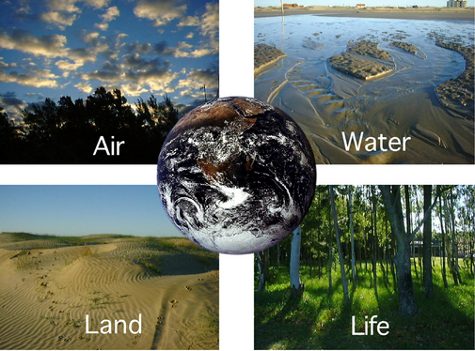

Slide 3
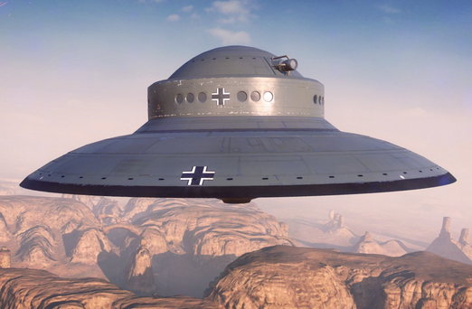
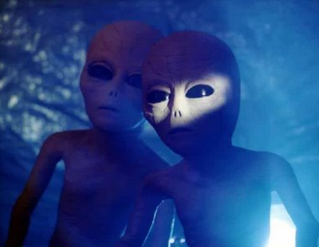
Solar system
Solar system
Earth
Unidentified Flying Object (UFO)
Aliens

Slide 4



UNIT 12: LIFE ON OTHER PLANETS
LESSON 1: GETTING STARTED

Slide 5
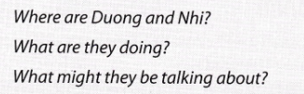
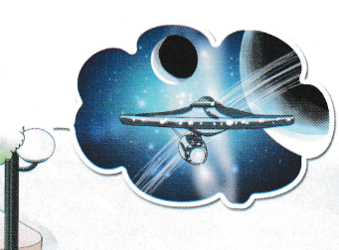
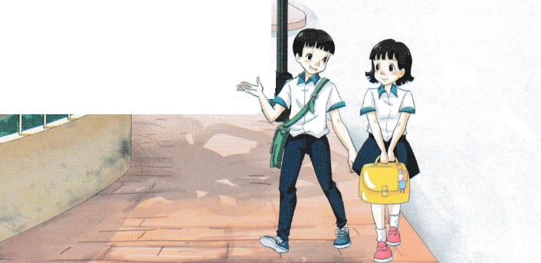
All Call
Student Demo

Slide 6
I. Vocabulary
1.
trek
(n)
: hành trình
2.
‘captain
(n)
: thuyền trưởng
3.
crew
(n)
: thủy thủ đoàn
4.
‘terrorist
(n)
: kẻ khủng bố
5.
‘alien
(n)
: người ngoài hành tinh
6.
space ‘buggy
(n)
: xe vũ trụ
7.
‘galaxy
(n)
: dải ngân hà
8.
‘solar system
(n)
: hệ mặt trời

Slide 7
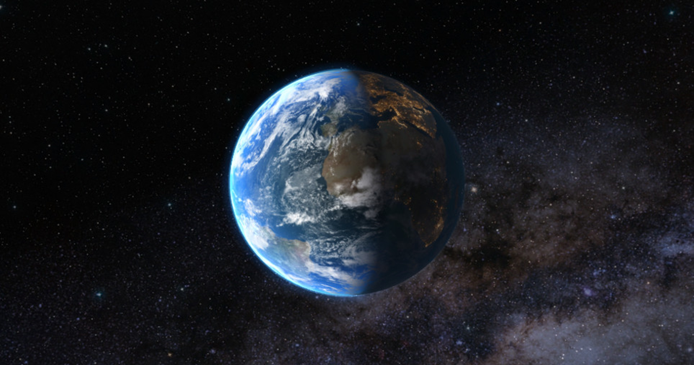

II. LISTEN AND READ

Slide 8

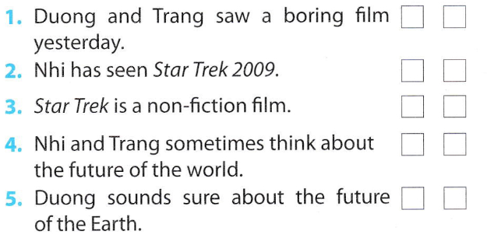

✓
✓
✓
✓
✓
All Call
Student Demo

Slide 9

II. LISTEN AND READ

Slide 10


James Kirk is the captain of the spaceship.
They went to Nibiru planet.
It happens in 2259.
It’s the name of the spaceship that the crew travels on.
He wants to destroy Earth.
All Call
Student Demo

Slide 11
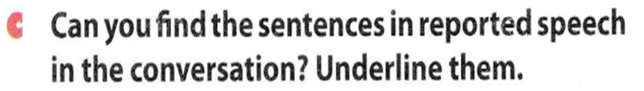
II. LISTEN AND READ

Slide 12

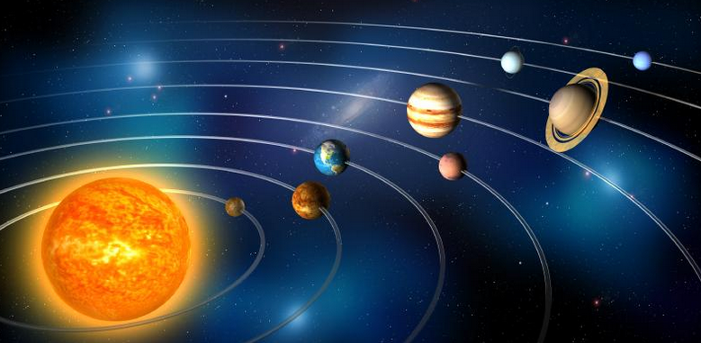
That’s funny, Trang also asked me what I thought would happen to Earth in the future.
I said I didn’t know but that Earth might be run by aliens!
All Call
Student Demo

Slide 13

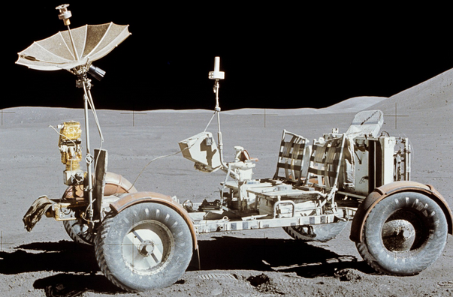


aliens space buggy galaxy planet
weight less solar system spaceship UFO
1.
Aliens
2.
Space buggy
All Call
ABProgram + StartA + AV1
Student Demo

Slide 14
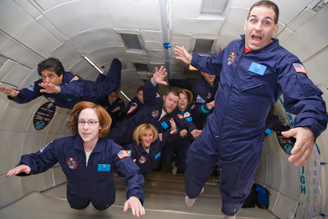
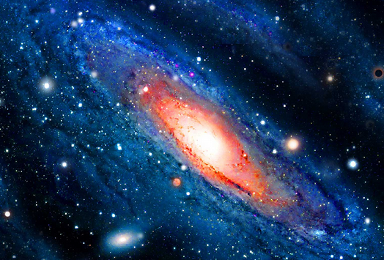
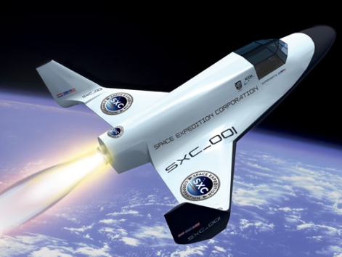
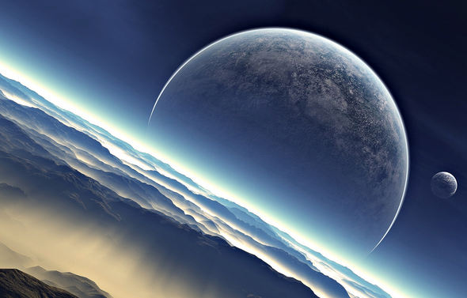

3.
UFO
4.
Weightless
5.
Galaxy
6.
Spaceship
7.
Planet
Solar system
8.
All Call
ABProgram + StartA + AV1
Student Demo

Slide 15
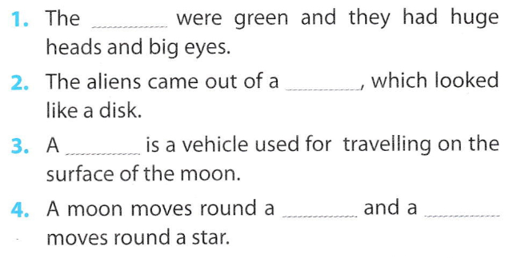
aliens space buggy galaxy planet
weight less solar system spaceship UFO
aliens
UFO
space buggy
planet planet
All Call
Student Demo

Slide 16
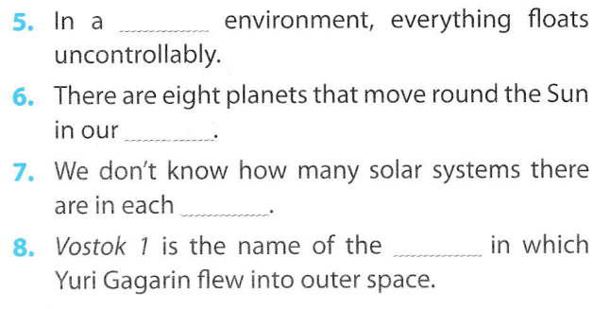
weightless
solar system
galaxy
spaceship
All Call
Student Demo

Slide 17
Homework
Learn by heart the new words.
Do wb U12 B1
Prepare for the next..

Slide 18


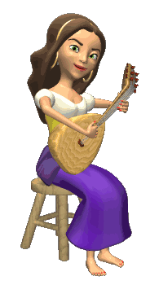

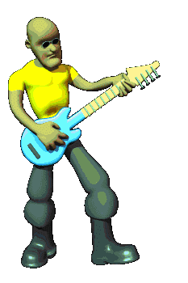
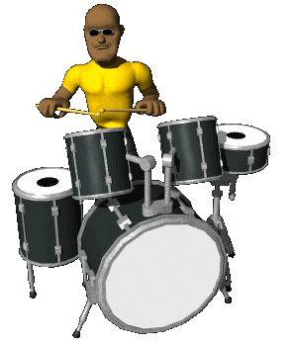

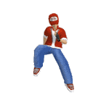



THANK YOU FOR ATTENTION!
GOOD BYE!
the end

Slide 19
LIFE ON OTHER PLANETS
- Can you tell me name of this planet where we are living?
How many planets in the solar system?
What planet in the solar system similar our Earth?

Slide 20


Slide 21
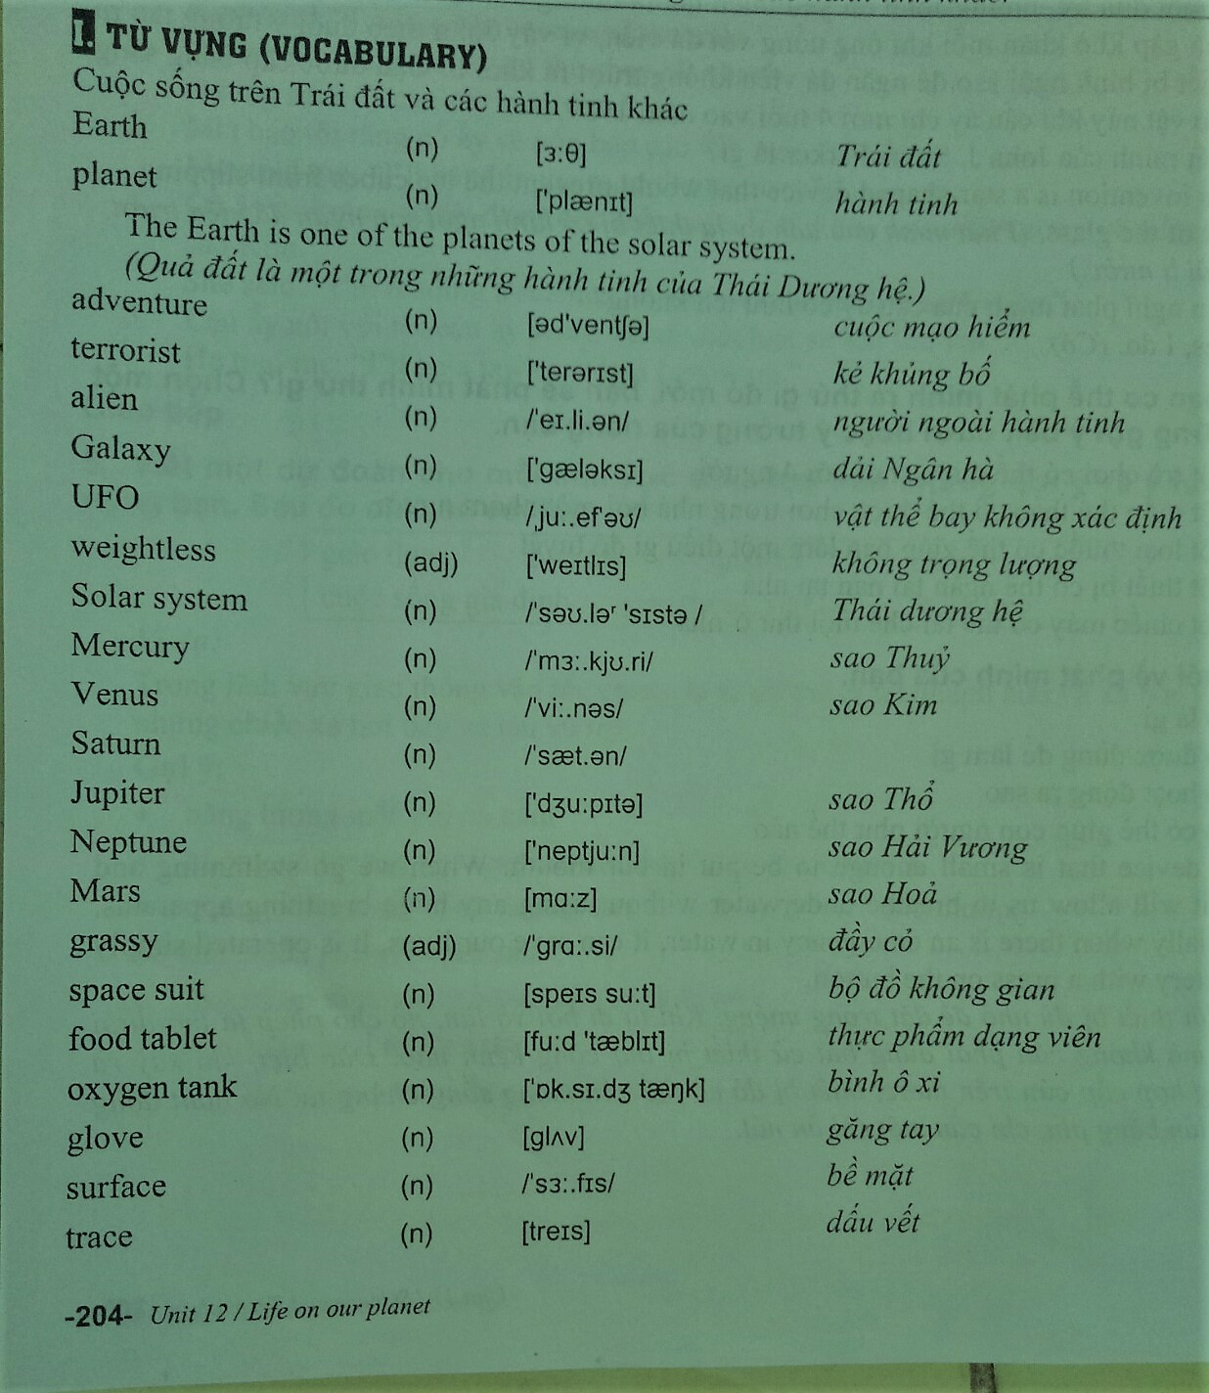

Slide 23
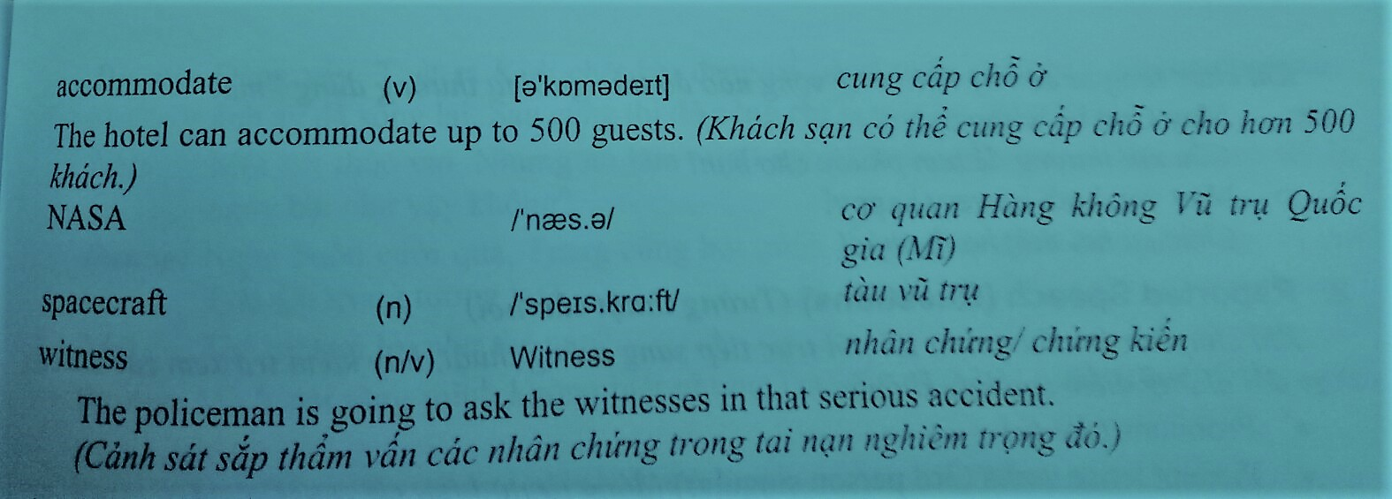

Slide 24

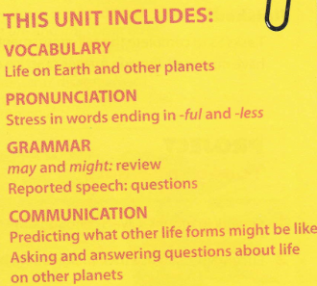

All Call
ABProgram + StartA + AV1
Student Demo

