Slide 1
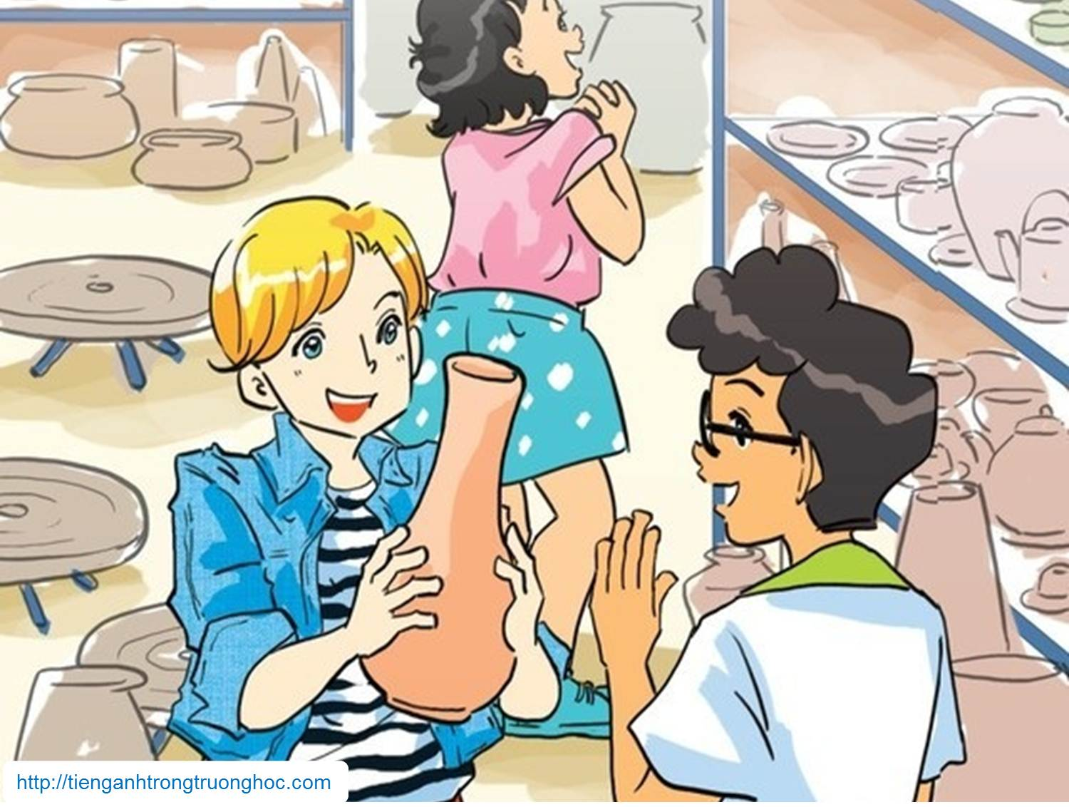
      UNIT 1: LOCAL ENVIRONMENT
      LESSON 5: SKILLS 1
English 9

Slide 2


I. Vocabulary
artisan (n) /ˌɑːtɪˈzæn/
string (n) /strɪŋ/
layer (n) /'leiə/
rely on (v) /rɪˈlaɪ ɒn/
preserve (v) /prɪˈzɜːv/
infrastructure (n) /ˈɪnfrəˌstrʌkʧə/
thợ thủ công
sợi dây
lớp
dựa vào
gìn giữ, bảo tồn
cơ sở hạ tầng

Slide 3

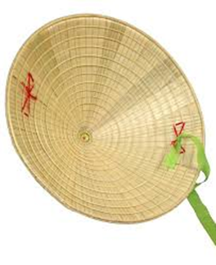
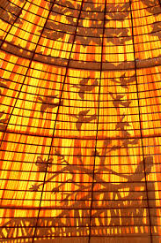
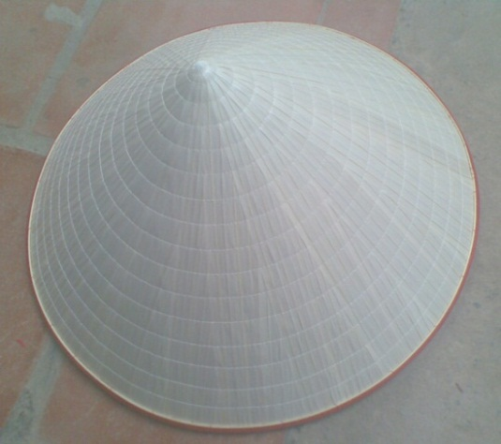
I. Reading
Activity 1. Work in pairs. One looks at Picture A, and the other looks at Picture B on page 15. Ask each other questions to find out the similarities and differences between your pictures.
Picture A
Picture B
Differences:
Picture A: light green, pictures between layers, blue string, look lighter Picture
Picture B: white, no decoration, pink string, look heavier
Similarities: conical hat, string

Slide 4
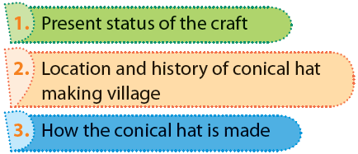

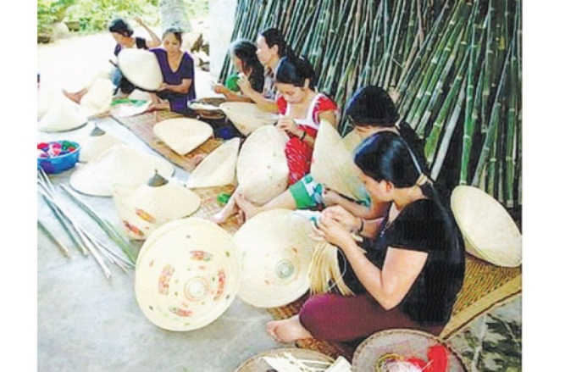
Activity 2. Mi visited Tay Ho village in Hue last month. She has decided to present what she knows about this place to the class. Read what she has prepared and match the titles with the paragraphs.
1C
2A
3B

Slide 5
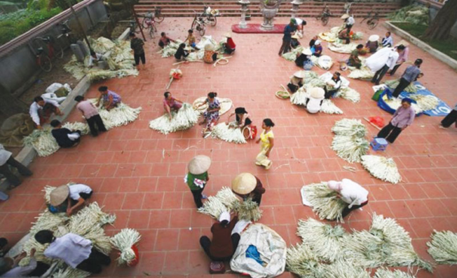
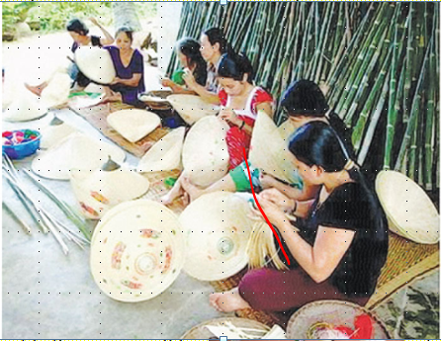
A
When you think about the conical hat, the first thing you think of is the region of Hue. Conical hat making has been a traditional craft there for hundreds of years, and there are many craft villages like Da Le, Phu Cam, and Doc So. However, Tay Ho is the most famous because it is the birthplace of the conical hat in Hue. It is a village on the bank of the Nhu Y River, 12 km from Hue City.
A conical hat may look simple, but artisans have to follow 15 stages, from going to the forest to collect leaves to ironing the leaves, making the frames, etc. Hue’s conical hats always have two layers of leaves. Craftsmen must be skilfull to make the two layers very thin. What is special is that they then add poems and paintings of Hue between the two layers, creating the famous bai tho or poetic conical hats.
Conical hat making in the village has been passed down from generation to generation because everybody, young or old, can take part in the process. It is a well-known handicraft, not only in Viet Nam, but all around the world.
B
C

Slide 6
Activity 3. Read the text again and answer the questions.
1. Why is Tay Ho the most well-known conical hat making village?
2. How far is it from Tay Ho to Hue City?
3. What is the first stage of conical hat making?
4. What is special about the hat layers?
5. What is special about the bai tho conical hat?
6. Who can make conical hats?
Because it is the birthplace of the conical hat in Hue.
It’s 12 km from Hue City.
It’s going to the forest to collect leaves.
They’re very thin.
It has poems and paintings of Hue between the 2 layers.
Everybody can, young or old.

Slide 7

II. Speaking
Activity 4. Read the following ideas. Are they about the benefits of traditional crafts (B) or challenges that artisans may face (C). Write B or C.
1. providing employment
2. losing authenticity
3. providing additional income
4. relying too much on tourism
5. treating waste and pollution
6. preserving cultural heritage
Can you add some more benefits and challenges?
B
C
B
C
C
Other benefits: creating national/regional pride, helping develop tourism, helping improve local infrastructure and services, creating cohesion between craft families and communities
B
Other challenges: limited designs, natural resources running out, competition from other countries

Slide 8
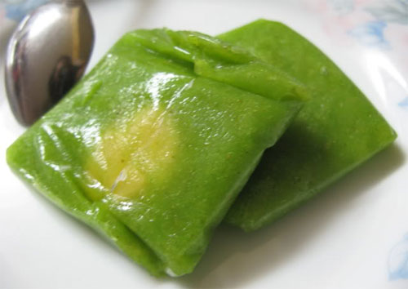
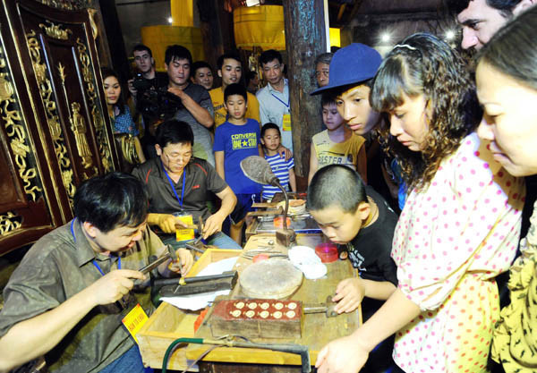
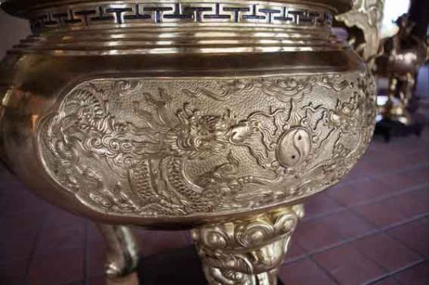
Activity 5. Imagine that your group is responsible for promoting traditional crafts in your area. Propose an action plan to deal with the challenges.
Square Sticky Rice Cake: Tranh Khuc village, Hanoi
Silver carving in Hang Bac street, Hanoi
Ngu Xa Bronze casting Ba Dinh District, Hanoi

Slide 9
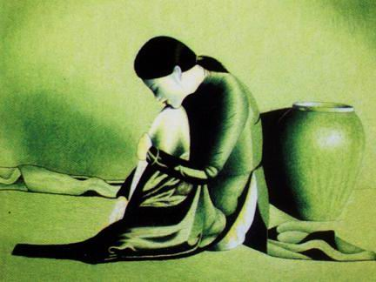
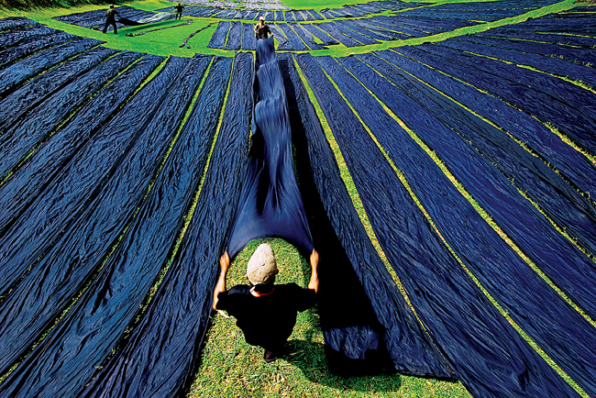
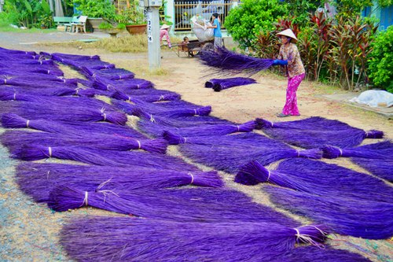
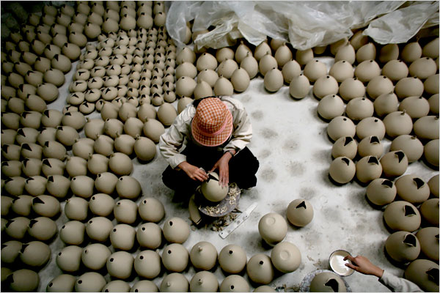
Embroidery: Quat Dong village, Ha Tay province
Silk: Van Phuc village, Ha Tay province
Sedge Mats : Dinh Yen village, Dong Thap province
Ceramics: Bat Trang village, Hai Dung province

Slide 10
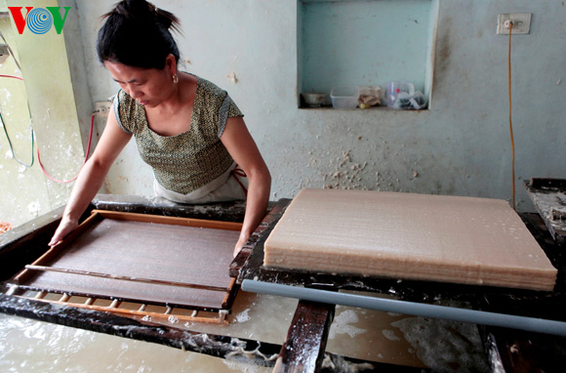
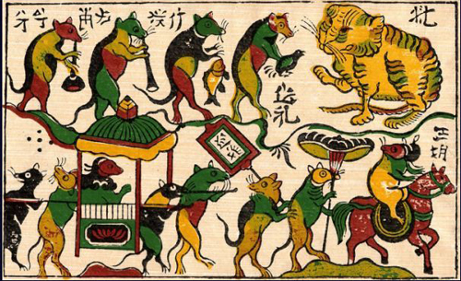
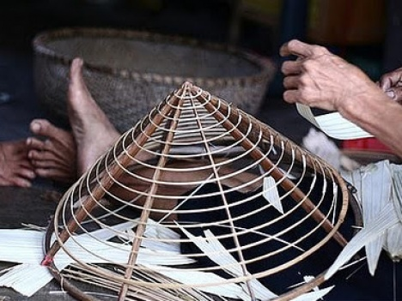
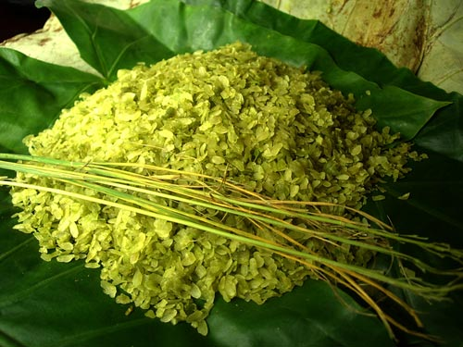
Poonah-Paper: Yen Thai village, Quang Binh province
Folklore Painting: Dong Ho painting, Bac Ninh province
Conical Hats: Chuong village, Ha Tay province
Green Young Sticky Rice: Vong village, Bac Ninh province

Slide 11

III. Homework
  Learn vocabulary by heart.
  Redo exercises.
  Prepare the next lesson: Skills 2

Slide 12
Bài giảng PPT tiếng Anh 9
12 Units + 4 Reviews
Content of the lesson
Vocabulary ( Transcription + audio)
Images
Game (Grammar)
Reading (Audio)
Bài giảng PPT tiếng Anh 6 (tập 1, 2)
Bài giảng PPT tiếng Anh 7 (tập 1, 2)
Bài giảng PPT tiếng Anh 8 (tập 1, 2)
Bài giảng PPT tiếng Anh 9 (tập 1, 2)
For even more PPT presentations and great resources visit: http://tienganhtrongtruonghoc.com/chia-se/
email: tienganhtrongtruonghoc@gmail.com

