Slide 1



UNIT 12: LIFE ON OTHER PLANETS
LESSON 3: A CLOSER LOOK 2

Slide 2
I Vocabulary
Grammar
May/ might
*form: S may/might (not ) V
*Usage : khả năng
2. Reported speech

Slide 3
2. Reported speech in questions
Form: S asked o Từ hỏi S biến V lùi
( bỏ trợ động từ- do/ does/ did; be và khuyết thiếu đảo về sau S và lùi thì )
Eg: a. She said What she did
b. He asked Where did he go.
→ Where he went
c. They asked how they to do → did

Slide 4
3. Reported speech in YES/ NO question
Form : S asked o if/ whether S biến V lùi

Slide 5
III. PRACTICE
IV. HOMEWORK
1. looking
2. ex4

Slide 6
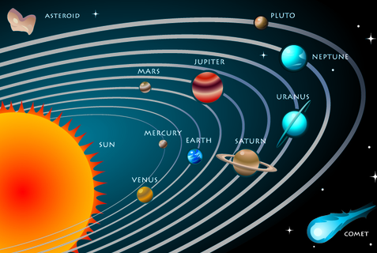

Slide 7
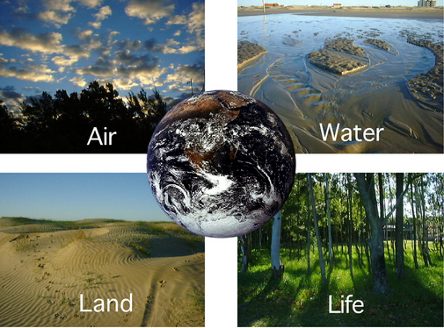

Slide 8
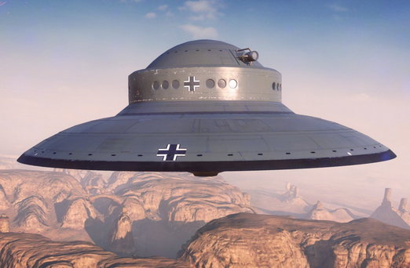
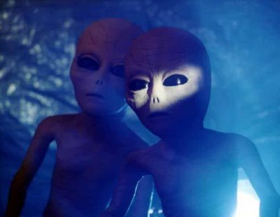
Solar system
Solar system
Earth
Unidentified Flying Object (UFO)
Aliens

Slide 9
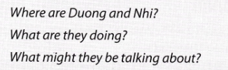
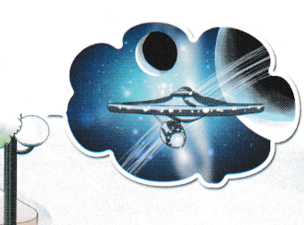
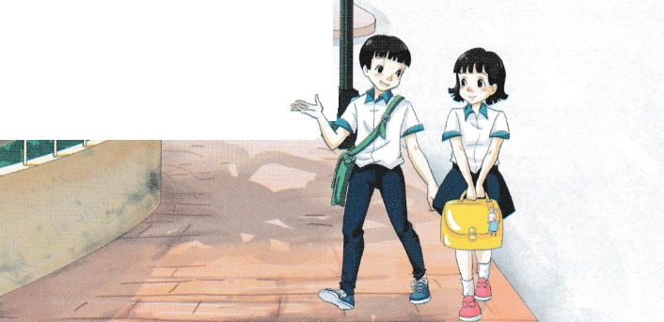
All Call
Student Demo

Slide 10
I. Vocabulary
1.
trek
(n)
: hành trình
2.
‘captain
(n)
: thuyền trưởng
3.
crew
(n)
: thủy thủ đoàn
4.
‘terrorist
(n)
: kẻ khủng bố
5.
‘alien
(n)
: người ngoài hành tinh
6.
space ‘buggy
(n)
: xe vũ trụ
7.
‘galaxy
(n)
: dải ngân hà
8.
‘solar system
(n)
: hệ mặt trời

Slide 11
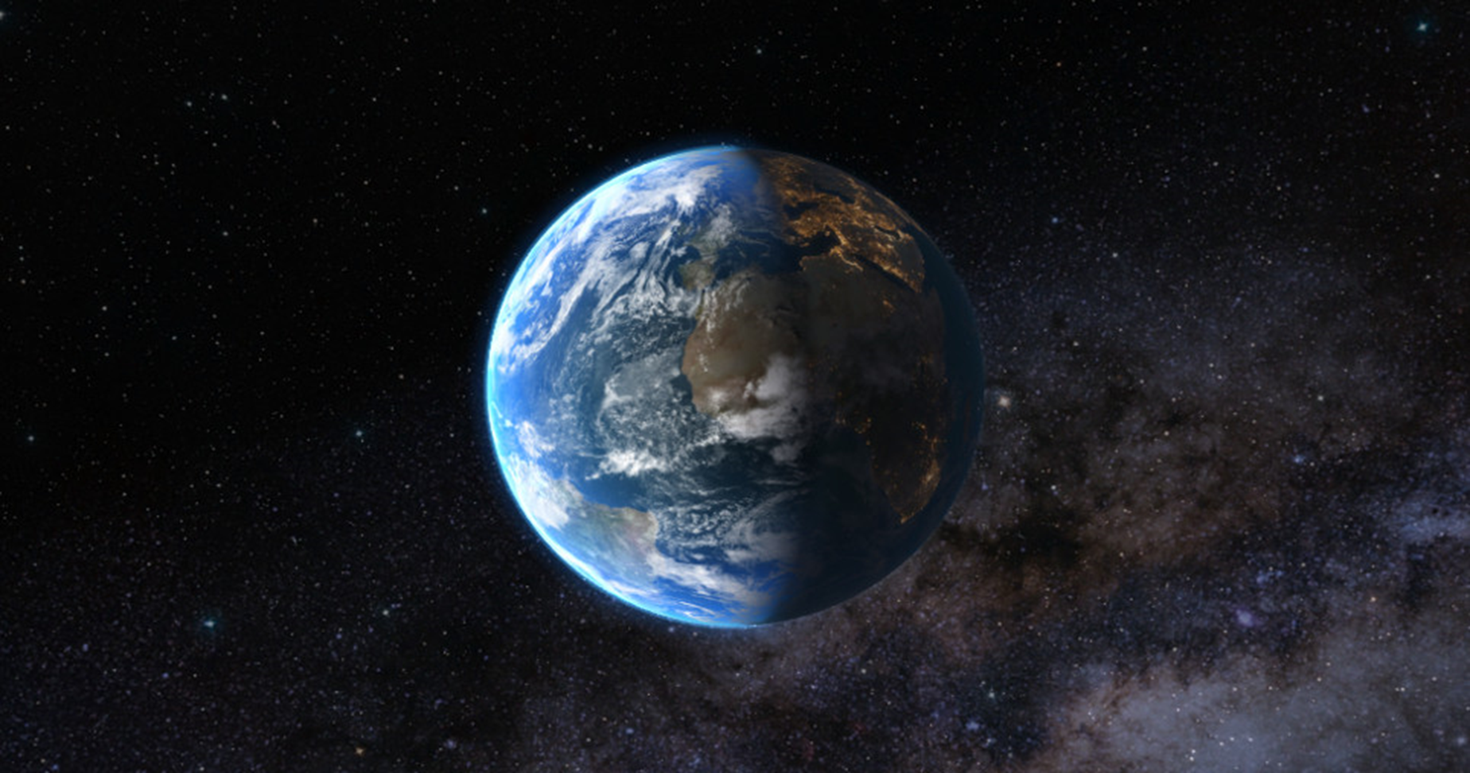

II. LISTEN AND READ

Slide 12

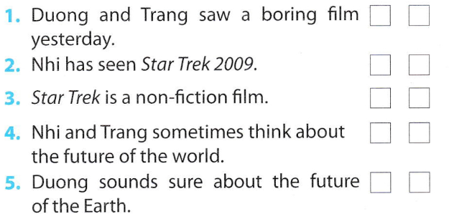

✓
✓
✓
✓
✓
All Call
Student Demo

Slide 13

II. LISTEN AND READ

Slide 14


James Kirk is the captain of the spaceship.
They went to Nibiru planet.
It happens in 2259.
It’s the name of the spaceship that the crew travels on.
He wants to destroy Earth.
All Call
Student Demo

Slide 15
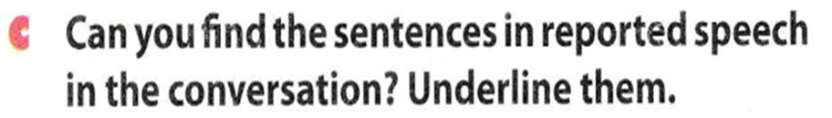
II. LISTEN AND READ

Slide 16

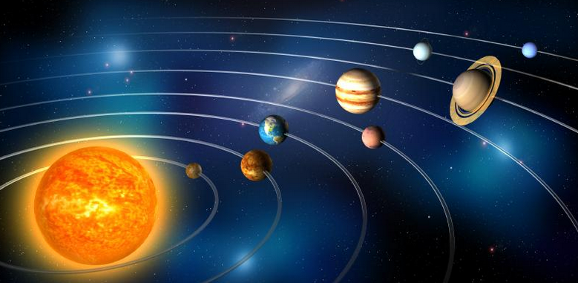
That’s funny, Trang also asked me what I thought would happen to Earth in the future.
I said I didn’t know but that Earth might be run by aliens!
All Call
Student Demo

Slide 17

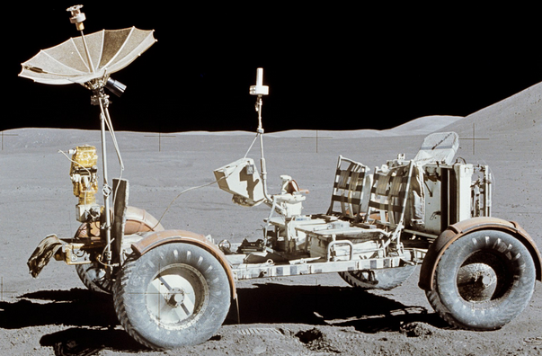


aliens space buggy galaxy planet
weight less solar system spaceship UFO
1.
Aliens
2.
Space buggy
All Call
ABProgram + StartA + AV1
Student Demo

Slide 18
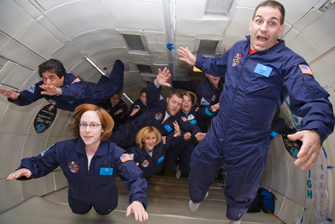
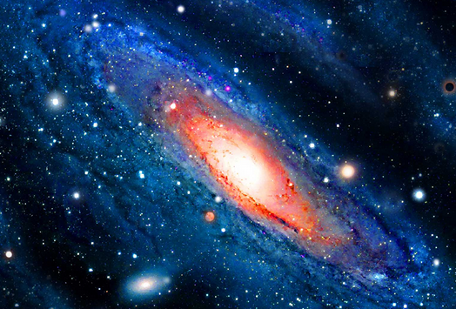
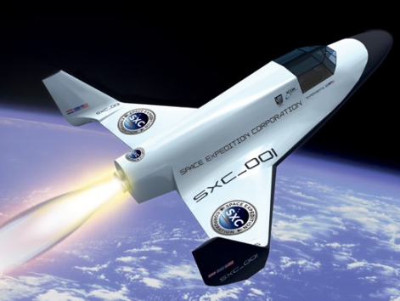
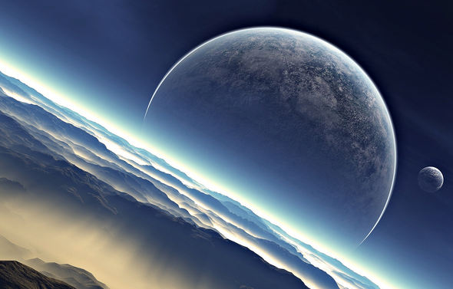

3.
UFO
4.
Weightless
5.
Galaxy
6.
Spaceship
7.
Planet
Solar system
8.
All Call
ABProgram + StartA + AV1
Student Demo

Slide 19
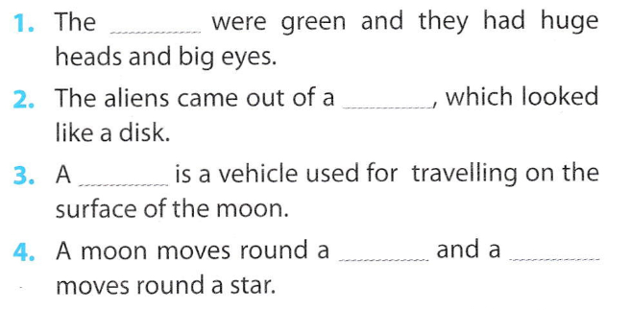
aliens space buggy galaxy planet
weight less solar system spaceship UFO
aliens
UFO
space buggy
planet planet
All Call
Student Demo

Slide 20
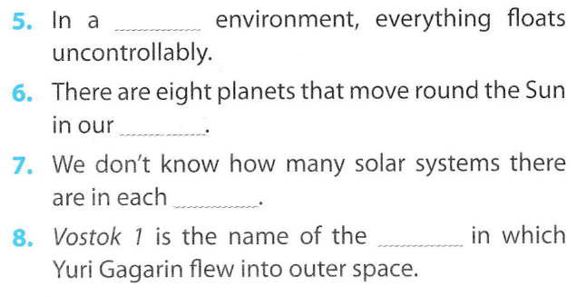
weightless
solar system
galaxy
spaceship
All Call
Student Demo

Slide 21
Homework
Learn by heart the new words.
Do wb U12 B1
Prepare for the next..

Slide 22


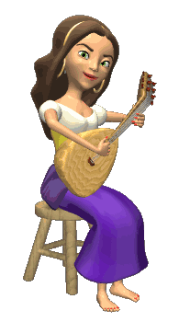

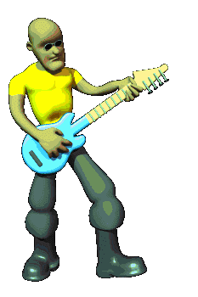
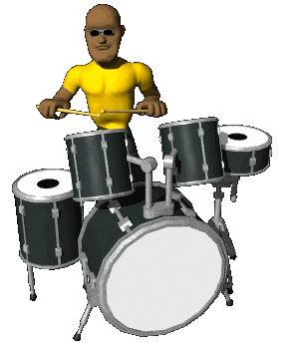

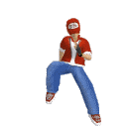



THANK YOU FOR ATTENTION!
GOOD BYE!
the end

Slide 23
LIFE ON OTHER PLANETS
- Can you tell me name of this planet where we are living?
How many planets in the solar system?
What planet in the solar system similar our Earth?

Slide 24


Slide 25
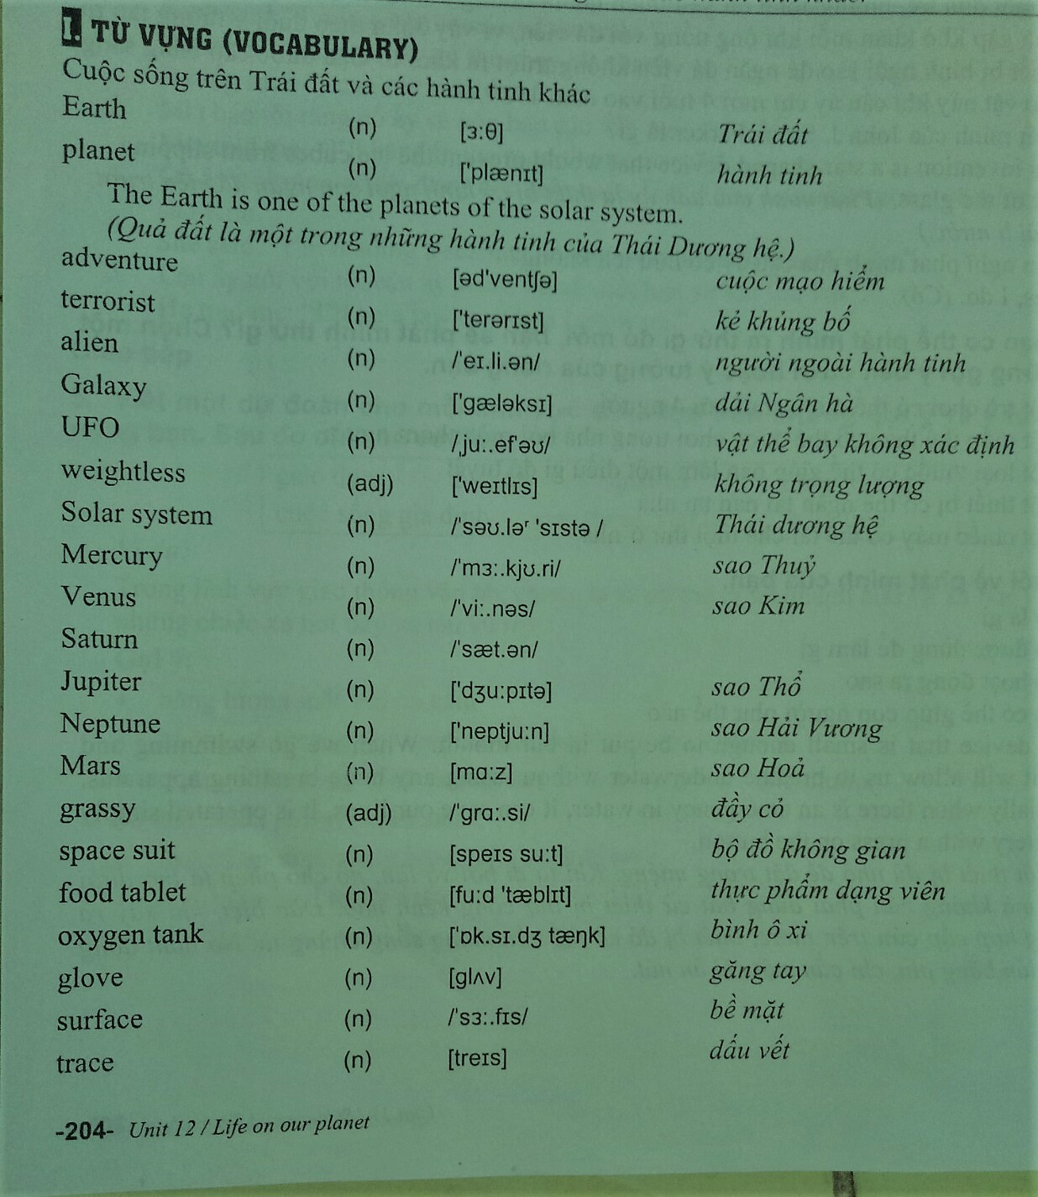

Slide 27
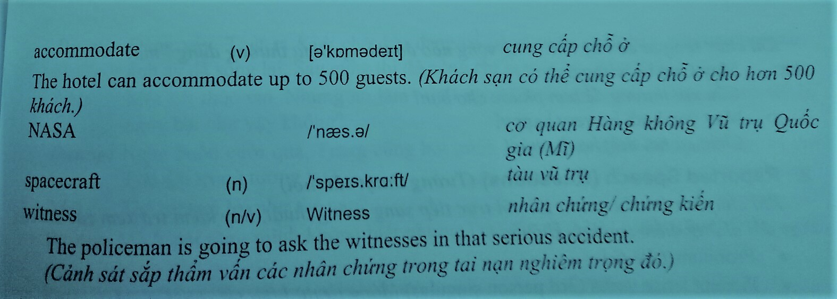

Slide 28

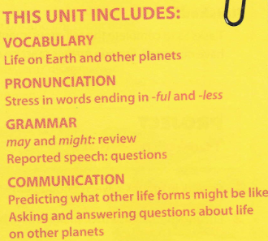
All Call
ABProgram + StartA + AV1
Student Demo

