Slide 1
UNIT 6:
LIFESTYLES
Lesson 3: A closer look 2

Slide 2
OBJECTIVES
By the end of this lesson, Students will be able to:
Knowledge
Competences
Personal qualities
use the future simple and first conditional
Develop communication skills, teamwork skills and creativity
Love and respect the lifestyles of Viet Nam and other countries around the world

Slide 3

6
Unjumble the sentences
Work in teams of 5-6
Unjumble the words to make meaningful sentences.
The fastest group will game 5 points for each correct sentence.

Slide 4
2. Arrange these words and phrases in the correct order to form meaningful sentences.
﻿1. We / first-term exams / our / will take / very soon /.
﻿→ We will take our first-term exams very soon.
2. Alaska / they / in an igloo / stay / when / visit / Will they / ?
→ ﻿Will they stay in an igloo when they visit Alaska?
3. She / the tribal groups / to help them / will work with / revive their culture /.
→ ﻿She will work with the tribal groups to help them revive their culture.

Slide 5
2. Arrange these words and phrases in the correct order to form meaningful sentences.
﻿4. online learning / in / I won’t choose / the second semester /.
→ ﻿I won't choose online learning in the second semester.
5. I’ll come / to / I go / to London / if / this summer / see you / .
→ ﻿I’ll come to see you if I go to London this summer.
future possibilities
conditions
Which tense is used in these sentences?
THE FUTURE
SIMPLE TENSE
What are these sentences describing?
future possibilities / conditions
Notes:
Point out the use of FST

Slide 6
1
Future simple
You can enter a subtitle here if you need it

Slide 7
THE FUTURE SIMPLE
We use the future simple to describe future possibilities or conditions.
+
S + will + V-inf + …
⎯
S + won’t + V-inf + …
?
Will + S + V-inf + …?

Slide 8
THE FUTURE SIMPLE
We use the future simple to describe future possibilities or conditions.
+
I will be a Tiktoker one day.
⎯
This video won’t go viral.
?
Will she be famous one day?

Slide 9
1. Use the verbs from the box with will or won’t to complete these dialogues.
﻿take have tell join attend do
﻿1. Alice: Are you taking exams next week, Phong?
Phong: I’m not sure. The teacher _________ us tomorrow.
2. Linh: Where are you going on the holiday, Chris?
Chris: We’re planning to visit Ta Ho Village. We ___________ the local
festival, but we ___________ the tribal dance as it is late in the evening.
3. Dad: Are you having online lessons tomorrow?
Daughter: No. We ____________ lessons, but we ________
experiments in the lab.
will tell
will attend
won’t join
won’t have
will do

Slide 10
2. Arrange these words and phrases in the correct order to form meaningful sentences.
﻿1. We / first-term exams / our / will take / very soon /.
﻿→ We will take our first-term exams very soon.
2. Alaska / they / in an igloo / stay / when / visit / Will they / ?
→ ﻿Will they stay in an igloo when they visit Alaska?
3. She / the tribal groups / to help them / will work with / revive their culture /.
→ ﻿She will work with the tribal groups to help them revive their culture.

Slide 11
2. Arrange these words and phrases in the correct order to form meaningful sentences.
﻿4. online learning / in / I won’t choose / the second semester /.
→ ﻿I won't choose online learning in the second semester.
5. I’ll come / to / I go / to London / if / this summer / see you / .
→ ﻿I’ll come to see you if I go to London this summer.
Which conditional sentence type is the 5th sentence?
We use first conditional to talk about things which are possible in the present or the future.
First conditional.
Notes:
Point out the use of FST

Slide 12
02
Conditional sentences
Unless / if … not / except if

Slide 13
FIRST CONDITIONAL
﻿- We use first conditional to talk about things which are possible in the present or the future.
If + Present simple, Future simple
﻿We can also use unless in conditional sentences.
Unless means “if … not” or “except if …”.
Example:
You will fail the test If you don’t study harder.
= You will fail the test unless you study harder.

Slide 14
3. Give the correct tense of the verbs in brackets, using the first conditional.
﻿1. If you (eat) ______ an apple every day, you will stay healthy.
2. Will Dan wear a kilt if he (go) ______ to Scotland?
3. He (have) _________ sore eyes if he spends too much time on the computer.
4. If you (not do) _________ anything bad, you won’t get into trouble.
5. ______ she (be) ______ able to eat the soup if I put some chillies in it?
eat
goes
will have
don’t do
Will
be

Slide 15
4. Fill in each blank with IF or UNLESS.
Unless
﻿1. _______ we eat lunch now, we won’t arrive at the cinema on time.
2. The teacher will be furious _____ you don’t do the homework.
3. I won’t eat kimchi when I go to Korea ________ I have to.
4. _____ you turn on the light, you will be able to see better.
5. You won’t be able to find the house ________ you use your GPS. There’s no one around.
if
unless
If
unless

Slide 16
5. Complete the following sentences to make them true for you. Then share your answers with a partner.
﻿1. If it rains tomorrow, ______.
2. Unless I get good marks, ______.
3. If I have free time this weekend, ______.
4. If I study harder, ______.
5. Unless I go to bed early, ______.
I will stay home.
I will stay home.
I will go picnicking with my friends
I can get a 9.0 IELTs score.
I will be late tomorrow.

Slide 17


GAME TIME
Fortune cookies
The fortune cookies will tell you your fortune next week.
Open the fortune cookies and complete the hidden messages using the future simple tense.
The fastest group will gain 10 points for each correct message.

Slide 18

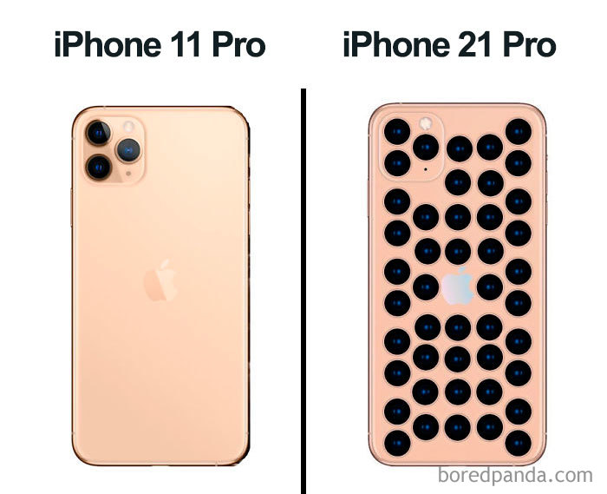


Complete the hidden messages using the future simple tense.
Monday
Tuesday
Wednesday
Thursday
Your teacher/ give/ an IPhone 21.
You/ ride/ a camel/ school.
If Linh ____ (go) out today, she ____ (meet) her future boyfriend.
Your teacher will give you an IPhone 21.
You will ride a camel to school.
You/ win/ lottery/ receive/ 2 billion dollars.
If Linh goes out today, she will meet her future boyfriend.
You will win the lottery and receive 2 billion dollars.

Slide 19

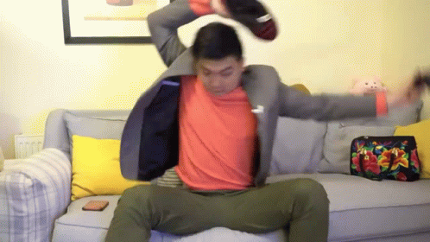
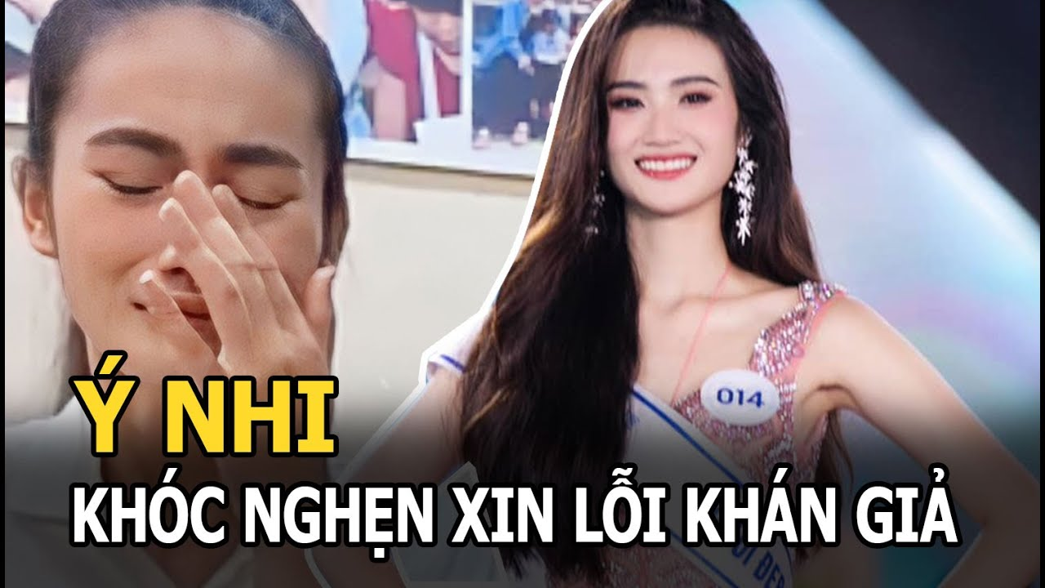
Complete the hidden messages using the future simple tense.
Friday
Saturday
Sunday
If you ____ (stop/eat) junk food, you ____ (be) the next Miss Grand.
Use Tik Tok for more than 180 minutes and you will be emotional damaged.
➔If_________________
Be humble or you will become the next Y Nhi.
➔Unless_______________
If you stop eating junk food, you will be the next Miss Grand.
➔ Unless you are humble, you will become the next Y Nhi.
➔If you use Tik Tok for more than 180 minutes, you will be emotional damaged.

Slide 20
3
Let’s warp up!
What have we learnt today?

Slide 21
We use future simple to describe….
FUTURE SIMPLE
FUTURE POSSIBILITIES
CONDITIONS

Slide 22
CONDITIONAL SENTENCES
UNLESS means
IF … NOT
EXCEPT IF…

Slide 23
HOMEWORK
Workbook: Unit 6 - Part B

Slide 24
Thanks for listening!

