Slide 1


Warm up
Charade
01
One student comes to the board, look at the teacher’s picture.
02
This student mimes (acts out) the festival in the picture to the whole class.
03
The other students try to guess the name of the festival.
If the student correctly guesses the festival, he/she earns a bonus point.

Slide 2
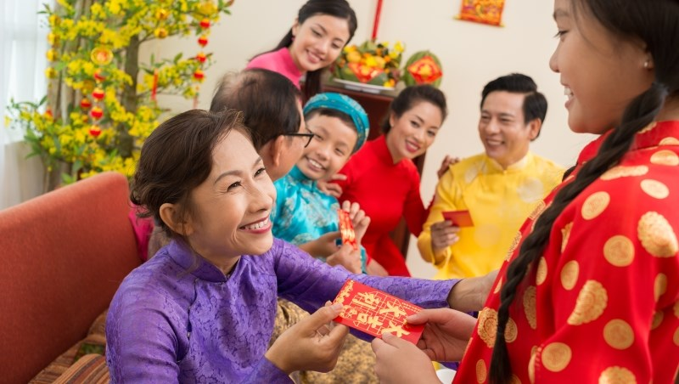
Tet Holiday

Slide 3
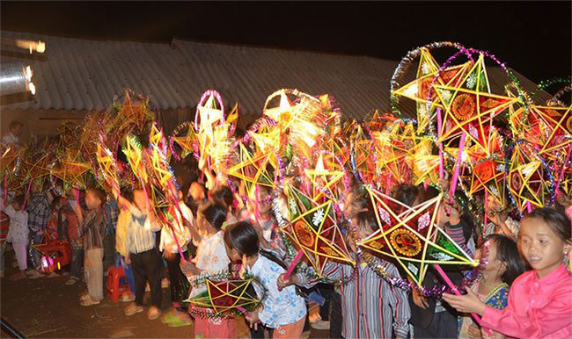
Mid-autumn festival

Slide 4
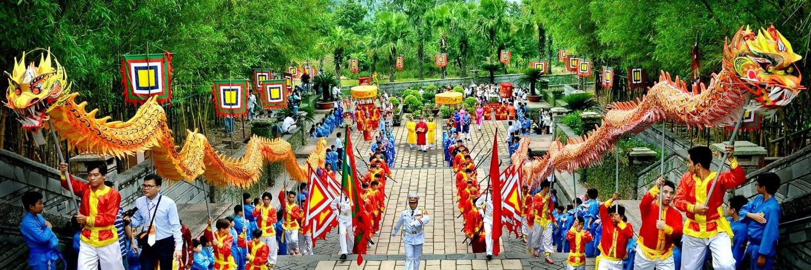
Hung King temple festival

Slide 5
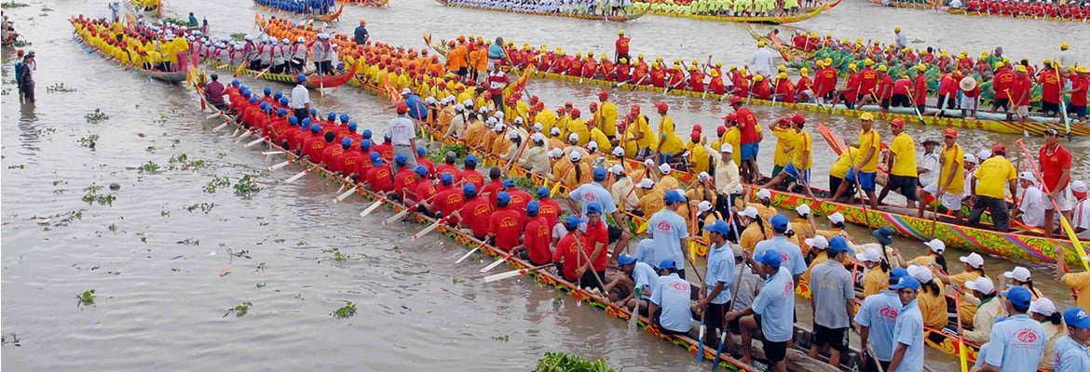
Om Ok Bok festival

Slide 6




Unit 5
Our customs and traditions
Lesson 6: Skills 2
(page 56,57)

Slide 7



After this lesson, Ss will be able to:
Listening
Writing
Listen for specific information about
a festival
Write an email to give advice on taking part in a festival

Slide 8


Listening

Slide 9


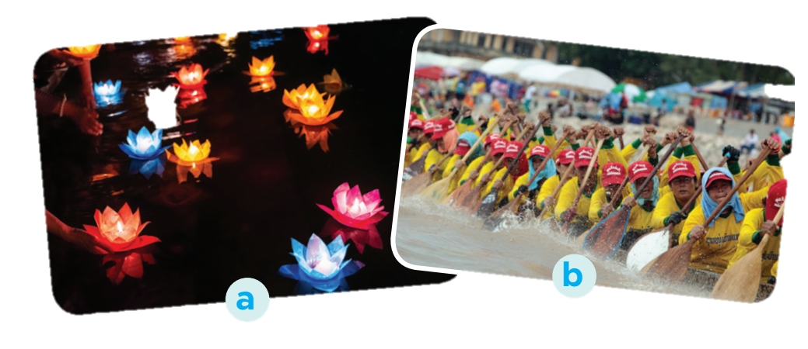
  Om Ok Bok festival
1. What can you see in the photos?
2. In which part of Viet Nam might the festival occur?

Slide 10

Listen to part of the programme “Charming Viet Nam”.
Fill in each blank with no more than TWO words.
Listening
Ok Om Bok Festival
Purposes | - to thank the Moon God - to mark the (1) ______ of the Khmer year
Time | mid-October (lunar calendar)
Offerings | (2) ___________ and fruits
Activities | - singing and dancing - games and traditional (3) ______________ - Ngo Boat (4) ______

Slide 11
Check your answers.
Listening
Ok Om Bok Festival
Purposes | - to thank the Moon God - to mark the (1) ______ of the Khmer year
Time | mid-October (lunar calendar)
Offerings | (2) ___________ and fruits
Activities | - singing and dancing - games and traditional (3) ______________ - Ngo Boat (4) ______
Traditionally, the Khmers use the festival to thank the Moon God for giving them a good harvest. It also marks the end of the year of the Khmer calendar
end
Notes:
Listening tapescript:
... Let's go to the Mekong Delta and join the Ok Om Bok Festival of the Khmer people. It is also called the Moon Worshipping Festival. Traditionally, the Khmers use the festival to thank the Moon God for giving them a good harvest. It also marks the end of the year of the Khmer calendar. Ok Om Bok occurs in mid-October according to the lunar calendar. When the moon is at its highest position, the monks and the elders offer young rice and fruits to the Moon God. Then, they take some young rice to feed children and ask them about their wishes. People sing and dance in the moonlight. Visitors can participate in games, watch traditional fashion shows and see flying lantern contests. The next day, villagers organise the Ngo Boat Race. This is a boat race that attracts many tourists. Here is some advice to tourists at the Ok Om Bok Festival. They should not wear shorts or sleeveless shirts when attending the religious ceremony. And don't litter the temple grounds. And now, let's ... [voice faded]

Slide 12
Check your answers.
Listening
Ok Om Bok Festival
Purposes | - to thank the Moon God - to mark the (1) ______ of the Khmer year
Time | mid-October (lunar calendar)
Offerings | (2) ___________ and fruits
Activities | - singing and dancing - games and traditional (3) ______________ - Ngo Boat (4) ______
end
When the moon is at its highest position, the monks and the elders offer young rice and fruits to the Moon God.
young rice
Notes:
Listening tapescript:
... Let's go to the Mekong Delta and join the Ok Om Bok Festival of the Khmer people. It is also called the Moon Worshipping Festival. Traditionally, the Khmers use the festival to thank the Moon God for giving them a good harvest. It also marks the end of the year of the Khmer calendar. Ok Om Bok occurs in mid-October according to the lunar calendar. When the moon is at its highest position, the monks and the elders offer young rice and fruits to the Moon God. Then, they take some young rice to feed children and ask them about their wishes. People sing and dance in the moonlight. Visitors can participate in games, watch traditional fashion shows and see flying lantern contests. The next day, villagers organise the Ngo Boat Race. This is a boat race that attracts many tourists. Here is some advice to tourists at the Ok Om Bok Festival. They should not wear shorts or sleeveless shirts when attending the religious ceremony. And don't litter the temple grounds. And now, let's ... [voice faded]

Slide 13
Check your answers.
Listening
Ok Om Bok Festival
Purposes | - to thank the Moon God - to mark the (1) ______ of the Khmer year
Time | mid-October (lunar calendar)
Offerings | (2) ___________ and fruits
Activities | - singing and dancing - games and traditional (3) ______________ - Ngo Boat (4) ______
end
People sing and dance in the moonlight. Visitors can participate in games, watch traditional fashion shows and see flying lantern contests.
young rice
fashion shows
Notes:
Listening tapescript:
... Let's go to the Mekong Delta and join the Ok Om Bok Festival of the Khmer people. It is also called the Moon Worshipping Festival. Traditionally, the Khmers use the festival to thank the Moon God for giving them a good harvest. It also marks the end of the year of the Khmer calendar. Ok Om Bok occurs in mid-October according to the lunar calendar. When the moon is at its highest position, the monks and the elders offer young rice and fruits to the Moon God. Then, they take some young rice to feed children and ask them about their wishes. People sing and dance in the moonlight. Visitors can participate in games, watch traditional fashion shows and see flying lantern contests. The next day, villagers organise the Ngo Boat Race. This is a boat race that attracts many tourists. Here is some advice to tourists at the Ok Om Bok Festival. They should not wear shorts or sleeveless shirts when attending the religious ceremony. And don't litter the temple grounds. And now, let's ... [voice faded]

Slide 14
Check your answers.
Listening
Ok Om Bok Festival
Purposes | - to thank the Moon God - to mark the (1) ______ of the Khmer year
Time | mid-October (lunar calendar)
Offerings | (2) ___________ and fruits
Activities | - singing and dancing - games and traditional (3) ______________ - Ngo Boat (4) ______
end
young rice
The next day, villagers organise the Ngo Boat Race. This is a boat race that attracts many tourists.
fashion shows
Race
Notes:
Listening tapescript:
... Let's go to the Mekong Delta and join the Ok Om Bok Festival of the Khmer people. It is also called the Moon Worshipping Festival. Traditionally, the Khmers use the festival to thank the Moon God for giving them a good harvest. It also marks the end of the year of the Khmer calendar. Ok Om Bok occurs in mid-October according to the lunar calendar. When the moon is at its highest position, the monks and the elders offer young rice and fruits to the Moon God. Then, they take some young rice to feed children and ask them about their wishes. People sing and dance in the moonlight. Visitors can participate in games, watch traditional fashion shows and see flying lantern contests. The next day, villagers organise the Ngo Boat Race. This is a boat race that attracts many tourists. Here is some advice to tourists at the Ok Om Bok Festival. They should not wear shorts or sleeveless shirts when attending the religious ceremony. And don't litter the temple grounds. And now, let's ... [voice faded]

Slide 15
Let’s check your memory
 | T | F
1. Ok Om Bok is the Moon Worshipping Festival.
2. On the night of the festival, the elders talk about their wishes.
3. There are lantern contests at the festival.
4. Tourists should wear informal clothes when attending the worshipping ceremony.

Slide 16
Listen again and check your answers
 | T | F
1. Ok Om Bok is the Moon Worshipping Festival.
2. On the night of the festival, the elders talk about their wishes.
3. There are lantern contests at the festival.
4. Tourists should wear informal clothes when attending the worshipping ceremony.

Slide 17

Listen again and check your answers
 | T | F
1. Ok Om Bok is the Moon Worshipping Festival.
2. On the night of the festival, the elders talk about their wishes.
3. There are lantern contests at the festival.
4. Tourists should wear informal clothes when attending the worshipping ceremony.
Let's go to the Mekong Delta and join the Ok Om Bok Festival of the Khmer people. It is also called the Moon Worshipping Festival.
Notes:
Listening tapescript:
... Let's go to the Mekong Delta and join the Ok Om Bok Festival of the Khmer people. It is also called the Moon Worshipping Festival. Traditionally, the Khmers use the festival to thank the Moon God for giving them a good harvest. It also marks the end of the year of the Khmer calendar. Ok Om Bok occurs in mid-October according to the lunar calendar. When the moon is at its highest position, the monks and the elders offer young rice and fruits to the Moon God. Then, they take some young rice to feed children and ask them about their wishes. People sing and dance in the moonlight. Visitors can participate in games, watch traditional fashion shows and see flying lantern contests. The next day, villagers organise the Ngo Boat Race. This is a boat race that attracts many tourists. Here is some advice to tourists at the Ok Om Bok Festival. They should not wear shorts or sleeveless shirts when attending the religious ceremony. And don't litter the temple grounds. And now, let's ... [voice faded]

Slide 18
Listen again and check your answers
 | T | F
1. Ok Om Bok is the Moon Worshipping Festival.
2. On the night of the festival, the elders talk about their wishes.
3. There are lantern contests at the festival.
4. Tourists should wear informal clothes when attending the worshipping ceremony.
When the moon is at its highest position, the monks and the elders offer young rice and fruits to the Moon God. Then, they take some young rice to feed children and ask them about their wishes.
Notes:
Listening tapescript:
... Let's go to the Mekong Delta and join the Ok Om Bok Festival of the Khmer people. It is also called the Moon Worshipping Festival. Traditionally, the Khmers use the festival to thank the Moon God for giving them a good harvest. It also marks the end of the year of the Khmer calendar. Ok Om Bok occurs in mid-October according to the lunar calendar. When the moon is at its highest position, the monks and the elders offer young rice and fruits to the Moon God. Then, they take some young rice to feed children and ask them about their wishes. People sing and dance in the moonlight. Visitors can participate in games, watch traditional fashion shows and see flying lantern contests. The next day, villagers organise the Ngo Boat Race. This is a boat race that attracts many tourists. Here is some advice to tourists at the Ok Om Bok Festival. They should not wear shorts or sleeveless shirts when attending the religious ceremony. And don't litter the temple grounds. And now, let's ... [voice faded]

Slide 19
Listen again and check your answers
 | T | F
1. Ok Om Bok is the Moon Worshipping Festival.
2. On the night of the festival, the elders talk about their wishes.
3. There are lantern contests at the festival.
4. Tourists should wear informal clothes when attending the worshipping ceremony.
Visitors can participate in games, watch traditional fashion shows and see flying lantern contests.
Notes:
Listening tapescript:
... Let's go to the Mekong Delta and join the Ok Om Bok Festival of the Khmer people. It is also called the Moon Worshipping Festival. Traditionally, the Khmers use the festival to thank the Moon God for giving them a good harvest. It also marks the end of the year of the Khmer calendar. Ok Om Bok occurs in mid-October according to the lunar calendar. When the moon is at its highest position, the monks and the elders offer young rice and fruits to the Moon God. Then, they take some young rice to feed children and ask them about their wishes. People sing and dance in the moonlight. Visitors can participate in games, watch traditional fashion shows and see flying lantern contests. The next day, villagers organise the Ngo Boat Race. This is a boat race that attracts many tourists. Here is some advice to tourists at the Ok Om Bok Festival. They should not wear shorts or sleeveless shirts when attending the religious ceremony. And don't litter the temple grounds. And now, let's ... [voice faded]

Slide 20
Listen again and check your answers
 | T | F
1. Ok Om Bok is the Moon Worshipping Festival.
2. On the night of the festival, the elders talk about their wishes.
3. There are lantern contests at the festival.
4. Tourists should wear informal clothes when attending the worshipping ceremony.
Here is some advice to tourists at the Ok Om Bok Festival. They should not wear shorts or sleeveless shirts when attending the religious ceremony.
Notes:
Listening tapescript:
... Let's go to the Mekong Delta and join the Ok Om Bok Festival of the Khmer people. It is also called the Moon Worshipping Festival. Traditionally, the Khmers use the festival to thank the Moon God for giving them a good harvest. It also marks the end of the year of the Khmer calendar. Ok Om Bok occurs in mid-October according to the lunar calendar. When the moon is at its highest position, the monks and the elders offer young rice and fruits to the Moon God. Then, they take some young rice to feed children and ask them about their wishes. People sing and dance in the moonlight. Visitors can participate in games, watch traditional fashion shows and see flying lantern contests. The next day, villagers organise the Ngo Boat Race. This is a boat race that attracts many tourists. Here is some advice to tourists at the Ok Om Bok Festival. They should not wear shorts or sleeveless shirts when attending the religious ceremony. And don't litter the temple grounds. And now, let's ... [voice faded]

Slide 21

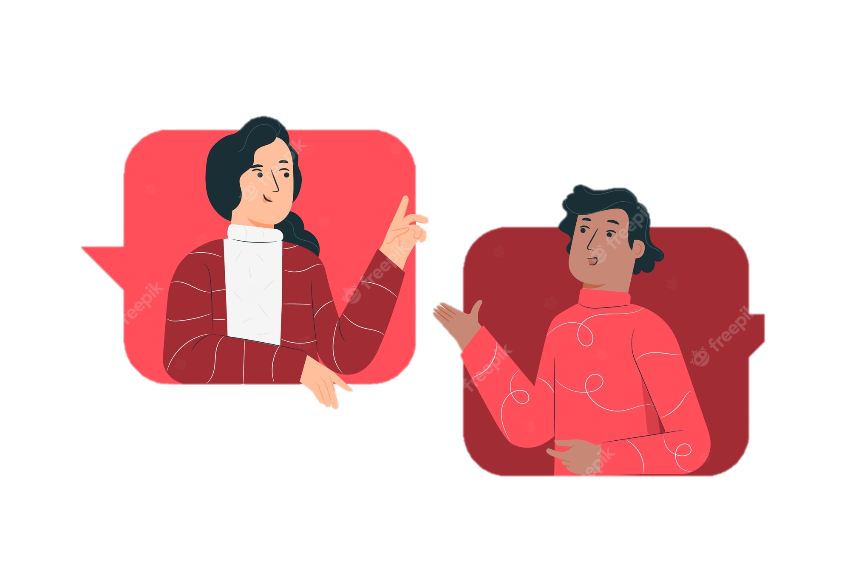
Extra activity
Work in groups of three.
Students listen the recording again,
write 2 TRUE statements and 1
FALSE statement about the listening.
Exchange the sentences with the group in front of/ behind.
Each pair tries to find the true statements and identify the false statements.

Slide 22

Writing

Slide 23

Read the following pieces of advice
for tourists at the Ok Om Bok Festival.
a
dress up for the Moon God offering ceremony
b
keep quiet when the monks and
the elders are talking
c
climb on the animal statues in the temple ground
d
show respect to the monks and the elders
e
refuse young rice when the elders offer it to you
f
litter the temple ground

Slide 24
Work in groups.
Put the ideas in the correct column.
a
dress up for the Moon God offering ceremony
Dos
b
keep quiet when the monks and
the elders are talking
a
b
d
c
climb on the animal statues in the temple ground
d
show respect to the monks and the elders
Don’ts
e
refuse young rice when the elders offer it to you
f
c
e
f
litter the temple ground

Slide 25




Tom sent you an email.
Read part of his email below.
Write an email (80 - 100 words) to advise Tom about participating in the Ok Om Bok Festival.
“… Guess what! My dad is taking me with him to Soc Trang Province. We will be there during the Ok Om Bok Festival. What are some dos and don’ts at this festival? ...”

Slide 26
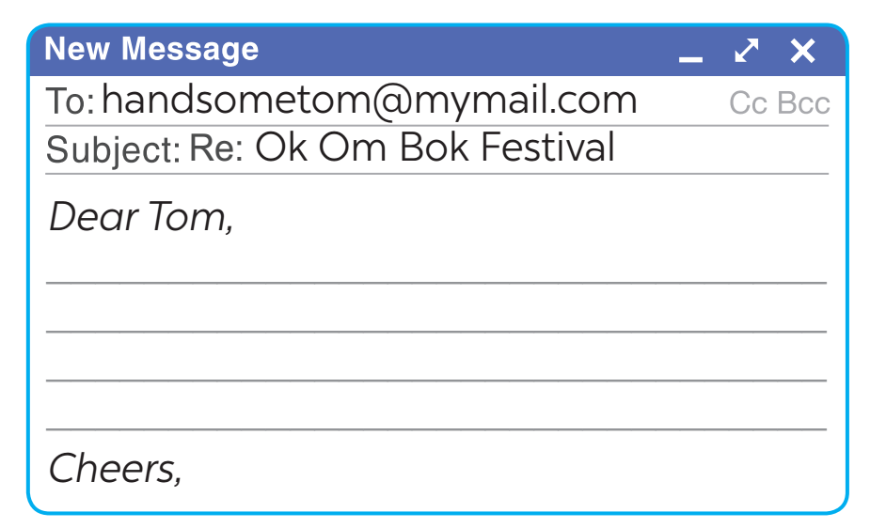

Suggested answer
Dear Tom,
Glad to hear you are coming to Soc Trang. You can't miss the Ok Om Bok Festival. Here are a few things for you to remember when joining the festival.
First, you should wear polite clothes when attending the Moon God offering ceremony. Always show respect to monks and elderly people. Remember to keep quiet when the monks and the elders are talking.
Besides, there are many animal statues in the temple ground. Don't climb on them. The young rice represents the hope for luck in the new year. Don't refuse when the elders give you some.
Send me an email if you need more information.
Warm regards,

Slide 27



Students swap notebooks/ papers to see other’s work and give comments to each other.
(follow the criteria below)
Class galery
Did he/she follow the format of an email?
Did he/she have any grammatical errors?
Did he/she write the vocabulary correctly, including spelling and words in context?
Did he/ she use the punctuations (dấu câu) correctly?

Slide 28


Wrap up
In this lesson, we have learnt to:
1
listen for specific information about Om Ok Bok festival
2
write an email to give advice on taking part in a festival

Slide 29
Thank you very much!

