Slide 1
Guess the phrases
What should we focus on when visiting a friend’s house for dinner?
T
A
B
L
E
M
A
N
N
E
R
S
Can you give me some examples of table manners?

Slide 2
Unit 5
Our customs and traditions
Lesson 4: Communication
(Page 54,55)

Slide 3
After this lesson, students will be able to:
01
02
Everyday English
give advice
Read and talk about
The Japanese lion dance and
Vietnamese unicorn dance

Slide 4
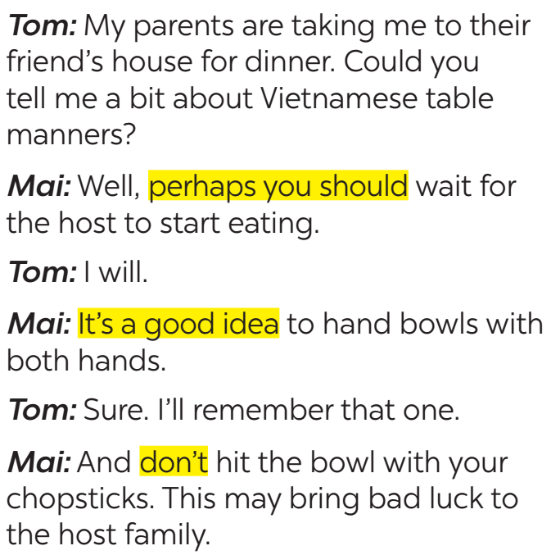



Exercise 1. Listen and read the conversation below. Pay attention to the highlighted parts.
Tom: My parents are taking me to their friend's house for dinner. Could you tell me a bit about Vietnamese table manners?
Mai: Well, perhaps you should wait for the host to start eating.
Tom: I will.
Mai: It's a good idea to hand bowls with both hands.
Tom: Sure. I'll remember that one.
Mai: And don't hit the bowl with your chopsticks. This may bring bad luck to the host family
should
shouldn’t

Slide 5
Should
EXAMPLES
Perhaps you should + V
Perhaps you should wait for the host to start eating.
It’s a good idea + V
It’s a good idea to hand bowls with
both hands.
Should not
Don’t + V
Don’t hit the bowl with your chopsticks

Slide 6
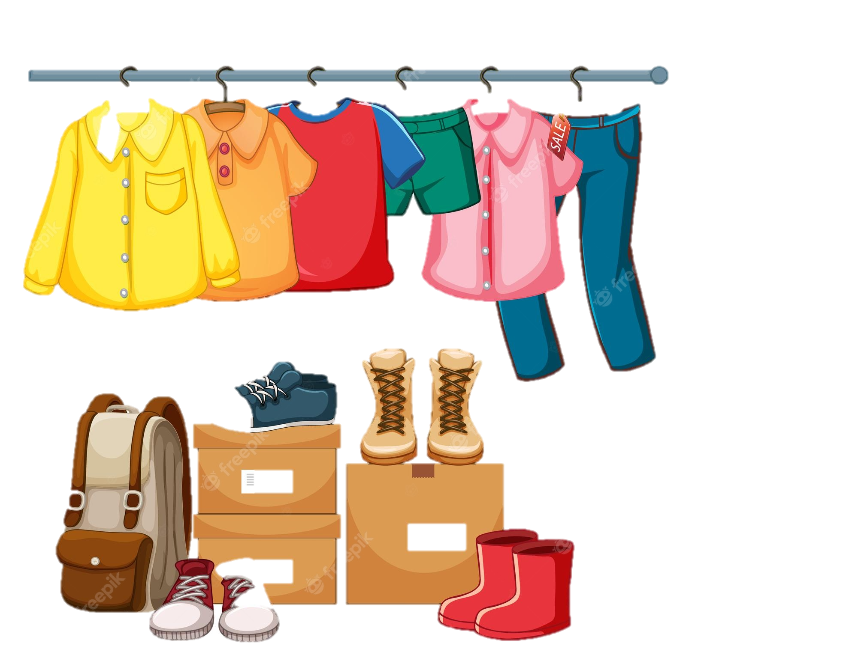
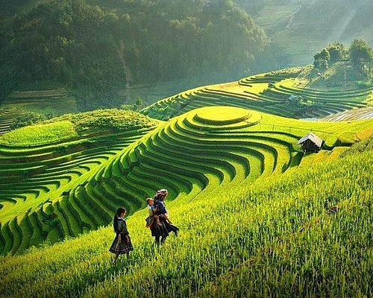
Exercise 2. Work in pairs. Make similar conversations with the following situations.
Student A is travelling to Sa Pa in winter.
He / She doesn’t know what to wear.
Student B gives advice.
1

Slide 7

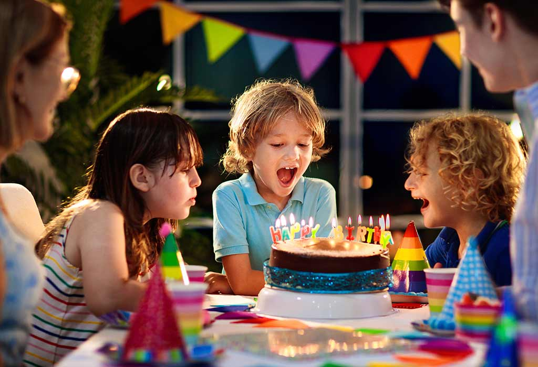
Exercise 2. Work in pairs. Make similar conversations with the following situations.
Student A is going to a birthday party.
He / She doesn’t know what kind of gift to bring. Student B gives advice.
2

Slide 8
Exercise 3. Read the text about the lion dance in Japan and complete the table with the information from the text.
JAPANESE LION DANCE
Japanese name | (1) __________________
Occasions | (2) ________________ - other important occasions
Number of performers | one or more
Skills | (3) ____________
Dance partner | no dance partner
Musical instruments | (4) _______ and drums
Purposes | - to chase away (5) ____________ - to bring good luck
The lion dance is called shishi-mai in Japanese. People perform it during New Year celebrations. Shishi-mai groups also perform at other important occasions such as business openings and weddings.
Most forms of shishi-mai have one or more people performing the dance. The performers are excellent at acrobatics.
One person controls the lion's head and the other moves the lion's body. The lion dances to the sounds of flutes and drums. The drummers and flute players often follow the lion around, but they do not dance with it.
The Japanese perform shishi-mai to chase away bad spirits and to bring good luck.

Slide 9
Exercise 3. Read the text about the lion dance in Japan and complete the table with the information from the text.
JAPANESE LION DANCE
Japanese name | (1) __________________
Occasions | (2) ________________ - other important occasions
Number of performers | one or more
Skills | (3) ____________
Dance partner | no dance partner
Musical instruments | (4) _______ and drums
Purposes | - to chase away (5) ____________ - to bring good luck
The lion dance is called shishi-mai in Japanese. People perform it during New Year celebrations. Shishi-mai groups also perform at other important occasions such as business openings and weddings.
Most forms of shishi-mai have one or more people performing the dance. The performers are excellent at acrobatics.
One person controls the lion's head and the other moves the lion's body. The lion dances to the sounds of flutes and drums. The drummers and flute players often follow the lion around, but they do not dance with it.
The Japanese perform shishi-mai to chase away bad spirits and to bring good luck.
Shishi-mai

Slide 10
Exercise 3. Read the text about the lion dance in Japan and complete the table with the information from the text.
JAPANESE LION DANCE
Japanese name | (1) __________________
Occasions | - (2) ________________ - other important occasions
Number of performers | one or more
Skills | (3) ____________
Dance partner | no dance partner
Musical instruments | (4) _______ and drums
Purposes | - to chase away (5) ____________ - to bring good luck
The lion dance is called shishi-mai in Japanese. People perform it during New Year celebrations. Shishi-mai groups also perform at other important occasions such as business openings and weddings.
Most forms of shishi-mai have one or more people performing the dance. The performers are excellent at acrobatics.
One person controls the lion's head and the other moves the lion's body. The lion dances to the sounds of flutes and drums. The drummers and flute players often follow the lion around, but they do not dance with it.
The Japanese perform shishi-mai to chase away bad spirits and to bring good luck.
Shishi-mai
New Year celebrations

Slide 11
Exercise 3. Read the text about the lion dance in Japan and complete the table with the information from the text.
JAPANESE LION DANCE
Japanese name | (1) __________________
Occasions | - (2) ________________ - other important occasions
Number of performers | one or more
Skills | (3) ____________
Dance partner | no dance partner
Musical instruments | (4) _______ and drums
Purposes | - to chase away (5) ____________ - to bring good luck
The lion dance is called shishi-mai in Japanese. People perform it during New Year celebrations. Shishi-mai groups also perform at other important occasions such as business openings and weddings.
Most forms of shishi-mai have one or more people performing the dance. The performers are excellent at acrobatics.
One person controls the lion's head and the other moves the lion's body. The lion dances to the sounds of flutes and drums. The drummers and flute players often follow the lion around, but they do not dance with it.
The Japanese perform shishi-mai to chase away bad spirits and to bring good luck.
Shishi-mai
New Year celebrations
acrobatics

Slide 12
Exercise 3. Read the text about the lion dance in Japan and complete the table with the information from the text.
JAPANESE LION DANCE
Japanese name | (1) __________________
Occasions | - (2) ________________ - other important occasions
Number of performers | one or more
Skills | (3) ____________
Dance partner | no dance partner
Musical instruments | (4) __________ and drums
Purposes | - to chase away (5) ____________ - to bring good luck
The lion dance is called shishi-mai in Japanese. People perform it during New Year celebrations. Shishi-mai groups also perform at other important occasions such as business openings and weddings.
Most forms of shishi-mai have one or more people performing the dance. The performers are excellent at acrobatics.
One person controls the lion's head and the other moves the lion's body. The lion dances to the sounds of flutes and drums. The drummers and flute players often follow the lion around, but they do not dance with it.
The Japanese perform shishi-mai to chase away bad spirits and to bring good luck.
Shishi-mai
New Year celebrations
acrobatics
flutes

Slide 13
Exercise 3. Read the text about the lion dance in Japan and complete the table with the information from the text.
JAPANESE LION DANCE
Japanese name | (1) __________________
Occasions | - (2) ________________ - other important occasions
Number of performers | one or more
Skills | (3) ____________
Dance partner | no dance partner
Musical instruments | (4) __________ and drums
Purposes | - to chase away (5) ____________ - to bring good luck
The lion dance is called shishi-mai in Japanese. People perform it during New Year celebrations. Shishi-mai groups also perform at other important occasions such as business openings and weddings.
Most forms of shishi-mai have one or more people performing the dance. The performers are excellent at acrobatics.
One person controls the lion's head and the other moves the lion's body. The lion dances to the sounds of flutes and drums. The drummers and flute players often follow the lion around, but they do not dance with it.
The Japanese perform shishi-mai to chase away bad spirits and to bring good luck.
Shishi-mai
New Year celebrations
acrobatics
flutes
bad spirits

Slide 14
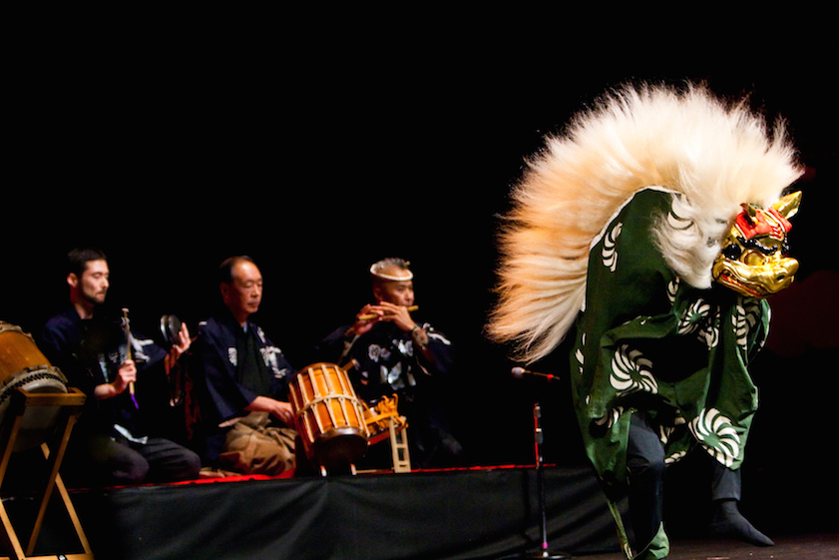
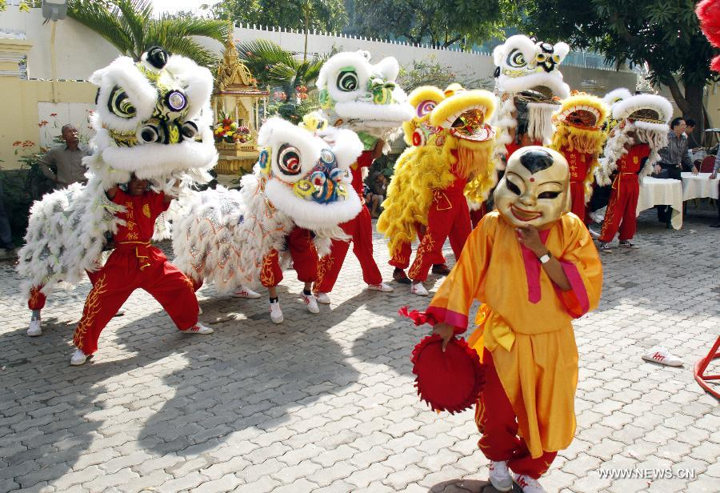
THE JAPANESE LION DANCE & VIETNAMESE UNICORN DANCE
What are the similarities and differences between two pictures?

Slide 15
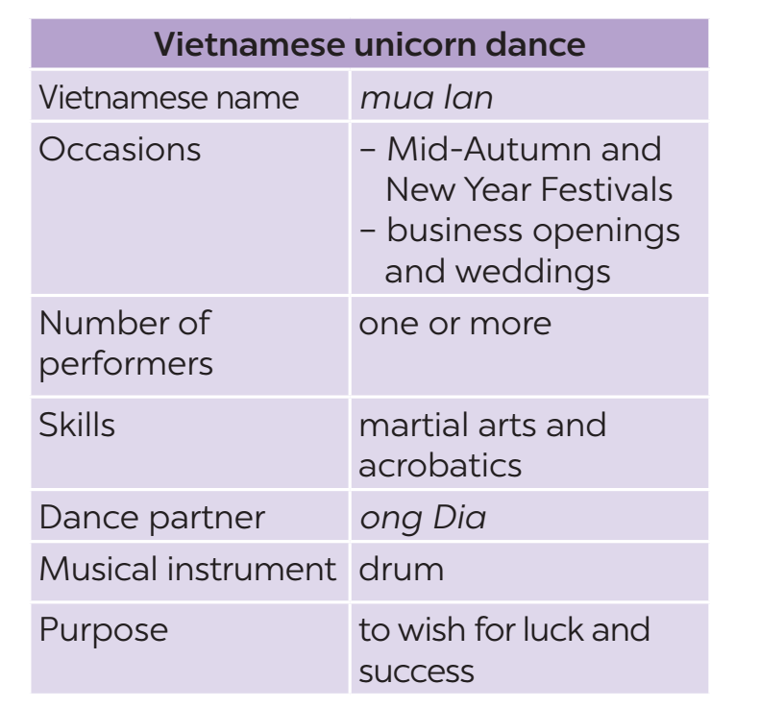
Exercise 4. Work in groups. Read Mai’s notes on the Vietnamese unicorn dance. Compare the Vietnamese unicorn dance with the Japanese lion dance.
JAPANESE LION DANCE
Japanese name | Shishi-mai
Occasions | - New Year celebrations - other important occasions
Number of performers | one or more
Skills | acrobatics
Dance partner | no dance partner
Musical instruments | flutes and drums
Purposes | - to chase away bad spirits - to bring good luck
Example:
The Vietnamese unicorn dance and the Japanese lion dance are both popular on New Year Festivals.

Slide 16
SPEAKING ACTIVITY
Festivals in Vietnam
- Work in groups of 4-5 students
- Think of a Vietnamese festival or holiday that foreigners are unfamiliar with.
- Create a dialogue between a Vietnamese student and a foreign student talking about the festival or holiday.
- In the dialogue, the Vietnamese student offers 2-3 pieces of advice using the highlighted phrases from 1.
Perhaps you should + V
It’s a good idea + V
Don’t + V

Slide 17
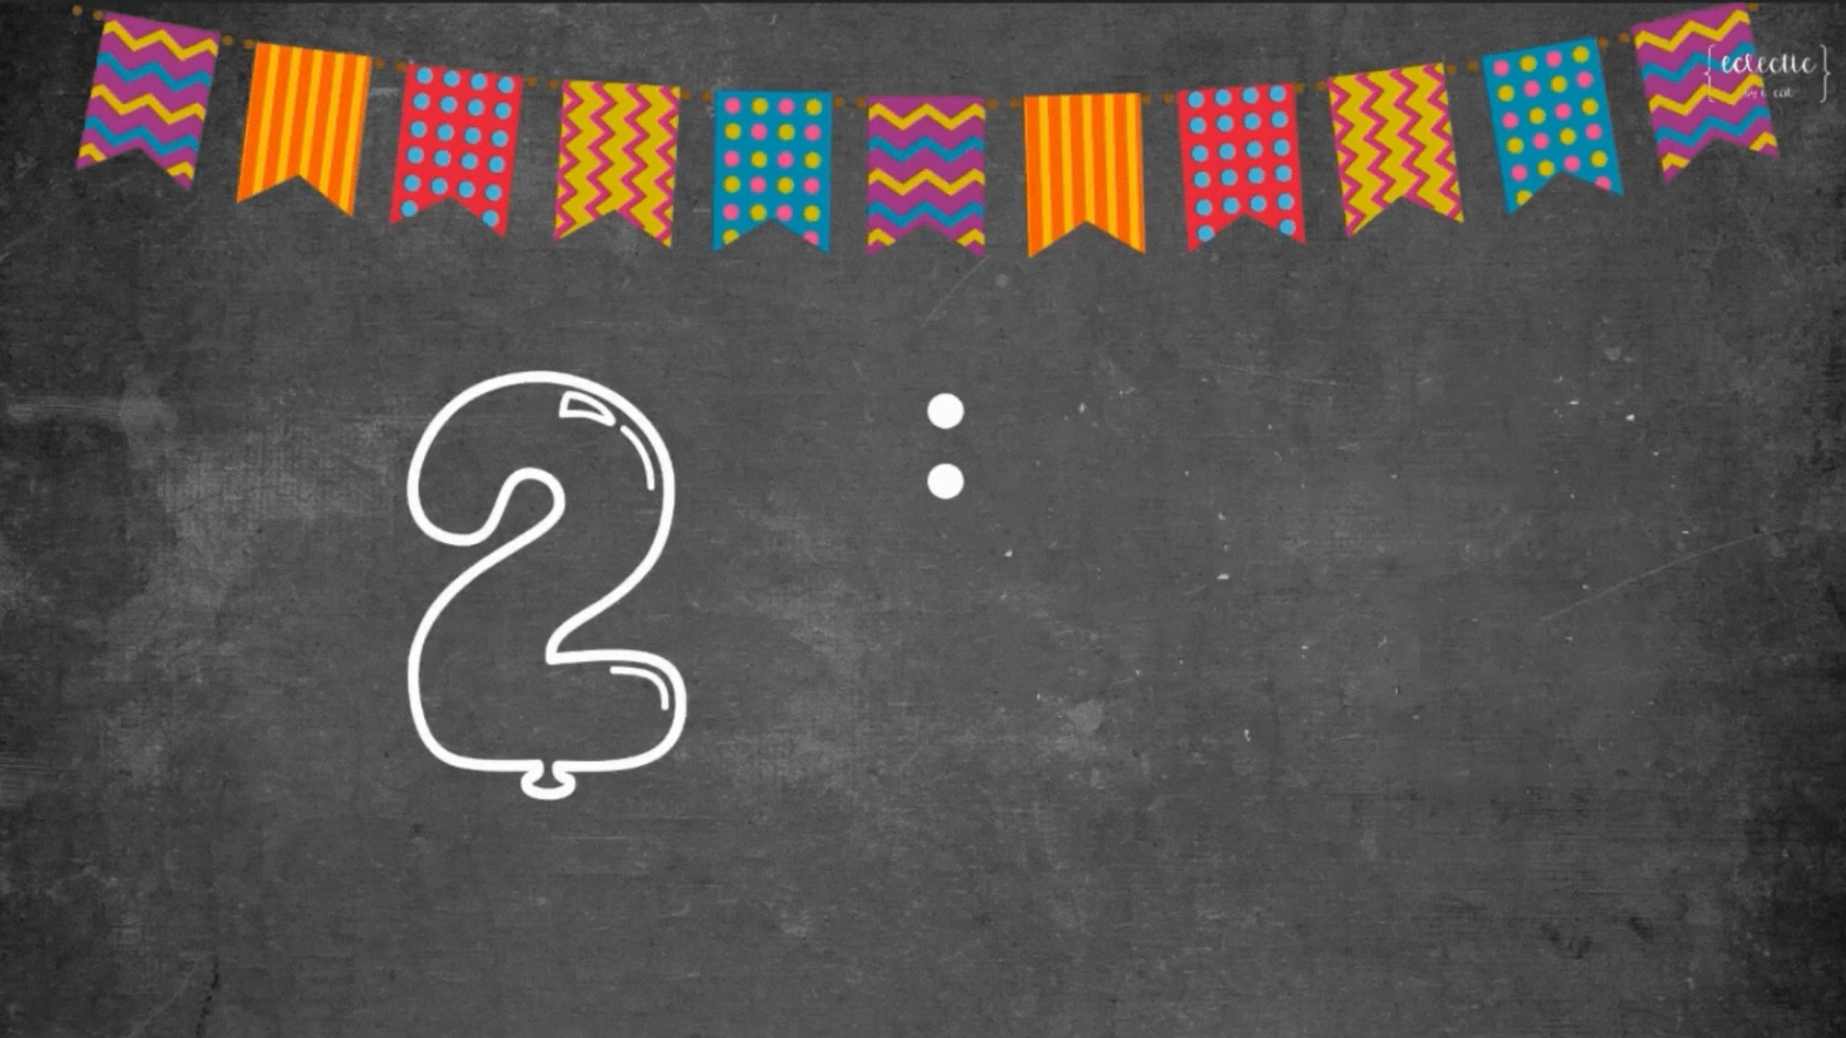
SPEAKING ACTIVITY (2)
Endless Comparisons
- T divides the class into 2-3 groups
.
- In 1 minute, each group tells ONE difference or similarity about Vietnamese unicorn dance with the Japanese lion dance.
- Take turn to give comparison
- Last team to answer loses when time runs out.

Slide 18
Consolidation/ Wrap-up
A
A
It’s good idea to + V
It’s good idea to + V
B
Wow, that’s incredible.
Ways to give advice
C
C
Perhaps you should + V
Perhaps you should + V
D
D
Don’t + V
Don’t + V

Slide 19
Thanks!
Do you have any questions?
youremail@freepik.com
+34 654 321 432
yourwebsite.com
Please keep this slide for attribution

Slide 20
Icon pack

Slide 21
Alternative resources
Here’s an assortment of alternative resources whose style fits the one of this template:
Vectors
Hand drawn monthly planner calendar
Hand drawn four seasons illustration

Slide 22
Resources
Did you like the resources on this template? Get them for free at our other websites:
Vectors
Realistic grainy paper texture
Hand drawn four seasons illustration I
Hand drawn monthly planner calendar I
Hand drawn monthly planner calendar II
Hand drawn monthly planner calendar III
Hand drawn monthly planner calendar IV
Hand drawn four seasons illustration II
Hand drawn four seasons illustration III
Photos
Medium shot kids playing with leaves
Side view kids playing on beach
Woman and girl playing together medium shot
Portrait of volunteer who organized donations for charity
Smiley man holding project documents
Icons
Icon Pack: Weather | Filled

