Slide 1
Warm up
Rearrange the sentences
1. Work in groups
2. Write your answers in a sheet of paper
3. Bring to table to teacher when finishing

Slide 2
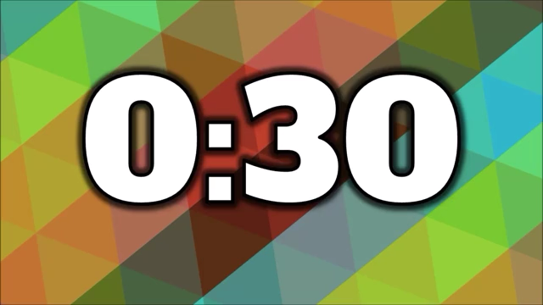
Try as fast as you can! :D
1. engineer/ an/ is/ She /./
2. family/ week/ We/ a/ held/ reunion/ last/./
enjoyable/was/ The/ party/./

Slide 3
Check your answers.
1. She is an engineer.
1. She is an engineer.
2. We held a family reunion last week.
The party was enjoyable.
2. We held a family reunion last week.
The party was enjoyable.
Why do we use articles (a/an/the) in each sentence?
Focus on them.

Slide 4
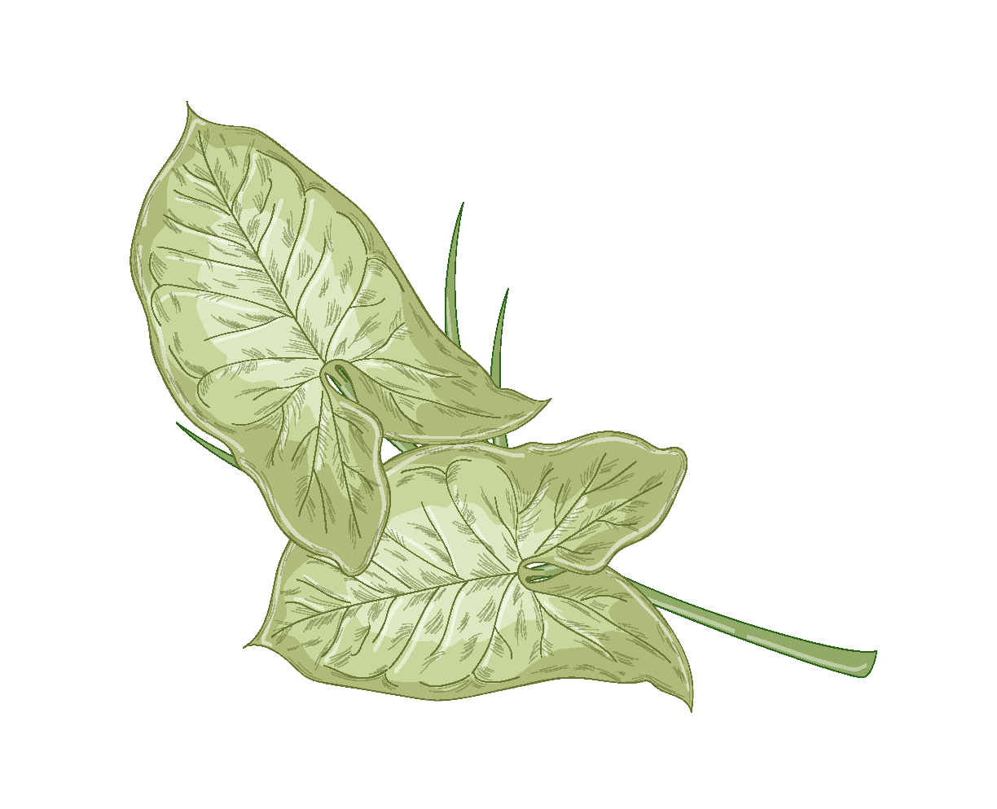
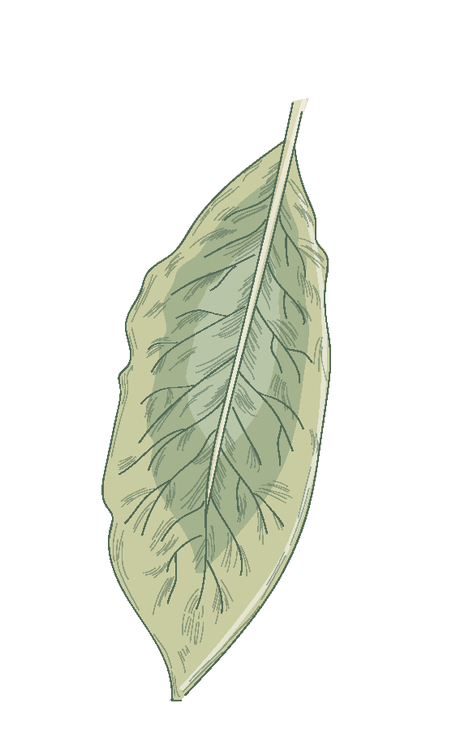
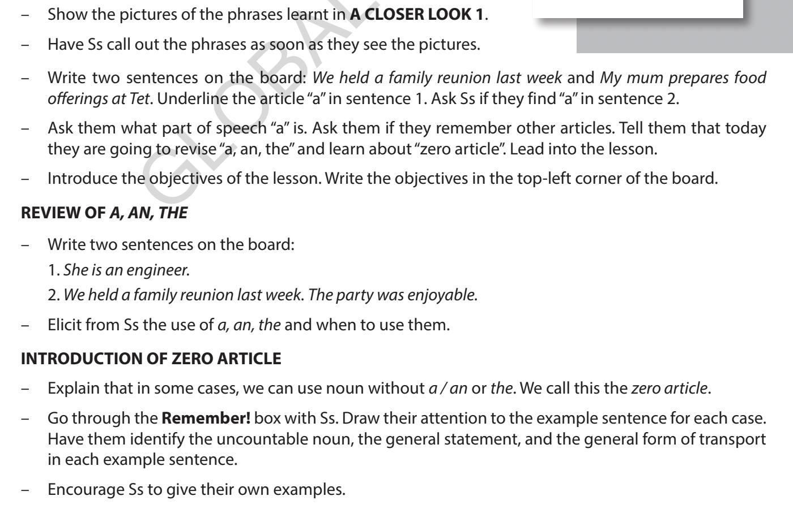
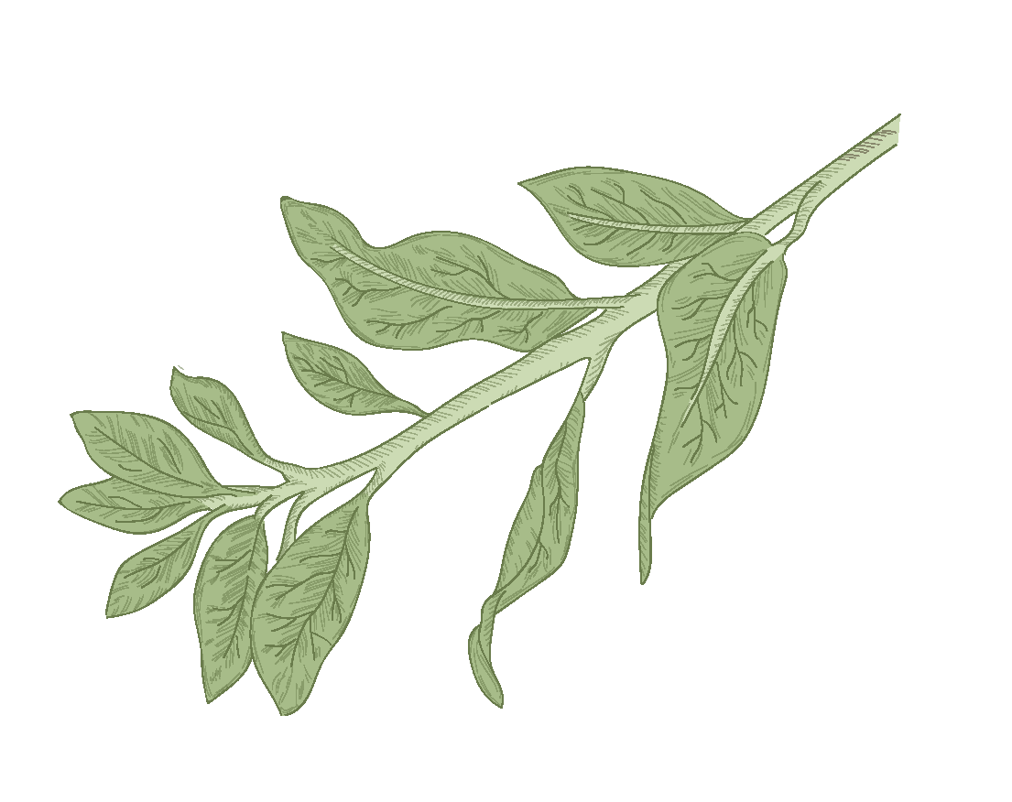
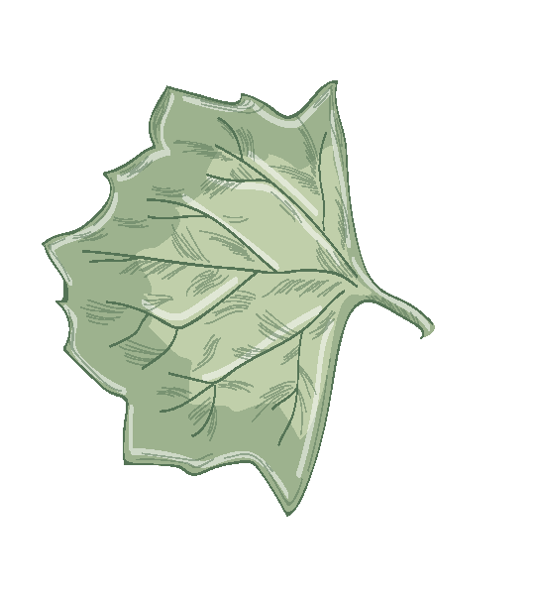
Unit 5
OUR CUSTOMS AND TRADITIONS
Lesson 3: A closer look 2

Slide 5
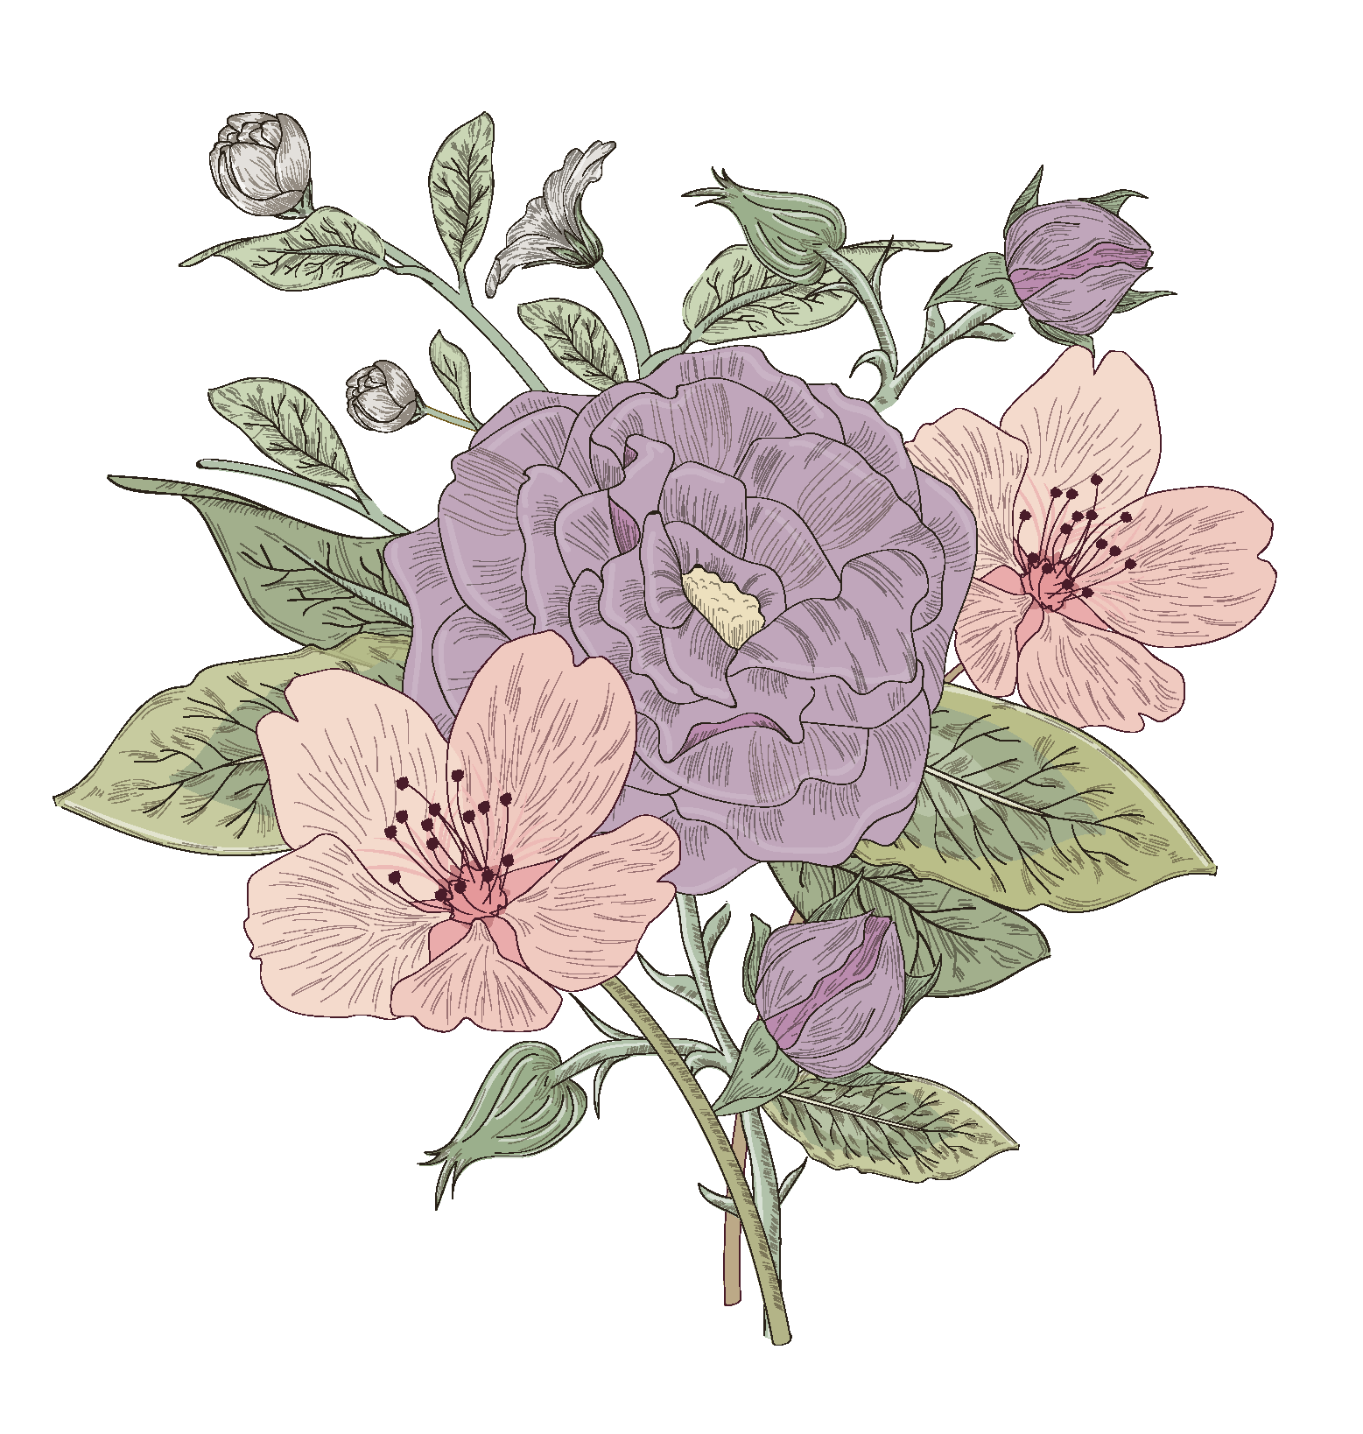
After this lesson, students will be able to:
01
to recall the usage of articles a/an/the.
02
to recognize and use the zero article (∅)

Slide 6
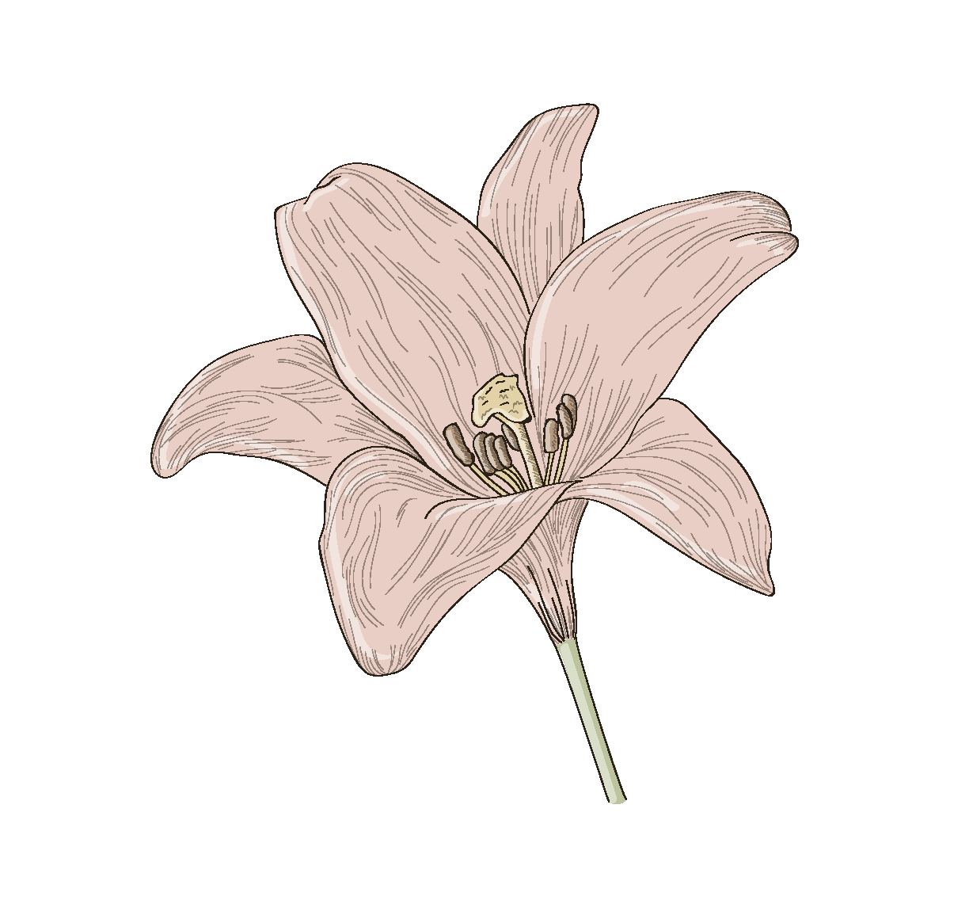
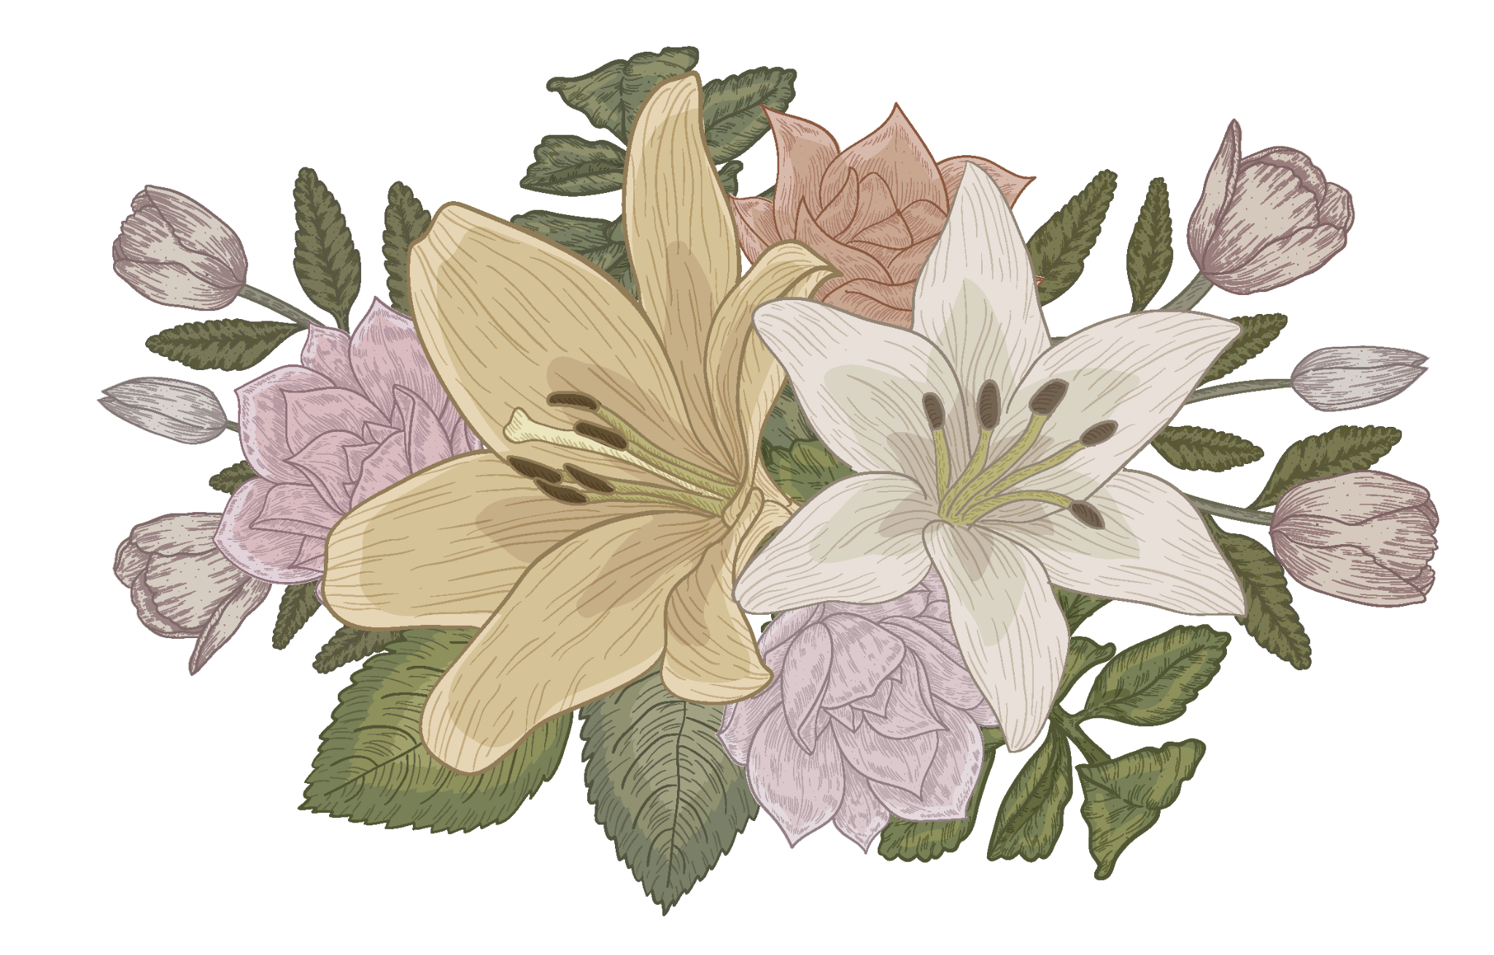
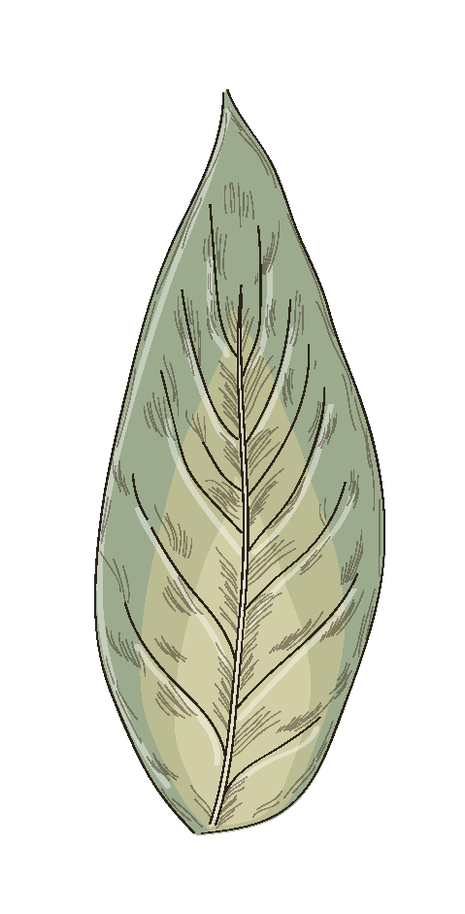
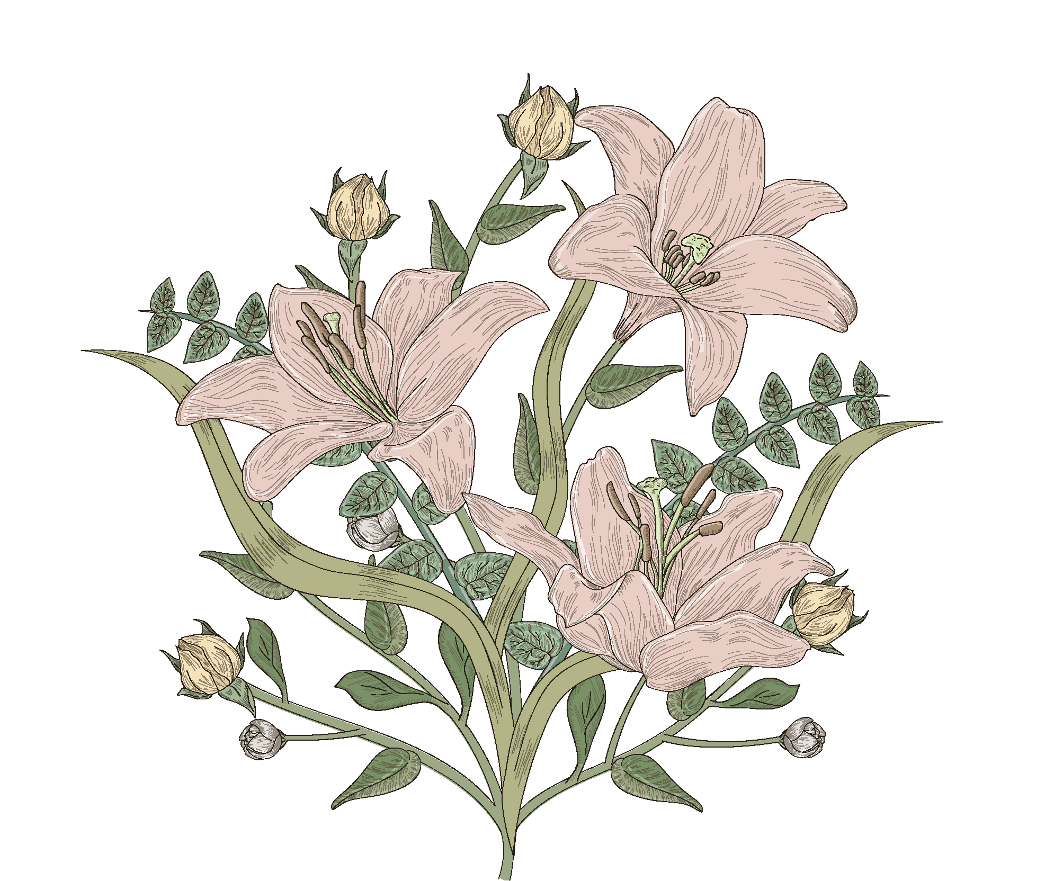
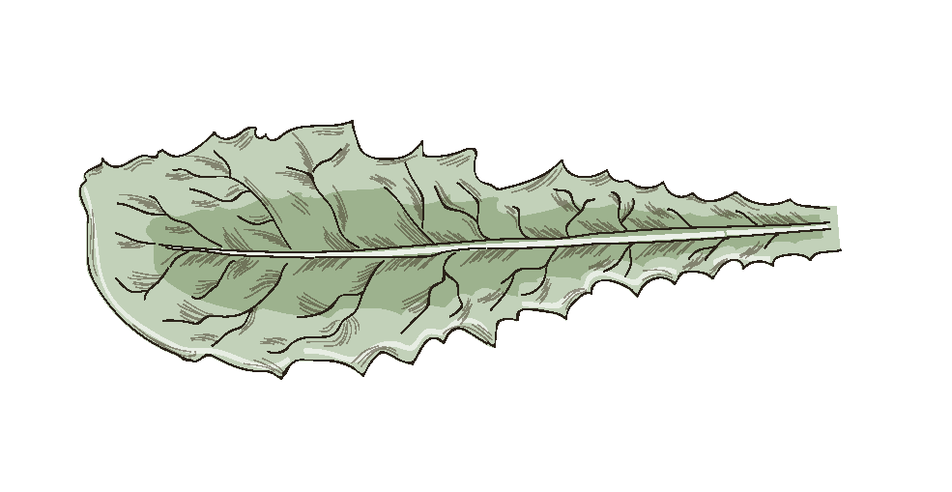
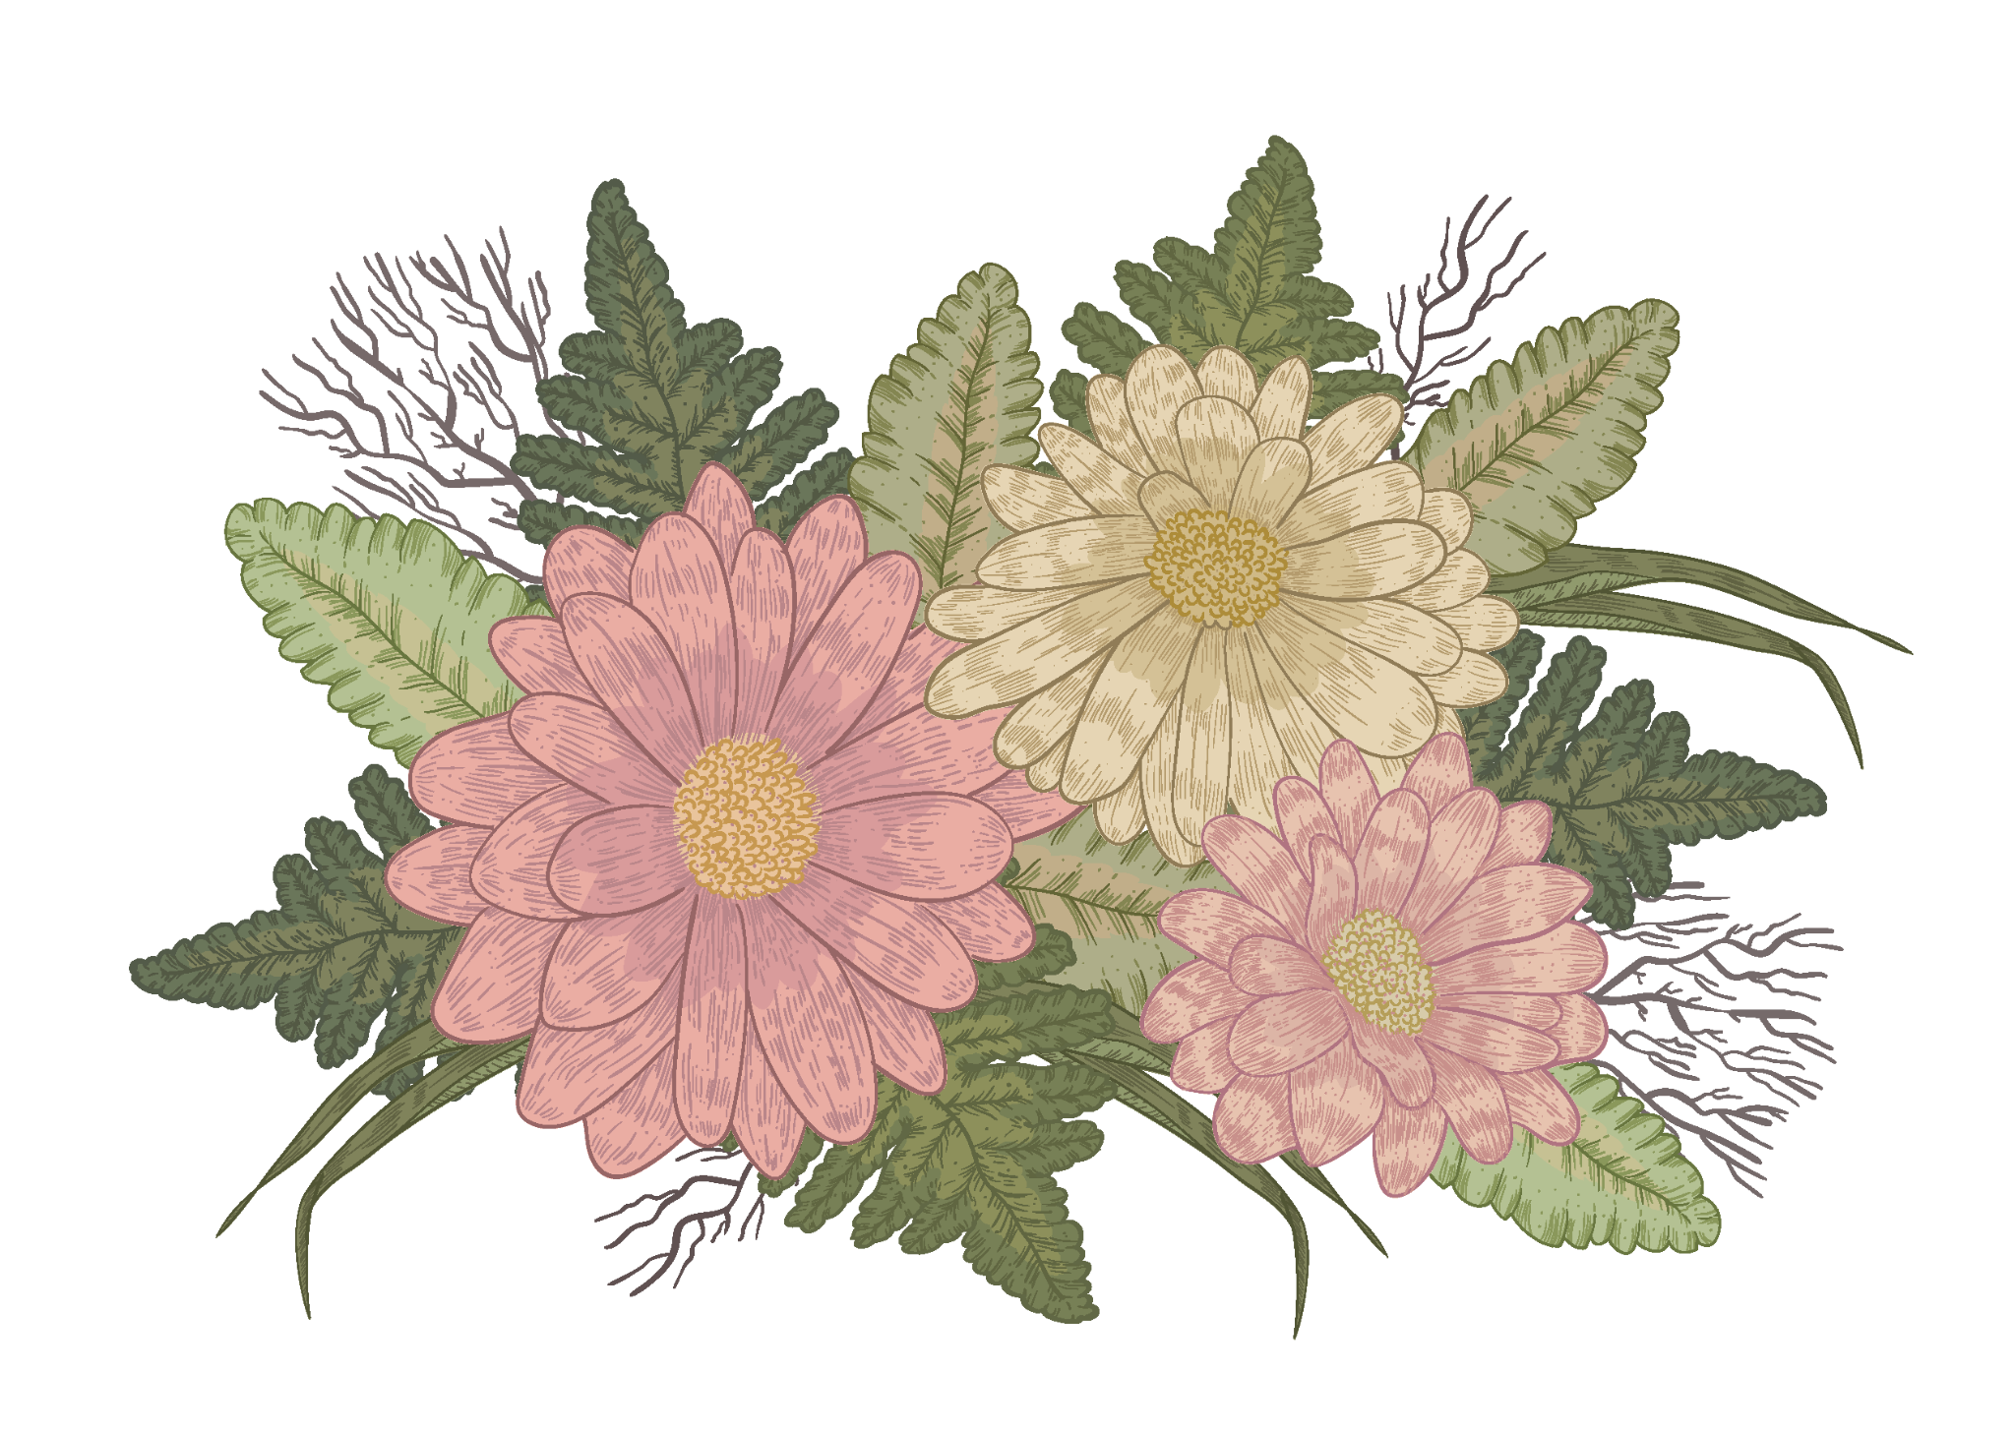
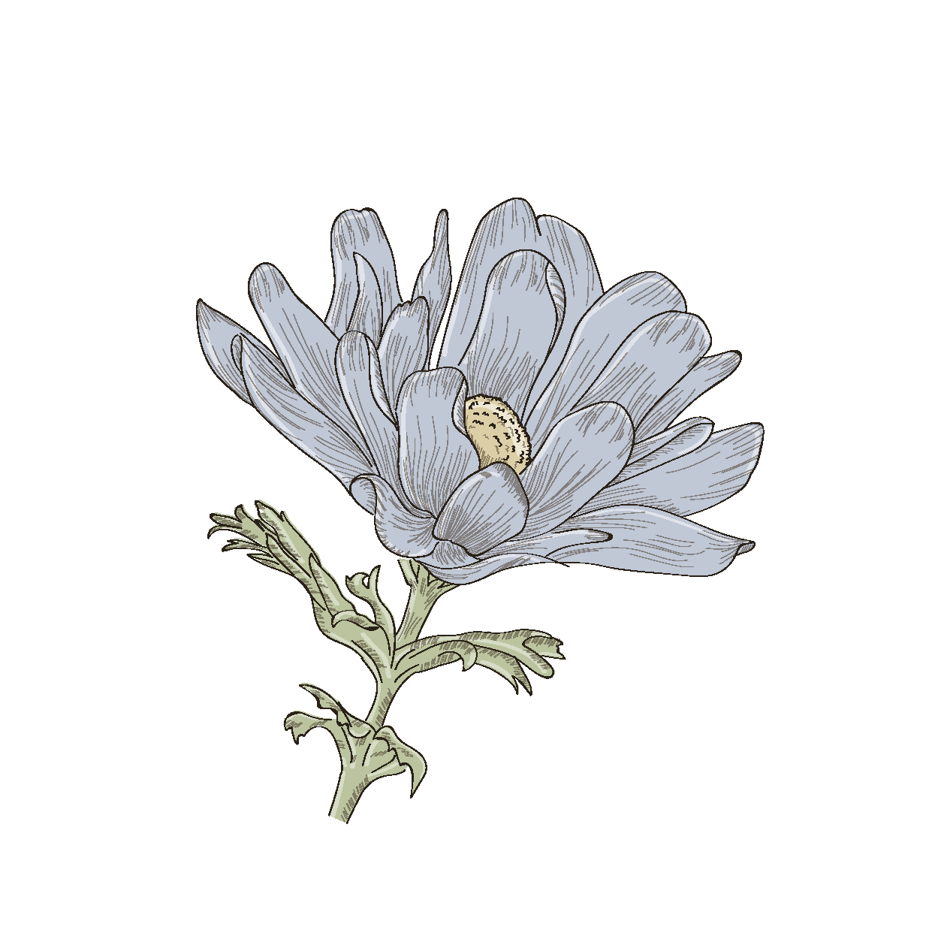
01
RECALL

Slide 7
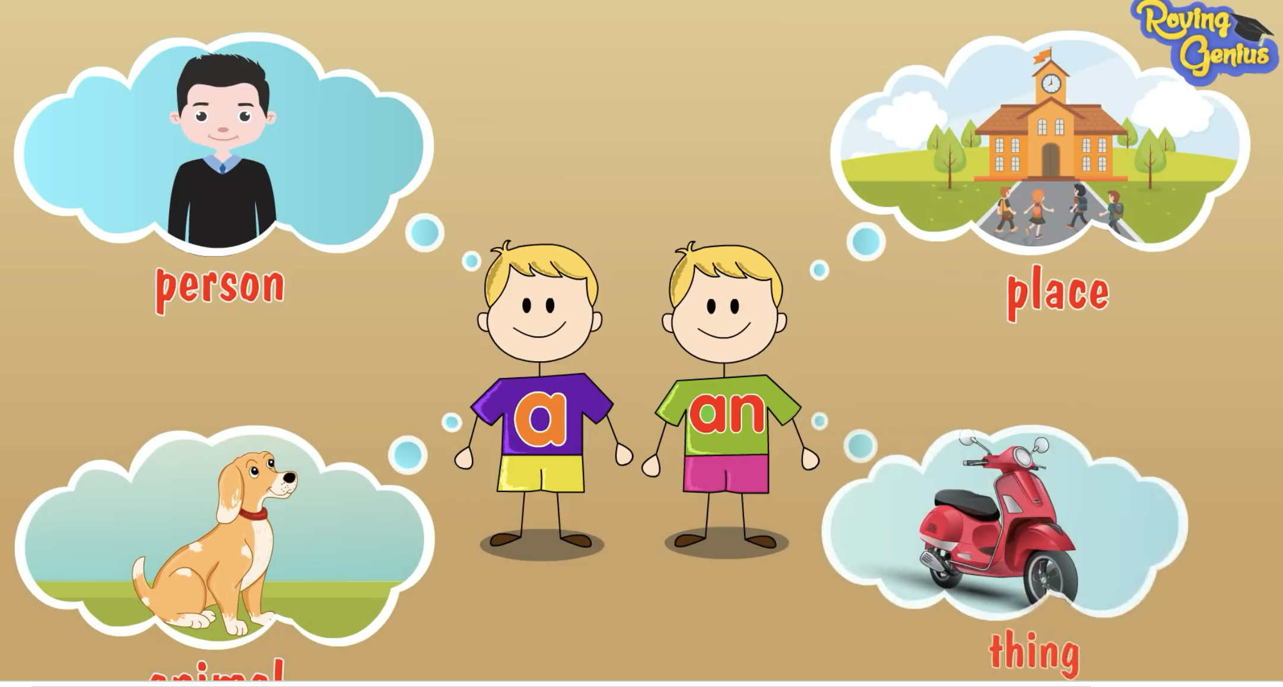
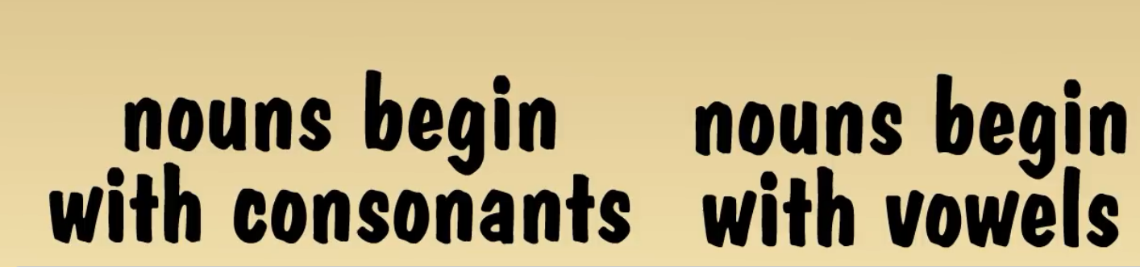
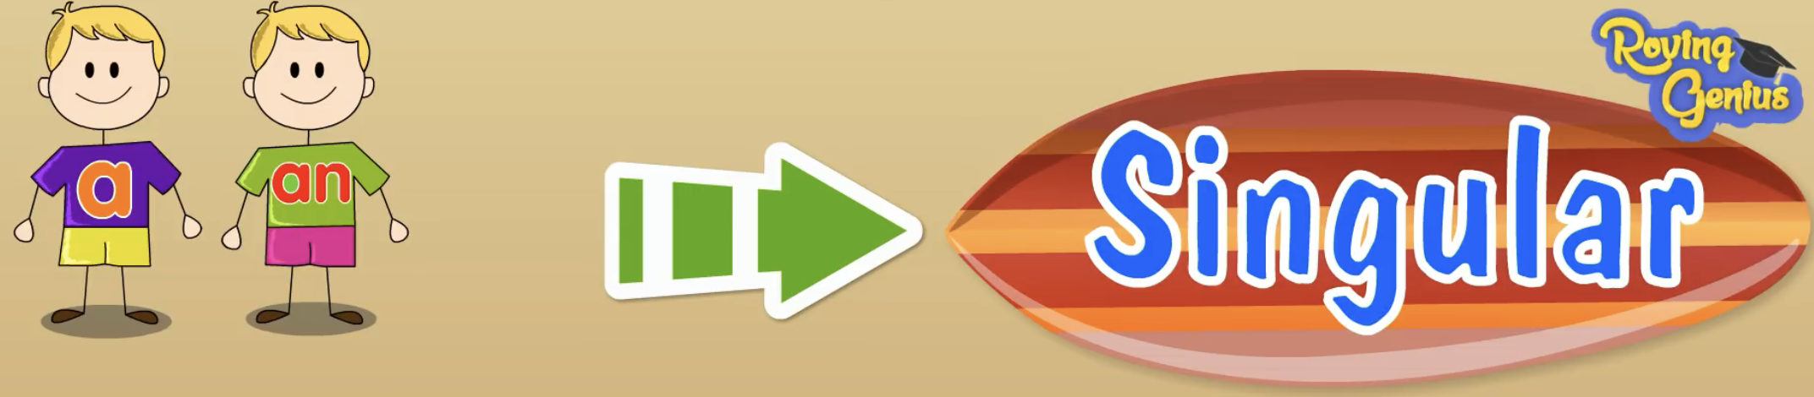
Usage of articles (a/an/the)
1. She is an engineer.
1. She is an engineer.
We use “A/An” with a singular noun
when we say what people's jobs are.
A
singular nouns begin with consonants (phụ âm)
An
singular nouns begin with vowels (nguyên âm)

Slide 8
Usage of articles (a/an/the)
2. We held a family reunion last week.
The party was enjoyable.
We use “A/An” when we when we talk about something for the first time.
We use “The” when the listener already knows which thing we are talking about because it was mentioned before

Slide 9
Identify the articles in these sentences.
1. Sugar is not good for your teeth.
2. Students should work hard.
3. We went there by boat.

Slide 10
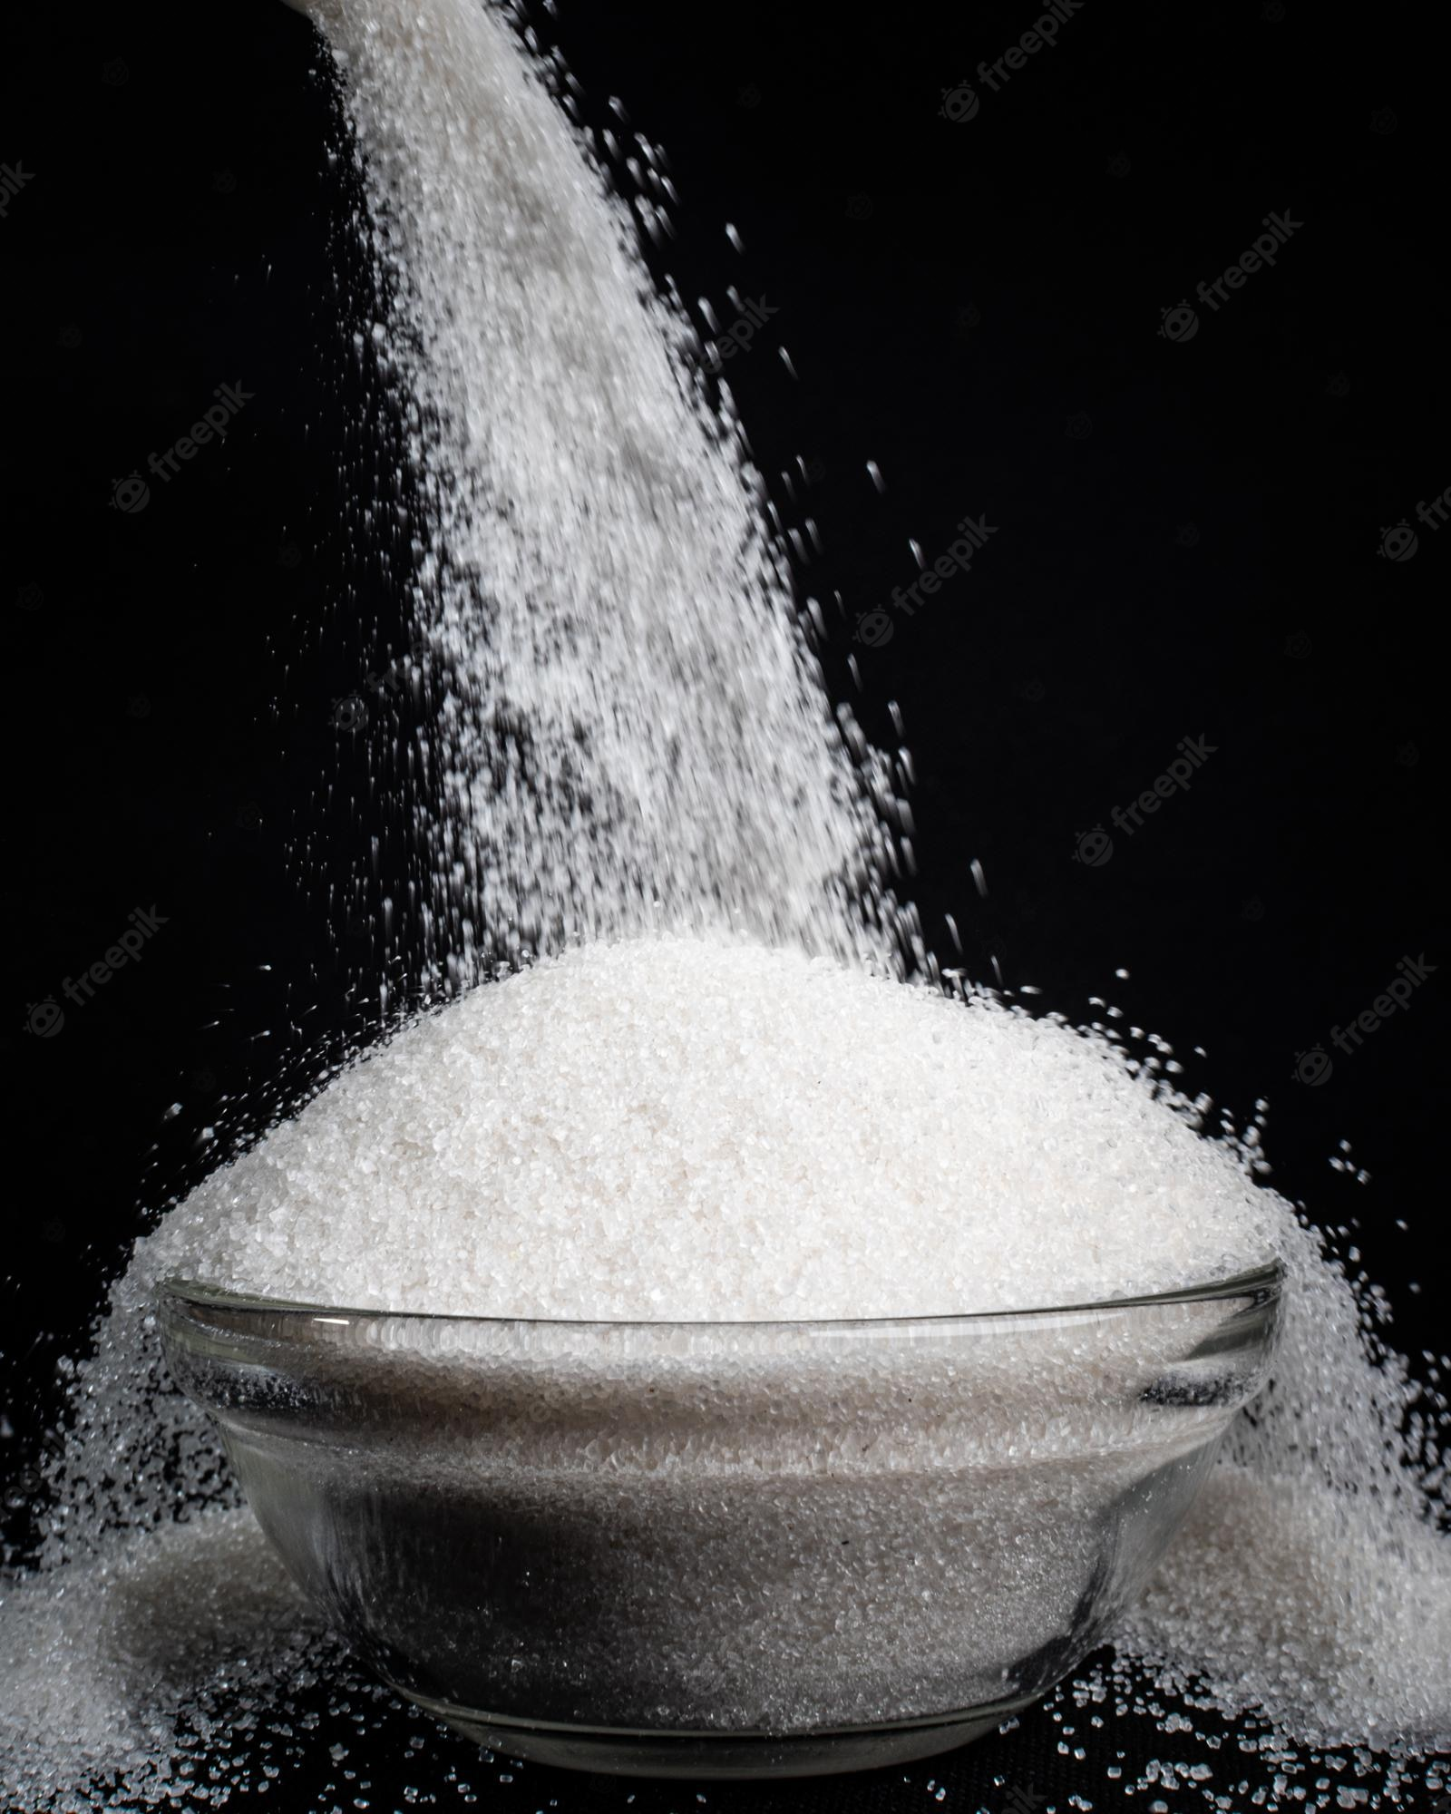
Usage of Zero article
Actually, in some cases, we can use noun without a/an/the.
We call this the Zero article.
1. Sugar is not good for your teeth.
1. Sugar is not good for your teeth.
with uncountable or abstract nouns

Slide 11
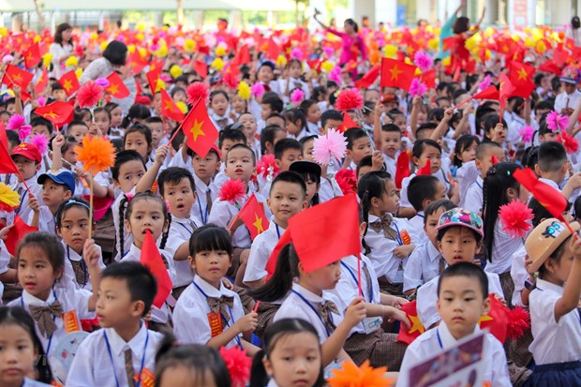
Usage of Zero article
Actually, in some cases, we can use noun without a/an/the.
We call this the Zero article.
2. Students should work hard.
2. Students should work hard.
when making general statement

Slide 12
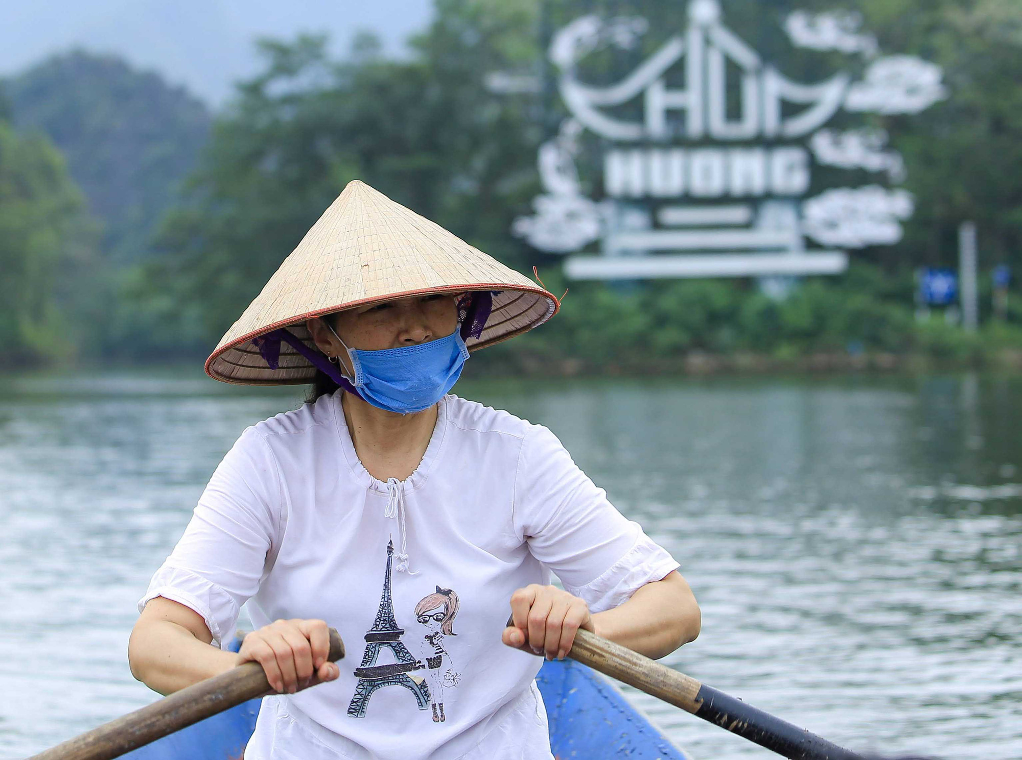
Usage of Zero article
Actually, in some cases, we can use noun without a/an/the.
We call this the Zero article.
3. We went there by boat.
3. We went there by boat.
when describing general forms
of transport

Slide 13
Usages of Zero article
Actually, in some cases, we can use noun without a/an/the.
We call this the Zero article.
1
with uncountable or abstract nouns
2
when making general statements
3
when describing general forms of transport

Slide 14
02
PRACTICE

Slide 15
Exercise 1. Choose the correct option in each sentence below. (page 53)
1. It takes more than a / an hour to drive to Can Tho.
2. It’s a / Ø tradition for children to wake up early on Christmas Day.
3. The Ok Om Bok Festival takes place in the / Ø October.
4. We went to Can Tho by an / Ø air.
5. A: Where’s a / the book?
B: I thought you left it next to the TV.

Slide 16
Exercise 1. Check your answer.
1. It takes more than a / an hour to drive to Can Tho.
2. It’s a / Ø tradition for children to wake up early on Christmas Day.
3. The Ok Om Bok Festival takes place in the / Ø October.
/aʊə/ singular noun
starting with a vower
singular noun – mentioning for the 1st time.
referring to the festival
as a general event

Slide 17
Exercise 1. Check your answer.
4. We went to Can Tho by an / Ø air.
5. A: Where’s a / the book?
B: I thought you left it next to the TV.
general form of transport
a specific book which listener and speaker already know about

Slide 18
GUESSING GAME
- Work in groups
- 5 questions and one KEY WORD.
- Answer each question to reveal the hint.
- Get +1 point if you can answer each question.
- Get +3 points if you can answer the KEY WORD.

Slide 19
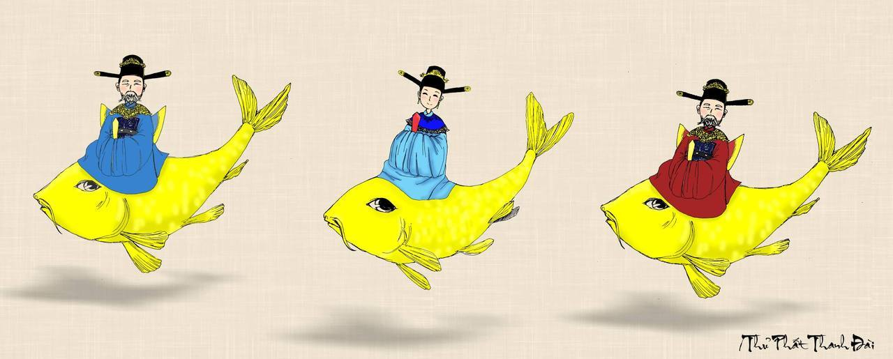
1
2
3
4
5

Slide 20

Which of the underlined parts in each question is incorrect? Find and correct it.
The worshipping Kitchen Gods is a long-time tradition of the Vietnamese.
Which of the underlined parts in each question is incorrect? Find and correct it.
The worshipping Kitchen Gods is a long-time tradition of the Vietnamese.
A. The
B. a
C. the Vietnamese
=> Ø
”Worshipping Kitchen Gods” is considered a general activity.
Back to
the game

Slide 21
Which of the underlined parts in each question is incorrect? Find and correct it.
People organise the worshipping ceremony at noon so that a Kitchen Gods can leave for Heaven at 12 o’clock.
A. the
B. noon
C. a
=> the
Back to
the game

Slide 22
Which of the underlined parts in each question is incorrect? Find and correct it.
Most families in the Viet Nam prepare oﬀerings for the Kitchen Gods.
Which of the underlined parts in each question is incorrect? Find and correct it.
Most families in the Viet Nam prepare oﬀerings for the Kitchen Gods.
A. Most
B. the
C. offerings
=> Ø
Back to
the game

Slide 23
Which of the underlined parts in each question is incorrect? Find and correct it.
The oﬀerings include a set of flowers and fruits, a paper clothes, and three carps.
Which of the underlined parts in each question is incorrect? Find and correct it.
The oﬀerings include a set of flowers and fruits, a paper clothes, and three carps.
A. The
B. set
C. a
=> Ø
Back to
the game

Slide 24
Which of the underlined parts in each question is incorrect? Find and correct it.
The Vietnamese people believe that the Kitchen Gods go to Heaven on carps.
A. The Vietnamese
B. the Kitchen Gods
C. carps
=> Vietnamese
Back to
the game

Slide 25
Exercise 3. Complete the sentences with a, an, the, or Ø (zero article).
1. It is a custom in my family to have ______ breakfast at home on Sundays.
2. When visiting a family home in some countries, you should bring ______ small gift with you.
3. Our village festival is held on the 10th of ______ January.
4. Ancient Egyptians worshipped ______ Sun.
5. Many people think that hard work is ______ important Vietnamese value.

Slide 26
Checking your answers
1. It is a custom in my family to have ______ breakfast at home on Sundays.
2. When visiting a family home in some countries, you should bring ______ small gift with you.
Ø
general thing
a
specific thing
mentioning for the 1st time

Slide 27
Checking your answers
3. Our village festival is held on the 10th of ______ January.
4. Ancient Egyptians worshipped ______ Sun.
5. Many people think that hard work is ______ important Vietnamese value.
Ø
general thing
the
the specific thing
an
a specific thing
starting with a vowel

Slide 28
Exercise 4. Complete the text with the or Ø (zero article).
A recent study in (1) ______ UK shows that family time traditions are good for (2) ______ teens. These traditions include family members playing card games, watching their favourite TV programmes, or performing (3) ______ karaoke shows at weekends with one another. These activities often lead to lots of laughter and (4) ______ fun conversations. By taking part in such activities, teens strengthen (5) ______ bonds with their family.
the
Ø
Ø
Ø
the

Slide 29
BINGO GAME
EASY MODE
HARD MODE
Notes:
HARD MODE CHO NHÓM NÀO GIỎI HƠN
EASY MODE CHO NHÓM HỌC ĐẠI TRÀ

Slide 30
EASY MODE
- Work in group of 4-5 students.
- There is ONE mistake in each sentence
- Find and correct the mistakes
- Say “BINGO!” as soon as you guys finish

Slide 31
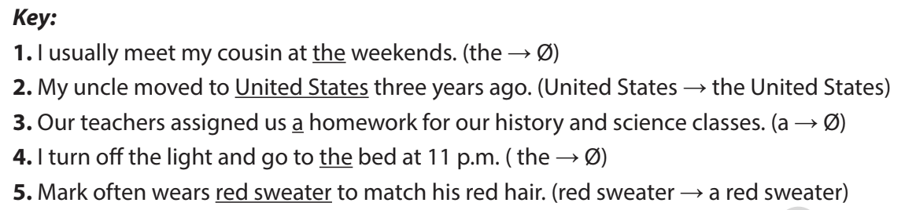
EASY MODE
1 . I usually meet my cousin at the weekends.
2. My uncle moved to United States three years ago.
3. Our teachers assigned us a homework for our history and science classes.
4.I turn off the light and go to the bed at 11 p.m.
5. Mark often wears red sweater to match his red hair.

Slide 32
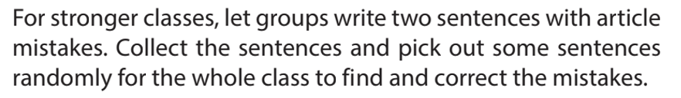
HARD MODE
Work in groups of 4-5 students
Write 2 sentences with article mistakes
Collect the sentences and pick out some sentences randomly for the whole class to correct.

Slide 33
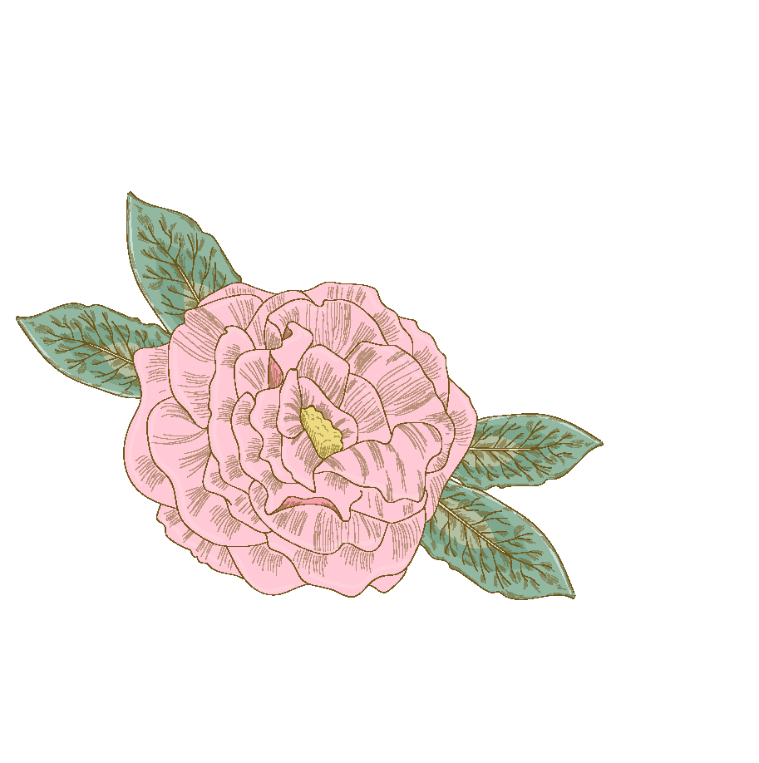

Consolidation/ Wrap up
We use the Zero article:
A. With uncountable or abstract nouns
B. When describing general forms of transport
C. When listener already knows what we’re talking about
D. When making general statements

Slide 34
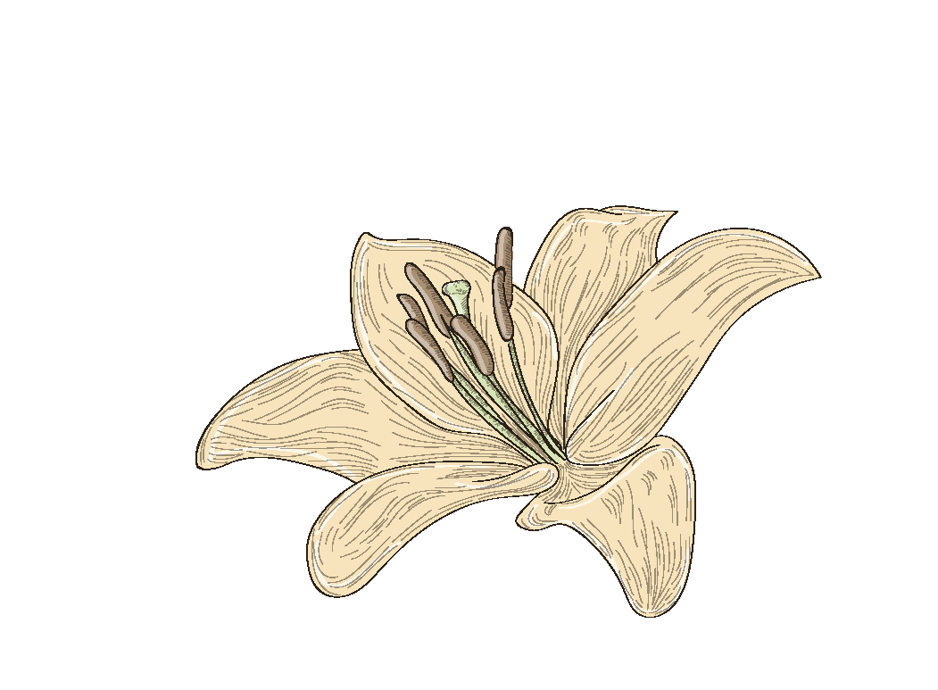
THANKS
DOES ANYONE HAVE ANY QUESTIONS?
addyouremail@freepik.com
+91 620 421 838
yourwebsite.com
Please keep this slide for attribution

Slide 35
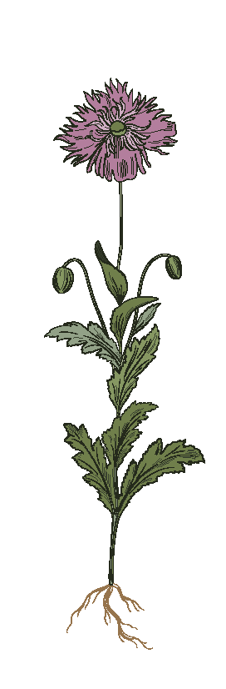
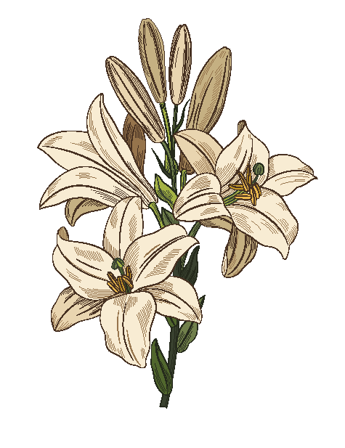
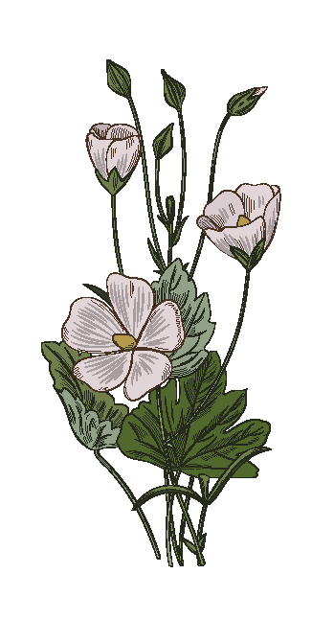
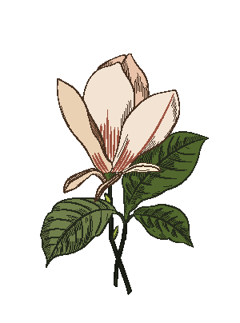

ALTERNATIVES RESOURCES
Here’s an assortment of alternative resources whose style fits that of this template:
VECTORS
Vintage botanical flower collection

Slide 36
RESOURCES
Did you like the resources in this template? Get them for free at our other websites:
PHOTOS
Portrait of young woman with flowers wearing a boho chic dress I
Portrait of young woman with flowers wearing a boho chic dress II
Portrait of young woman with flowers wearing a boho chic dress III
Portrait of young women in a garden aesthetic with boho dresses
Portrait of young woman wearing chic boho dress amongst flowers
Portrait of young woman in boho dress with romantic garden aesthetic and vegetation
Medium shot guy with blue eyes and brown hair
VECTORS
Vintage floral bouquet
Vintage flower bouquet
Floral bouquet in vintage design

Slide 37
RESOURCES
Did you like the resources in this template? Get them for free at our other websites:
VECTORS
Beautiful floral bouquet in vintage design
Vintage botanical background
Vintage botanical background
Vintage leaves collection
Vintage leaves collection
Vintage botanical pattern
Vintage bouquet
Vintage bouquet
Vintage flower collection
Vintage flower collection
Elegant floral bouquet in vintage design
Beautiful redhead woman portrait close-up
Red cheeked young ginger woman looking at camera

