Slide 1
Unit 5
Our customs and traditions
Lesson 2
A closer look 1
(Page 52,53)

Slide 2
After this lesson, Ss will be able to:
01
02
Vocabulary
use the words and expressions related to customs and traditions
Pronunciation
correctly pronounce words/sentences that contain the sounds /n/ and /ŋ/

Slide 3
01
Vocabulary

Slide 4

Vocabulary matching
T divides class into 3 groups.
1
+1 point for a
correct sentence
2
Students will take turns matching the words with their meanings
3
Students create ONE meaningful sentence using that vocabulary

Slide 5
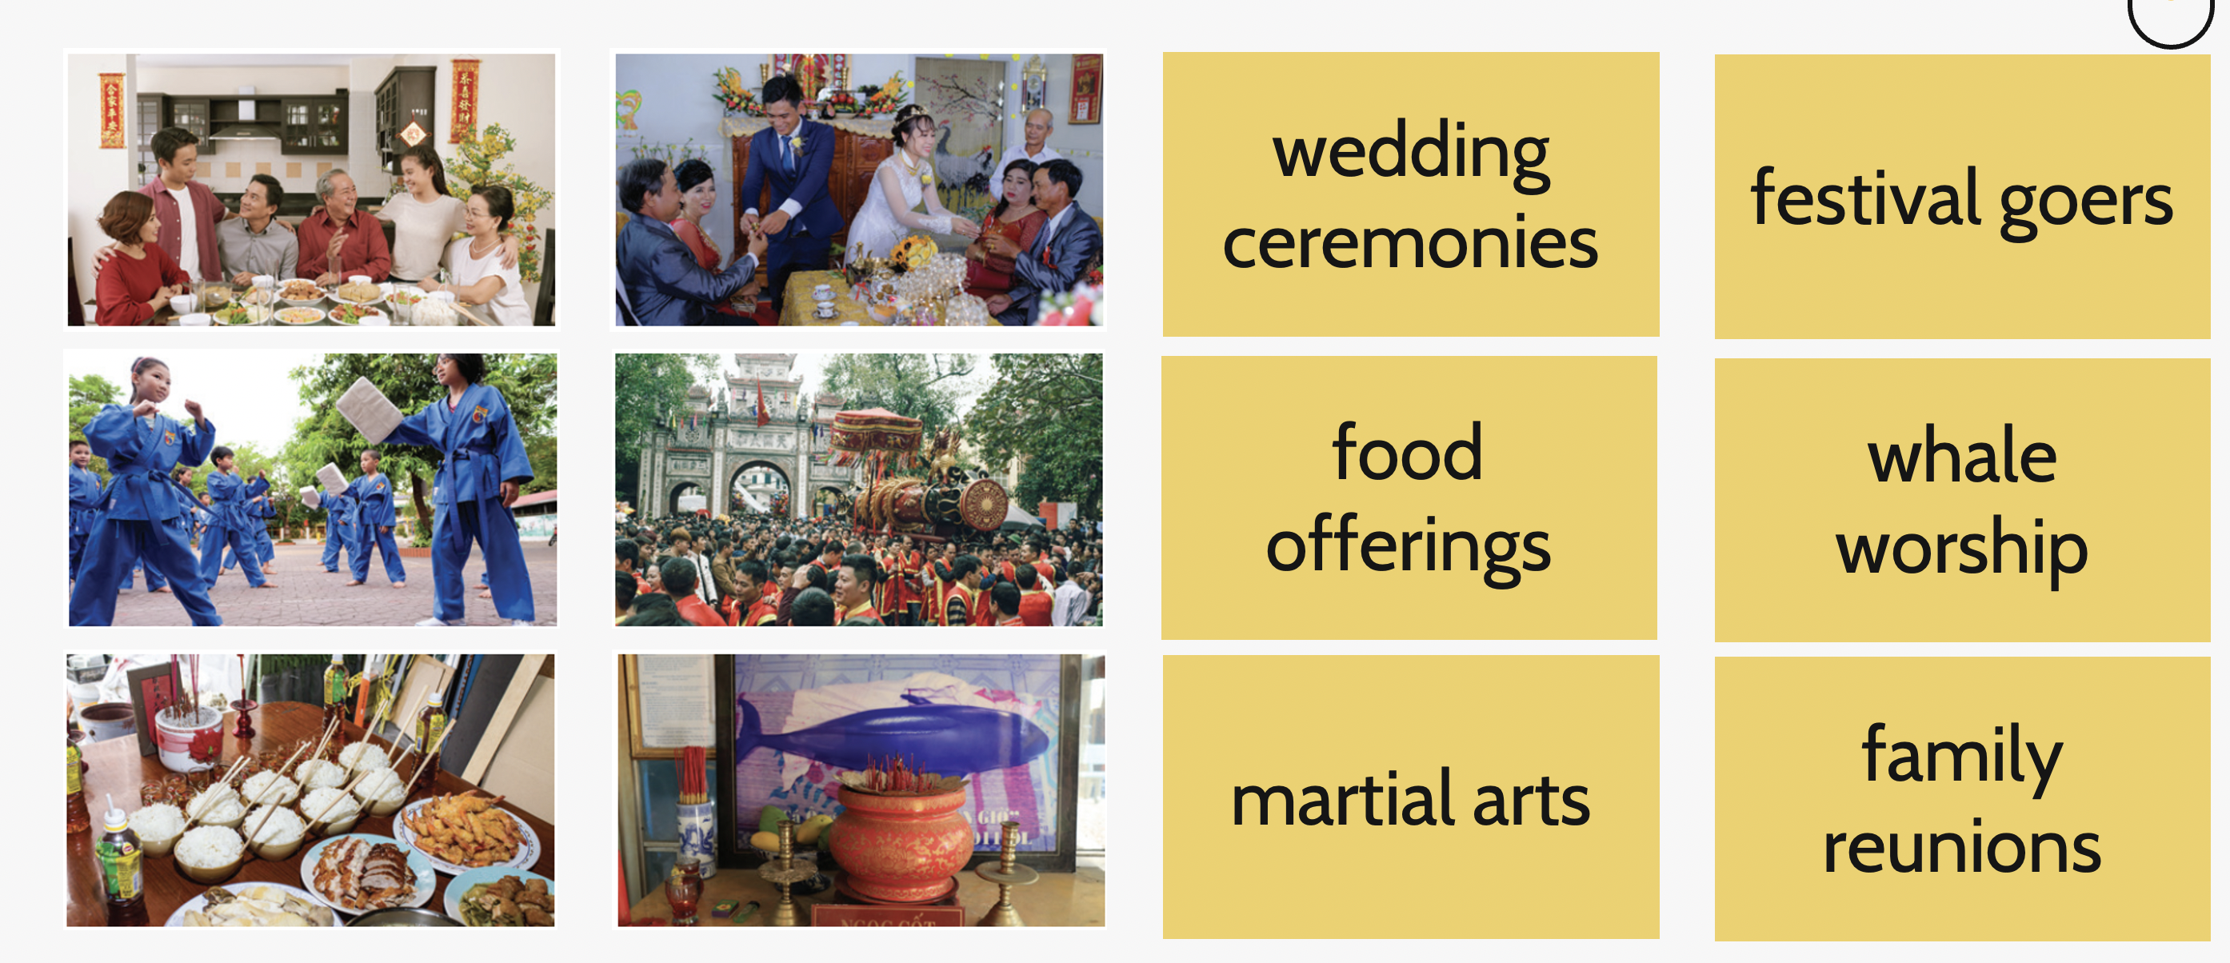
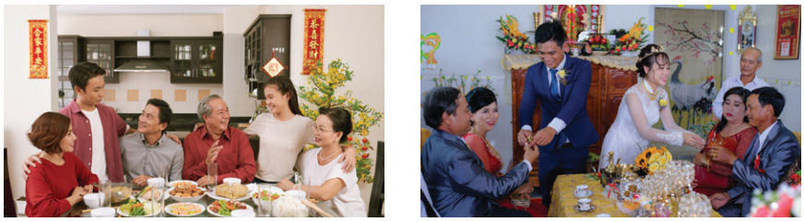
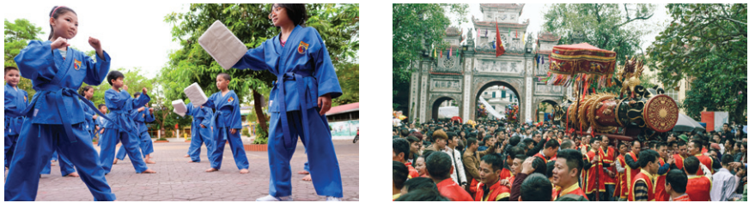
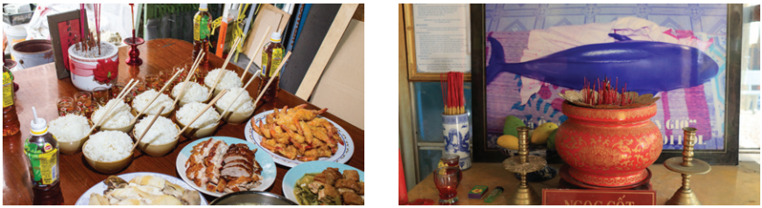
Randomly choose a pair of cards.
1
2
wedding ceremonies
A
festival goers
B
3
4
food offerings
C
whale worship
D
5
6
martial arts
E
family reunions
F
Notes:
Nếu học sinh chọn mở sai các thầy cô kick lại ô đó để đóng.
Đáp án: 1-F / 2-A / 3-E / 4-B / 5-C/ 6-D

Slide 6

Checking your answers
1._______________
2.__________________
family reunion
wedding ceremony
/ˌfæməli ˌriːˈjuːniən/
/ˈwedɪŋ ˌserəməni/

Slide 7
Checking your answers
3._______________
4.__________________
food offerings
whale worship
/fuːd ˈɒfərɪŋ/
/weɪl ˈwɜːʃɪp/

Slide 8
Checking your answers
5._______________
6.________________
martial arts
festival goers
/ˌmɑːʃl ˈɑːts/
/ˈfestɪvlˌgəʊə/

Slide 9
Extra activity
Divide the class into four teams.
Have Ss close their books.
Read the first word in one of the phrases in 1. When Ss know the next word in the phrase, they raise their hand.
Choose the first student who raises his / her hand to give the answer. If his / her answer is correct, award his / her team one point.
Continue with the remaining phrases. The team with the most points wins.
Play another round but this time provide the phrase and the teams work together to create a sentence using the phrase. The first team to create a correct sentence using the phrase wins two points.

Slide 10
Relay Race
S
T
A
R
T
1
T divides class into 3 teams.
2
T shows one question at a time.
3
The first student from each team goes around the class, finds the appropriate answer and stick on the board.
4
The next student goes, and the process continues.
The first team to complete all five questions correctly wins.
Notes:
Trò chơi này nếu các thầy cô giáo cẩn than soạn bài trước khi dạy và muốn format lớp học khác thì nên in trước các câu trả lời và dán quanh khắp lớp cho học sinh đi tìm. Cũng là một hình thức vận động. Còn ai đó không triển khai được hoạt động vận động thì chỉ đơn giản là chiếu các câu hỏi để học sinh lên để viết câu trả lời.

Slide 11
Complete each sentence with the correct option A, B or C.
1. We have a tradition of holding a family ______ on the first day of Tet.
A
reunion
B
work
C
meal

Slide 12
Complete each sentence with the correct option A, B or C.
2. She broke with family tradition by not practising ______.
A
acrobats
B
martial arts
C
offerings

Slide 13
Complete each sentence with the correct option A, B or C.
3. Traditionally, the Vietnamese prepare ______ to worship their ancestors during Tet.
A
offerings
B
decoration
C
worshipping

Slide 14
Complete each sentence with the correct option A, B or C.
4. It’s a tradition for shops to have a lion dance performance at their opening ______.
A
worship
B
celebration
C
ceremony

Slide 15
Complete each sentence with the correct option A, B or C.
5. The tradition of ______ whales is popular in Vietnamese coastal villages.
A
admiring
B
worshipping
C
praying

Slide 16
Checking your answers.
1. We have a tradition of holding a family ______ on the first day of Tet.
A. reunion B. work C. meal
2. She broke with family tradition by not practising ______.
A. acrobat B. martial arts C. oﬀering
3. Traditionally, the Vietnamese prepare ______ to worship their ancestors
during Tet.
A. oﬀerings B. decoration C. worshipping
4. It’s a tradition for shops to have a lion dance performance at their opening ______.
A. worship B. celebration C. ceremony
5. The tradition of ______ whales is popular in Vietnamese coastal villages.
A. admiring B. worshipping C. praying
family reunion:
đoàn tụ gia đình
practise martial arts: luyện võ thuật
prepare offerings:
chuẩn bị đồ cúng
opening ceremony:
lễ khai trương
worshipping whales:
thờ cá Ông

Slide 17

Exercise 3. Complete the sentences with the words from the box.
custom | practise | keep | break | traditionally
1. This year, we will ______ with tradition and go on holiday instead of staying at home during Tet.
2. ___________, children in the US go from house to house to ask for sweets on halloween.
3. Holding a party to wish our grandparents longevity is one of the customs we ________ at Tet.
4. Organising a folk song club is one way for us to ______ our traditions alive.
5. It’s becoming a _______ for young people to celebrate new years in addition to Tet.
Focus on the part of speech of each word we can fill in.

Slide 18
Exercise 3. Guess the part of speech
custom | practise | keep | break | traditionally
verb
1. This year, we will ______ with tradition and go on holiday instead of staying at home during Tet.
2. ___________, children in the US go from house to house to ask for sweets on halloween.
3. Holding a party to wish our grandparents longevity is one of the customs we ________ at Tet.
4. Organising a folk song club is one way for us to ______ our traditions alive.
5. It’s becoming a _______ for young people to celebrate new years in addition to Tet.
Adverb
verb
verb
noun

Slide 19
Exercise 3. Complete the sentences with the words from the box.
custom | practise | keep | break | traditionally
break
1. This year, we will ______ with tradition and go on holiday instead of staying at home during Tet.
2. ___________, children in the US go from house to house to ask for sweets on halloween.
3. Holding a party to wish our grandparents longevity is one of the customs we ________ at Tet.
4. Organising a folk song club is one way for us to ______ our traditions alive.
5. It’s becoming a _______ for young people to celebrate new years in addition to Tet.
break with sth:
phá vỡ thứ gì đó
Traditionally
Traditionally (adv)
Theo truyền thống
practise (v)
thực hiện
practise
keep
keep traditions alive:
lưu giữ truyền thống
custom
custom (n)
phong tục

Slide 20
02
Pronunciation

Slide 21

Listen and write all the words
1
6
2
7
3
8
4
9
5
10

Slide 22
Check your answers. Focus on highlighted letters.
1
thin
6
thing
2
land
7
thank
3
ceremony
8
single
4
longevity
9
language
5
tradition
10
offering

Slide 23

Watch the videos. Focus on two sounds.

Slide 24

Exercise 5. Listen and practice the sentences. Underline the words with the sound /n/ and circle the words with the sounds / ŋ/
1. Mary wore a pink dress last night.
2. I think we should buy this ornamental tree.
3. He thanked the host for the enjoyable party.
4. My mum made the spring rolls for the longevity party.
5. I will bring some food to the party on Saturday.
/pɪŋk/
/naɪt/
/ θɪŋk /
/ˌɔːnəˈmentl /
/ θæŋkt/
/ ɪnˈdʒɔɪəbəl /
/ sprɪŋ/
/ lɒnˈdʒevəti/
/ brɪŋ/
/ɒn/

Slide 25
WRAP UP
1. Quickly tell the phrases
weeding
ceremony
food
offerings
martial
arts
festival
goers
family
reunion
whale
worship

Slide 26
WRAP UP
2. Choose the one with different pronunciation
A
singer
plant
B
C
onion
lemon
D

Slide 27
Thanks!
Do you have any questions?
youremail@freepik.com
+34 654 321 432
yourwebsite.com
Please keep this slide for attribution

Slide 28
Icon pack

Slide 29
Alternative resources
Here’s an assortment of alternative resources whose style fits the one of this template:
Vectors
Social media background with hand-drawn elements and color details

Slide 30
Resources
Did you like the resources on this template? Get them for free at our other websites:
Vectors
Hand drawn education concept youtube cover
Hand drawn education concept landing page
Hand drawn education concept landing page
Photos
Female teacher at desk writing close-up
Front view of man making plans to redecorate home on the floor
Close up on still life of hard exams
Young adults meeting up to study
College students of different ethnicities cramming
Icons
Icon Pack: Online learning | Lineal

