Slide 2
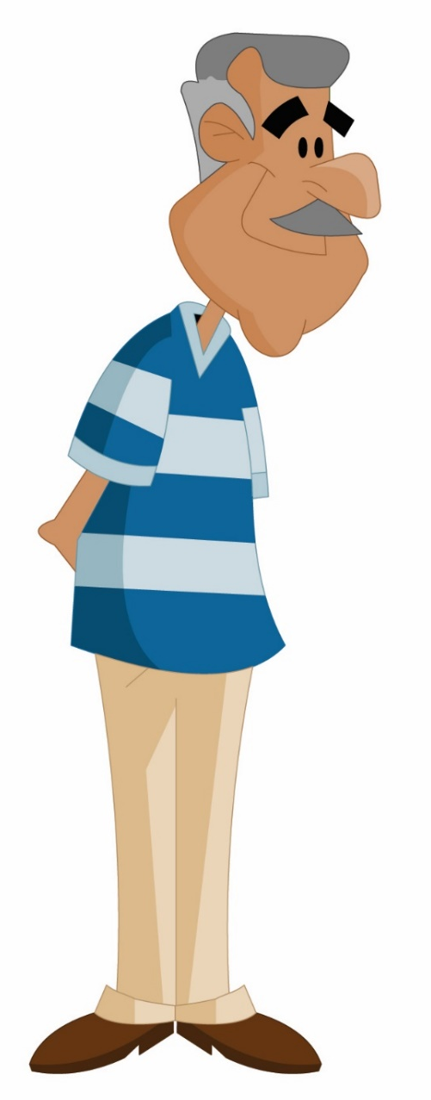
WARM-UP
old
Describe the man using words and phrases
black eyes
big nose
grey hair
blue shirt
tall
white pants
handsome?
Notes:
Teacher plays the song on speakers.
Teacher and students sing along and point at the mentioned body parts in the song lyrics. Do 2-3 times and make it faster each time.
Link: https://www.youtube.com/watch?v=YGi3f_fHIzg

Slide 3

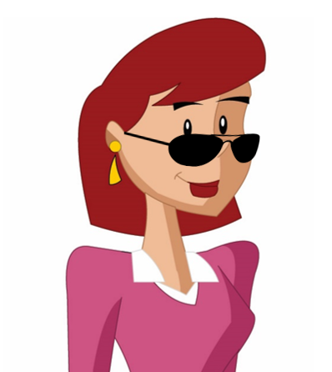

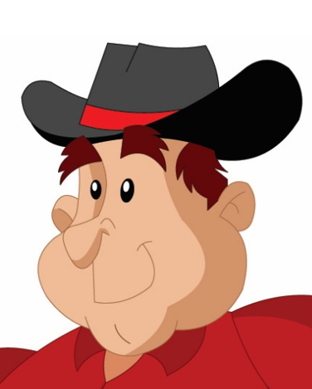

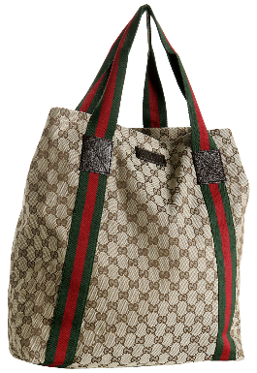
WARM-UP
Group 1 and 3
Group 2 and 4
Notes:
Teacher plays the song on speakers.
Teacher and students sing along and point at the mentioned body parts in the song lyrics. Do 2-3 times and make it faster each time.
Link: https://www.youtube.com/watch?v=YGi3f_fHIzg

Slide 4


Unit
3
MY FRIENDS
LESSON 1: GETTING STARTED
A surprise guest
1

Slide 5
Unit
3
MY FRIENDS
LESSON 1: GETTING STARTED
By the end of the lesson, you will be able to:
1
Have an overview of the topic My Friends
2
Use vocabulary related to appearance and parts of the body

Slide 6
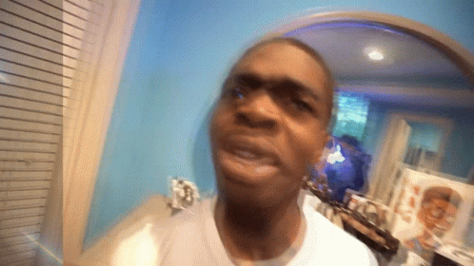
VOCABULARY
surprise (n)
/səˈpraɪz/
sự ngạc nhiên

Slide 7
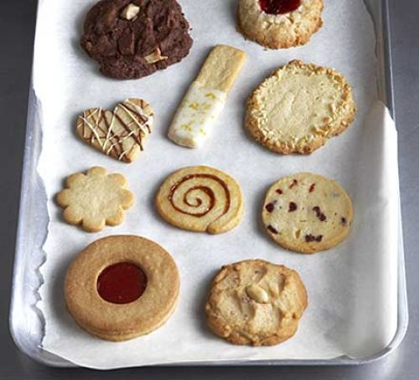
VOCABULARY
biscuit (n)
/ˈbɪskɪt/
bánh quy

Slide 8
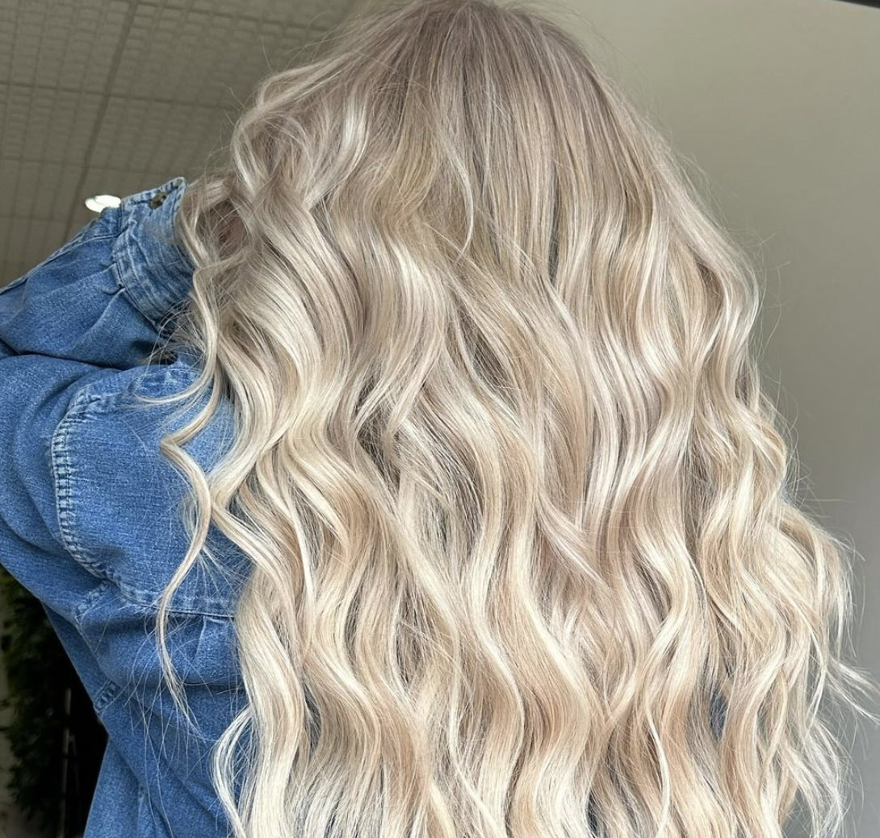
VOCABULARY
blonde (adj)
/blɒnd/
(tóc) vàng

Slide 9
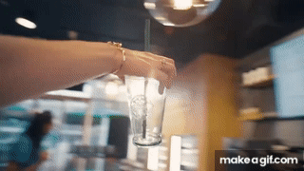
VOCABULARY
pass (v)
/pɑːs/
đưa qua

Slide 10
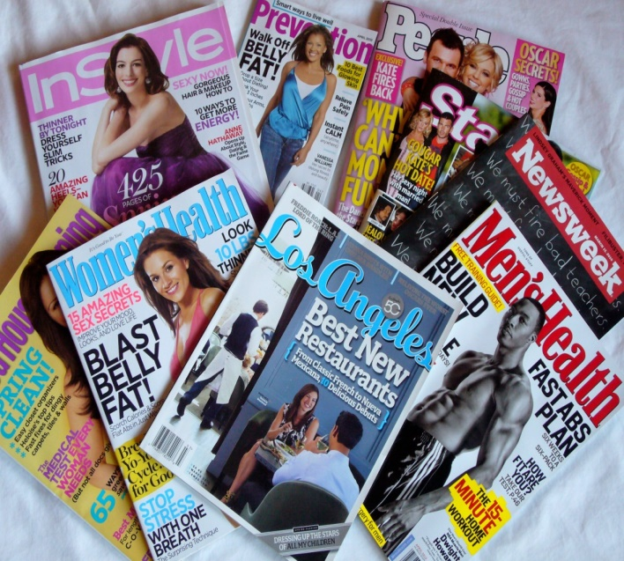
VOCABULARY
magazine (n)
/ˌmæɡəˈziːn/
tạp chí

Slide 11
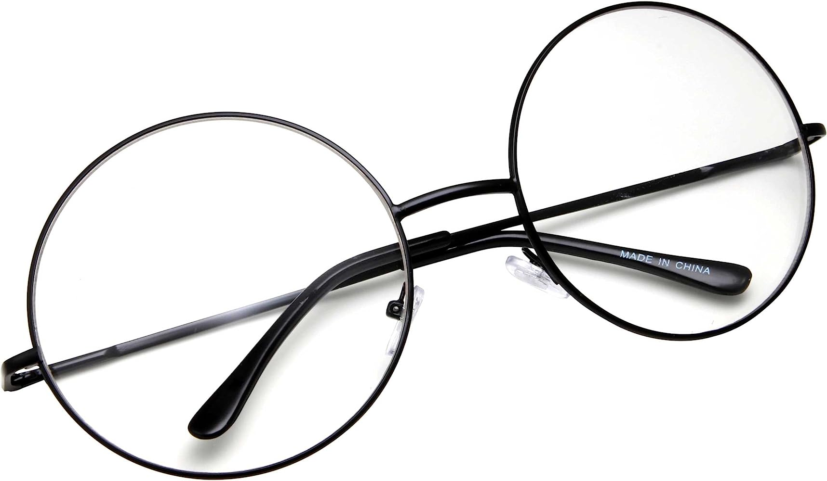
VOCABULARY
glasses (n)
/ˈɡlɑːsɪz/
mắt kính

Slide 12
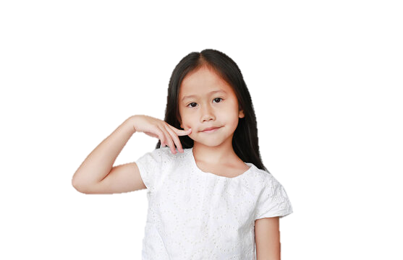
VOCABULARY
cheek (n)
/tʃiːk/
má

Slide 13
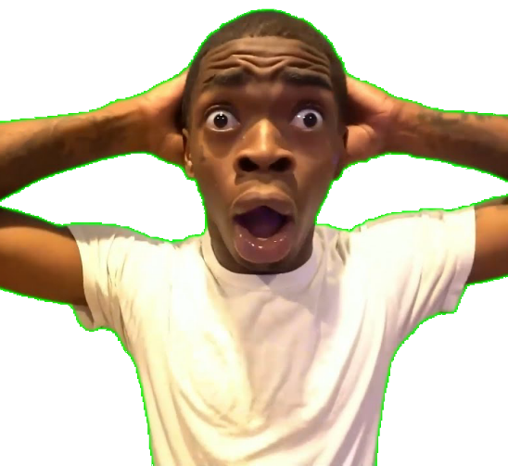

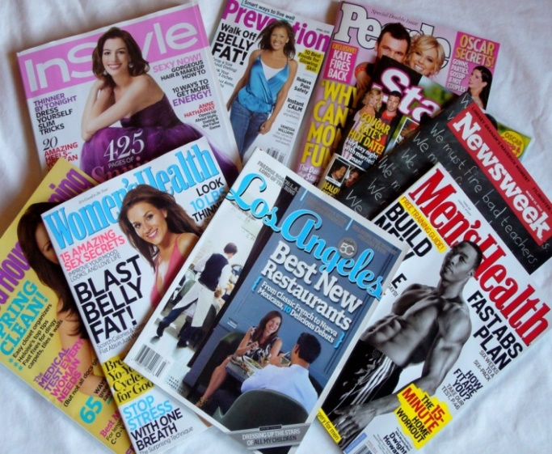
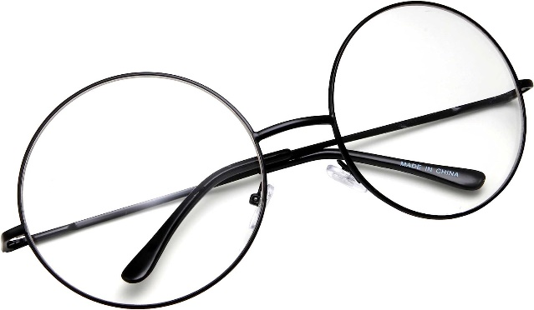
VOCABULARY

Slide 14
VOCABULARY
New words | Pronunciation | Meaning
surprise (n) | /səˈpraɪz/ | sự ngạc nhiên
biscuit (n) | /ˈbɪskɪt/ | bánh quy
blonde (adj) | /blɒnd/ | tóc vàng
pass (v) | /pɑːs/ | đưa qua
magazine (n) | /ˌmæɡəˈziːn/ | tạp chí
glasses (n) | /ˈɡlɑːsɪz/ | kính mắt
cheek (n) | /tʃiːk/ | má

Slide 15
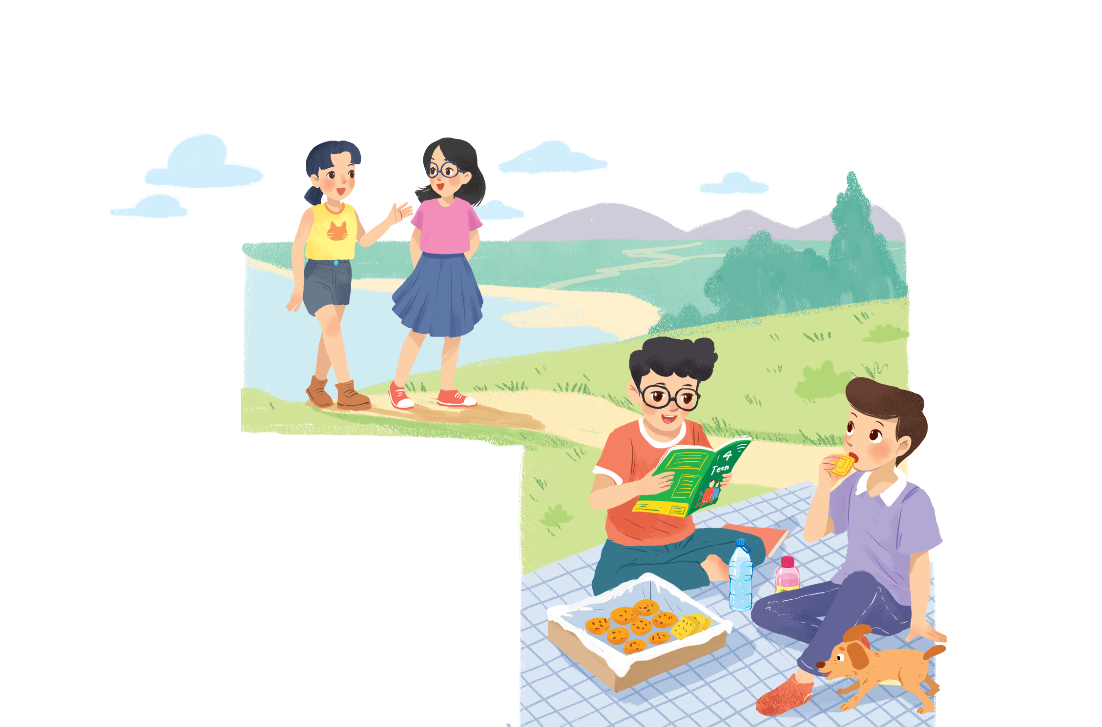
LEAD IN
A surprise guest
Answer the questions
1. How many people can you see?
2. What are the boys doing?
3. Where are the two girls going?
Notes:
Suggested answers:
They are having a picnic.
It’s …
They see …
They are going to …

Slide 16
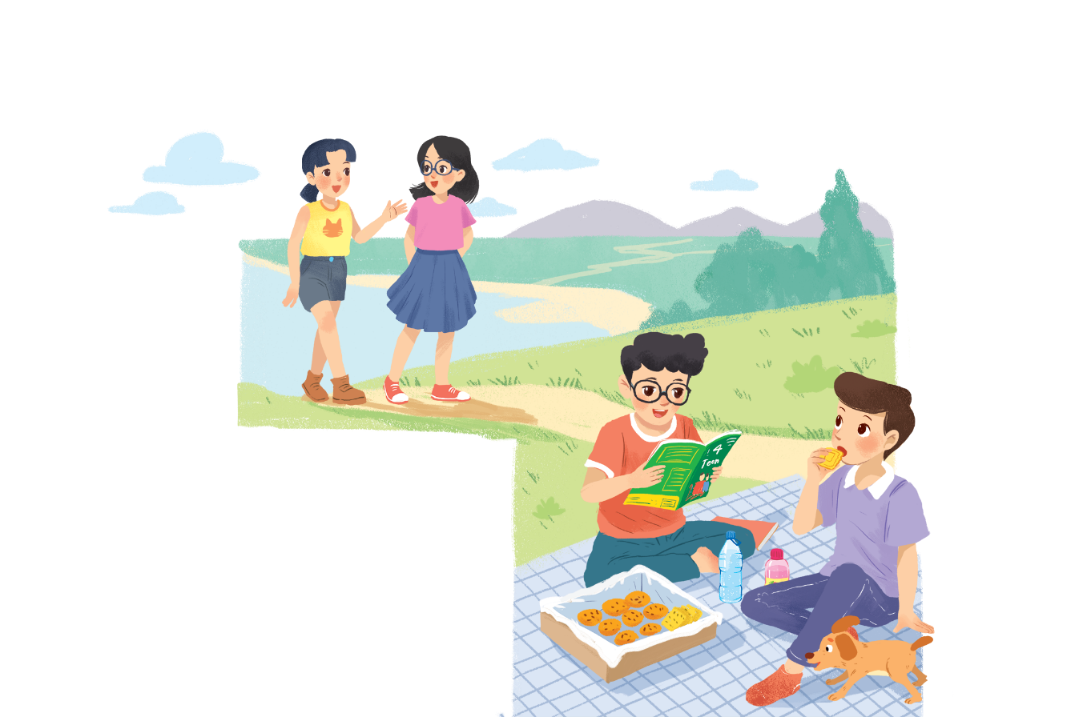

PRACTICE
1
Listen and read.
Phong: That was a great idea, Nam. I love picnics!
Nam: Please pass me the biscuits.
Phong: Sure. Here you are.
Nam: Thanks. What are you reading, Phong?
Phong: 4Teen. It’s my favourite magazine!
Nam: Look! It’s Mai. And she is with someone.
Phong: Oh, who’s that? She has glasses and long black hair.
Nam: I don’t know. They’re coming over.
Mai: Hi there. This is my friend Chau.
Phong & Nam: Hi, Chau. Nice to meet you.
Chau: Nice to meet you, too.
Nam: Would you like to sit down? We have lots of food.
Mai: Oh, sorry, we can’t. We’re going to the bookshop.
Chau: Bye for now.
Phong & Nam : Bye bye.

Slide 17
PRACTICE
2
Fill the blanks with the words from the conversation.
1. Phong and Nam are having a _______.
2. 4Teen is Phong’s __________________.
3. Phong and Nam see _____ and ______.
4. Chau has _________ and _______________.
5. Mai and Chau _____________ the bookshop.
picnic
favourite magazine
Mai
Chau
glasses
long black hair
are going to

Slide 18
PRACTICE
Can you find more structures like this?
Nam: Thanks. What are you reading, Phong?
Phong: 4Teen. It’s my favourite magazine!
Nam: I don’t know. They’re coming over.
Mai: Oh, sorry, we can’t. We’re going to the bookshop.

Slide 19
PRACTICE
Who is he talking about?
Nam: Look! It’s Mai. And she is with someone.
Phong: Oh, who’s that? She has glasses and long black hair.

Slide 20
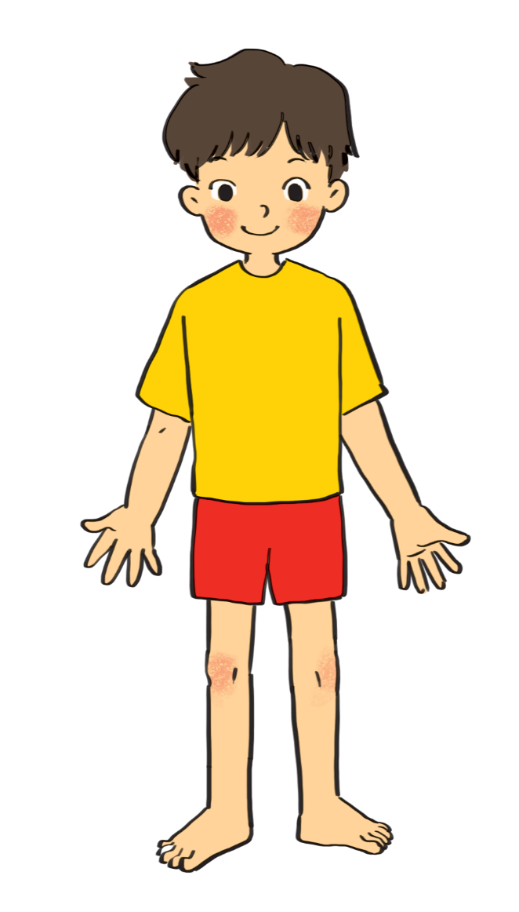
PRACTICE
3
Label the body parts with the words in the box.
1.
10.
9.
2.
8.
3.
7.
4.
5.
6.

Slide 21

PRACTICE
3
cheek
eye
hand
arm
mouth
cheek
eye
hand
arm
mouth
leg
nose
hair
shoulder
foot
leg
nose
hair
shoulder
foot
eye
hair
1.
10.
Do you know any other words for body parts?
2.
nose
9.
cheek
shoulder
8.
mouth
3.
7.
arm
4.
hand
5.
leg
foot
6.

Slide 22
PRACTICE
Do you know any other words for body parts?
face
ears
head
elbow
finger
knee

Slide 23
PRACTICE
4
Work in groups. Complete the word webs.
arms
hair
nose
eyes
Example:
long / short
big / small
leg
hair
blonde
curly
hair

Slide 24
PRACTICE
4
Work in groups. Complete the word webs.
Example:
nose
eyes
big / small
head
feet
hand
ears

Slide 25
PRACTICE
4
Work in groups. Complete the word webs.
Example:
blonde
curly
long/ short
black
hair
wavy
straight
fair

Slide 26


PRODUCTION
5
Guessing
Work in groups. Take turns to describe a classmate. Other group members guess who he / she is.
Example:
A: She has long hair and big eyes.
B: Is that Lan?
A: That’s right.

Slide 27

CONSOLIDATION
1
Wrap-up
What have we learnt in this lesson?
Have an overview of the topic My Friends
Use vocabulary related to appearance and parts of the body

Slide 28

CONSOLIDATION
2
Homework
- Do exercises in the workbook.
- Prepare lesson 2: A Closer Look 1.

Slide 29
CONSOLIDATION
New words | Pronunciation | Meaning
surprise (n) | /səˈpraɪz/ | sự ngạc nhiên
biscuit (n) | /ˈbɪskɪt/ | bánh quy
blonde (adj) | /blɒnd/ | tóc vàng
pass (v) | /pɑːs/ | đưa qua
magazine (n) | /ˌmæɡəˈziːn/ | tạp chí
glasses (n) | /ˈɡlɑːsɪz/ | kính mắt
cheek (n) | /tʃiːk/ | má

Slide 30
THANK YOU!

