Slide 1




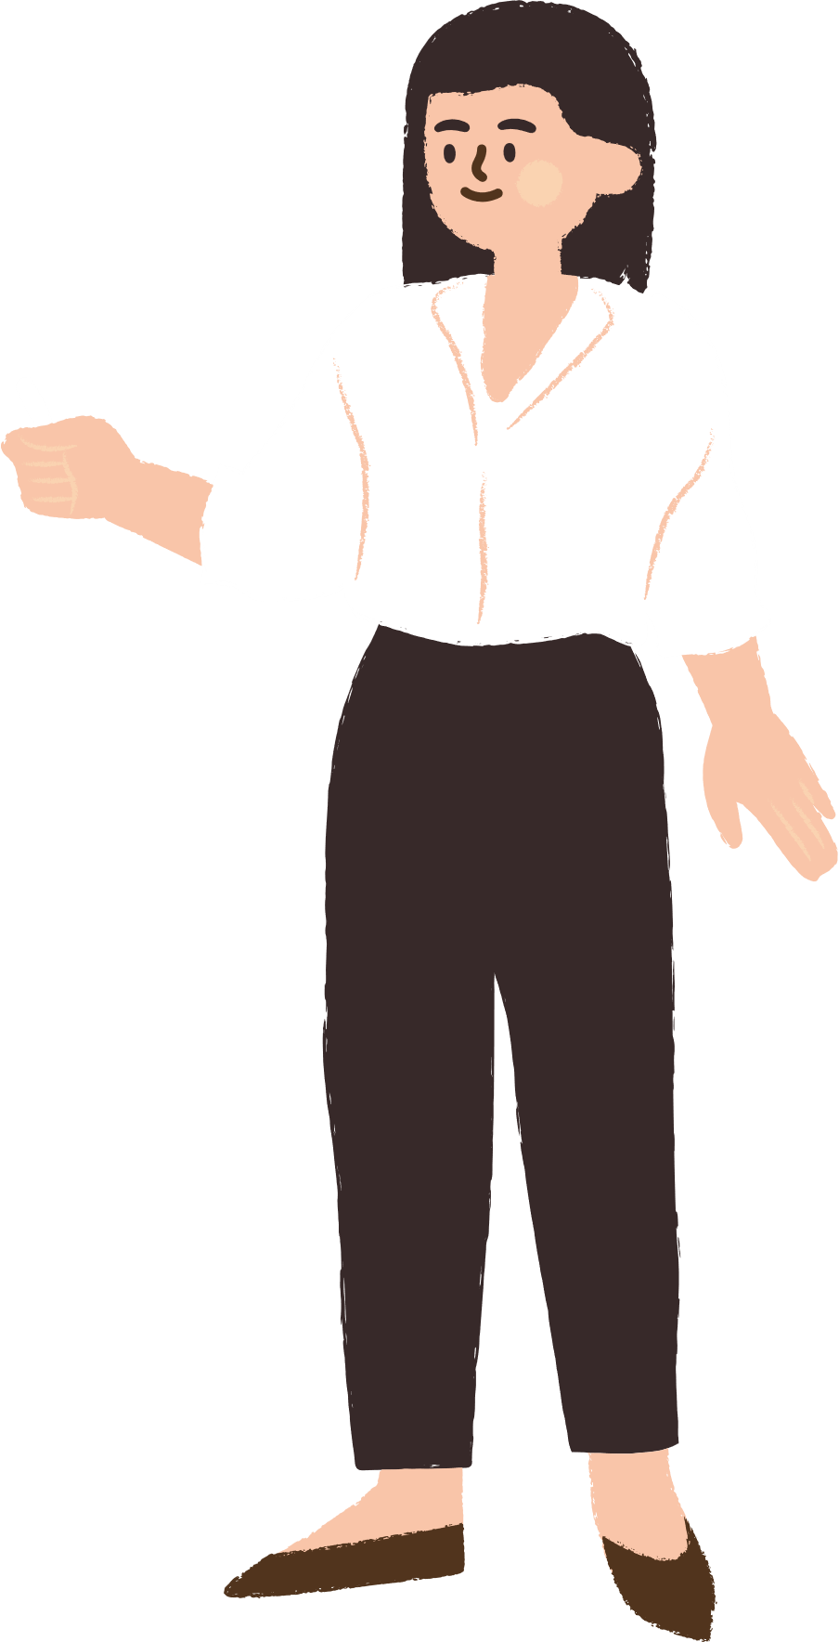




Good Afternoon
class
Teacher: Trịnh Thùy Trang

Slide 2


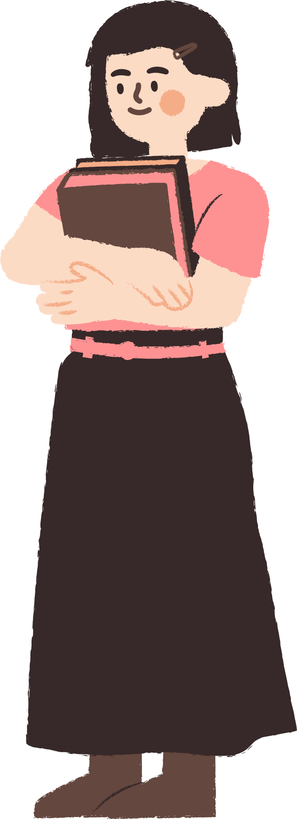




* WARM-UP
The team with the more correct answers wins.
A | N | C | H | E | C | K | E
P | P | O | S | T | O | S | E
I | E | N | A | C | U | U | B
C | O | N | M | U | A | T | E
T | W | E | B | S | I | T | E
U | A | C | L | I | P | D | I
R | S | T | D | Y | F | K | L
E | R | P | Q | E | A | O | V

Slide 3
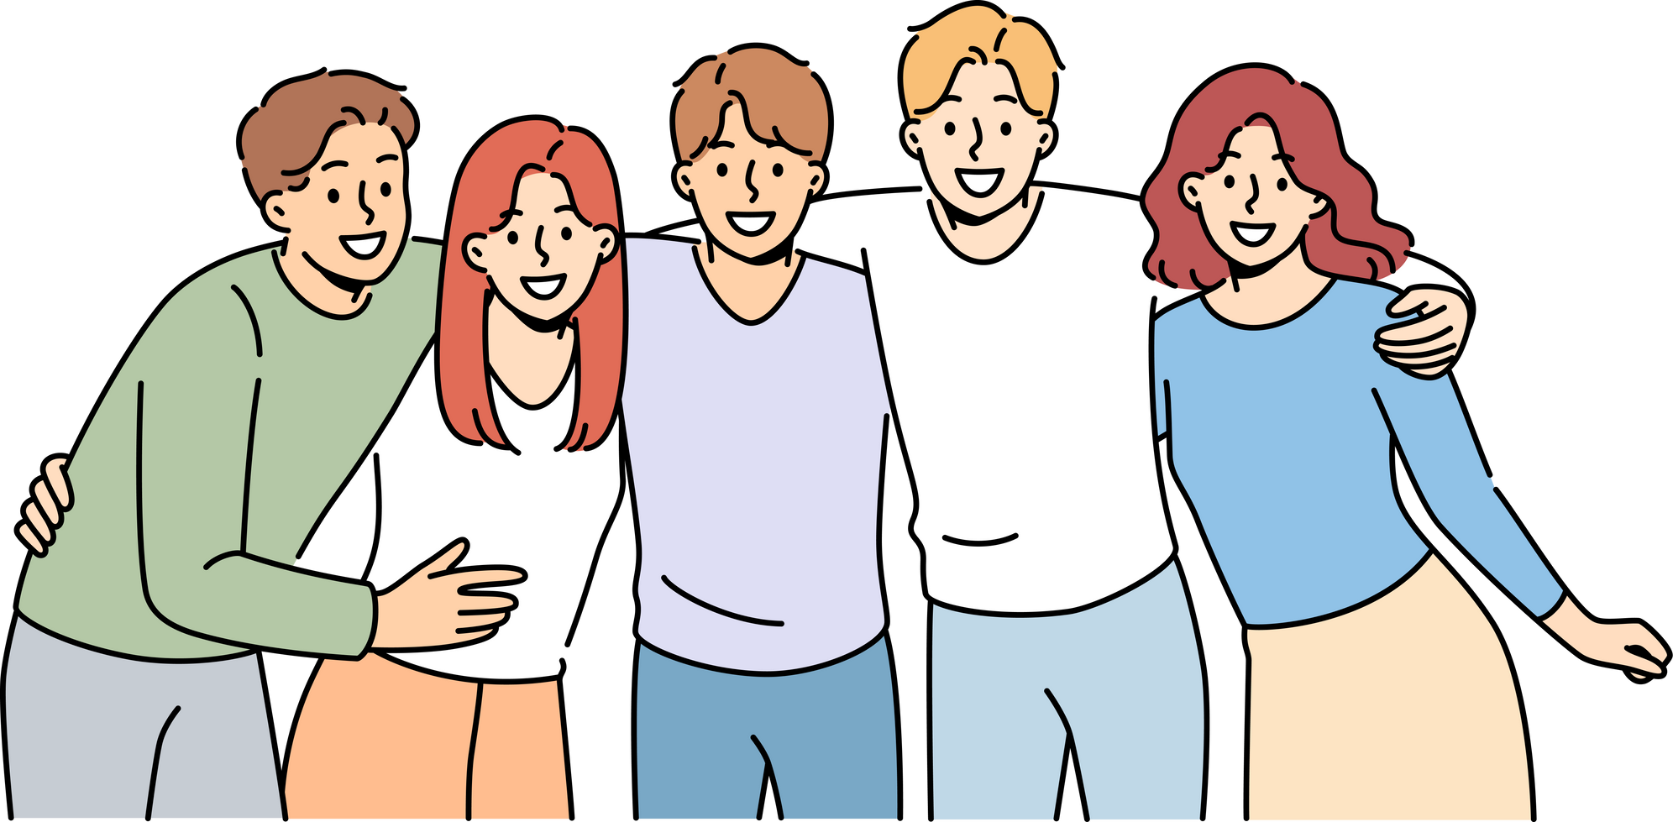



UNIT 3
TEENAGERS
LESSON 2: A CLOSER LOOK 1

Slide 4




*VOCABULARY
tải lên

Slide 5

*VOCABULARY
browse (v):
đọc lướt, tìm (trên mạng)
/braʊz/

Slide 6


*VOCABULARY
notification (n):
thông báo
/ˌnəʊtɪfɪˈkeɪʃn/

Slide 7

*VOCABULARY
log on to (v):
đăng nhập
/lɒɡ ɒn tə/

Slide 8
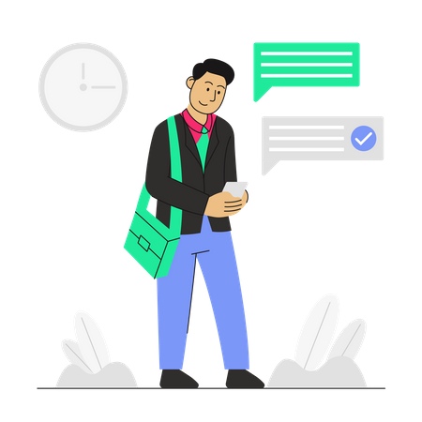
*VOCABULARY
check (v):
kiểm tra
/tʃek/

Slide 9


*VOCABULARY

Slide 10
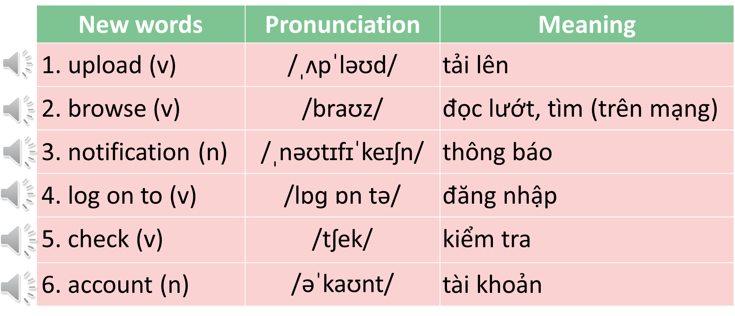
*VOCABULARY

Slide 11
* RUB OUT AND REMEMBER
New words | Pronunciation | Meaning
1. | /ˌʌpˈləʊd/ | tải lên
2. | /braʊz/
3. | /ˌnəʊtɪfɪˈkeɪʃn/ | thông báo
4. | /lɒɡ ɒn tə/
5. | /tʃek/ | kiểm tra
6. | /əˈkaʊnt/ | tài khoản
upload (v)
browse (v)
đọc lướt, tìm (trên mạng)
notification (n)
log on to (v)
đăng nhập
check (v)
account (n)

Slide 12
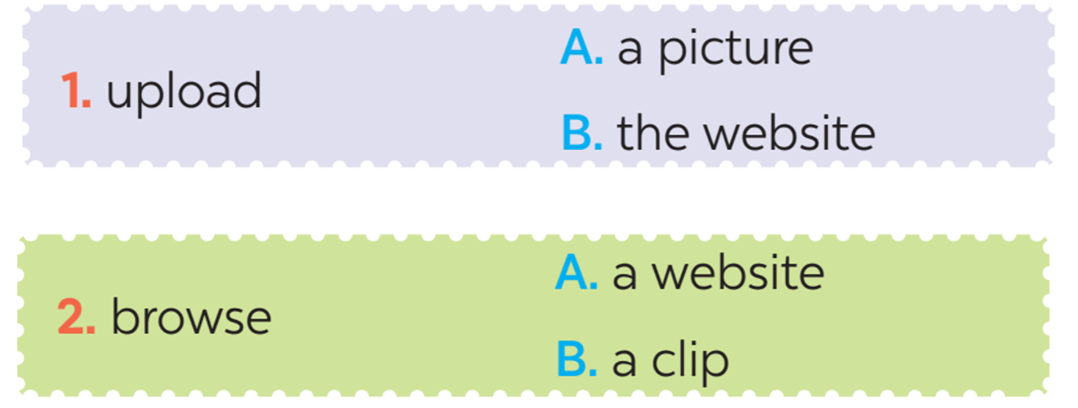
*VOCABULARY

Slide 13
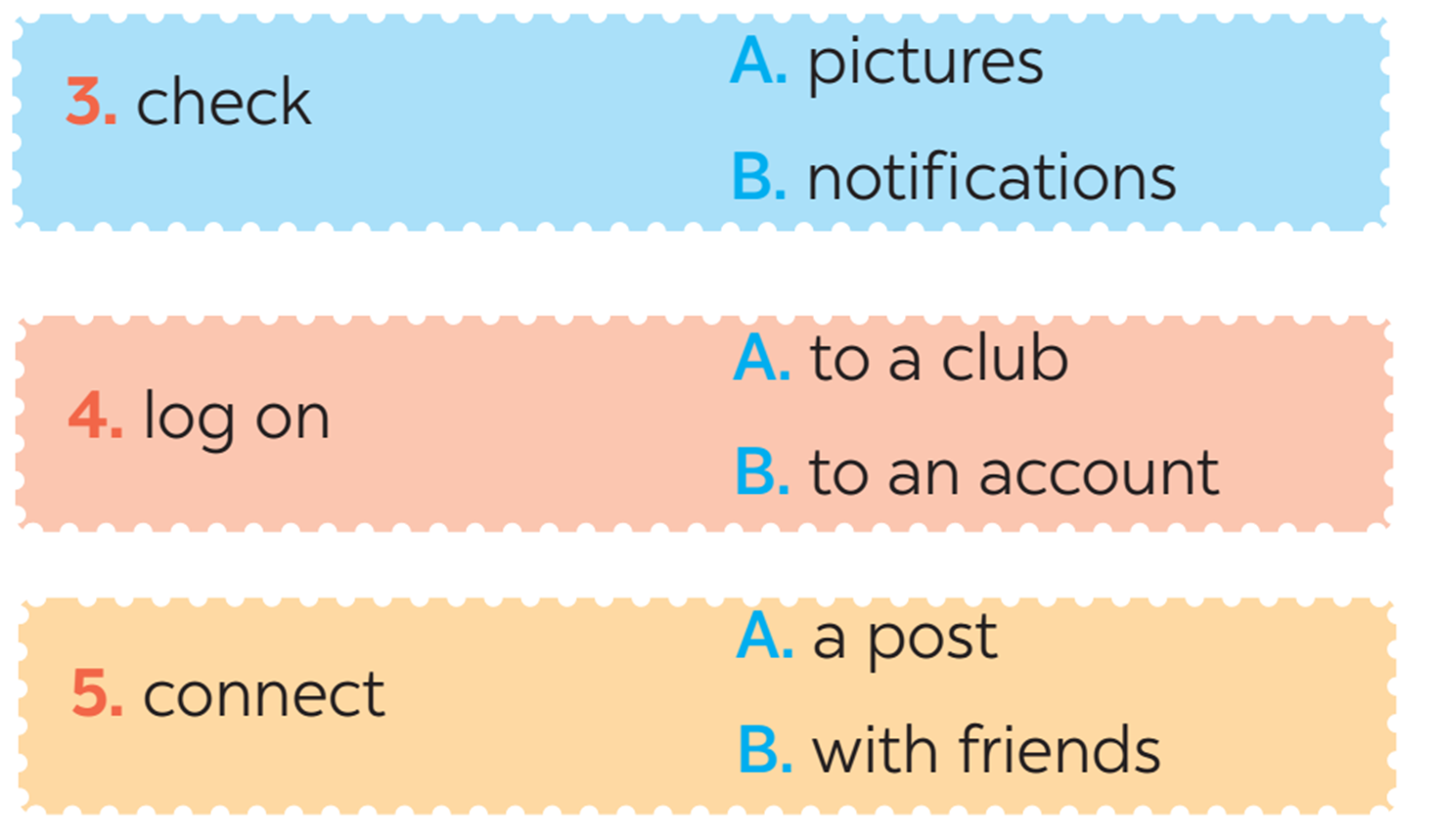
*VOCABULARY

Slide 14
2. Use the correct forms of the verbs in 1 to complete the sentences.
1. I________ the school website and found pictures of school activities.
2. Our teacher ________ a video of our last meeting in our forum for everyone to see.
3. She ________ with some old friends at the English club.
4. Tom ________ the notifications and saw some new posts.
5. Mi often ________ to her Instagram account to chat with her friends.

Slide 15
2. Use the correct forms of the verbs in 1 to complete the sentences.
browsed
1. I _________ the school website and found pictures of school activities.
uploaded
2. Our teacher ____________ a video of our last meeting in our forum for everyone to see.
connects
3. She __________with some old friends at the English club.
checked
4. Tom _________ the notifications and saw some new posts.
logs on
5. Mi often ________ to her Instagram account to chat with her friends.

Slide 16
3.Choose the correct answer A, B, or C.
1. Our class has a(n)______, and we often post questions there to discuss.
A. office
B. forum
C. club
2. We try to meet our parents’ ______, but it is hard.
A. dreams
B. interests
C. expectations
3. He is a big ______ and scares his weaker classmates.
A. bully
B. forum
C. pressure
4. She was chatting with her friends, so she couldn’t ______ on the lesson.
A. concentrate
B. coach
C. advise
5. We have ______ from our exams, peers, and parents. This makes us feel very stressed.
A. interests
B. pressure
C. friends

Slide 17

Choose the best answer

Slide 18


3
5
4
1
1. We try to meet our parents’ ______, but it is hard.
3
2
A. dreams
B.expectations
C. interests

Slide 19
3
5
4
1
2. Our class has a(n)______, and we often post questions there to discuss.
3
2
A. office
B. forum
C. club

Slide 20
3
5
4
1
3. We have ______ from our exams, peers, and parents. This makes us feel very stressed.
3
2
C. friends
B. interests
A. pressure

Slide 21
3
5
4
1
4. He is a big ______ and scares his weaker classmates.
3
2
C. pressure
B. forum
A. bully

Slide 22
3
5
4
1
5. She was chatting with her friends, so she couldn’t ______ on the lesson.
3
2
A. advise
B. coach
C. concentrate

Slide 23
4
Listen and repeat the words. Pay attention to the sound /ʊə/ and /ɔɪ/.
Then put the words into the correct columns
boy tourist toy ensure
avoid choice sure tournament
/ʊə/ | /ɔɪ/
tourist
boy
ensure
toy
sure
avoid
tournament
choice

Slide 24
5
Listen and practice the sentences. Underline the words with /ʊə/ and circle the words /ɔɪ/.
She is a noisy and curious girl.
They joined a full-day city tour.
I found it enjoyable to watch the tournament.
She’ll record our voices during the interview.
He is not acting very mature and is starting to annoy me.

Slide 25

*WRAP-UP
Vocabulary: upload, browse, notification, log on, check, account.
Pronuncation: /ʊə/ and /ɔɪ/

Slide 26

HOMEWORK:
Do exercises in WB: Part A
Find 5 more words with the sound /ʊə/ and 5 more words with the sound /ɔɪ/. Write them down on your notebook.
Prepare new lesson: Unit 3 – A closer look 2.

Slide 27


