Slide 1


Slide 2
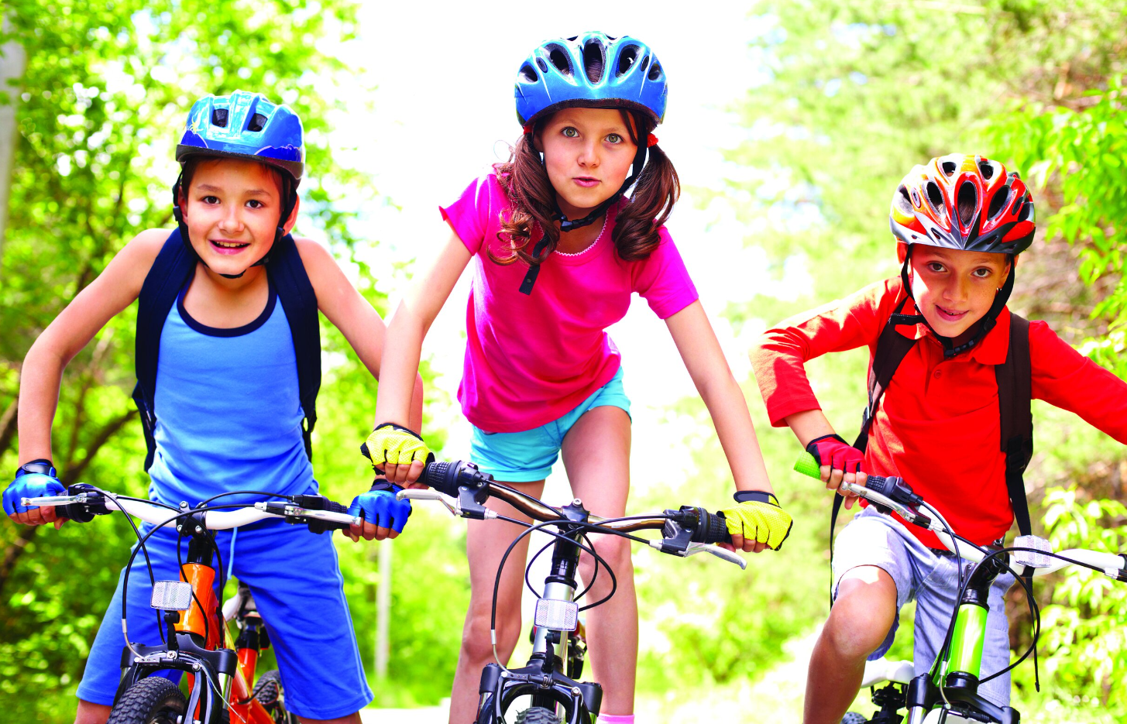
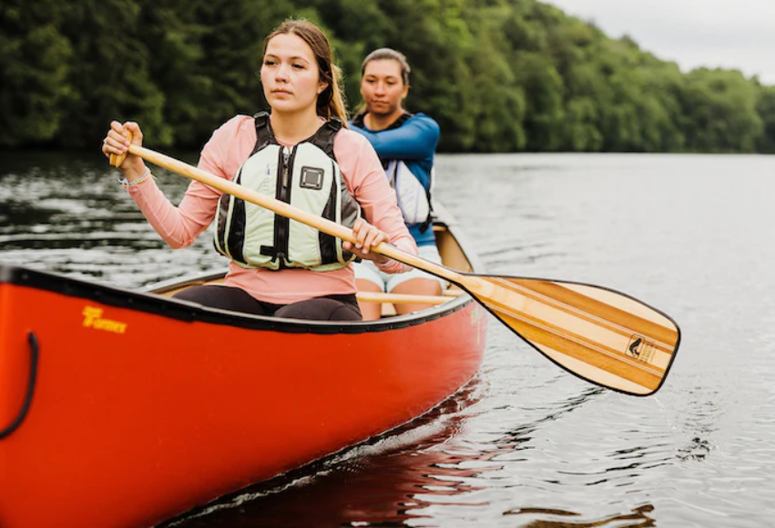
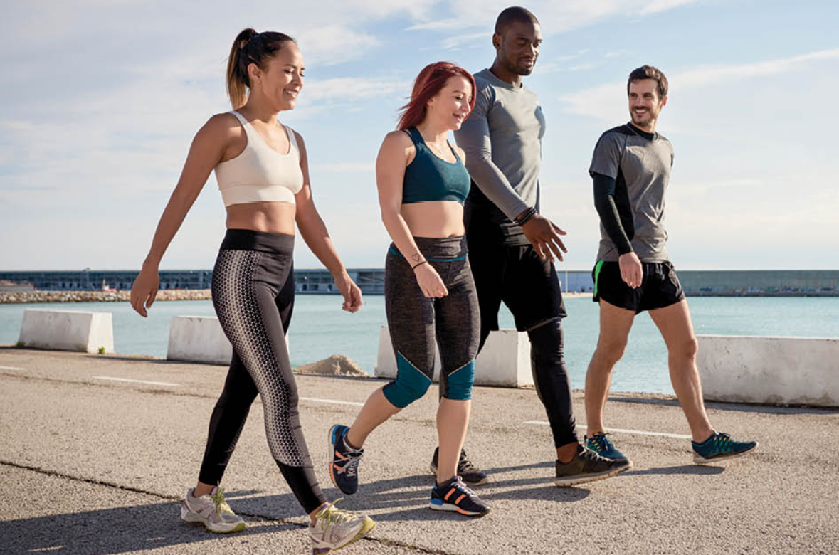

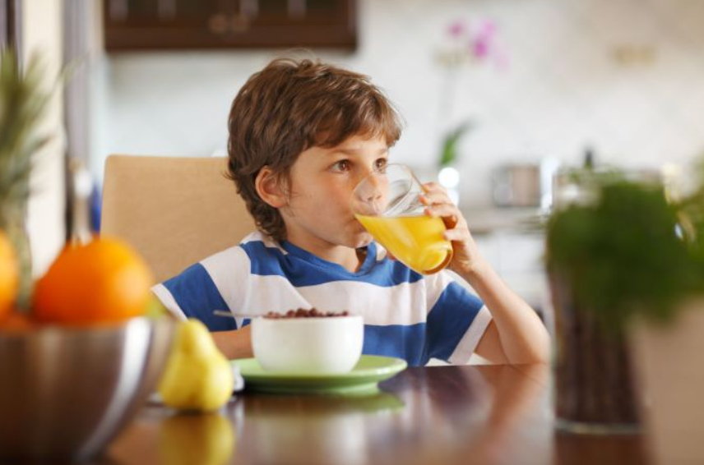
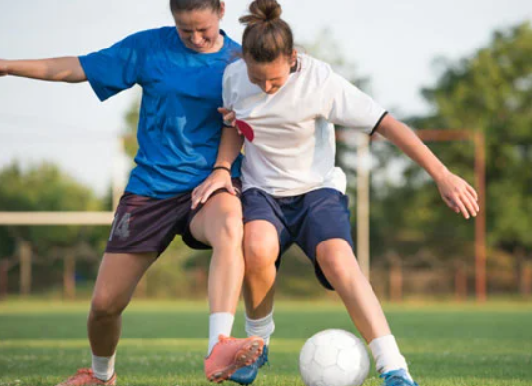
WARM UP
HEALTHY ACTIVITIES

Slide 3

WARM-UP: FACE TO FACE
HEALTHY ACTIVITIES

Slide 4



Unit
2
HEALTHY LIVING
LESSON 2: A CLOSER LOOK 1
By the end of the lesson, you will be able to
1
Use the words about healthy activities and health problems
1
2
Pronounce and recognize the sounds /f/ and /v/

Slide 5

VOCABULARY
dim light (n)
/dɪm lait/
ánh sáng lờ mờ

Slide 6
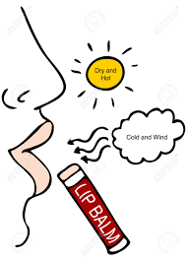
VOCABULARY
lip balm (n)
/ˈlɪp ˌbɑːm/
son dưỡng môi

Slide 7
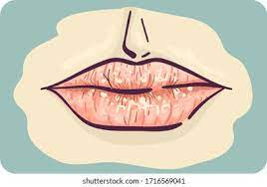
VOCABULARY
chapped lips (n)
/tʃæpt lɪps /
môi nứt nẻ

Slide 8
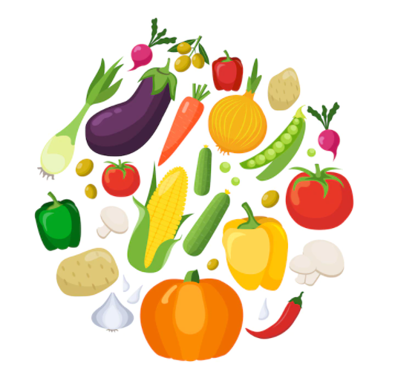
VOCABULARY
coloured vegetables (n)
/ ˈkʌləd ˈvedʒtəbəl/
rau có màu sắc

Slide 9
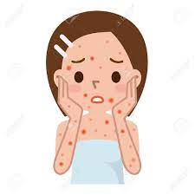
VOCABULARY
red spots (n)
/red spɒt/
đốm đỏ

Slide 10
VOCABULARY
New words | Pronunciation | Meaning
1. dim light (n) | /dɪm lait/ | ánh sáng lờ mờ
2. lip balm (n) | /ˈlɪp ˌbɑːm/ | son dưỡng môi
3. chapped lips (n) | /tʃæpt lɪps / | môi nứt nẻ
4. coloured vegetables (n) | / ˈkʌləd ˈvedʒtəbəl/ | rau có màu sắc
5. red spots (n) | /red spɒt/ | đốm đỏ

Slide 11
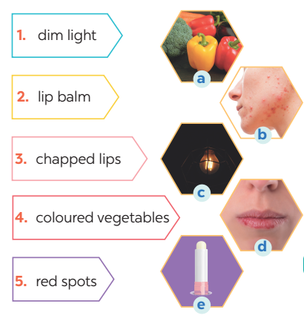
VOCABULARY
1
Match the phrase on the left with the correct pictures on the right.
1. c
2. e
3. d
4. a
5. b

Slide 12
VOCABULARY
2
Complete the sentences with the correct words and phrases.
skin condition soft drinks coloured vegetables sunburn fit
coloured vegetables
1. - Please name some ________________________.
- Carrots and tomatoes.
2. ___________ are not good for your health.
3. My parents go cycling every Sunday. It keeps them _______.
4. The weather may affect our ________________.
5. - How do we get _________?
- When we spend a long time in the sun without a hat or suncream.
Soft drinks
fit
skin condition
sunburn

Slide 13


VOCABULARY
3
Discuss and tick each activity in the table as H (Healthy) or U (Unhealthy).
 | H | U
1. washing your hands often
2. reading in dim light
3. eating tofu and coloured vegetables
4. brushing your teeth twice a day
5. touching your face with dirty hands

Slide 14

PRONUNCIATION
/f/ and /v/
Aims of the stage:
to help students identify how to pronounce the final sounds /f/ and /v/ at the end of the words

Slide 15

PRONUNCIATION
/f/ and /v/
Notes:
Chèn clip phát âm của HEID

Slide 16
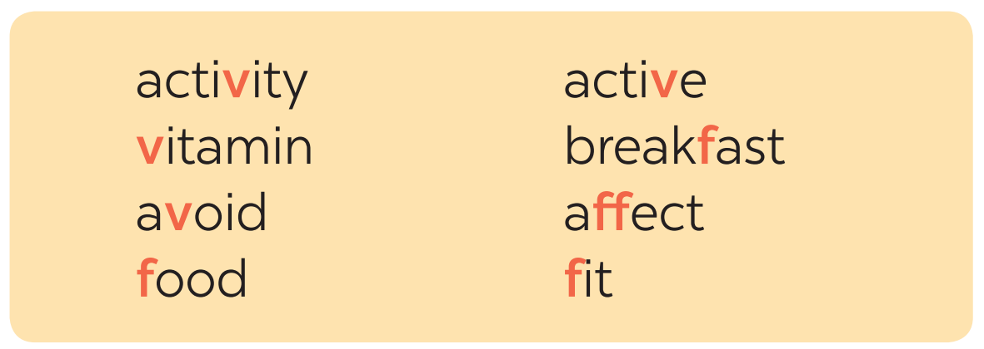

PRONUNCIATION
4
Listen and repeat the words. Pay attention to the sounds /f/ and /v/.

Slide 17
PRONUNCIATION
5
Listen and repeat, paying attention to the underlined words.
1. Coloured vegetables are good food.
2. My favorite outdoor activity is cycling.
3. We need vitamin A for our eyes.
4. Being active helps keep you fit.
5. Jack never eats fish.
/f/ and /v/

Slide 18
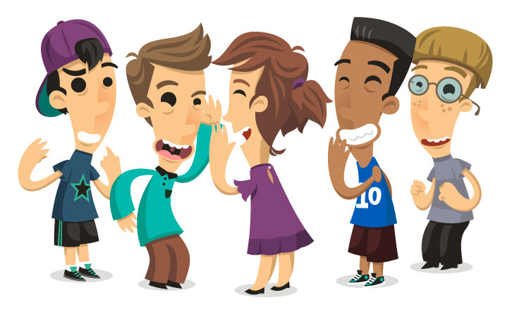
PRODUCTION
Game: Tongue twister
Aims of the stage:
to give students chance to apply what they have learnt

Slide 19
PRODUCTION
Game: Tongue twister
Victoria fried some fresh fish.
2. Van fried the fish in half a vat of fat.

Slide 20
CONSOLIDATION
1
WRAP-UP
VOCABULARY
PRONUNCIATION
Healthy activities and health problems
/f/ and /v/

Slide 21
CONSOLIDATION
2
HOMEWORK
Find 5 more words with the sound /f/ and 5 more words with the sound /v/. Write them down and practice pronouncing the words.

Slide 22

Website: hoclieu.vn
Fanpage: facebook.com/www.tienganhglobalsuccess.vn/

