Slide 1

UNIT 7
RECIPES AND EATING HABITS
Period 57
Lesson 3: A close look 2

Slide 2
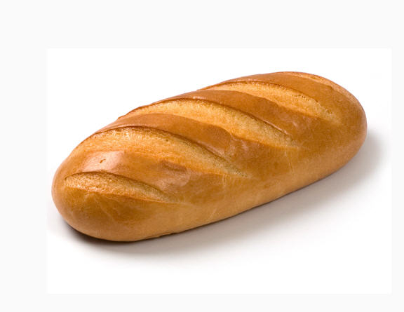
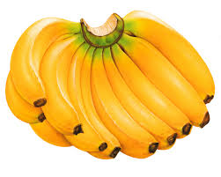
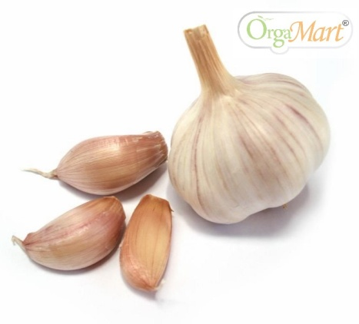
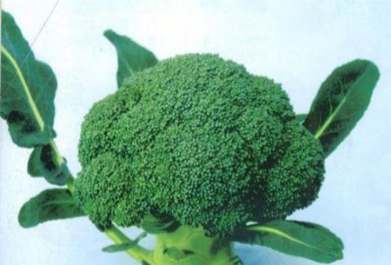
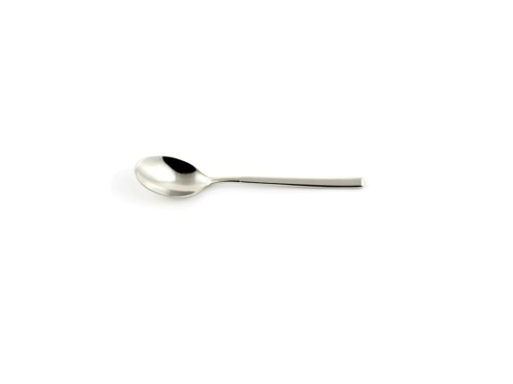

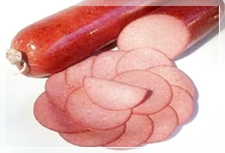
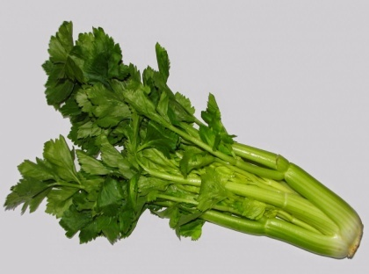
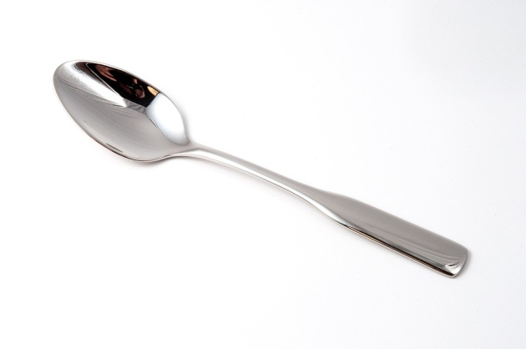
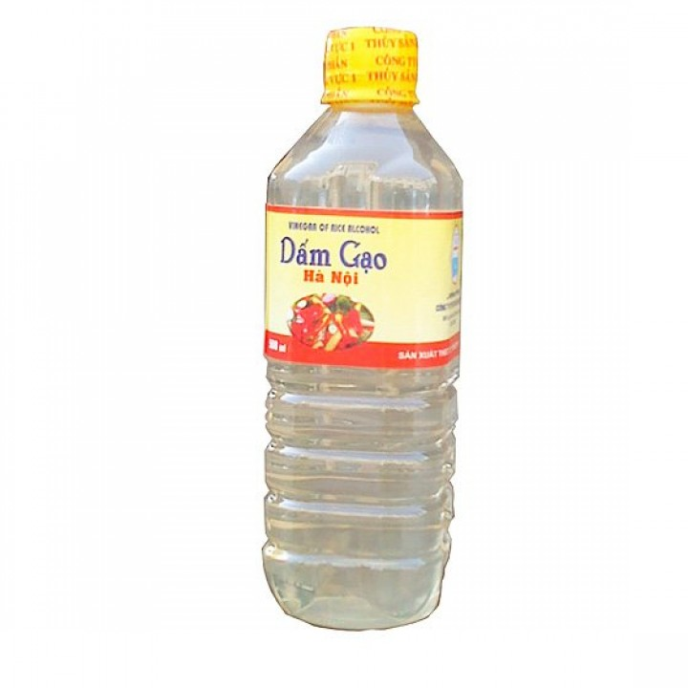
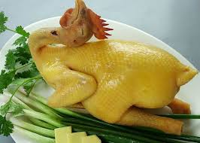

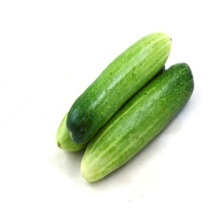
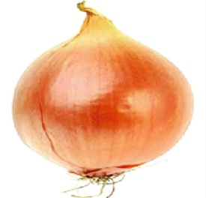

Slide 3
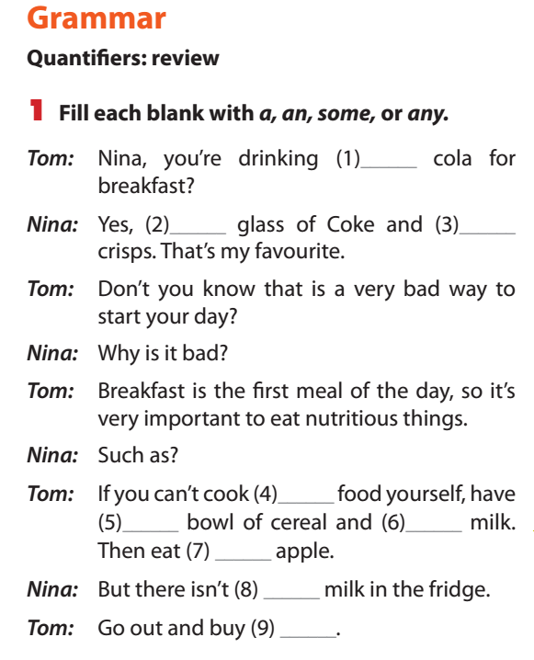
a
a
some
any
a
some
an
any
some

Slide 4
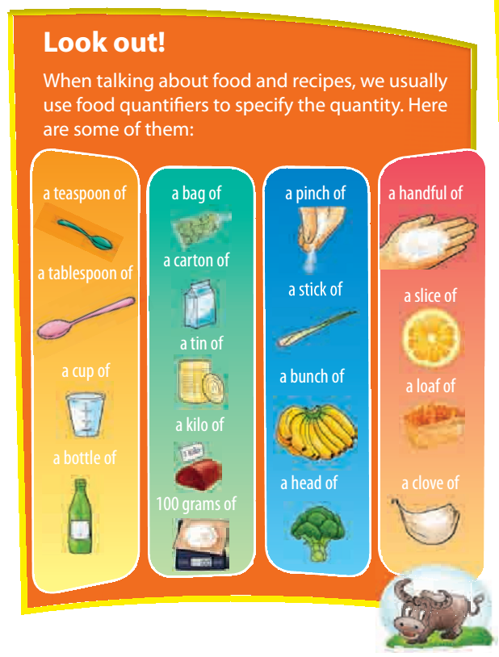

Slide 5
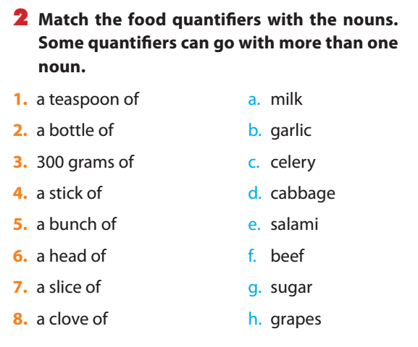

Slide 7
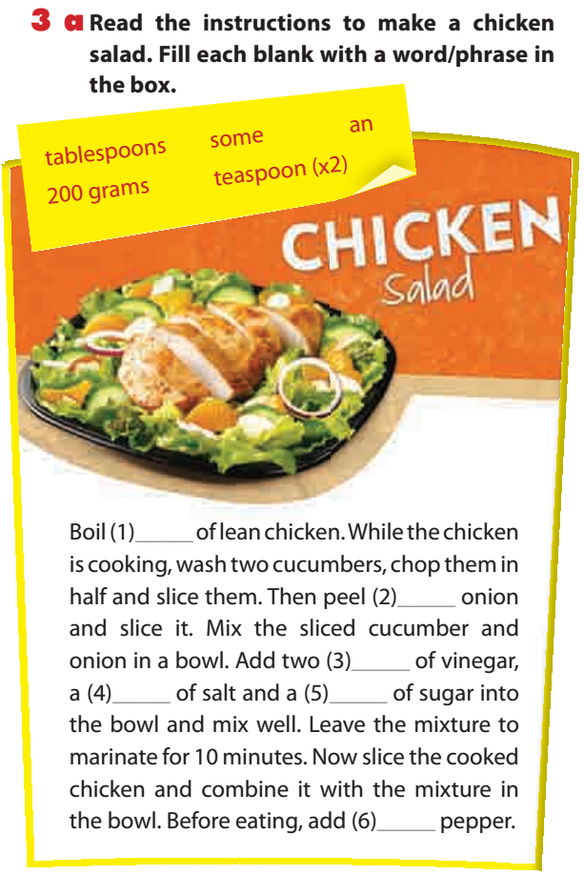
200 grams
an
tablespoons
teaspoon
teaspoon
some

Slide 8
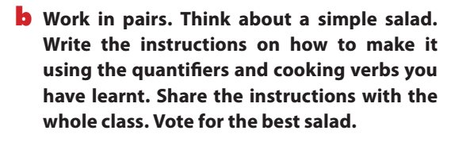
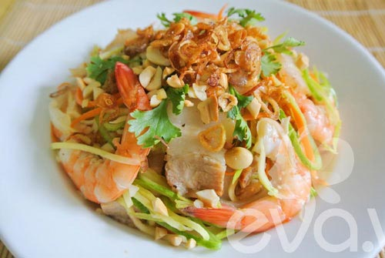

Slide 9
Preparing and cooking verbs:
- Wash
- Chop/ slice
- Boil
- Peel
- Mix/ combine
- Add

Slide 10
II. Modal verbs in conditional sentences type 1
Eg: I can help you to make chicken salad if you like.
If + S + V(s/es)…, S + will/can/must/should/may… +V

Slide 11
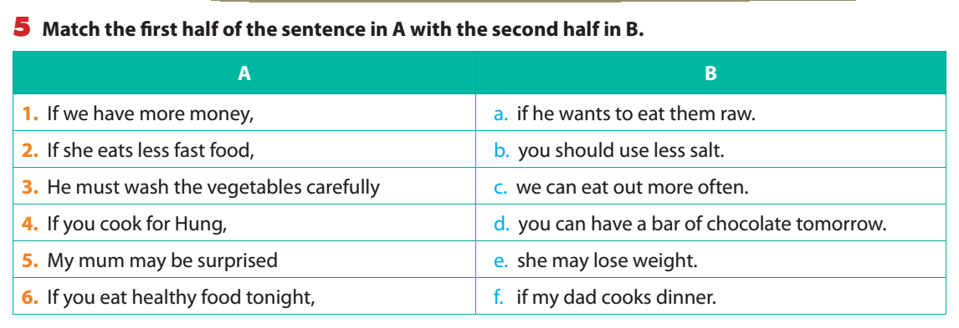

Slide 12
6. What will you say in these situation? Use suitable modal verbs with conditional sentences type 1
1. If you want to have good health, you must reduce the amount of salt in your food.
2. If my brother is hungry, he can eat three bowls of rice.
3. You can take a cooking class if it is at the weekend.
4. If I eat this undercooked pork, I may have a stomachache.
5. You should whisk the eggs for 10 minutes if you want a
lighter cake.

Slide 13
Homework
Do exercises 5,6,7 in workbook
Redo the exercises 3b and 6.

Slide 14

Thank you for your attendance. Good bye!
14

