Slide 1
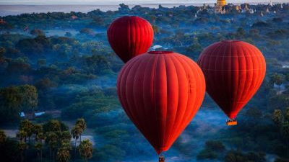
Welcome
teachers and students!
Teacher: DAO THI THU HIEN

Slide 2
* WARM-UP
There are 3 sets of pictures
Find a keyword for each set of pictures.
1
2
3

Slide 3



* WARM-UP
Find a keyword for each set of pictures.
SET 1
Teenagers

Slide 4
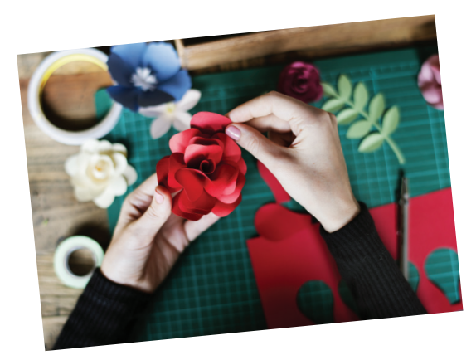

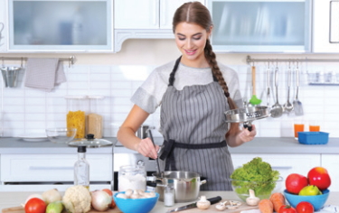
* WARM-UP
Find a keyword for each set of pictures.
SET 3
Leisure time activities

Slide 5
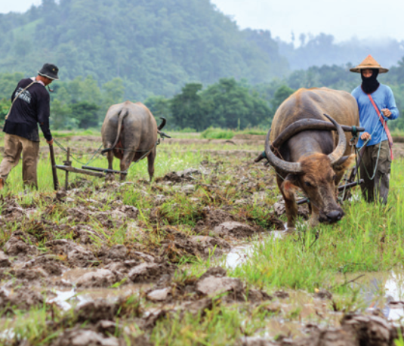
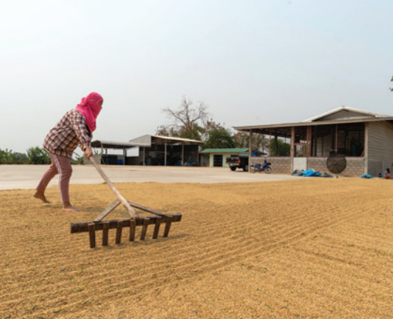
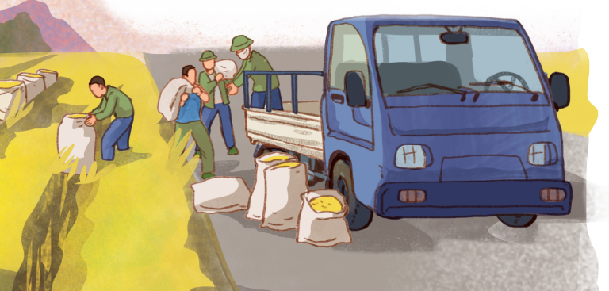
* WARM-UP
Find a keyword for each set of pictures.
SET 2
Life in the countryside

Slide 6





PERIOD 23: REVIEW 1 LANGUAGE

Slide 7

REVIEW
1
UNITS 1-2-3
LESSON 1: LANGUAGE
Pronunciation
Vocabulary
Grammar
UNITS
1-2-3
HOBBIES

Slide 8

OBJECTIVES
Vocabulary about:
Unit 1:Leisure time
Unit 2: Life in gthe countryside
Unit 3: Teenagers
Pronunciation:
/ʊ/ & /u:/, /ǝ/ & /ɪ/, /ʊǝ/ & /ɔɪ/.
Grammar about:
+ Verbs of liking/ disliking + V-ing/ to V
+ Verbs of liking/ disliking + V-ing
+ Comparative Adverbs
+ Simple sentences and Compound Sentences

Slide 9
* PRONUNCIATION
1
Circle the word whose underlined part is pronounced differently from the others.
good B. cool C. foot D. cook
A. June B. rude C.truth D. put
village B. buffalo C. cottage D. shortage
A. ensure B. insure C. picture D. surely
A. avoid B. doing C. choice D. join
/ɡʊd/
/kuːl/
/fʊt/
/kʊk/
/dʒuːn/
/ruːd/
/truːθ/
/pʊt/
/ˈvɪl.ɪdʒ/
/ˈbʌf.ə.ləʊ/
/ˈkɒt.ɪdʒ/
/'∫ɔ:tIdʒ/
/ɪnˈʃɔːr/
/ˈʃɔː.li/
/ɪnˈʃɔːr/
/ˈpɪk.tʃər/
/əˈvɔɪd/
/ˈduːɪŋ/
/tʃɔɪs/
/dʒɔɪn/

Slide 10
* VOCABULARY
2
Circle the correct answer A, B, or C to complete each sentence.
1. Mi is _____ gardening in her free time.
A. in B. into C. to
2. Mai is interested _____ building websites for her friends.
A. of B. with C. in
3. Minh is not fond of _____ puzzles because he thinks it takes a lot of time.
A. making B. doing C. building
4. I'm not keen on _____ our class photos to the forum.
A. uploading B. surfing C. messaging
5. While l was _____ some websites, I saw an advertisement about a resort.
A. creating B. browsing C. uploading
Game

Slide 11
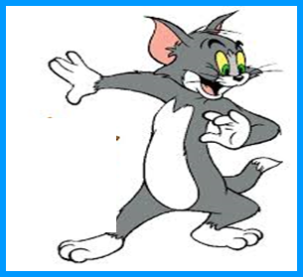
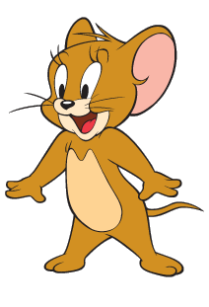
Game: Lucky numbers
1
2
3
4
5
6
7
8
GA
GB
GA
2
4
6
8
10
12
14
GB
2
4
6
8
10
12
14
K

Slide 12
* VOCABULARY
2
Circle the correct answer A, B, or C to complete each sentence.
1. Mi is ______ gardening in her free time.
A. in B. into C. to

Slide 13
* VOCABULARY
2
Circle the correct answer A, B, or C to complete each sentence.
2. Mai is interested ______ building websites for her friends.
A. of B. with C. in

Slide 14
2
Circle the correct answer A, B, or C to complete each sentence.
3. Minh is not fond of ______ puzzles because he thinks it takes a lot of time.
A. making B. doing C. building

Slide 15
2
Circle the correct answer A, B, or C to complete each sentence.
4. I’m not keen on ______ our class photos to the forum.
A. uploading B. surfing C. messaging

Slide 16
2
Circle the correct answer A, B, or C to complete each sentence.
5. While I was ______ some websites, I saw an advertisement about a resort.
A. creating B. browsing C. uploading

Slide 17

LUCKY NUMBER!
you get 2 plus points

Slide 18
LUCKY NUMBER!
you get 2 plus points

Slide 19


UNLUCKY NUMBER

Slide 20
* VOCABULARY
2
Circle the correct answer A, B, or C to complete each sentence.
1. Mi is _____ gardening in her free time.
A. in B. into C. to
2. Mai is interested _____ building websites for her friends.
A. of B. with C. in
3. Minh is not fond of _____ puzzles because he thinks it takes a lot of time.
A. making B. doing C. building
4. I'm not keen on _____ our class photos to the forum.
A. uploading B. surfing C. messaging
5. While l was _____ some websites, I saw an advertisement about a resort.
A. creating B. browsing C. uploading
Game

Slide 21
* VOCABULARY
3
Complete the sentences with the words from the box.
bully trained hospitable pressure focus
hospitable
1. People in my village are very ______________ to all visitors.
2. Parents in our village don’t put much _________ on their children to do well at school.
3. In my school, we can _______ on study and play, and do not have to worry about bullies.
4. The best ________player in our chess club will not be able to join the competition.
5. If a boy uses his strength to frighten weaker peers, he is a ______.
pressure
focus
trained
bully

Slide 22
* GRAMMAR
4
Choose the corect answer A,B, or C.

Slide 23



5
4
1
1. Mai dislikes ______ her pictures to Facebook. She prefers not to show them to others.
3
2
A. uploading
B. to upload
C. upload

Slide 24
5
4
1
2. We enjoy ______ photos of different types of scenery, so we took a camera with us.
3
2
A. taking
B. To take
C. take

Slide 25
5
4
1
3. She did the puzzles ______ than I did, so I won the competition.
3
2
A. slowly
B. slower
C. More slowly

Slide 26
5
4
1
4. Tom worked ______ than Mi; therefore, he got better results in the exams.
3
2
A. hardly
B. harder
C. more hard

Slide 27
5
4
1
5. Now they all chat with each other ______ than before because they have smartphones
3
2
A. more frequently
B. frequent
C. frequently

Slide 28
5
Underline the correct bold word in each sentence.
1. Minh is interested in painting, so / but yesterday he decided to join the arts and crafts club.
2. Life in the city seems to be more comfortable, otherwise / but I prefer life in the countryside.

Slide 29
5
Underline the correct bold word in each sentence.
3. She tries to focus more on her studies; therefore / otherwise, she won’t pass her exams.
4. During harvest time, farmers have to get up earlier, and / so they have to work harder.
5. Parents now have higher expectations of their children; therefore / so, children are under more pressure than before.

Slide 30
WRAP - UP
/ʊ/ & /u:/, /ǝ/ & /ɪ/, /ʊǝ/ & /ɔɪ/
+ Verbs of liking/ disliking + V-ing/ to V
+ Verbs of liking/ disliking + V-ing
+ Comparative Adverbs
+ Simple sentences and Compound Sentences
PRONUNCIATION
GRAMMAR
REVIEW 1
VOCABULARY
Leisure time
Life in gthe countryside
Teenagers

Slide 31

* Homework
- Do test yourself in the workbook
- Prepare review 1 (Skills)

Slide 32




