Slide 1


Welcome to class

Slide 2

Unit 8: Sports and games
Lesson 3: A closer look 2

Slide 3
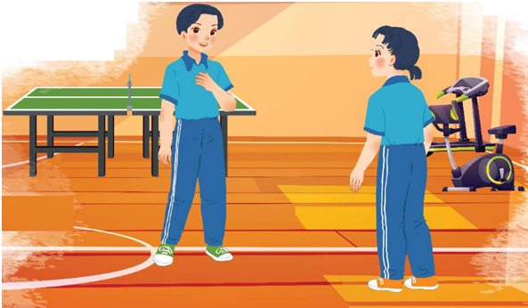
.
At the gym
When did Duong play table tennis?
Did he win?
He played table tennis yesterday.
Ved
Yes, he did. He won
V2

Slide 4
The past simple
We use the past simple to talk about something that happened in the past.(yesterday( hôm qua), last night( tối qua)
Example | Forms
He played badminton yesterday.
S+ V2/Ved
played
He didn’t play badminton yesterday.
didn’t play
S+ didn’t + V
Did he play badminton yesterday?
Did he play
Did + S+ V?
Tobe:
I was at home last night
I/He/She+ was...
was
They were not at home last night
You/ They/ We were...

Slide 5
VERBS
PAST FORMS
is/am/are
saw
1. see
had
2. go
ate
played
3. have
4. visit
was/ were
scored
5. eat
went
6. score
visited
7. play
Click the possessive pronouns to complete the chart

Slide 6

Act 1. Choose the correct answer A, B, or C.
1.
There _______ an interesting match on TV last night.
A.
is
B.
were
C.
were
2.
My dad _______ a lot of tennis some years ago.
A.
plays
B.
played
C.
is playing
3.
I was at the gym last Sunday, but I _______ you there.
A.
B.
don’t see
C.
didn’t see
not saw
4.
The teacher ____ us about our homework this morning.
A.
B.
not asking
C.
doesn’t ask
didn’t ask
5.
_______ sleep well last night?
A.
B.
Did you
C.
Were you
Do you

Slide 7
2. Write the correct form of the verbs to complete the conversation.
Nick: Hi, there.
Sonny: Hello, Nick. Did you have a nice weekend?
Nick: Yeah, it was OK. On Sunday, I (1. go) _______ fishing with my dad. How about you?
Sonny: Oh, I (2. have) _______ a good weekend, too.
Nick: Really? What _______ you (3. do) _______?
Sonny: I (4. visit) _______ the museum with my family, then we (5. eat) _______ at my favourite restaurant.
Nick: Did you watch football last Sunday
Sonny: Oh, yeah! My favourite team (6. score) _______ a fantastic goal!
went
had
did
do
visited
ate
scored

Slide 8
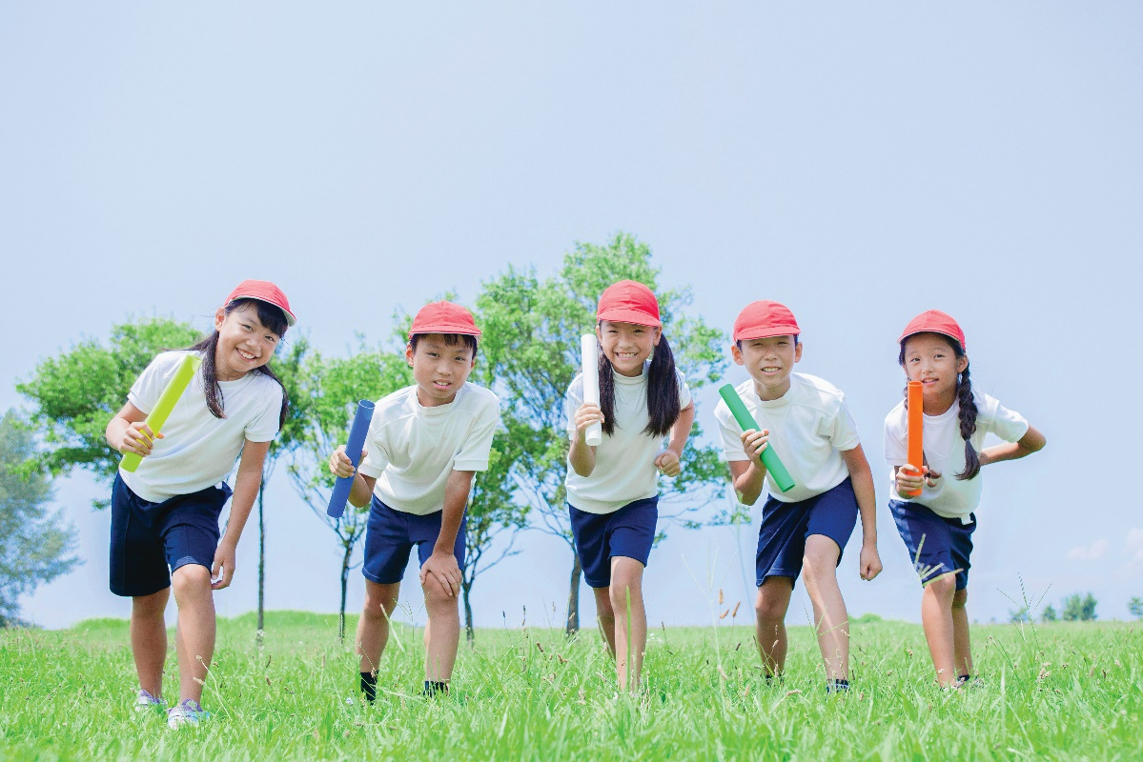
3. Work in groups. Ask and answer questions about last weekend.
A: Did you do any sport last weekend?
B: Oh yes, and I was exhausted.
C: Really? What did you do?
B: ........................
I played some games with my friends

Slide 9
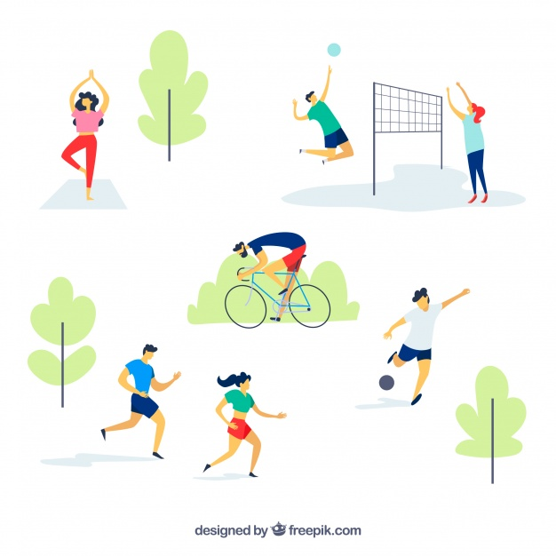
What did you do yesterday?
I danced
I played volleyball
I cycled
I ran
I played football

Slide 10
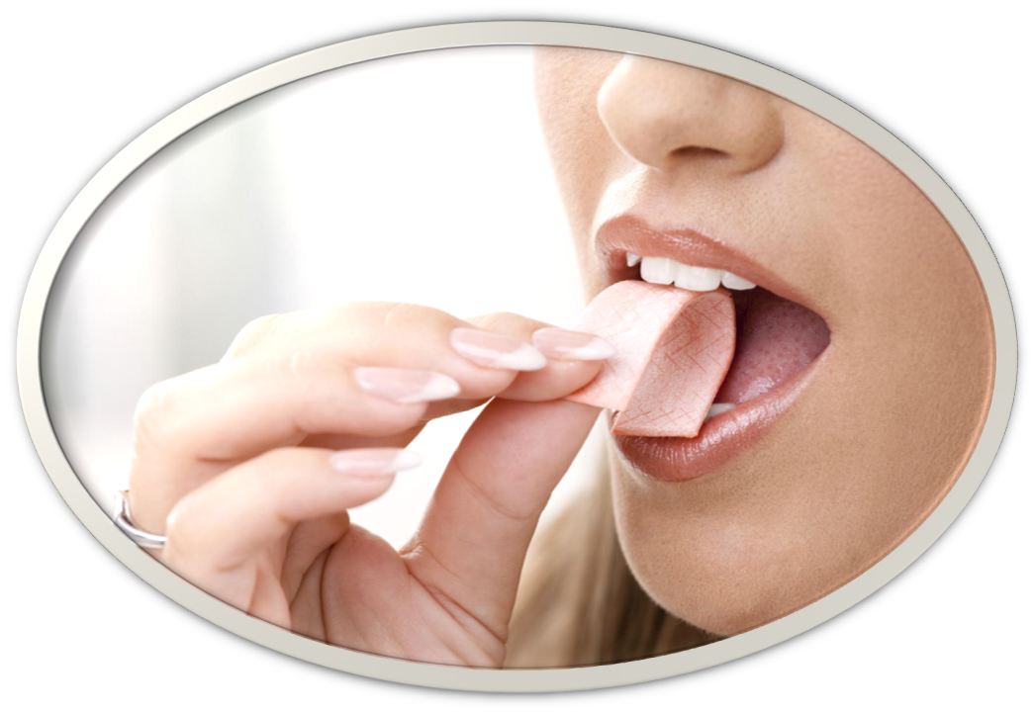
* GRAMMAR : Imperatives
We use Imperatives to tell someone to do something or to give a direct order.
* Positive : Vo+ …..
* Negative: Don’t+ Vo+ …
Example:
- It's chewing gum.
- Chew it.
- Don't swallow it.

Slide 11
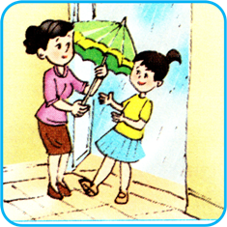


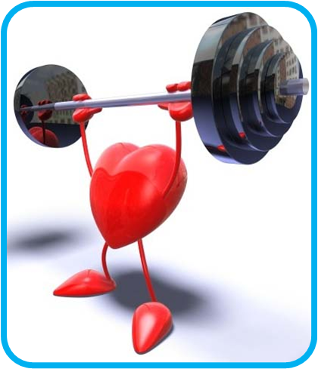

1. It's raining.
Take your umbrella.
2. Please don’t litter.
3. It's late now. Please hurry up.
4. Exercising is good but don’t train too hard.
5. It's cold.
Put on your coat.

Slide 12



Tell your friends what to do and what not to do at the gym.
GYM RULES
Example:
Change your clothes.
Don’t speak loudly.
_______
_______
_______

Slide 13

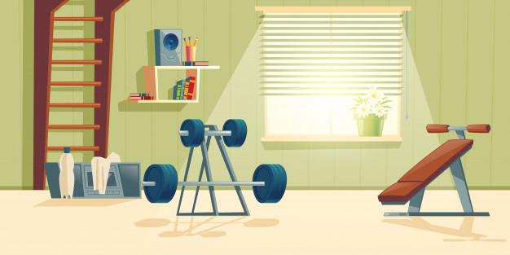




Act 5. Tell your friends what to do and what not to do at the gym.
Examples: - Change your clothes.
- Don’t talk loudly.
Some possible sentences:
- Pay your fee first.
- Put on your trainers/ sports shoes.
- Listen to the instructor carefully.
- Don‛t litter.
- Don‛t eat or drink at the gym.

Slide 14
HOMEWORK
Learn the lesson’s today
prepare for new lesson: Skill 1

Slide 15


