Slide 1
Unit 8: Sports and games
Lesson 6: Skills 2
TEACHER: NGUYEN THI HONG NGA

Slide 2

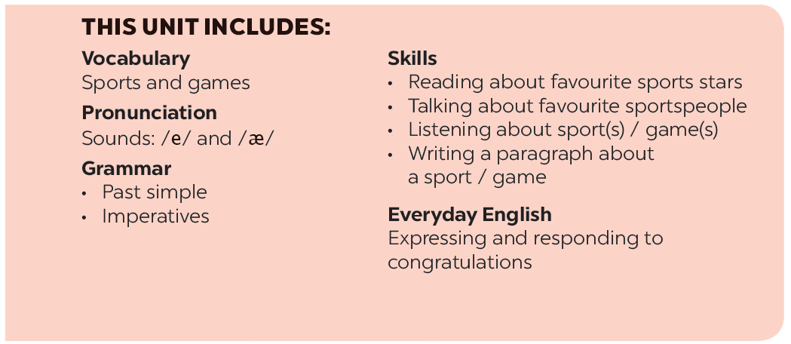

Slide 3







Listening
Writing
Listen to the passages. Who are they about?
Work in pairs. Talk about the sport / game you like. Use the following questions as cues.
Listen to the passages again. Then tick () T (True) or F (False) for each sentence.
Write a paragraph of 40-50 words about the sport / game you talked about in 4. You can also refer to the listening passages.
Listen again and fill each blank with a word to complete each sentences.

Slide 4
WARM UP!

Slide 5
VOCABULARY

Slide 6
VOCABULARY
cycle /ˈsaɪkl/ (v): đi xe đạp
aerobics /eəˈrəʊbɪks/ (n): thể dục dụng cụ
volleyball /ˈvɒlibɔːl/ (n): bóng chuyền
table tennis /ˈteɪbl/ /ˈtɛnɪs/ (n): bóng bàn

Slide 7
LISTENING

Slide 8



Listen to the passages. Who are they about?
The listening passages are about Hai and Alice.
Audio script

Slide 9
AUDIO SCRIPT
Hello. My name's Hai. I love sport. I play volleyball at school and I often go cycling with my dad at the weekend. But my favourite sport is karate. I practise it three times a week. It makes me strong and confident.
My name's Alice. I'm twelve years old. I don't like doing sport very much, but I like watching sport on TV. My hobby is playing chess. My friend and I play chess every Saturday. I sometimes play computer games, too. I hope to create a new computer game one day.

Slide 10

Listen to the passages again. Then tick () T (True) or F (False) for each sentence.
 | T | F
1. The passages are about two sportsmen.
2. Hai goes cycling at the weekend.
3. Hai’s favourite sport is karate.
4. Alice doesn’t like doing sport very much.
5. Alice plays computer games every day.





Audio script

Slide 11
AUDIO SCRIPT
Hello. My name's Hai. I love sport. I play volleyball at school and I often go cycling with my dad at the weekend. But my favourite sport is karate. I practise it three times a week. It makes me strong and confident.
My name's Alice. I'm twelve years old. I don't like doing sport very much, but I like watching sport on TV. My hobby is playing chess. My friend and I play chess every Saturday. I sometimes play computer games, too. I hope to create a new computer game one day.

Slide 12

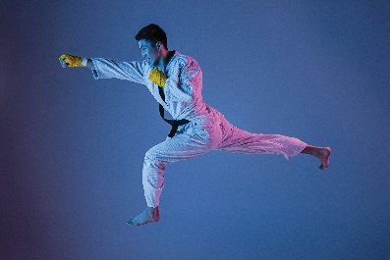

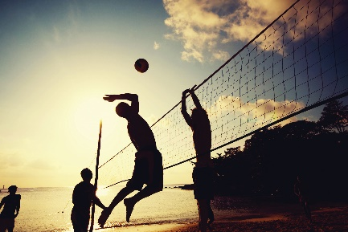
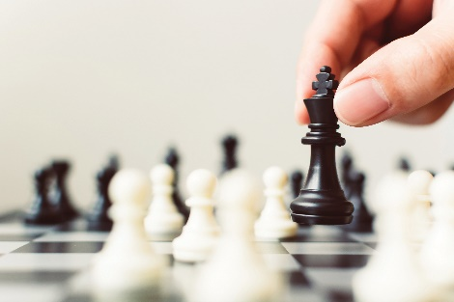
Listen again and fill each blank with a word to complete each sentences.
Hai plays
_______ at school.
1.
volleyball at school.
2.
_______ times a week.
Hai practises karate at the club
three times a week.
Alice likes watching sport on TV.
3.
_______ likes watching sport on TV.
Alice plays
_______ every Saturday.
4.
chess every Saturday.
Audio script

Slide 13
AUDIO SCRIPT
Hello. My name's Hai. I love sport. I play volleyball at school and I often go cycling with my dad at the weekend. But my favourite sport is karate. I practise it three times a week. It makes me strong and confident.
My name's Alice. I'm twelve years old. I don't like doing sport very much, but I like watching sport on TV. My hobby is playing chess. My friend and I play chess every Saturday. I sometimes play computer games, too. I hope to create a new computer game one day.

Slide 14
WRITING

Slide 15

Work in pairs. Talk about the sport / game you like. Use the following questions as cues.
What is the name of the sport / game?
How many players are there?
How often do you play it?
What equipment does it need?
Why do you like it?

Slide 16



Write a paragraph of 40-50 words about the sport / game you talked about in 4. You can also refer to the listening passages.

Slide 17

REMEMBER WHAT HAVE YOU LEARNT TODAY!

Slide 18
HOMEWORK
- Learn by heart new words.
- Complete the paragraph talk about the sport/ game you like.
- Prepare: LOOKING BACK AND PROJECT.

Slide 19
THANKS

