Slide 1
Unit 4:
Life in the past
Lesson 5: Skills 1
TEACHER: NGUYEN THI HONG NGA

Slide 2
01
WARM UP
BRAINSTORMING

Slide 3
How teens entertained themselves in the past compared to the present.
In the past | At present

Slide 4
How teens entertained themselves in the past compared to the present.
In the past | At present
- play traditional games - read books - climb trees / mountains - go walking - play with dolls quietly - play outside more often - help parents with the housework: looking after the youngers sisters or brothers / cooking meals / collecting water , gathering wood,.. | - play modern games : bowling , computer games, Zooniverse , building blocks… - go to the sports centre - learn how to play a sport - use computer. - play inside ( to prevent them from: kid napping , accidents…) - watch TV / ads on TV

Slide 5
READING

Slide 6
1. Think
1. How different is the way teenagers entertain themselves nowadays compared to the past?
- play outdoor/ indoor games.
- enjoy fresh air.
- team games / individual games.
- have good health/ no obesity
2. What do you think might be the biggest difference?
I think they used to………………… in the fresh air in the past but now they ……………………

Slide 7
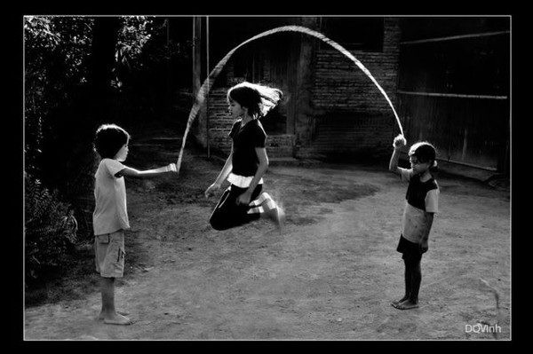
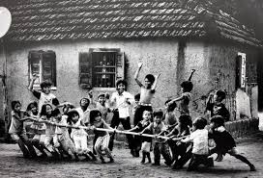
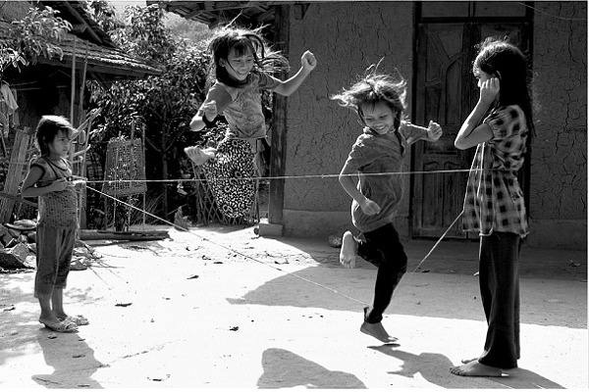
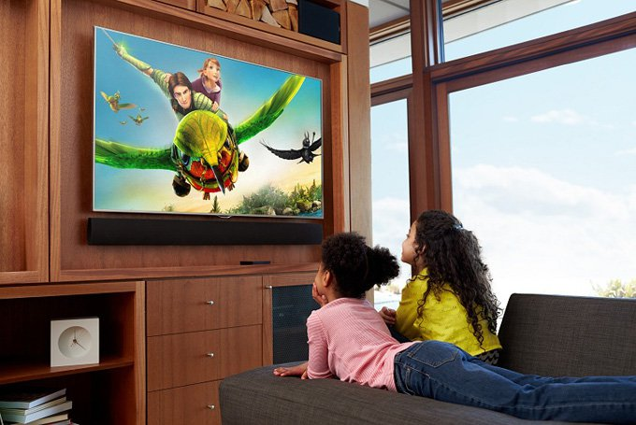
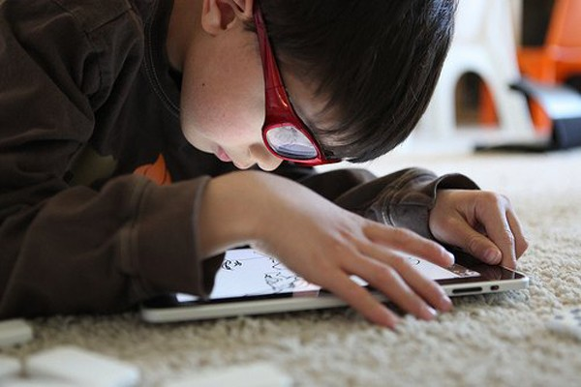
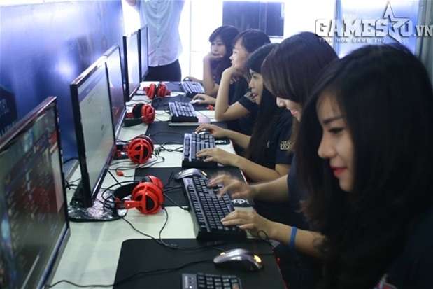
skip rope
play tug of war
jump elastic-band
Watch TV
Use mobile phone
play computer game
1.How different is the way teenagers entertain themselves nowadays compared to the past?
- In the past, they used to skip rope, …….
- Now, they ……….

Slide 8
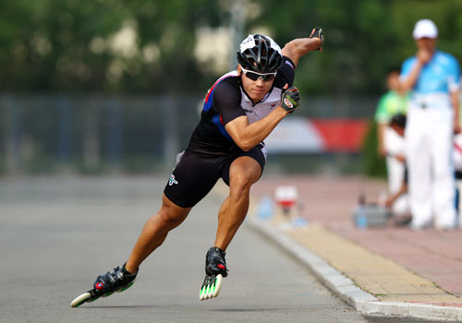
2.What do you think might be the biggest difference ?
modern equipments

Slide 9
2. Read the conversation between Phong and his mother, and answer the questions.
Phong: Mum, how did you use to entertain yourself when you were a teenager?
Mother: Well, kids in my days did a lot of physical activities in the fresh air: playing football, riding bikes, flying kites... We used nature as our playground. We also spent a lot of time with each other, playing and talking face to face, not on a screen like today.
Phong: It sounds nice, actually.
Mother: Yes. And this lifestyle kept us healthy and in shape. We didn't know about obesity. Girls didn't worry about getting fat and going on a diet.
Phong: Didn't you eat out with your friends?
Mother: No, we mostly ate at home. Sometimes we just had a snack from a street vendor.
Phong: I like street food. And did you watch much TV?
Mother: Only wealthy households had a TV. Instead, we read a lot. Unlike watching television, you had to use your imagination when you read. Ah! Now I remember - I used to keep a diary.
Phong: A diary? What did you write in it?
Mother: Lots of things: events, feelings, my private thoughts... you know.
Phong: Nowadays we just post them on Facebook.
Mother: I know. Life has changed so much, my darling.

Slide 10
* Answer the questions:
1. Where did teenagers in the past use to play?
They used to play outdoors, in the fresh air.
2. How did they communicate with each other?
They met and talked face to face.
3. What was the advantage of this lifestyle?
It kept them healthy and in shape.
4. Where did they mostly eat?
They mostly ate at home.
5. What did Phong's mother say about reading?
You had to use your own imagination.
6. Did teenagers in the past publicise their emotions?
No, they didn’t.

Slide 11
SPEAKING

Slide 12
3. Discuss in groups: What do you think about teenagers’ pastimes in 2?
Example:
Pastime: riding a bicycle
Response A: I love it . I wish I could do it more often.
Response B: I think it’s inconvenient, especially when it rains. I prefer a fitness centre.
Pastimes:
1. doing physical activities in the fresh air
2. using nature as your playground
3. meeting and talking face-to-face
4. reading
5. keeping a diary

Slide 13
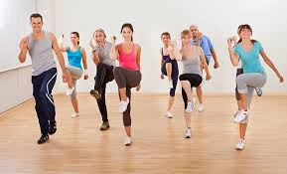
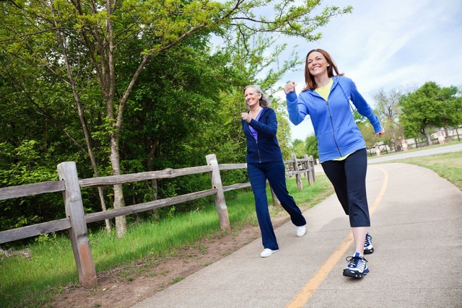
* Suggsetions:
1. doing physical activities in the fresh air.
A: I love it. I wish I could do it more often.
B: I think …….…………………………
but I prefer ….……………………..
we can keep fit and stay healthy

Slide 14
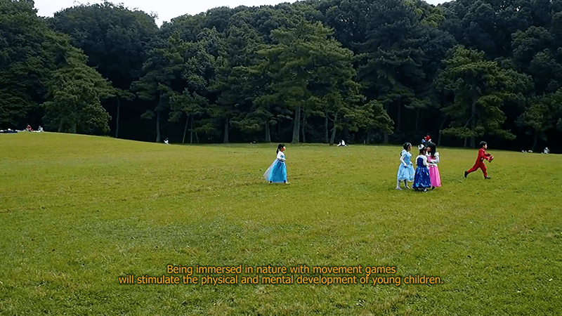
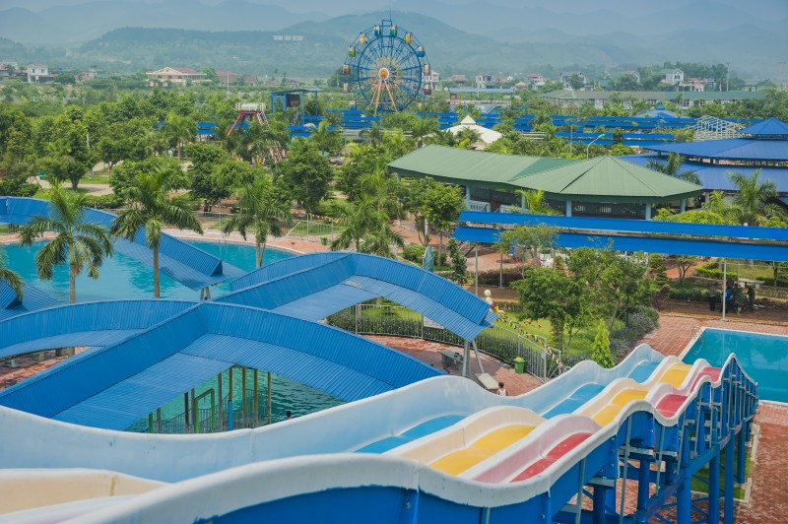
2. using nature as your playground
A: I enjoy it. I wish I could do it more often.
B: I think …….…………………………
but I prefer ………………………...
we can get fresh air

Slide 15


3. meeting and talking face to face
A: I like it. I wish I could do it more often.
B: I think …….…………………………
but I prefer ………………….
we can understand each others./ we have a friendly relationship with our friends.

Slide 16
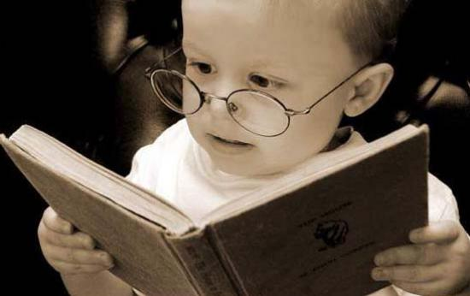

4. reading
A: I love it. I wish I could do it more often.
B: I think ….……………………...……
………………………………
but I prefer………………………...
we can get a lot of useful information./ we can improve our knowledge.

Slide 17
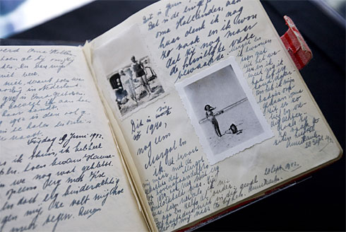

5. keeping a diary
A: I like it. I wish I could do it more often.
B: I think it……………………...……
…………………………..
but I prefer ……………………...........
helps us improve emotionally./ we can keep our memories in daily life.

Slide 18
4. Work in groups.
What do you think about these habits which have been long practised by children in Viet Nam? Would you like to preserve them? Why/Why not?
1. hand-written homework
2. playing traditional games like hide-and-seek, elastic-band jumping, skipping, and catch the chickens
3. crossing one's hands in the front and bowing when you greet a person of seniority
4. obeying your parents/teachers without
talking back

Slide 19
4. Work in groups.
What do you think about these habits which have been long practised by children in Viet Nam? Would you like to preserve them? Why/Why not?
Remember!
When you express your opinion, you can use:
(+) In my opinion, + clause.
I think/believe + clause.
I totally agree with the idea that + clause.
(-) I’m afraid I can’t agree (with) + clause.
I’m sorry but I have to say that + clause

Slide 20
* Suggestions:
In my opinion, I would like to preserve hand - written
homework because it makes the writing more beautiful. /
it helps us remember permanently.
2. I think playing traditional games like hide and seek, elastic- band jumping, skipping, and catch the chickens can provide not only entertainment and spectacle, but also an opportunity to renew connections to the history and the culture.
3. I believe that crossing one’s hands in the front and bowing when you greet a person of seniority can it shows respectfully, politically and friendly.
4. In my opinion, obeying your parents/ teachers without talking back shows your respect to them and it is also a tradition in Viet Nam.

Slide 21
HOME WORK
- Learn the word by heart.
- Be ready for Skills 2.

