Slide 1
Unit 4:
Life in the past
Lesson 4: Communication
TEACHER: NGUYEN THI HONG NGA

Slide 2
VOCABULARY

Slide 3
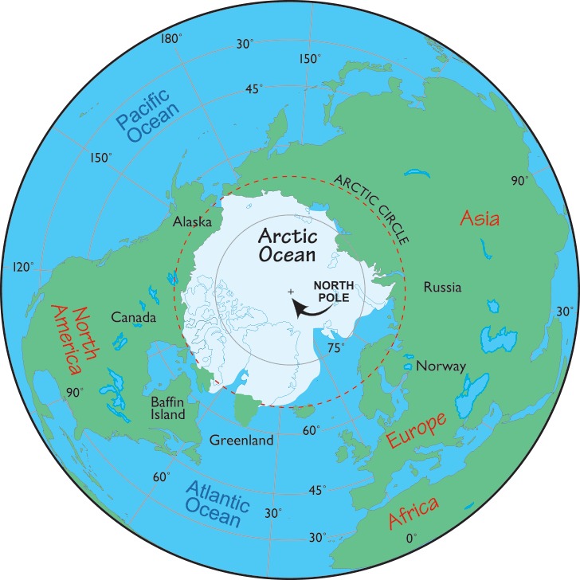
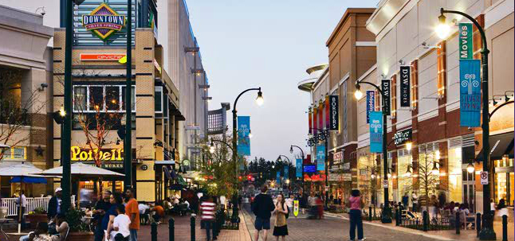
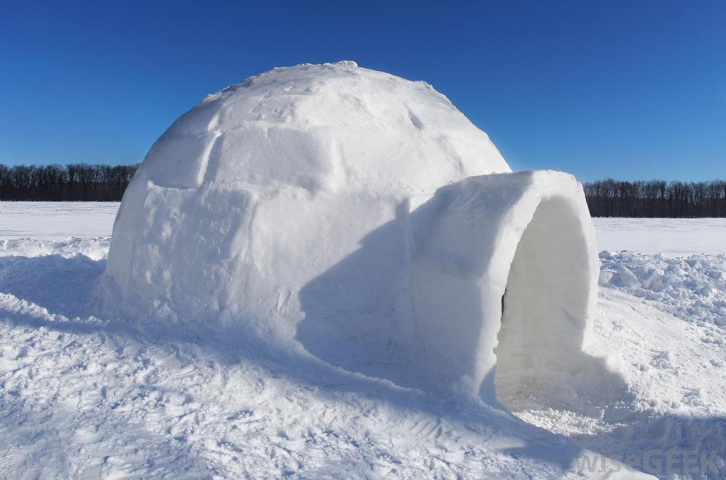
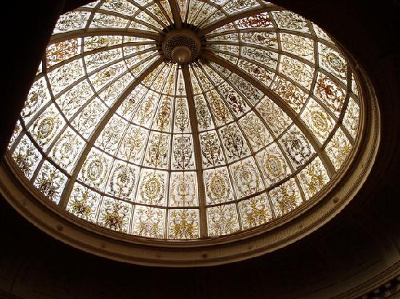
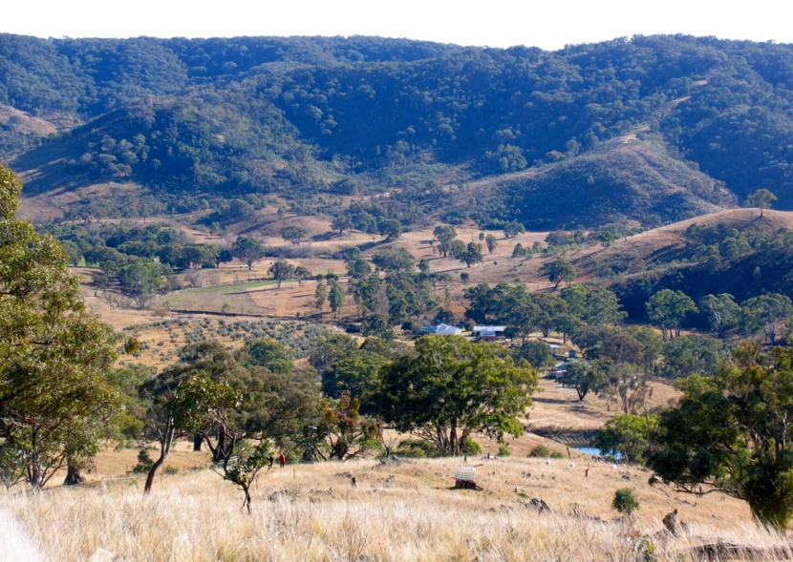
Extra vocabulary
downtown /ˈdaʊntaʊn/
Khu buôn bán
remote area /rɪˈmoʊt /ˈeəriə/
Vùng xa xôi
igloo /ˈɪɡluː/
Lều tuyết
Arctic /ˈɑːrktɪk/
(thuộc về) Bắc Cực
domed (adj) /doʊmd/
hình vòm

Slide 4
1a. Look at the introduction to the competition that was launched on the 4Teen website. Discuss the questions.
1. What do you think is the purpose of the Looking Back competition?
It collects stories about the past to help people understand more about life in that time.
2. Who do you think sent in the stories to the competition?
I think the elderly/ everybody sent in the stories to the competition.
3. What do you think the stories below are about?
The first story is about work of a postman in a remote area and the second one is about life and traditions in Baffin Island long time ago.

Slide 5
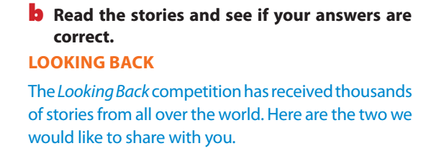
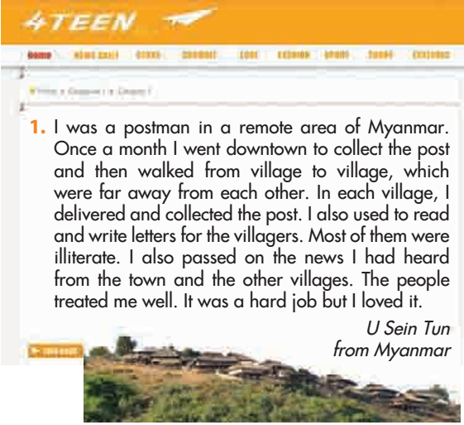

Slide 6
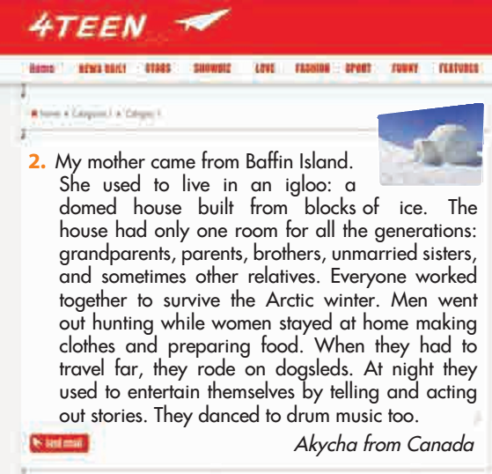

Slide 7
Story 1
1. not able to read or write:
2. tell:
3. behave towards (somebody):
2. Read the stories and find the words which mean:
illiterate
pass on
Story 2
1. a cubed chunk:
2. to live in difficult conditions:
3. a vehicle that travels over snow:
treat (someone)
block
survive
dogsled

Slide 8
3. What do YOU think?
Work in groups. Discuss the questions.
Why did the postman have to walk from village to village?
Why were most villagers illiterate?
Why did the people in Baffin Island use ice blocks to build their houses?
4. Why did each house have only one room?
-It was difficult to reach the villagers on the mountain./
There were no other means of transport available.
-There was no school in the villages./
The nearest school might be too far away.
-There were no other materials available in that deserted land./
-There were no easy means to transport materials from other
places to the island.
It was impossible to build a big house with several rooms
in the ice and snow./
- People felt safer living in communal groups.

Slide 9
4. Which responses relate to which story?
1. It must be incredible travelling by dogsled. I wish I could do it
Story 2
2. The job was hard but worthwhile. I respect him for what he did.
Story 1
3. Unbelievable! How could they stand the cold?
Story 2
4. I hope the are now able to get more information from the outside world.
Story 1
5. Was it possible for them to grow crops?
Story 2

Slide 10
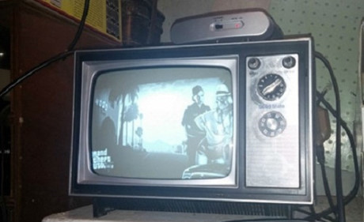
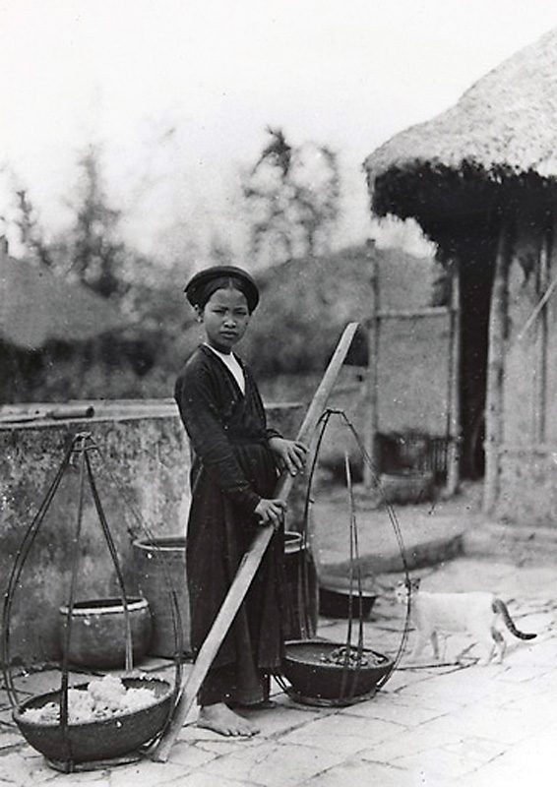
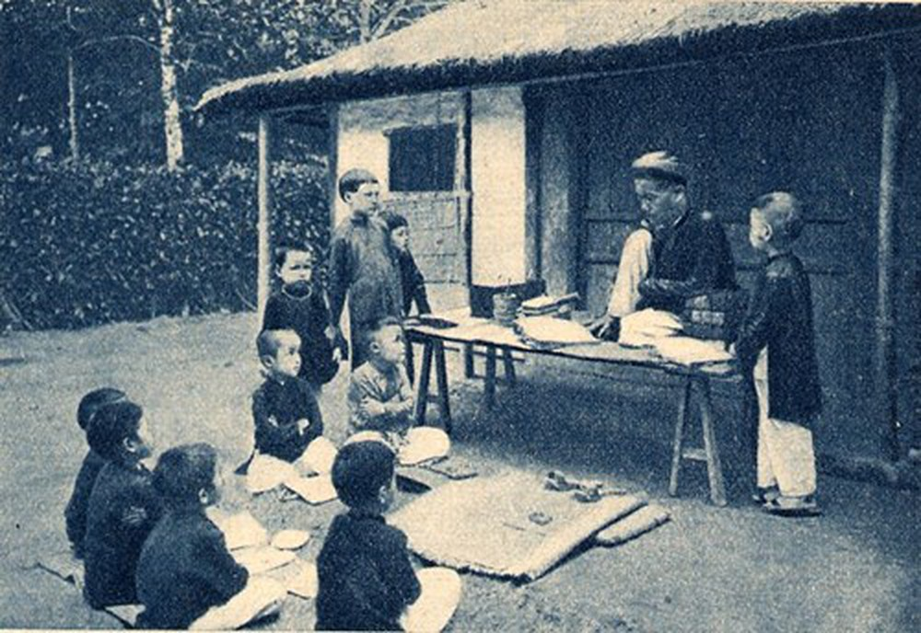
5. Work in groups Work out a story for the Looking back competition?
what aspect of life you want to talk about
how was it practised
If you wish it would still be practised

Slide 11
+ Example:
My father grew up in the countryside nearby Hanoi. He used to play with the peers in the village. Back to that time, there was no computer or smart phones ; and toys were really rare and luxurious. However, my father said he had had a quite memorable childhood with his friends. They created physical games to entertain themselves. Traditional games were really popular. They play with marbles, plastic band, leaves and flowers instead of stuffed animals, dolls or miniature vehicle. At that time, there were also more outdoor space for children than at present. They could easily find a place for going fishing or flying a kite. I find the story about my father’s childhood really interesting and amazing. I wish I could do things like him at that time with my friends now. That must be wonderful!

Slide 12

HOME WORK
Learn the vocabulary by heart
Write the story in your notebook
Review past simple tense
Prepare: Skills 1

