Slide 1

UNIT 8: MY FRIENDS AND I
Review and Practice
Page 118

Slide 2
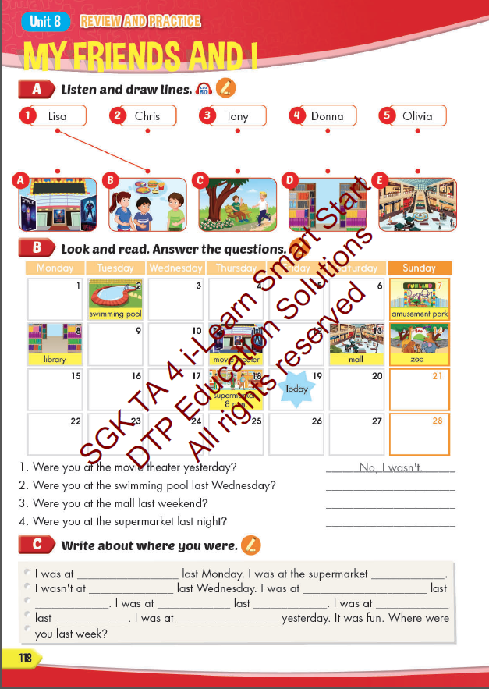
Lesson Outline
Warm-up
Listening
Reading
Writing
Consolidation
Wrap-up

Slide 3
Objectives
By the end of this lesson, students will be able to review the vocabulary items and the sentence structures in Unit 8.
Vocabulary:
Feelings: hungry, thirsty, scared, surprised, tired, excited
Places: movie theater, playground, museum, mall, supermarket, amusement park.
Time: yesterday, last night, last Tuesday, last week, last weekend, last month.
Structure:
I was/ wasn’t tired.
Lucy and Ben were/ weren’t scared.
Were you at the movie theater yesterday? No, I wasn’t./ Yes, I was.
Where were you last night? I was at the movie theater.

Slide 4

WARM UP

Slide 5
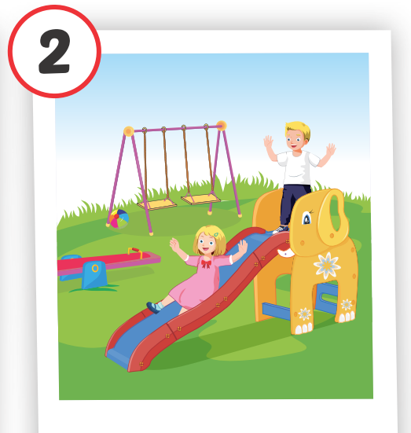
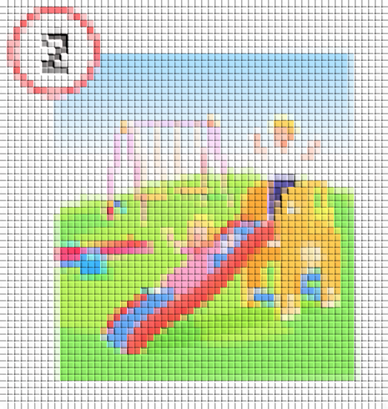
REVIEW VOCABULAY
Guess the picture.
CHECK
playground

Slide 6
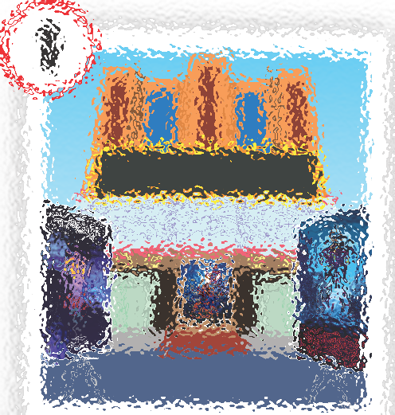
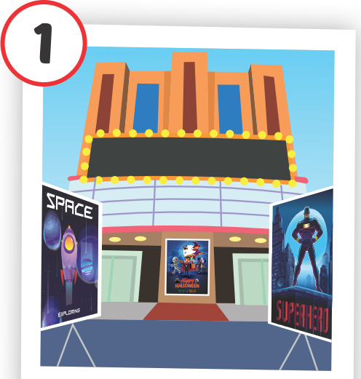
REVIEW VOCABULAY
Guess the picture.
CHECK
movie theater

Slide 7
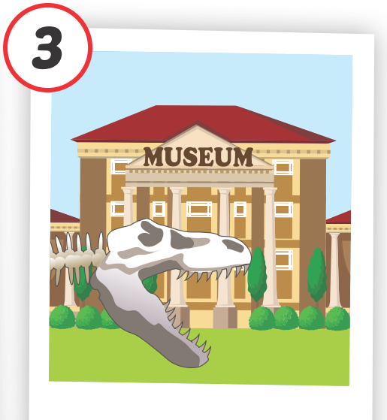

REVIEW VOCABULAY
Guess the picture.
CHECK
museum

Slide 8

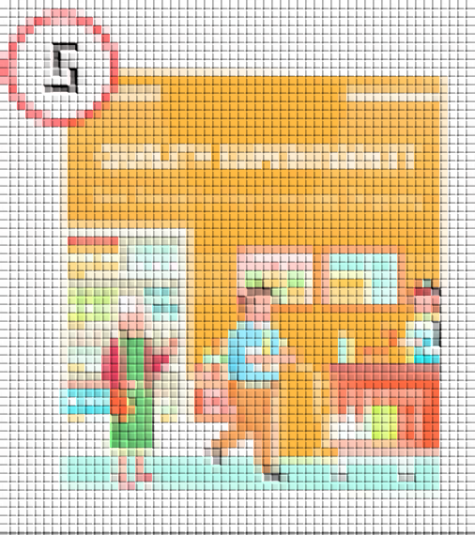
CHECK
supermarket

Slide 9
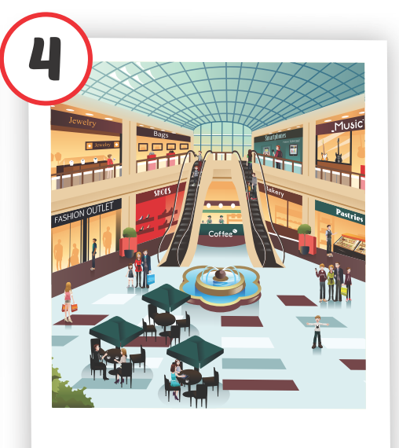
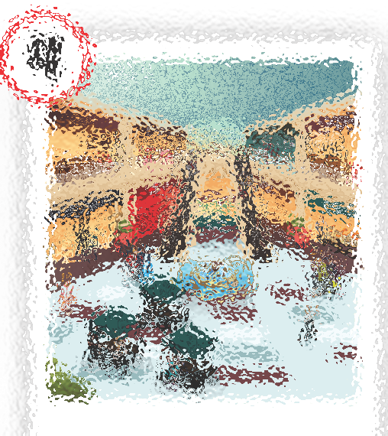
CHECK
mall

Slide 10
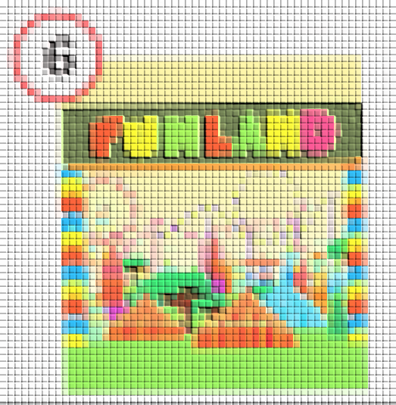
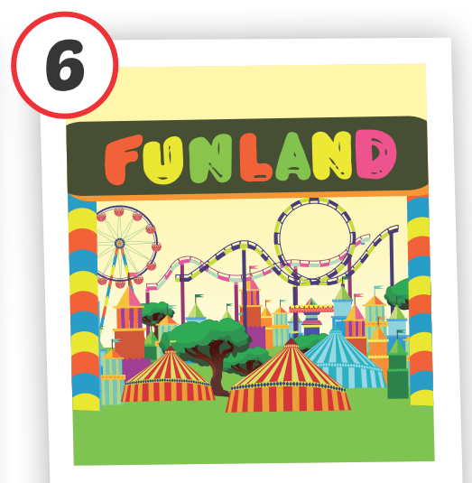
CHECK
amusement park

Slide 11

It’s time to learn …

Slide 12

Listening

Slide 13

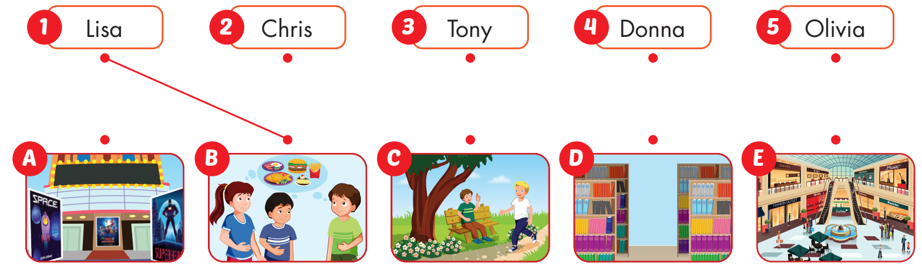

BEFORE YOU LISTEN
Listen and draw lines
What do you have to do?
How many pictures are there?
There are 5 pictures.
Look and read the names. Look at the picture and say the names of places.

Slide 15
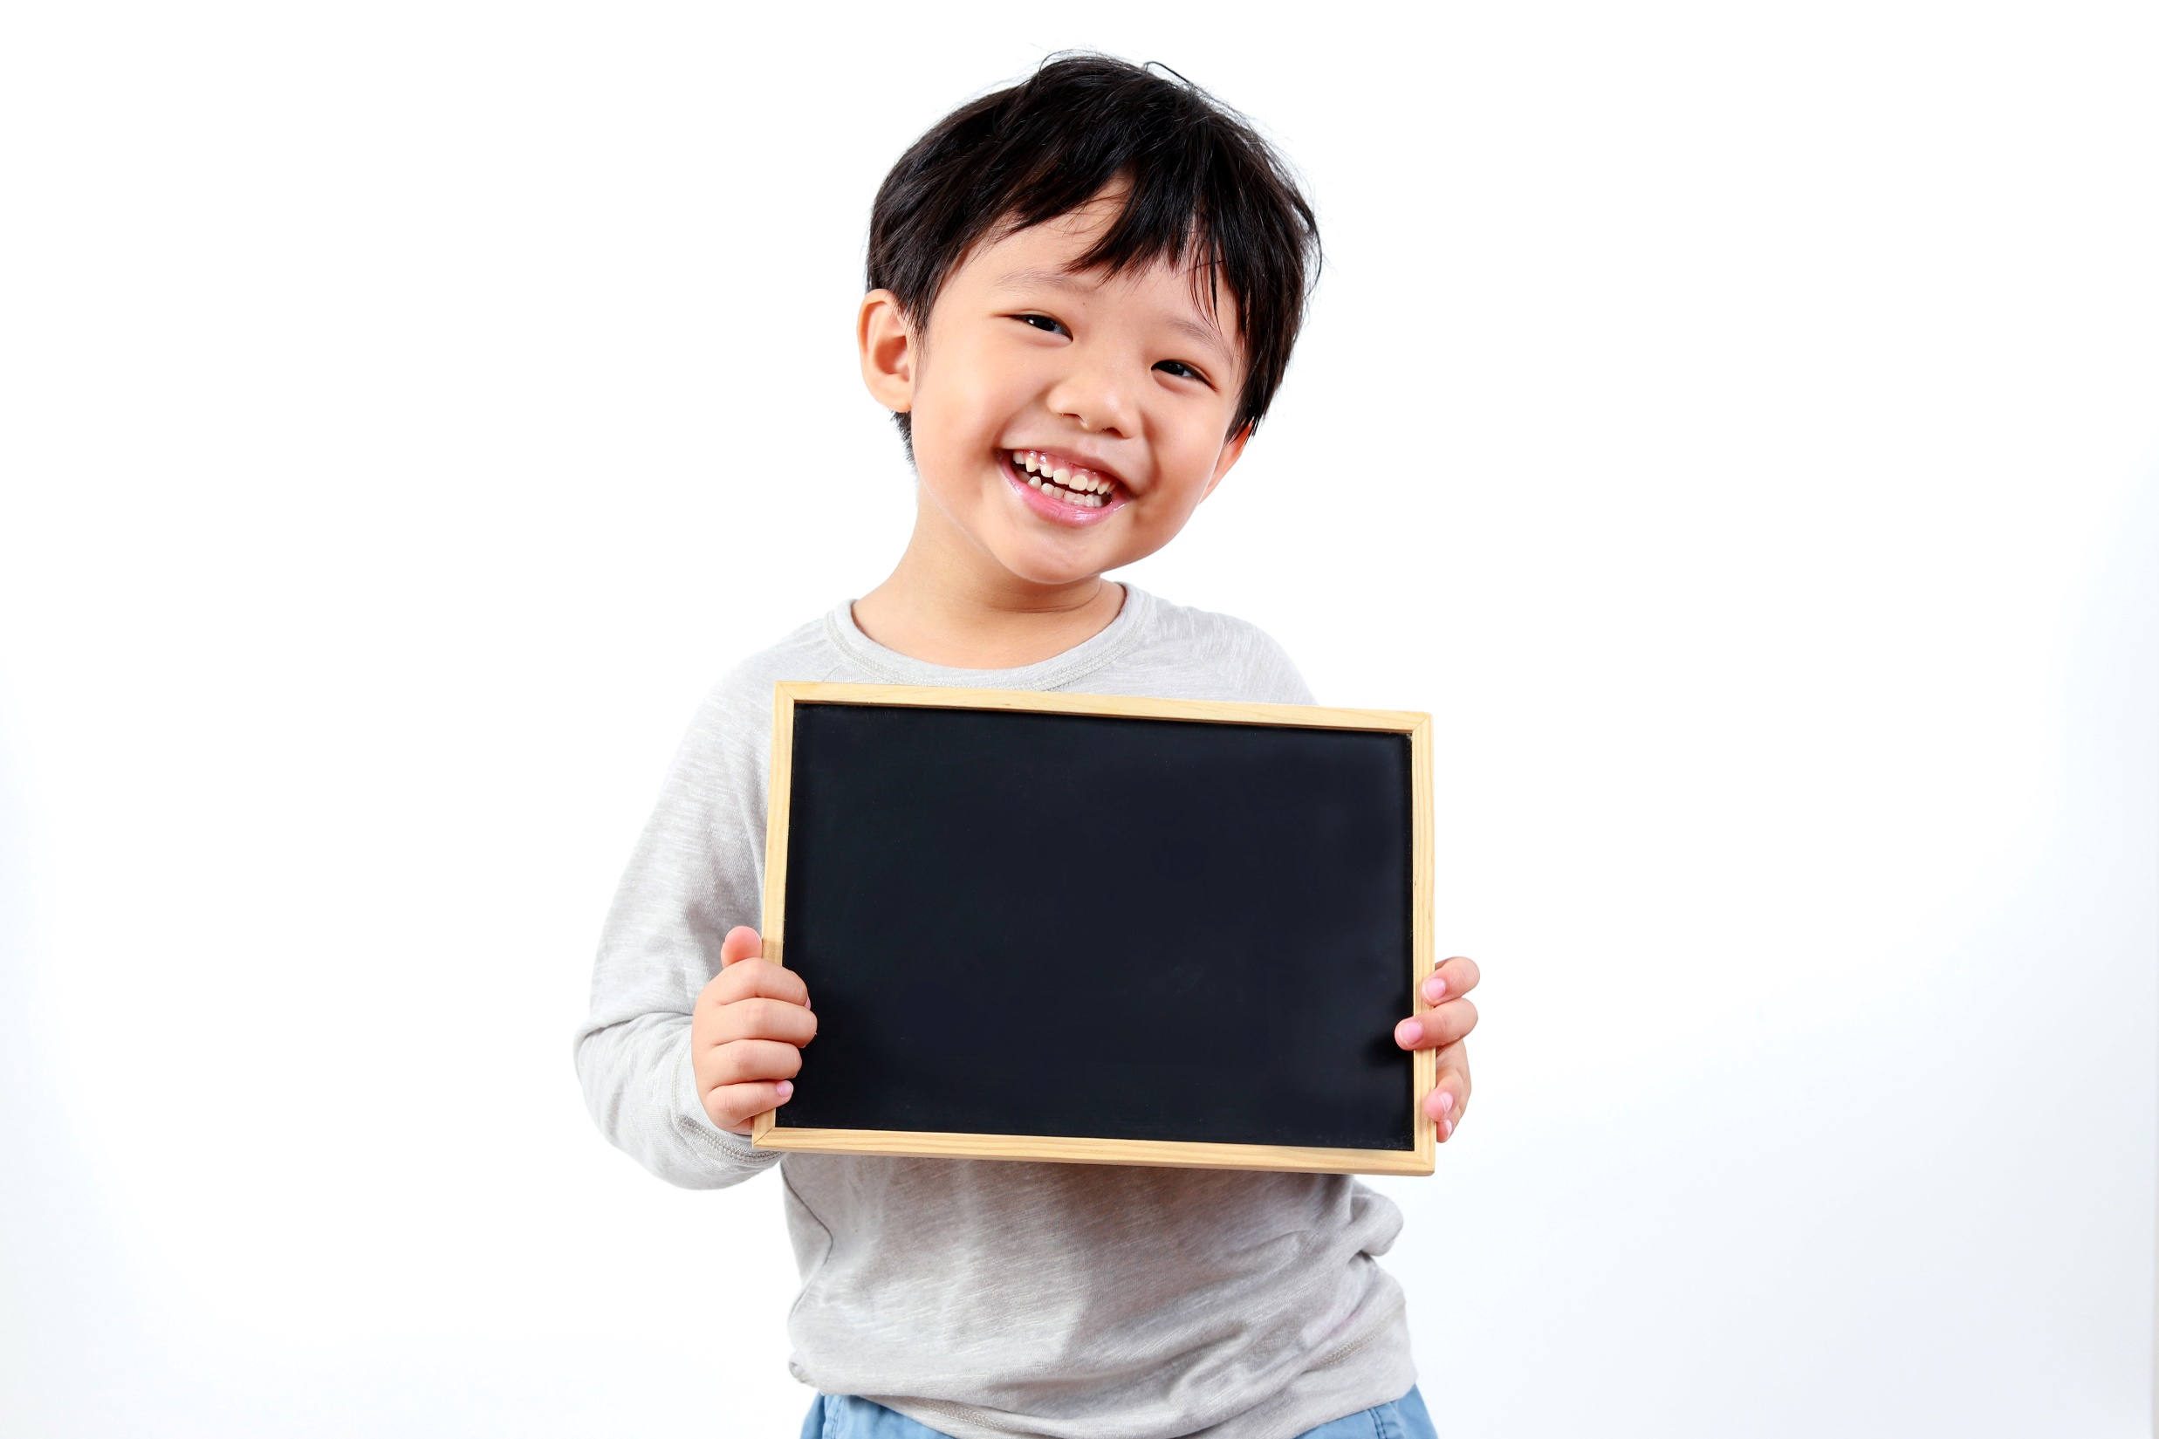
Reading

Slide 16
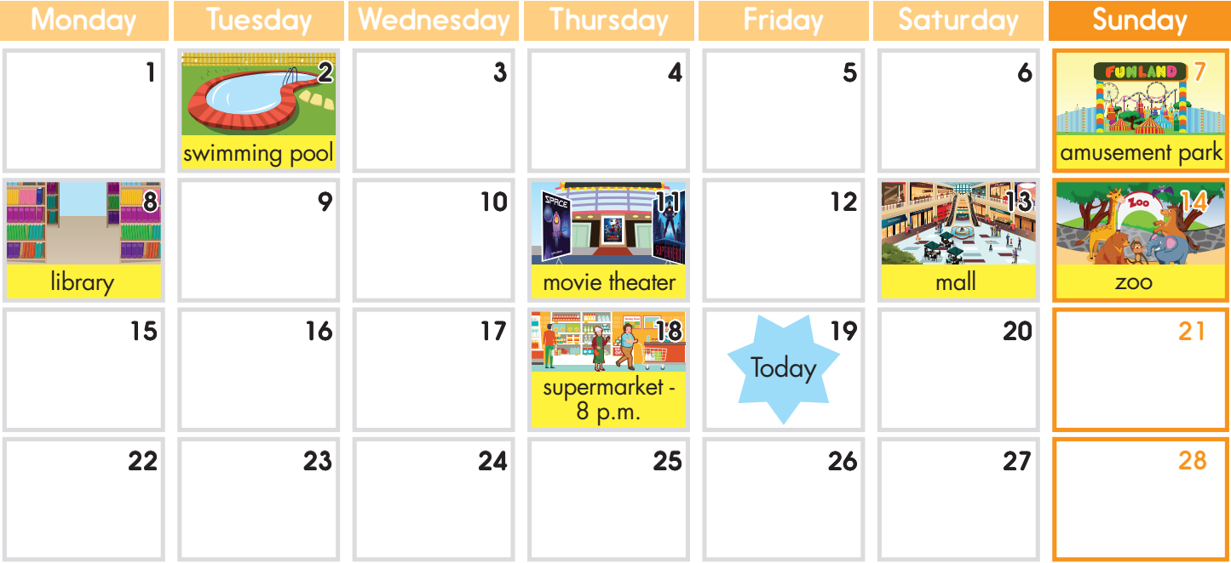

Slide 17
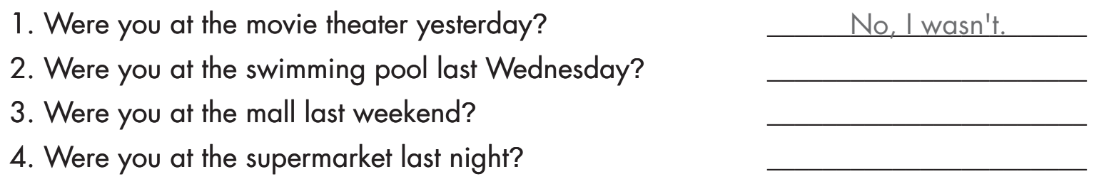
No, I wasn’t.
Yes, I was.
Yes, I was.

Slide 18

Writing

Slide 19
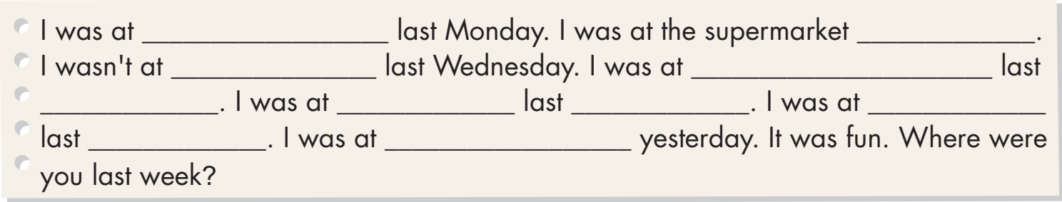

Slide 20
Suggested answer
school
last weekend
the mall
the movie theater
night
home
Sunday
the playground
month
the supermarket

Slide 21

CONSOLIDATION

Slide 22
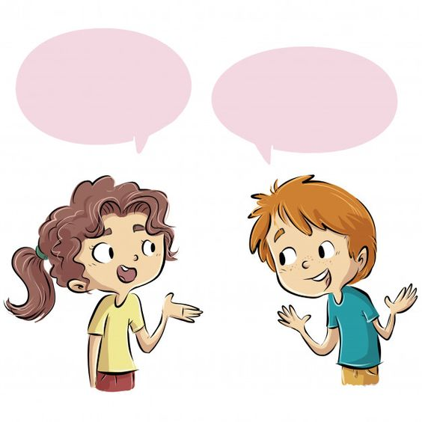
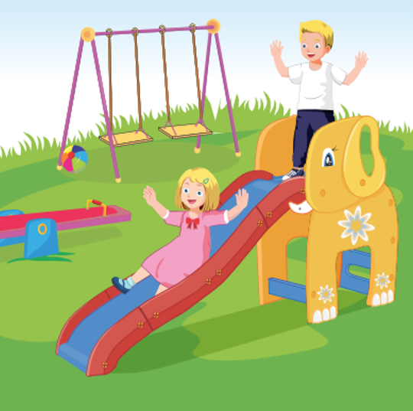
Were you at home yesterday?
No, I wasn’t.

Slide 23
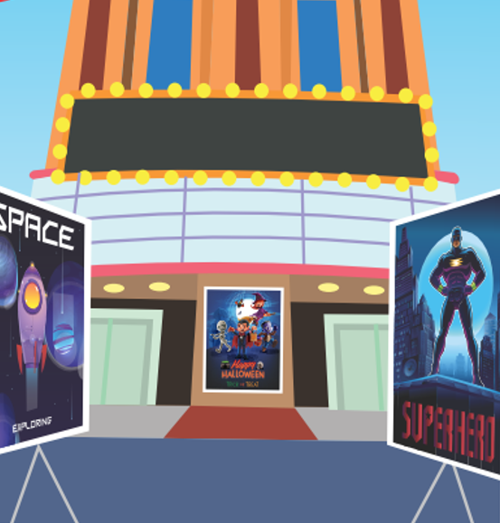
Were you at the movie theater last week?
Yes, I was.

Slide 24
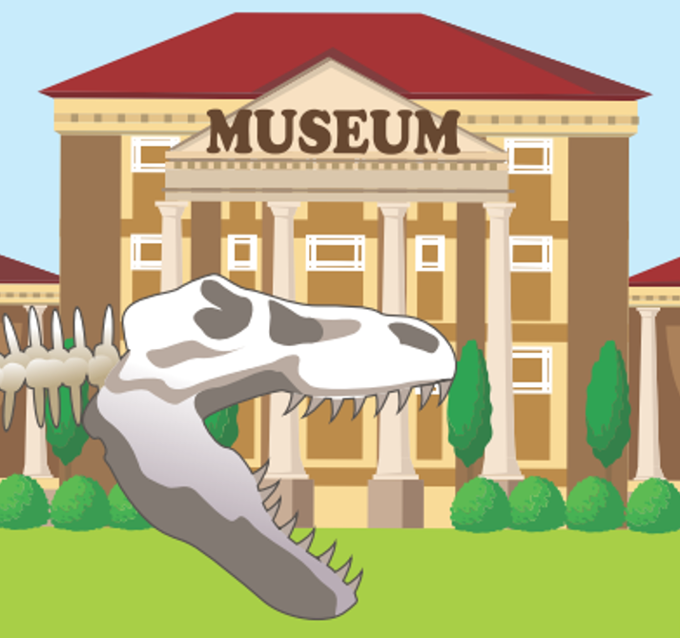
Were you at the amusement park yesterday?
No, I wasn’t.

Slide 25

Were you at the mall last weekend?
No, I wasn’t.

Slide 26
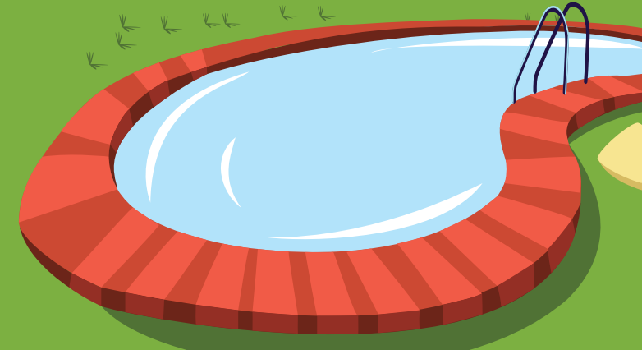
Were you at the swimming pool last Sunday?
Yes, I was.

Slide 27
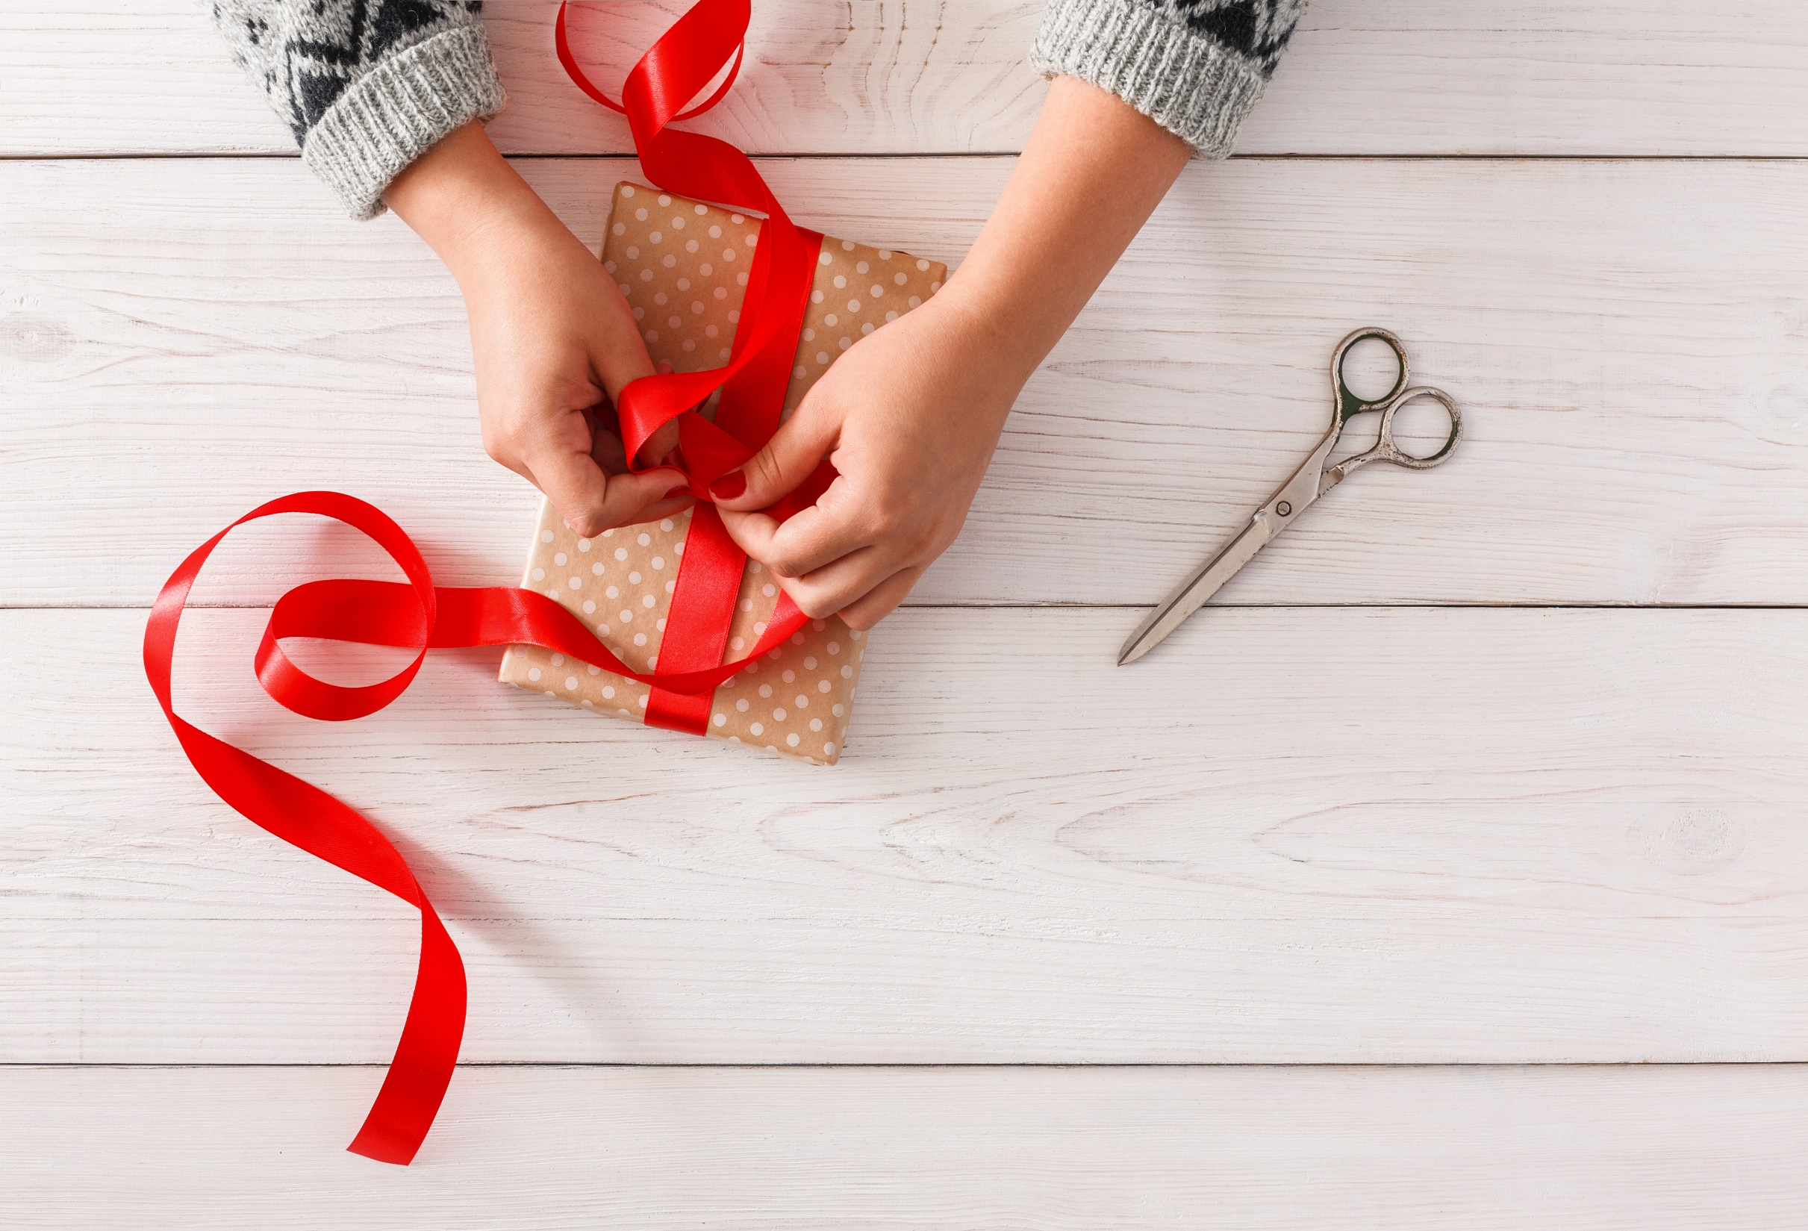
WRAP-UP

Slide 28
Today’s lesson
Structures/ Sentence patterns
Were you at the movie theater yesterday?
- No, I wasn’t.
Were you at the mall last weekend?
- Yes, I was.
Vocabularies
movie theater, playground, museum, mall, supermarket, amusement park

Slide 29
Homework
Practice the vocabularies and structure; and make sentences using them.
Do the exercises in Tiếng Anh 4 i-Learn Smart Start SB (page 80) Do the exercises in Tiếng Anh 4 i-Learn Smart Start Notebook (page 50)
Play the consolidation games in Tiếng Anh 4 i-Learn Smart Start DHA App on www.eduhome.com.vn

Slide 30
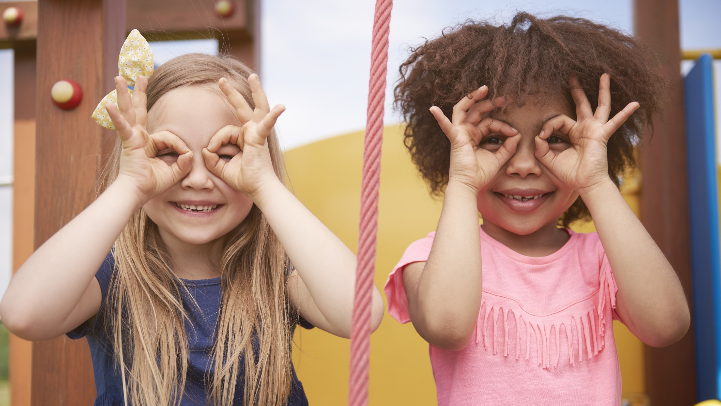
Enjoy your day!

