Slide 1
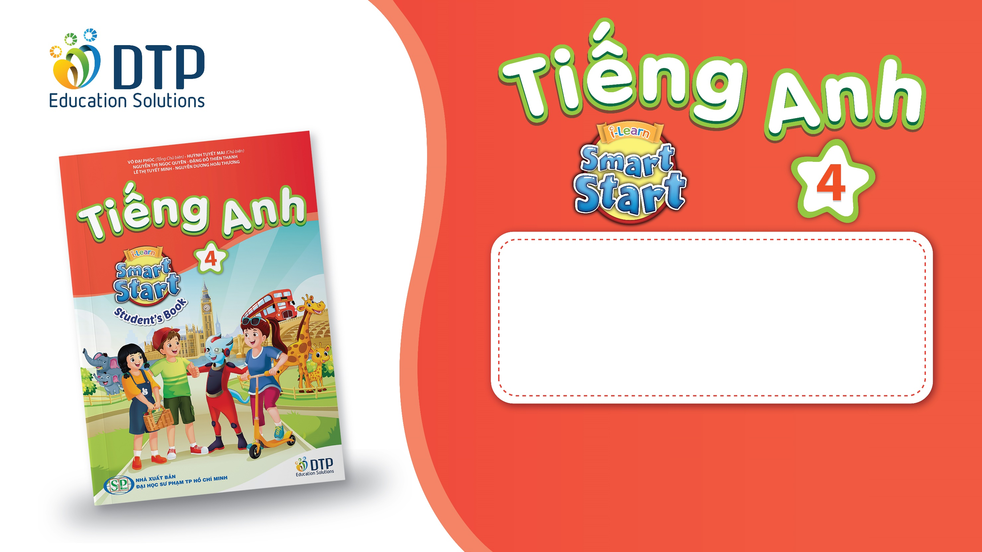
Unit 8: MY FRIENDS AND I
Lesson 3 - Page 113

Slide 2
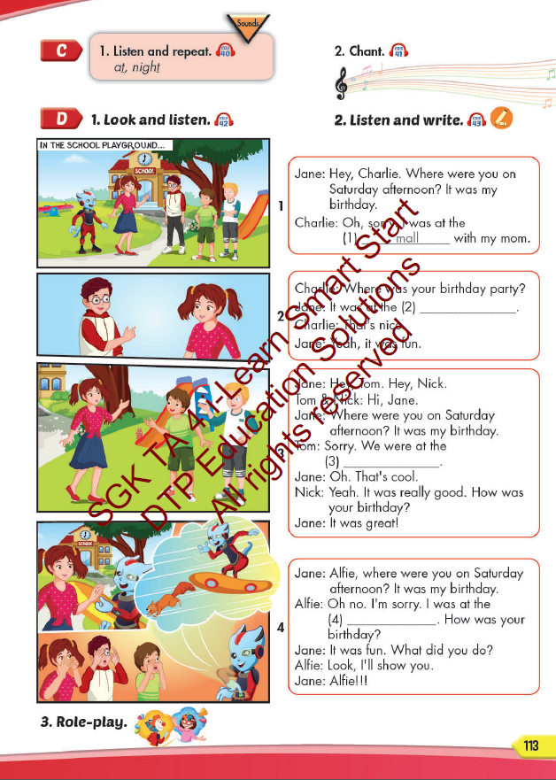
Lesson Outline
Warm-up
Listening
Consolidation
Wrap-up

Slide 3
Objectives
By the end of this lesson, students will be able to pronounce the sound /t/; and practice asking and answering what where people were.
Vocabulary: movie theater, playground, museum, mall, supermarket, amusement park.
Structure:
Where were you last night? I was at the movie theater.
Where was Nick last Saturday? He was at the mall.
Where were Alfie and Mai yesterday? They were at the park.

Slide 4

WARM UP

Slide 5
REVIEW: VOCABULARY AND STRUCTURE
1
4
6
1
SPIN
2
5
2
5
4
3
3
6
Next Part

Slide 6
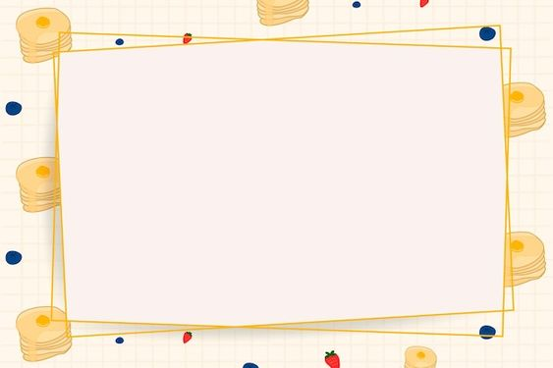
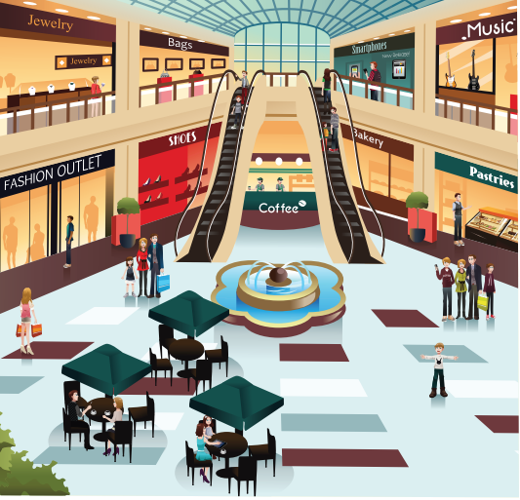
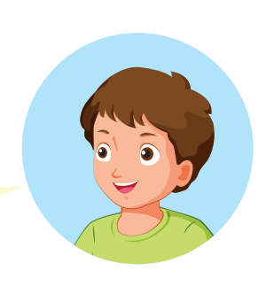
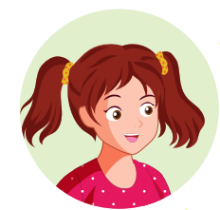
Where were you last week?
I was at the mall.
Go back

Slide 7

Where was your sister last week?
she was at the amusement park.
Go back

Slide 8
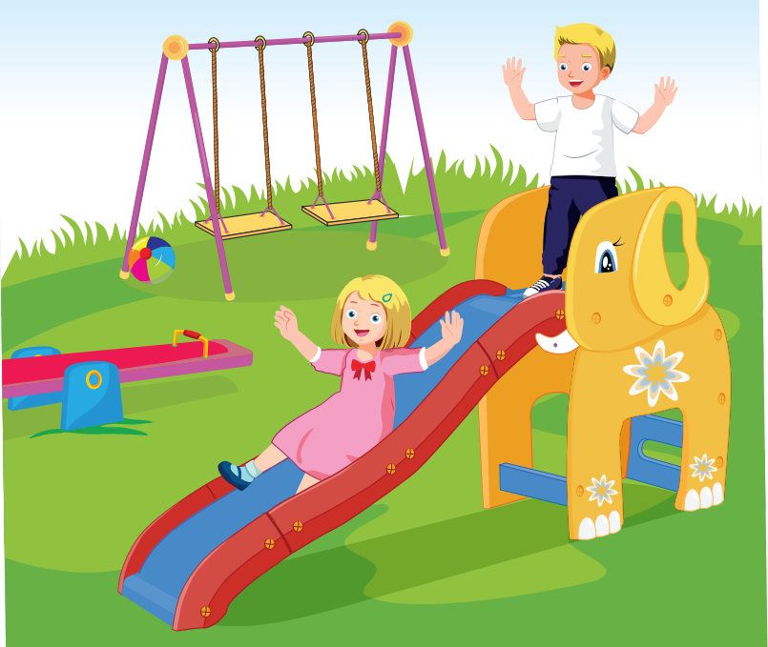
Where were Bill and Sue you yesterday?
They were at the playground.
Go back

Slide 9
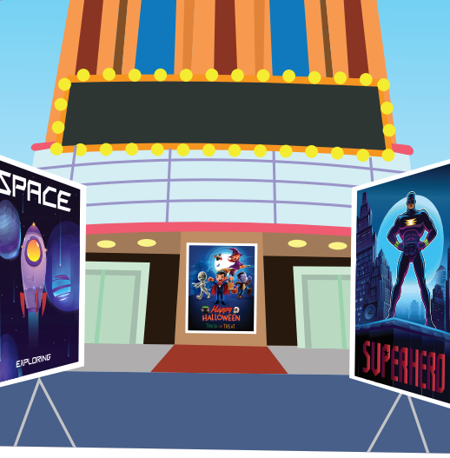
Where were you last weekend?
I was at the movie theater.
Go back

Slide 10

Where were your father last night?
He was at the supermarket.
Go back

Slide 11
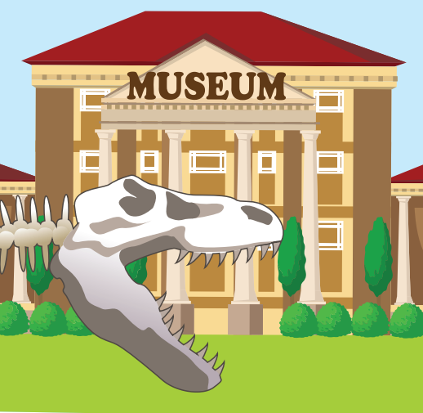
Where were you last week?
I was at the museum.
Go back

Slide 12
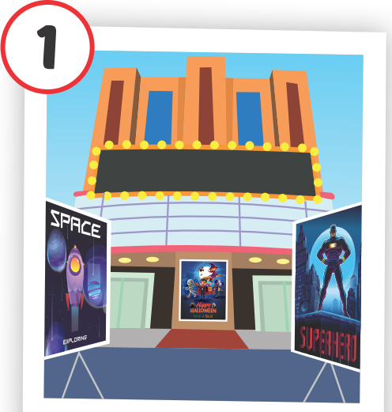
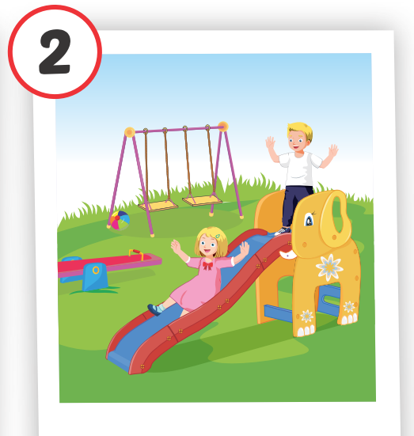
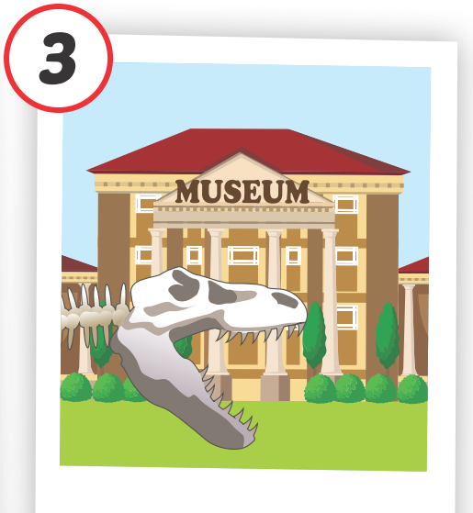

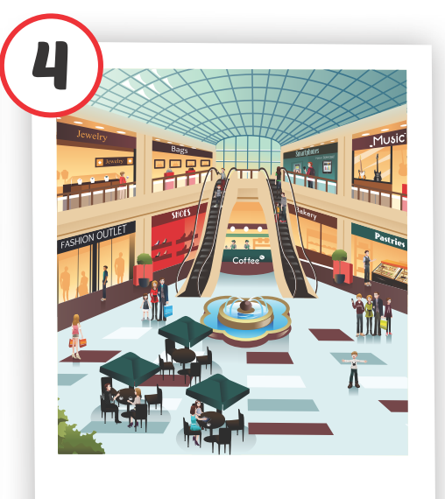

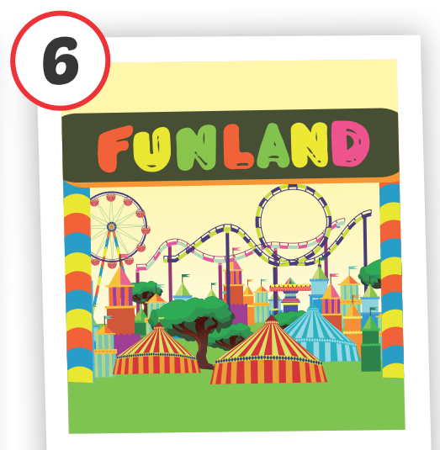
REVIEW
Structure
1. Where were you last night?
- I was at the movie theater.
2. Where was Nick last Saturday?
- He was at the mall.
3. Where were Alfie and Mai yesterday?
- They were at the park.
movie theater
playground
museum
mall
supermarket
amusement park
Click on each English word to hear the sound.

Slide 13

It’s time to learn …

Slide 14

Phonics
/t/

Slide 15
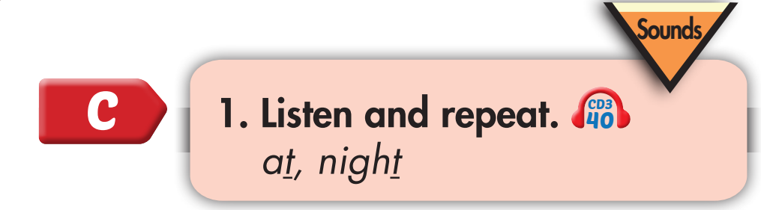
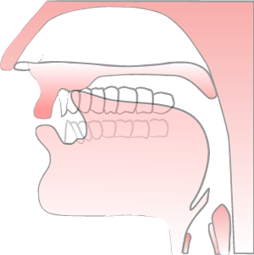
/t/, /t/, at
/t/, /t/, night

Slide 16
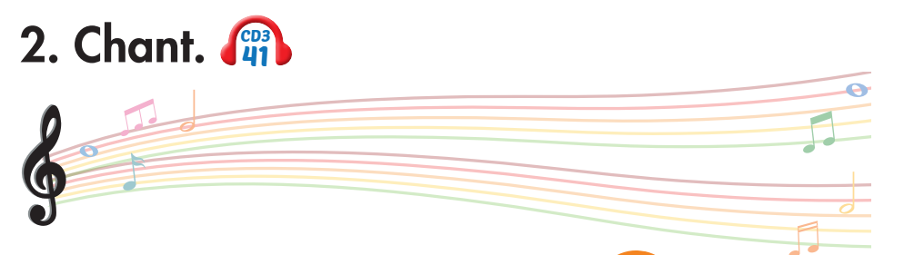
I’m reading a comic book at home
Listen and arrange the sentences into the correct order of the chant.
I was at the mall.
Where were you yesterday afternoon?
Where were you last night?
I was at the supermarket.
Notes:
1. Listen.
2. Listen and chant.

Slide 17
I’m reading a comic book at home
Listen and arrange the sentences into the correct order of the chant.
Where were you yesterday afternoon?
I was at the supermarket.
Where were you last night?
I was at the mall.
Notes:
1. Listen.
2. Listen and chant.

Slide 18
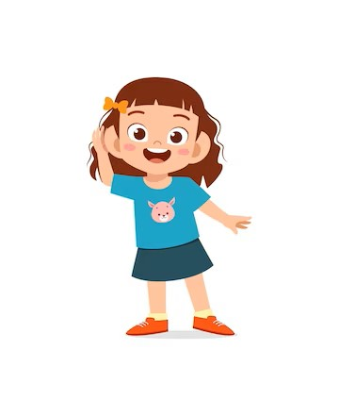
Listen. Clap your hands and repeat when you hear /t/ sound.
Notes:
T says
Mall
Supermarket
Museum
Night
Swimming pool
Cat
Music
Great

Slide 19
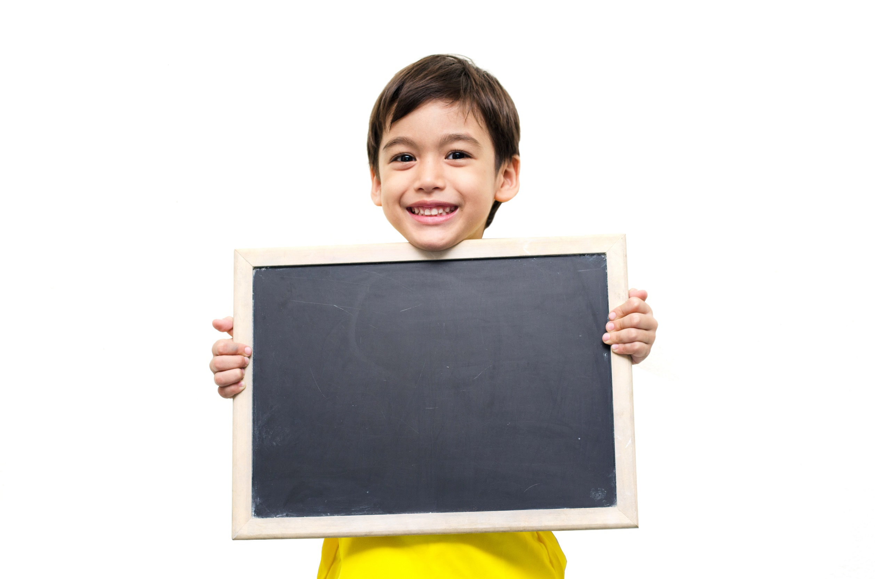
Listening

Slide 20
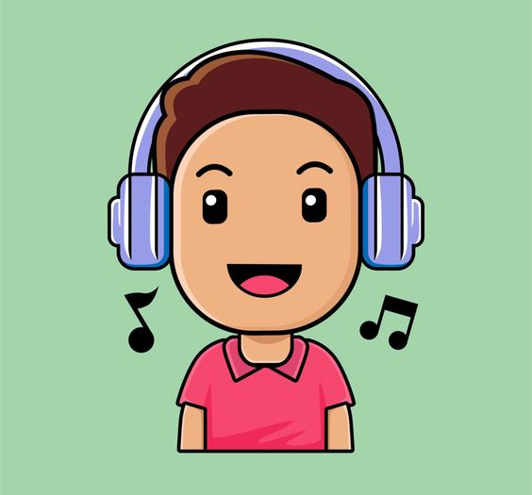
BEFORE YOU LISTEN

Slide 21
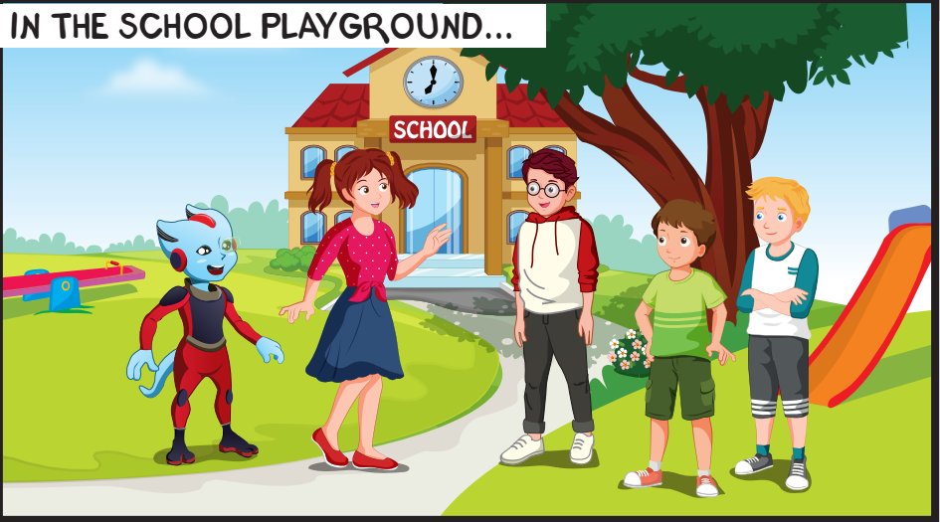
Where are they?
What are they talking about?
Notes:
Encourage Ss to guess

Slide 22
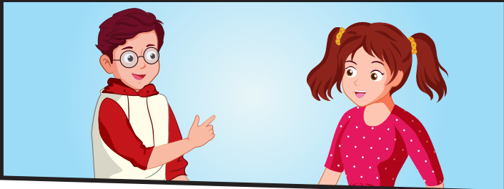
What are they talking about?

Slide 23
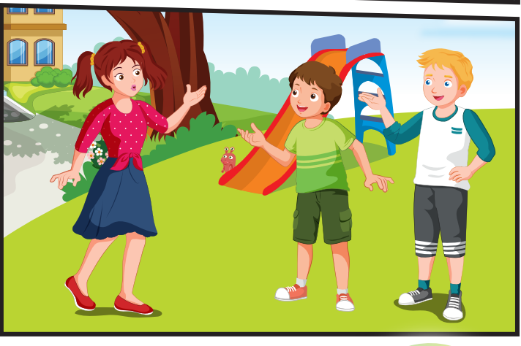
Were Tom and Nick at Jane’s birthday?

Slide 24
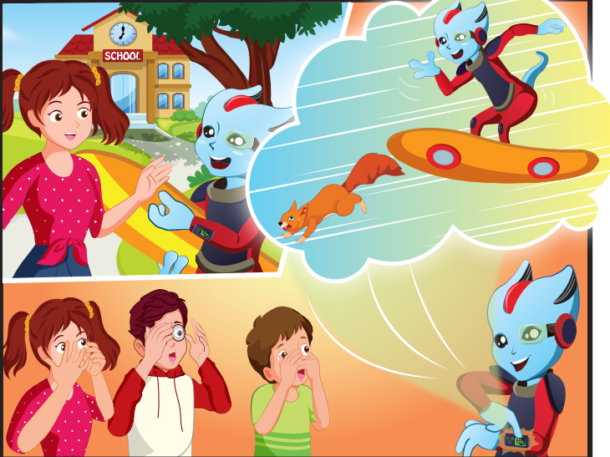
Where was Alfie?

Slide 25
WHILE YOU LISTEN

Slide 26

Notes:
Encourage Ss to guess

Slide 27
Notes:
Encourage Ss to guess

Slide 28
Notes:
Encourage Ss to guess

Slide 29
Notes:
Encourage Ss to guess

Slide 30

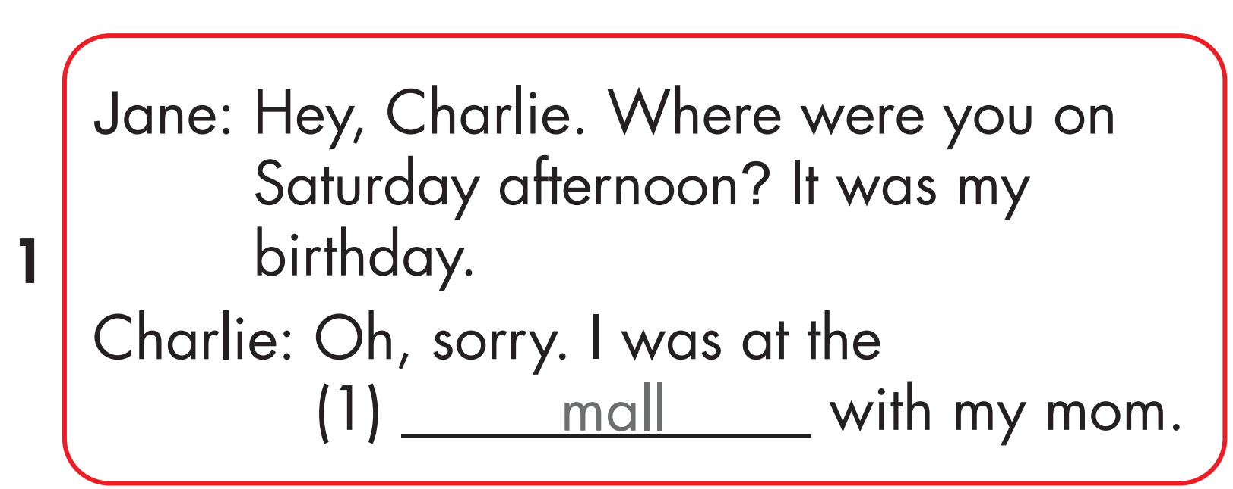

Slide 31
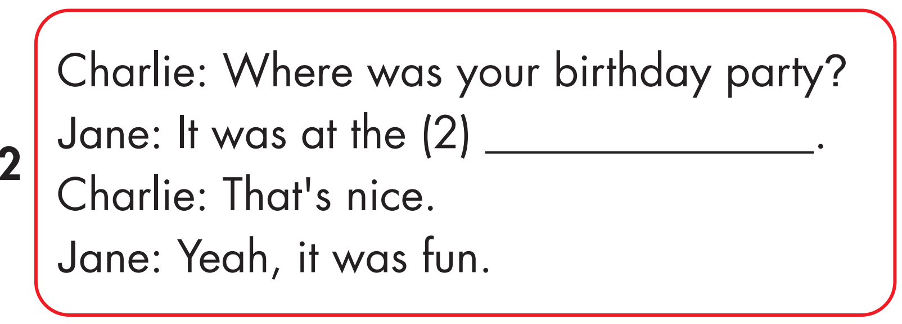
playground

Slide 32
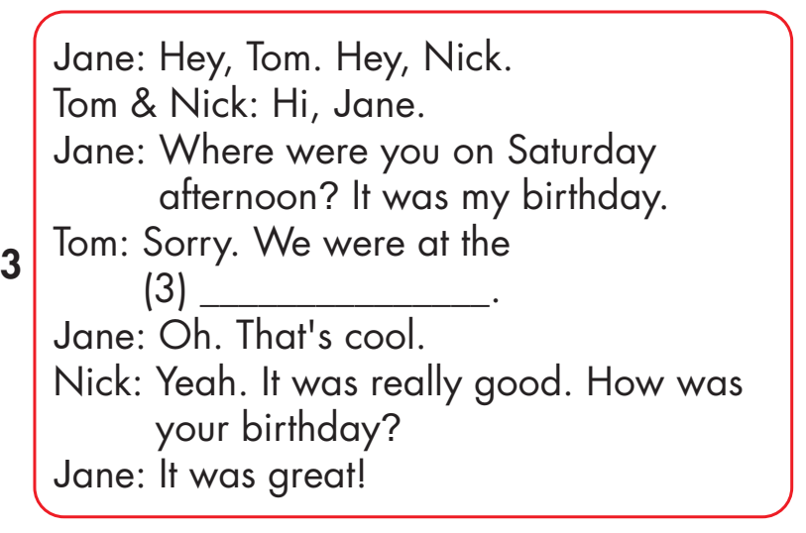
movie theater

Slide 33
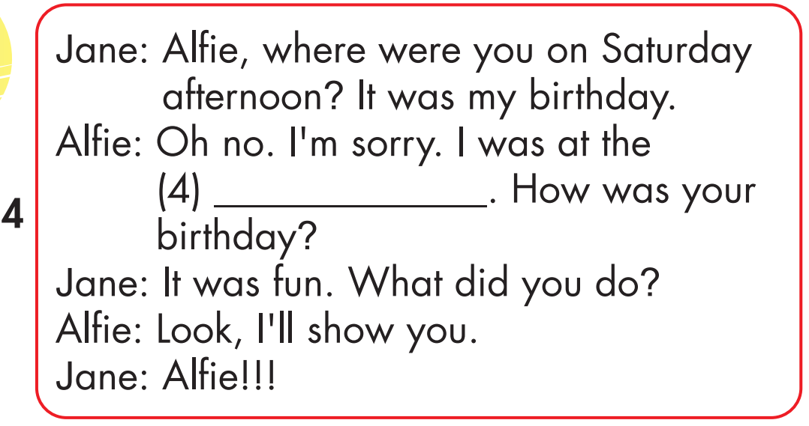
park

Slide 34
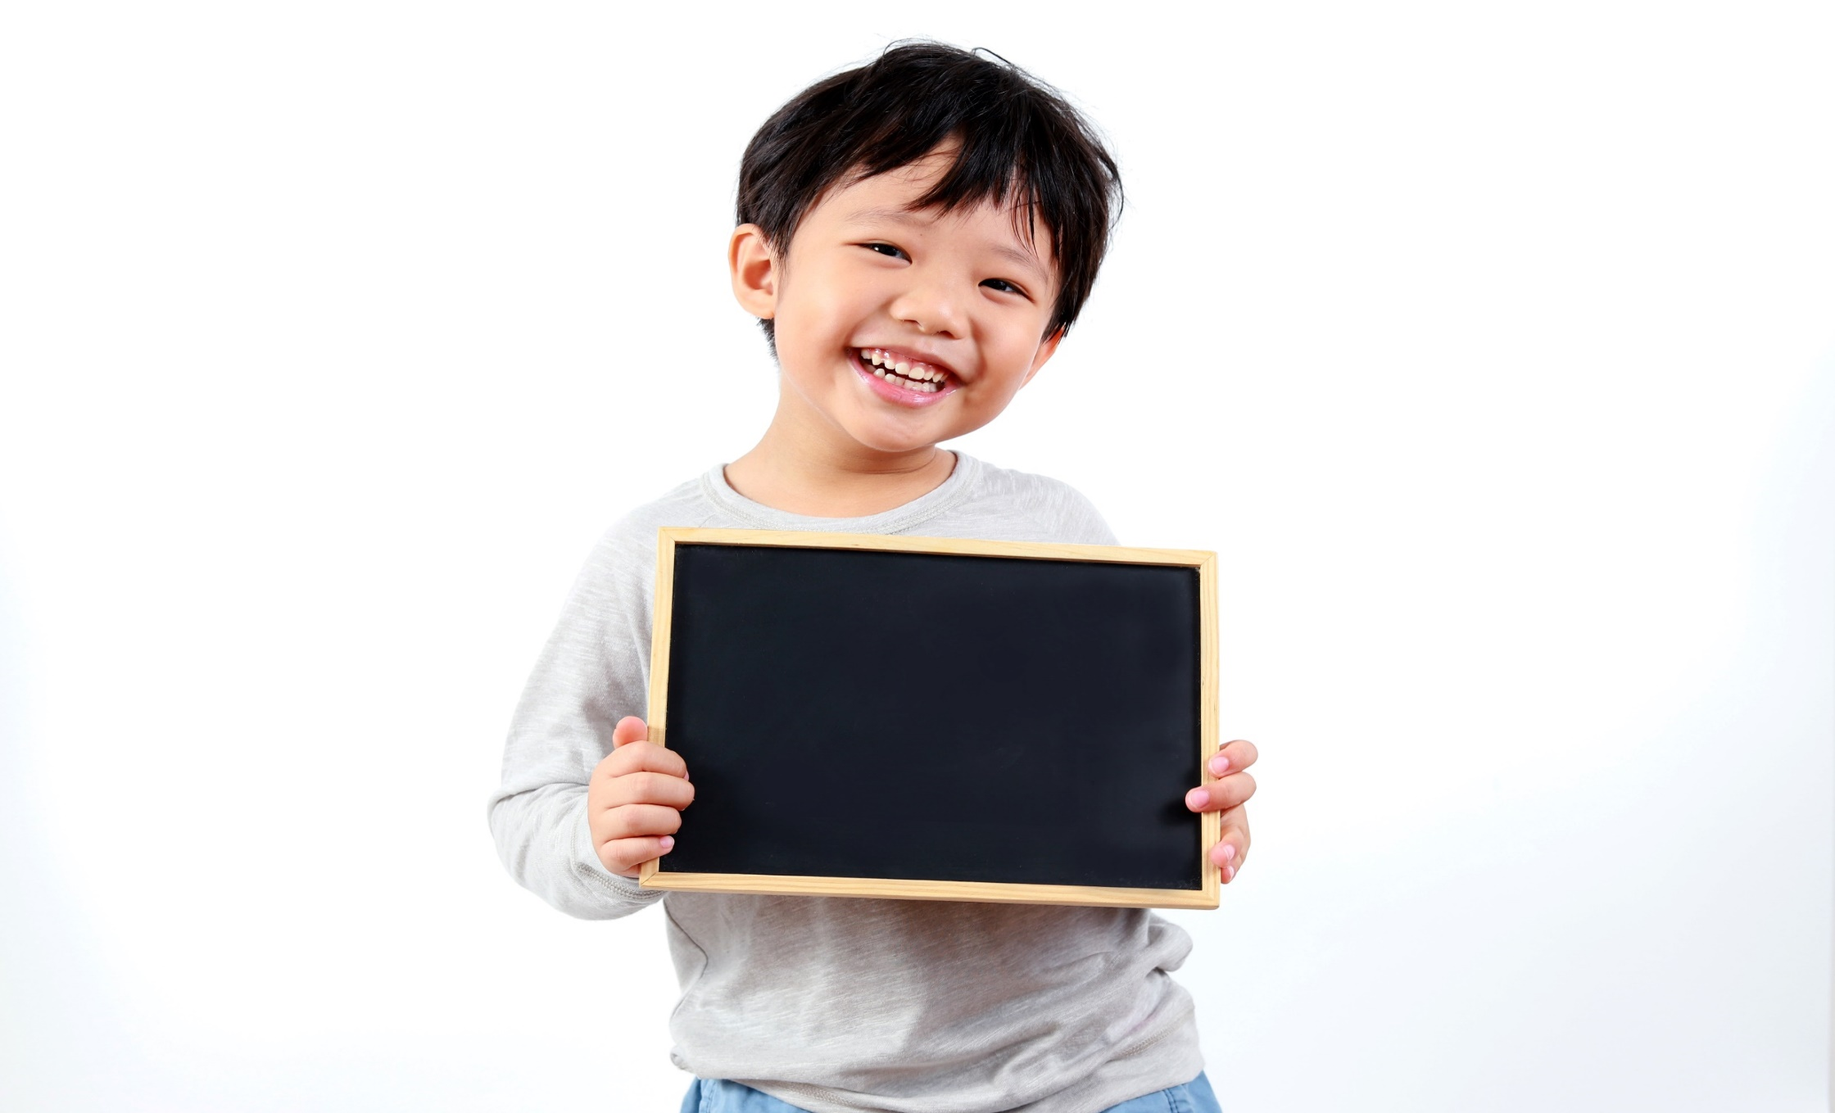
Practice

Slide 36
playground

Slide 37
movie theater

Slide 38
park

Slide 39
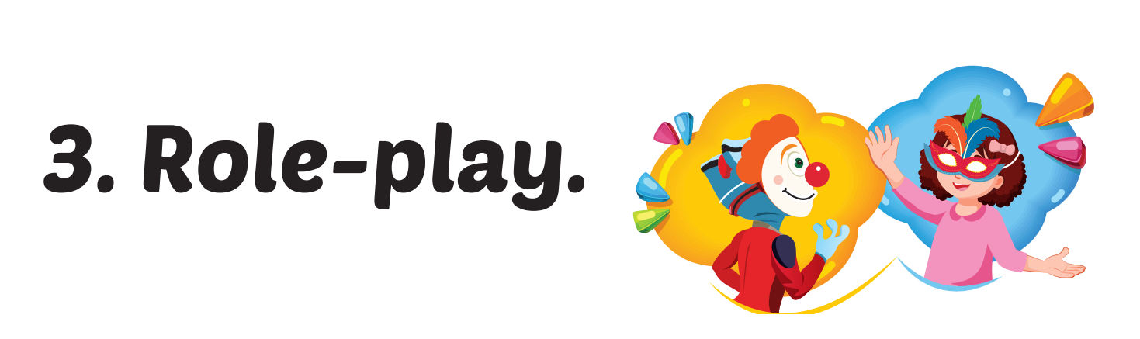

Slide 40

CONSOLIDATION

Slide 41
WHAT’S NEXT?
pa__ __
park
mu__ __ __ __
museum
su__ __ __ __ __ __ __ __ __
supermarket
ma__ __
mall
pl__ __ __ __ __ __ __ __
playground
movie th__ __ __ __ __
movie theater
Notes:
Ss write down the words on the individual board.

Slide 42

WRAP-UP

Slide 43
Objectives
Vocabulary: movie theater, playground, museum, mall, supermarket, amusement park.
Structure:
Where were you last night? I was at the movie theater.
Where was Nick last Saturday? He was at the mall.
Where were Alfie and Mai yesterday? They were at the park.

Slide 44
Today’s lesson
Vocabularies
movie theater
playground
museum
mall
supermarket
amusement park
Structures/ Sentence patterns
Where were you last night? I was at the movie theater.
Where was Nick last Saturday? He was at the mall.
Where were Alfie and Mai yesterday?
They were at the park.

Slide 45
Homework
Practice the vocabularies and structure, and make sentences using them.
Do the exercise C in Tiếng Anh 4 i-Learn Smart Start WB (page 77)
Do the exercise in Tiếng Anh 4 i-Learn Smart Start (Page 48)
Prepare the next lesson (page 114, SB)
Play the consolidation games in Tiếng Anh 4 i-Learn Smart Start DHA App on www.eduhome.com.vn

Slide 46
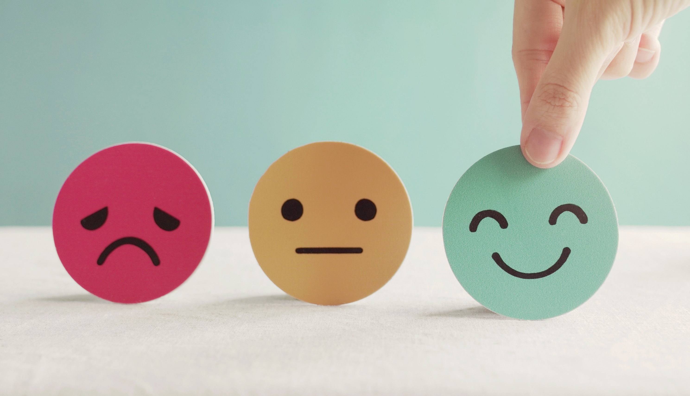
Lesson 3
Stay positive and have a nice day!

