Slide 1

Unit 8: MY FRIENDS AND I
Lesson 4 - Page.115

Slide 2
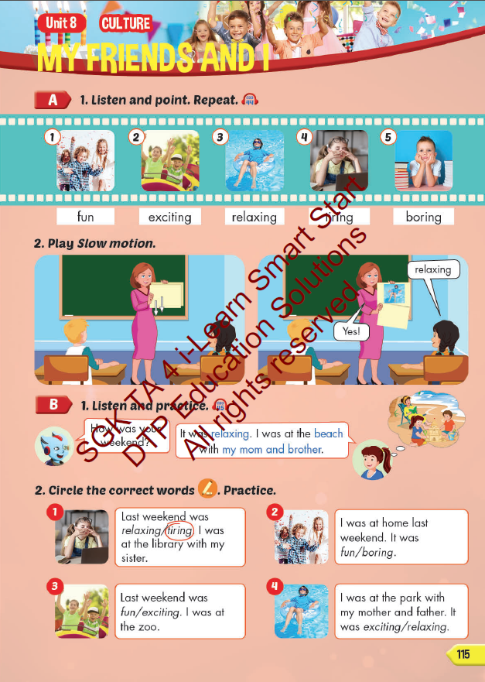
Lesson Outline
Warm-up
Vocabulary
Structure
Consolidation
Wrap-up

Slide 3
Objectives
By the end of this lesson, students will be able to talk about their weekend.
Vocabulary: fun, exciting, relaxing, tiring, boring.
Structure:
How was your weekend?
It was relaxing. I was at the beach with my mom and brother.

Slide 4

WARM UP

Slide 5


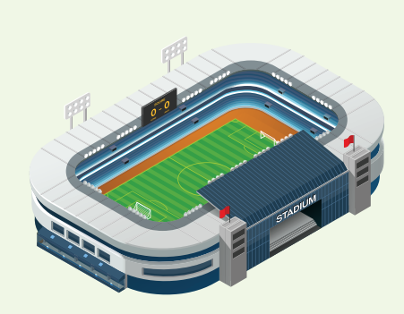


REVIEW
What’s next?
?
?

Slide 6
REVIEW 2
What’s next?
?
?

Slide 7
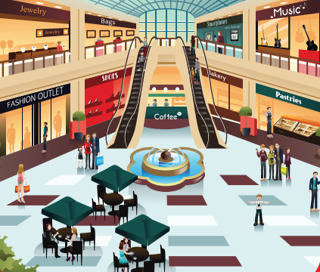
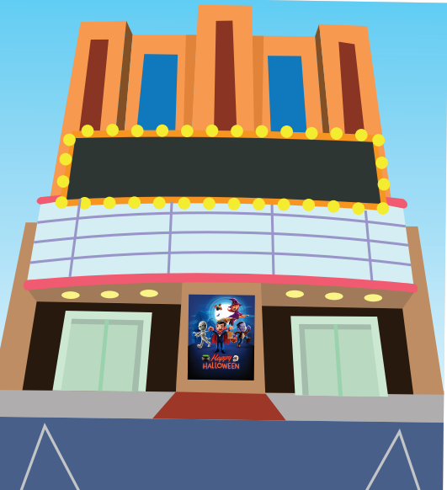
REVIEW 2
What’s next?
?
?

Slide 8

It’s time to learn …

Slide 9

New words
fun
exciting
relaxing
tiring
boring.

Slide 10

Presentation

Slide 11



Click on each English word to hear the sound.
fun
/fʌn/ vui

Slide 12

Click on each English word to hear the sound.
exciting
/ɪkˈsaɪtɪŋ/ phấn khởi

Slide 13
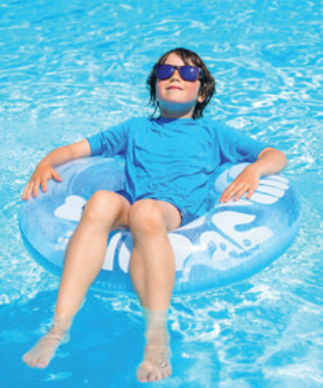
Click on each English word to hear the sound.
relaxing
/rɪˈlæksɪŋ/ thư giãn

Slide 14

Click on each English word to hear the sound.
tiring
/ˈtaɪərɪŋ/ mệt mỏi

Slide 15

Click on each English word to hear the sound.
boring
/ˈbɔːrɪŋ/ chán nản

Slide 16

Practice

Slide 17
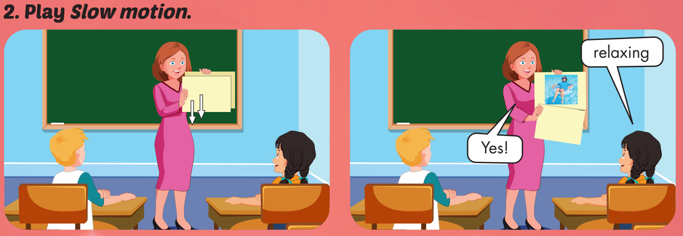

Slide 18

WHAT IS IN THE CLOCK?
HOW TO PLAY
Click on clock to play.
Click CHECK to show the answer.

Slide 19


CHECK
relaxing

Slide 20
CHECK
boring

Slide 21
CHECK
fun

Slide 22
CHECK
tiring

Slide 23
CHECK
exciting

Slide 24
WHAT’S MISSING?
fun
tiring
boring
boring
relaxing
exciting
exciting
exciting
tiring
relaxing
fun
tiring
relaxing
boring
boring
fun
exciting
exciting
tiring
fun
fun
relaxing
relaxing
tiring
tiring
fun
boring
boring

Slide 25
Structures
- How was your weekend?
- It was relaxing. I was at the beach with my mom and brother.

Slide 26

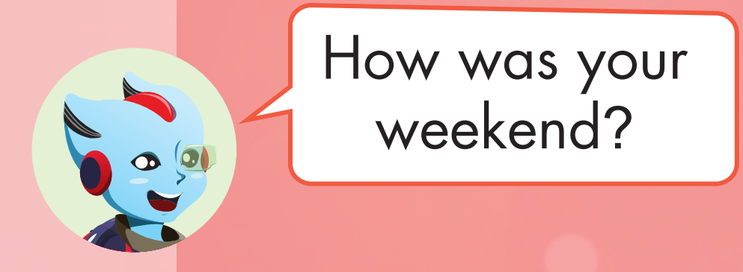
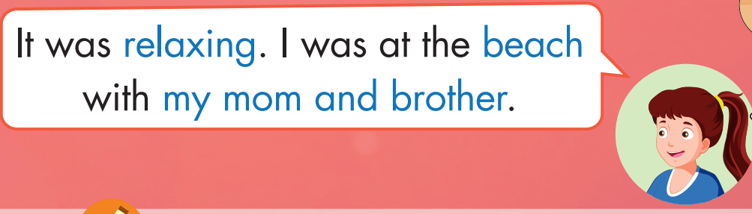

Slide 27
Practice

Slide 28


How was your weekend?
It was fun.

Slide 29
How was your weekend?
It was boring.

Slide 30
How was your weekend?
It was relaxing.

Slide 31
How was your weekend?
It was exciting.

Slide 32
How was your weekend?
It was boring.

Slide 33
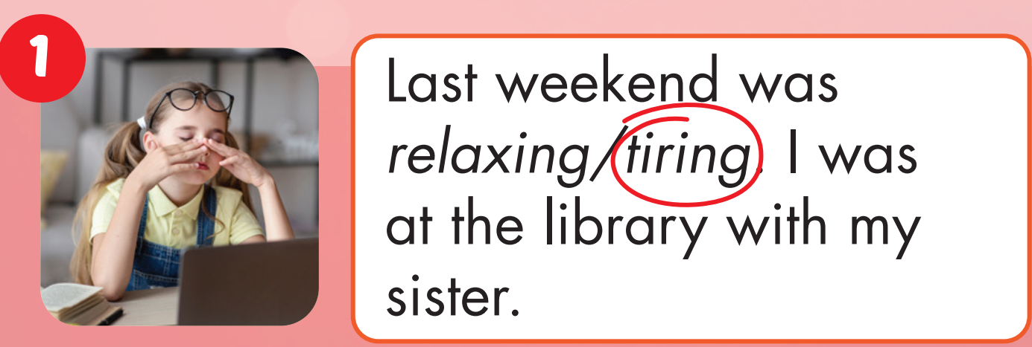
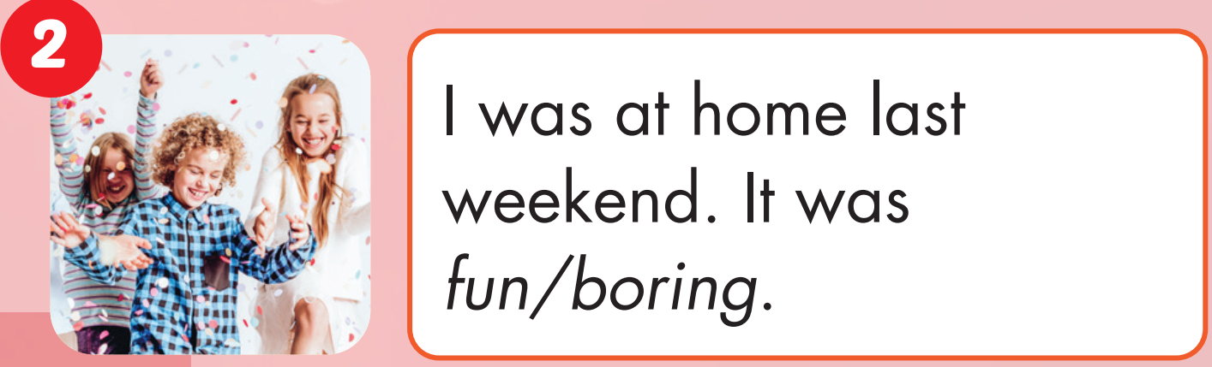

Slide 34
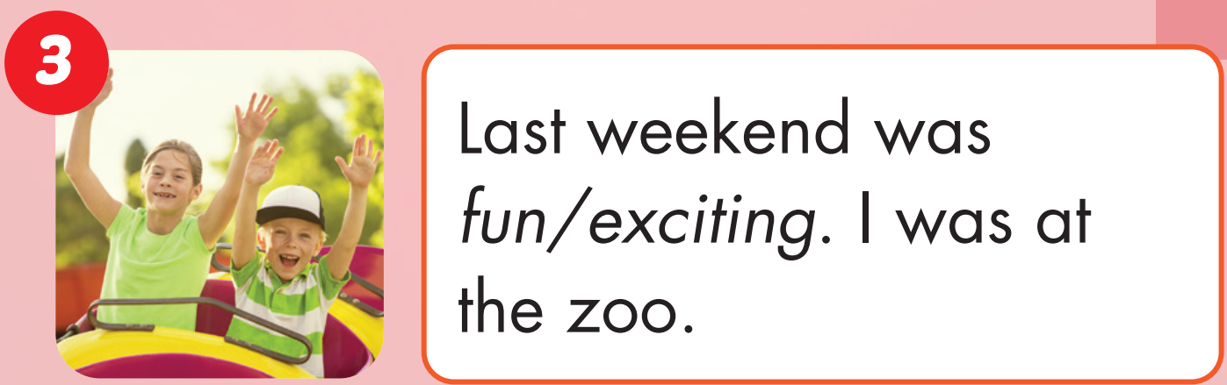
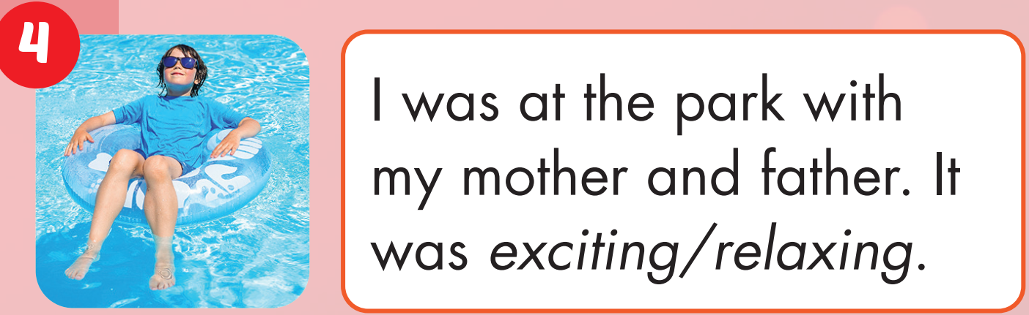

Slide 35

CONSOLIDATION

Slide 36

WRAP-UP

Slide 37
Today’s lesson
Vocabularies
fun
exciting
relaxing
tiring
boring
Structures/ Sentence patterns
How was your weekend?
It was relaxing. I was at the beach with my mom and brother.

Slide 38
Homework
Practice the vocabularies and structure, and make sentences using them.
Do the exercises in Tiếng Anh 4 i-Learn Smart Start WB (page 78)
Do the exercises in Tiếng Anh 4 i-Learn Smart Start Notebook (page 49)
Prepare the next lesson (page 116, SB)
Play the consolidation games in Tiếng Anh 4 i-Learn Smart Start DHA App on www.eduhome.com.vn

Slide 39

Enjoy your day!

