Slide 1

Unit 7: Toys
Lesson 3.1
Page 102

Slide 2
Lesson Outline
Warm-up
Vocabulary
Structure
Consolidation
Wrap-up

Slide 3
Objectives
By the end of this lesson, students will be able to…
Vocabulary: Pronounce and use the words related to the topic properly: under, on, in, toy box, wardrobe
Structure: Instruct someone to put an item somewhere else by using:
Put the ball on the chair.

Slide 4

WARM UP

Slide 5









GAME WITH
DOREAMON
Start
Notes:
Thanh Yến Trần 0967 255 149 zalo/ FB https://www.facebook.com/thanhyentrananhngutaymy/

Slide 6



Trò chơi gồm 4 câu hỏi trắc nghiệm
Ở mỗi câu hỏi, các em sẽ có thời gian 10 giây để đưa ra đáp án.
Để trả lời, em sẽ giơ thẻ màu tương ứng với
màu đáp án:
Cam
Xanh
dương
Xanh
lá
Đỏ
Các em có thời gian 1 phút để chuẩn bị các thẻ màu nhé!
Notes:
Thanh Yến Trần 0967 255 149 zalo/ FB https://www.facebook.com/thanhyentrananhngutaymy/

Slide 7








Yeahhh,
That’s right!
Huhu,
That is wrong.
Try your best
How many dolls?
Seven dolls.
Ten dolls.
Eight dolls.
Nine dolls.
Notes:
Thanh Yến Trần 0967 255 149 zalo/ FB https://www.facebook.com/thanhyentrananhngutaymy/

Slide 8



Yeahhh,
That’s right!
Huhu,
That is wrong.
Try your best
.
How many robots?
Eight robots.
Nine robots.
Six robot.
Ten robots.

Slide 9


Yeahhh,
That’s right
Huhu,
That is wrong.
Try your best
How many dice?
Seven dice.
Ten dice.
Nine dice.
Eight dice.

Slide 10


Yeahhh,
That’s right
Huhu,
That is wrong.
Try your best
How many cars?
Five cars.
Seven cars.
Six cars.
Eight cars.

Slide 11





GAME WITH
DOREAMON
THANKS
SO MUCH!

Slide 12

It’s time to learn …

Slide 13

New words
under,
on,
in,
toy box,
wardrobe

Slide 14

Presentation

Slide 15

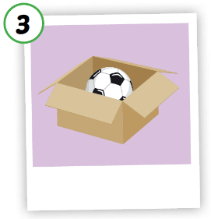
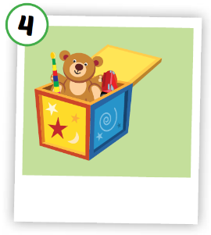
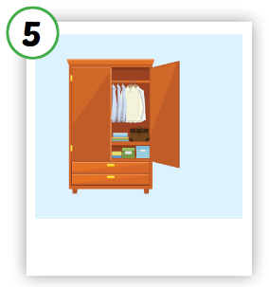
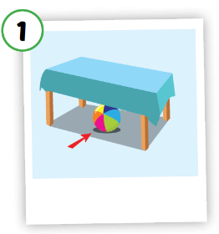
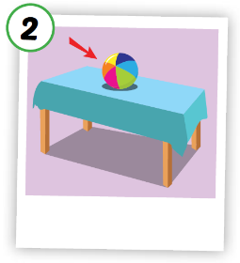





Click A to hear the sound
Notes:
Click vào hình A. 1. Listen and point. Repeat để cho cả audio full chạy

Slide 16
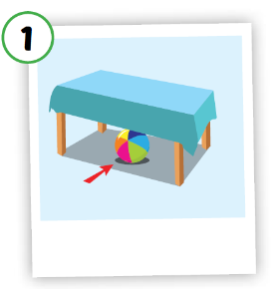




Click on each picture to hear the sound.
/ˈwɔːrdrəʊb/
tủ đồ,
tủ quần áo
/ˈʌndər/
ở dưới
/ɑːn/
ở trên
/ɪn/
ở trong
/tɔɪ bɑːks/
hộp đồ chơi
Notes:
Click vào hình A. 1. Listen and point. Repeat để cho cả audio full chạy

Slide 17

Click on each picture to hear the sound.
/ˈʌndər/
ở dưới
Notes:
Click vào hình A. 1. Listen and point. Repeat để cho cả audio full chạy

Slide 18

Click on each picture to hear the sound.
/ɑːn/
ở trên
Notes:
Click vào hình A. 1. Listen and point. Repeat để cho cả audio full chạy

Slide 19

Click on each picture to hear the sound.
/ɪn/
ở trong
Notes:
Click vào hình A. 1. Listen and point. Repeat để cho cả audio full chạy

Slide 20

Click on each picture to hear the sound.
/tɔɪ bɑːks/
hộp đồ chơi
Notes:
Click vào hình A. 1. Listen and point. Repeat để cho cả audio full chạy

Slide 21

Click on each picture to hear the sound.
/ˈwɔːrdrəʊb/
tủ đồ,
tủ quần áo
Notes:
Click vào hình A. 1. Listen and point. Repeat để cho cả audio full chạy

Slide 22

Practice

Slide 23
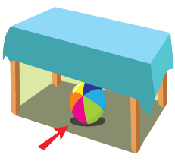
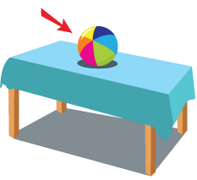









1
2
3
4
5
a
b
c
d
e

Slide 24

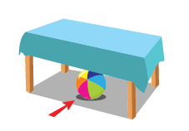

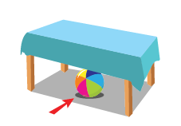
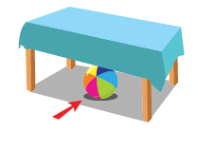
Extra Practice
WB, P. 72
1
in

Slide 25


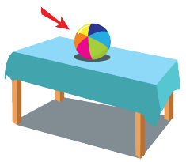
Extra Practice
WB, P. 72
2
wardrobe

Slide 26

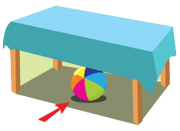
Extra Practice
WB, P. 72
3
under

Slide 27

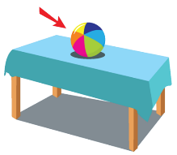
Extra Practice
WB, P. 72
4
on

Slide 28


Extra Practice
WB, P. 72
5
toy box

Slide 29
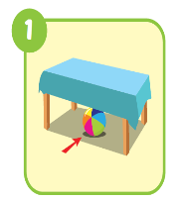
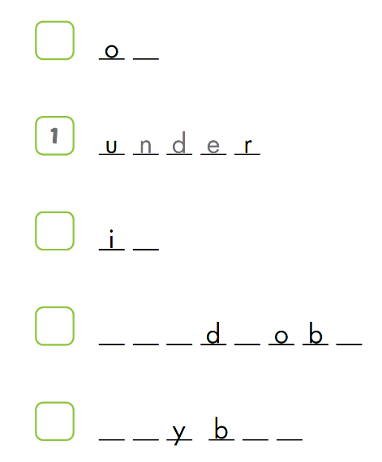

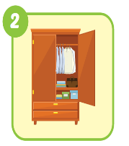
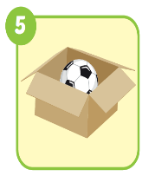
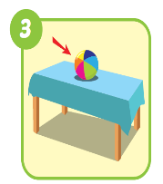
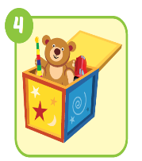
Extra Practice
WB, P. 72
n
n
w a r r e
t o o x

Slide 30
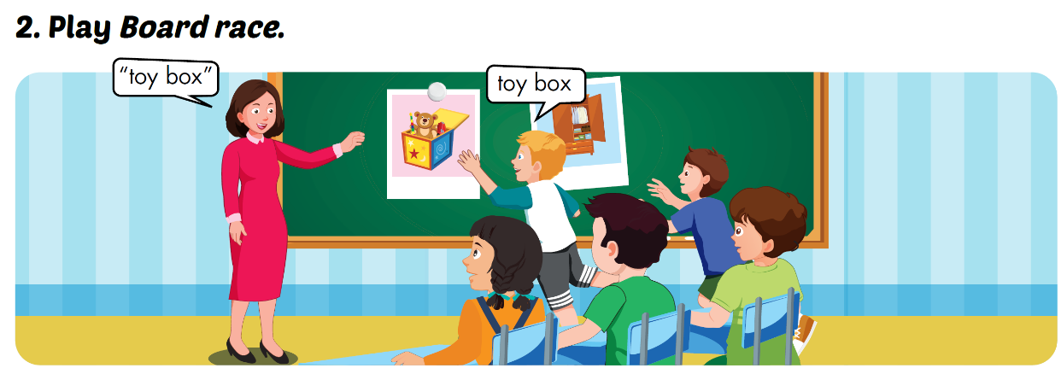

Slide 31
Structures
Put the ball on the chair.

Slide 32

Presentation

Slide 33




Click on each sentence to listen

Slide 34

Practice

Slide 35
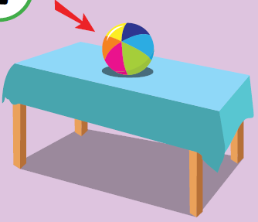
Put the ball on the table.
Practice

Slide 36

Put the ball in the box.
Practice

Slide 37

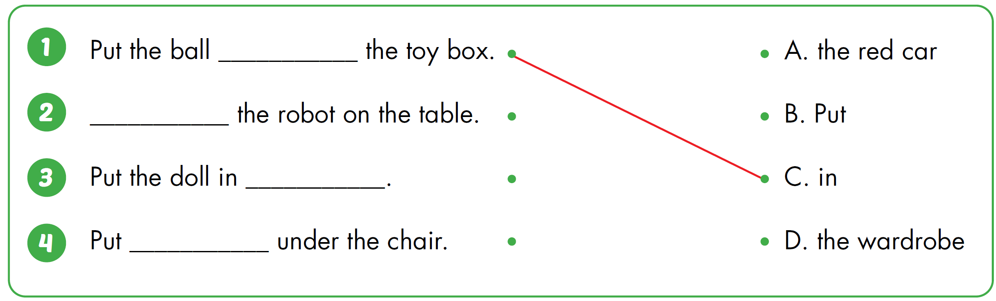




Slide 38

CONSOLIDATION

Slide 39
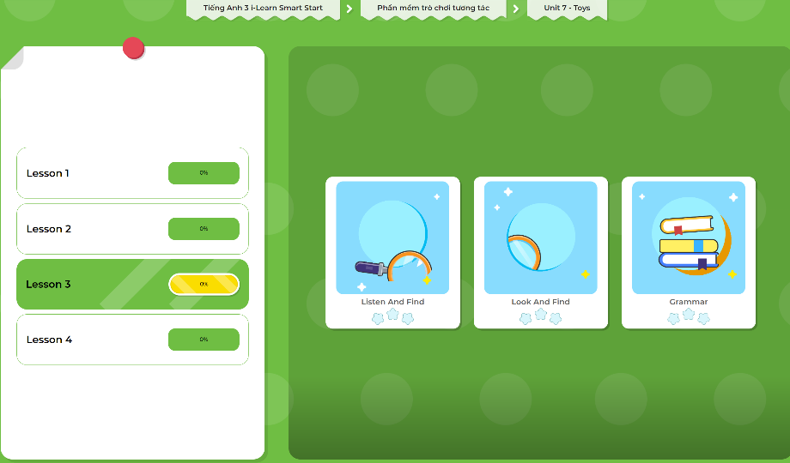
Extra Practice
DHA App
LET’S PLAY!
Click here to play the games

Slide 40

WRAP-UP

Slide 41
Today’s lesson
Vocabularies
under, on, in, toy box, wardrobe
Structures/ Sentence patterns
Put the ball on the chair.

Slide 42
Homework
Practice the vocabularies and structure; and make sentences using them.
Do the exercises in Tiếng Anh 3 i-Learn Smart Start WB (page 72)
Do the exercise in Tiếng Anh 3 i-Learn Smart Start DHA Notebook (page 48)
Prepare the next lesson (page 103 SB)
Play the consolidation games in Tiếng Anh 3 i-Learn Smart Start DHA App on www.eduhome.com.vn

Slide 43

Enjoy your day!

