Slide 1

Unit 7: MY FAMILY
Lesson 3.2
Page 99

Slide 2
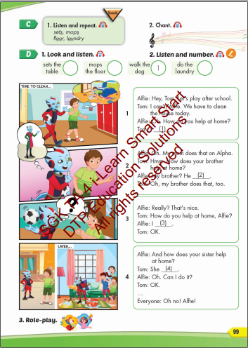
Lesson Outline
Warm-up
Listening
Consolidation
Wrap-up

Slide 3
By the end of this lesson, students will be able to talk about chores they do.
Vocabularies
sets, mops
floor, laundry
Structures/ Sentence patterns
How do you help at home?
I set the table.
How does your brother help at home?
He mops the floor.

Slide 4

WARM UP

Slide 5


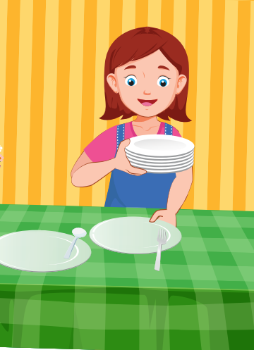
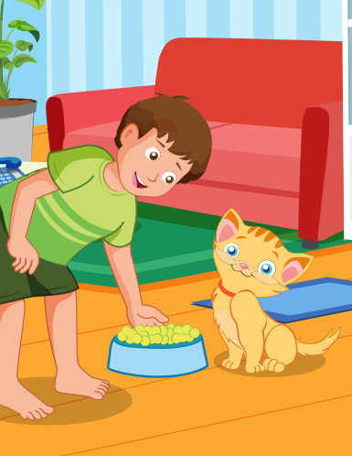
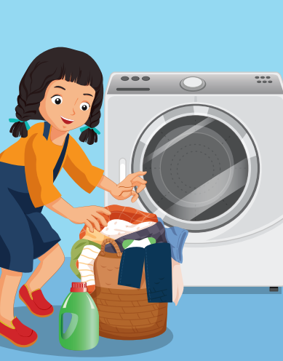

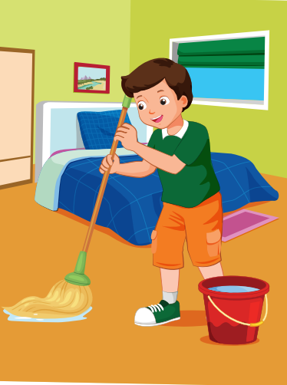
CLICK HERE TO LISTEN ️🎧
LISTEN AND CHOOSE THE PICTURE
WRONG
WRONG
WRONG
CORRECT
WRONG
NEXT
WRONG

Slide 6
CLICK HERE TO LISTEN ️🎧
LISTEN AND CHOOSE THE PICTURE
WRONG
WRONG
CORRECT
WRONG
WRONG
NEXT
WRONG

Slide 7
CLICK HERE TO LISTEN ️🎧
LISTEN AND CHOOSE THE PICTURE
WRONG
WRONG
WRONG
WRONG
CORRECT
NEXT
WRONG

Slide 8
CLICK HERE TO LISTEN ️🎧
LISTEN AND CHOOSE THE PICTURE
CORRECT
WRONG
WRONG
WRONG
WRONG
NEXT
WRONG

Slide 9
CLICK HERE TO LISTEN ️🎧
LISTEN AND CHOOSE THE PICTURE
WRONG
WRONG
WRONG
WRONG
WRONG
NEXT
CORRECT

Slide 10
CLICK HERE TO LISTEN ️🎧
LISTEN AND CHOOSE THE PICTURE
WRONG
CORRECT
WRONG
WRONG
WRONG
NEXT
WRONG

Slide 11

It’s time to learn …

Slide 12

Listening

Slide 13
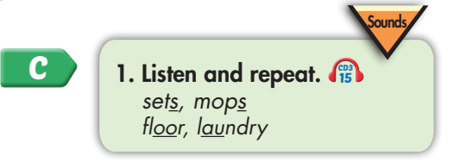
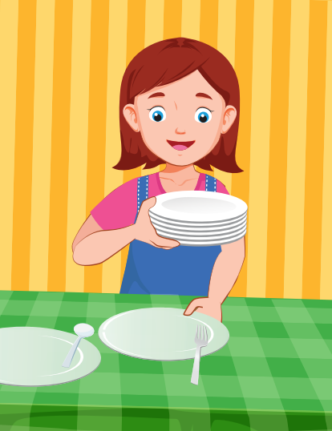
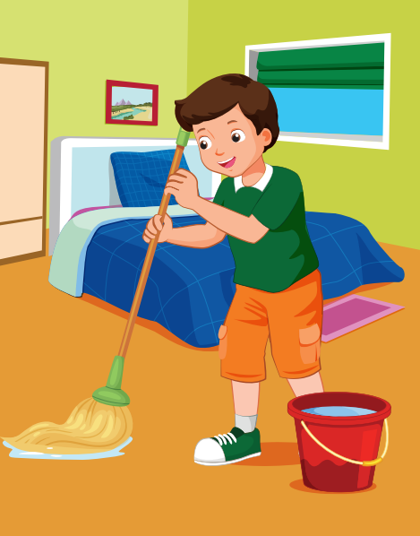
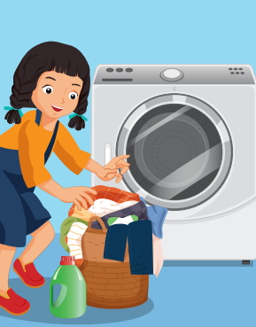
Click each English word to hear the sound.
sets
mops
floor
laundry
/set/
Chuẩn bị
/mɑːp/
Lau, chùi
/flɔːr/
Sàn nhà
/ˈlɑːndri/
Giặt

Slide 14


Click the earphone to hear the sound.
Who mops the floor?
Elfie mops the floor.
Who sets the table?
Elfie sets the table.
Who does the laundry?
Elfie does the laundry.

Slide 15

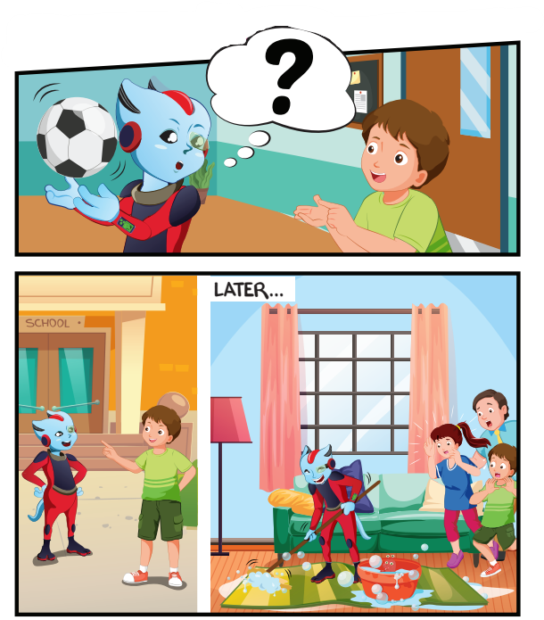
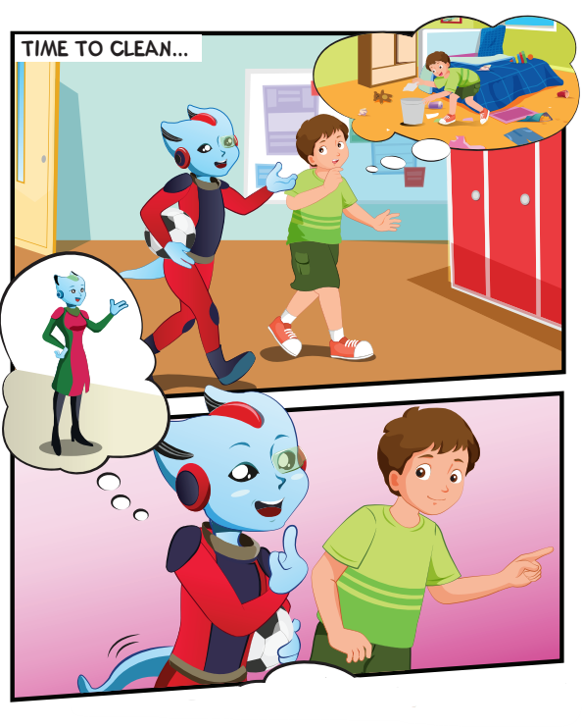

Slide 16
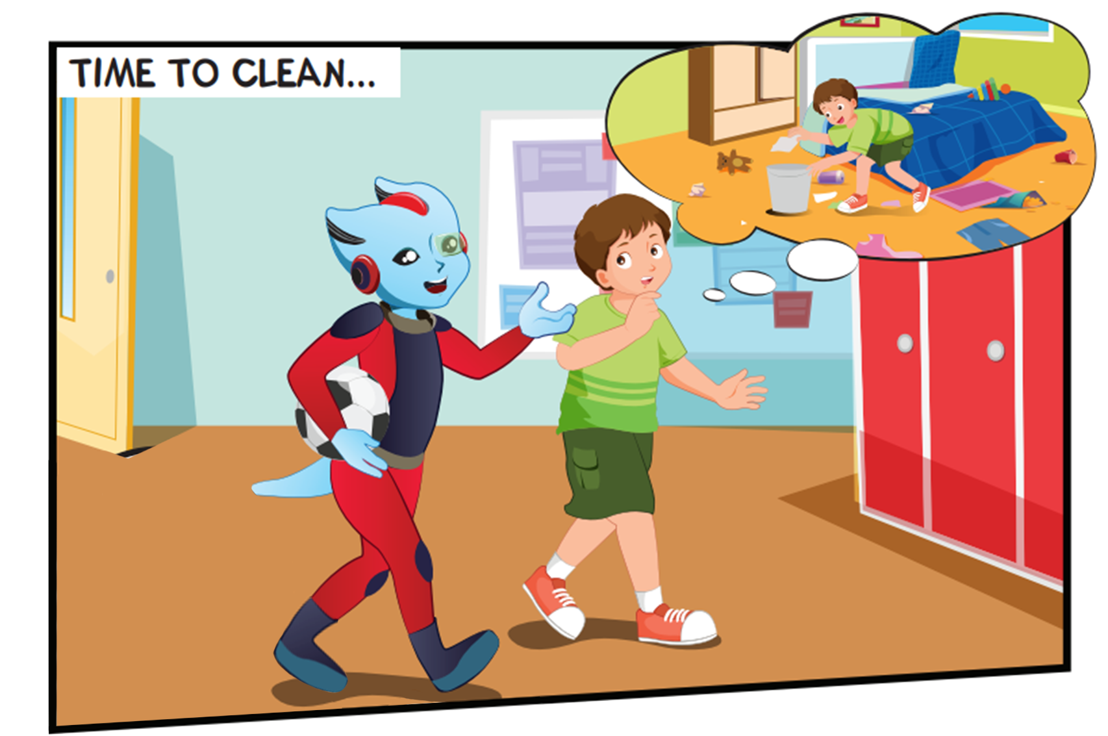
Where are they?
What are they doing?

Slide 17
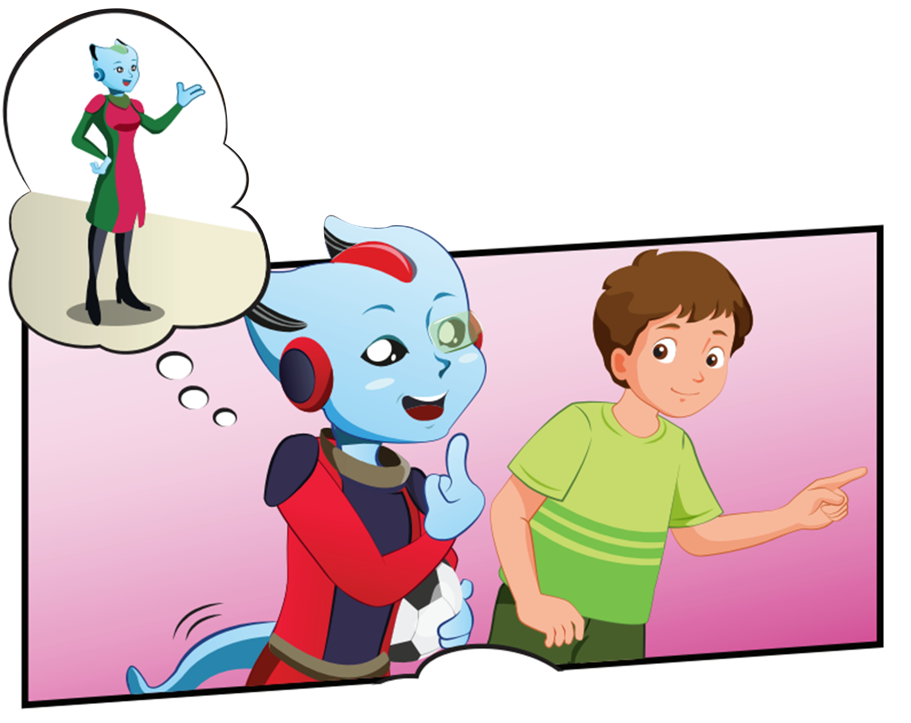
Who are they?
What are they doing?

Slide 18
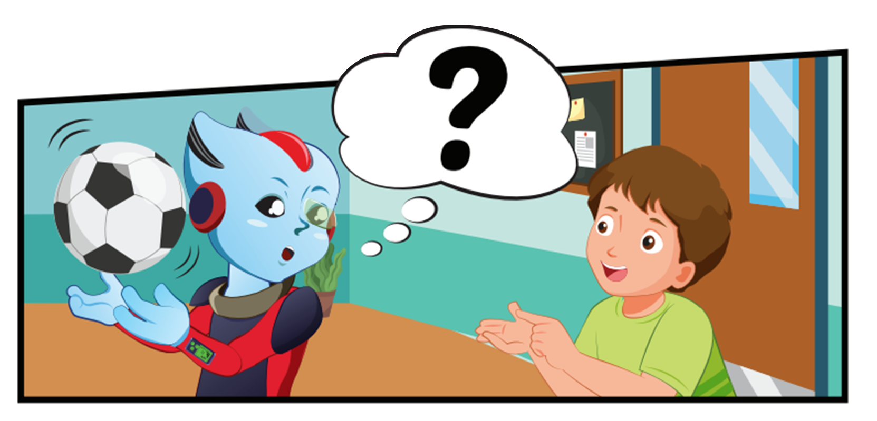
What is Alfie holding?

Slide 19
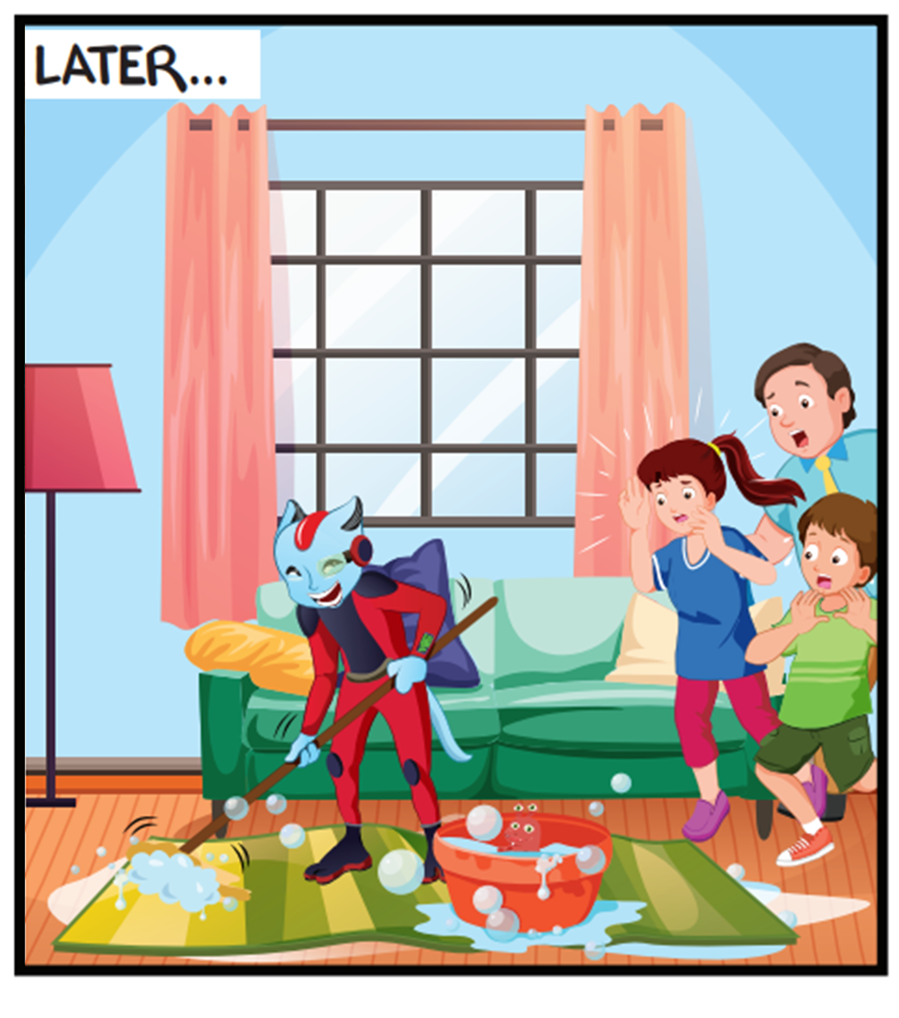
Where are they?
What are they doing?

Slide 20

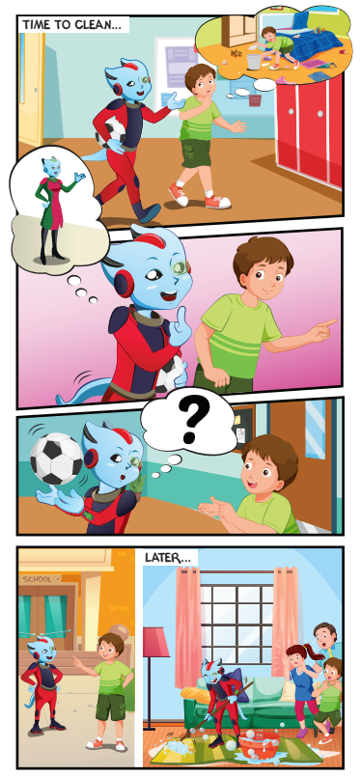
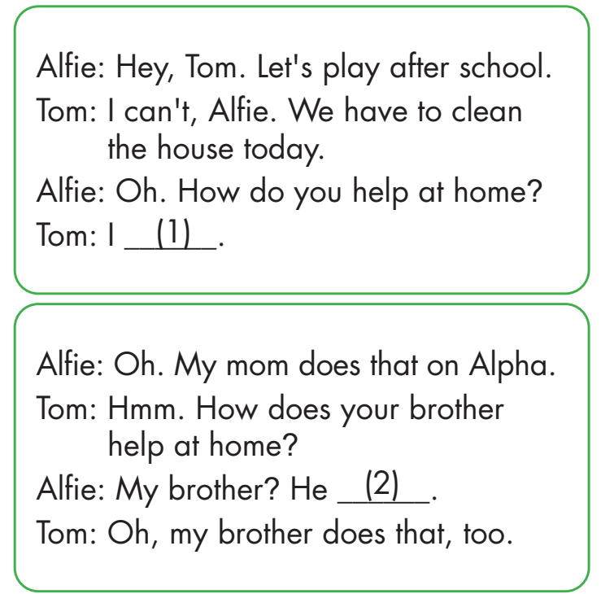
walk the dog.
sets the table

Slide 21
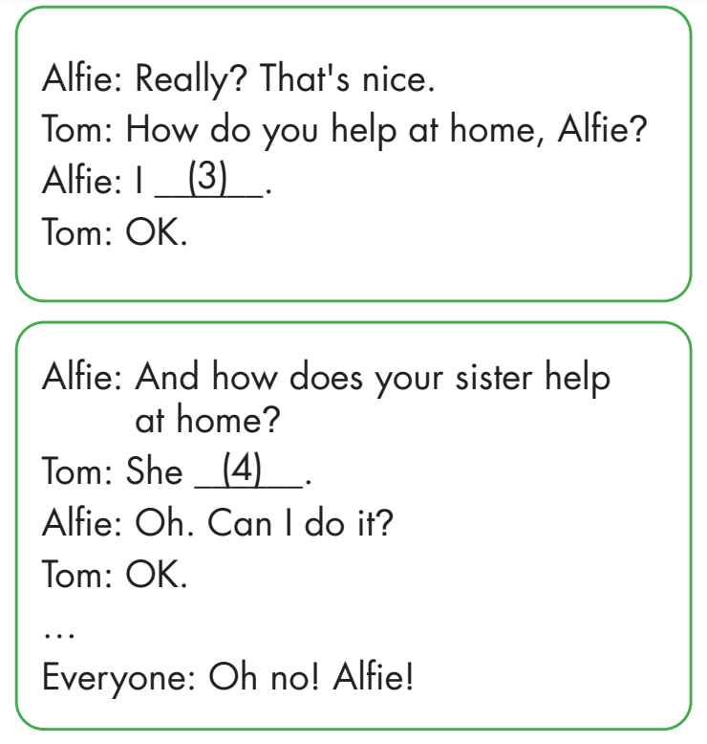
do the laundry.
mops the floor.

Slide 22

Practice

Slide 23



How do you help at home, Alfie?
I mop the floor.
Ok, me too.

Slide 24
How does your sister help at home, Alfie?
She does the laundry.
Oh, my sister does that, too.

Slide 25
How do you help at home, Alfie?
I feed the cat.
Oh, that’s great!

Slide 26
How does your brother help at home, Alfie?
He sets the table.
Oh, my brother does that, too.

Slide 27

CONSOLIDATION

Slide 28



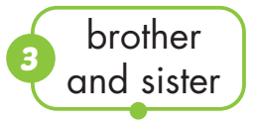


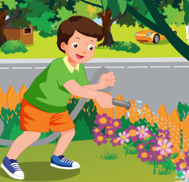
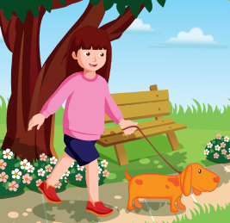
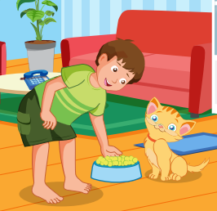
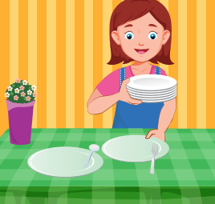

Slide 29
How to Play:
Teacher choose student to answer
Student spell each letter in the correct order
Who is wrong will have to sing

Slide 30
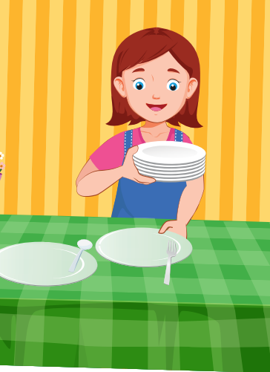
e
s
h
e
e
t
b
t
l
a
t

Slide 31

a
w
t
h
l
o
k
g
d
e

Slide 32
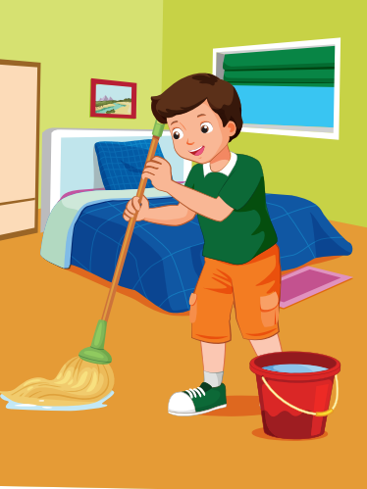
o
m
h
e
r
p
o
t
o
l
f

Slide 33
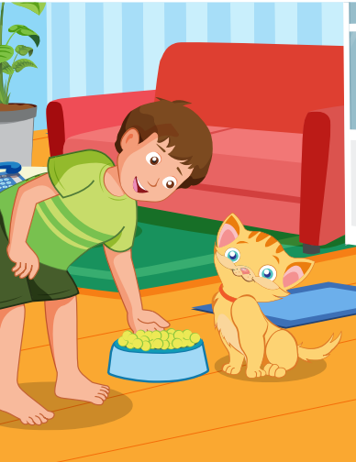
e
f
t
h
e
a
d
t
c
e

Slide 34

WRAP-UP

Slide 35
Today’s lesson
Vocabularies
sets, mops
floor, laundry
Structures/ Sentence patterns
How do you help at home?
I set the table.
How does your brother help at home?
He mops the floor.

Slide 36
Homework
Practice the vocabularies and structure; and make sentences using them.
Do the exercises in Tiếng Anh 4 i-Learn Smart Start WB (page 67)
Do the exercises in Tiếng Anh 4 i-Learn Smart Start Notebook (page 42)
Prepare the next lesson (page 100 SB)
Play the consolidation games in Tiếng Anh 4 i-Learn Smart Start DHA App on www.eduhome.com.vn

Slide 37

Have a nice day!

