Slide 1

Unit 7: MY FAMILY
Lesson 1.2
Page 93

Slide 2
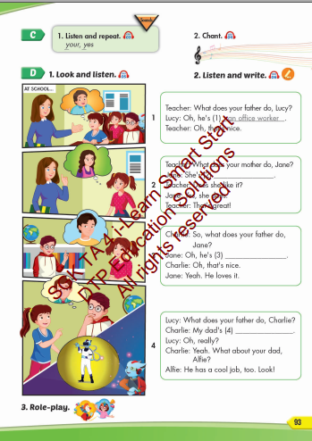
Lesson Outline
Warm-up
Listening
Consolidation
Wrap-up

Slide 3
Objectives
By the end of this lesson, students will be able to talk about what job their family members do.
Vocabulary: your, yes
Phonics: /j/
Structure: What does your father do?
He's a doctor.
What does your mother do?
She's an office worker.

Slide 4

WARM UP

Slide 5

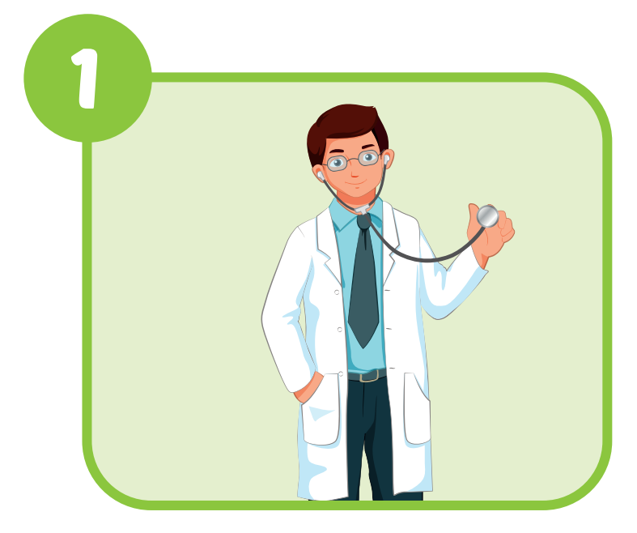
ocotdr
doctor

Slide 6
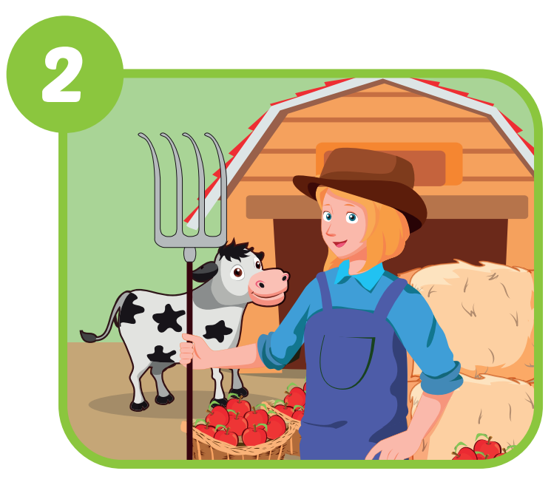
mafrre
farmer

Slide 7
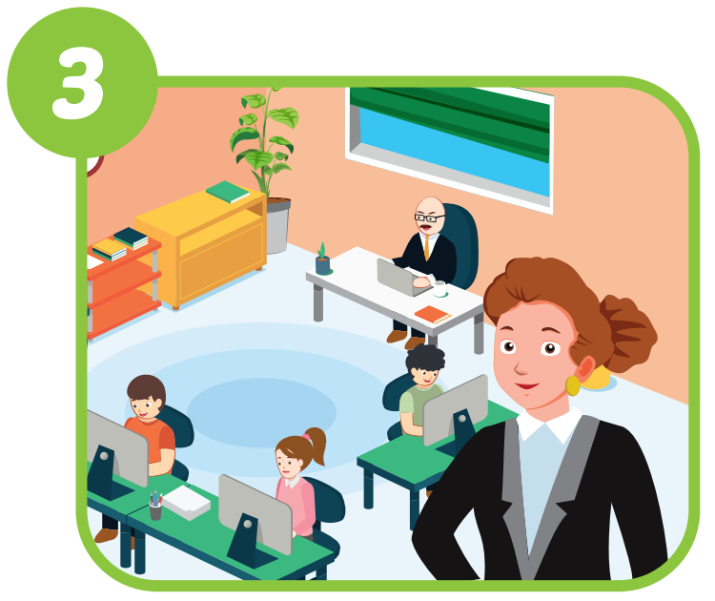
iofcef
rokwre
office
worker

Slide 8
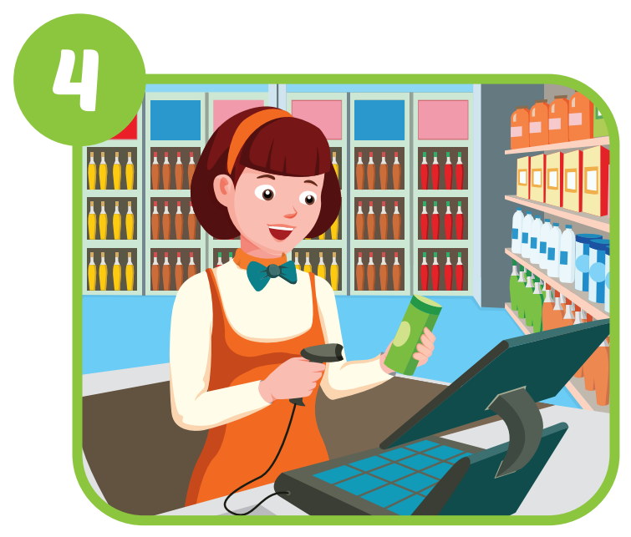
iacsrhe
cashier

Slide 9
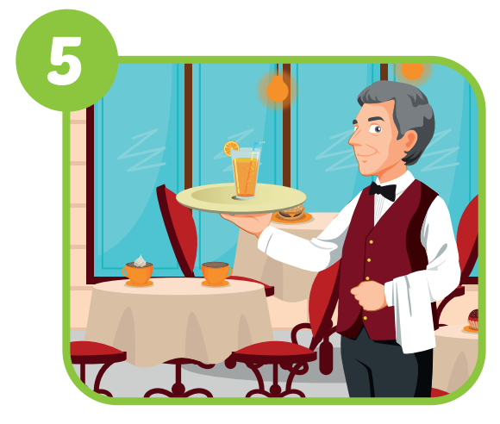
tiawre
waiter

Slide 10
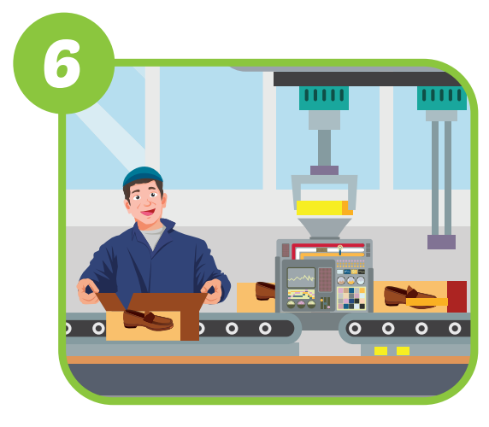
cyratof
korwre
factory
worker

Slide 11

It’s time to learn …

Slide 12

Listening

Slide 13


Click each English word to hear the sound.
your
yes
/jʊr/
của bạn
/jes/
có

Slide 14


Click the earphone to hear the sound.
Is the father a waiter?
Yes, he is.
Is the mother a cashier?
Yes, she is.

Slide 15

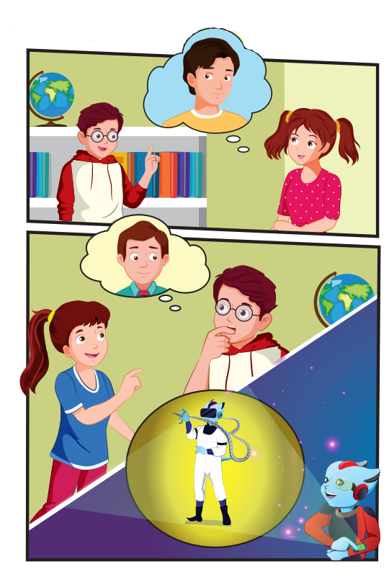
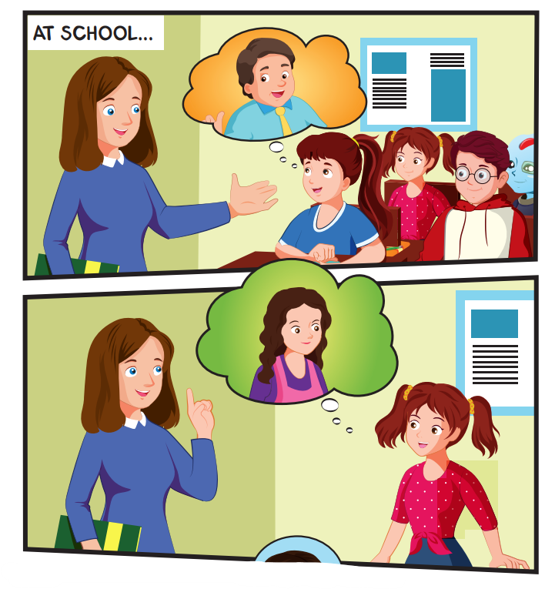
Click each English word to hear the sound.

Slide 16
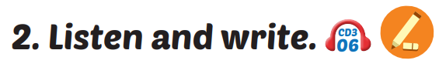
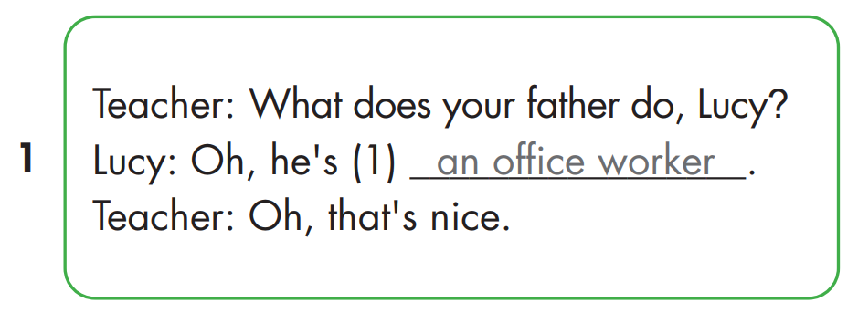

Slide 17
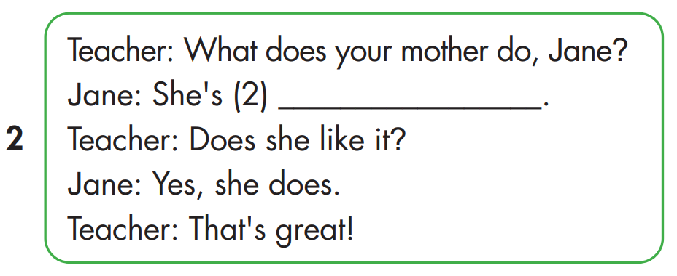
a factory worker

Slide 18
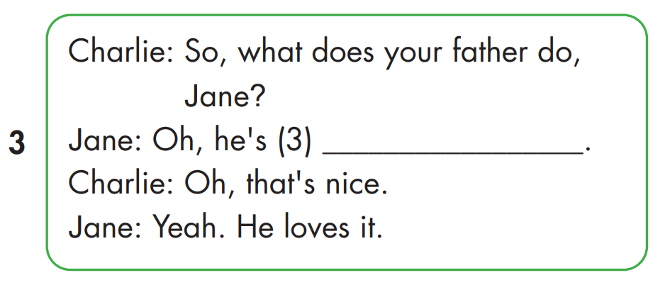
a farmer

Slide 19
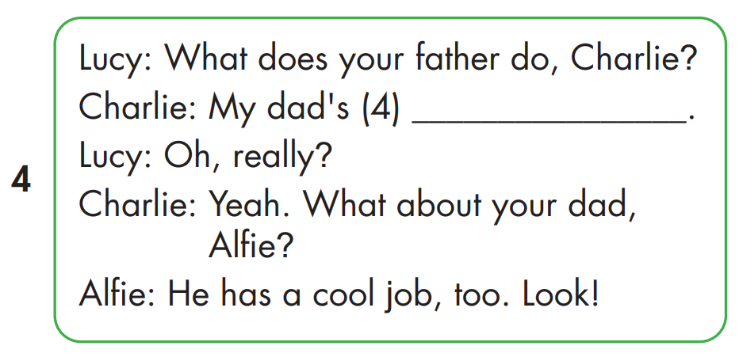
a doctor

Slide 20

Practice

Slide 21
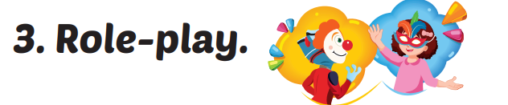


What does your father do?
He's a doctor.
She's an
office worker.
What does your mother do?

Slide 22
What does your father do?
He's a farmer.
She's a cashier.
What does your mother do?

Slide 23
What does your father do?
He's a waiter.
She's a
factory worker.
What does your mother do?

Slide 24

CONSOLIDATION

Slide 25

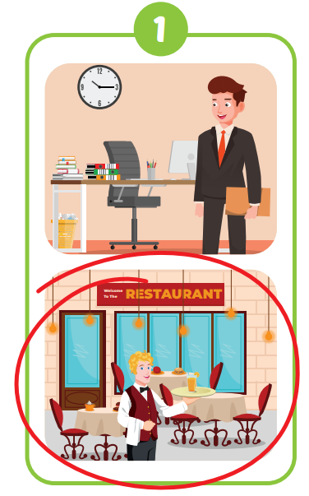
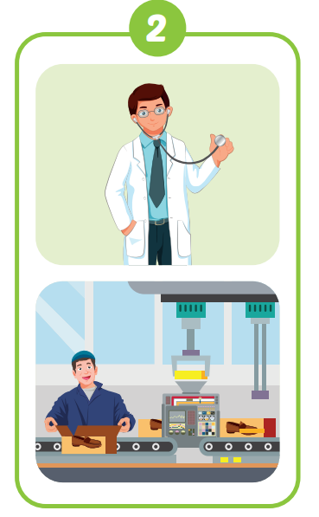

Slide 26
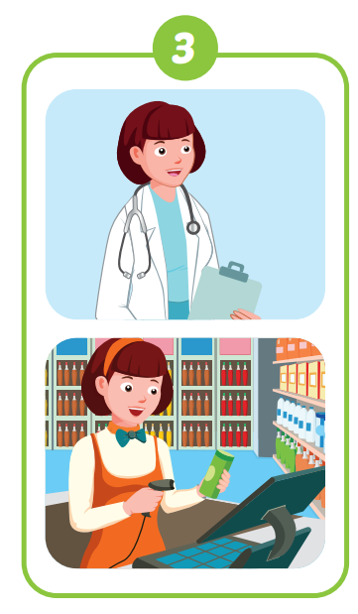
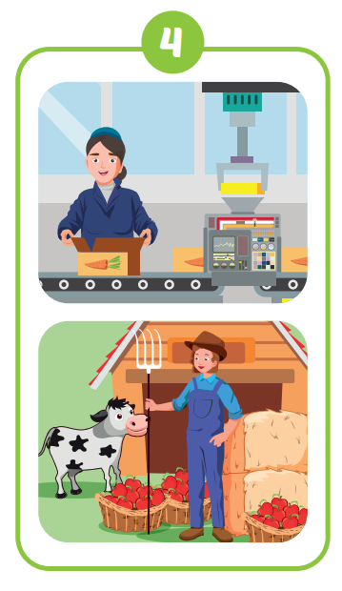

Slide 27

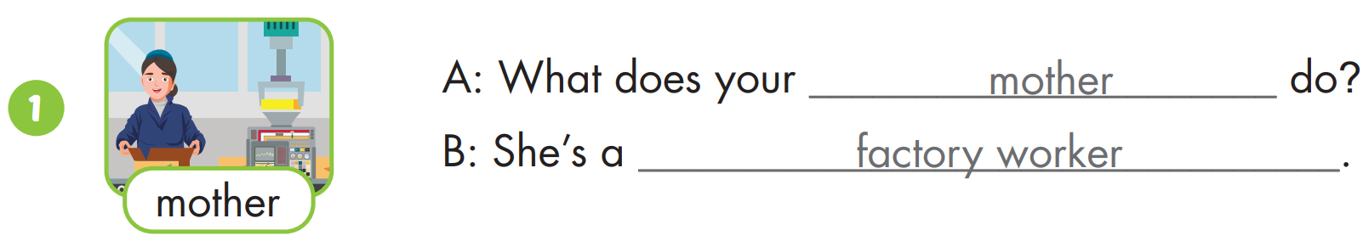

Slide 28
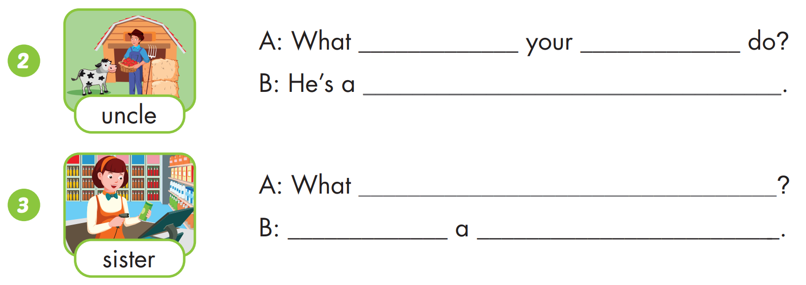
does
uncle
farmer
does your sister do
She’s
cashier

Slide 29
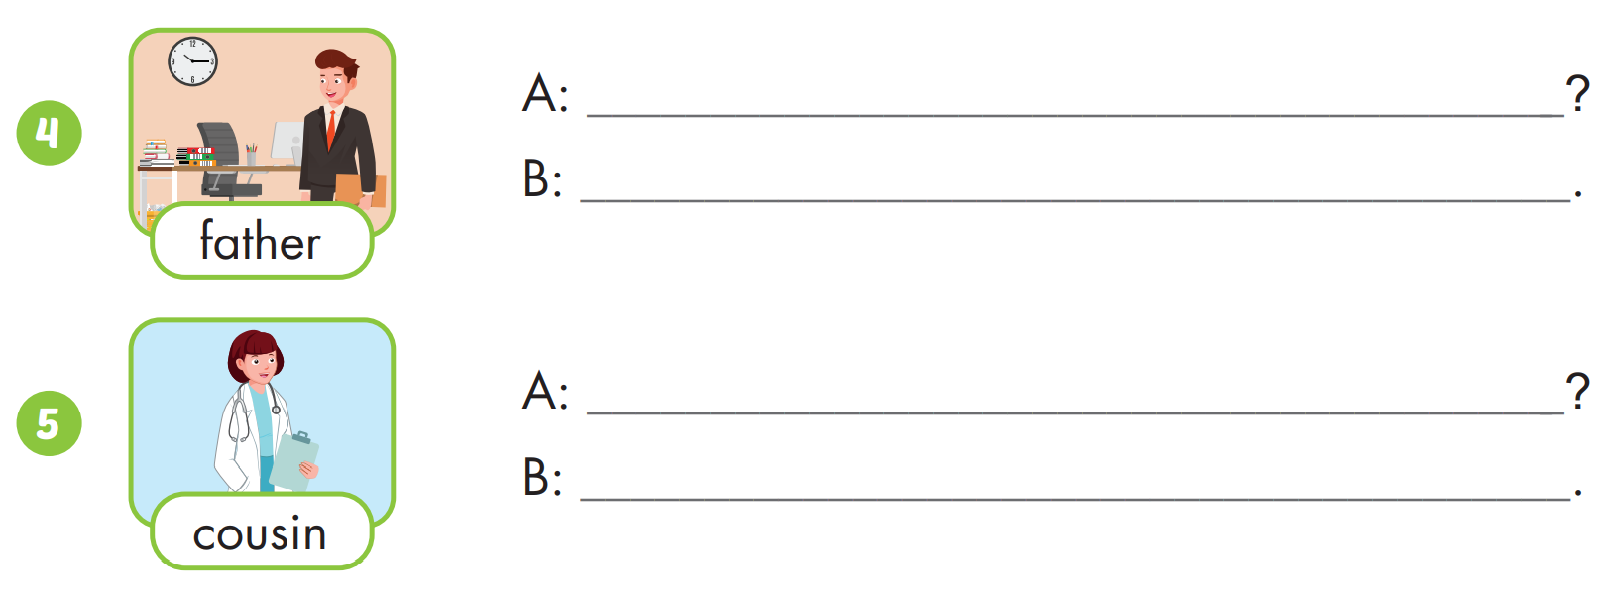
What does your father do
He’s an office worker
What does your cousin do
She’s a doctor

Slide 30

WRAP-UP

Slide 31
Today’s lesson
Vocabularies
your, yes
Structures/ Sentence patterns
What does your father do?
He's a doctor.
What does your mother do?
She's an office worker.

Slide 32
Homework
Practice the vocabularies and structure; and make sentences using them.
Do the exercises in Tiếng Anh 4 i-Learn Smart Start WB (page 63)
Do the exercises in Tiếng Anh 4 i-Learn Smart Start Notebook (page 40)
Prepare the next lesson (page 94 SB)
Play the consolidation games in Tiếng Anh 4 i-Learn Smart Start DHA App on www.eduhome.com.vn

Slide 33

Have a nice day!

