Slide 1

Unit 4: Travel
Lesson 3.2
Page 55

Slide 2
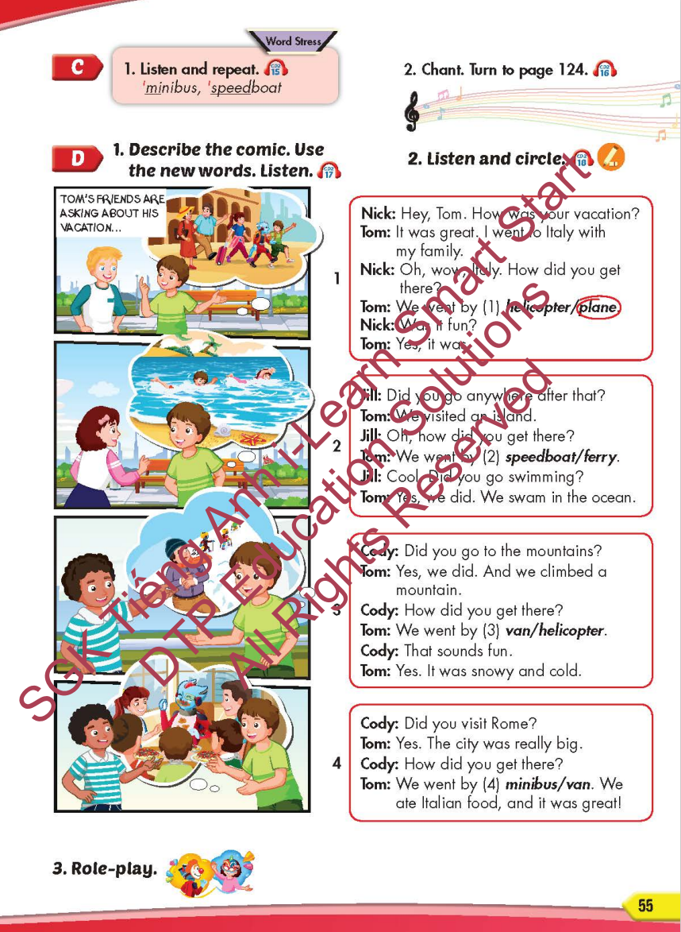
Lesson Outline
Warm-up
Listening
Consolidation
Wrap-up

Slide 3
Objectives
By the end of this lesson, students will be able to…
Word stress: 'minibus, 'speedboat
Structure: How did you get there? - We went by helicopter.

Slide 4

WARM-UP

Slide 5
CHECK-UP

Slide 6

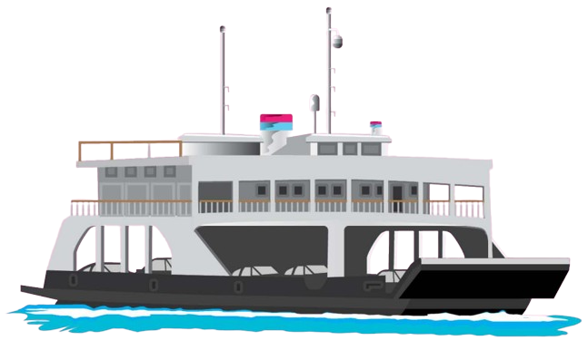
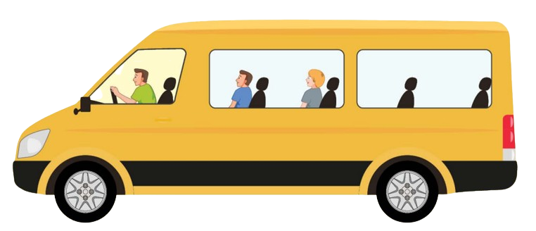




Listen and choose
A
B

Slide 7
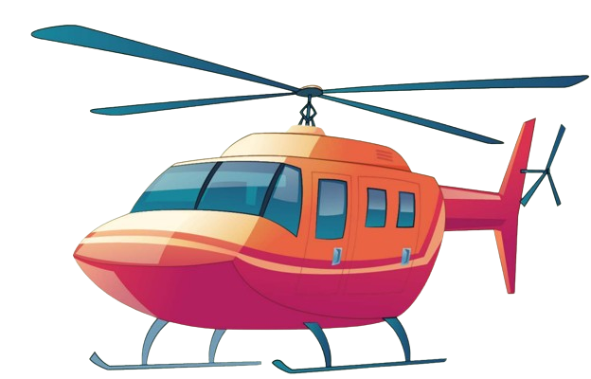
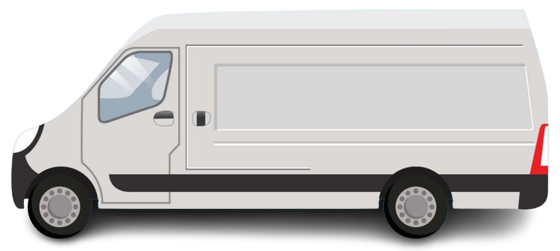
Listen and choose
A
B

Slide 8
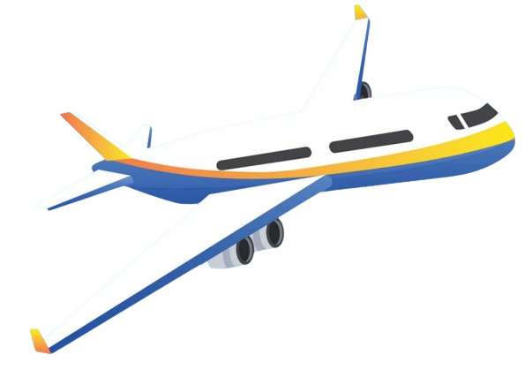
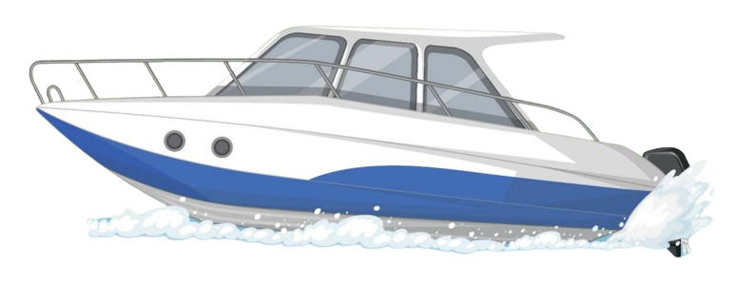
Listen and choose
A
B

Slide 9
Listen and choose
A
B

Slide 10
Listen and choose
A
B

Slide 11
Listen and choose
A
B

Slide 12

It’s time to learn …

Slide 13

Word stress
'minibus, 'speedboat

Slide 14

Listening

Slide 15
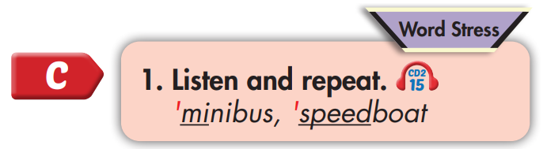
'minibus
'speedboat

Slide 16
Practice

Slide 17



Slide 18
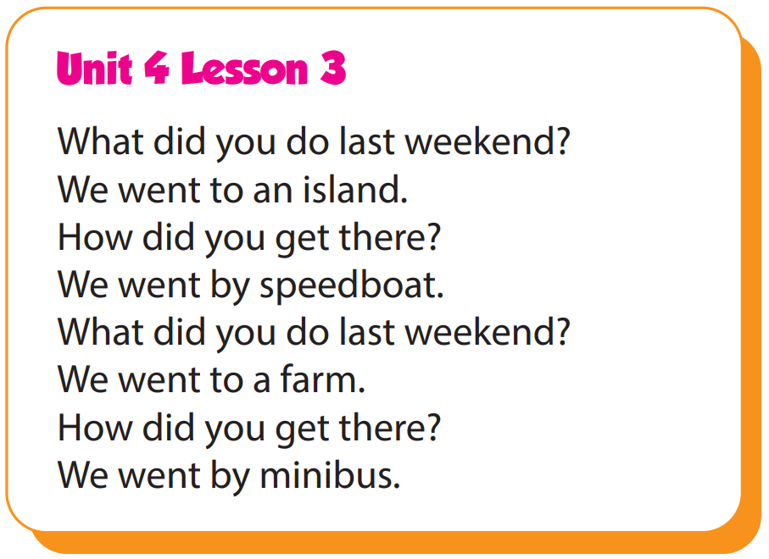

Slide 19
Structure
How did you get there?
- We went by helicopter.

Slide 20

Speaking

Slide 21
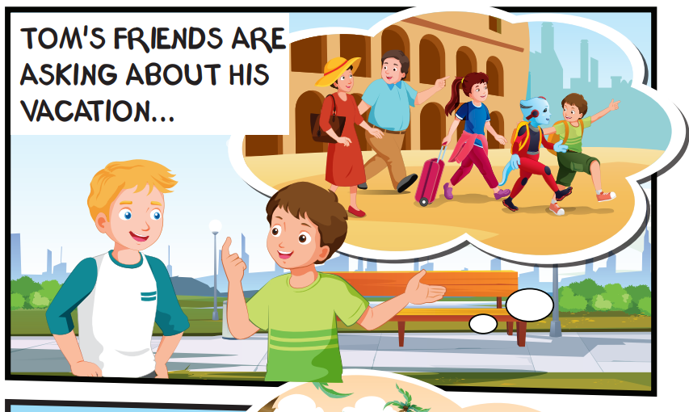
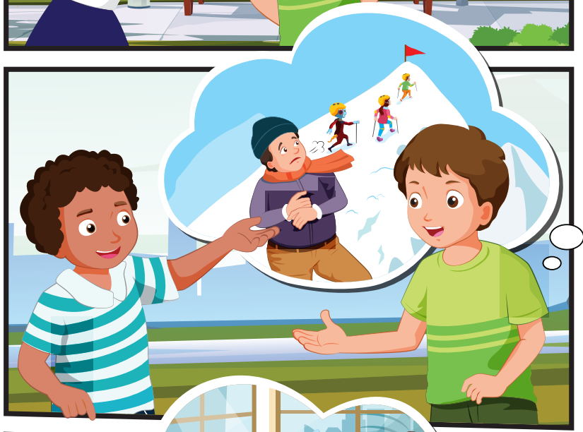
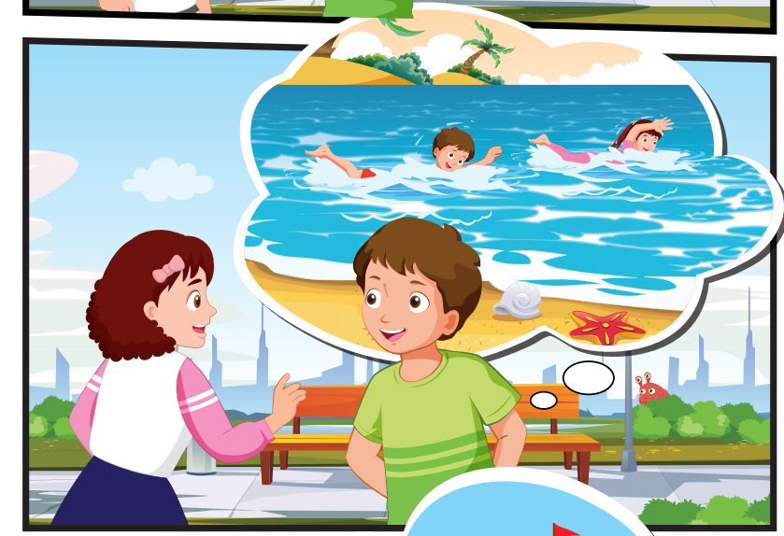
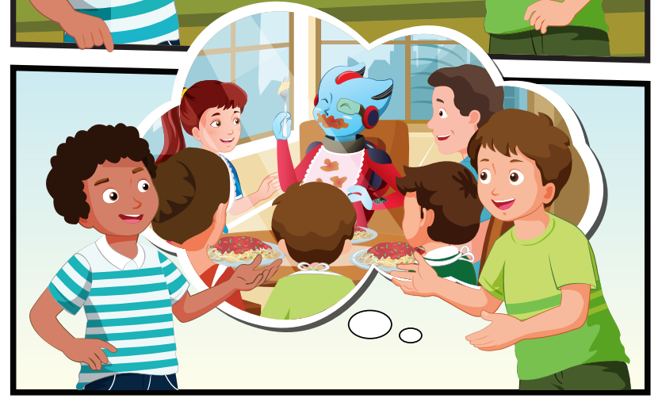
Who can you see?
Tom and his family, Alfie, Nick, Jill, Cody

Slide 22
Where are they?
Tom, Nick, Jill, and Cody are outside

Slide 23
What are they talking about?
Tom's vacation

Slide 24

Listening

Slide 25


Slide 26

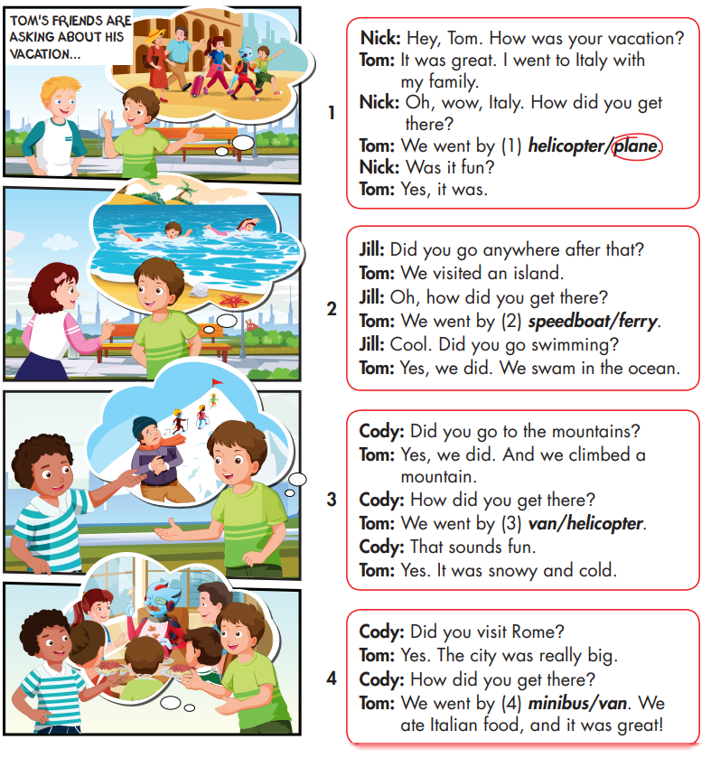

Slide 27
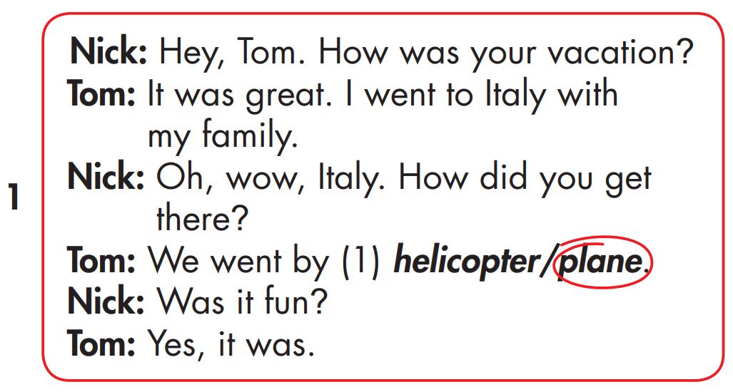

Slide 28
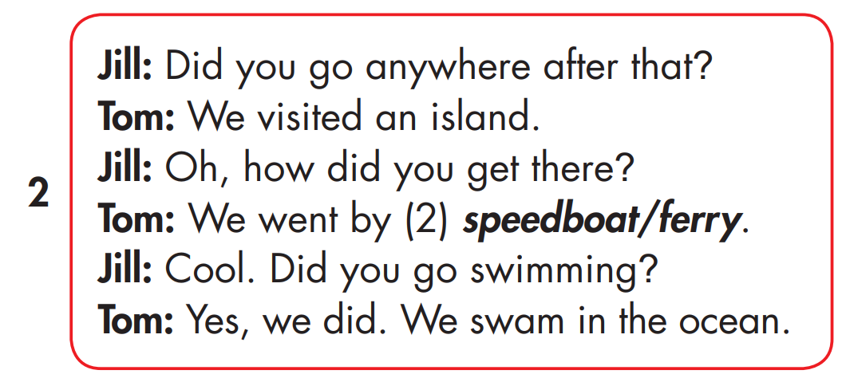


Slide 29
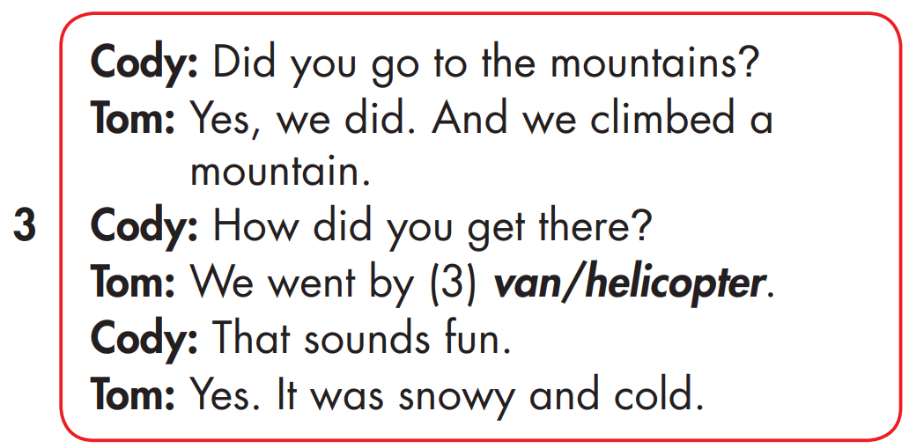

Slide 30
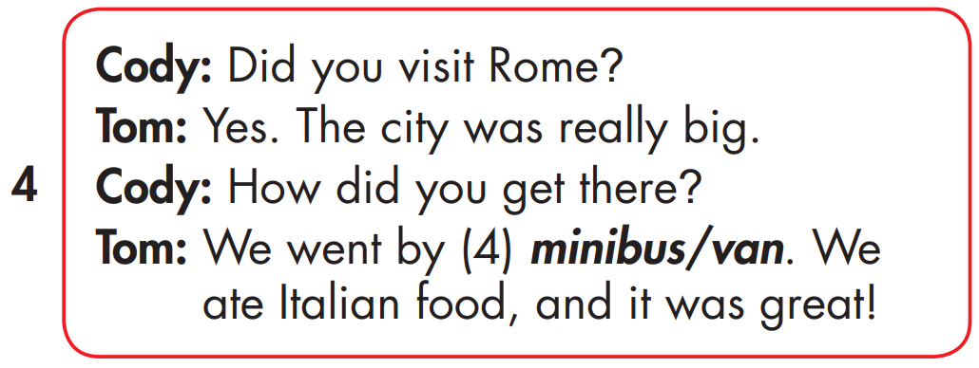

Slide 31

Speaking

Slide 32



Slide 33

Writing

Slide 34
MAKE YOUR OWN STORY

Slide 35

Production

Slide 36

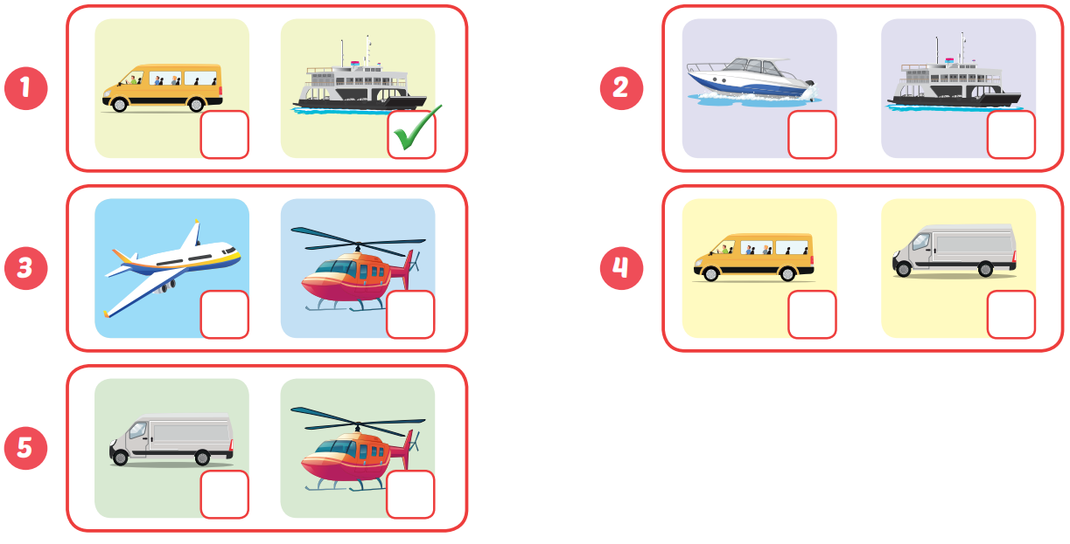

Extra Practice
WB, page 36

Slide 37

CONSOLIDATION

Slide 38

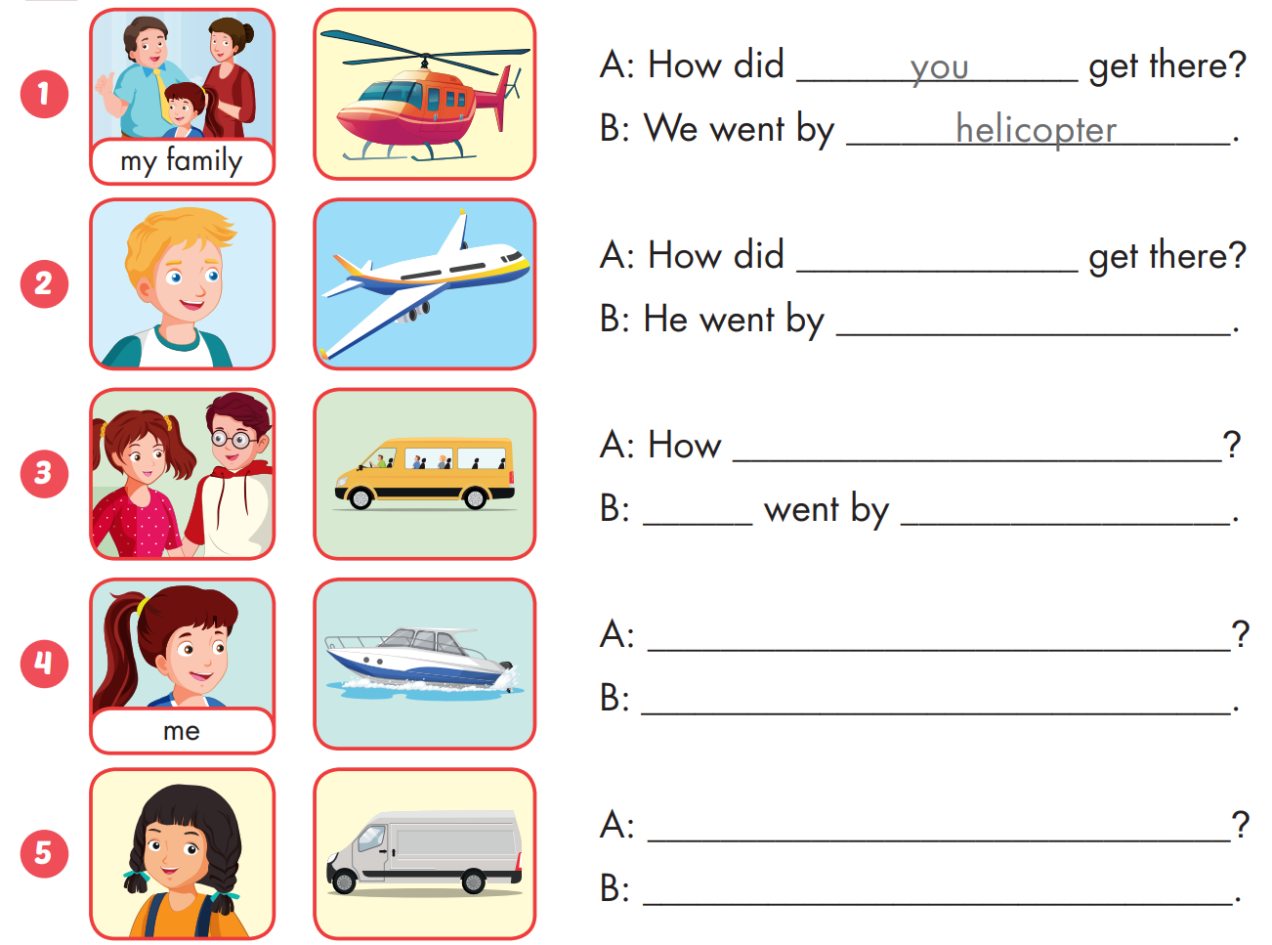
Extra Practice
WB, page 36

Slide 39

Extra Practice
WB, page 36
he
plane

Slide 40
Extra Practice
WB, page 36
did they get there
They
minibus
How did you get there
I went by speedboat.
How did she get there
She went by van

Slide 41

WRAP-UP

Slide 42
Today’s lesson
Word stress
'minibus, 'speedboat
Structures/ Sentence patterns
How did you get there?
- We went by helicopter.

Slide 43
Homework
Practice the vocabularies and structure, and make sentences using them.
Do the exercises in Tiếng Anh 5 i-Learn Smart Start WB (page 35)
Do the exercises in Tiếng Anh 5 i-Learn Smart Start Notebook (page 24)
Prepare the next lesson (page 56 SB)
Play the consolidation games in Tiếng Anh 5 i-Learn Smart Start DHA App on www.eduhome.com.vn

Slide 44

Enjoy your day!

Slide 45

Lesson 3
Stay positive and have a nice day!

