Slide 1

Unit 3: School
Review 1
Page 50

Slide 2
Lesson Outline
Warm-up
Reading
Listening
Consolidation
Wrap-up

Slide 3
Objectives
By the end of this lesson, students will be able to review asking who owns different school supplies, asking what subjects people like, and talking about their school timetables.

Slide 4

WARM UP

Slide 5
Let’s play!
The hangman

Slide 6
The hangman
How to play..
Think of a word and write the dashes on the board to show how many letters there are.
Ask students to suggest a letter. If it appears in the word, write it in all of the correct spaces. If the letter does not appear, write it off to the side and begin drawing the image of a hanging man.
Continue until the students guess the word correctly (they win).

Slide 7

It’s time to learn …

Slide 8

Listening

Slide 9
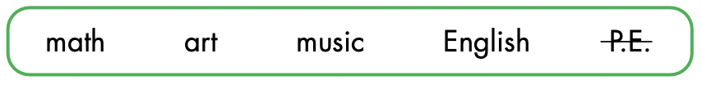
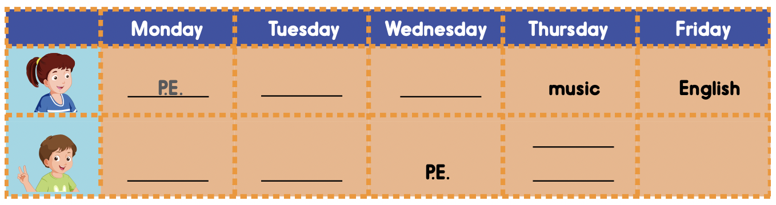
Look at the table and call out the days and subjects.

Slide 10



Slide 11
Listen and check.
math
math
art
English
music
English

Slide 12

Writing

Slide 13
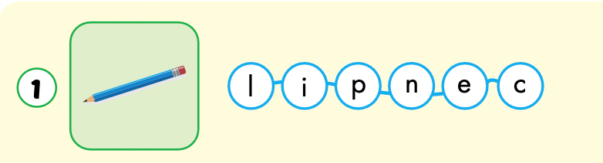
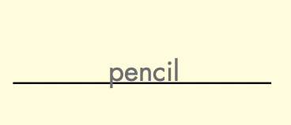

Slide 14
Have students individually look at the mixed up letters.
Have students write the words in the spaces provided.

Slide 15
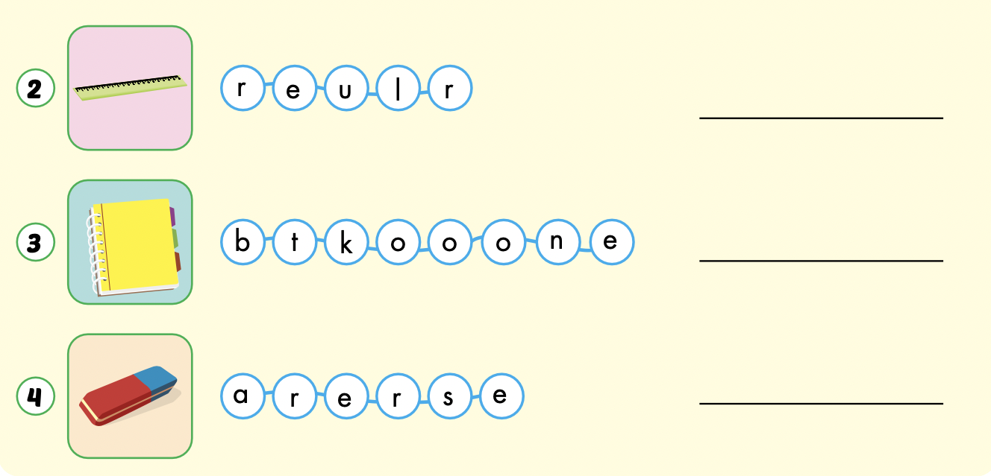
ruler
notebook
eraser

Slide 16

MYSTERY Box Game
Keep / Give The Box?

Slide 17
HOW TO PLAY:
Make 2 teams
Pick a letter and answer the question
Then you must choose:
KEEP THE BOX
or
GIVE THE BOX to the other team

Slide 18
BE CAREFUL!
The points in the box can be GOOD or BAD

Slide 19
ARE YOU READY?

Slide 20

A
B
C
D
E
F
G
H
I
J
K

Slide 21

What is this?

Slide 22


Slide 23

+100

Slide 24

What are these?

Slide 26

-100

Slide 27

What color is this?

Slide 28


Slide 29
+1000

Slide 30
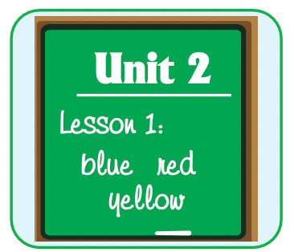
What subject is this?

Slide 32
-500

Slide 33
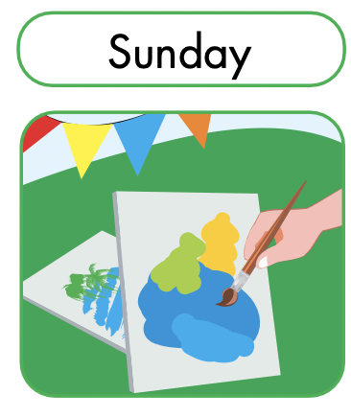
When do you have art?

Slide 35
+1

Slide 36


Do you like purple?

Slide 38
-200

Slide 39
Red and blue make…
?
?

Slide 41
+300

Slide 42
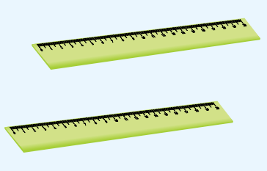

Are these your rulers?

Slide 44
+50

Slide 45

What color is it?

Slide 47
+600

Slide 48
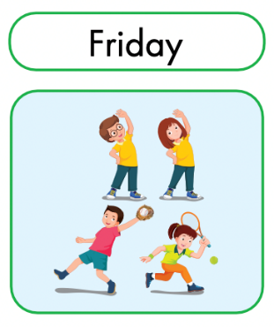
When do you have P.E?.

Slide 50
-1000

Slide 51

CONSOLIDATION

Slide 52
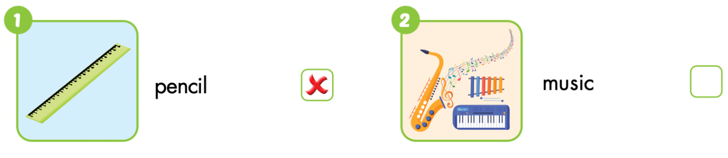
Extra Practice
WB p. 36

Slide 53
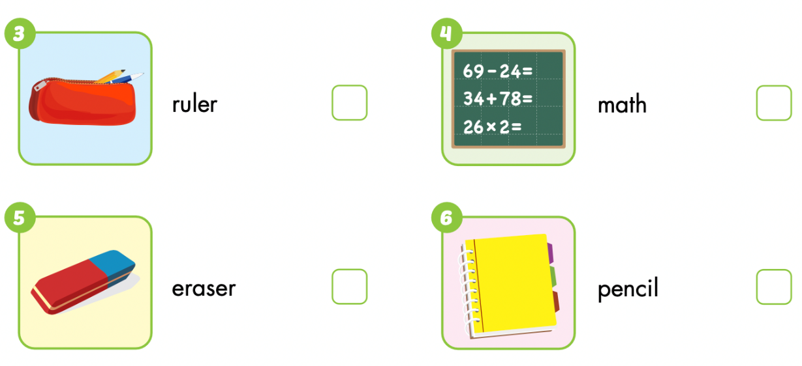


Slide 54
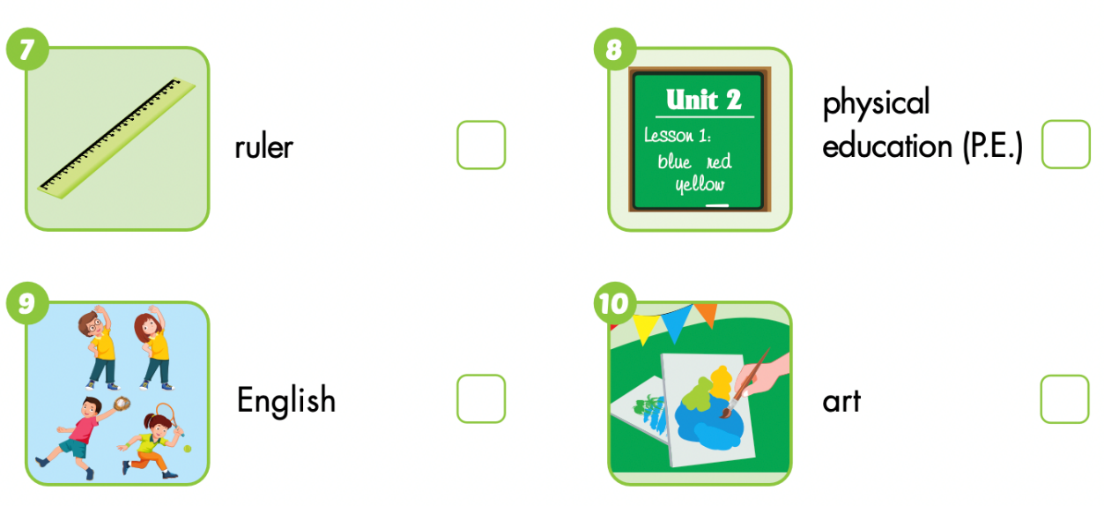

Slide 55

WRAP-UP

Slide 56
Lesson 3
Today’s lesson
Vocabularies:
Monday, Tuesday, Wednesday, Thursday, Friday, Saturday, Sunday
math, art, English, music, P.E.
Pencil, ruler, notebook, eraser
Structures/ Sentence patterns
When do you have math?
I have math on Monday.

Slide 57
Lesson 3
Homework
Review all the vocabularies and structures. Make sentences using them.
Do the exercises on page 36 WB
Play the consolidation games in Tiếng Anh 3 i-Learn Smart Start Notebook on www.eduhome.com.vn
Prepare the next lesson (page 51 SB)

Slide 58
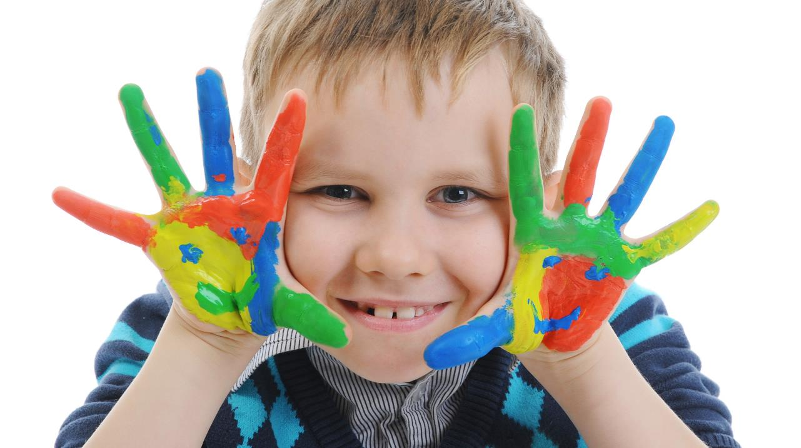
Enjoy your day!

Slide 59
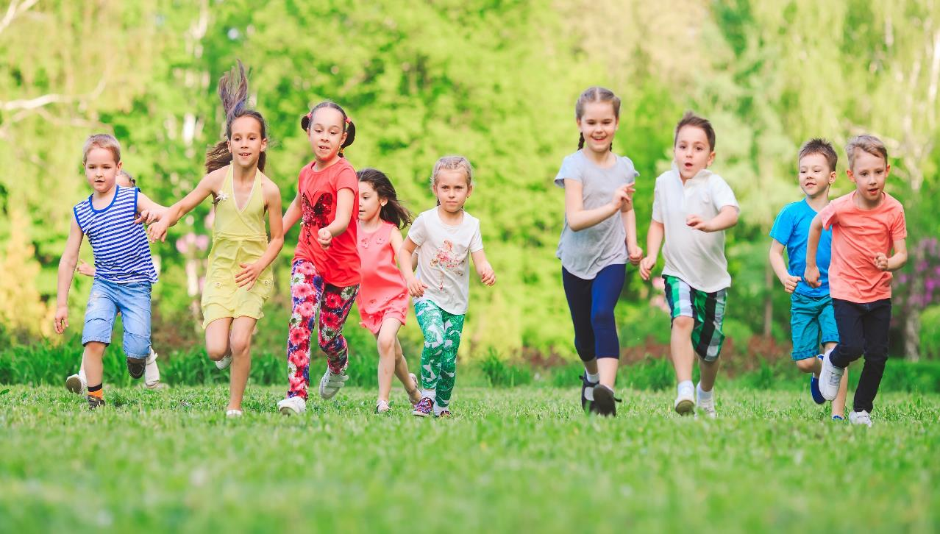
Have a nice day!

Slide 60

Lesson 3
Stay positive and have a nice day!

