Slide 1

Unit 4: ACTIVITIES
Lesson 4
Page 57

Slide 2
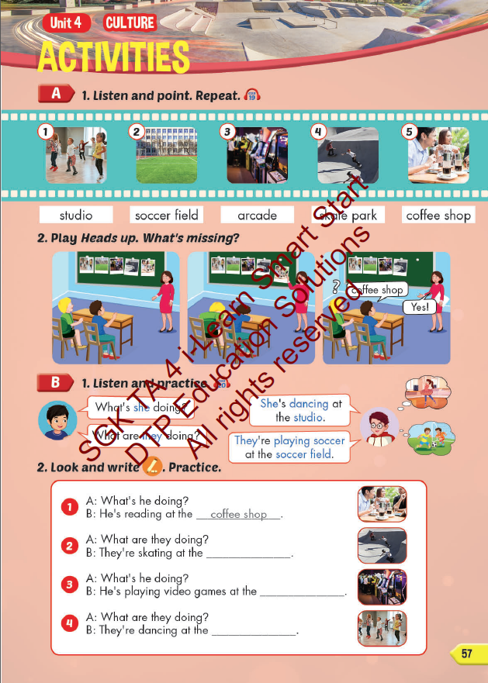
Lesson Outline
Warm-up
Vocabulary
Structure
Consolidation
Wrap-up

Slide 3
Objectives
By the end of this lesson, students will be able to learn vocabulary and structure to talk about where they do some different activities that are popular in their culture.
Vocabulary: studio, soccer field, arcade, skate park, coffee shop.
Structure:
What is she doing?
She’s dancing at the studio.
What are they doing?
They are playing soccer at the soccer field.

Slide 4

WARM UP

Slide 5

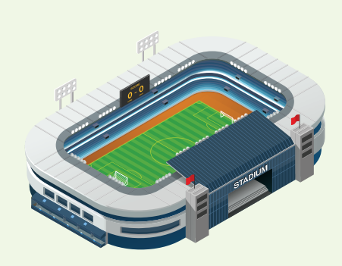
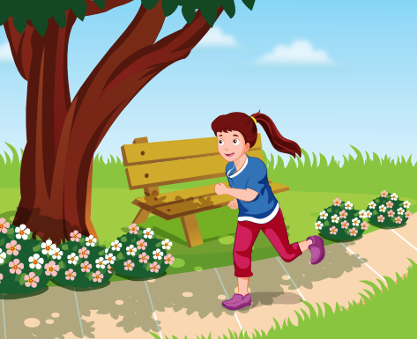
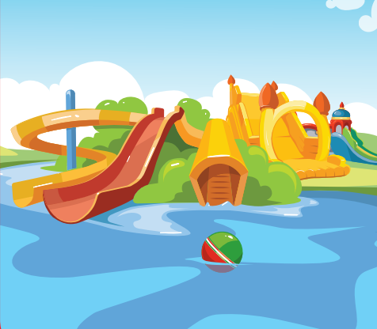
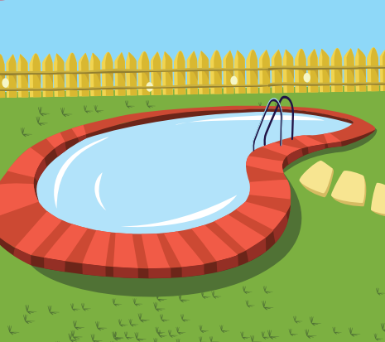
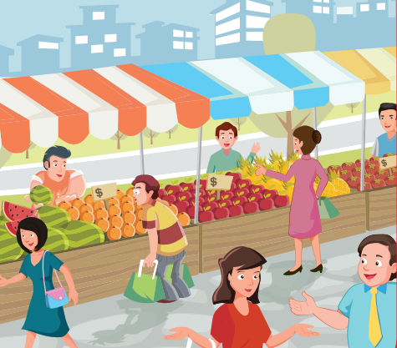
REVIEW 1
library
stadium
park
water park
swimming pool
market

Slide 6
REVIEW 2
What’s next?
?
?

Slide 7
REVIEW 2
What’s next?
?
?

Slide 8
REVIEW 2
What’s next?
?
?

Slide 9

It’s time to learn …

Slide 10

New words
studio, soccer field, arcade, skate park, coffee shop.

Slide 11

Presentation

Slide 12

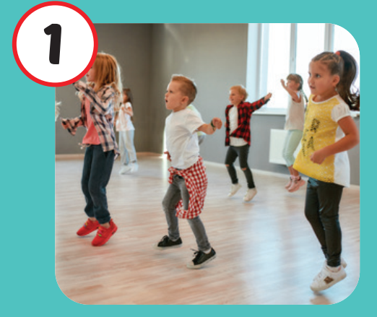
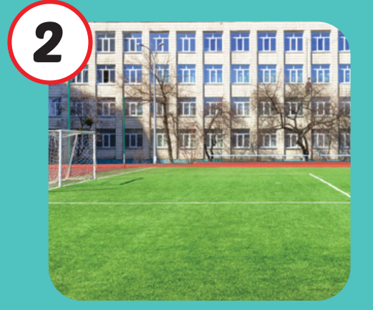
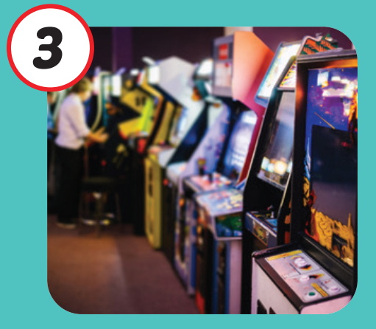

Click on each English word to hear the sound.
studio
soccer field
arcade
/ˈstuːdioʊ/
phòng tập
/ˈsɑːkər fiːld/
sân đá bóng
/ɑːrˈkeɪd/
khu vực máy giải trí

Slide 13

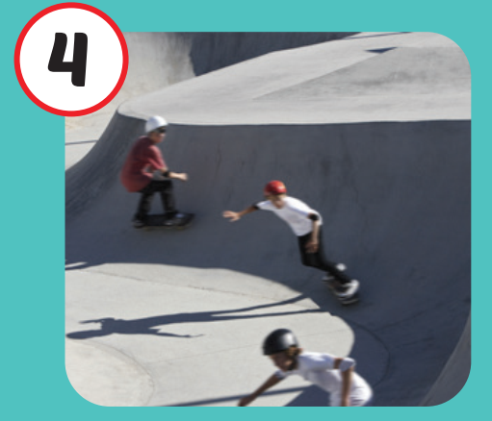

Click on each English word to hear the sound.
skate park
coffee shop
/skeɪt pɑːrk/
khu trượt ván
/ˈkɑːfi ʃɑːp/
quán cà phê

Slide 14

Practice

Slide 15
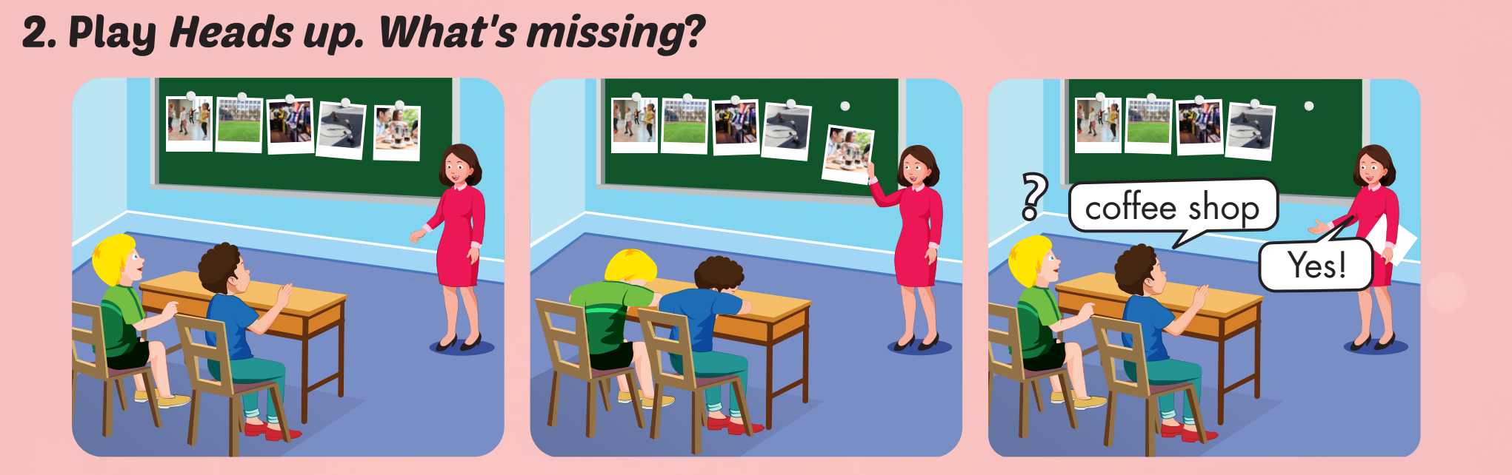

Slide 16

WHAT IS IN THE CLOCK?
HOW TO PLAY
Press START to play.
Click CHECK to show the answer.

Slide 17


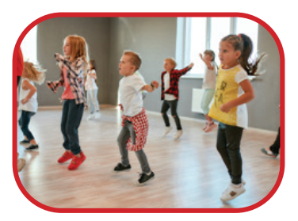
START
CHECK

Slide 18
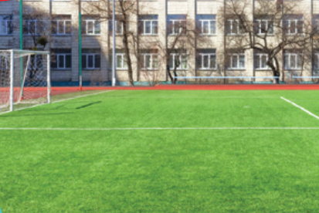
START
CHECK

Slide 19
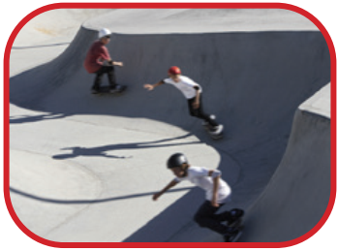
START
CHECK

Slide 20

START
CHECK

Slide 21

START
CHECK

Slide 22
WHAT’S MISSING?
soccer field
studio
coffee shop
coffee shop
arcade
skate park
skate park
skate park
studio
arcade
soccer field
studio
arcade
coffee shop
coffee shop
soccer field
skate park
skate park
studio
soccer field
soccer field
arcade
arcade
studio
studio
soccer field
coffee shop
coffee shop

Slide 23
Structures
What is she doing?
She’s dancing at the studio.
What are they doing?
They’re playing soccer at the soccer field.

Slide 24

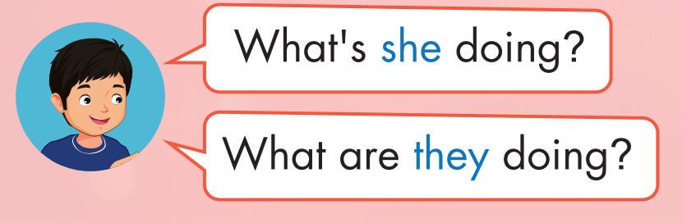
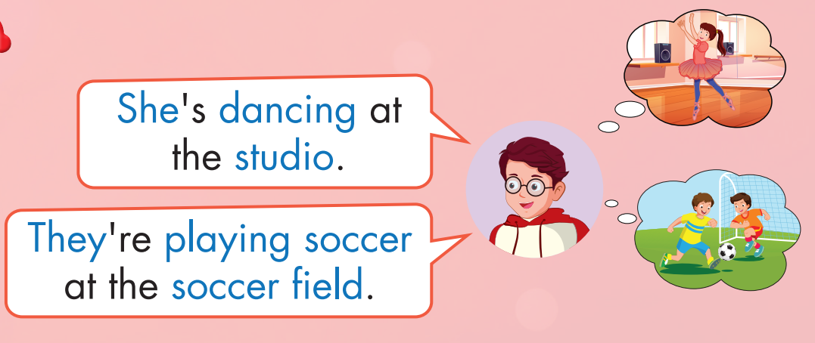
Click on the headphone icon to hear the sound.

Slide 25
Practice

Slide 26
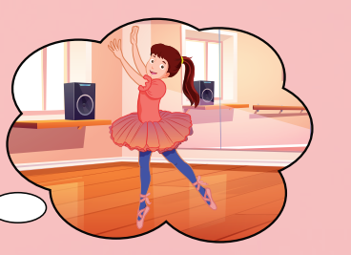


What is she doing?
She’s dancing at the studio.

Slide 27
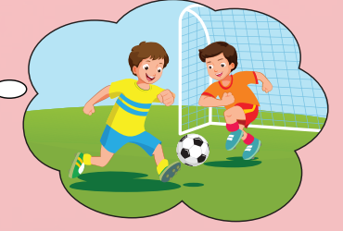
What are they doing?
They’re playing soccer at the soccer field.

Slide 28
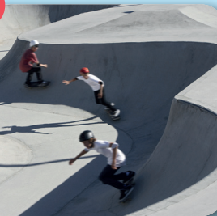
What are they doing?
They’re skating at the skate park.

Slide 29

What is he doing?
He’s playing at the arcade.

Slide 30

What are they doing?
They’re chatting at the coffee shop.

Slide 31

CONSOLIDATION

Slide 32

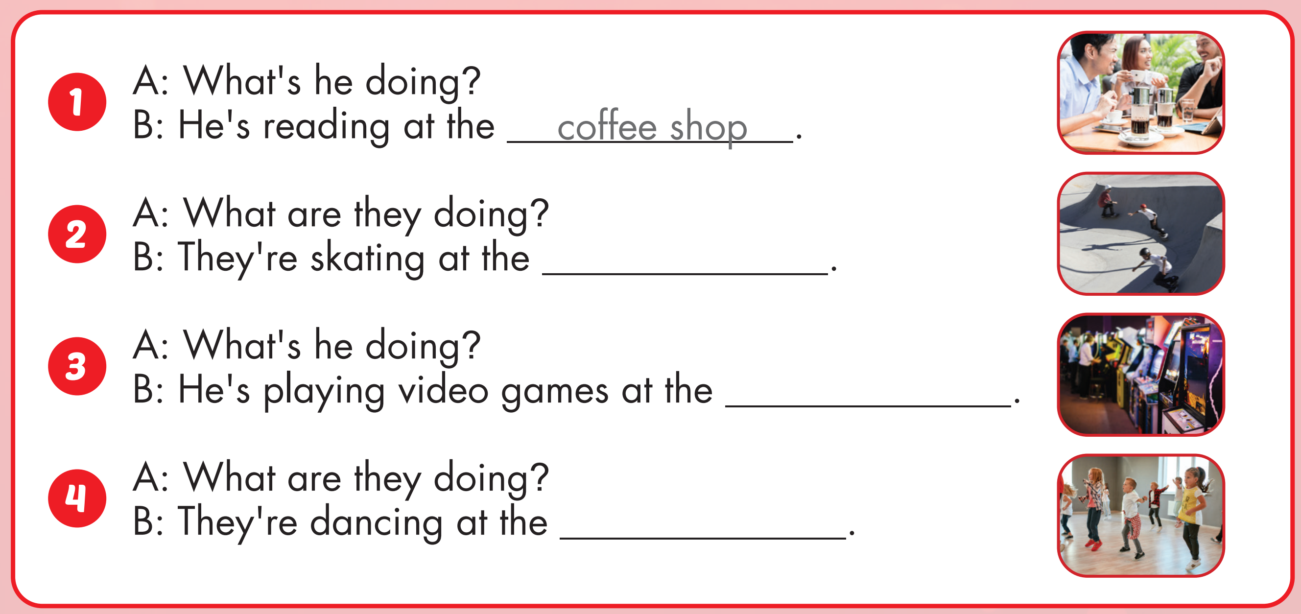
skate park
arcade
studio

Slide 33

WRAP-UP

Slide 34
Today’s lesson
Vocabularies
studio, soccer field, arcade, skate park, coffee shop.
Structures/ Sentence patterns
What is she doing?
She’s dancing at the studio.
What are they doing?
They are playing soccer at the soccer field.

Slide 35
Homework
Practice the vocabulary and structure, and make sentences using them.
Do the exercises in Tiếng Anh 4 i-Learn Smart Start WB (page 38)
Do the exercises in Tiếng Anh 4 i-Learn Smart Start Notebook (page 25)
Prepare the next lesson (page 58 SB)
Play the consolidation games in Tiếng Anh 4 i-Learn Smart Start DHA App on www.eduhome.com.vn

Slide 36
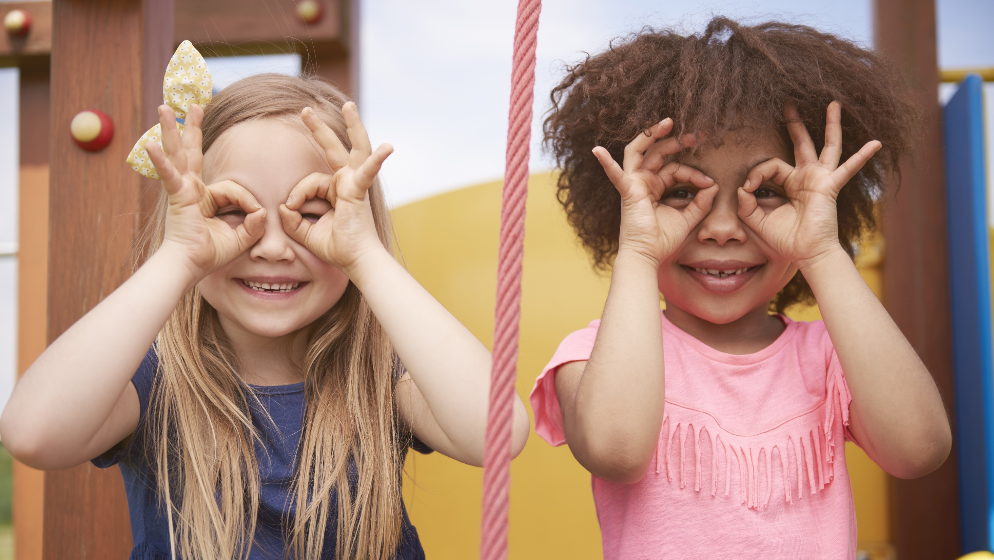
Enjoy your day!

