Slide 1

Unit 4: Travel
Lesson 1.2
Page 49

Slide 2
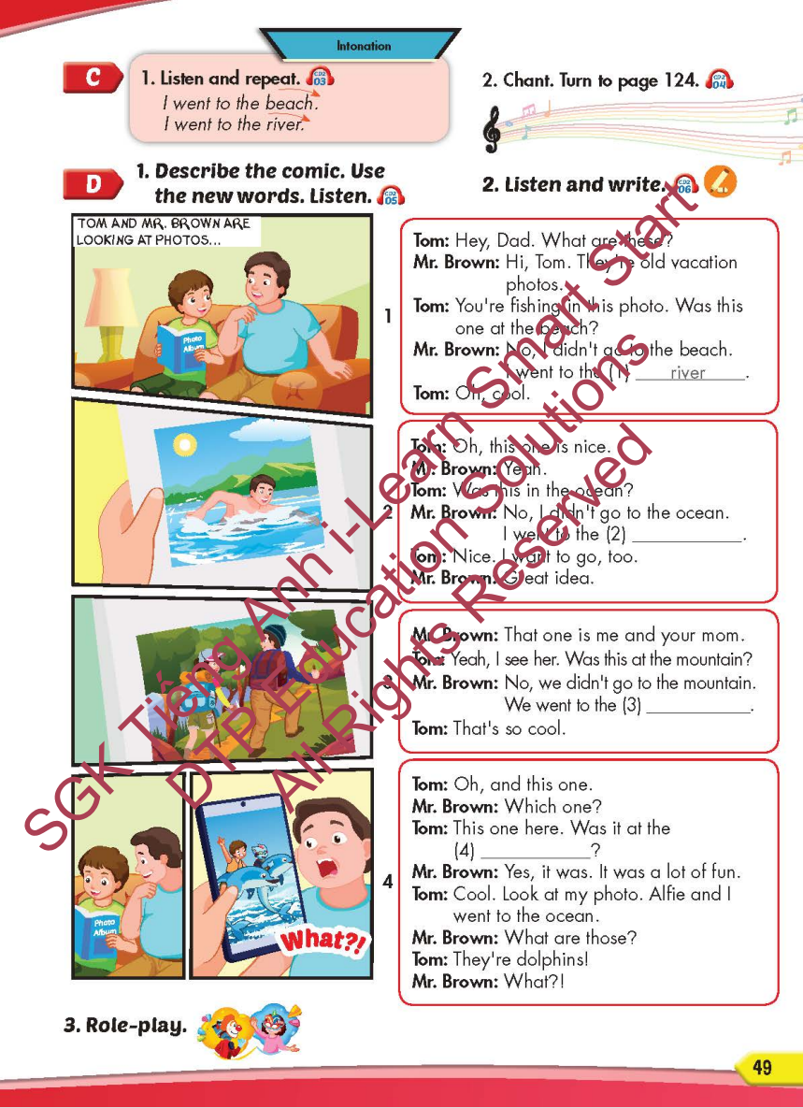
Lesson Outline
Warm-up
Listening
Consolidation
Wrap-up

Slide 3
Objectives
By the end of this lesson, students will be able to…
Itonation: Falling intonation.
Structure: I didn't go to the river. I went to the beach.

Slide 4

WARM-UP

Slide 5
CHECK YOUR MEMORY

Slide 6


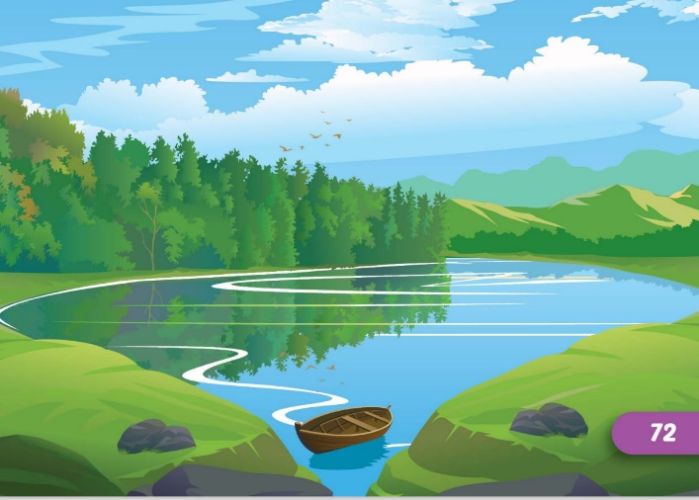
Look and say which is missing?
START
CHECK

Slide 7


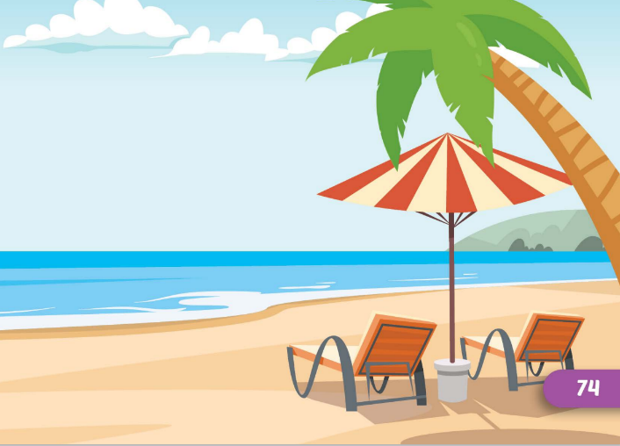
Look and say which is missing?
START
CHECK

Slide 8


Look and say which is missing?
START
CHECK

Slide 9


Look and say which is missing?
START
CHECK

Slide 10



Look and say which is missing?
START
CHECK

Slide 11
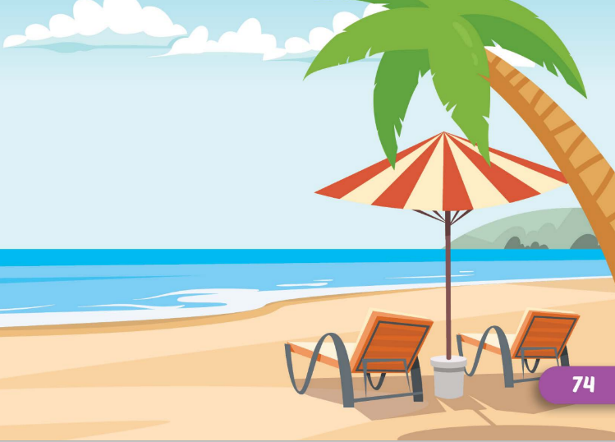


Look and say which is missing?
START
CHECK

Slide 12

It’s time to learn …

Slide 13


Intonation
Falling intonation

Slide 14

Listening

Slide 15
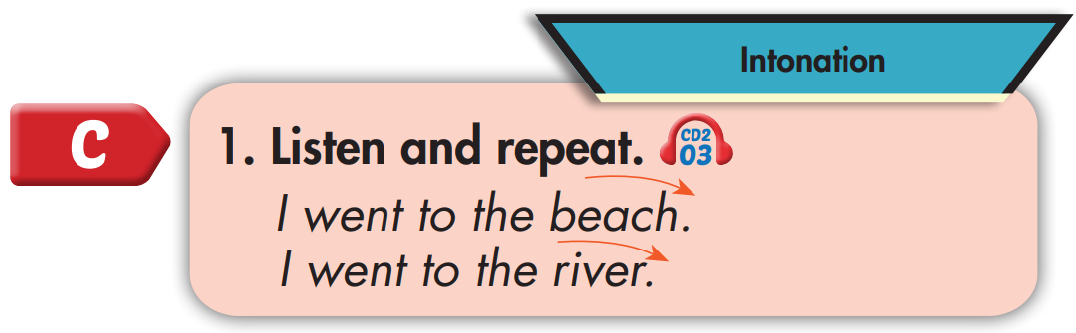

I went to the beach.
I went to the river.

Slide 16
Practice

Slide 17



Slide 18
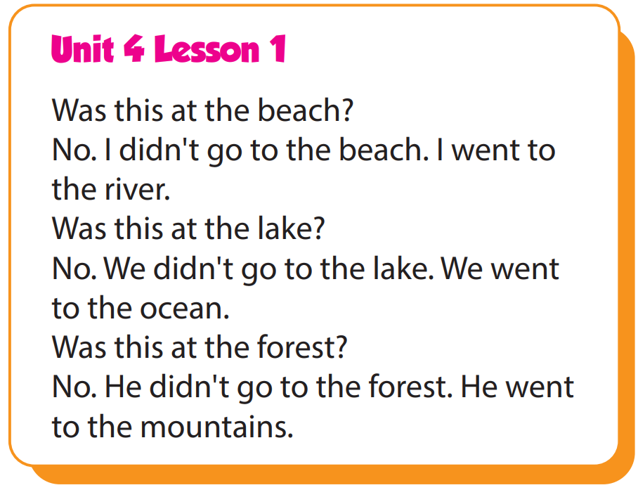

Slide 19
Structure
I didn't go to the river.
I went to the beach.

Slide 20

Speaking

Slide 21
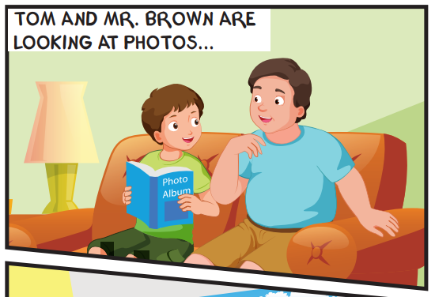
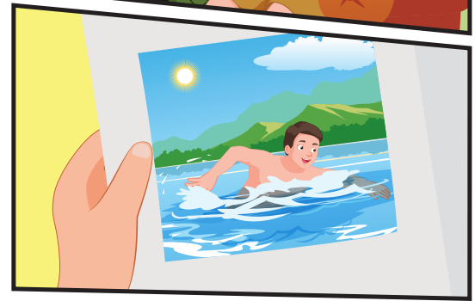
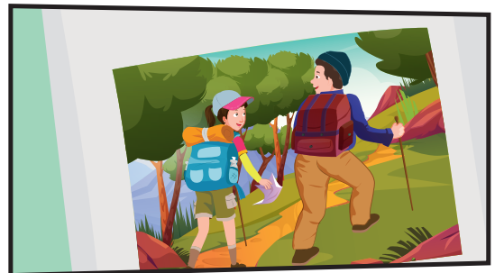
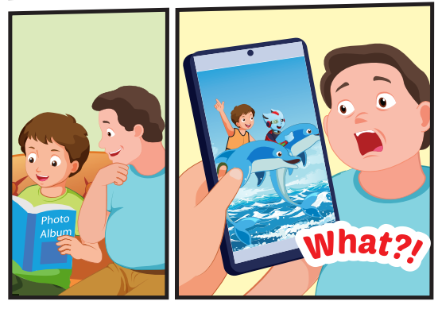
Who can you see?
Tom, Mr. Brown, Mrs. Brown, Alfie

Slide 22
Where are they?
They're at home.

Slide 23
What are the people doing in the photos?
Mr. Brown: swimming, Mr. Brown and Mrs. Brown: walking, Alfie and Tom: playing with dolphins

Slide 24

Listening

Slide 25


Slide 26

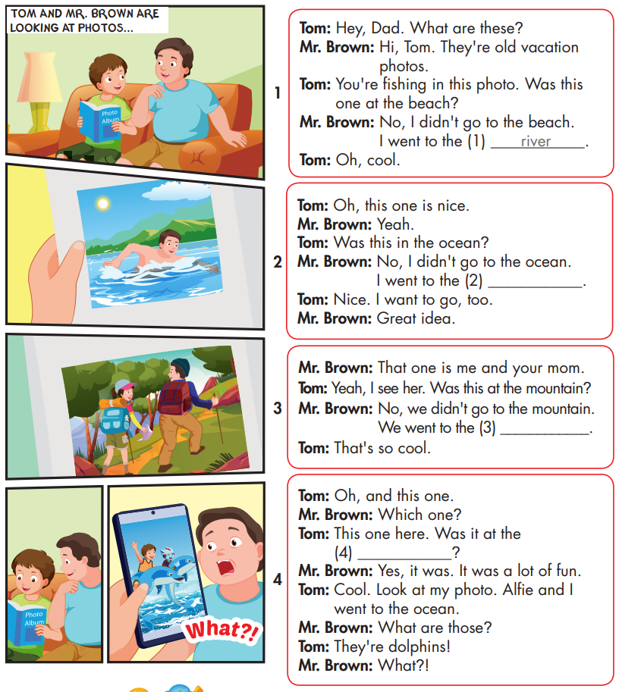

Slide 27
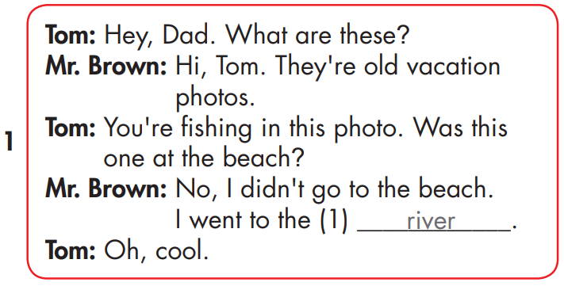

Slide 28
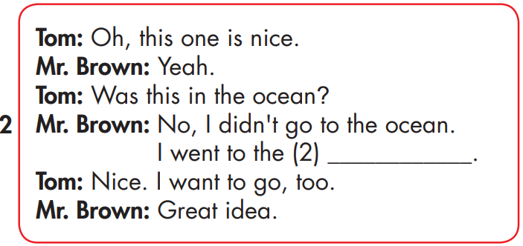
lake

Slide 29
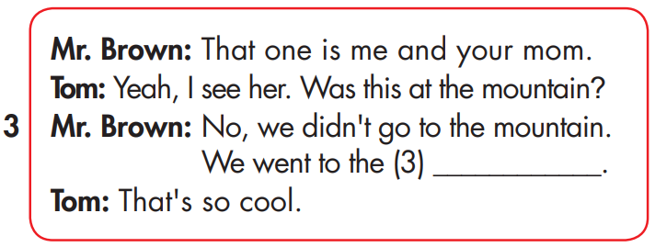
forest

Slide 30
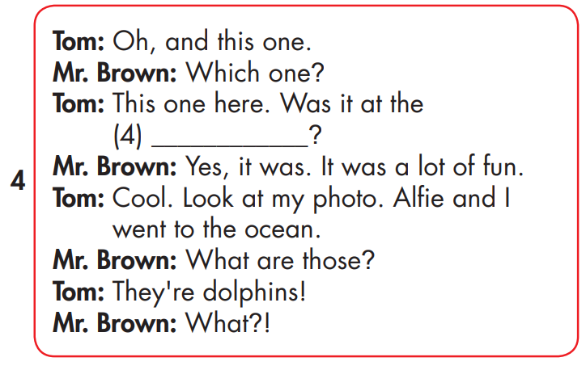
beach

Slide 31

Speaking

Slide 32



Slide 33

Writing

Slide 34
MAKE YOUR OWN STORY
lake
beach
forest

Slide 35

Production

Slide 36


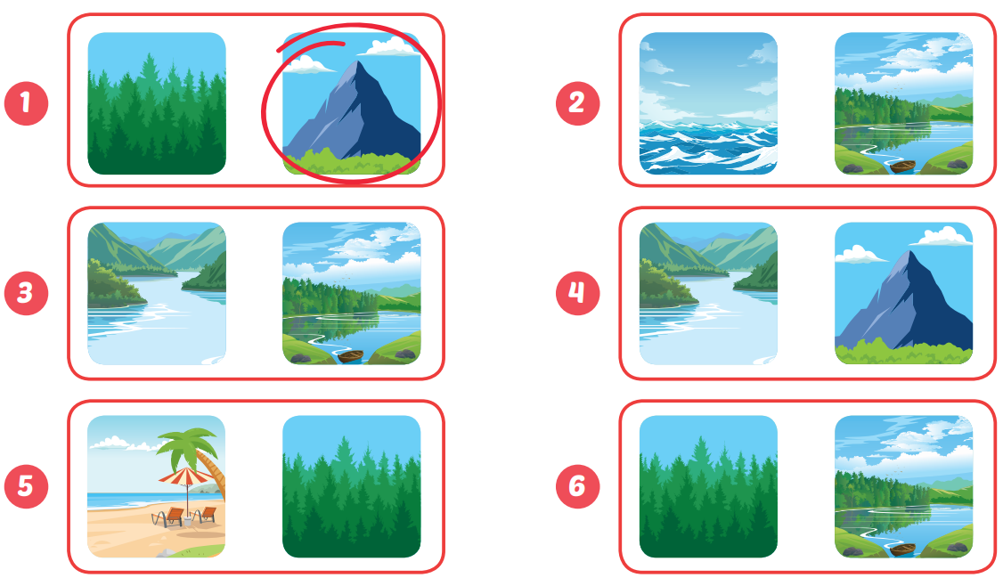
Extra Practice
WB, page 33

Slide 37

CONSOLIDATION

Slide 38

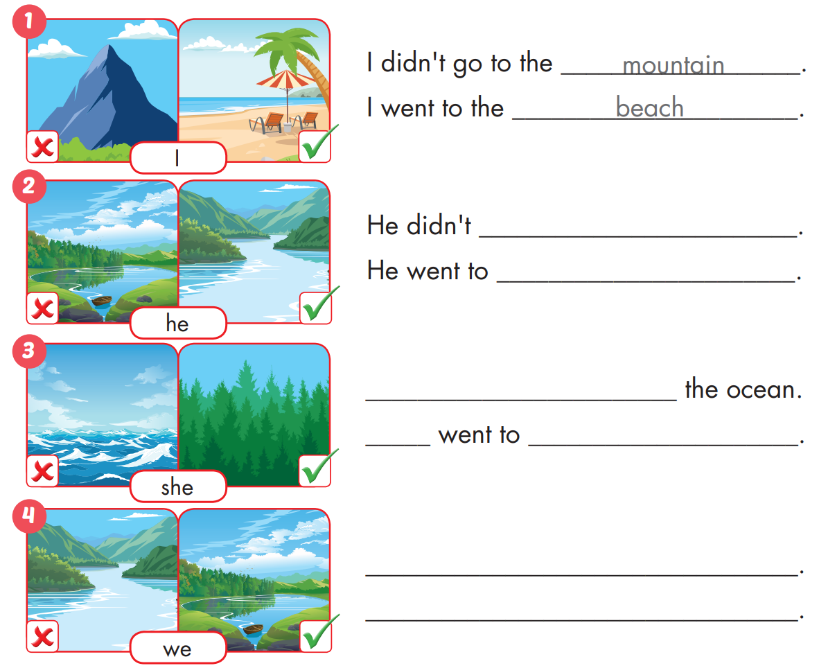
Extra Practice
WB, page 33

Slide 39
Extra Practice
WB, page 33
go to the lake
the river

Slide 40
Extra Practice
WB, page 33
She didn't go to
She
the forest
We didn't go to the river.
We went to the lake.

Slide 41

WRAP-UP

Slide 42
Today’s lesson
Intonation
Falling intonation.
Structures/ Sentence patterns
I didn't go to the river.
I went to the beach.

Slide 43
Homework
Practice the vocabularies and structure, and make sentences using them.
Do the exercises in Tiếng Anh 5 i-Learn Smart Start WB (page 33)
Do the exercises in Tiếng Anh 5 i-Learn Smart Start Notebook (page 22)
Prepare the next lesson (page 50 SB)
Play the consolidation games in Tiếng Anh 5 i-Learn Smart Start DHA App on www.eduhome.com.vn

Slide 44

Enjoy your day!

Slide 45

Lesson 3
Stay positive and have a nice day!

