Slide 1

Unit 3: MY FRIENDS AND I
Lesson 3.1
Page 40

Slide 2
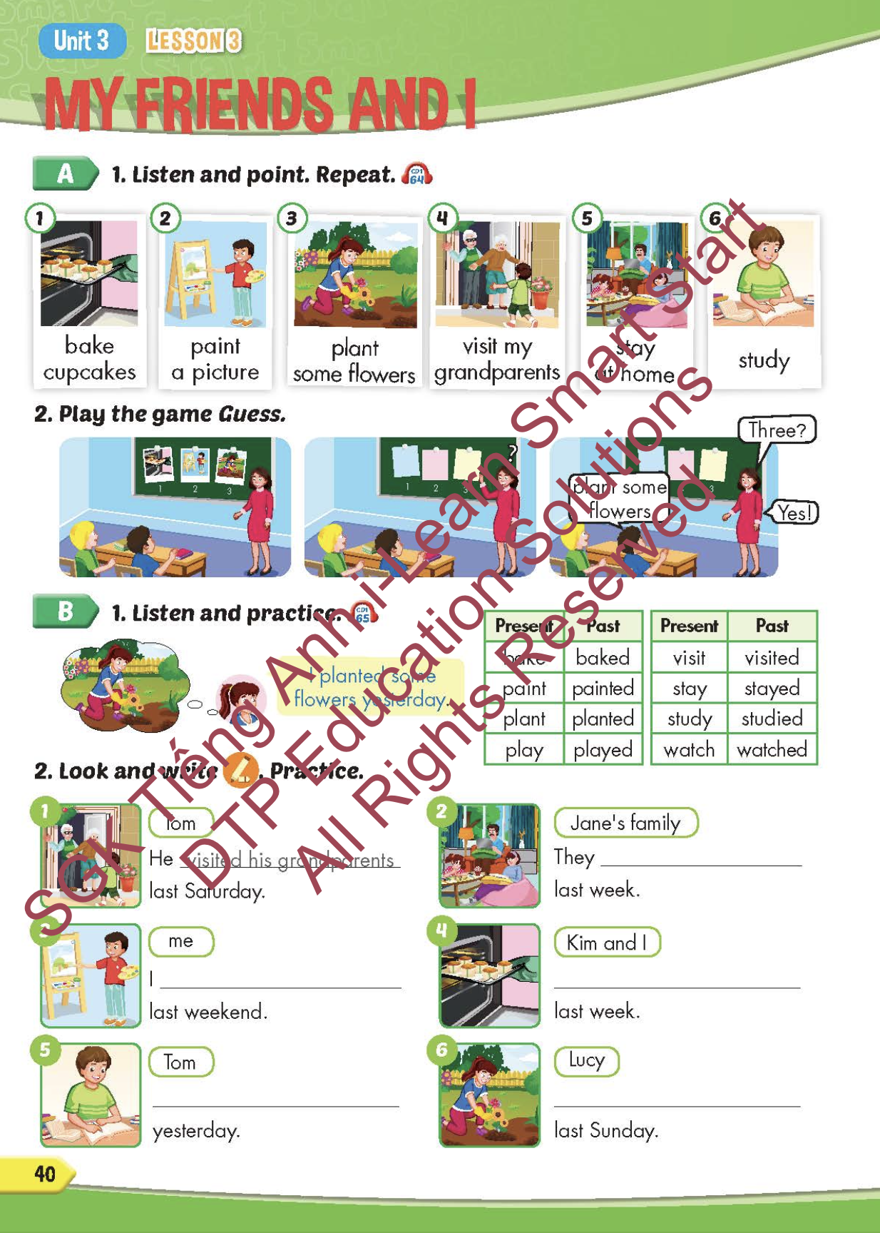
Lesson Outline
Warm-up
Vocabulary
Structure
Consolidation
Wrap-up

Slide 3
Objectives
By the end of this lesson, students will be able to point out and say different activities.
Vocabulary: bake cupcakes, paint a picture, plant some flowers, visit my grandparents, stay at home, study.
Structure: I planted some flowers yesterday.

Slide 4

WARM-UP

Slide 5






WAS - WERE

Slide 6

was
I _______ at home yesterday.
was
were
NEXT

Slide 7
were
The people _______ noisy.
was
were
NEXT

Slide 8
were
They _______ at home last Sunday.
was
were
NEXT

Slide 9
was
The food _______ delicious.
was
were
NEXT

Slide 10
were
The stores _______ busy last night.
was
were
END

Slide 11

It’s time to learn …

Slide 12

New words
bake cupcakes,
paint a picture,
plant some flowers,
visit my grandparents,
stay at home,
study.

Slide 13

Presentation

Slide 14


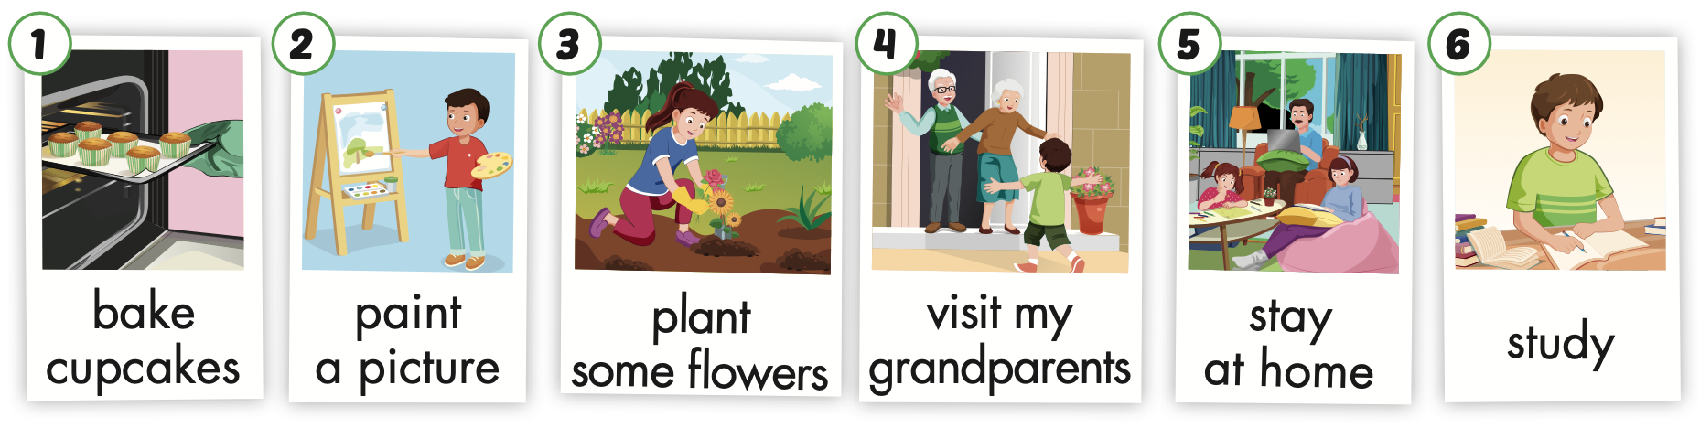
Notes:
Click vào hình A. 1. Listen and point. Repeat để cho cả audio full chạy

Slide 15
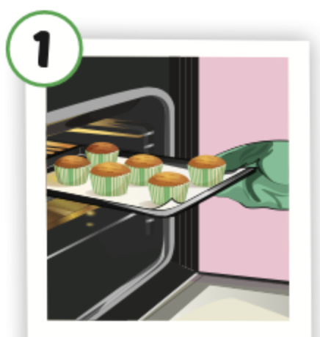
bake cupcakes
/beɪk ˈkʌpkeɪks/
nướng bánh ngọt nhỏ có kem

Slide 16
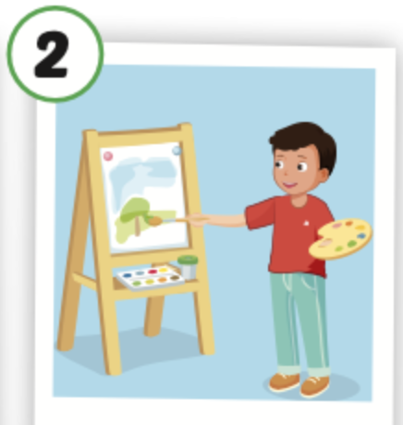
paint a picture
/peɪnt ə ˈpɪktʃər/
Vẽ tranh

Slide 17
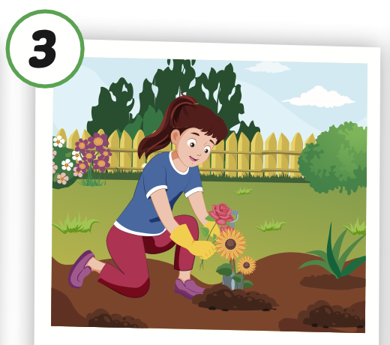
plant some flowers
/plænt səmˈflaʊərz/
trồng hoa

Slide 18
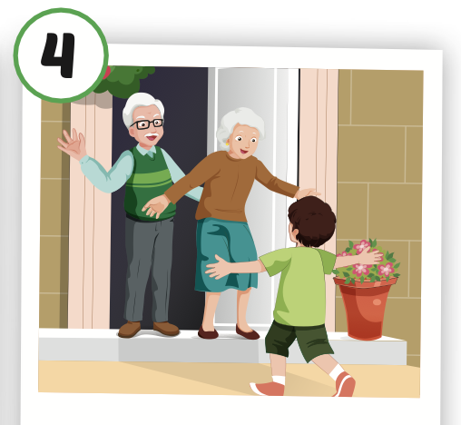
visit my grandparents
/ ˈvɪzɪt maɪ ˈɡrænperənts/
đến thăm ông bà

Slide 19
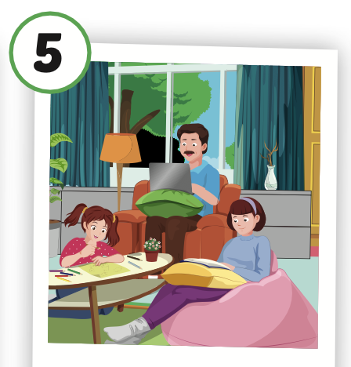
stay at home
/ steɪ ət hoʊm/
ở nhà

Slide 20
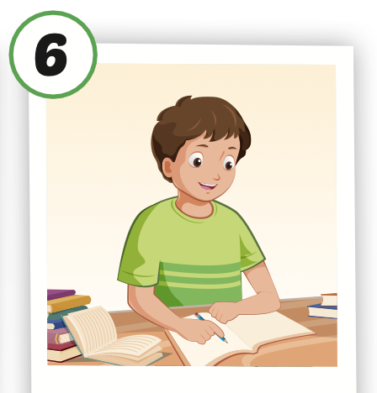
study
/ˈstʌdi/
học

Slide 21
Practice

Slide 22
Look, read and choose. Then say.

Slide 23

study
A
B
C

Slide 24
Plant some flowers
A
B
C

Slide 25
visit my grandparents
A
B
C

Slide 26
paint a picture
A
B
C

Slide 27

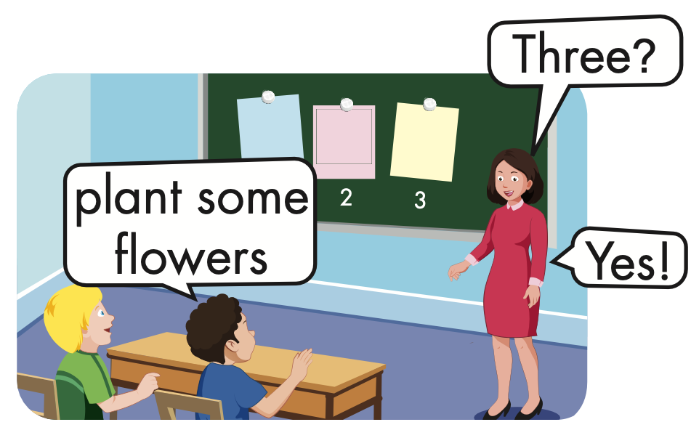
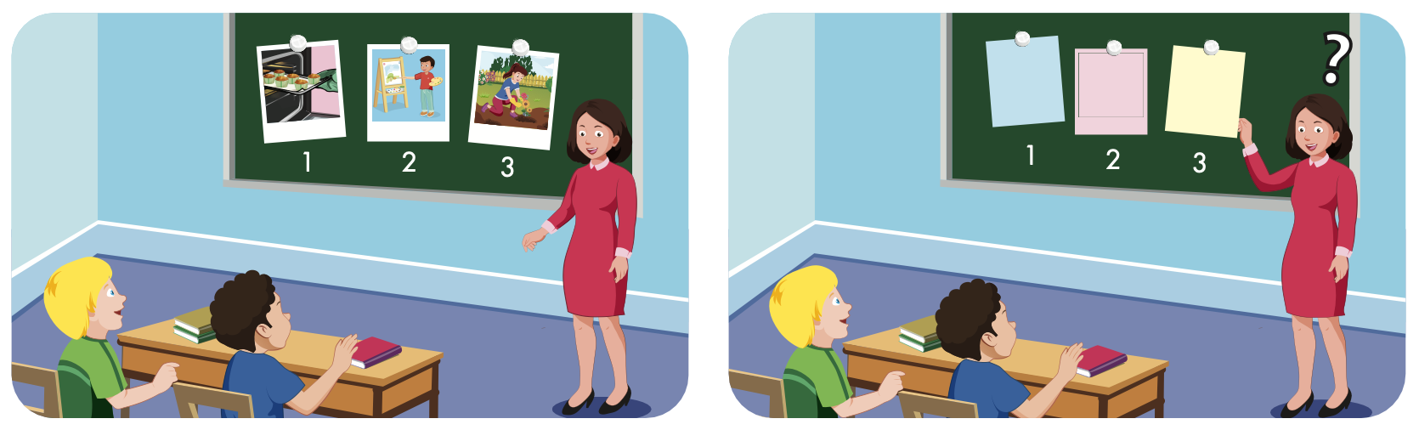

Slide 28
Structure
I planted some flowers yesterday.

Slide 29
Presentation

Slide 30

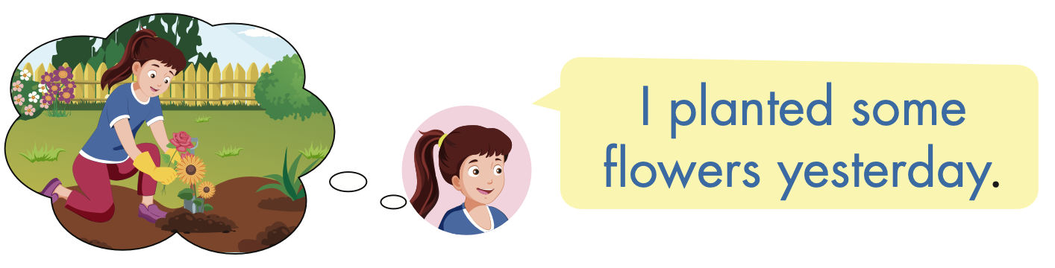
Structure

Slide 31
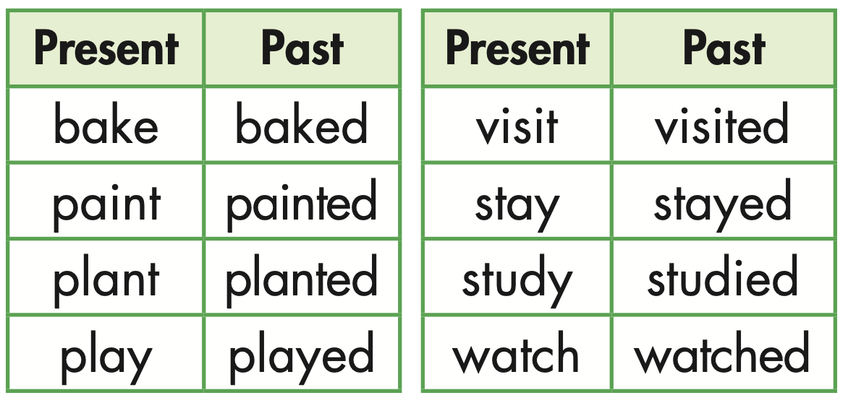

Slide 32

Practice

Slide 33


Slide 34


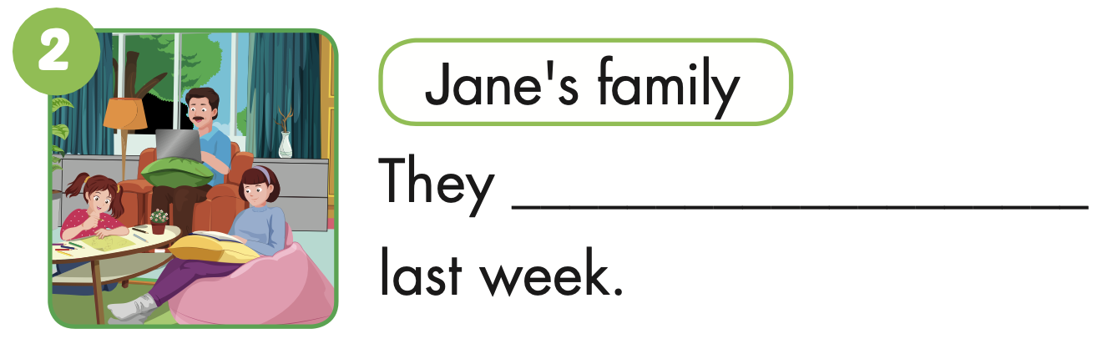
stayed at home

Slide 35
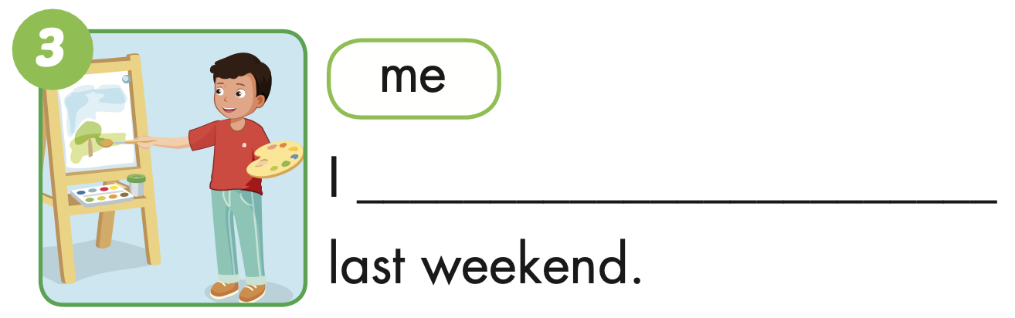
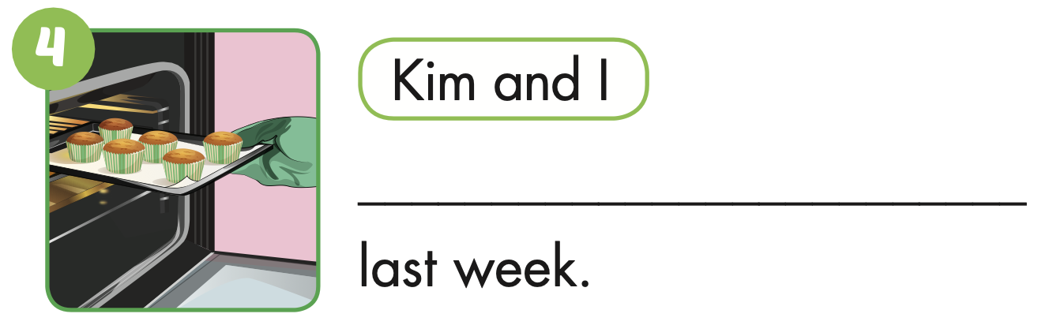
painted a picture
We baked some cupcakes

Slide 36

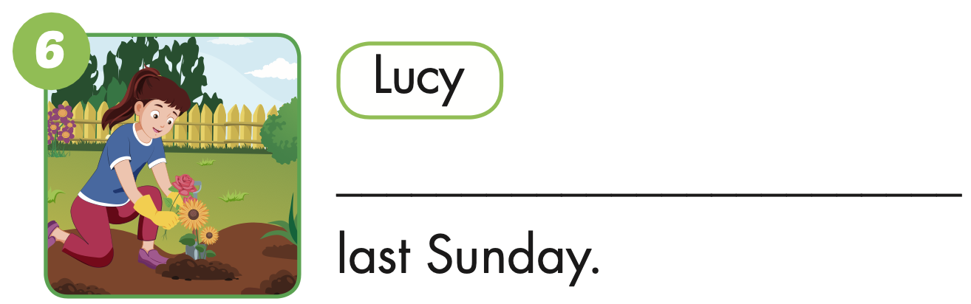
He studied
She planted some flowers

Slide 37

Production

Slide 38
Make sentences using these words. Then read your sentences to a partner.
I planted some flowers yesterday.

Slide 39

CONSOLIDATION

Slide 40

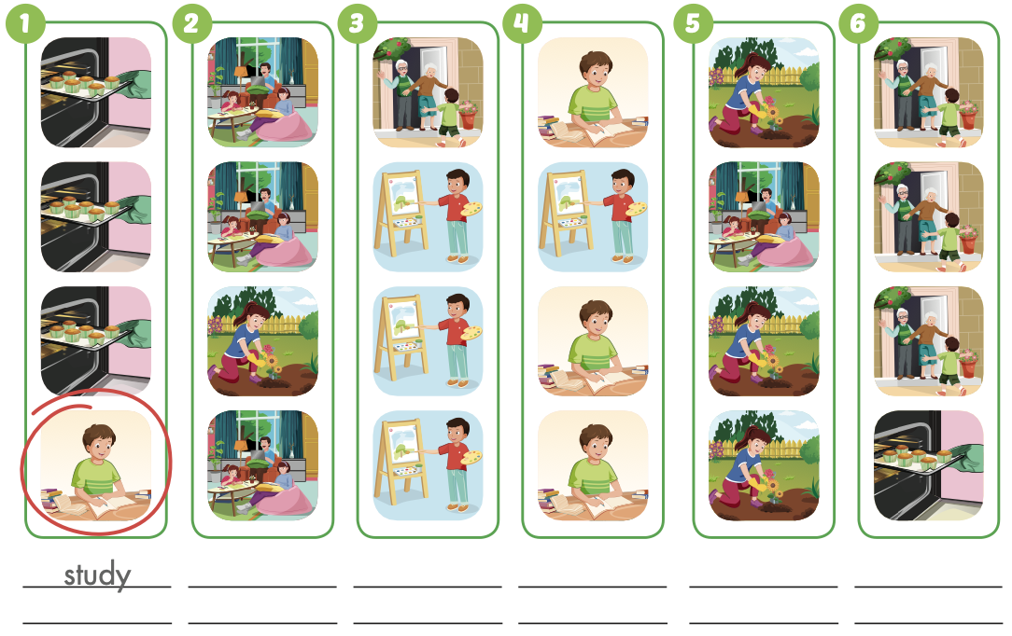
Extra Practice
WB, page 26

Slide 41
Extra Practice
WB, page 26
plant some flowers

Slide 42
Extra Practice
WB, page 26
visit my grandparents
paint a picture

Slide 43
Extra Practice
WB, page 26
stay at home
bake some cupcakes

Slide 44

WRAP-UP

Slide 45
Today’s lesson
Vocabularies
bake cupcakes,
paint a picture,
plant some flowers, visit my grandparents, stay at home,
study.
Structures/ Sentence patterns
I planted some flowers yesterday.

Slide 46
Homework
Practice the vocabularies and structure, and make sentences using them.
Do the exercises in Tiếng Anh 5 i-Learn Smart Start WB (page 26).
Do the exercises in Tiếng Anh 5 i-Learn Smart Start Notebook.
Prepare the next lesson (page 41 SB).
Play the consolidation games in Tiếng Anh 5 i-Learn Smart Start DHA App on www.eduhome.com.vn

Slide 47

Enjoy your day!

Slide 48

Lesson 3
Stay positive and have a nice day!

