Slide 1

Unit 2: MY FRIENDS AND I
Lesson 1.2
Page 35

Slide 2
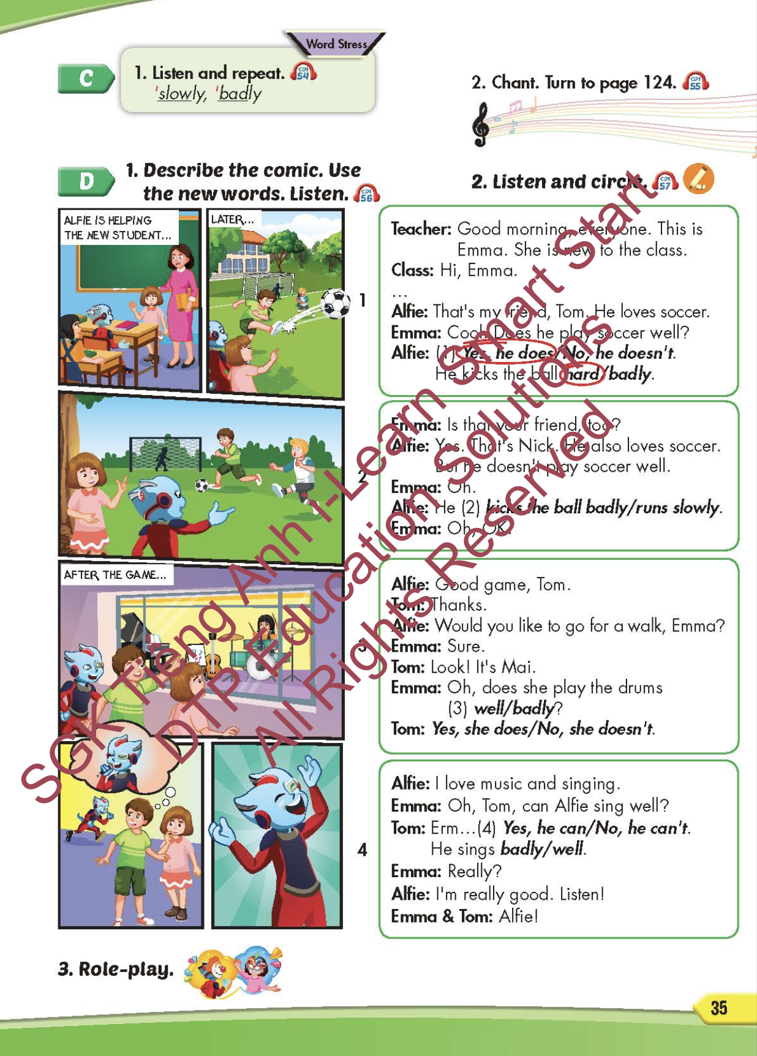
Lesson Outline
Warm-up
Pronunciation
Listening
Speaking
Consolidation
Wrap-up

Slide 3
Objectives
By the end of this lesson, students will be able to identify the word stress and practice the conversations.
Pronunciation: word stress
Structure: Tom kicks the ball hard.

Slide 4

WARM-UP

Slide 5
Listen and choose. Then say.

Slide 6


Listen and choose
slowly
fast
badly
A
B
C

Slide 7
Listen and choose
well
fast
badly
A
B
C

Slide 8
Listen and choose
well
fast
hard
A
B
C

Slide 9
Listen and choose
well
fast
badly
A
B
C

Slide 10

It’s time to learn …

Slide 11

Pronunciation
WORD STRESS

Slide 12

Presentation

Slide 13
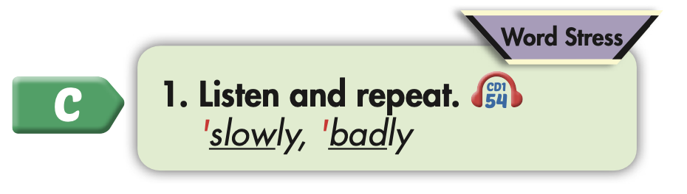
Click on the picture to hear the sound.

Slide 14
Practice

Slide 15



Slide 16
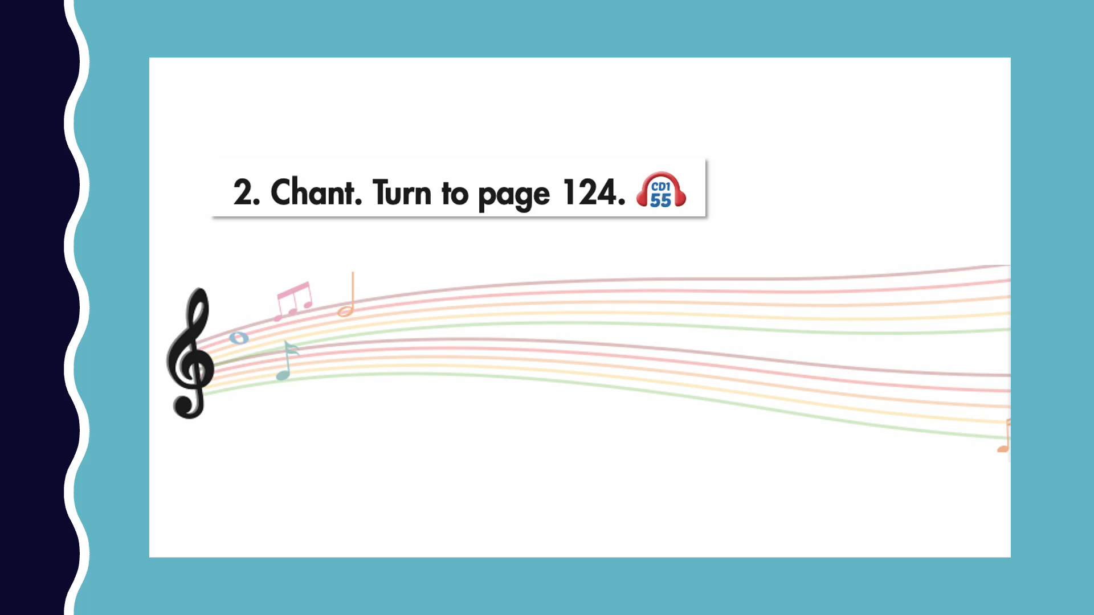

Slide 17
Listening

Slide 18
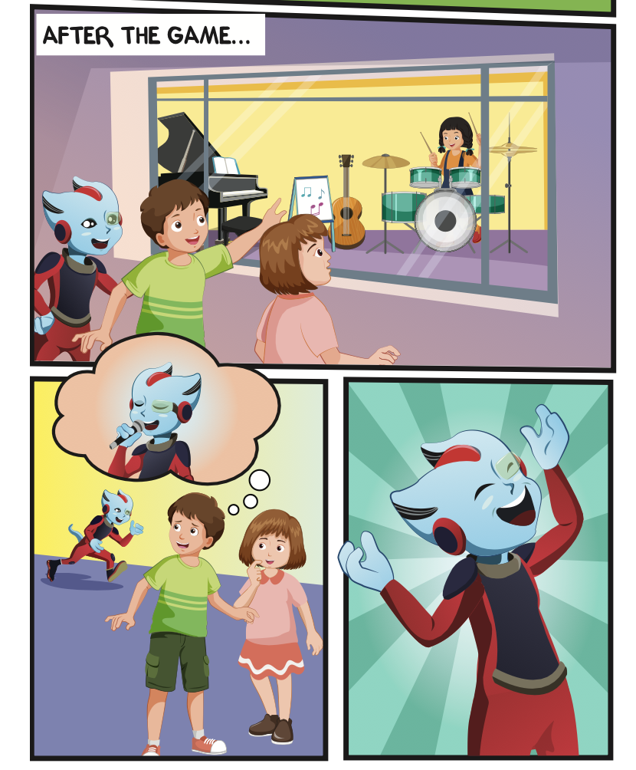
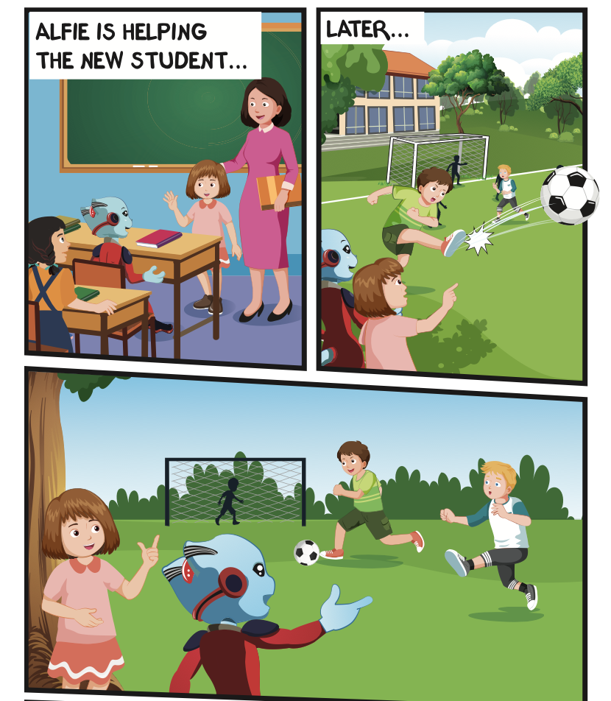
Where are they?
Who is talking?

Slide 19


Slide 20

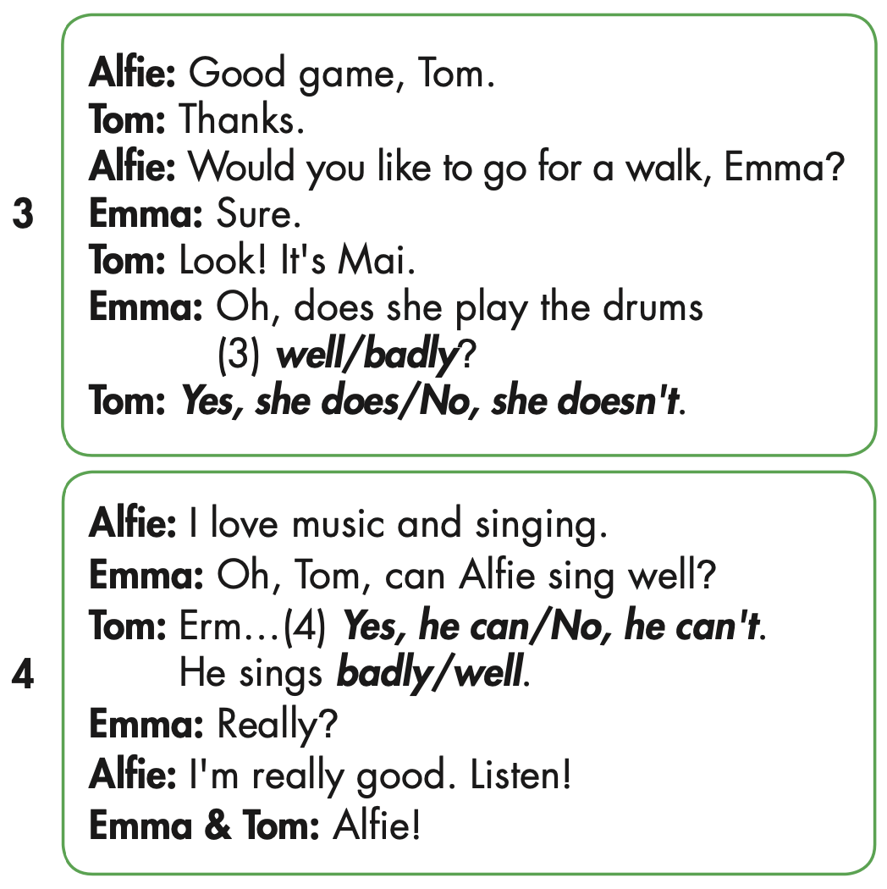
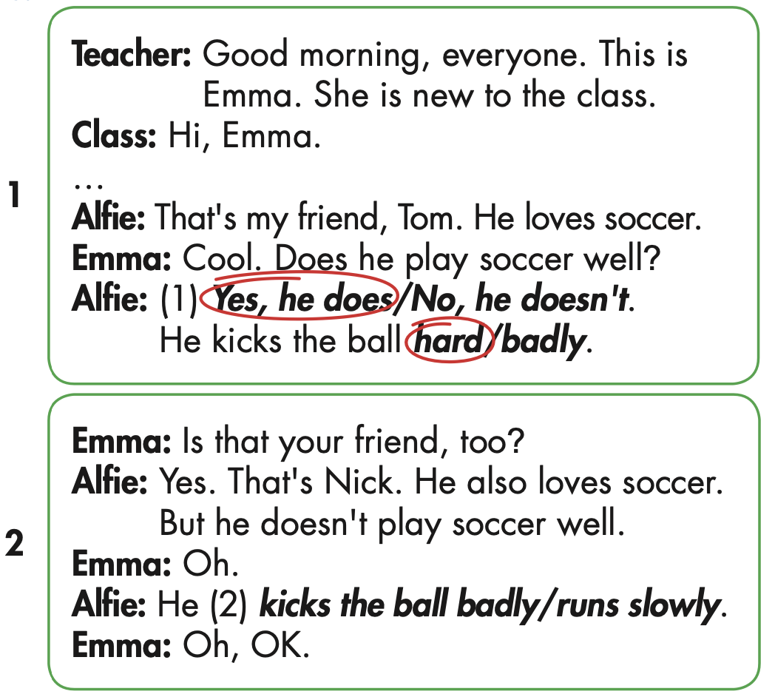

Slide 25

Speaking

Slide 26

Role-play the conversation. Mind your word stress.

Slide 27

Production

Slide 28

Writing

Slide 29
MAKE YOUR OWN STORY

Slide 30

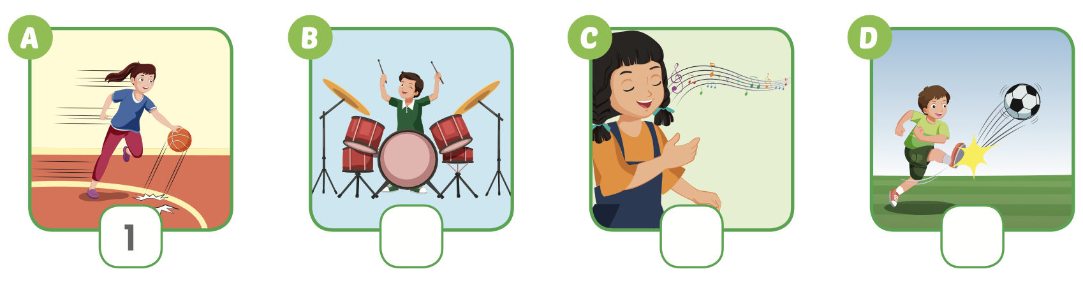
Extra Practice
WB, page 23
4
3
2

Slide 31

CONSOLIDATION

Slide 32
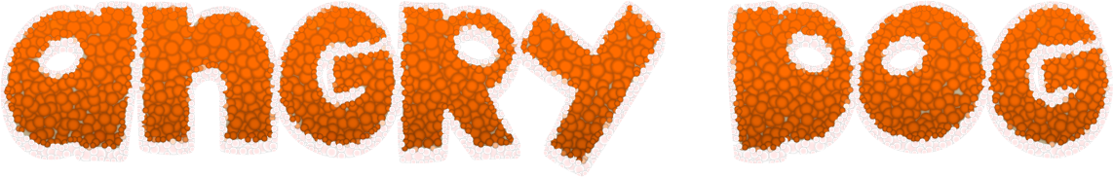



GAME
GAME ON ADVERBS OF MANNER
Notes:
32

Slide 33
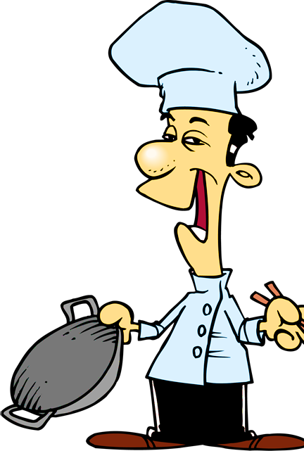

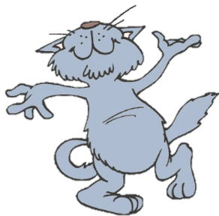
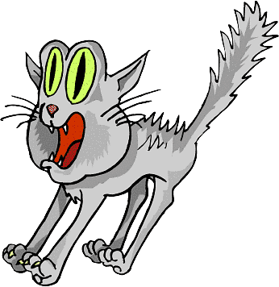

He sings ____________.
You got it!
badly
bad
NEXT
Notes:
33

Slide 34
She sings beautifully.
She is a _________ singer.
You got it!
good
well
NEXT

Slide 35
This bus is too _______ .
We will be late for school.
You got it!
slow
slowly
NEXT
Notes:
35

Slide 36
They are fantastic dancers.
They dance really _______.
You got it!
well
badly
NEXT
Notes:
36

Slide 37
I don’t want to go with him.
He drives too ________ .
You got it!
fast
slow
END

Slide 38

WRAP-UP

Slide 39
Today’s lesson
Pronunciation
Word stress
Structures/ Sentence patterns
Tom kicks the ball hard.

Slide 40
Homework
Practice the vocabularies and structure, and make sentences using them.
Do the exercises in Tiếng Anh 5 i-Learn Smart Start WB (page 23).
Do the exercises in Tiếng Anh 5 i-Learn Smart Start Notebook.
Prepare the next lesson (page 36 SB).
Play the consolidation games in Tiếng Anh 5 i-Learn Smart Start DHA App on www.eduhome.com.vn

Slide 41

Enjoy your day!

Slide 42

Lesson 3
Stay positive and have a nice day!

