Slide 1

Unit 3: WEATHER
Lesson 2.3
Page 39

Slide 2
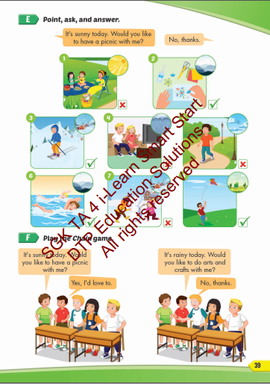
Lesson Outline
Warm-up
Practice
Speaking
Consolidation
Wrap-up

Slide 3
Objectives
By the end of this lesson, students will be able to the weather like today.
Vocabularies:
do arts and crafts, fly a kite, make a snowman, go skiing, go for a walk, have a picnic.
Structure: It's windy today.
Would you like to fly a kite with me?
Yes, I'd love to./ No, thanks.

Slide 4

WARM UP

Slide 5

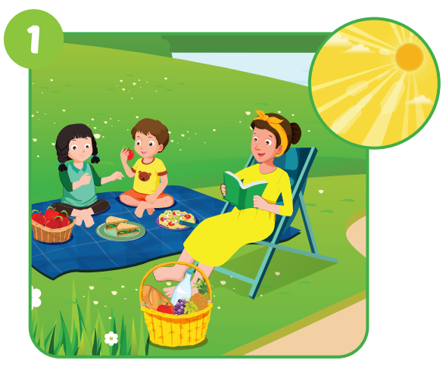



Click on the right word
A. Go skiing
B. Play games
C. Have a pinic

Slide 6

Click on the right word
A. Make a snowman
B. Do arts and crafts
C. Fly a kite

Slide 7
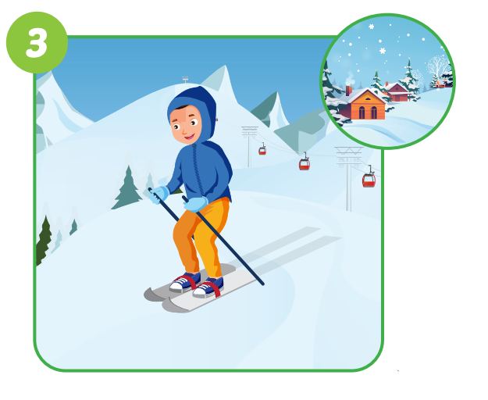
Click on the right word
A. Go swimming
B. Make a snowman
C. Go skiing

Slide 8
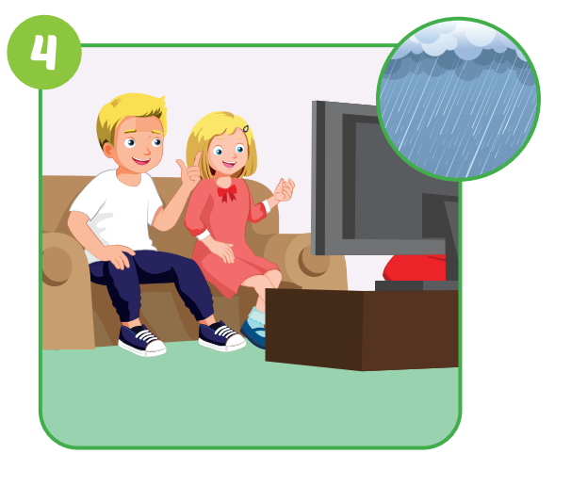
Click on the right word
A. Go party
B. Watch TV
C. Do exercise

Slide 9
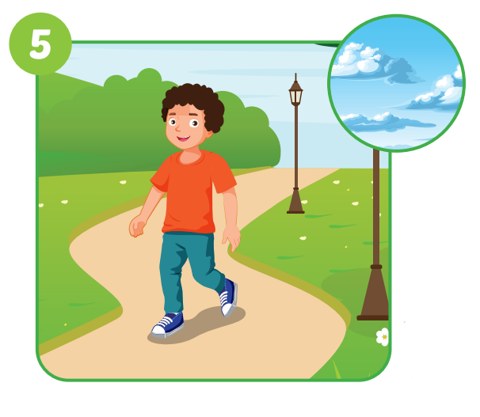
Click on the right word
A. Go fishing
B. Go for a walk
C. Play soccer

Slide 10
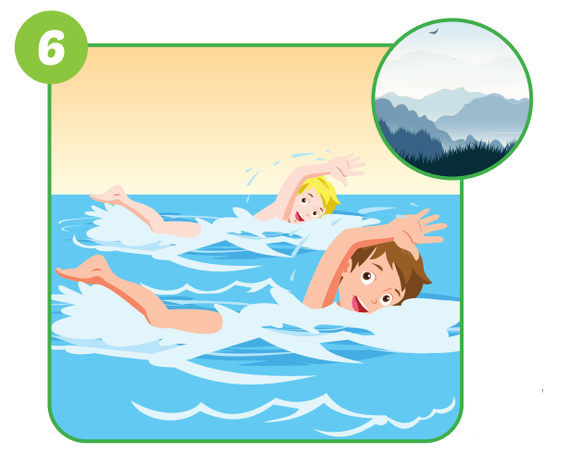
Click on the right word
A. Ride a bike
B. Watch TV
C. Go Swimming

Slide 11
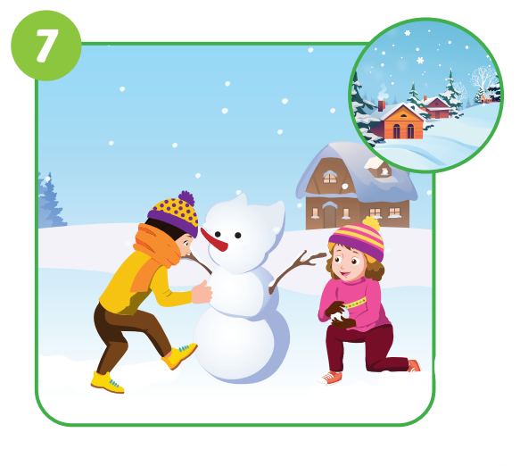
Click on the right word
A. Do homework
B. Listen music
C. Make a snowman

Slide 12
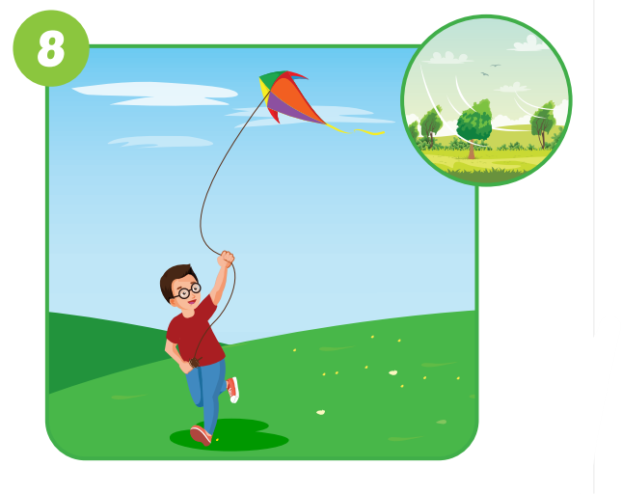
Click on the right word
A. Fly a kite
B. Sing a song
C. Watch a movie

Slide 13

Practice

Slide 14

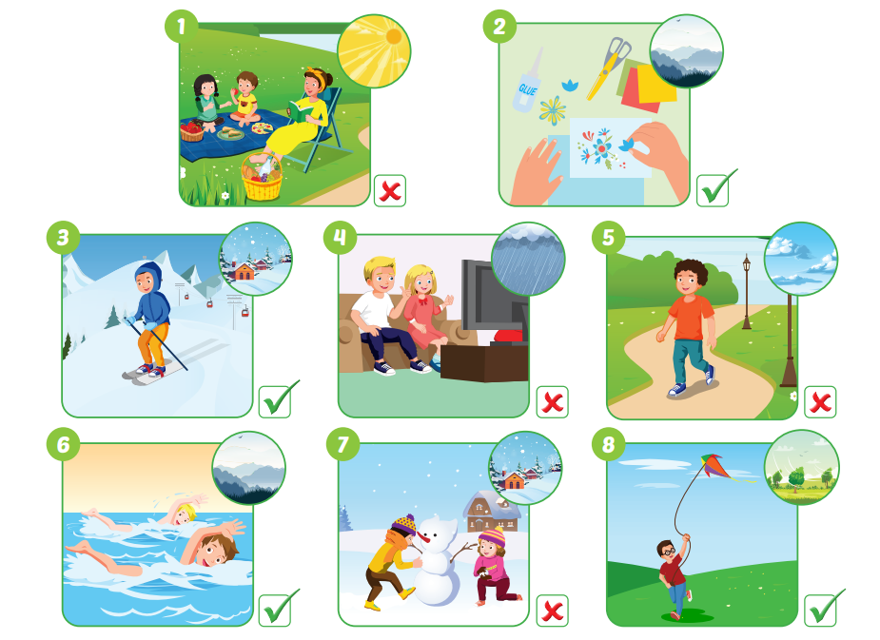
It's sunny today. Would you like to have a picnic with me?
No, thanks.

Slide 15
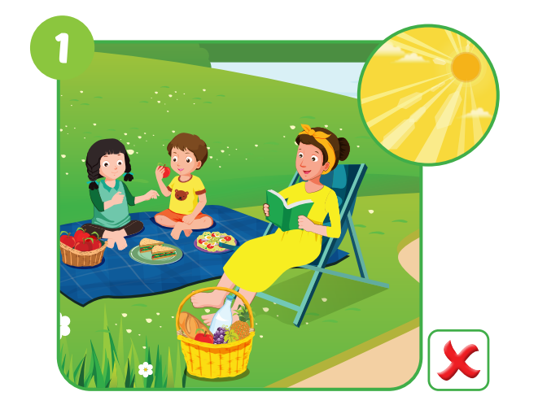
It's sunny today. Would you like to have a picnic with me?
No, thanks.

Slide 16
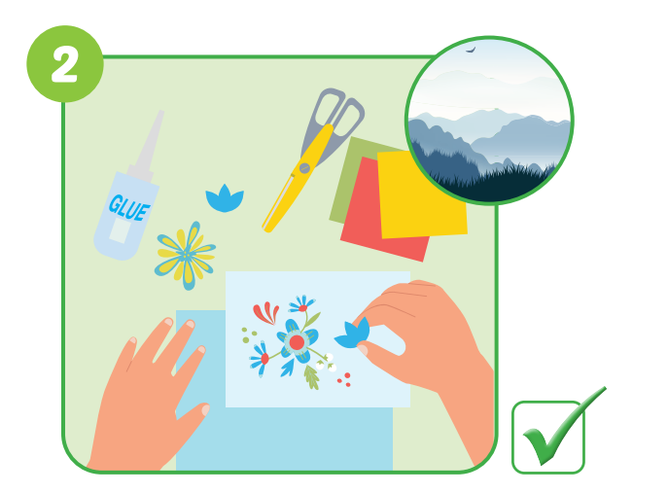
It’s foggy today. Would you like to make arts and crafts with me?
Yes, I’d love to.

Slide 17
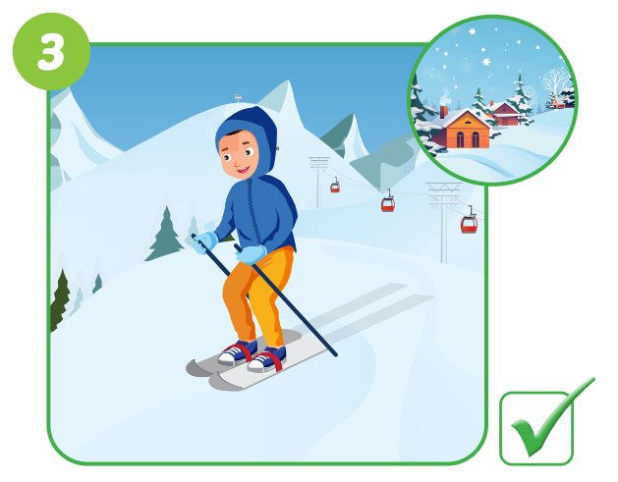
It’s snowy today. Would you like to go skiing with me?
Yes, I’d love to.

Slide 18
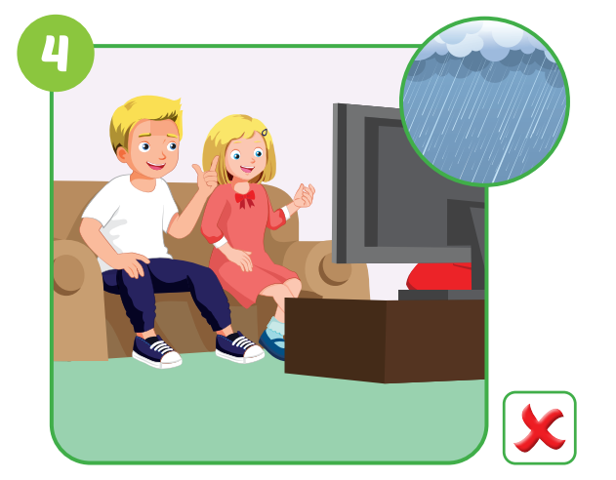
It’s rainy today. Would you like to watch TV with me?
No, thanks.

Slide 19
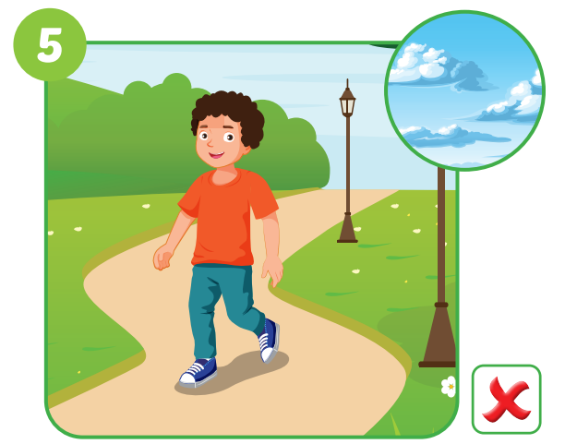
It’s cloudy today. Would you like to go for a walk with me?
No, thanks.

Slide 20
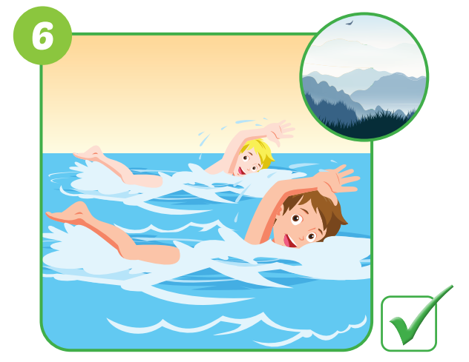
It’s foggy today. Would you like to go swimming with me?
Yes, I’d love to.

Slide 21
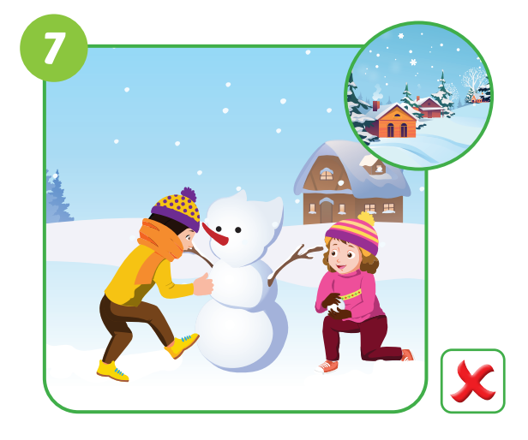
It’s snowy today. Would you like to make a snowman with me?
No, thanks.

Slide 22
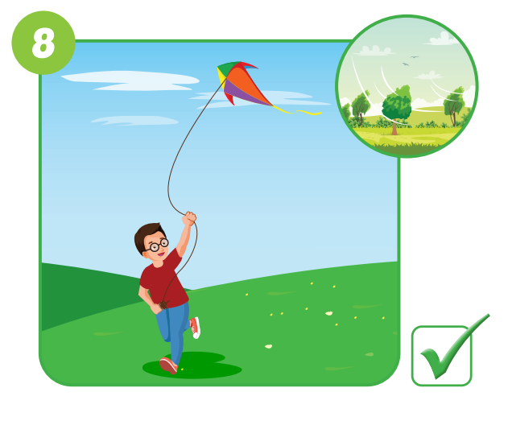
It’s windy today. Would you like to fly a kite with me?
Yes, I’d love to.

Slide 23

Speaking

Slide 24

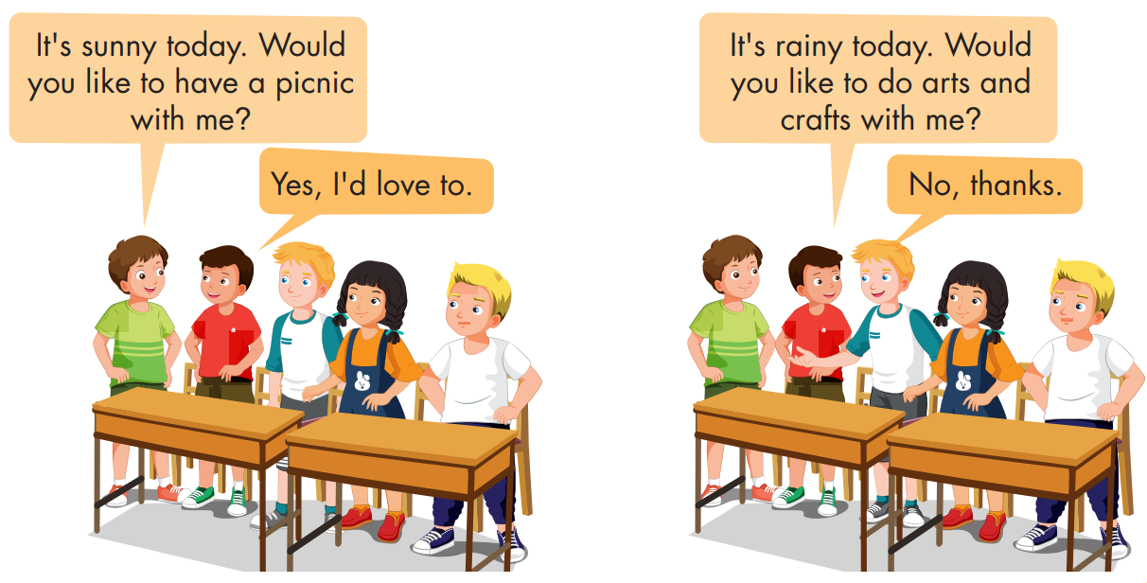

Slide 25

CONSOLIDATION

Slide 26
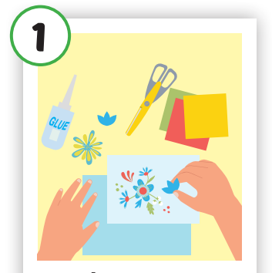

Choose a letter to fill in.
Do arts and cra ts
f
_ _ _ _ _ _
a
b
c
d
f
y
g
e
i
j
k
l
m

Slide 27
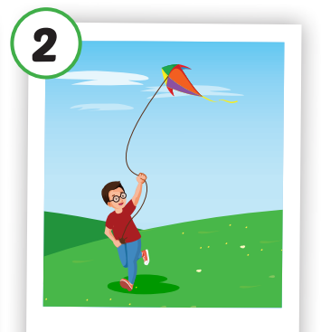
Choose a letter to fill in.
Fly a ite
K
_ _ _ _
a
b
c
d
e
o
g
l
i
j
w
k
m

Slide 28
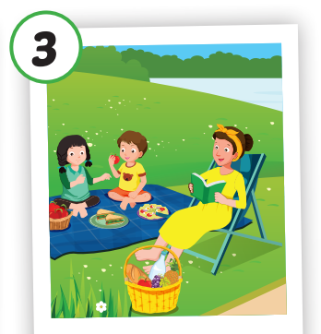
Choose a letter to fill in.
Have a P cnic
i
_ _ _ _ _ _
a
b
c
d
k
f
g
h
u
j
i
l
m

Slide 29
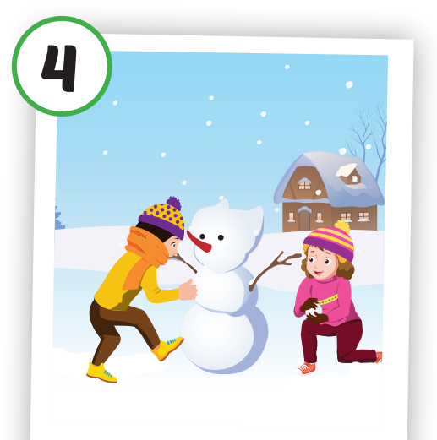
Choose a letter to fill in.
Make a sn wman
o
_ _ _ _ __ _ _
n
b
c
d
e
f
g
h
i
j
k
l
o

Slide 30
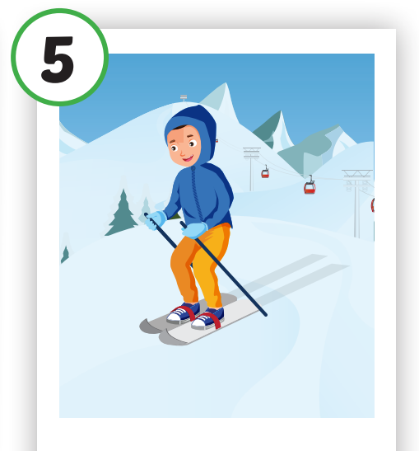
Choose a letter to fill in.
Go sk ing
i
_ _ _ _ _ _
a
b
c
d
k
f
g
h
n
j
i
l
m

Slide 31
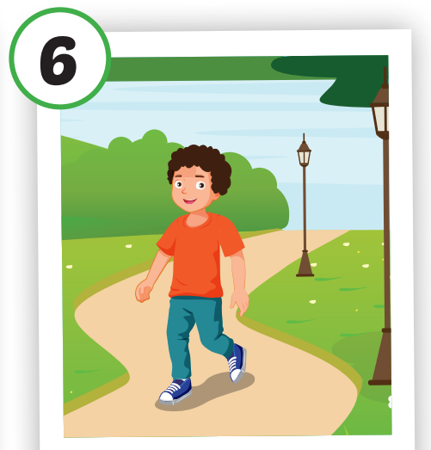
Choose a letter to fill in.
a
Go for a w lk
_ _ _ _
n
b
c
d
o
f
g
h
i
j
k
l
a

Slide 32

WRAP-UP

Slide 33
Today’s lesson
Vocabularies
do arts and crafts, fly a kite, make a snowman, go skiing, go for a walk, have a picnic.
Structures/ Sentence patterns
It's windy today.
Would you like to fly a kite with me?
Yes, I'd love to./ No, thanks.

Slide 34
Homework
Practice the vocabularies and structure; and make sentences using them.
Do the exercises in Tiếng Anh 4 i-Learn Smart Start WB (page 25).
Do the exercises in Tiếng Anh 4 i-Learn Smart Start Notebook (page 17).
Prepare the next lesson (page 40 SB).
Play the consolidation games in Tiếng Anh 4 i-Learn Smart Start DHA App on www.eduhome.com.vn

Slide 35
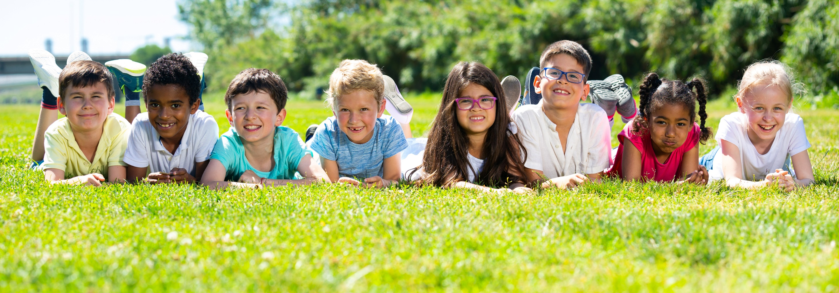
Have a nice day!

