Slide 1

Unit 3: WEATHER
Lesson 2.1
Page 37

Slide 2
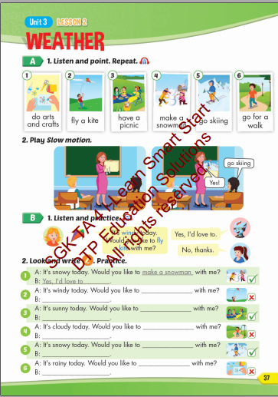
Lesson Outline
Warm-up
Vocabulary
Structure
Consolidation
Wrap-up

Slide 3
Objectives
By the end of this lesson, students will be able to invite people to do activities in different kinds of weather.
Vocabulary: do arts and crafts, fly a kite, make a snowman, go skiing, go for a walk, have a picnic.
Structure: Please list the structure taught in the lesson
Phonics: It's windy today.
Would you like to fly a kite with me?
Yes, I'd love to./ No, thanks.

Slide 4

WARM UP

Slide 5
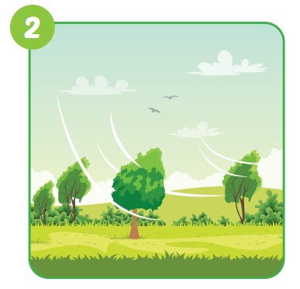

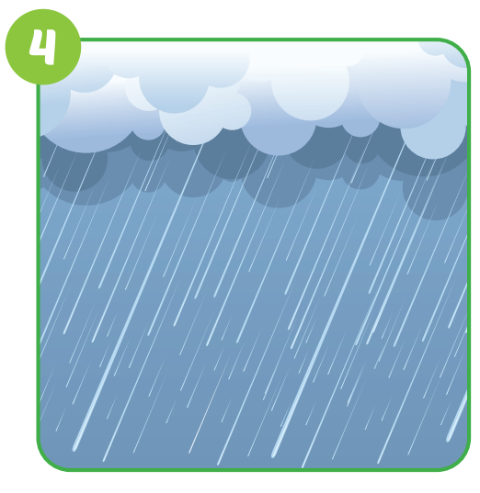




Slide 6
windy

Slide 7
cloudy

Slide 8
snowy

Slide 9
foggy

Slide 10
rainy

Slide 11
sunny

Slide 12

Vocabulary

Slide 13

New words
do arts and crafts, fly a kite,
make a snowman, go skiing,
go for a walk,
have a picnic.

Slide 14
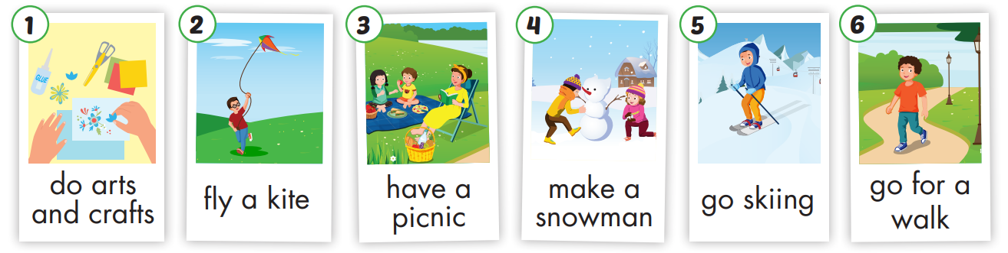

Slide 15

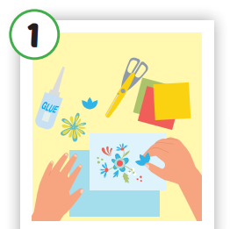
Click each English word to hear the sound.
do arts and crafts
/duː ˌɑːrts ən ˈkræfts/
làm đồ thủ công

Slide 16
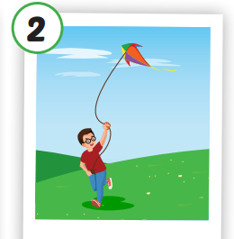
Click each English word to hear the sound.
fly a kite
/flaɪ ə kaɪt/
thả diều

Slide 17
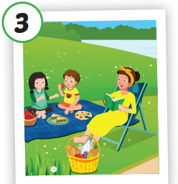
Click each English word to hear the sound.
have a picnic
/hæv ə ˈpɪknɪk/
đi dã ngoại

Slide 18
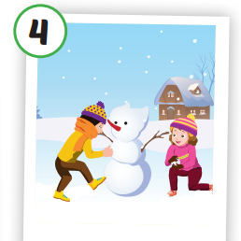
Click each English word to hear the sound.
make a snowman
/meɪk ə ˈsnoʊmæn/
tạo ra người tuyết

Slide 19
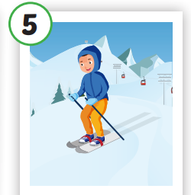
Click each English word to hear the sound.
go skiing
/ɡoʊ ˈskiːɪŋ/
chơi trượt tuyết

Slide 20
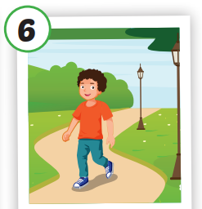
Click each English word to hear the sound.
go for a walk
/ɡoʊ fɔːr ə wɑːk/
đi dạo

Slide 21
Click each English word to hear the sound.
do arts and crafts
fly a kite
have a picnic
make a
snowman
go skiing
go for a
walk
/duː ˌɑːrts ən ˈkræfts/
làm đồ thủ công
/flaɪ ə kaɪt/
thả diều
/hæv ə ˈpɪknɪk/
đi dã ngoại
/meɪk ə ˈsnoʊmæn/
tạo ra người tuyết
/ɡoʊ ˈskiːɪŋ/
chơi trượt tuyết
/ɡoʊ fɔːr ə wɑːk/
đi dạo

Slide 22

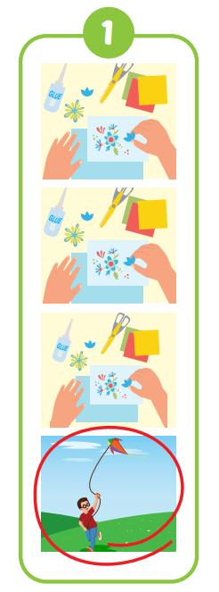
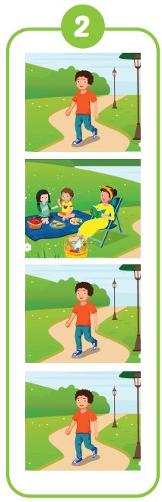
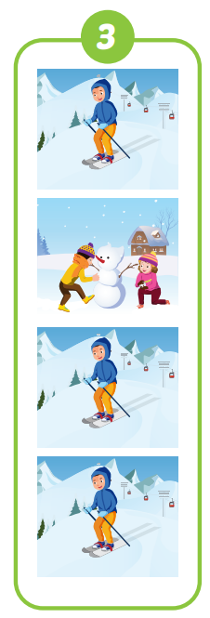
have a
picnic
make a
snowman
fly a kite

Slide 23
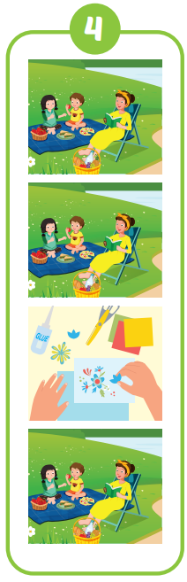
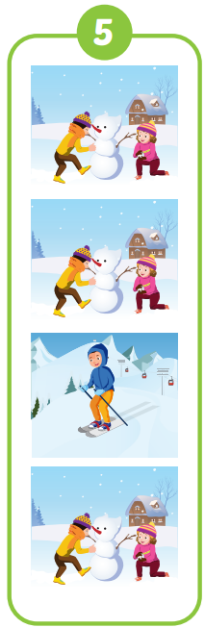
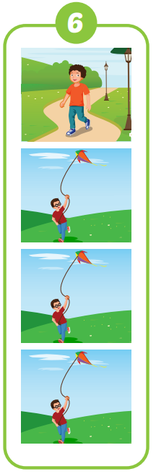
Go for a walk
do arts
and crafts
Go skiing

Slide 24

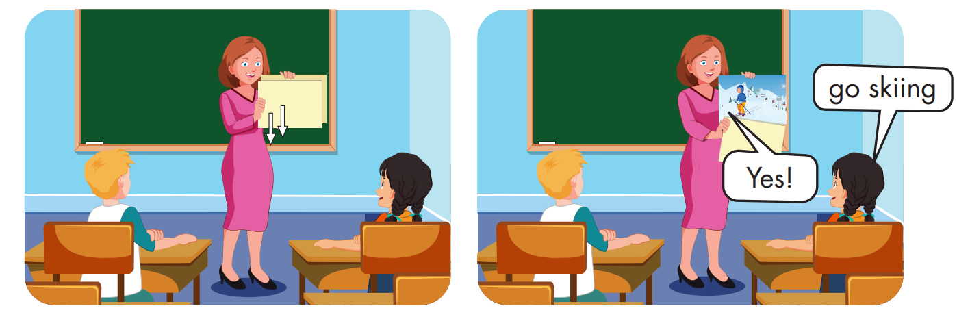

Slide 25

Structure

Slide 26
Structures
It's windy today.
Would you like to fly a kite with me?
Yes, I'd love to.
No, thanks.

Slide 27



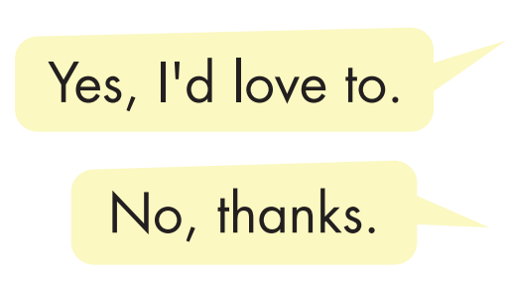
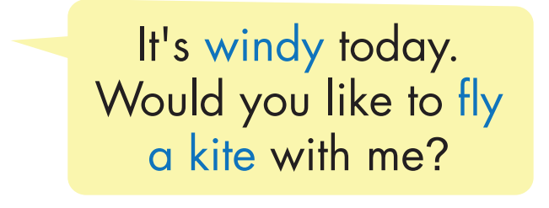

Slide 28
Practice

Slide 29
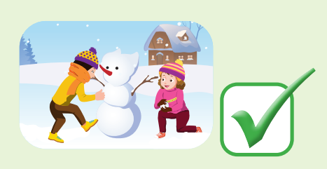

make a snowman
Yes, I'd love to
fly a kite
No, thanks

Slide 30

CONSOLIDATION

Slide 31

Choose a letter to fill in.
_ _ _ _ _ _
c l o u d
y
a
b
c
d
y
f
g
e
i
j
k
l
m

Slide 32
Choose a letter to fill in.
w
_ _ _ _ _
i n d y
a
b
c
d
e
o
g
l
i
j
k
w
m

Slide 33
Choose a letter to fill in.
u
s n n y
_ _ _ _ _
a
b
c
d
k
f
g
h
i
j
u
l
m

Slide 34
Choose a letter to fill in.
r i n y
a
_ _ _ _ _
n
b
c
d
e
f
g
h
i
j
k
l
a

Slide 35
Choose a letter to fill in.
It’s snowy.
s o w y
n
_ _ _ _ _
a
b
c
d
k
f
g
h
i
j
n
l
m

Slide 36
Choose a letter to fill in.
f g g y
o
_ _ _ _ _
n
b
c
d
a
f
g
h
i
j
k
l
o

Slide 37

WRAP-UP

Slide 38
Lesson 3
Today’s lesson
Vocabularies
rainy, snowy.
Structures/ Sentence patterns
What's the weather like today?
It's sunny.

Slide 39
Lesson 3
Homework
Practice the vocabularies and structure; and make sentences using them.
Do the exercises in Tiếng Anh 4 i-Learn Smart Start WB (page 24)
Do the exercises in Tiếng Anh 4 i-Learn Smart Start Notebook (page 17)
Prepare the next lesson (page 38 SB)
Play the consolidation games in Tiếng Anh 4 i-Learn Smart Start DHA App on www.eduhome.com.vn

Slide 40

Have a nice day!

