Slide 1

Unit 2: Holidays
Lesson 1.3
Page 22

Slide 2
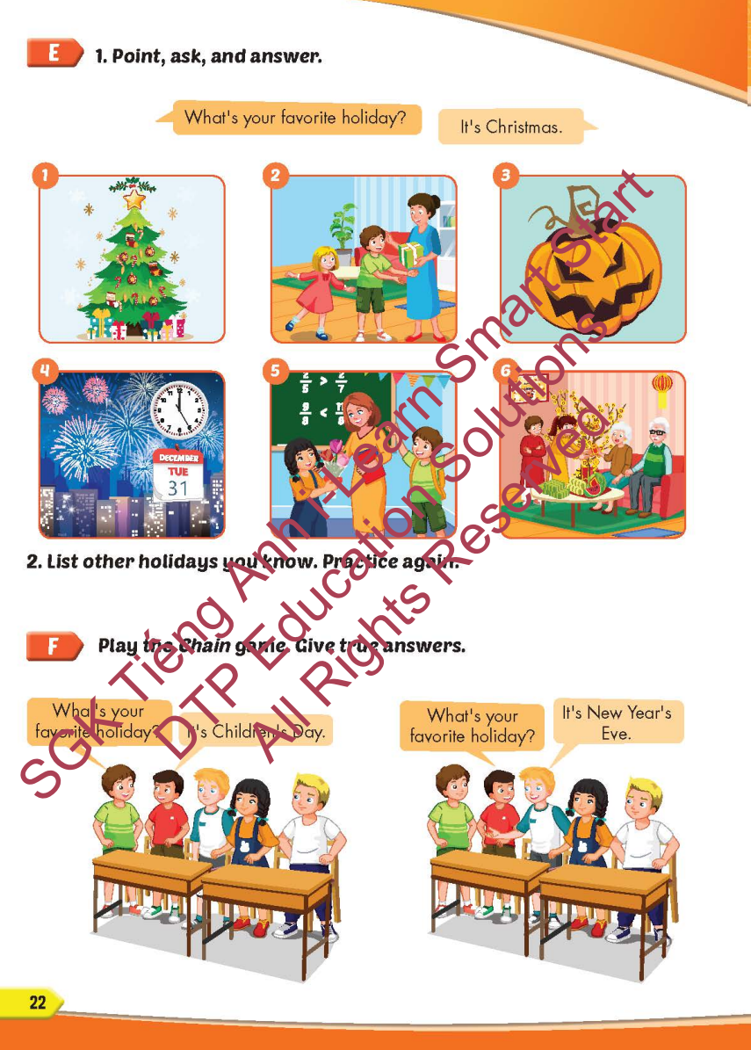
Lesson Outline
Warm-up
Practice
Speaking
Consolidation
Wrap-up

Slide 3
Objectives
By the end of this lesson, students will be able to…
Vocabulary: Pronounce and use the words related to the topic properly: Halloween, New Year's Eve, Lunar New Year (Tết), Christmas, Teachers' Day, Children's Day.
Structure: Ask and answer about someone’s favorite holiday
What's your favorite holiday? - It's Halloween.
What's her favorite holiday? - It's Christmas

Slide 4

WARM-UP

Slide 5



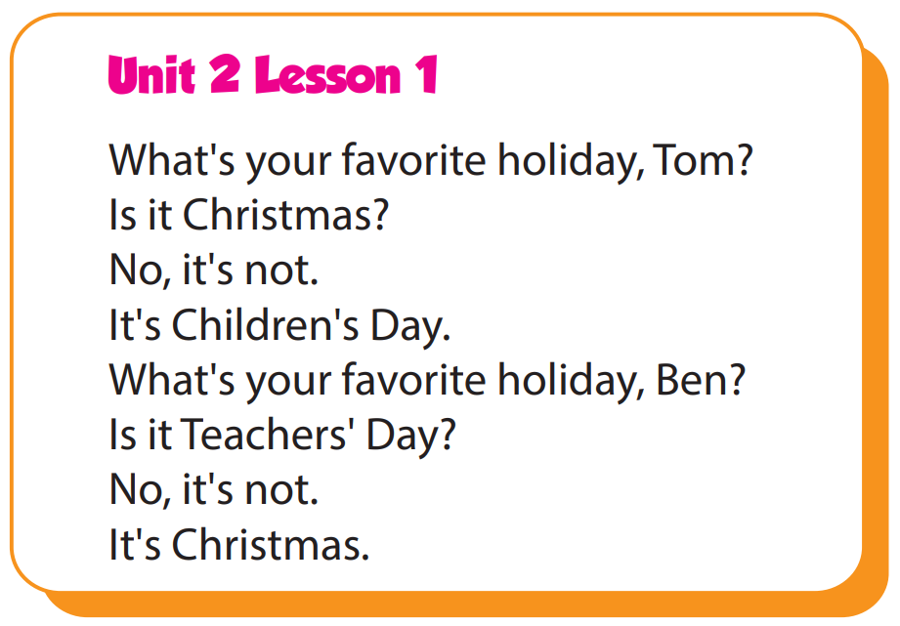

Slide 6

It’s time to learn …

Slide 7

Practice

Slide 8

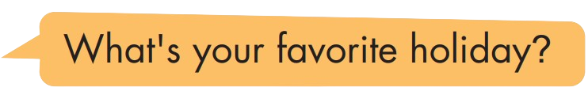
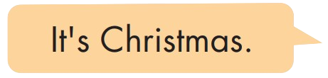
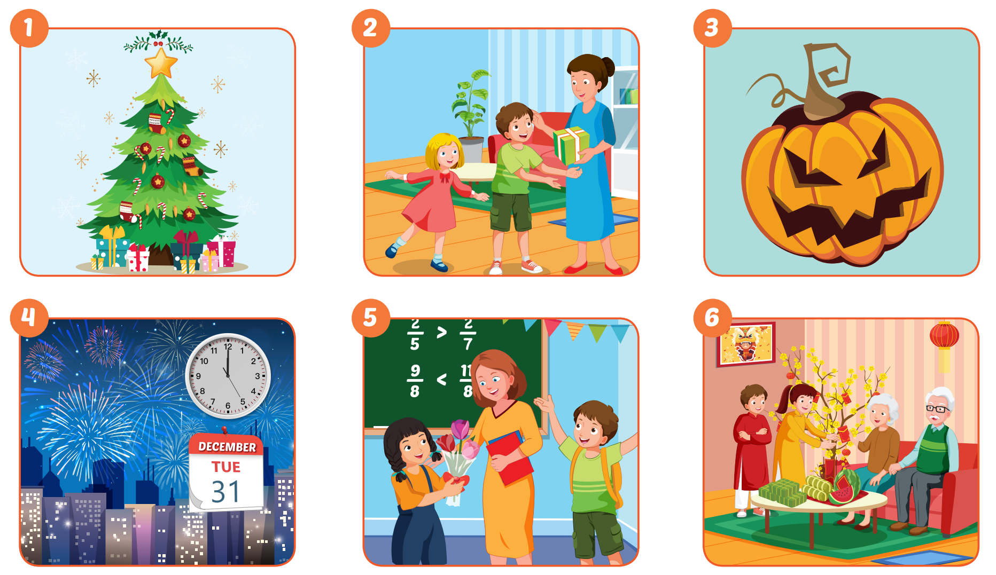

Slide 9
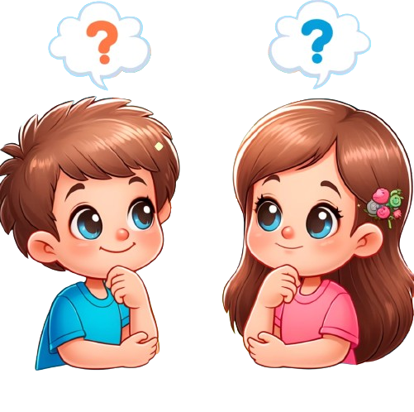
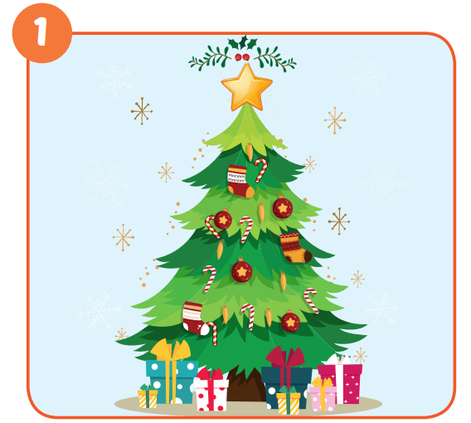
It's Christmas Day.

Slide 10
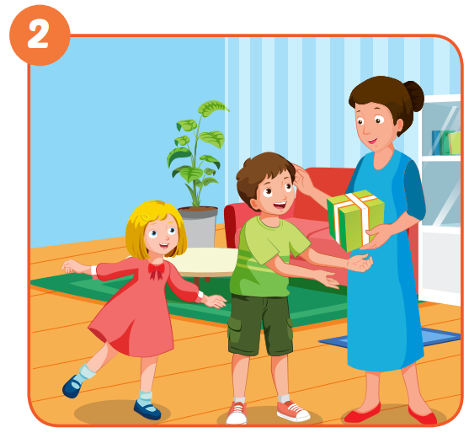
It's Children's Day.

Slide 11
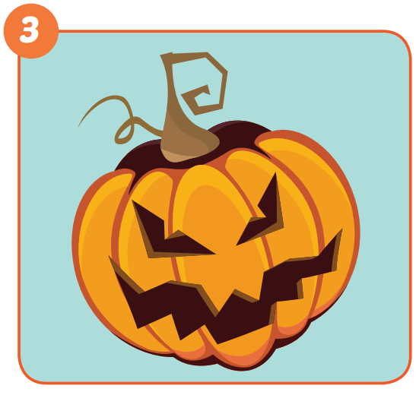
It's Halloween Day.

Slide 12
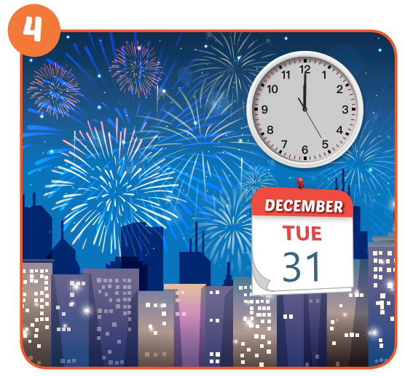
It's New Year's Eve.

Slide 13
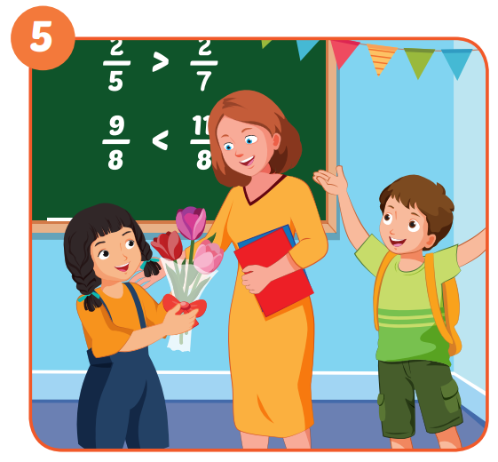
It's Teachers' Day.

Slide 14
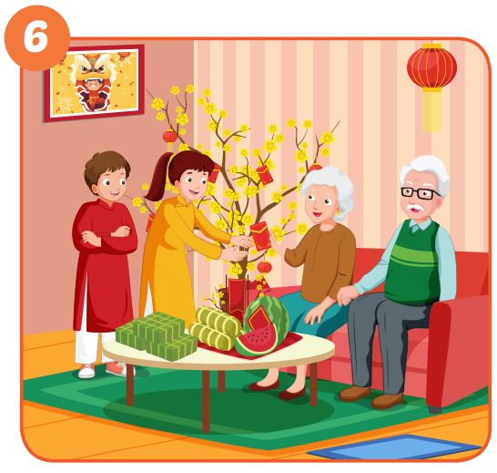
It's Lunar New Year.

Slide 15

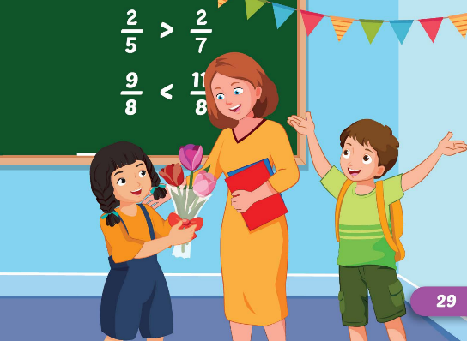
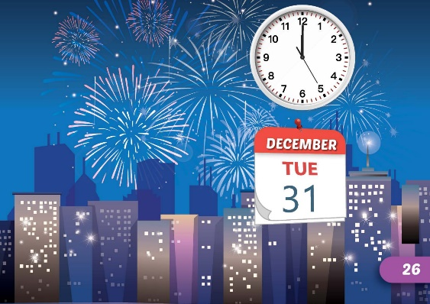
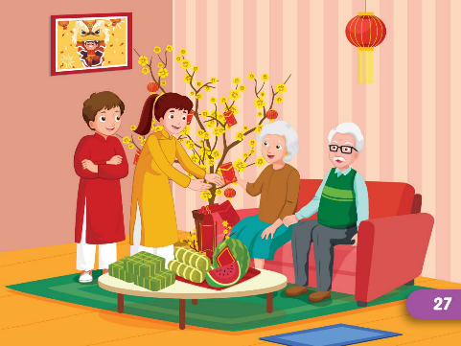


It's Christmas Day.

Slide 16

Production

Slide 17
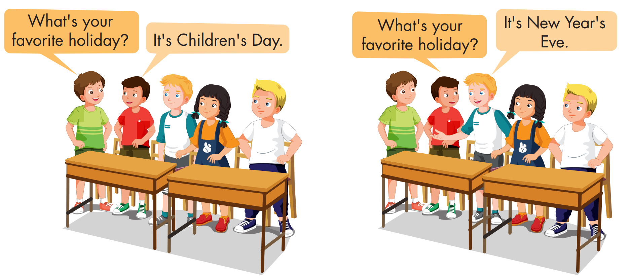

Slide 18

CONSOLIDATION

Slide 19

UNSCRAMBLE THE WORDS

Slide 20
holiday?/What's/favorite/your
What's your favorite holiday?

Slide 21
New/Eve/Year's/It's
It's New Year's Eve.

Slide 22
Day/It's/Children
It's Children's Day.

Slide 23
It's/Year/Lunar/New
It's Lunar New Year.

Slide 24
Christmas/Day/It's
It's Christmas Day.

Slide 25
It's/Day/Teachers'
It's Teachers' Day.

Slide 26

WRAP-UP

Slide 27
Today’s lesson
Vocabularies
Halloween, NewYear's Eve, Lunar New Year (Tết), Christmas, Teachers' Day,
Children's Day
Structures/ Sentence patterns
What's your favorite holiday?
- It's Halloween.
What's her favorite holiday?
- It's Christmas.

Slide 28
Homework
Practice the vocabularies and structure, and make sentences using them.
Do the exercises in Tiếng Anh 5 i-Learn Smart Start WB (page 13)
Do the exercises in Tiếng Anh 5 i-Learn Smart Start Notebook (page 10)
Prepare the next lesson (page 23 SB)
Play the consolidation games in Tiếng Anh 5 i-Learn Smart Start DHA App on www.eduhome.com.vn

Slide 29

Enjoy your day!

Slide 30

Lesson 3
Stay positive and have a nice day!

