Slide 1

Unit 1: Animals
Lesson 4.3 Science
Page 17

Slide 2
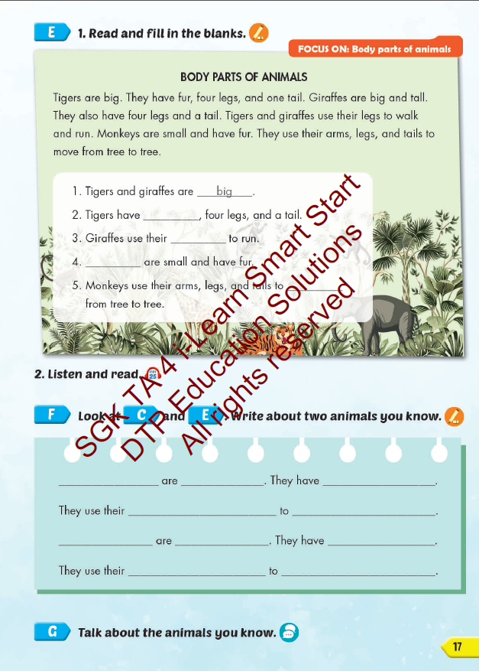
Lesson Outline
Warm-up
Reading
Writing
Consolidation
Wrap-up

Slide 3
Objectives
By the end of this lesson, students will be able to…
Vocabulary: Pronounce and use the words related to the topic properly: wing, feather, tail, fin, fur, claw.
Structure: Birds have feathers, two wings, and two legs.

Slide 4

WARM UP

Slide 5
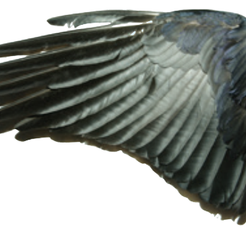
Guessing game
wing

Slide 6
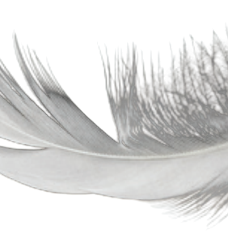
Guessing game
feather

Slide 7
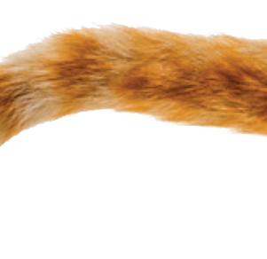
Guessing game
tail
Notes:
Instruction:
Get students read the question.
Say that there’s a flag of a country behind the wall and they need to guess it first.
Click on the wall piece by piece to open it.
Click on the heart to show answer.

Slide 8
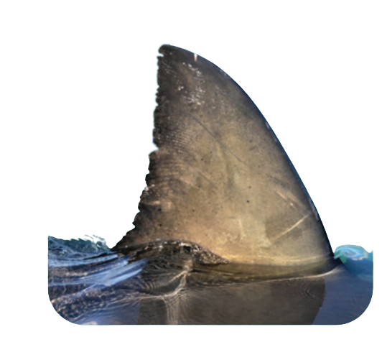
Guessing game
fin

Slide 9

Guessing game
fur

Slide 10

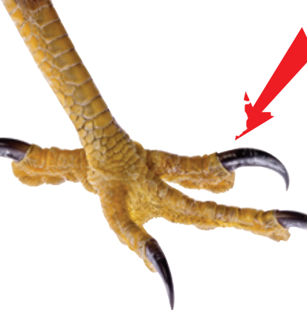
Guessing game
claw
Notes:
Instruction:
Get students read the question.
Say that there’s a flag of a country behind the wall and they need to guess it first.
Click on the wall piece by piece to open it.
Click on the heart to show answer.

Slide 11

It’s time to learn …

Slide 12

Reading

Slide 13
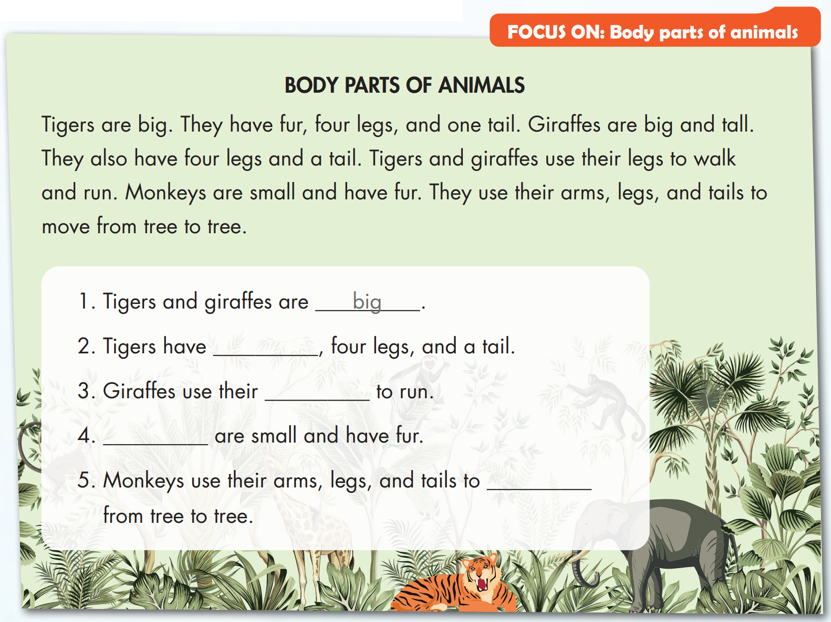
fur
legs
Monkeys
move

Slide 14


fur
legs
Monkeys
move

Slide 15

Production

Slide 16

Writing

Slide 17
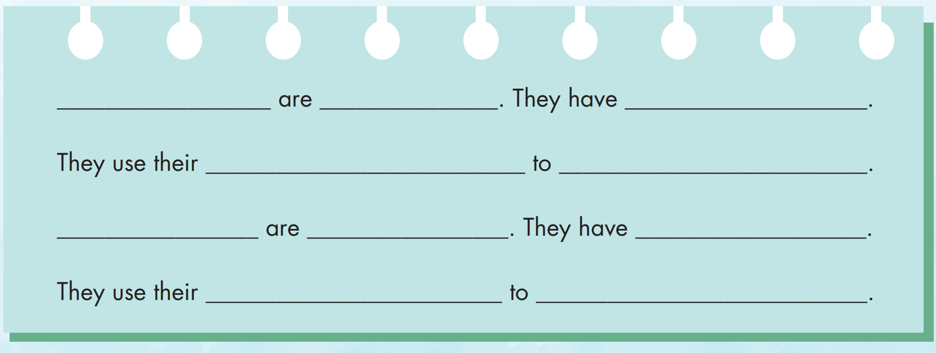

Slide 18
Speaking

Slide 20
Writing

Slide 21
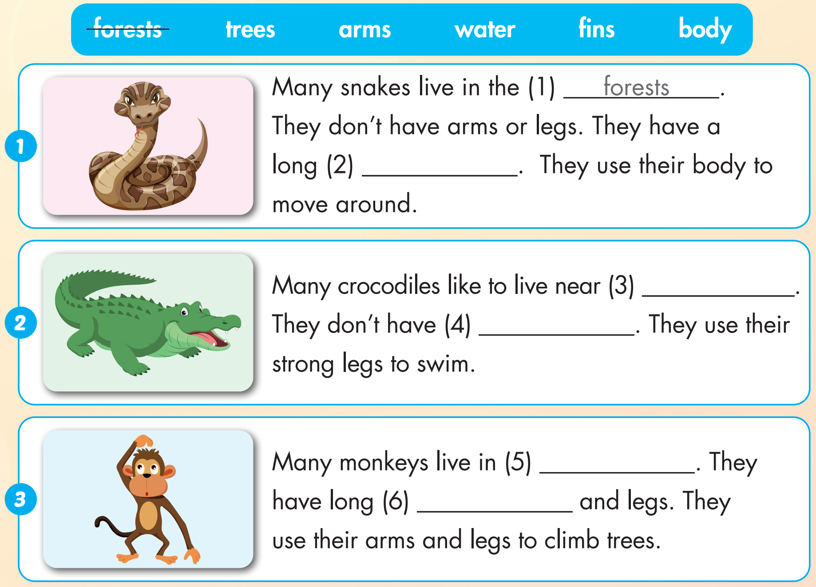

Extra Practice
WB, page 9
body
water
fins
trees
arms

Slide 22

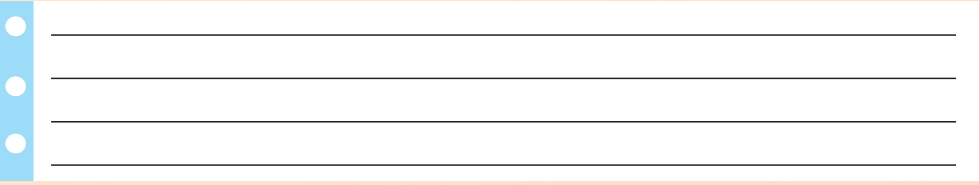
Extra Practice
WB, page 9

Slide 23

WRAP-UP

Slide 24
Today’s lesson
Vocabularies
wing, feather, tail, fin, fur, claw.
Structures/ Sentence patterns
Birds have feathers, two wings, and two legs.

Slide 25
Homework
Practice the vocabularies and structure; and make sentences using them.
Do the exercises in Tiếng Anh 4 i-Learn Smart Start WB (page 9)
Prepare the next lesson (page 18 SB)
Play the consolidation games in Tiếng Anh 4 i-Learn Smart Start DHA App on www.eduhome.com.vn

Slide 26

Enjoy your day!

